Slide 1
Beam Shape Effects in Pythia8
Brian Page
ATHENA Software WG Meeting
June 3rd, 2021

Slide 2
Intro and Motivation
Both interaction regions at the EIC will feature significant beam crossing angles (25 mRad for IP6 and 35 mRad for IP8)
Other effects such as intrinsic beam energy spread, beam divergence, and crabbing momentum kicks randomly change the momentum of the incoming beams
The crossing angle and crab rotation also affect the position and time of the interaction vertex
All of these effects need to be included in our simulations
Currently developing two approaches: A generator agnostic after-burner that boosts particle 4-vectors into the correct frame and a scheme that utilizes the internal PYTHIA8 BeamShape class which allow changes to beam momentum / vertex position directly in the generator
Following studies focus on central detector region only (-4 < eta < 4)! Lepton beam is defined to sit along z-axis and hadron beam takes full crossing angle

Slide 3
Energy (Pz) Variation
Pythia BeamShape class allows variation in z-component of beam momentum (assume change is small enough that physics processes or cross sections do not appreciably change)
ΔPz = (Beam Pz)*sigma*randomGauss
Sigma is taken from tables 3.3 and 3.4 in the CDR with ΔP/P on the order of 10⁻⁴ to 10⁻³, depending on beam energy

Slide 4
Crossing Angle
The lepton and hadron beams will cross at an angle (use 25 milliradian) w.r.t each other
Take lepton beam as z-axis as it will align with the center of the detector and apply momentum modifications to hadron beam only
Assume crossing angle imparts momentum kick only in x (horizontal) direction
ΔPx = (Beam Pz + PzSmear)*Sin(Crossing Angle)
ΔPz = (Beam Pz + PzSmear)*Cos(Crossing Angle) – (Beam Pz) (Here PzSmear is Pz variation of the beam)
x
Lab Frame
Beam Pz + PzSmear
Lepton
ΔPx
z
θ
ΔPz
Hadron

Slide 5
Beam Divergence
Will get transverse momentum kicks from beam angular divergence in horizontal and vertical directions
Use angular divergence (Δθ) from table 3.3 in CDR: h/v 150/150 (Hadron) and 202/187 (Lepton)
Assume that momentum kicks in the horizontal and vertical direction are with respect to the beam. The beam will be rotated in the x direction due to the crossing angle – need to translate transverse momentum kick in horizontal direction into lab frame
ΔPx += (Beam Pz + PzSmear)*Sin(Divergence Angle_h)*Cos(Crossing Angle) (Hadron Beam only, lepton beam has no xing angle)
ΔPy += (Beam Pz + PzSmear)*Sin(Divergence Angle_v)
X_lab
(Beam Pz + PzSmear)*Sin(θ_d)
ΔPz += (Beam Pz + PzSmear)*Sin(Divergence Angle_h)*Sin(Crossing Angle) (For hadron beam only; for horizontal (x) divergence only as crossing is purely in x direction)
Θ_c
Θ_d
Beam Pz + PzSmear
(Beam Pz + PzSmear)*Sin(θ_d)*Cos(θ_c)
Θ_c
Z_lab

Slide 6
Crabbing Effects on Vertex Position
Determine the x, y, and z vertex of the collision along with the time of collision
Assume each bunch is rotated through half the beam crossing angle and assume it stays in a fixed orientation throughout the colliding region
Assume particles in bunch are distributed along z as a gaussian with a sigma of the RMS bunch length cited in CDR table 3.3, 3.4. Correct collision distribution should follow automatically
Assume particles in bunch are distributed in x,y as a gaussian with sigma given by Sqrt(RMS emittance x beta*) as given in CDR table 3.3, 3.4
Procedure:
Chose z (in in-bunch coordinates) of colliding particle in hadron and lepton bunch
Propagate bunches until colliding particles overlap – this sets collision z, t, and a central x offset
Randomly sample an x value according to beam widths and add to central x offset. Randomly sample a y value
Rotate system from ‘accelerator frame’ into ‘detector frame’

Slide 7
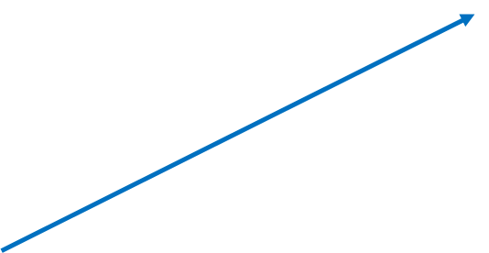
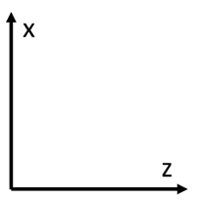
Crab Cavities rotate proton and electron bunches through half the crossing angle
Assume orientation of bunches is constant through course of bunch interaction – Think they rotate somewhat, but ignore this for now
Increasing Time
Increasing Time
Choose random position in z of each bunch to collide. Assume gaussian distribution with sigma = RMS bunch length
θ
In-bunch z
(θ/2k)*sin(kz) = (θ/2)*z

Slide 8
Once interacting particle positions are chosen, determine time of collision, x y & z of collision, and z of center of hadron bunch at time of collision
Solve set of equations below
Increasing Time
Increasing Time
Z_hpart
Z_hbunch
t
Z_hpart = Cos(θ/2)*t + Z_hbunch
Z_lpart = -Cos(θ/2)*t + Z_lbunch

Slide 9
Configuration at collision
Collision time is when Z_hpart = Z_lpart
Z_hCenter
t_col = (z_lbunch – z_hbunch)/(2*Cos(θ/2))
Z_col = (z_lbunch + z_hbunch)/2.0
Z_hCenter = Cos(θ/2)*t_col
X_col = Z_hCenter*Tan(θ/2) or Sin(θ/2)*t_col

Slide 10
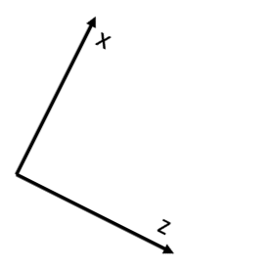
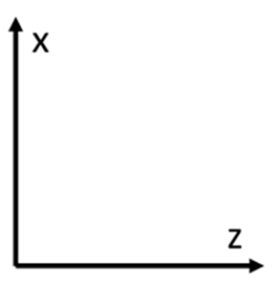
$$R_y= \begin{matrix}Cos(\frac{θ}{2}) & 0 & Sin(\frac{θ}{2}) \\ 0 & 1 & 0 \\ −Sin(\frac{θ}{2}) & 0 & Cos(\frac{θ}{2})\end{matrix}$$
Detector Frame
Accelerator Frame
We now have the x, y, and z position of the collision in the ‘accelerator frame’
Remember that the central detector will be aligned along the lepton beam
Rotate around y-axis from accelerator frame to detector frame

Slide 11
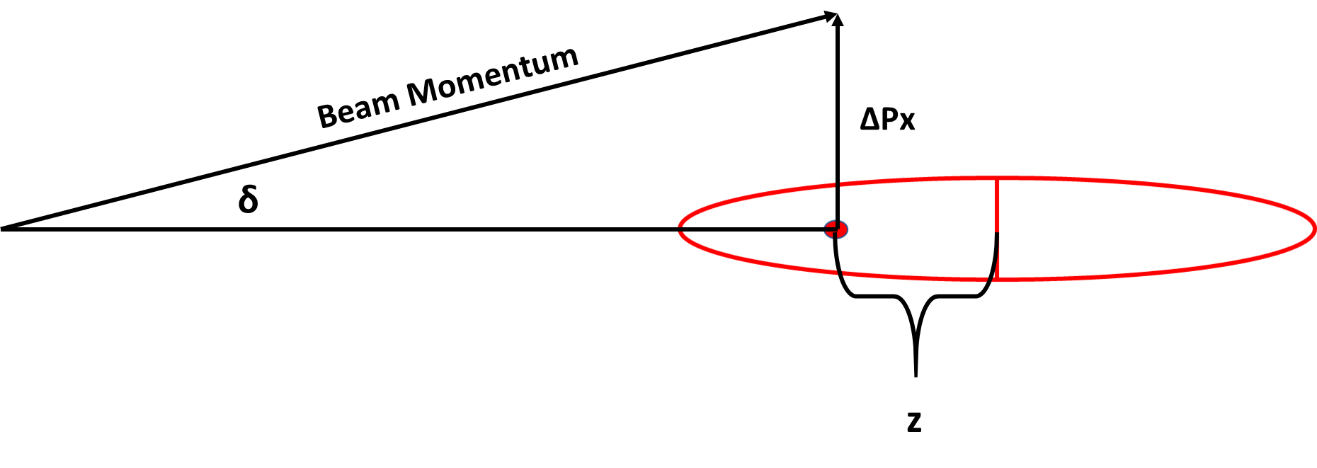
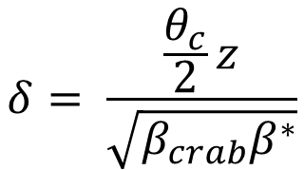
Crabbing Effects on Beam Momentum
Crabbing rotation will impart momentum kicks along the x-direction to particles within the bunch
The size of this kick will depend on the z-position of the particle within its bunch
For Beam Momentum = 275, z = 10 cm -> ΔPx = 0.01 GeV
Rotate this into detector frame: ΔPx` = ΔPx*Cos(θ/2) and ΔPz` = -ΔPx*Sin(θ/2)

Slide 12
PYTHIA-8 Implementation
Code to run beam effects in Pythia8 and generate diagnostic histograms (as well as optional HEPMC2 files) exists on github: https://github.com/bspage912/eicSimuBeamEffects
Heart of the code is in eicBeamShape.h/.cxx where the user-defined extensions to the BeamShape constructor and virtual void BeamShape::pick() are implemented. Pick() contains code to realize beam effects described above and ensure that user input configuration matches used steering file
Steering files for beam energy combinations of 18x275, 10x275, 10x100, 5x100, and 5x41 in both the high divergence and high acceptance configurations (see tables 3.3 and 3.4 of CDR) are included
Below we show plots using 18x275 and 5x41 beam energies with a 25 and 35 mRad crossing angle. All are made with the high divergence settings

Slide 13
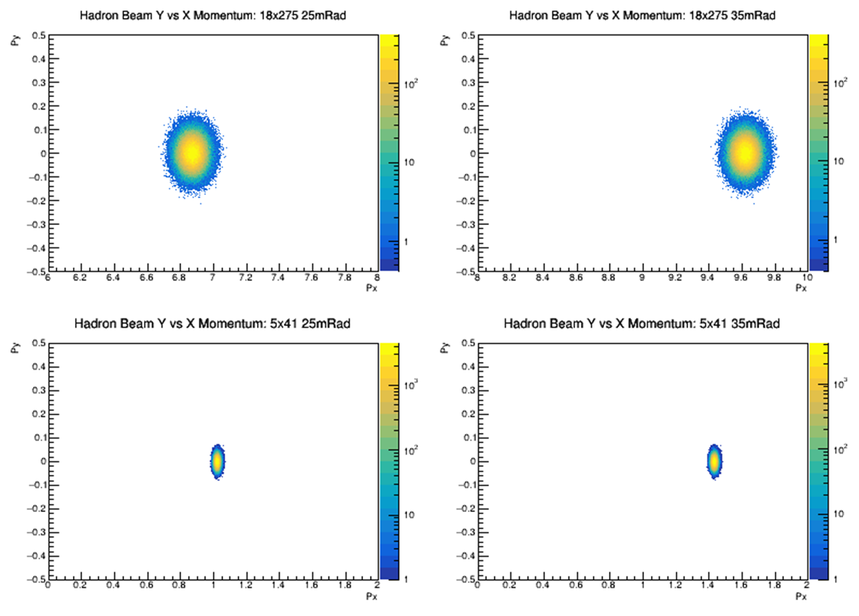
Beam Momentum: Y vs X Component

Slide 14
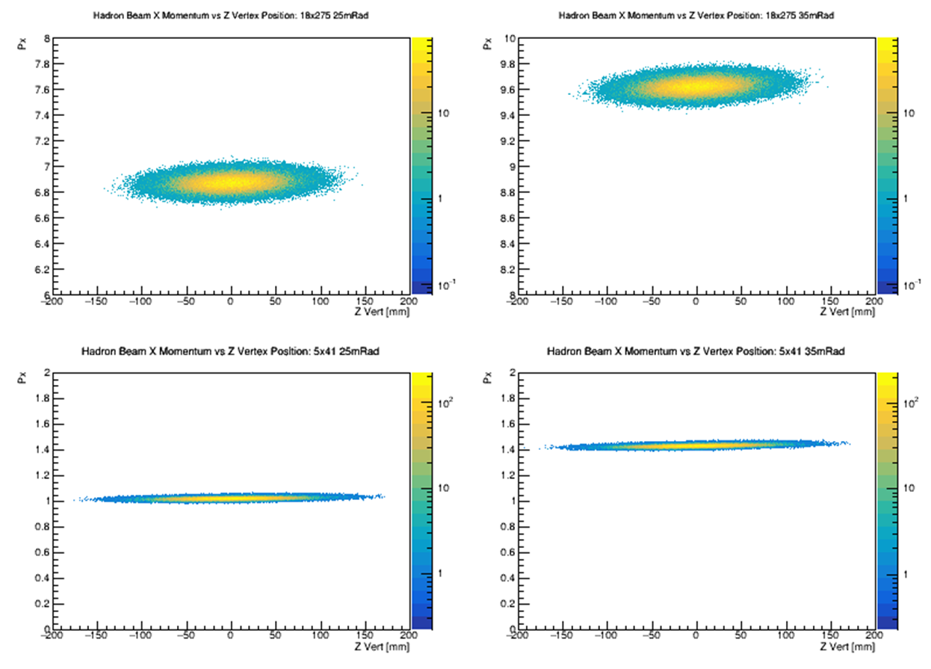
Beam Momentum: X Component vs Z-vertex

Slide 15
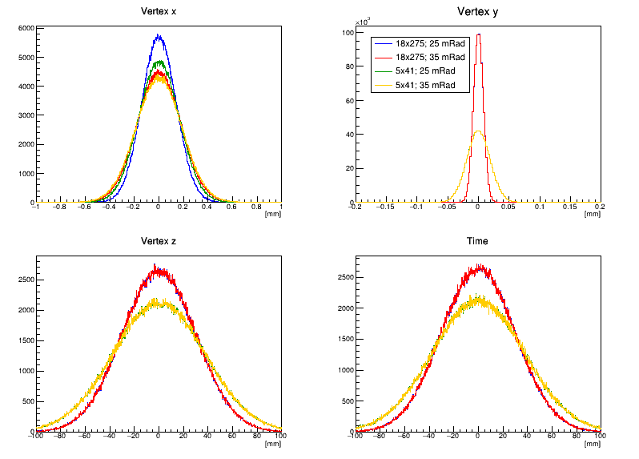
Vertex Distributions: 1-D

Slide 16
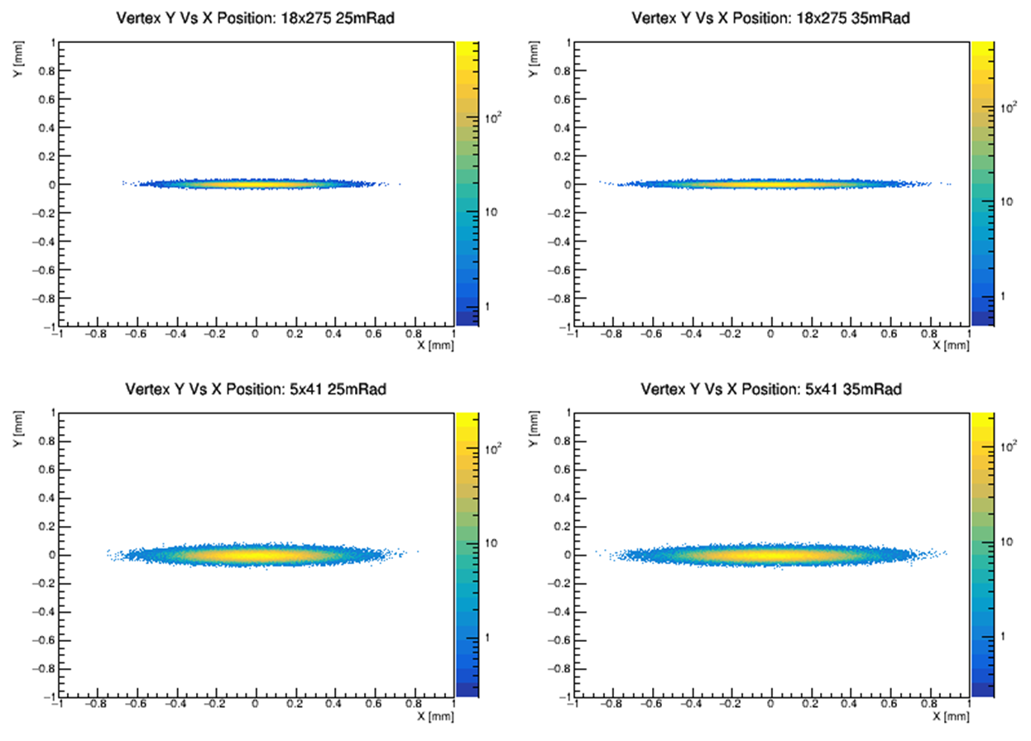
Vertex Distributions: Y vs X Interaction Vertex Position

Slide 17
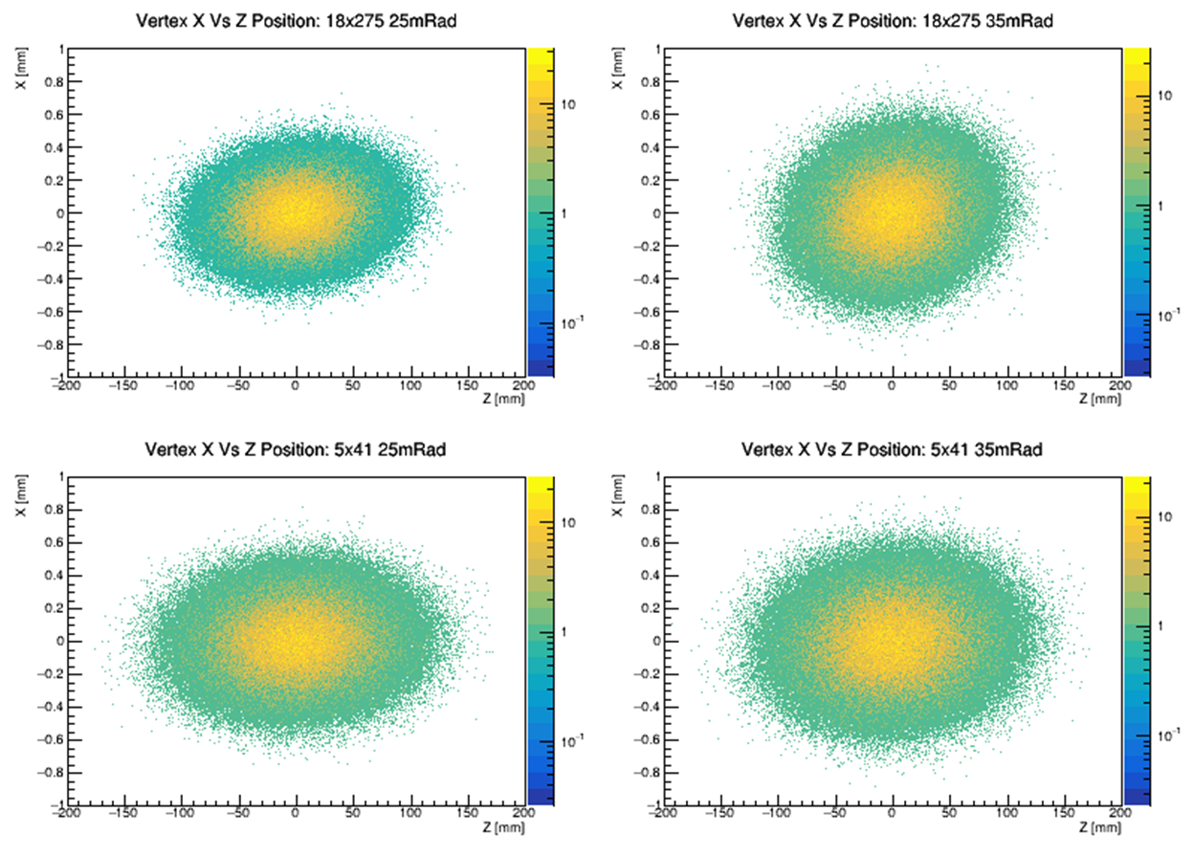
Vertex Distributions: X vs Z Interaction Vertex Position

Slide 18
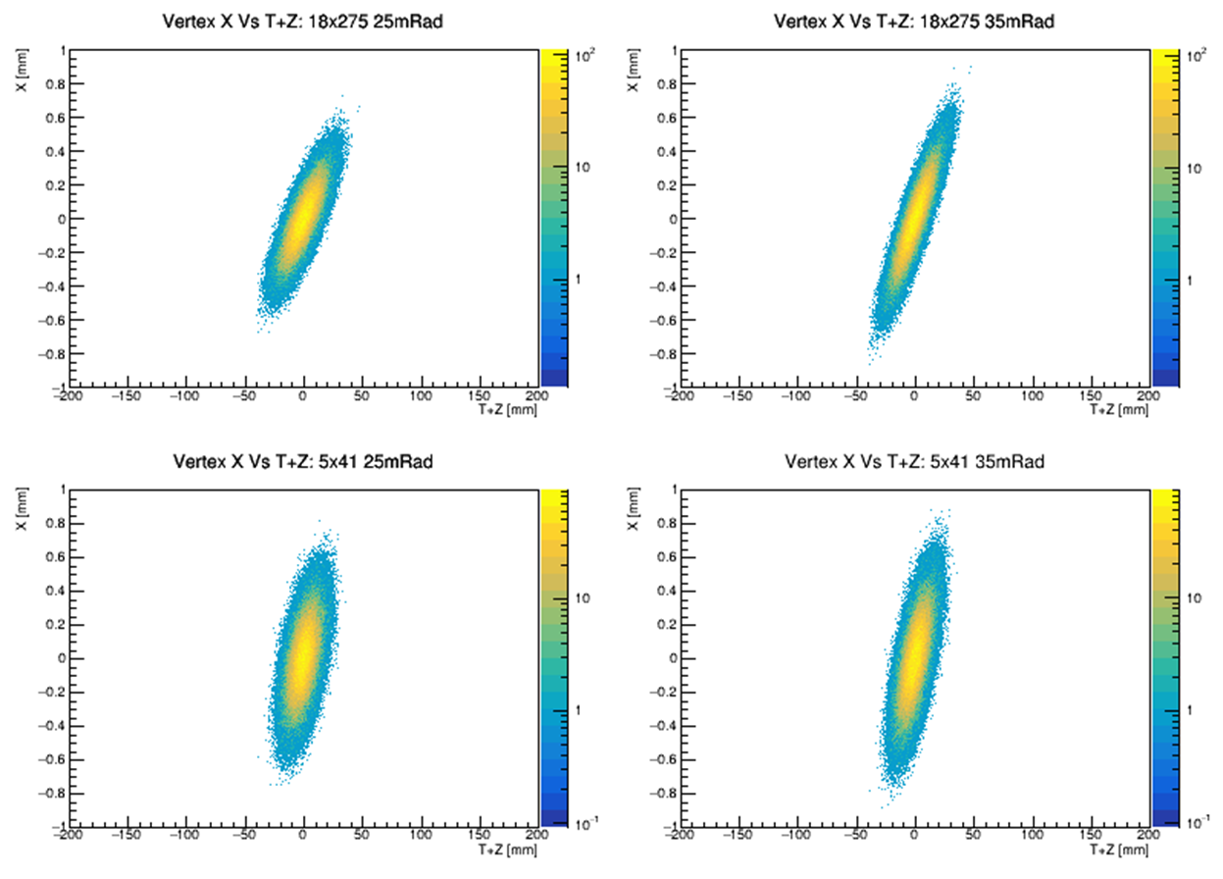
Vertex Distributions: X vs T+Z

Slide 19
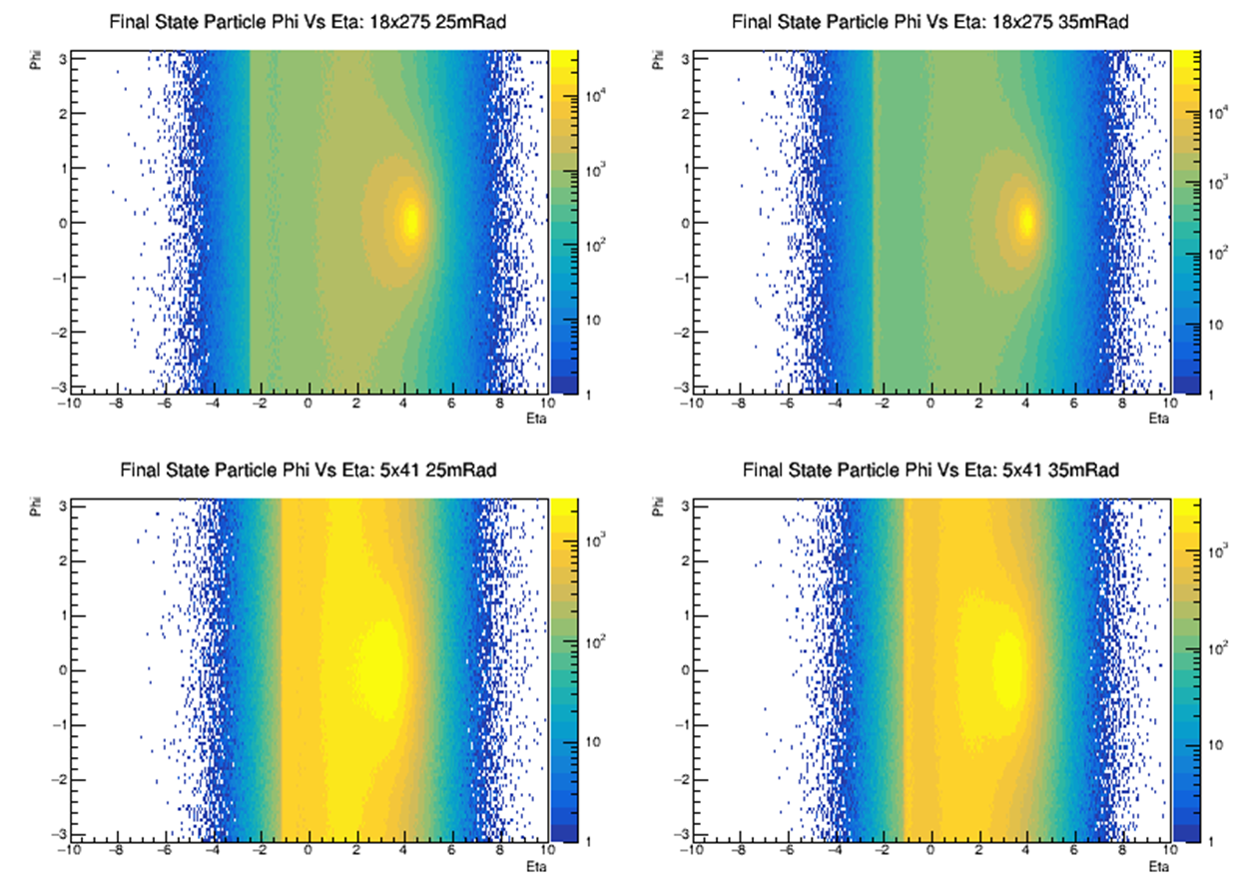
Particle Distributions: Phi Vs Eta (w/ Beam Effects)

Slide 20
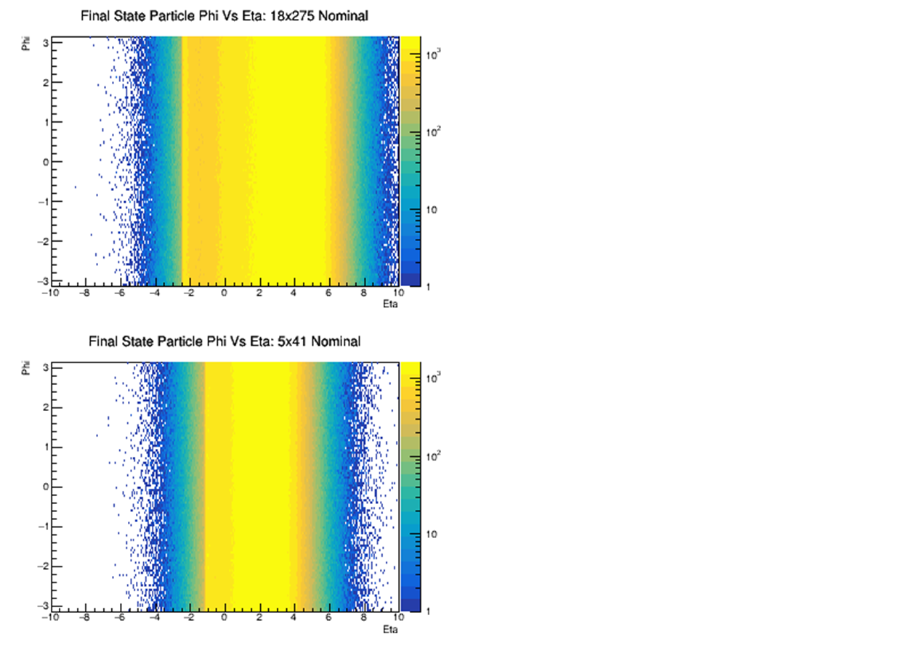
Particle Distributions: Phi Vs Eta (w/o Beam Effects)

Slide 21
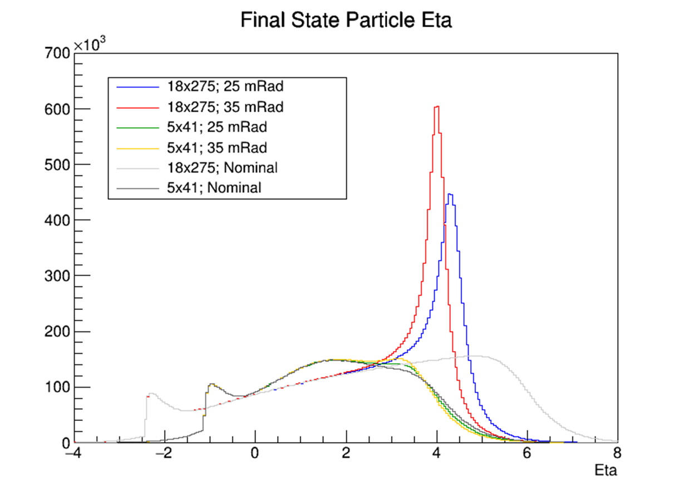
Particle Distributions: Eta Projection

Slide 22
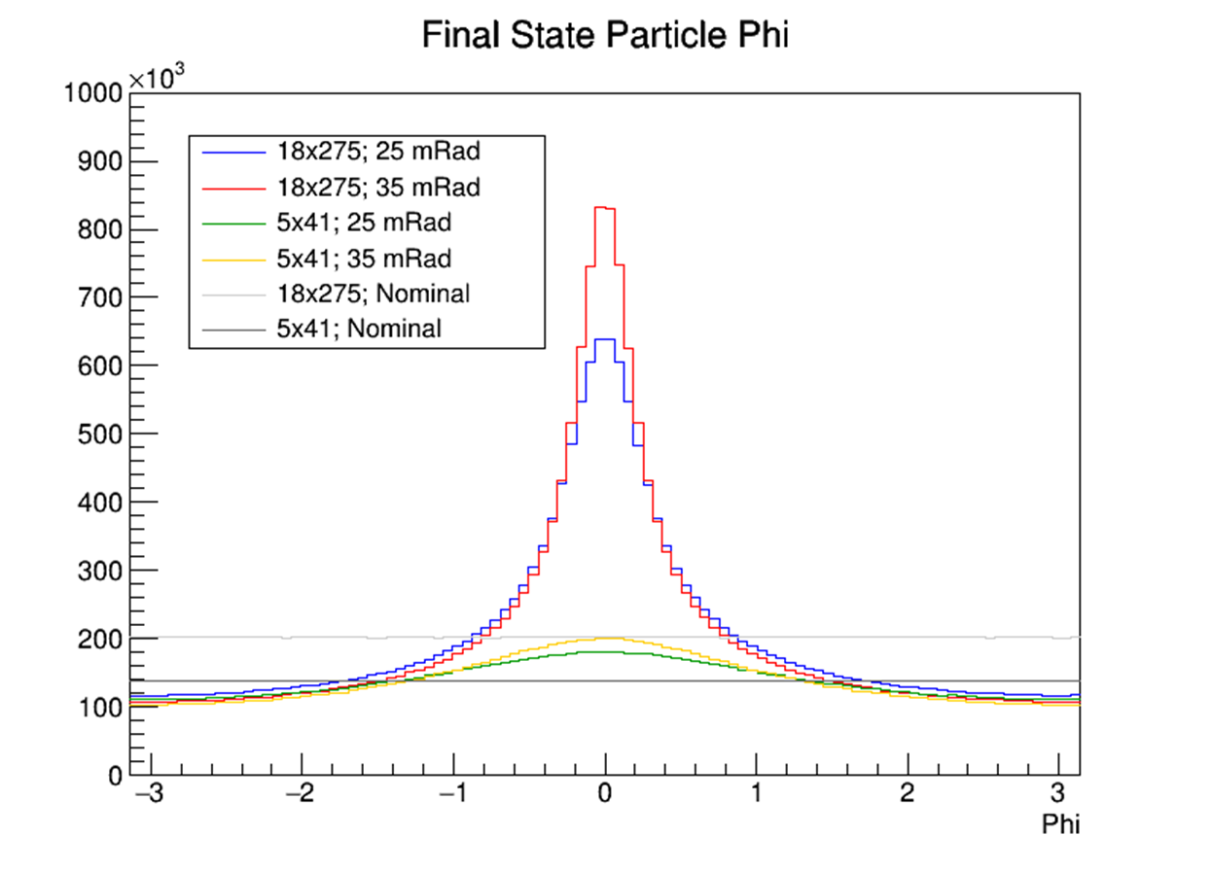
Particle Distributions: Phi Projection

Slide 23
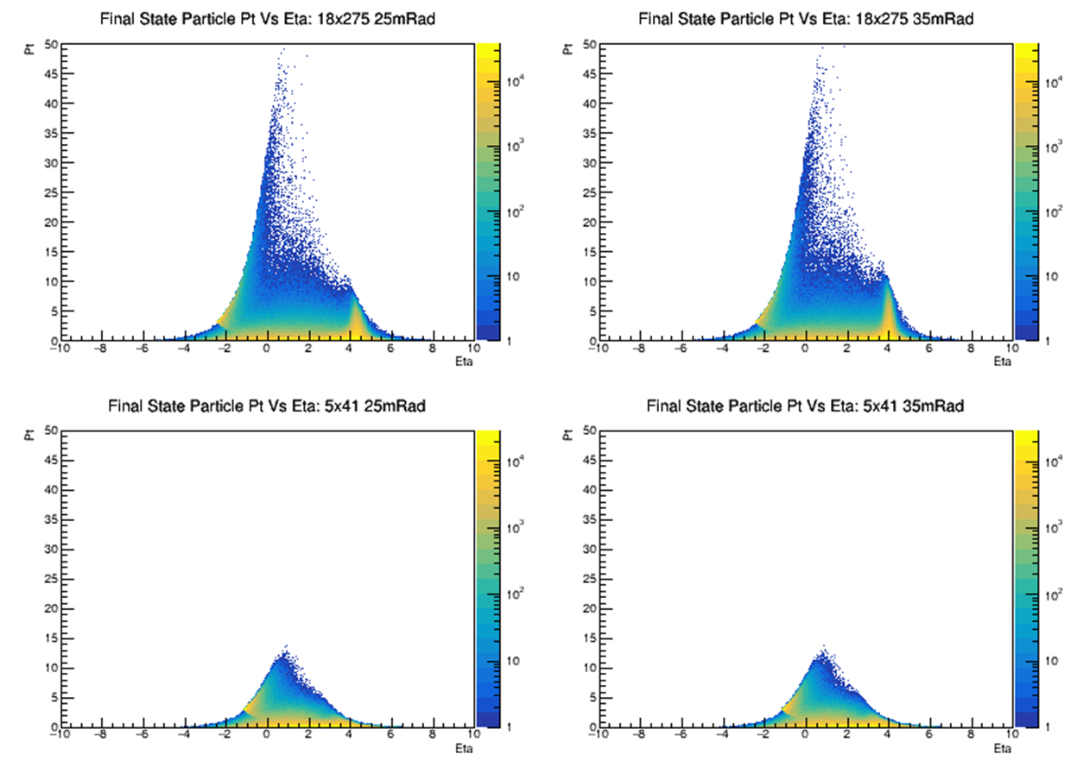
Particle Distributions: Pt Vs Eta (w/ Beam Effects)

Slide 24
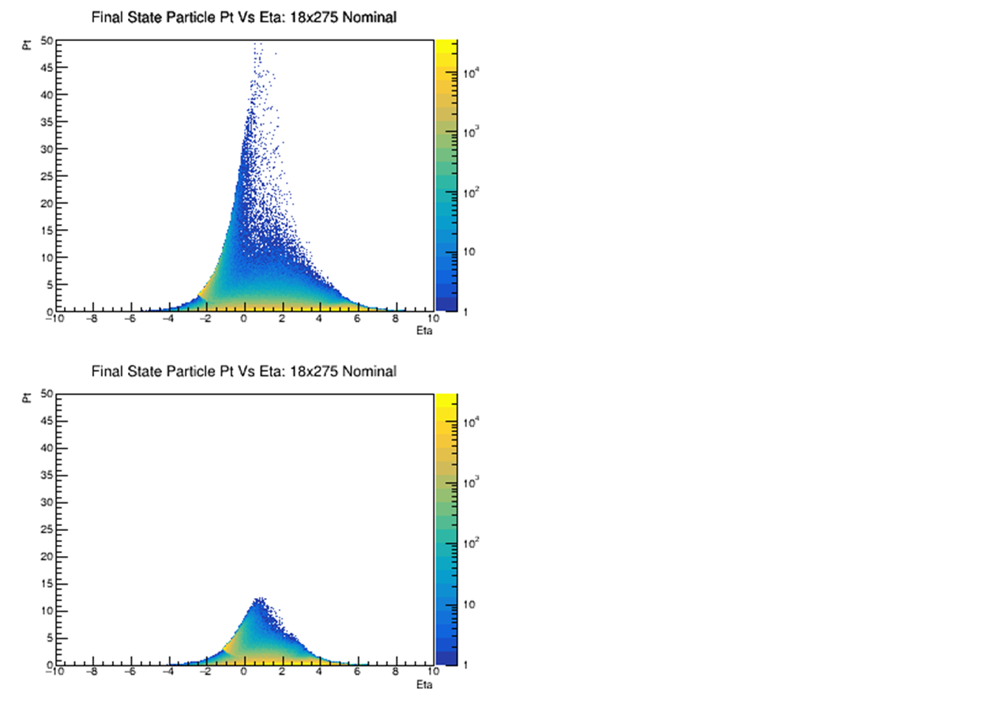
Particle Distributions: Pt Vs Eta (w/o Beam Effects)

Slide 25
Comparison with After-burner
Need to ensure that the Pythia8 scheme described above matches the after-burner implementation
Start by comparing the effects of crossing angle and divergence
After-burner cannot easily incorporate beam energy spread – compare quantities with and without this effect turned on in Pythia8
Work on comparing with crabbing effects included is ongoing
Two methods agree remarkably well – better than 1% level
Beam energy variation has no visible systematic impact on agreement (effect on sensitive precision probes like threshold production have not been evaluated)

Slide 26
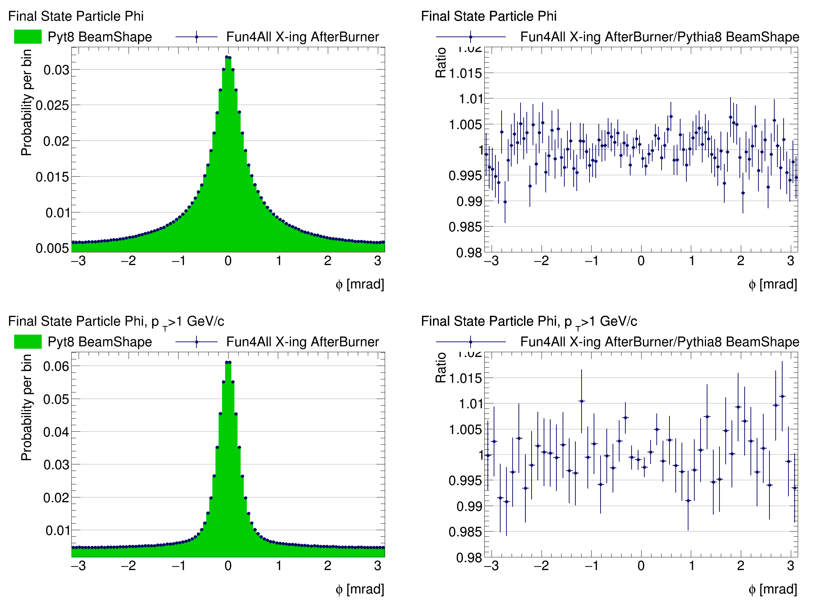
PYTHIA-8 / After-burner Phi Comparison (Energy Smear Off)

Slide 27
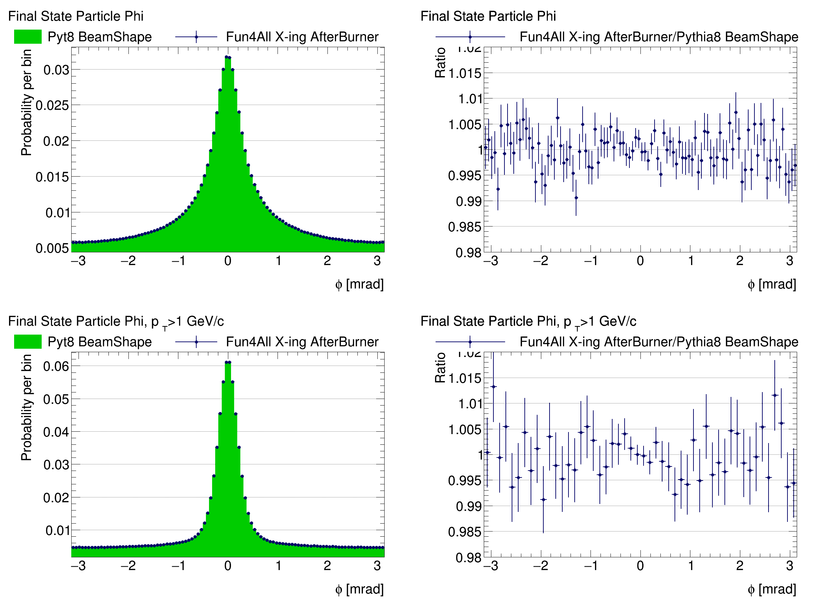
PYTHIA-8 / After-burner Phi Comparison (Energy Smear On)

Slide 28
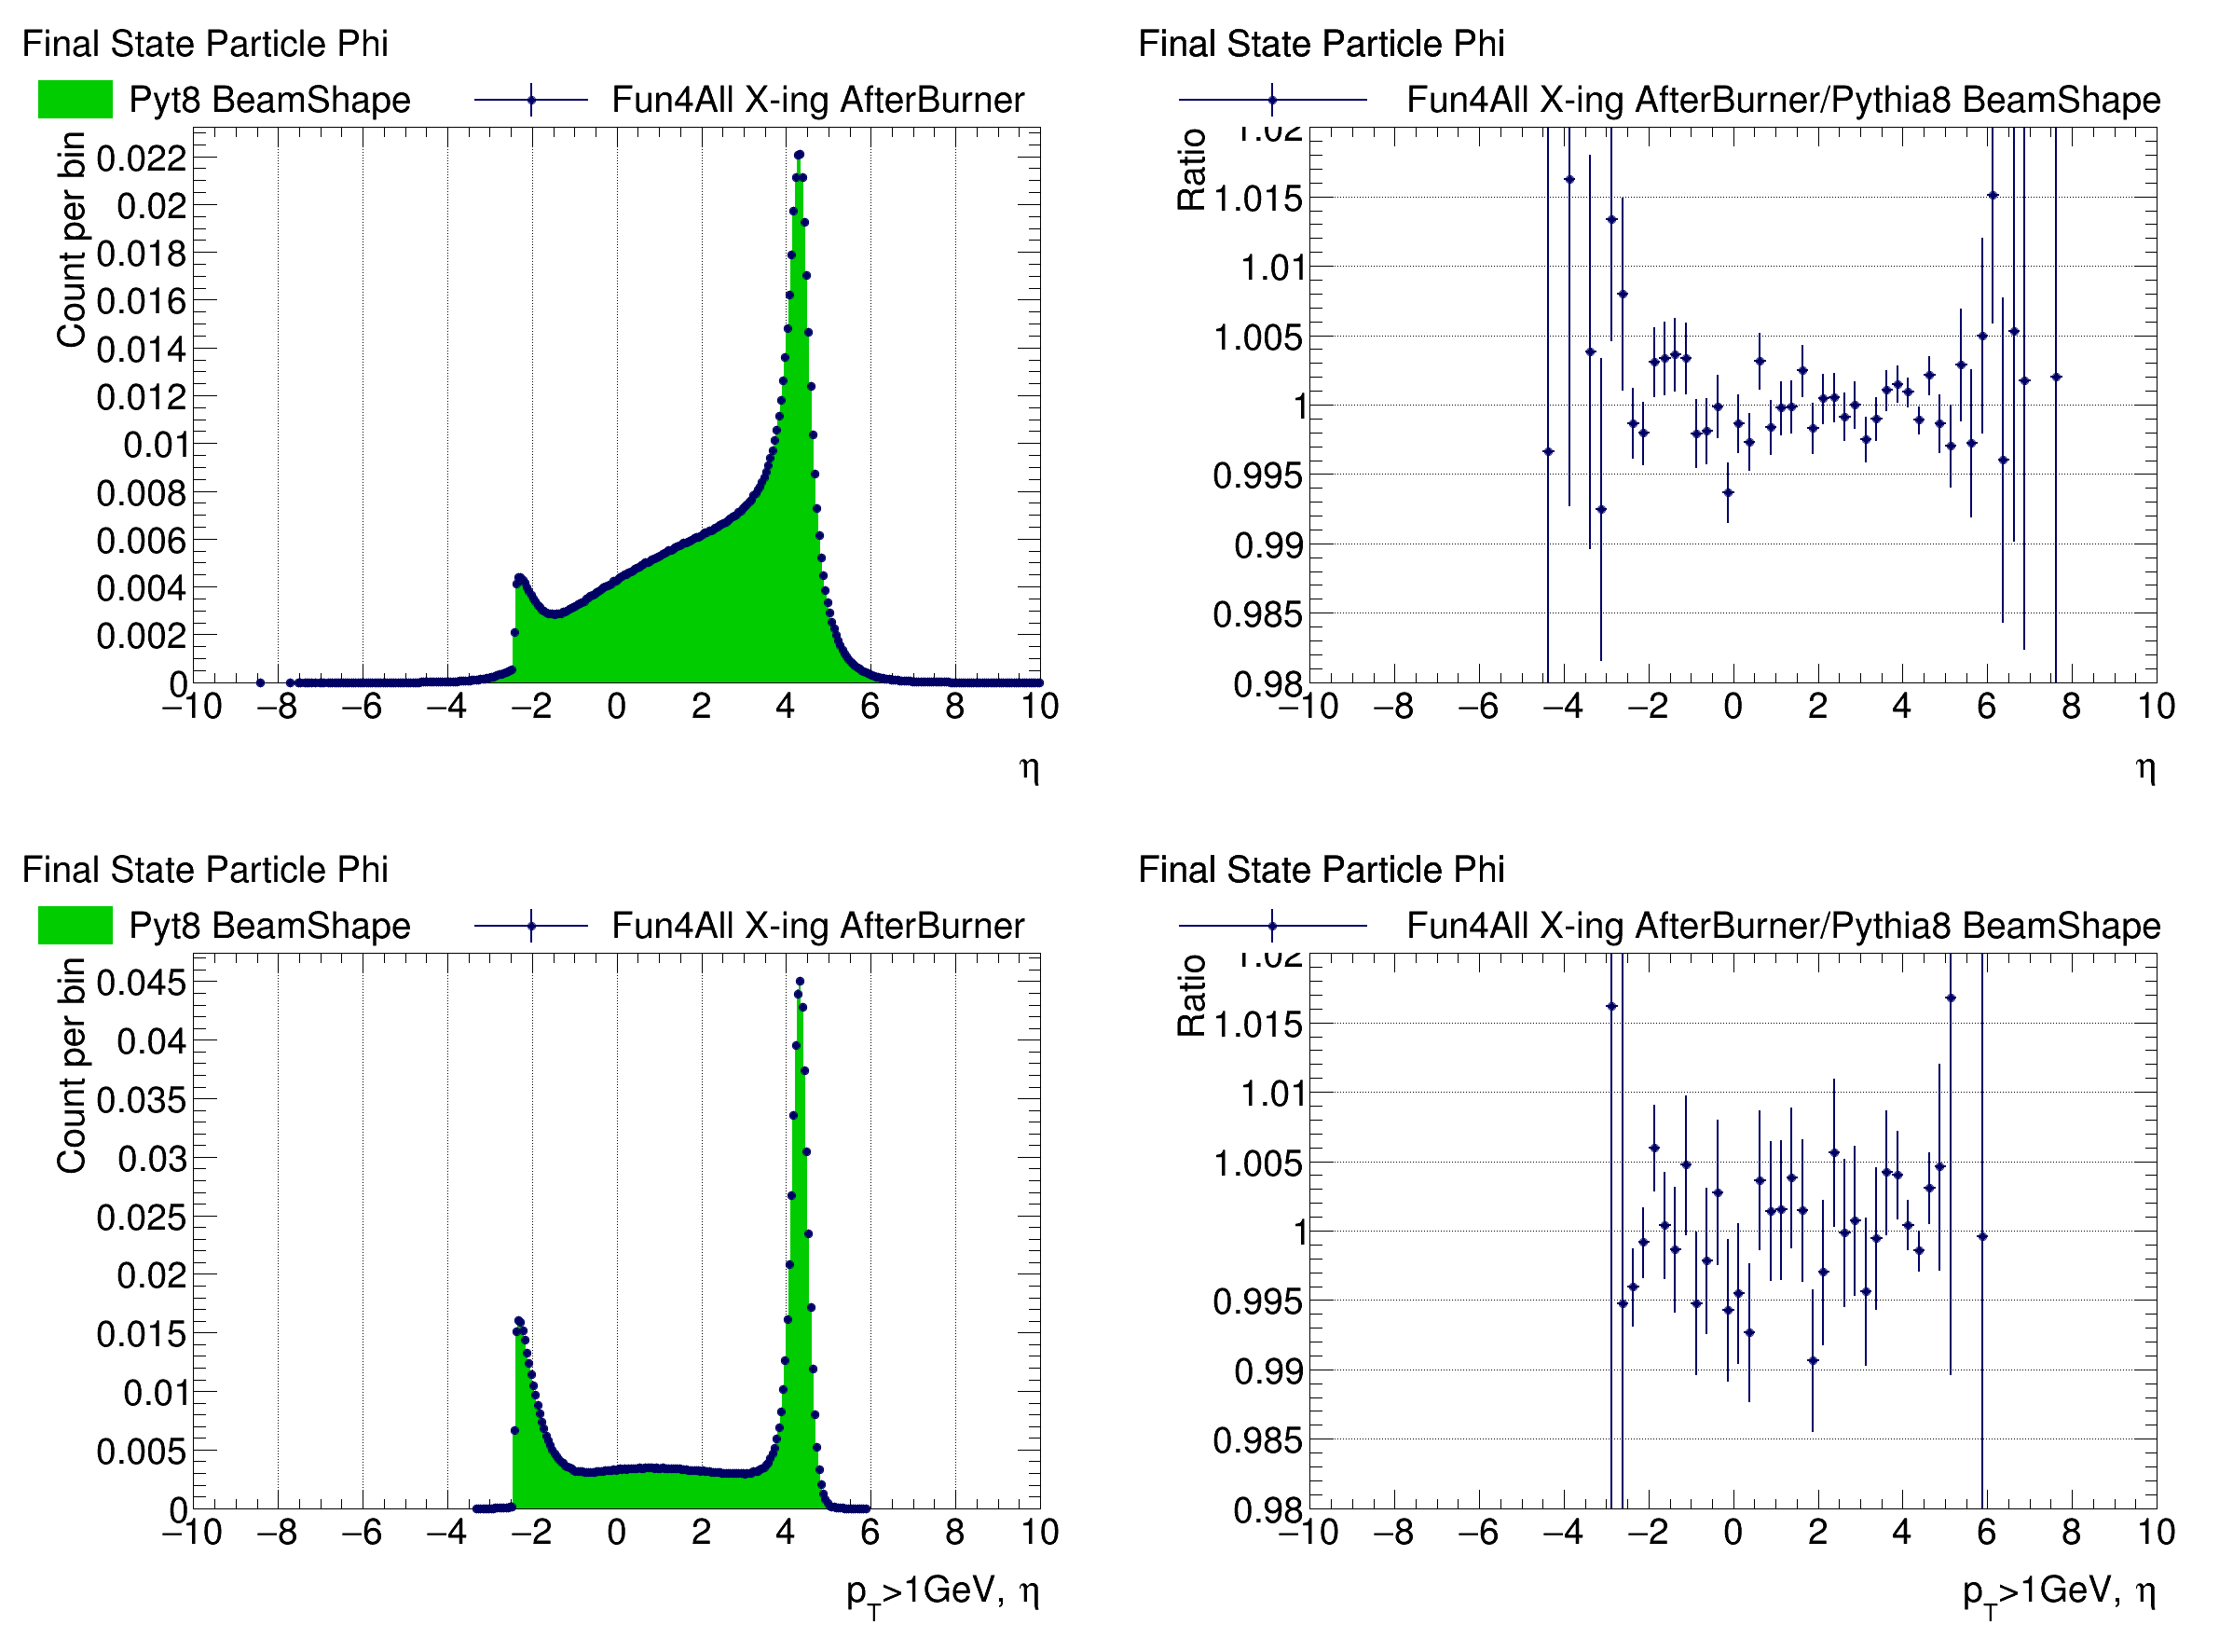
PYTHIA-8 / After-burner Eta Comparison (Energy Smear Off)

Slide 29
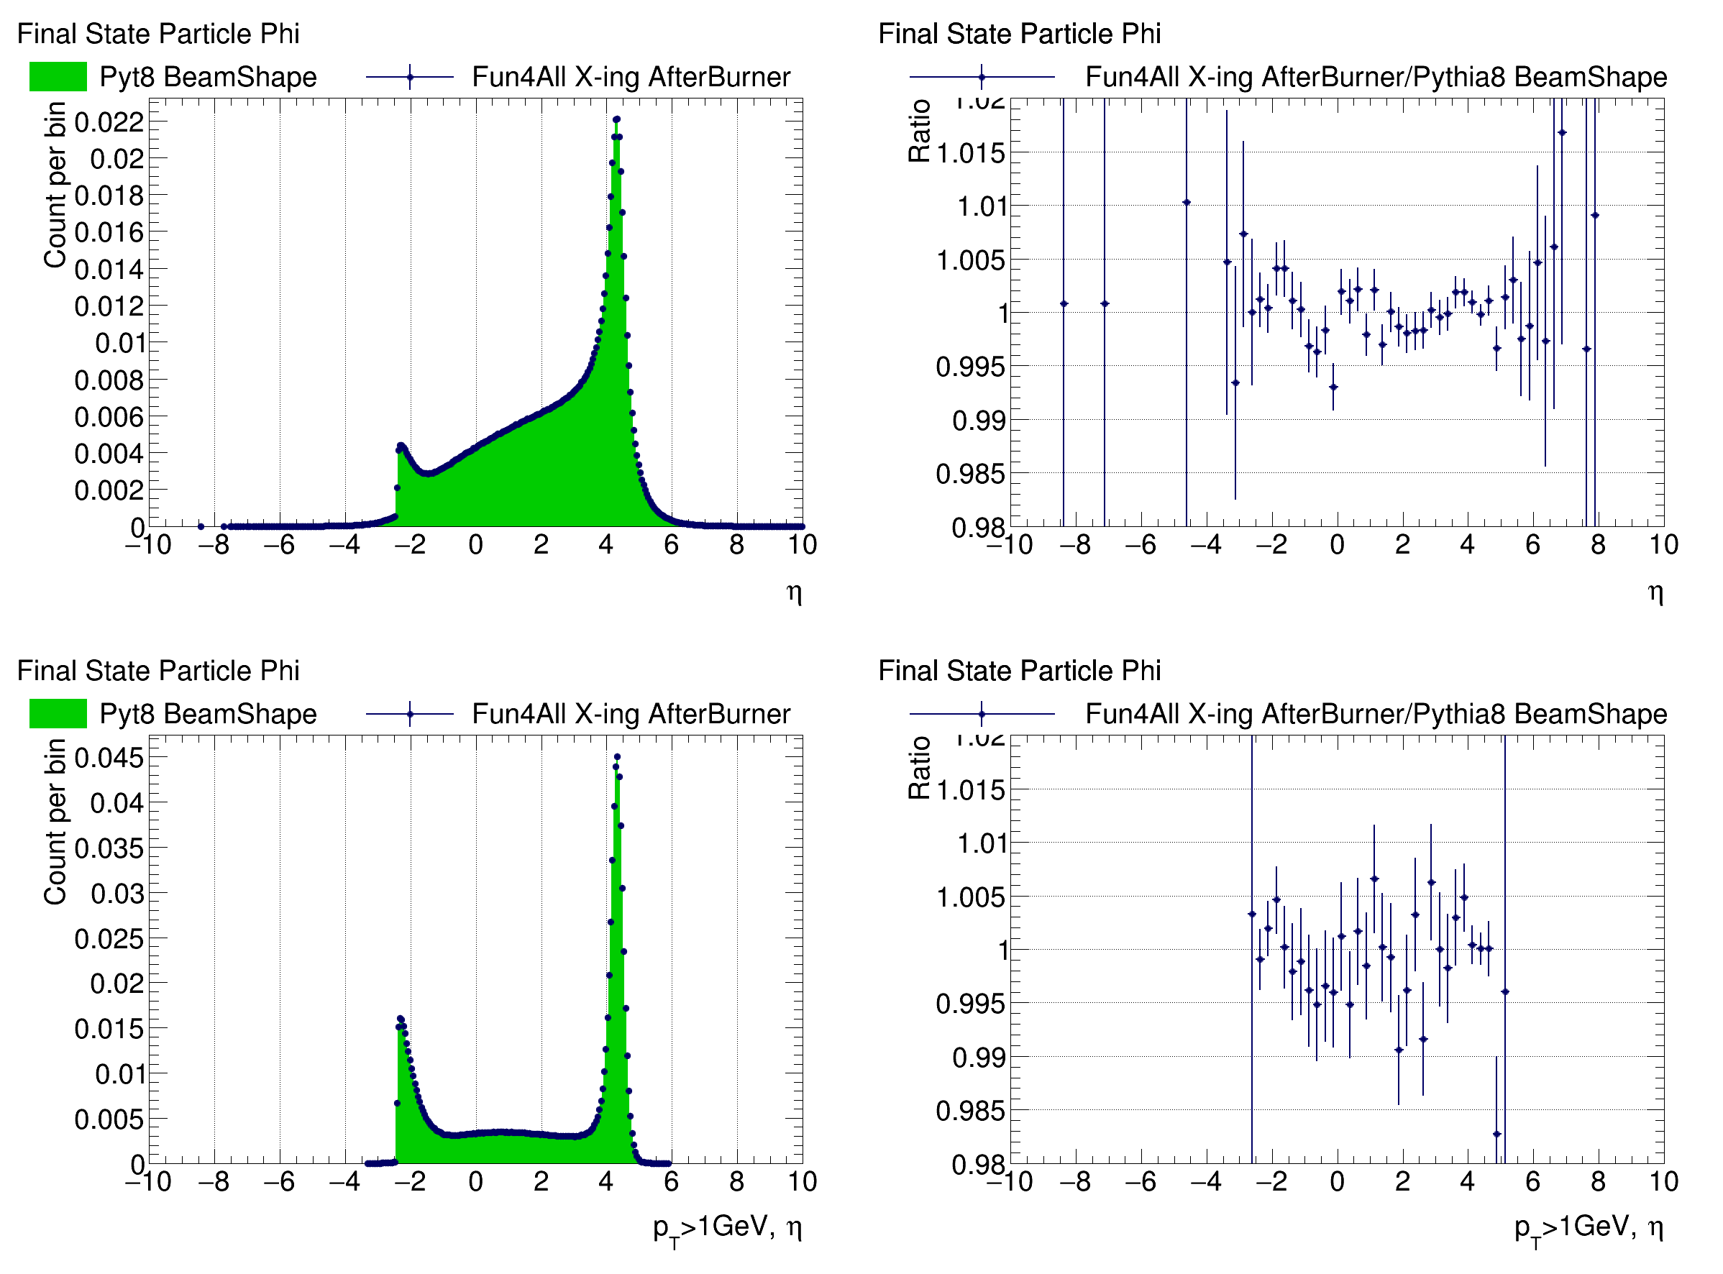
PYTHIA-8 / After-burner Eta Comparison (Energy Smear On)

Slide 30
Summary
Impact of crossing angle, beam divergence, beam energy spread, and crabbing on beam momentum, vertex, and final state particle distributions shown
Displayed limiting cases of 18x275 and 5x41 beam energies for 25 and 35 mRad crossing angles
Crossing angle will have large impact on distribution and momentum of final state particles in the central detector – needs to be taken into account in all analyses
Comparisons between Pythia8 and After-burner implementations show excellent agreement
Beam energy variation has no impact on agreement between methods at our level of precision – may need to look at again for sensitive probes
Comparisons including crabbing effects are ongoing
Either method should provide accurate simulation of beam effects – details of implementation will need to be discussed further
Can in principle boost to a head-on frame in which distortions to final state particle distributions disappear – see further slides for some preliminary discussion about this point

Slide 31
Head-On Frame
My previous studies have shown what the distribution of particles will look like in the detector in the presence of a crossing angle (and other beam effects)
This is relevant because this is what the detector will see and therefore will define the resolutions and acceptances we work with
The lab/detector frame is not necessarily the one in which we will do analyses as it is in principle possible to transform to a frame in which the crossing angle effects are negated
Below, I describe this transformation and look at a few relevant issues

Slide 32
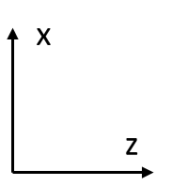
Boost
(6.896/293.29,0.022/293.29,257.15/293.29)
(0.003,-0.001,-18.026,18.026)
(6.892,0.023,275.176,275.264)
Initial Configuration in the Lab Frame (beam momenta from a random event)

Slide 33
(-1.402,-0.006,-70.420,70.434)
(1.402,0.006,70.420,70.440)
Initial Configuration in the Lab Frame (beam momenta from a random event)
Boost by sum of beam 4-momenta to get to CM Frame

Slide 34
(0.0,-0.006,-70.434,70.434)
(0.0,0.006,70.434,70.440)
Initial Configuration in the Lab Frame (beam momenta from a random event)
Boost by sum of beam 4-momenta to get to CM Frame
Rotate about y-axis to eliminate x-component of momentum

Slide 35
Boost
(0.0,0.0,-257.15/293.29)
(0.0,0.0,-18.048,18.048)
(0.0,0.0,274.890,274.891)
Initial Configuration in the Lab Frame (beam momenta from a random event)
Boost by sum of beam 4-momenta to get to CM Frame
Rotate about y-axis to eliminate x-component of momentum
Rotate about x-axis to eliminate y-component of momentum (not shown)
Boost back along z to (nearly) restore original beam energies

Slide 36
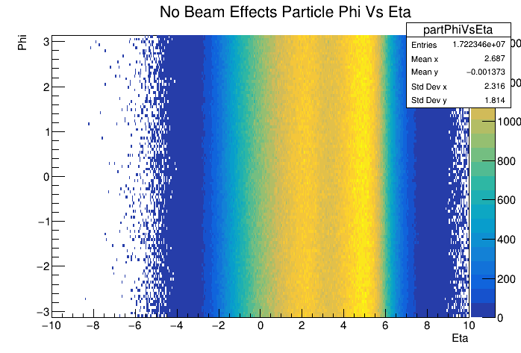
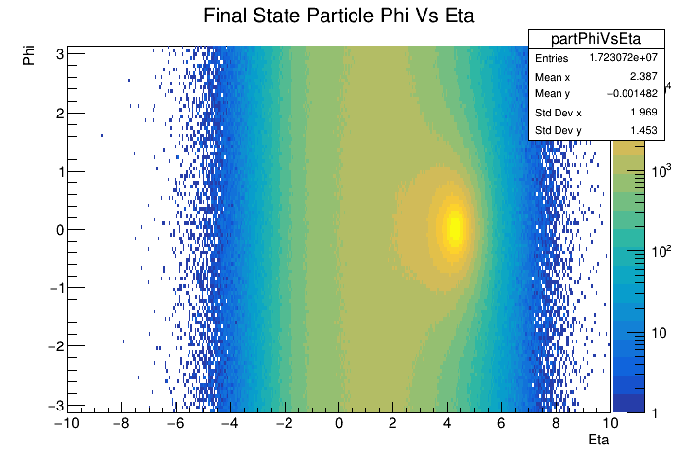
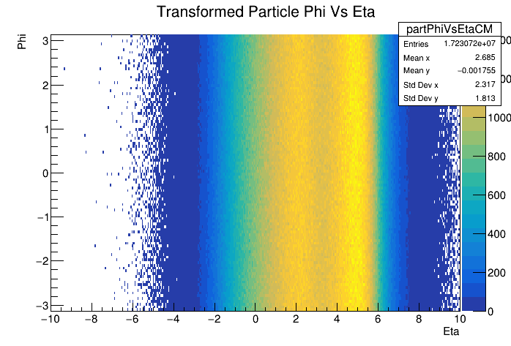
Frame Comparison: Phi Vs Eta
Transform
Crossing angle introduces a hot-spot at phi = 0 and eta = ~4.2 in the lab frame (top left)
Transformation described above removes phi modulation and smooths out eta (bottom right)
Matches very well with distribution obtained from default Pythia with no beam effects included (top right)

Slide 37
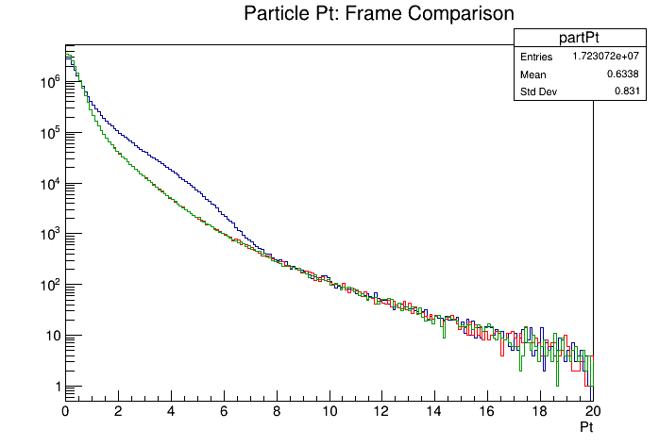
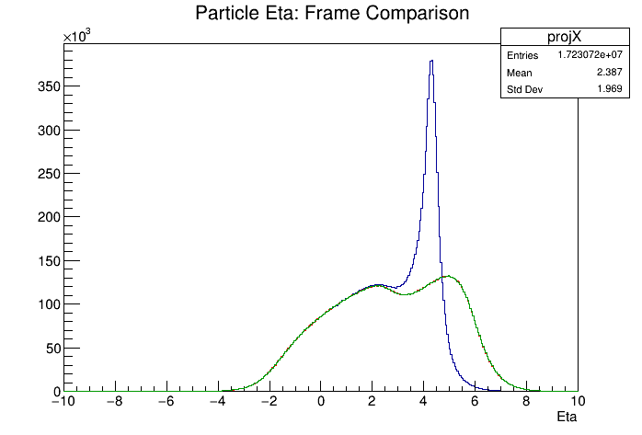
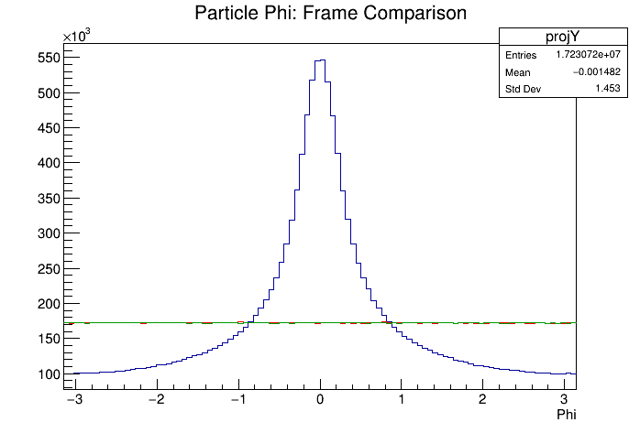
Frame Comparison: Pt, Eta, & Phi
Transformed eta and phi distributions from Pythia sample with beam effects matches exactly the lab frame distributions from default Pythia
Particle Pt distributions match as well
Transformation does what we expect
Lab Frame (Beam Effects)
Transformed (Beam Effects)
Lab Frame (No Beam Effects)

Slide 38
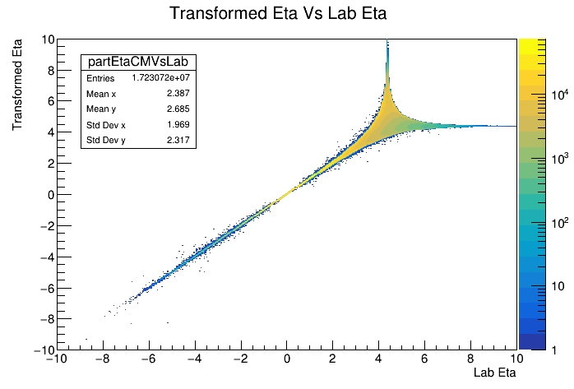
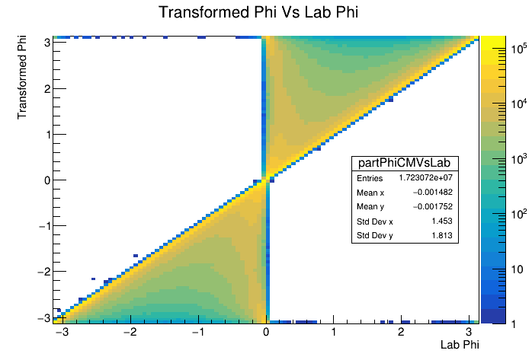
Transformed Vs Original Phi and Eta
Correlation between transformed and lab eta for Pythia sample with beam effects is one-to-one for low eta
Correlation begins to smear out at higher eta with singular behavior near eta = 4.2

Slide 39
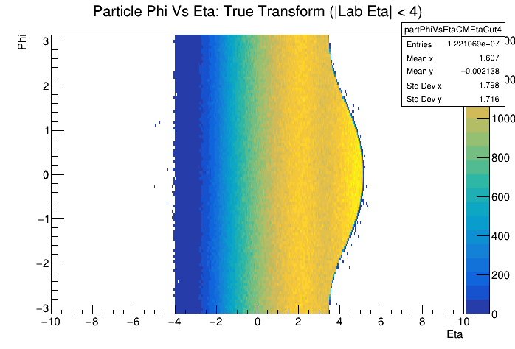
Acceptance Effects: Lab Eta < 4
We have seen that the transformed eta/phi distributions match the default Pythia values very well when considering all particles
How does limiting acceptance due to finite detector acceptance effect transformed distribution
See the ‘bulge’ from crossing angle, but particle distribution is still flat in phi within this region

Slide 40
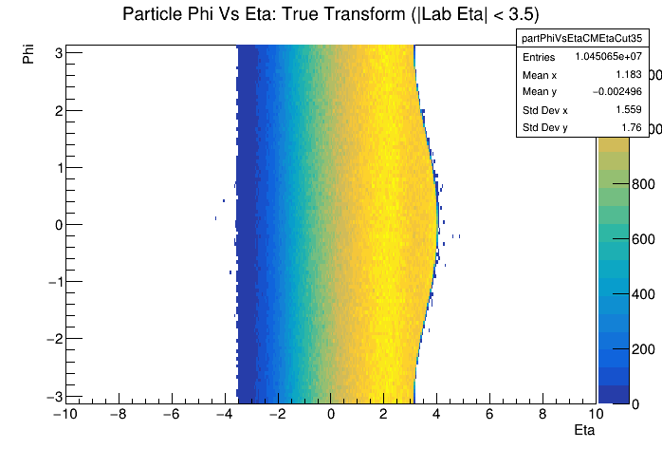
Acceptance Effects: Lab Eta < 3.5
If we look at acceptance of eta between +/- 3.5 in the lab frame (nominal tracking range), ‘bulge’ decreases, but eta range also decreases (no surprise)

Slide 41
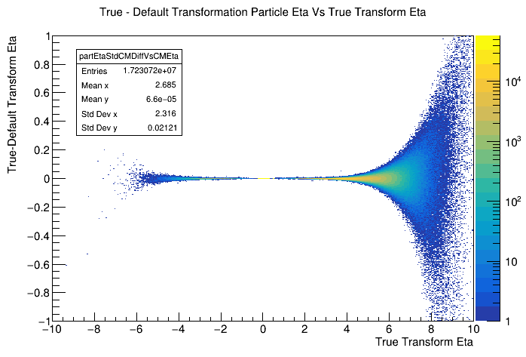
Beam Smearing Effects
All plots above used transformation constructed assuming perfect knowledge of incoming beams
Divergence, beam energy spread, etc introduce momentum deviations which cannot be measured event by event
Compare true transformation (assuming perfect knowledge) with default transformation (assume nominal beam energies and crossing angle)
Deviations are small at mid-rapidity but grow sizable as you move forward

Slide 42
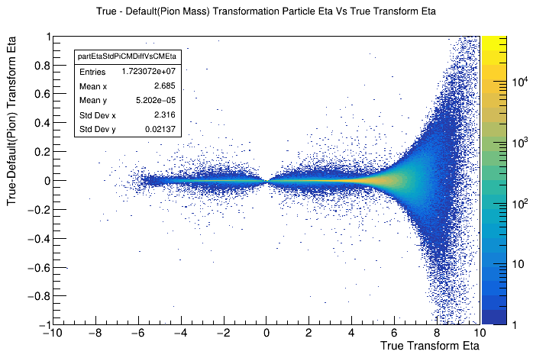
Beam Smearing Without PID
Lorentz transformation depends on momentum and energy of the particle being transformed
How is the transformation affected if we don’t know the energy of the track
Assume all tracks are pions and all neutrals are massless
Look at deviation between true transformation and transformation assuming nominal crossing angle and beam energy as well as the pion mass and massless neutrals assumptions
TODO: Look at detector smearing

