Slide 1

Accelerator and Beam conditions critical for physics
E.C. Aschenauer (BNL)

Slide 2
Effects to be considered for the Main Detector
All needed information is in the EIC CDR https://www.bnl.gov/ec/files/EIC_CDR_Final.pdf
specifically in section 3.1 and tables 3.3 to 3.5 and section 3.2
detector solenoid aligned with the lepton beam → 8 mrad
→ reduction of synchrotron radiation
→ electron beam displacement at the end of the solenoid would be too big to handle
Backward
p/A beam
electron beam
Forward

Slide 3
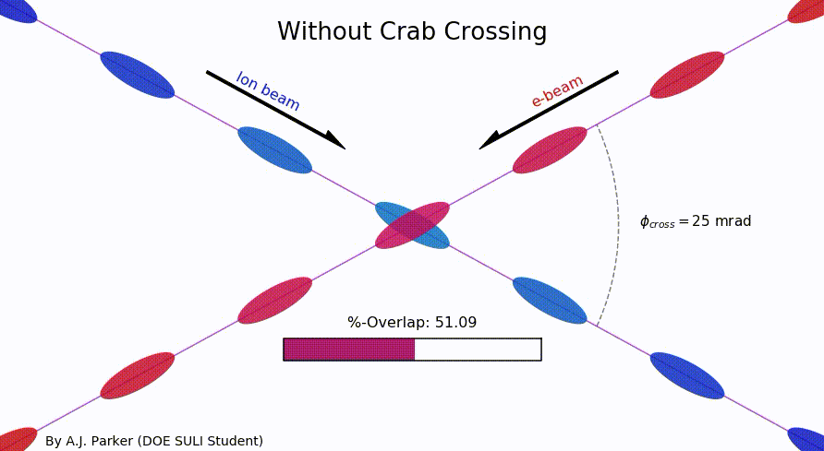
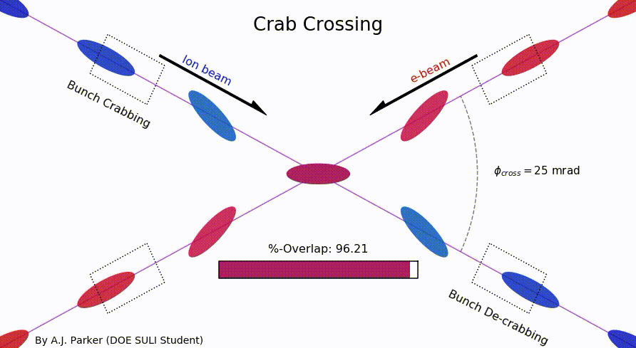
Consequences of Crossing Angle
Crossing angle of 25 mrad
  bring focusing magnets close to IP
  no separator dipole
  → reduce detector background
  → reduced SR
    → beams less in one common beam pipe
  Multi-staged separation → separate beam
  from particles needed for physics
  → space for forward equipment along beam line
However, crossing angle causes
  Low luminosity
  more challenging Beam dynamics
  → avoided by Crab Crossing
Impact on Physics:
Size of crab angle directly impacts angular opening of the first forward spectrometer dipole B0 (polar angle)
Impact on main detector acceptance → beams not back to back → solenoid aligned with electron beam → very small charged particle bending on one side of the outgoing hadron beam line → poor momentum resolution (and a strong functional azimuthal asymmetry of the acceptance at high η)
transverse vertex (x-direction) is depending on what collisions ones has head head vs. tail-tail

Slide 4
Important particle beam parameters
Angular beam divergence
  Angular “spread” of the beam away from the central trajectory.
  Gives some small initial transverse momentum to the beam particles
  → impact on p_{T} resolution
Beam Energy spread
  beam energy is a gaussian centered on value i.e 5 GeV, with a RMS ~10⁻⁴ GeV
Bunch length
  both beams have a longitudinal extension hadron beam < 10 cm & electron beam ~1cm

Slide 5
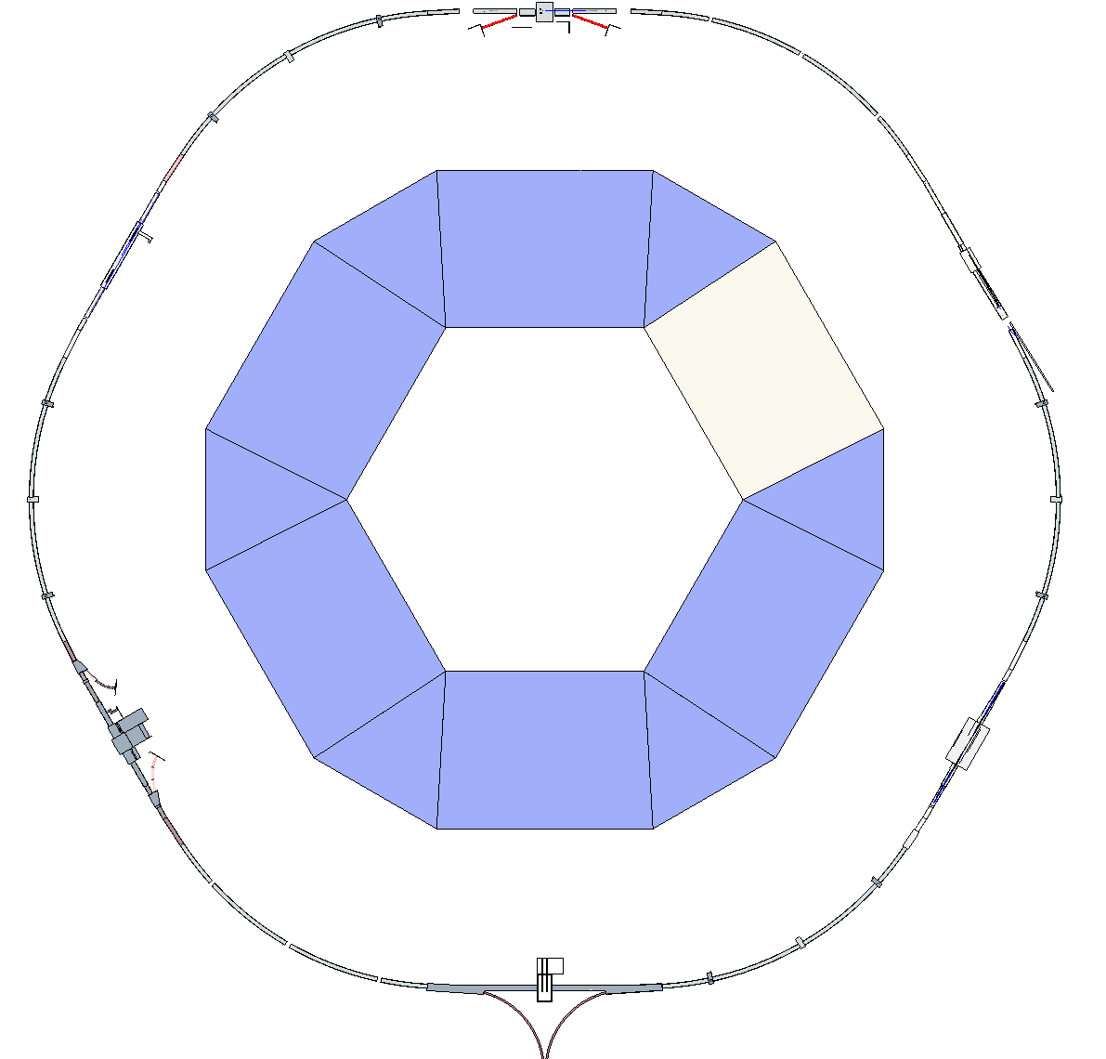
Rotate eSR
Rotate the ESR reference plane about a line through IP6 and IP8 by ~200 µRad
  for IP-6 this means a vertical shift of 1.521mm at the end of b2er (z=14998.27mm), that makes it a about 100μrad angle
  very small angle should be not to critical for science
1022.3 m
ESR elevation at IR2 & IR12 = 1066 mm
(low by 204 mm)
510.8 m
X
Z
ESR elevation at IR4 & IR10 = 1168 mm
(low by 102 mm)
Rotate ESR Plane about line through IP6 and IP8 by ~200 µR
ESR elevation at IR 6 & IR8 = 1270 mm

Slide 6
Effects to be considered for the Forward Detectors
All the effects from before
  angular beam divergence
  beam energy spread
  bunch length
  crossing angle and crab cavities
    Roman pot detectors need to sit before the crab cavities to avoid decorrelation of forward scattered protons and IP info
~1.25mm
Looking along the beam with no crabbing.
RMS hadron bunch length ~10cm.
Because of the rotation, the Roman Pots see the bunch crossing smeared in x.
Vertex smearing = 12.5mrad (half the crossing angle) * 10cm = 1.25 mm
If the effective vertex smearing was for a 1cm bunch, we would have .125mm vertex smearing.

Slide 7
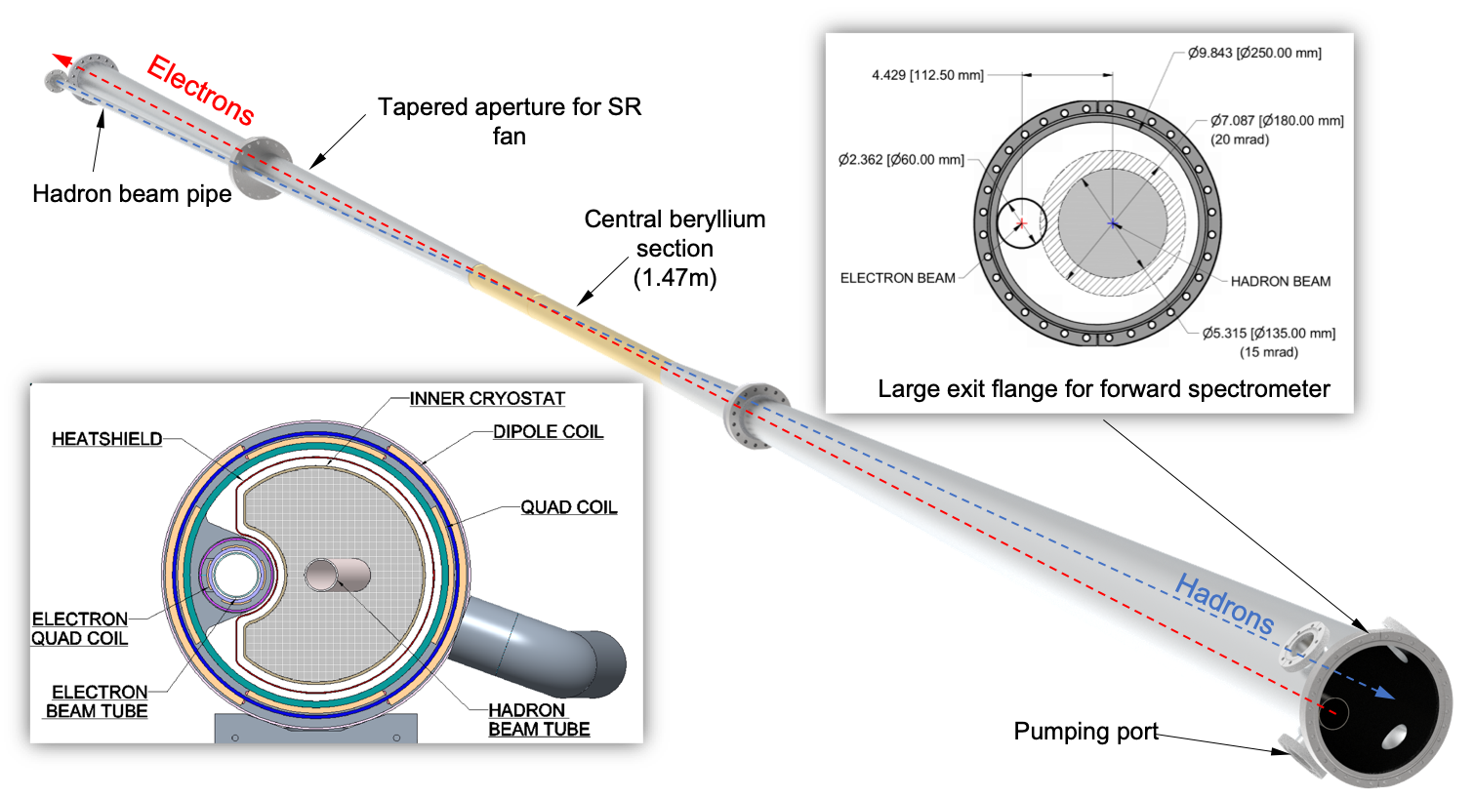
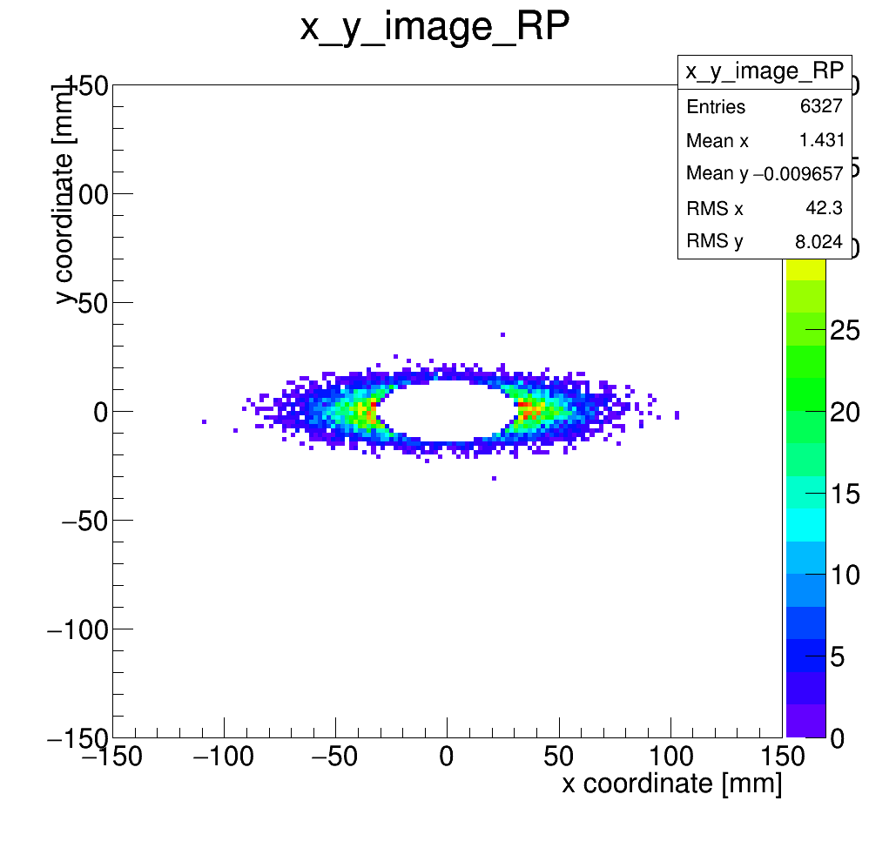
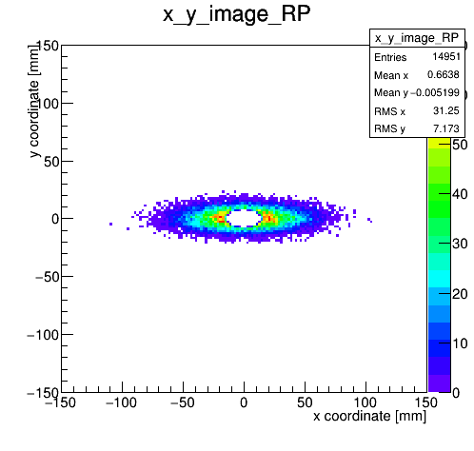

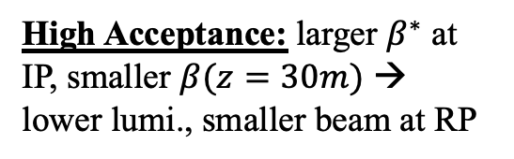
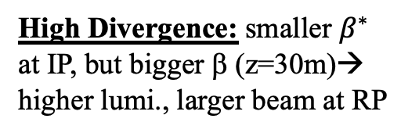
Effects to be considered for the Forward Detectors
Acceptances: Beam-pipe and Magnet apertures
low p_{T} - Acceptance: normalized beam emittance and beta function
  10σ separation RP to beam
$$σ_{x,y}=\sqrt{β_{x,y}ε_{n}/γ}$$
High Divergence: smaller $β^{∗}$ at IP, but bigger β (z=30m)→ higher lumi., larger beam at RP
High Divergence
High Acceptance
High Acceptance: larger $β^{∗}$ at IP, smaller $β(z=30m)$ → lower lumi., smaller beam at RP
~20 cm

Slide 8


