Slide 1
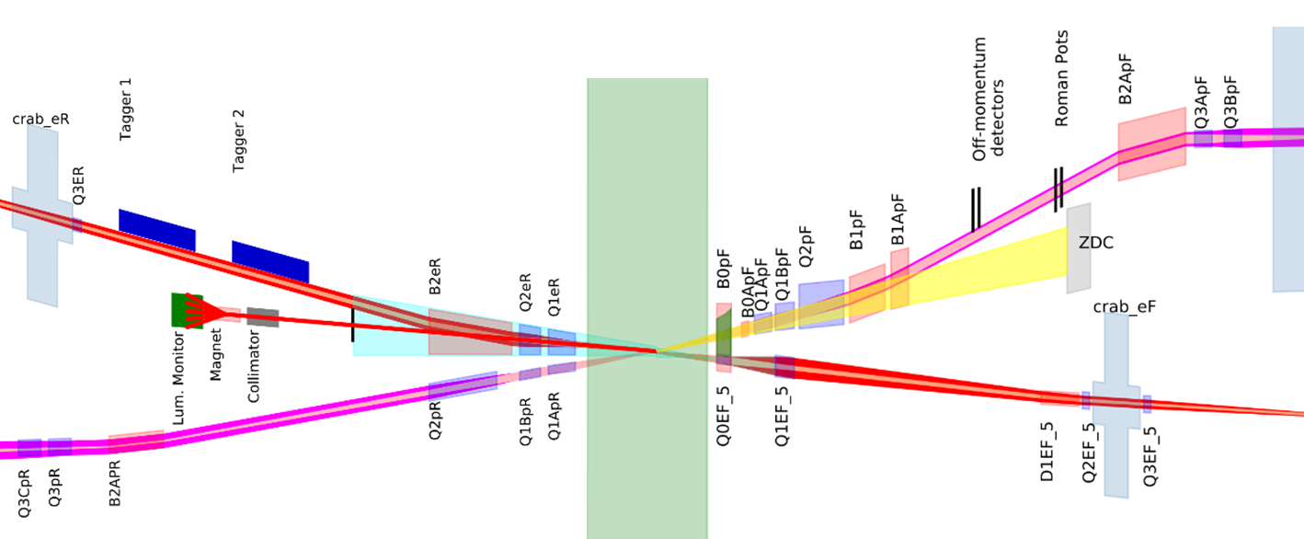
Interaction Region Overview
Hadrons
Electrons
Roman pots
(Complex chamber)
Low Q² taggers
(Beryllium windows)
Off momentum detectors
(Beryllium window)
Forward spectrometer
(Thin wall exit window)
SR absorber
Luminosity monitor
(Exit window TBD)
Rear cryostat
Forward cryostat

Slide 2
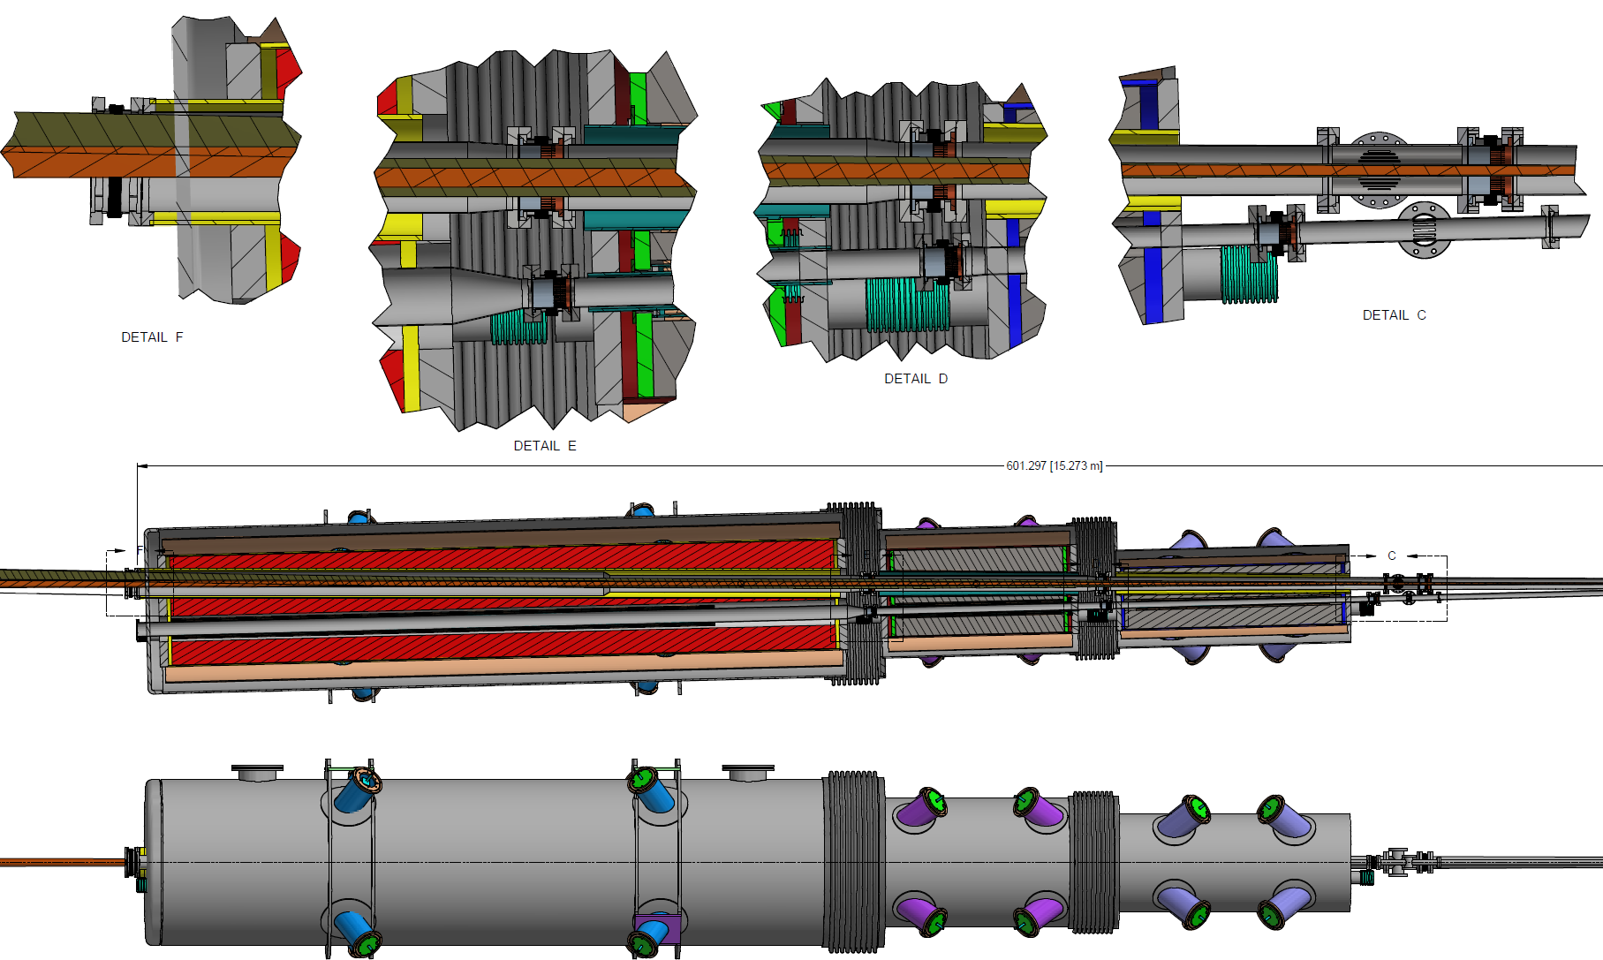

Slide 3
Exit of Rear Cryostat
Old
B2AeR beam pipe
R = 77mm
B2AeR beam pipe
R = 98mm
New
Electrons
Hadrons

Slide 4
Exit of Rear Cryostat
RF shielded bellows
13 sigma electron beam
18.5m from IP
18.644m from IP
Continuation of electron beam pipe
Electron beam axis through IP
2mrad cone from IP
Exit window
250 mrad
2.6mm thick
(10mm of aluminum)
3.125m drift pipe

Slide 5
Simulation Information (10GeV, 2.5A)
Lattice date: 210405
0.5m shift included
ε_{x}/ε_{y} = 20/1.3nm
ΔE/E = 5.8 x 10⁻⁴
Tails included
All surfaces assumed copper
Central section beryllium
Exit window aluminum
Roughness ratio = 0.05
Forward magnets include:
D1eF
Q1eF
Q0eF
Rear magnets include:
B2AeR
B2BeR
Q1eF
Core (90%)
Tails (10%)

Slide 6
Forward magnets
0.524 kW
Forward magnets + B2A
6.72 kW
Forward magnets + B2A + B2B
10.20 kW
Total power: 1.94 kW
Total power: 8.13 kW
Total power: 25.60 kW
B2A field
B2A field
B2B field
Q2eR backscatter
9.08 x 10¹² ph/s
Q2eR backscatter
2.80 x 10¹³ ph/s
Q2eR backscatter
2.70 x 10¹³ ph/s
Q1eR backscatter
1.34 x 10¹² ph/s
Q1eR backscatter
3.94 x 10¹² ph/s
Q1eR backscatter
3.98 x 10¹² ph/s
Beryllium backscatter 0 ph/s
Beryllium backscatter 0 ph/s
Beryllium backscatter 0 ph/s

Slide 7
Power on Exit Window (10GeV)
2.0mrad
8.0kW
1.5mrad
5.6kW
B2B radiation
2.5kW
Radiation from forward magnets
B2A radiation
Electron beam axis through IP

Slide 8
3mm (80µrad)
7.0kW
2mrad collection angle

Slide 9
Simulation Information (18GeV, 227mA)
Lattice date: 210405
0.5m shift included
ε_{x}/ε_{y} = 24/2.0nm
ΔE/E = 10.9 x 10⁻⁴
Tails included
All surfaces assumed copper
Central section beryllium
Exit window aluminum
Roughness ratio = 0.05
Forward magnets include:
D1eF
Q1eF
Q0eF
Rear magnets include:
B2AeR
B2BeR
Forward magnets + B2A + B2B
9.91 kW
Total power: 24.70 kW
B2A field
B2B field
Q2eR backscatter
2.61 x 10¹² ph/s
Q1eR backscatter
3.40 x 10¹¹ ph/s
Beryllium backscatter 0 ph/s

Slide 10
Power on Exit Window (18GeV)
2.0mrad
7.6kW
1.5mrad
5.3kW
B2B radiation
2.3kW
Radiation from forward magnets
B2A radiation
Electron beam axis through IP

Slide 11
Comparison (10GeV vs 18GeV)
 | 10GeV | 18GeV
Total Power [kW] | 25.6 | 24.7
Window Power [kW] | 10.2 | 9.91
Total Flux [ph/s] | 6.32x10¹⁹ | 1.12x10¹⁹
Window Flux [ph/s] | 2.68x10¹⁹ | 4.77x10¹⁸

Slide 12
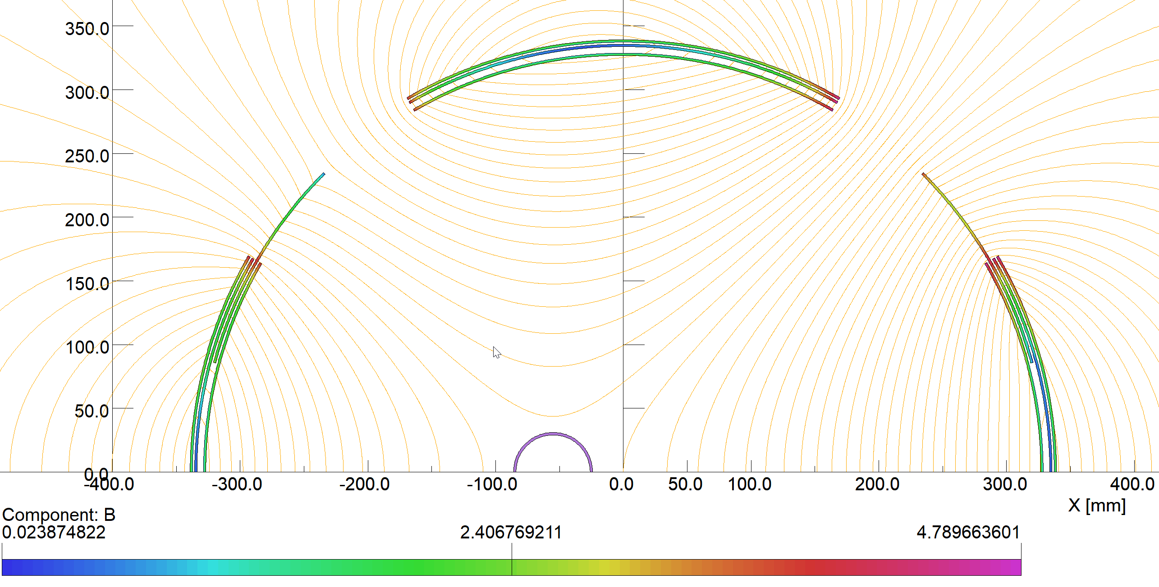
Effect of B0 Field
Lattice date: 210405
0.5m shift included
10GeV, 2.5A
ε_{x}/ε_{y} = 20/1.3nm
ΔE/E = 5.8x10⁻⁴
Tails included
All surfaces assumed copper
Central section beryllium
Exit window aluminum
Roughness ratio = 0.05
Center of Q0eF
6m
B0
55mm
Q0eF

Slide 13
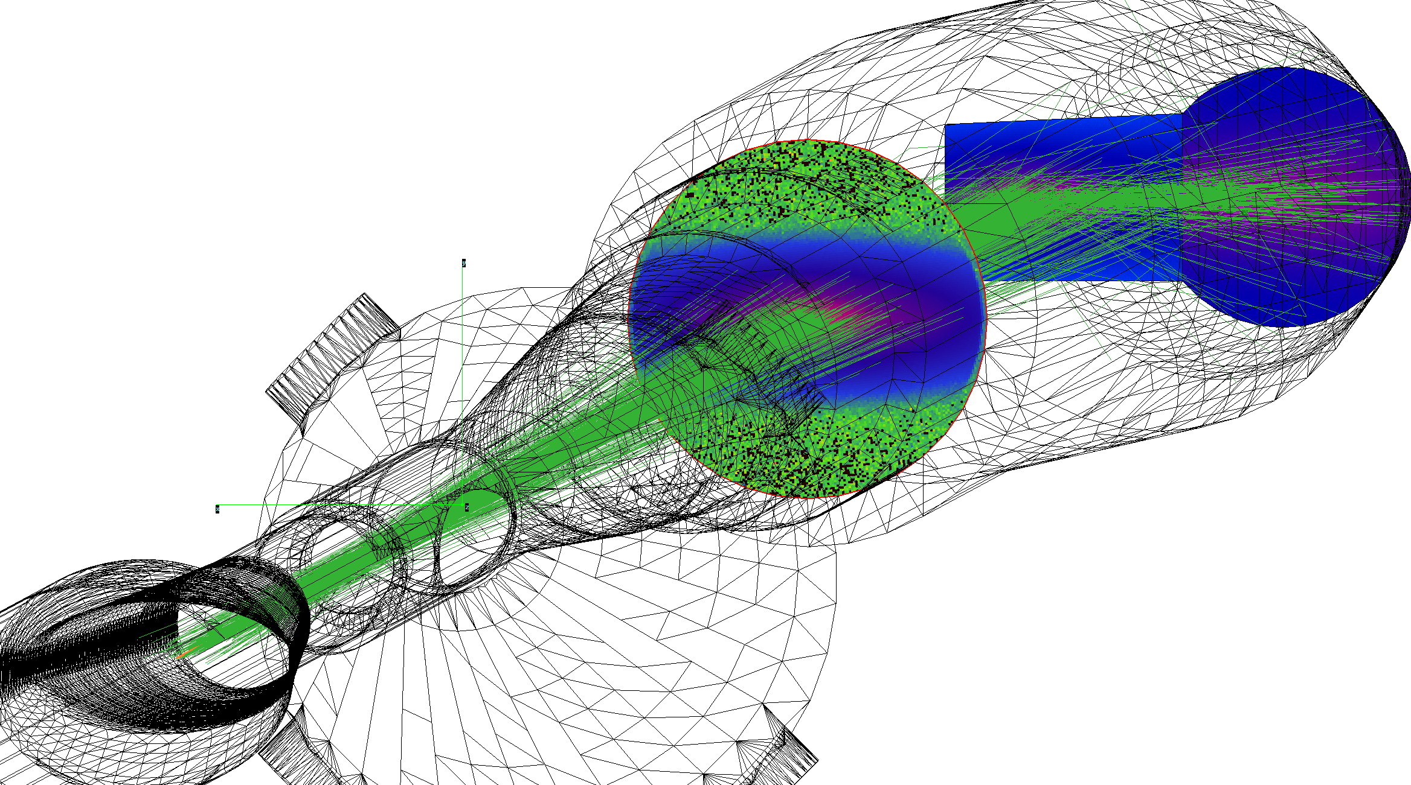
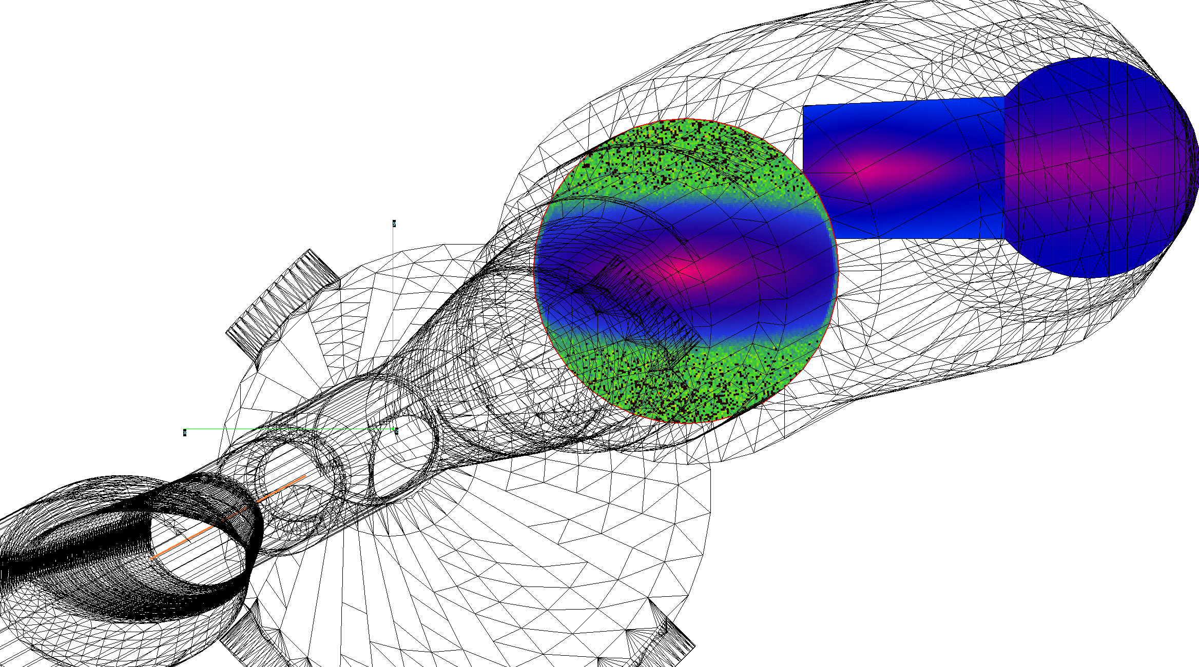
B0 Wiggle (55mm offset)
Total Power: 113 W
Total Flux: 2.53x10¹⁸ ph/sec
Flux Be section: 1.26x10¹⁴ ph/sec (6mW)
Spectrum (10GeV)
Entrance of B2AeR
Flux (10GeV)
154mm
Forward Magnets (for reference)
Total power: 1940 W
Total Flux: 1.24x10¹⁹ ph/sec
Flux Be section: 2.26x10¹⁶ ph/sec (2.1W)

