Slide 1
IR Meetings across
Proto-Collaborations
E.C. Aschenauer (BNL)
R. Ent (JLab)
Co-Associate Directors for the Experimental Program
June 7th, 2021

Slide 2
Meetings across Proto-Collaborations
Idea is to address topics, which affect all proto-collaborations the same way
Far-forward/backward IR meeting, example topics are IR layout, SR and beam-gas background, beampipe design, ……
  Topics: will solicitate input from proto-collaboration far-forward and backward WG conveners
  Organizers: E.C. Aschenauer & Rolf Ent
  Meeting: Mondays 2:00 pm
  Frequency: once per month or when needed
  Mailing list: YR-report mailing list eicug-yr-detector-forward-ir@eicug.org
  ZOOM: https://bnl.zoomgov.com/j/1616690483?pwd=UndKZDk5ekZISEJWVFVEbW9KMXZNQT09Meeting ID: 161 669 0483 Passcode: 127333
  Indigo: https://indico.bnl.gov/category/284/
Today’s Topic 2nd IR design for IP-8

Slide 3

Complementarity for 1st-IR & 2nd-IR
Since CD-1 we made significant progress in the preliminary design for the 2nd IR with a focus on complementarity
1st IR (IP-6)
2nd IR (IP-8)
Geometry:
ring inside to outside
ring outside to inside
tunnel and assembly hall
are larger
Tunnel: ⦰ 7m +/- 140m
tunnel and assembly hall are smaller
Tunnel: ⦰ 6.3m to 60m then 5.3m
Crossing Angle:
25 mrad
35 mrad
secondary focus
different blind spots
different forward detectors and acceptances
different acceptance of central detector
Luminosity:
more luminosity at lower E_{CM}
optimize Doublet focusing FDD vs. FDF
→ impact of far forward p_{T} acceptance
Experiment:
1.5 Tesla or 3 Tesla
different subdetector technologies

Slide 4
2nd IR layout at IR-8
The layout of the 2nd IR is currently early pre-CDR level
High level Assumptions:
  IR needs to be affordable and be compatible with overall EIC accelerator design
    obey chromaticity, divergence, crab cavity constraints
    no changes to EIC base parameters, numbers of bunches, Power limits, …….
  reuse as many RHIC magnets as possible to match IR into the RHIC ARCs
  detector solenoid is aligned with the electron beam
  no civil construction to Tunnel layout
What you will get:
  total crossing angle is 35 mrad, electron beam 8 mrad and hadron beam 27 mrad
  electron beam layout identical to IP-6
  2nd focus integrated in IR layout
  optics parameters for both beams: β*, β-functions, divergence, ……..
  information on magnet bore sizes and layout in forward/backward direction suited for detailed acceptance studies as in Yellow report and CDR

Slide 5
Today’s Meeting – 2nd IR Design for IP-8
Introduction – Elke Aschenauer and Rolf Ent (5’)
2nd IR Layout – Bamunuvita (Randika) Gamage (20’)
2nd IR Physics Performance – Alexander Jentsch (20’)
Summary and Next Steps – Elke Aschenauer and Rolf Ent (10’)

Slide 6
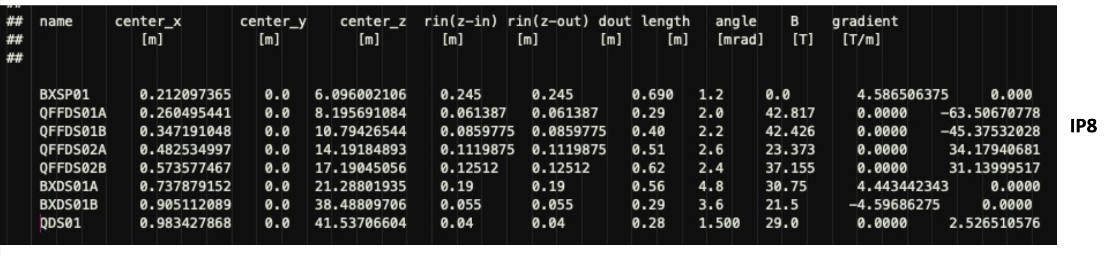
2nd IR layout at IR-8: What is next
Outgoing hadron beam magnet setup
layout z-axis along electron beam → all crossing angle in hadron beam
same convention as for IP-6
All information will be posted at todays meeting Indigo page

Slide 7
2nd IR layout at IR-8: What is next
What you will need to do:
  Optimize detector locations (Roman Pots, Off-Momentum Detectors, ZDC, …)
What is NOT yet done:
  a full integration of the 2nd IR into the EIC accelerator
  machine checks for operations
  any background simulations, i.e. beam gas and SR
  no design of the SR masks and simulations how effective the collimator system is with 2 IR → but as electron beam is not touched should be the same as IP-6
  beam pipe design – this will need work as the larger crossing angle will make the transition into B0 more complicated
  a design of the IR magnets – first checks that magnet parameters are reasonable (peak fields okay for conductor) have been done, but have not yet done designs such that we can guarantee cross-talks can be sufficiently limited.
.

Slide 8
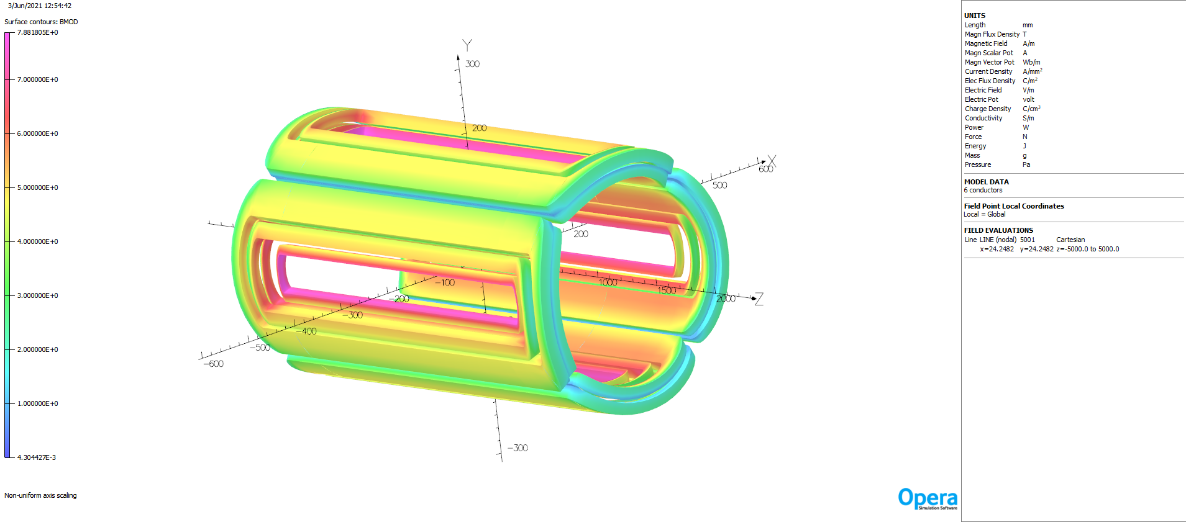
2nd IR layout at IR-8: What is next
First checks on magnets by Renuka Rajput-Ghoshal & Jlab Magnet Group
Design and analysis parameter for all the ion magnets, the values in red are not safe from magnet design point
  change bore size by 15% to come in the safe region
Example:
Coil field for the QFFDS02B quadrupole

Slide 9
2nd IR layout at IR-8: What is next
Design and analysis parameter for all the ion magnets, the values in red are not safe from magnet design point
  change bore size by 15% to come in the safe region
  new results table → used in study as presented
  studies need to be further refined, i.e BXSP01

Slide 10
2nd IR layout at IR-8: What is next
What you will need to do:
  Optimize detector locations (Roman Pots, Off-Momentum Detectors, ZDC, …)
What is NOT yet done:
  a full integration of the 2nd IR into the EIC accelerator
  machine checks for operations
  any background simulations, i.e. beam gas and SR
  no design of the SR masks and simulations how effective the collimator system is with 2 IR → but as electron beam is not touched should be the same as IP-6
  beam pipe design – this will need work as the larger crossing angle will make the transition into B0 more complicated
  a design of the IR magnets – first checks that magnet parameters are reasonable (peak fields okay for conductor) have been done, but have not yet done designs such that we can guarantee cross-talks can be sufficiently limited.
→ Hence, this design still comes with some risk!
We will investigate what tasks should be on the Project as they are required for a feasibility of a second IR (top-level EIC requirement) and what is not on the Project.

Slide 11


Slide 12
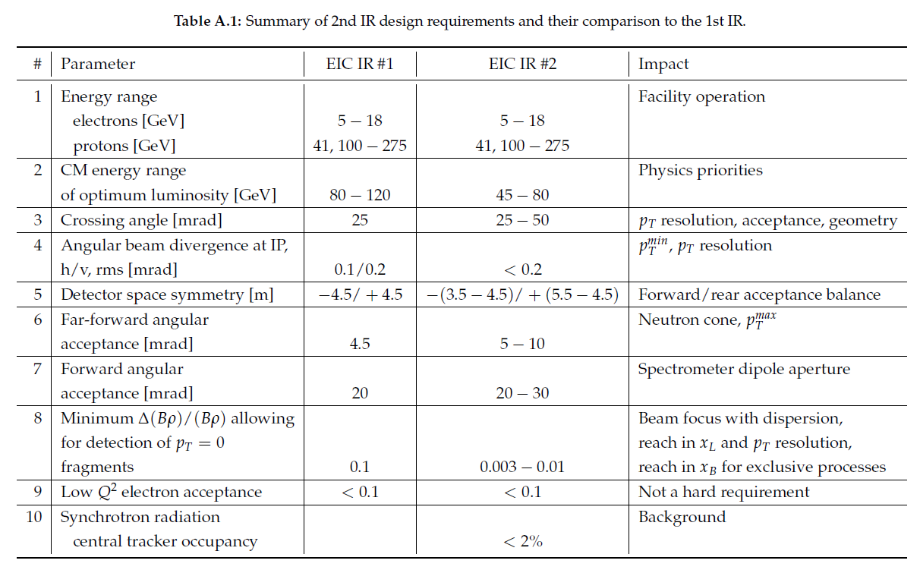
EIC IR Design Requirements
From V Morozov talk at 3rd YR meeting, September 2020
now both IRs are optimized for 30 to 140 GeV
assume -4.5 to 5.0 m for both IRs
Engineering Constraint: Maximum aperture-edge field at 275 GeV = 4.6 T

Slide 13
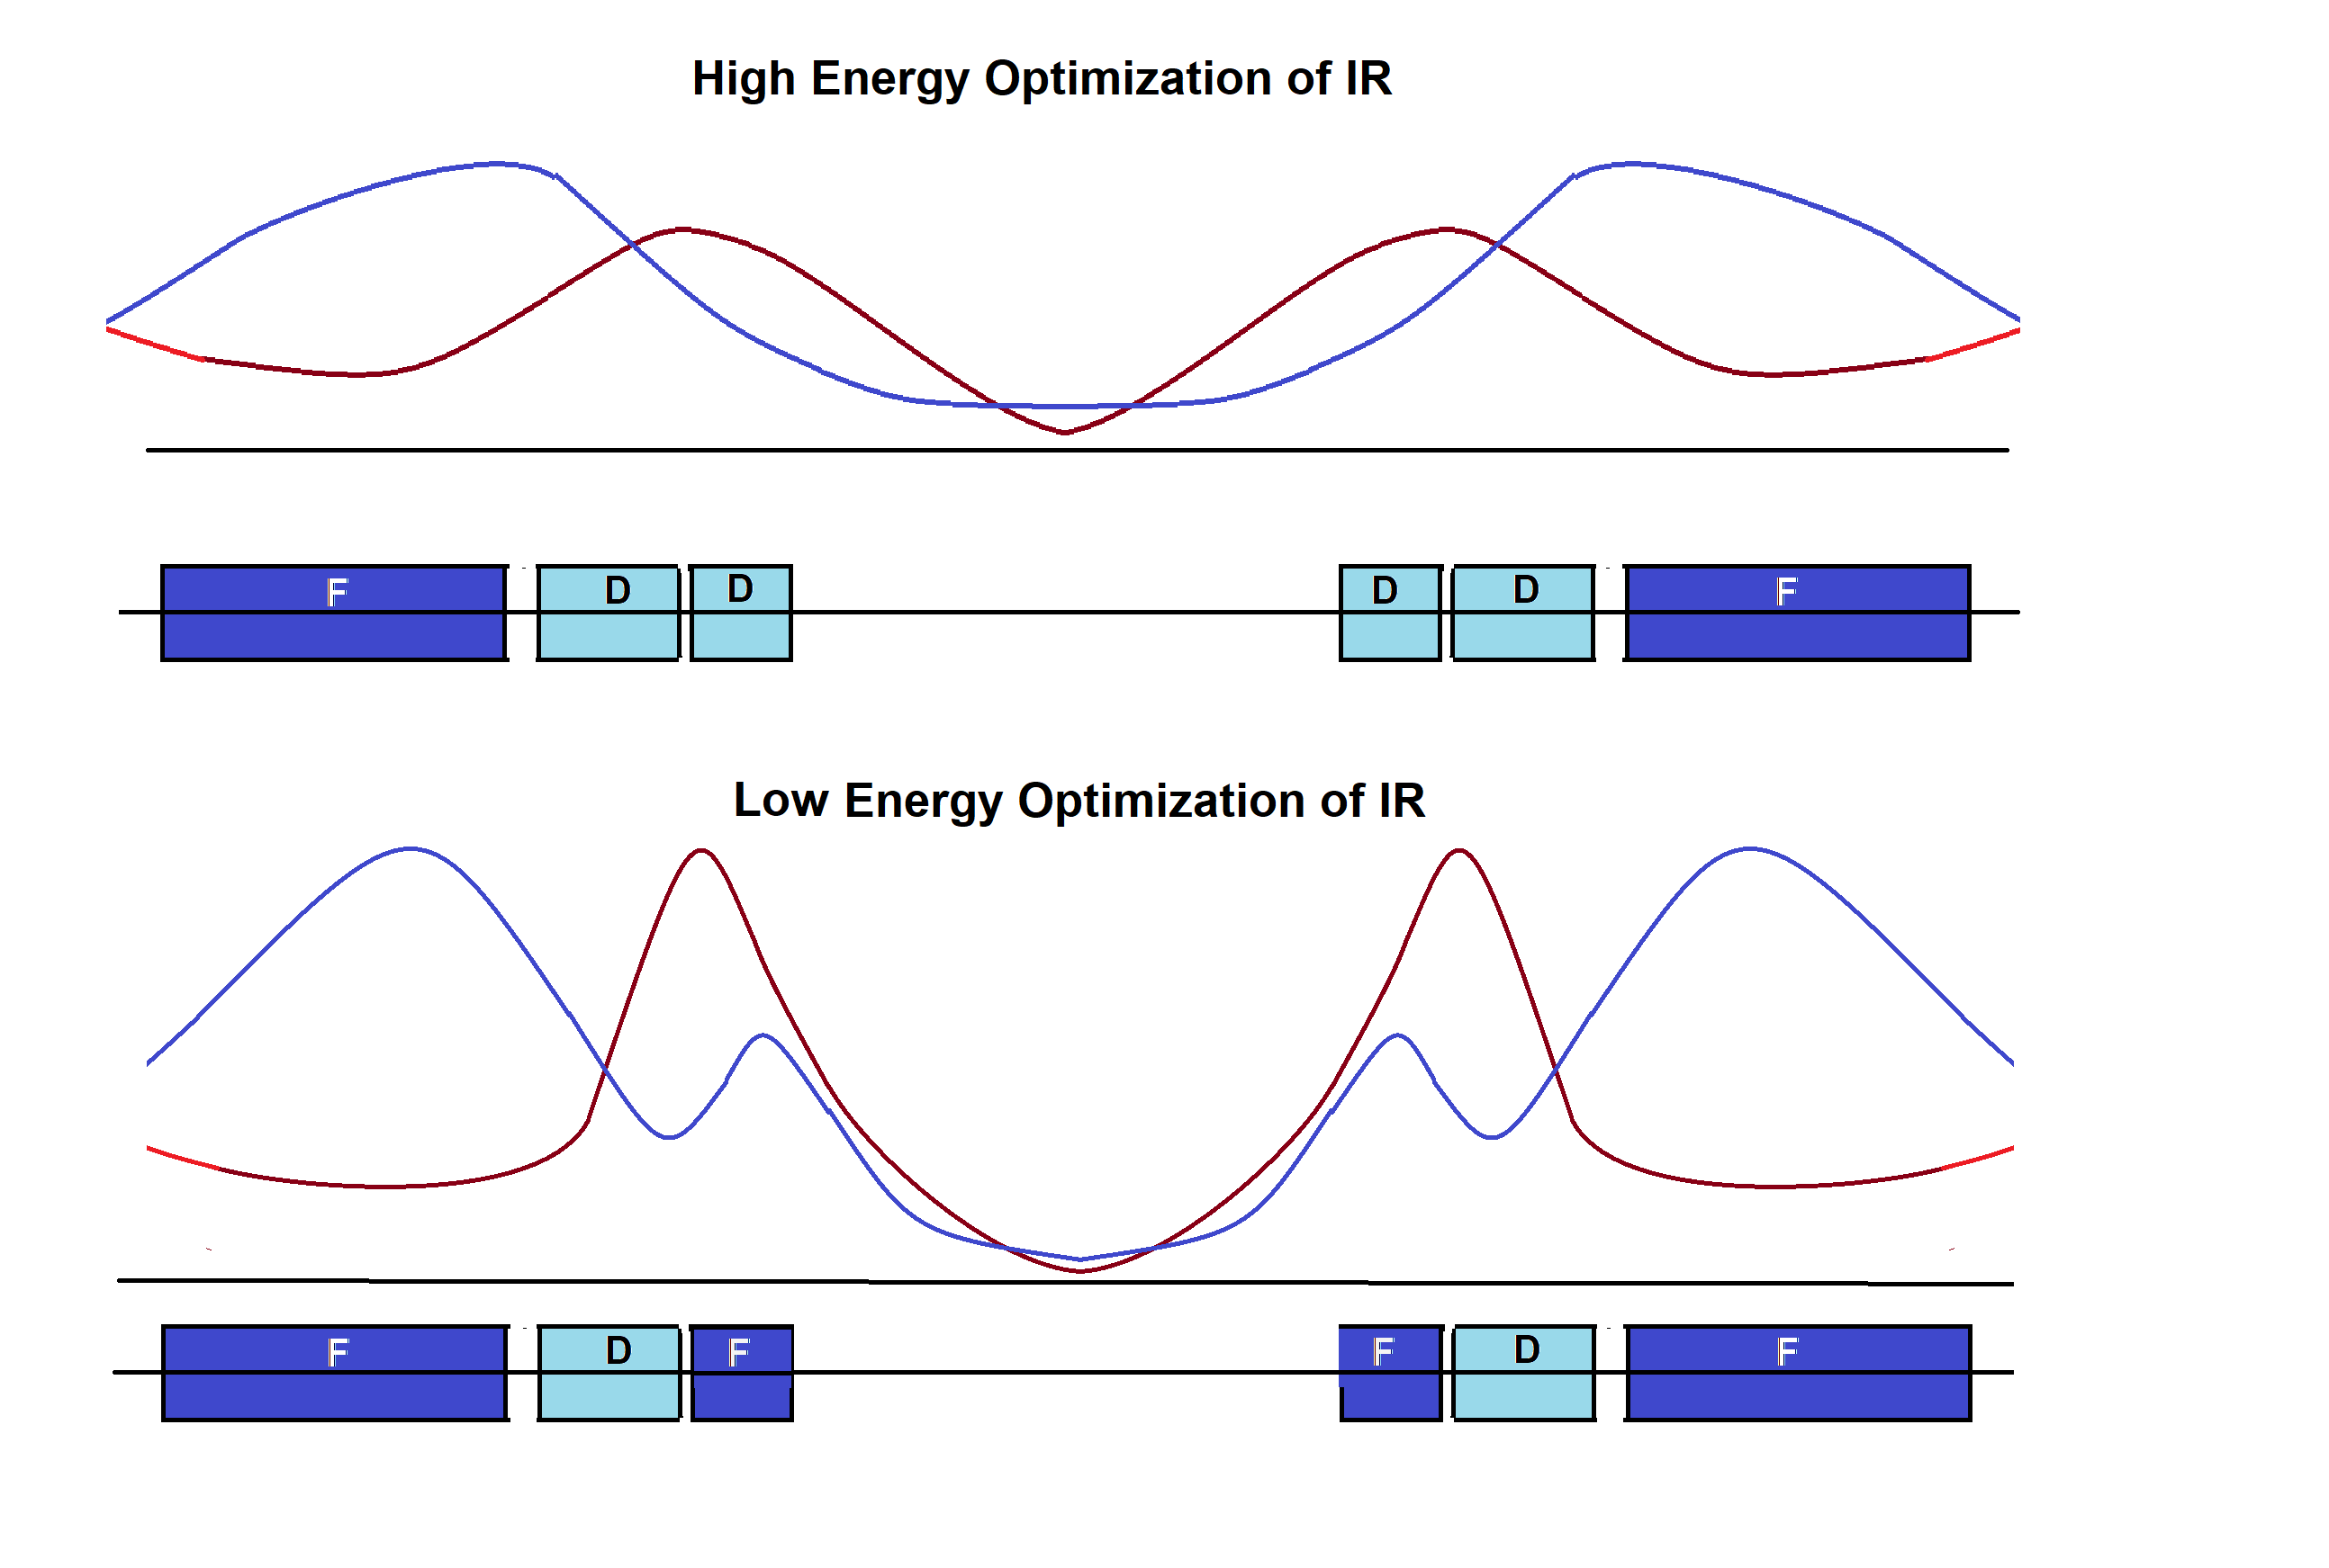
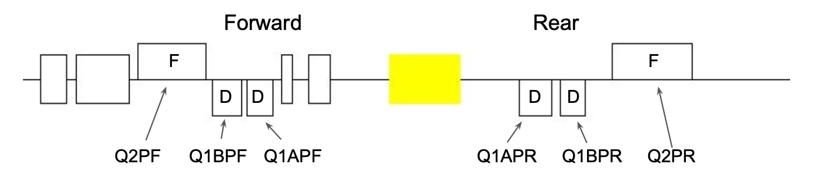
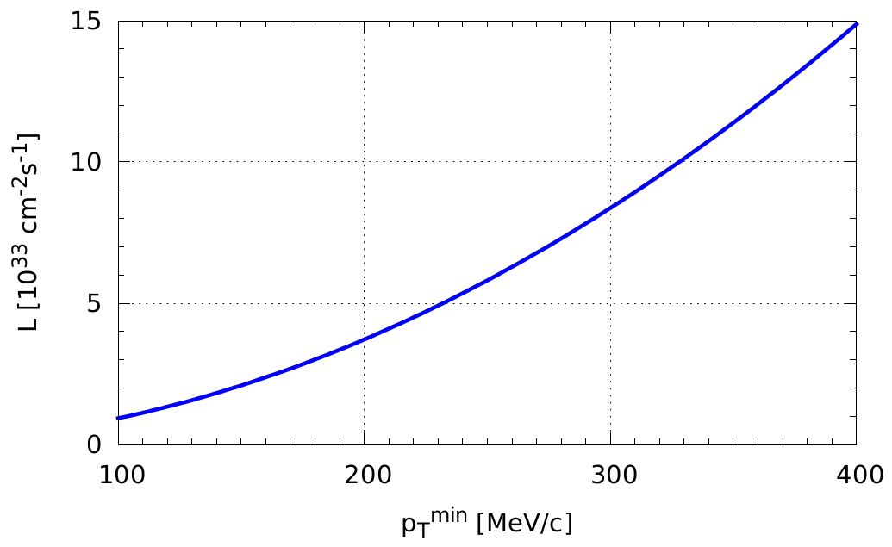

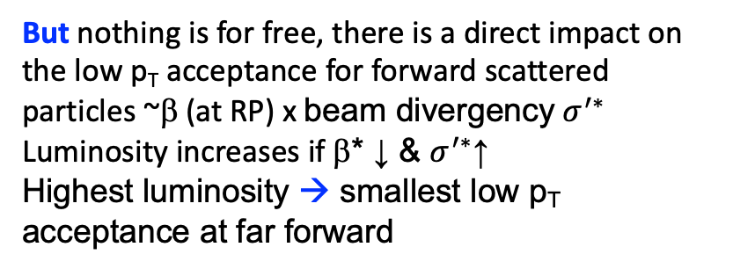
Increased luminosity at lower E_{cm}
Simplest way change focusing scheme of final focusing quads
  Advantage independent of Interaction Region → can be done both at IP-6 and/or IP-8
schematics of concept
change polarity of quads DDF to FDF
→ needs to be done only on the rear side (incoming hadron beam) hadron quads
→ change polarity of quads at low E_{CM}
Doublet focusing
Triplet focusing
hadron beam
But nothing is for free, there is a direct impact on the low p_{T} acceptance for forward scattered particles ~β (at RP) x ${\text{beam} \text{divergency} σ}^{′∗}$
Luminosity increases if β* ↓ & $σ^{′∗}$↑
Highest luminosity → smallest low p_{T} acceptance at far forward
High-divergence
Highest $L$
High-acceptance

Slide 14


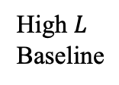

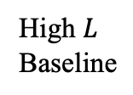



Increased luminosity at lower E_{cm}
High $L$
Baseline
$L$ operating one IR at a time
Annual Integrated Luminosity [fb⁻¹]
Peak Luminosity [cm⁻²s⁻¹]
10³⁴
10³³
10³²
High $L$
Baseline
L operating both IRs with a fair-share
$$7.9$$
$$10⋅{10}^{33}$$
$$6.1$$
100
10
1
Tomography (p/A)
$$1.54$$
Spin and Flavor Structure of
the Nucleon and Nuclei
$$0.44$$
Internal
Landscape of the Nucleus
QCD at Extreme Parton Densities-
Saturation
150
Center of Mass Energy E_{cm} [GeV]

