Slide 1
Jet/HF/EW/BSM
Weekly meetings: Tuesday’s starting at 13:30 EDT
Indico: https://indico.bnl.gov/category/367
Mailing list: https://lists.bnl.gov/mailman/listinfo/eic-ip6-phys-jet-hq-l
Miguel Arratia – Miguel.Arratia@ucr.edu
Brian Page – bpage@bnl.gov
Stephen Sekula – ssekula@smu.edu
Ernst Sichtermann – EPSichtermann@lbl.gov
ATHENA Conveners Meeting, June 4th 2021

Slide 2
We have begun identifying people interested in working on topics germane to our group
Work on ‘low-level’ tasks (E-Flow algo, calo clustering, granularity studies) has begun
Several analysis topics have been claimed, spanning the principle performance metrics and detector subsystems

Slide 3
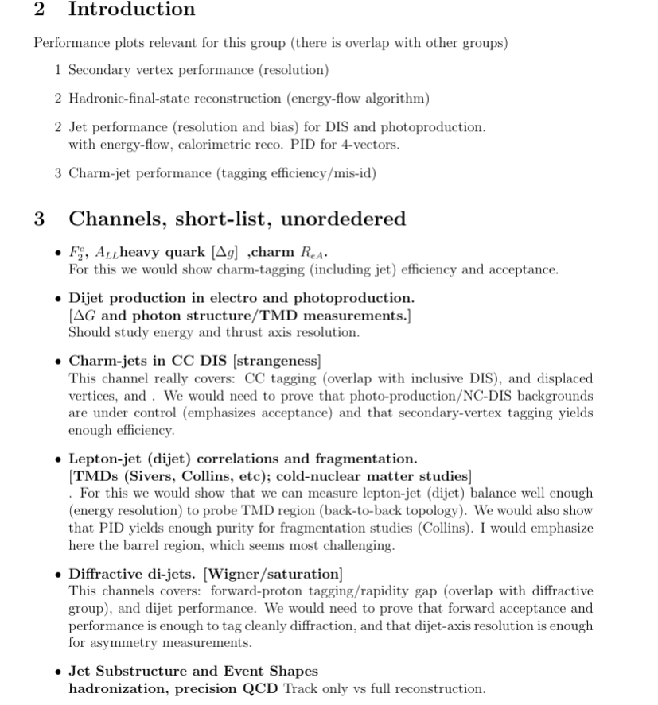
We have begun identifying people interested in working on topics germane to our group
Work on ‘low-level’ tasks (E-Flow algo, calo clustering, granularity studies) has begun
Several analysis topics have been claimed, spanning the principle performance metrics and detector subsystems
Conveners have identified a set of core measurements to validate, which will feed into our summary plots – still need to identify people for a few topics
Should communicate with diffractive/tagging WG on diffractive dijets

Slide 4
Recent Activity
Jets/HF/EW/BSM Working Group Meeting: June 1st (https://indico.bnl.gov/event/12038/)
Quick verbal overview of PID capabilities in fast simulation (Delphes)
Need to interface with PID group to inform them of our capabilities and determine what they would like to see from us on a shortish time-scale
Update from Miguel on HCal implementation in DD4HEP
Barrel and Endcap Fe/Sc HCal models now exist in DD4HEP
KLM type Barrel HCal also implemented by Wouter
Clustering studies have begun
Quick overview from Brian on simulating realistic beam effects in PYTHIA-8
See presentation in Software WG on June 3rd for a more comprehensive overview (https://indico.bnl.gov/event/12022/)
Calorimetry Working Group Meeting: June 2nd (https://indico.bnl.gov/event/12027/)
Discuss impact of magnet on barrel hadron calorimetry
Current magnet material is ~2 interaction lengths thick – seriously degrades potential energy/spatial resolution
Can a highly segmented ECal extension / inner HCal help us – how much space do we really have inside the magnet?
Other: Impact of B-Field maps on tracking; benchmarking of tracker in DD4HEP with existing studies

Slide 5
Simulation Estimation
To get an idea of needed resources, the Software WG has asked all other WGs to provide an estimate of their simulation needs for the duration of the proposal preparation period
They ask for:
Number of generator-level events
Number of fast simulation events
Number of full simulation events
Number of Particle Gun events
Basis of estimate
Can use Yellow Report as starting point
What do we need in terms of ‘Particle Gun’ events – simple simulation to test performance of detector components
Will certainly need to divide by Q2 (photoproduction sample will be especially challenging – maybe need some form of filtering?)
Maybe not for this exercise, but very soon, we should coordinate with other PWGs to define common simulation samples

