Slide 1
PID chat w/ SIDIS
Warning:
Possibly Bizarre Amalgam of Old Slides
Meant to spur discussion more than be a coherent presentation
Thomas K Hemmick

Slide 3
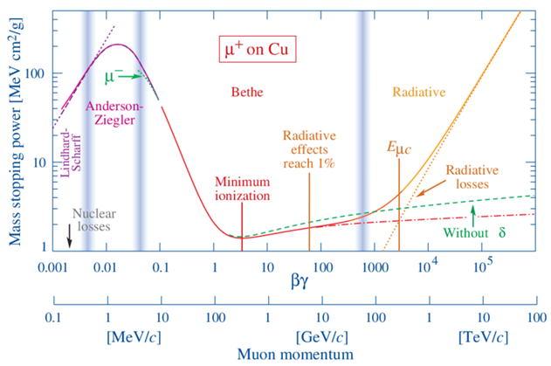
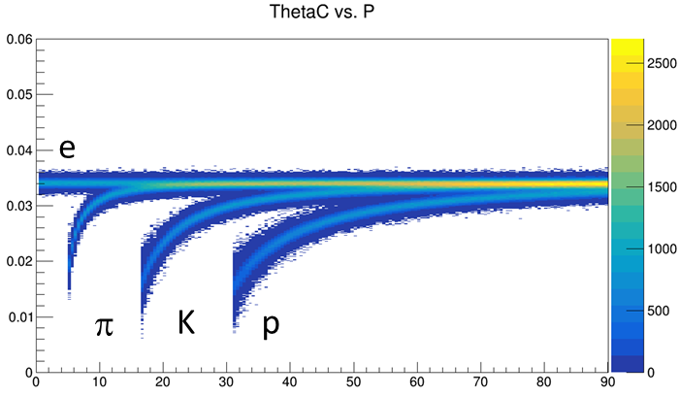
PID ~ Velocity
p = mγβ E = mγ velocity(β) measurement yields mass.
Direct measurement:
Record signal time at multiple locations, calculate v.
“Fast” detector = low transit time spread (most easily achieved at small transit time)
Velocity-dependent interaction(s) with detector:
Specific Ionization (aka $\frac{dE}{dx}$)
Cherenkov Radiation: $\cos{θ_{C}=\frac{1}{nβ}}$
θ_{C} measured wrt track direction.
Thus dependent upon deliverables from tracking
Bremsstrahlung: $P= \frac{q^{2}γ^{4}}{6πε_{0}c}\left({\dot{β}}^{2}+\frac{{\left(\vec{β}∙\dot{\vec{β}}\right)}^{2}}{1−β^{2}}\right)$
Transition Radiation: $I=\frac{Z^{2}e^{2}γω_{p}}{3c}$
eID mechanisms
TOF covered well in prior presentations, not repeated here

Slide 4
Cartoonish eta
Layout vs capability
Discussion order:
Central arm
Electron arm
Hadron arm

Slide 5
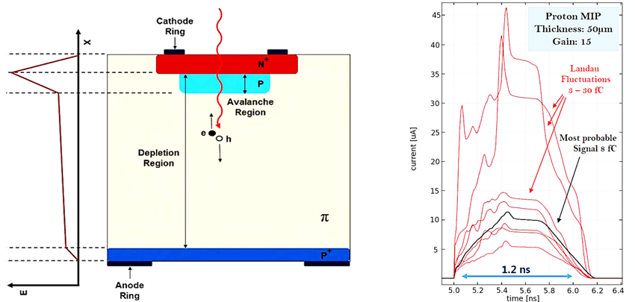
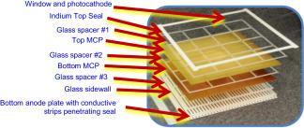
Time-of-Flight (everywhere?)
MCP: Micro Channel Plate
Direct measurements of velocity require a fast charge collection device.
The time resolution is automatically helped by small devices:
LGAD: Low Gain Avalanche Device. Instantly small.
MCP: Micro Channel Plate ➔ LAPPD (Large Area Picosecond Photon Detector)
TOF can be standalone.
TOF can also be intrinsic to tracking in the barrel (LGAD (LAPPD field-limited) )
TOF can also be intrinsic to photo-detectors (DIRC/mRICH/dRICH Possible LAPPD)

Slide 6
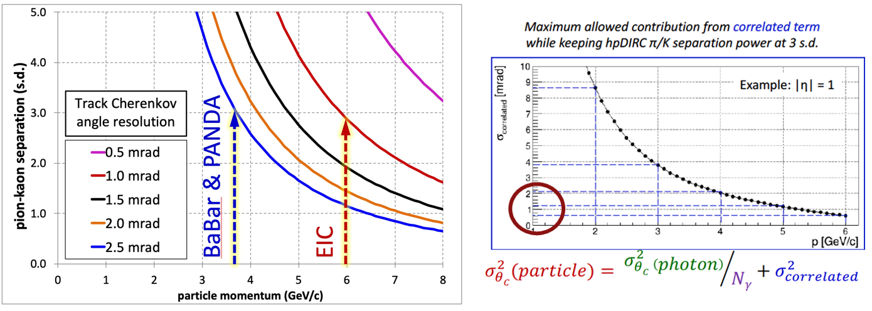
Central Arm Principal Technology: DIRC
hpDIRC ala eRD14
:
At normal incidence, Cerenkov light is internally reflected for $n>\sqrt{2}$
Cerenkov angle preserved if bars meticulously flat with 90 degree corners.
Spectacularly compact PID device with photon detection at end.
Generic reference design: 1m barrel radius, 16 sectors
176 bars: synthetic fused silica,17mm (T) ´ 32mm (W) ´ 4200mm (L)
Photo sensors: MCP-PMTs -3x3mm2 pixels
Kaon threshold = 0.47 GeV/c
Curling Limit p_{T} = 0.45 GeV/c
What about lower momentum?
6

Slide 7
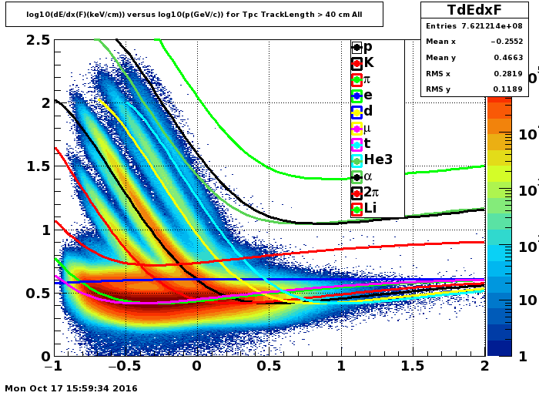
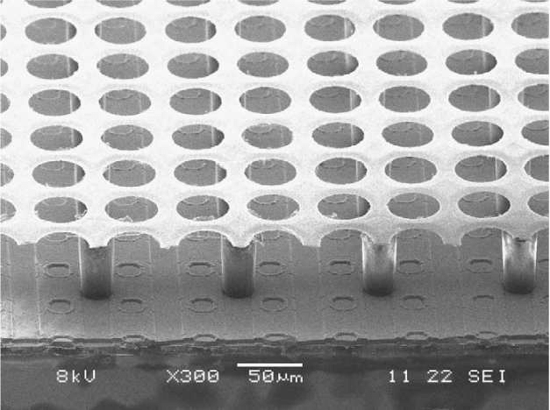
Restate the problem:
DIRC has low-p limitations:
Curl Up (0.45 GeV/c)
Kaon threshold (0.47 GeV/c)
Rather than lower the field:
PID at low radius.
dE/dx separations huge!
1.6X pi-K
2.25X K-p
GridPIX
Established
Robust
Excellent tracking
3.6X
1.6X
P < 0.5 GeV/c
Dual Approach:
Standalone Garfield (optimize detector)
GEANT (integrate into full simulation)

Slide 8
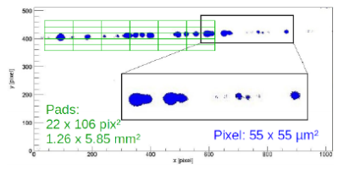
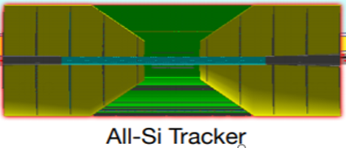
Low Momentum PID Idea???
High magnetic field curls low(er) momentum particles.
Option #1: We don’t care about them. (bad option)
Option #2: Lower the B-field for “special runs”. (poor option)
Option #3: PID on these particles BEFORE they curl up.
dE/dx Device (below 500 MeV)
membrane
GridPIX
Mostly

Slide 9
High Momentum PID Idea???
dE/dx Device (beyond 6 GeV)
GridPIX
membrane
dE/dx Device (below 500 MeV)
membrane
GridPIX
Mostly

Slide 10
High & Low Momentum PID Idea???
dE/dx Device (beyond 6 GeV)
GridPIX
membrane
LGAD:
TOF & P.H.?
Mostly

Slide 11
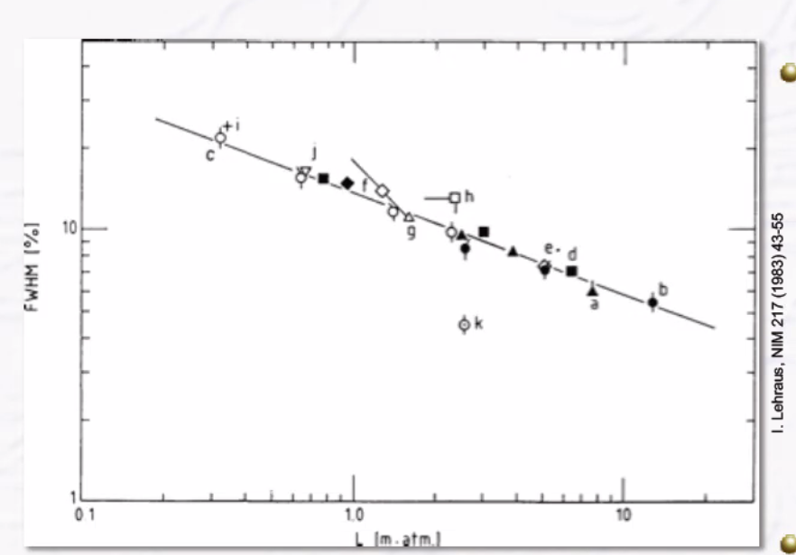
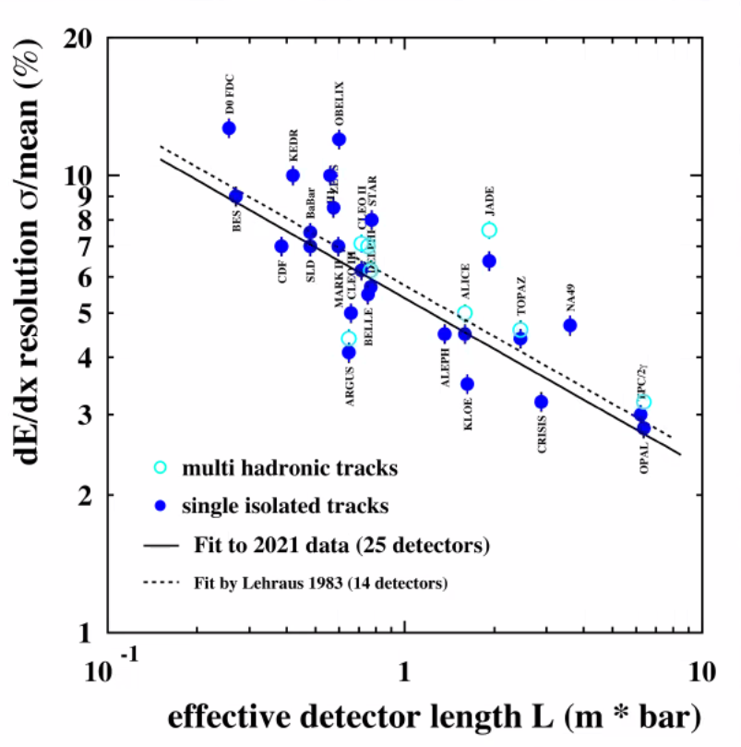
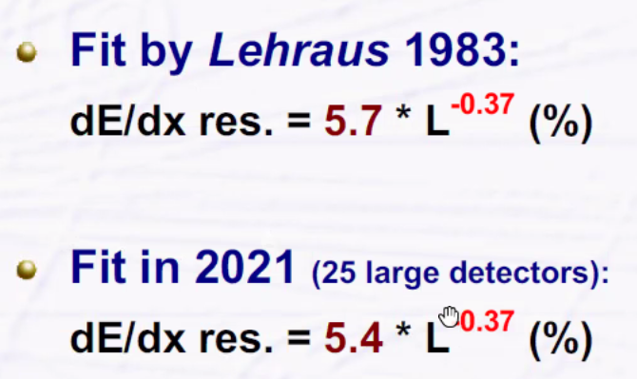
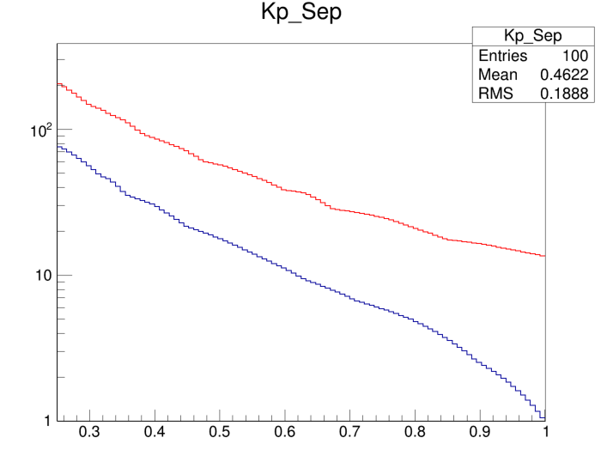
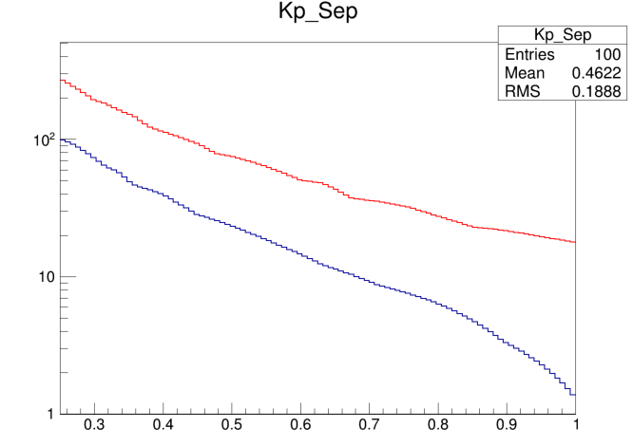
Anticipated dE/dx Resolution
Lehraus Plot
Using 5.4 as a standard TPC
5.4*(0.25)^{-0.37} = 9.0
Measured for GridPIX (truncated Mean)
4.1% at 1 meter
4.1*(0.25)^{-0.37} = 6.85
This was the prior assumption quoted by us.
Roughly 20 sigma at 0.5 GeV/c
Useful range overlaps with DIRC
#σ
#σ
9.0%
6.85%
K-p
K-p
π-K
π-K
Momentum
Momentum

Slide 12
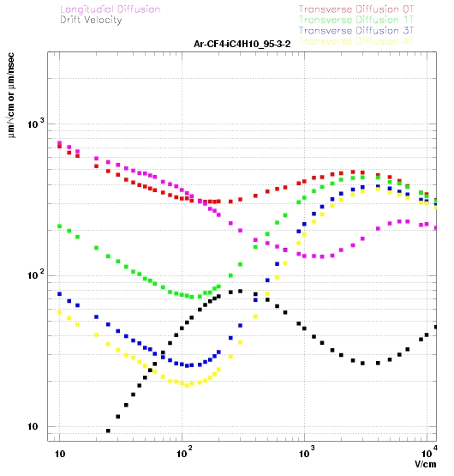
Overly Simplified Momentum Resolution
Figure of Merit:
$σ_{p}∝ \frac{σ_{hit}}{\sqrt{N_{meas}}} ≡Figure of Merit$
Can be compared to Silicon with detailed Monte Carlo
Here is simple-minded estimate
$Figure of Merit(Si)= \frac{{20 μm}/{\sqrt{12}}}{\sqrt{4}}=2.9 μm$
Gas:
Including efficiency ~3000 electrons (minimum!) per track
Each suffers digitization (σ = 55 μm/sqrt(12) = 16 μm)
Diffusion(Length) = $25\frac{μm}{\sqrt{cm}} \sqrt{L}$
D(2cm) = 35 μm ➔ FOM = 0.70 μm
D(25cm) = 125 μm ➔ FOM = 2.3 μm
D(50cm) = 176 μm ➔ FOM = 3.2 μm
D(100cm) = 250 μm ➔ FOM = 4.6 μm
Although ignoring many significant effects, initial result is on the order of the layers of silicon.
Noon meeting with some Silicon Tracker Experts

Slide 13
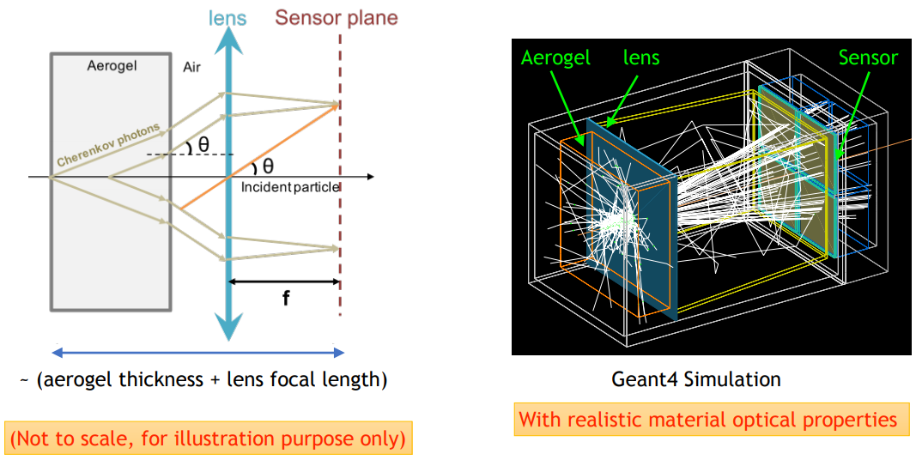
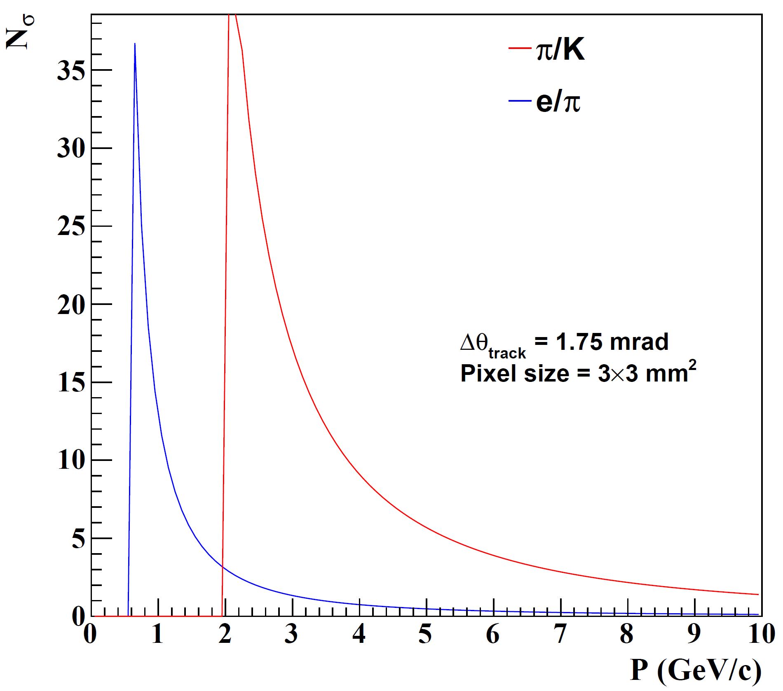
Electron Arm: Modular RICH
Cherenkov radiator
(Aerogel) refractive index, n = 1.03
Length of the radiator, L = 3cm
lens with focal length, 𝑓= 6”
Photon Detector
3 mm pixel size
Hadron ID requirements relaxed…aerogel only
Additionally require eID ~ 4GeV/c
Modular RICH focused by Fresnel Lens
Sharp image improves resolution.
Transmission of lens combats dispersion
Provides TOF with suitable readout device (LAPPD)
NOTE: Similar performance to aerogel in dRICH

Slide 14
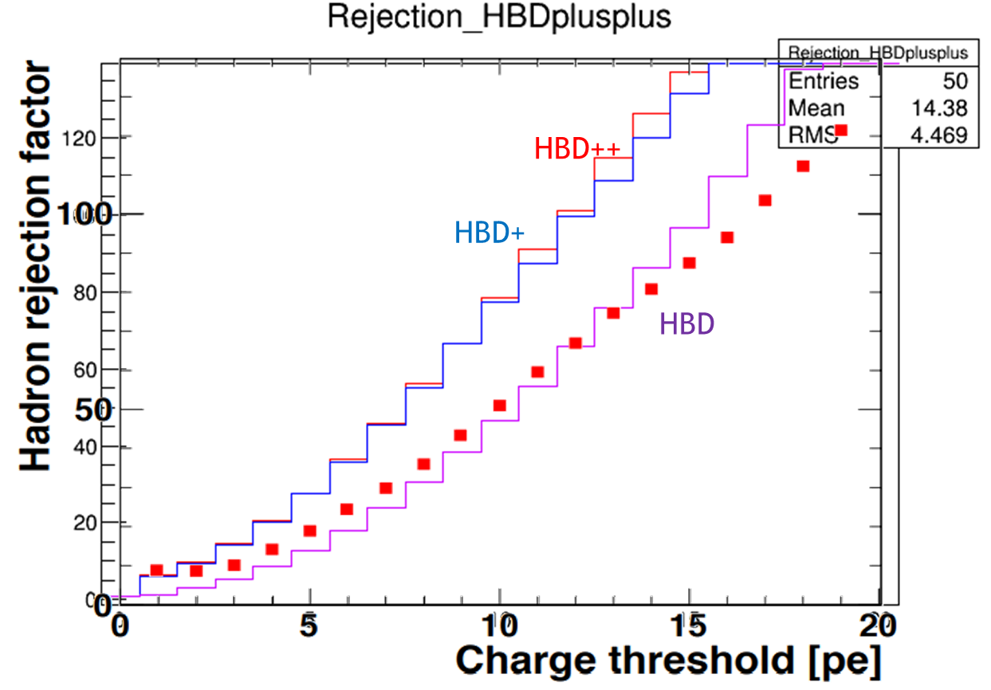
Speculative HBD++ for eID
HBD: Phenix
HBD+: Gem + 1-stage μM gain
HBD++: GEM _ 2-stage μM gain
Conceptual Idea
G
μ₁
μ₂
microMEGAS provide the smallest gas length.
Gain from any or all of three layers:
Gain from GEM
Gain from μ₁
Gain from μ₂
Presently no group is following this
However, Received Email contact:
Possible interest from Indian group…

Slide 15
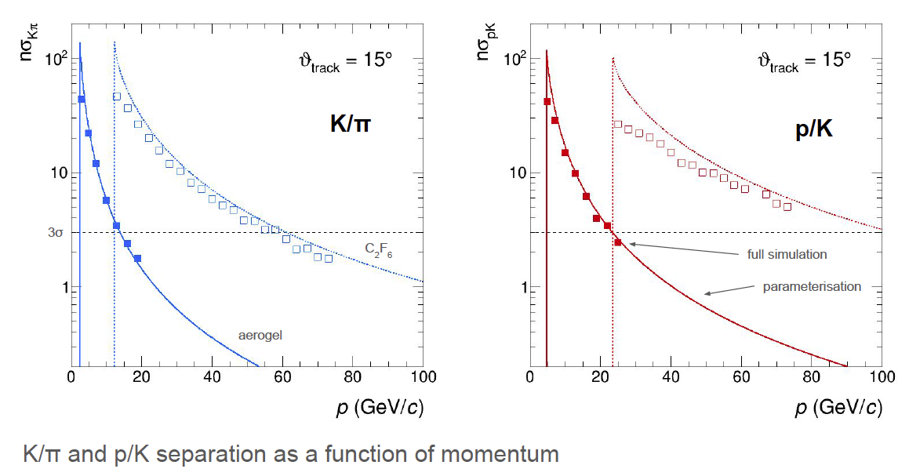
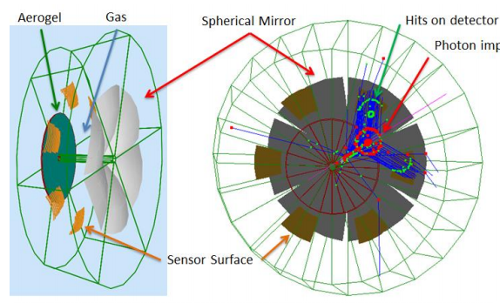
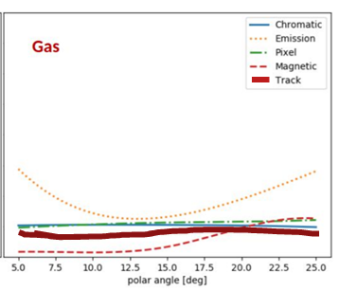
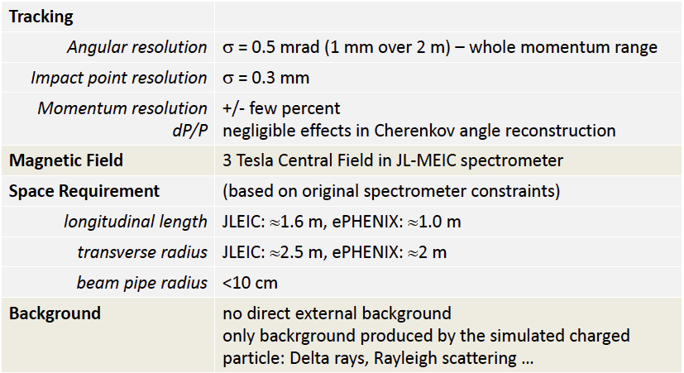
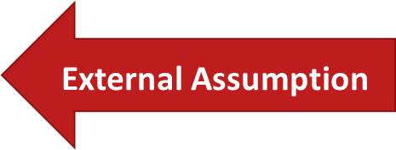
Hadron End: Dual RICH
Cherenkov radiator
○ Refractive Index
n = 1.02 (aerogel) 1.0008 (C₂F₆)
○ Length of the radiator
L = 4 cm (aerogel) , 160 cm (C₂F₆)
Mirrors
Photon Detector
3 mm pixel size; 200-500 nm MAPMT
Particle Generation
Originate from the vertex
Exquisite detail in simulation.
AI-based optimization.
Uses constant external angular resolution assumption.
Similar external constraint assumed as deduced for separate gas & aerogel RICHes
Tracking maybe tolerates ~2X sim (0.5 – 1.0 mrad)
NOTE: PMTs to the side makes optical aberration (“Emission”) dominant

Slide 16
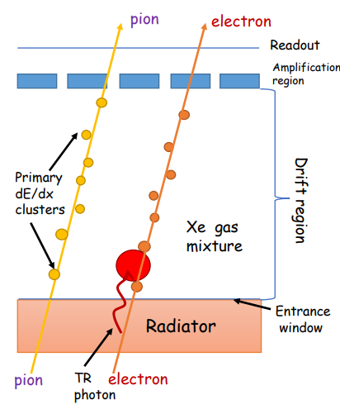
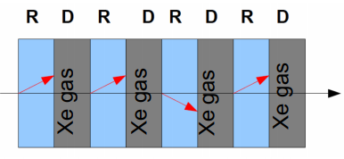
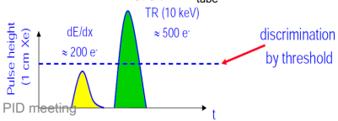
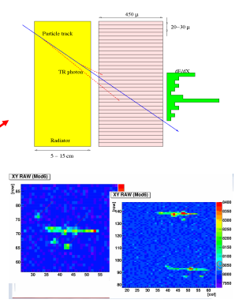
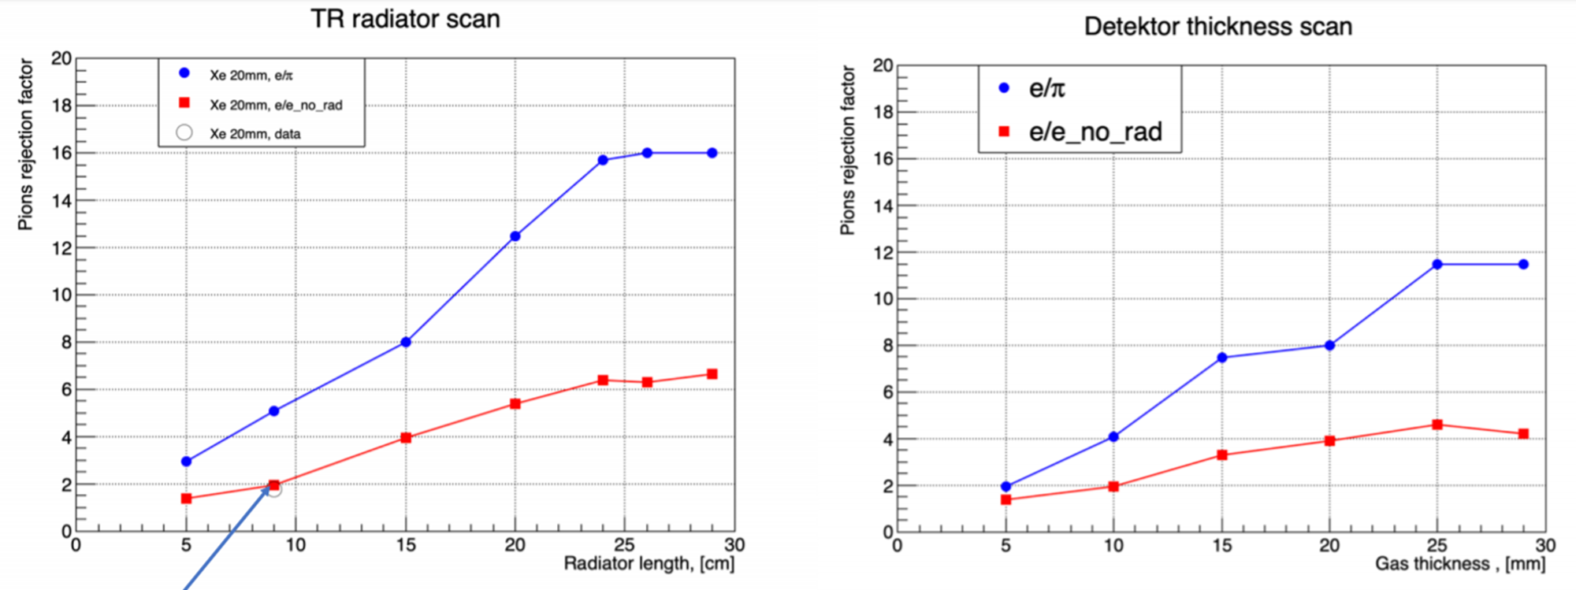
eID by Transition Radiation (TRD)
3: ID TR photons by energy/pos
1: Make TR photons:
Index, n, change
X-ray regime
Film, foam, fleece
2: Layered to get more photons
4: Reject Pions
“Threshold detector” (TR X-rays produced or not)
P_{min} ~ 1 GeV (rejection ~constant at higher momentum)
Balance between X₀ and rejection

Slide 17
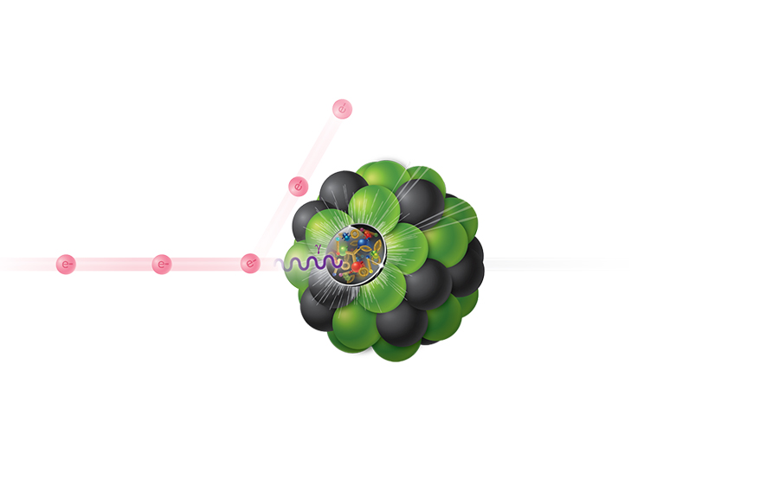
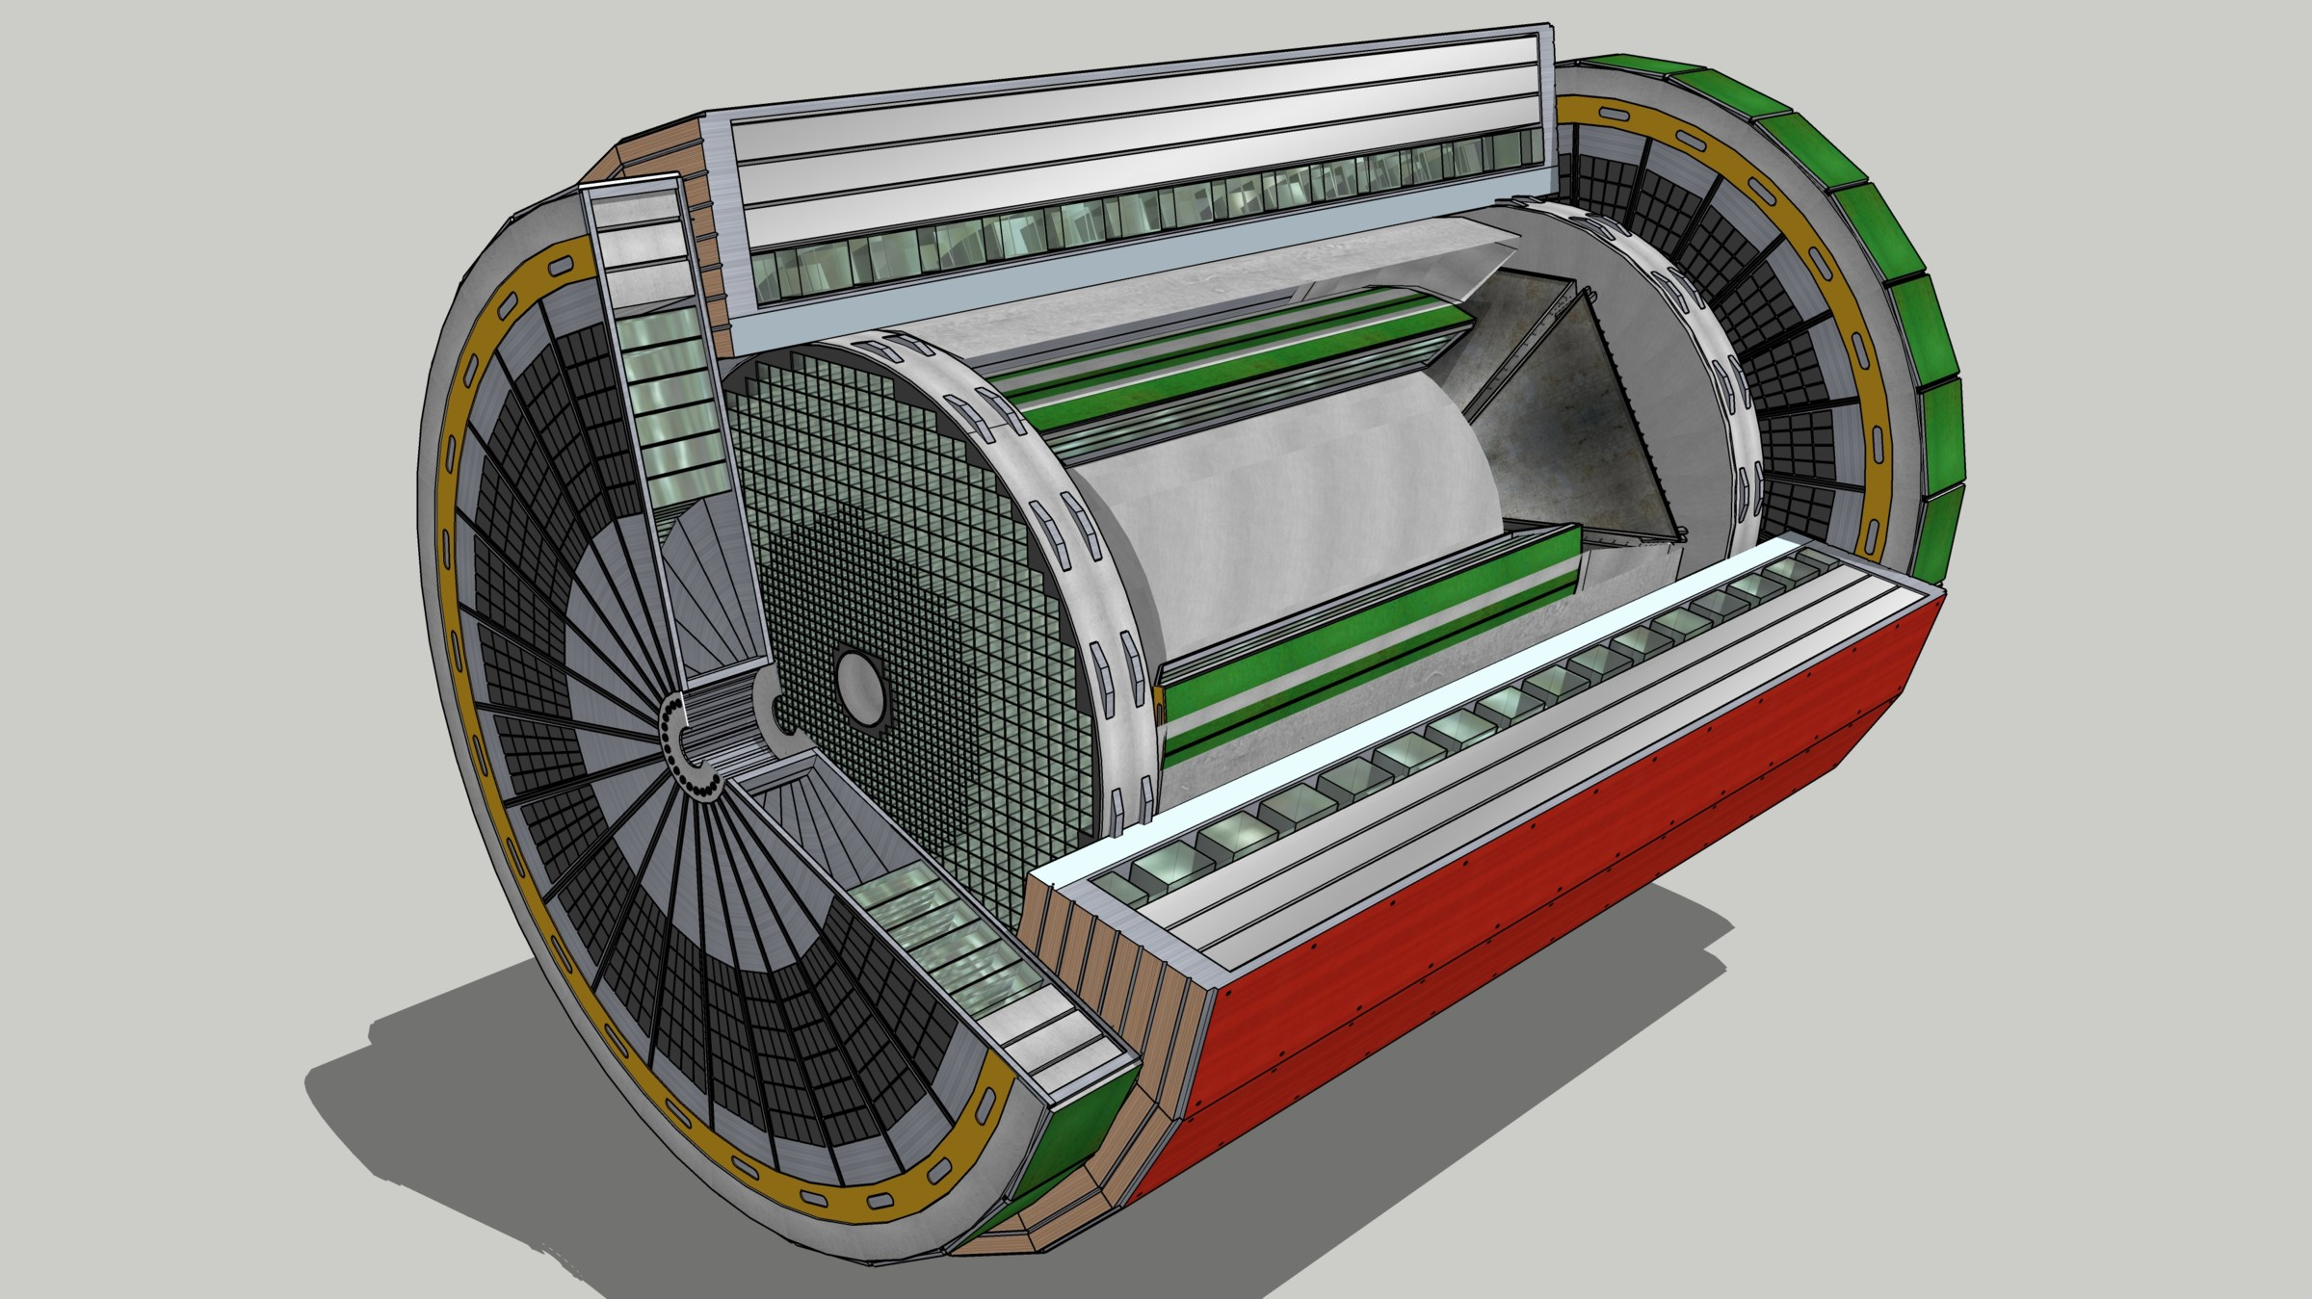
Summary
All PID technology has a “dynamic range”
Most of the locations require multiple/complementary solutions.
Complex phase space…

Slide 18
BACKUP SLIDES

Slide 19
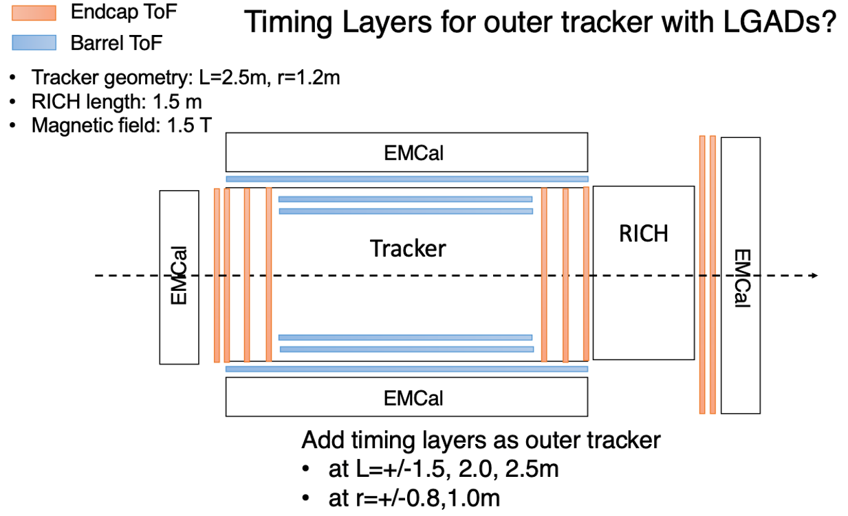
TOF @ EIC: Available space
PID from TOF requires:
Time resolution.
Maximum path length.
Known ring makes size restrictions!
Civil construction already there.
One ring outsize the detector.
Practical Implementation:
Tempting to assume time resolution scales as $\sqrt{N}$
Extreme care required to minimize or eliminate correlated errors (e.g. “start clock jitter”)

Slide 20
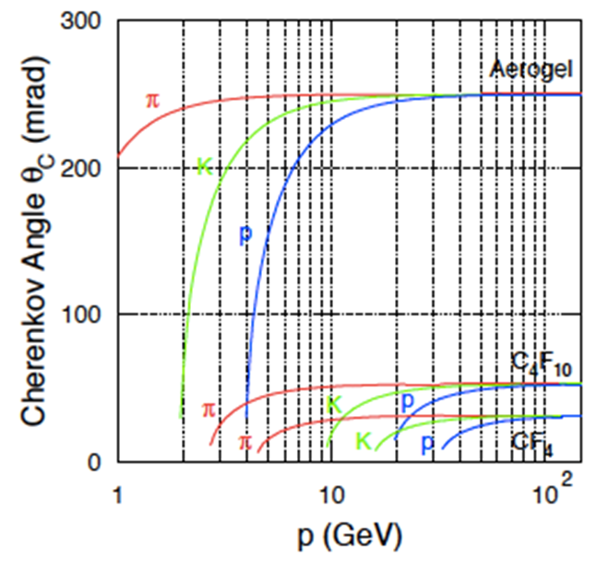
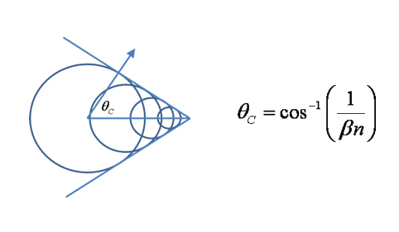
Cherenkov Light
Cherenkov Angle determines β
Makes a circle (ring)
Ellipse if mirror tilted

Slide 21
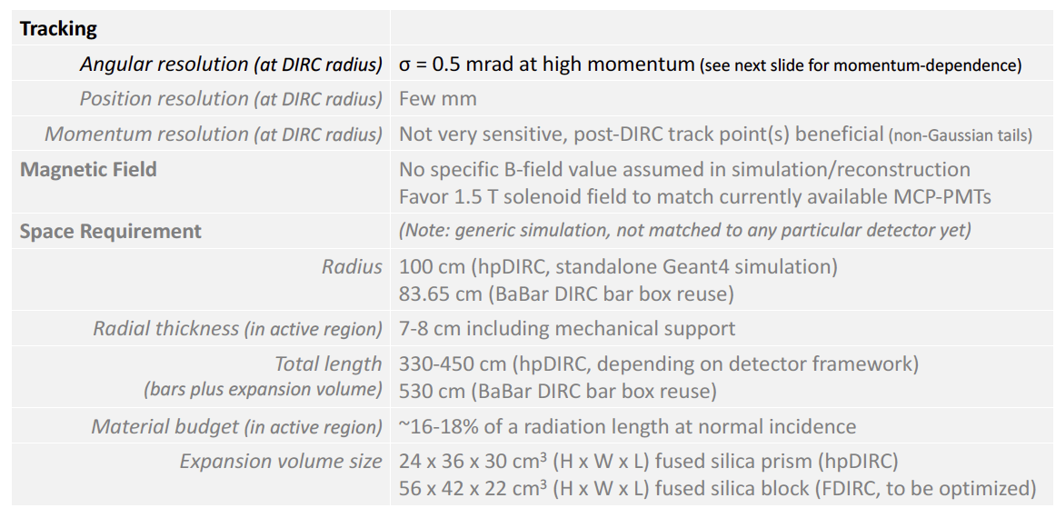
hpDIRC Performance Simulations
Original BaBar DIRC was effectively “proximity focused”
hpDIRC section creates focused ring improving resolution.
Excellent match to EIC needs.
Strict requirements on “correlated terms”, (e.g. angular resolution of tracking)
Works with either standard tracking solution.

Slide 22
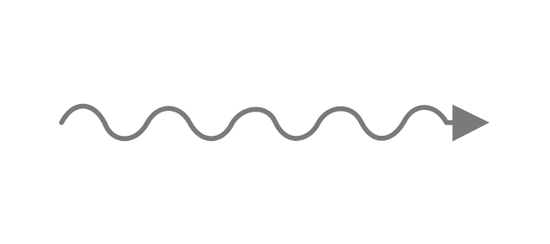
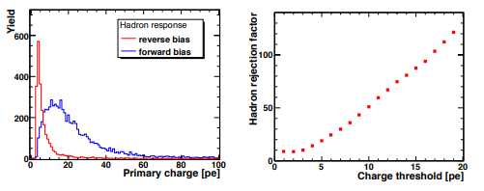
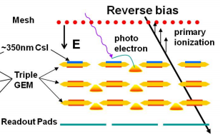
eID by Hadron Blind Detector
Unfocused Threshold
Cherenkov
electron
Limited by 1st Gap
Garfield + Fast Monte Carlo
Pion Signals Simulated
PHENIX HBD optimized for 1e-vs-2e separation.
20 photoelectrons vs 40 photelectrons
Non-zero hadron response.
Re-optimize for EIC??
1st Gap Dominates!
Fractional Contribution to signal

Slide 23
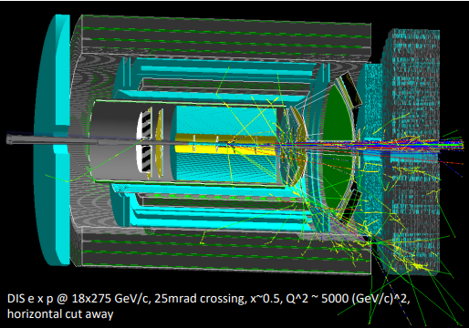
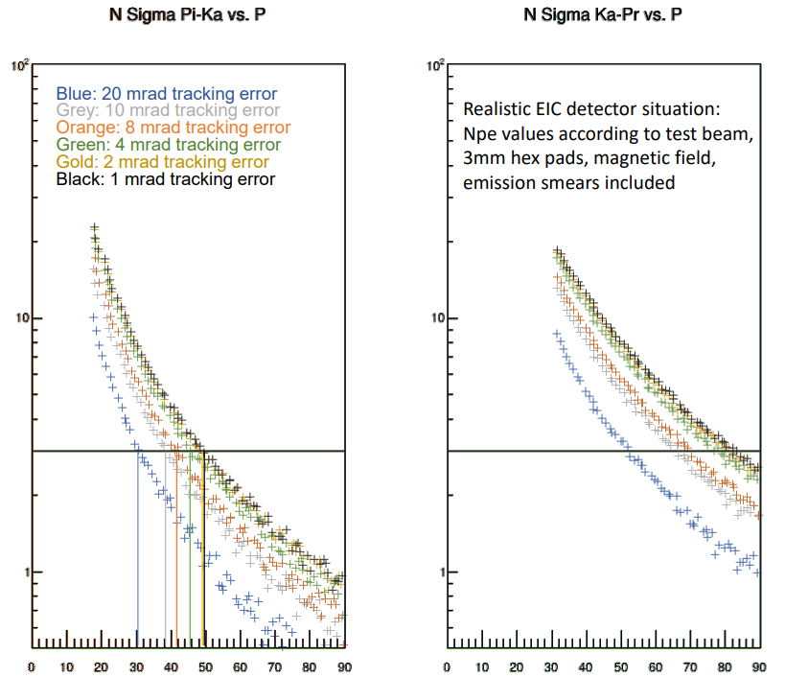
Compact High Momentum GEM RICH
1m of CF₄ radiator at 1.003 bar (slightly overpressure)
CsI Photocathode on top GEM
Mirror in deep UV -> MgF₂ coating
Single Photon Capability ->quintuple GEM stack with APV25-SRS
Particles ~perpendicularly incident on spherical mirror, focused onto a GEM stack directly
Windowless Photodetector!
λ_{min} down to gas transparency
Low λ is where the light is.
Brightest Cherenkov Ever!
hmm
OK
p
p
Performance from Parameterized Test Beam Data

