Slide 1
ECCE with Hcal mods
Paul Brindza
June 7, 2021

Slide 2
Study effects of mods to Hcal iron
Original 50 % iron density in all iron
First mod use 10 % in Hcal
Remove Hcal iron completely
Use iron after Hcal at 440-460 @ 100 % density
Some models have primitive piston inserted

Slide 3
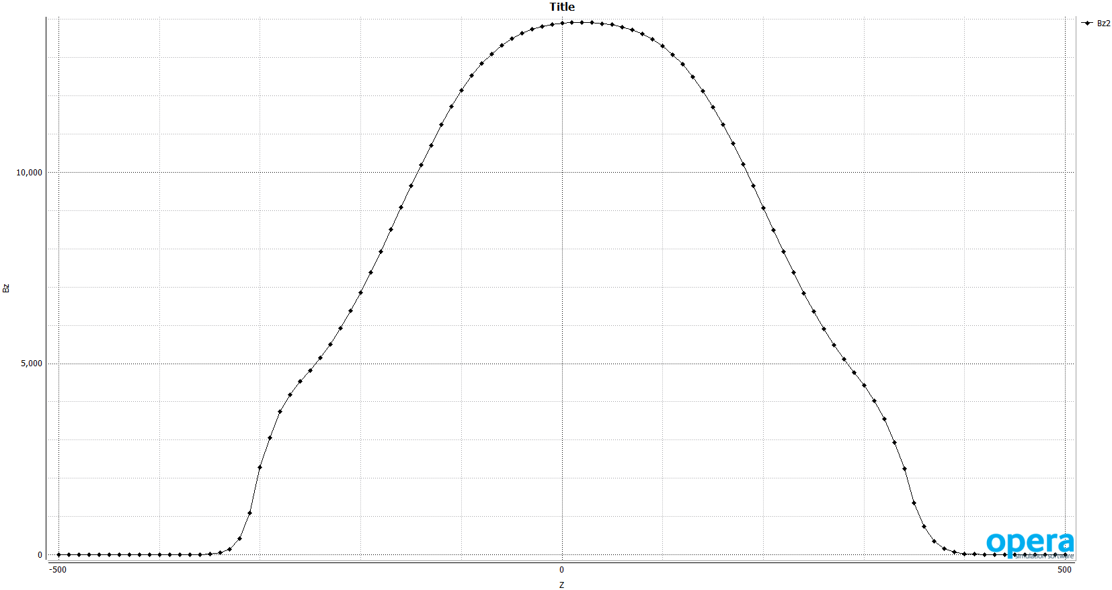
Bz on axis ( gauss) 50 % iron density

Slide 4

Bz on Z with Hcal density 10 %

Slide 5
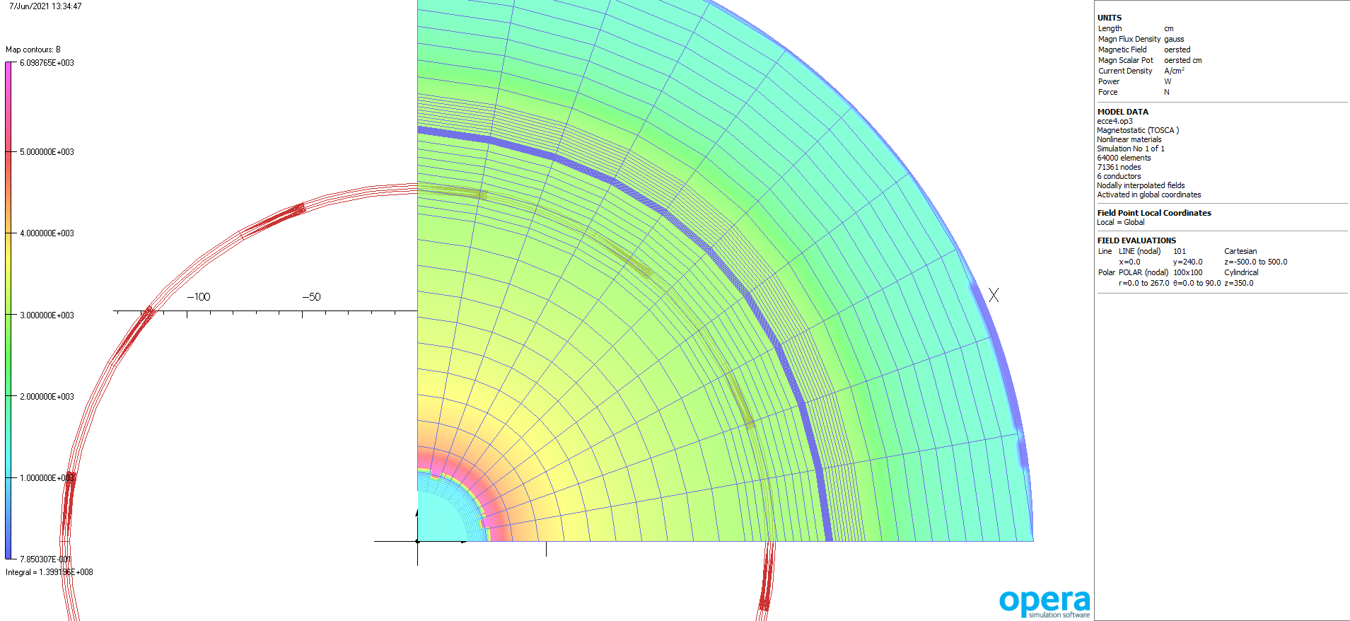
B in center of Hcal 10 %

Slide 6
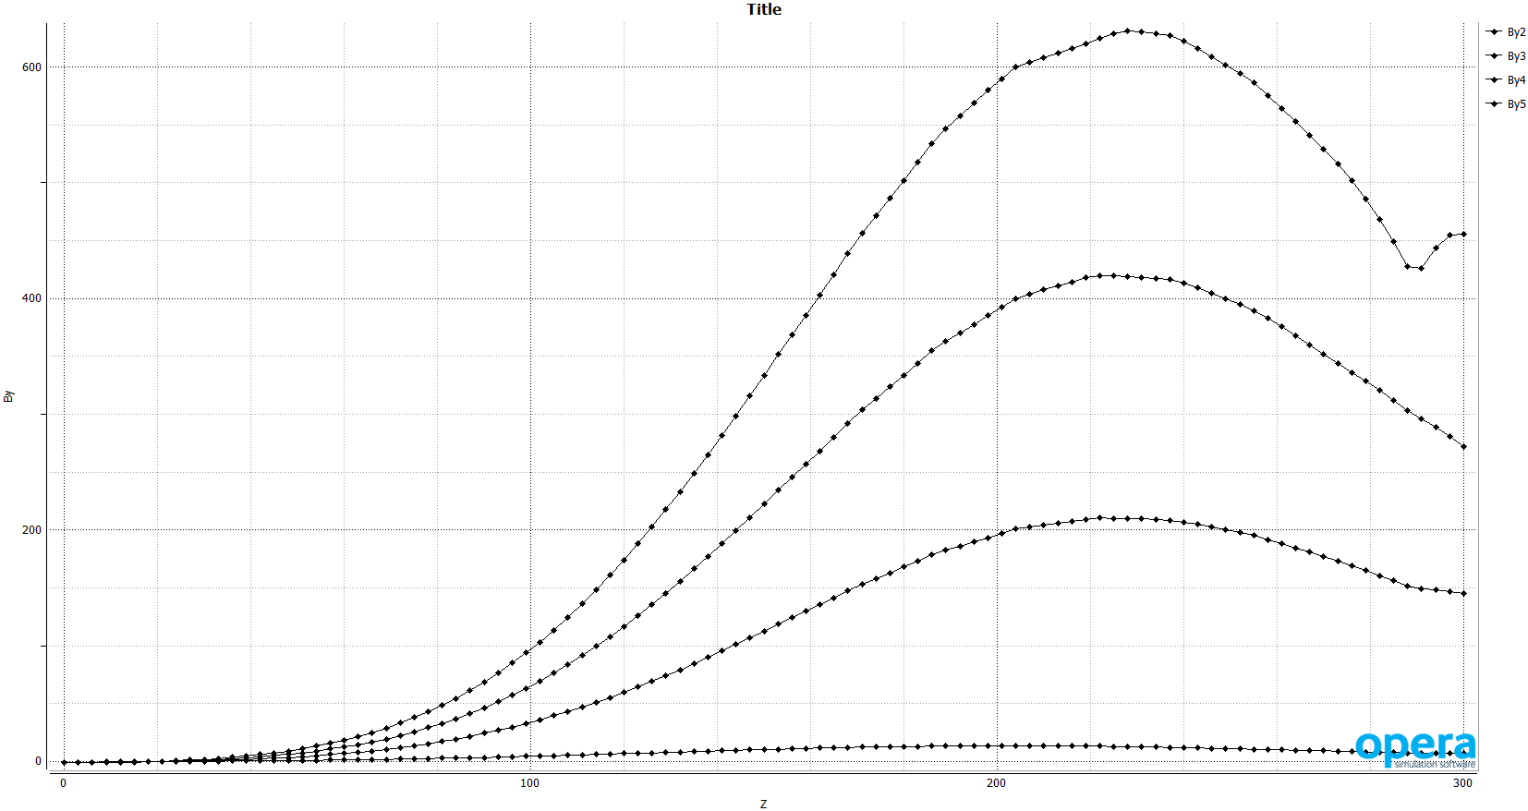
B perp near axis .95,2.1,3.8,5.7 deg.

Slide 7
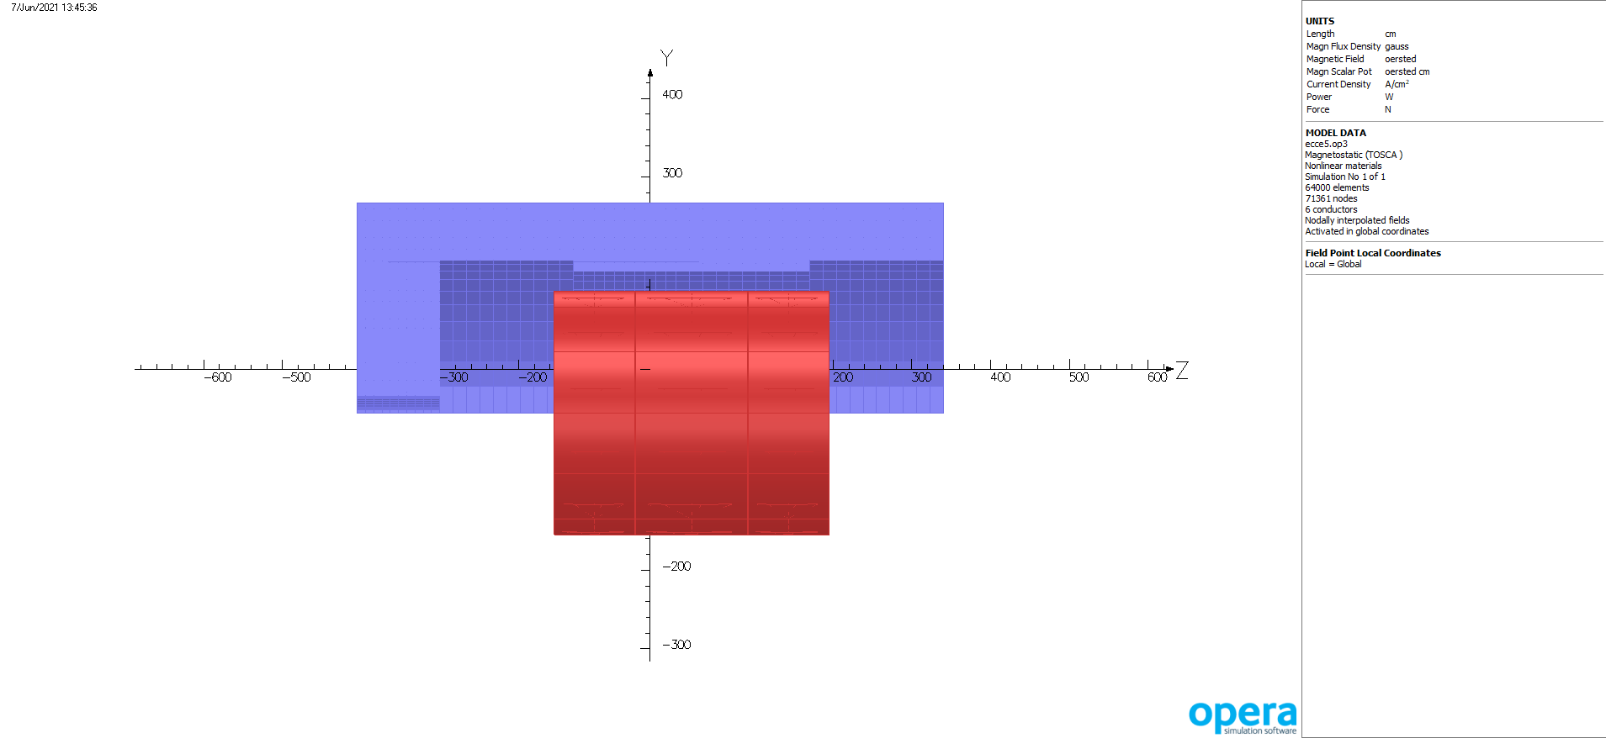
Model with no Hcal iron

Slide 8
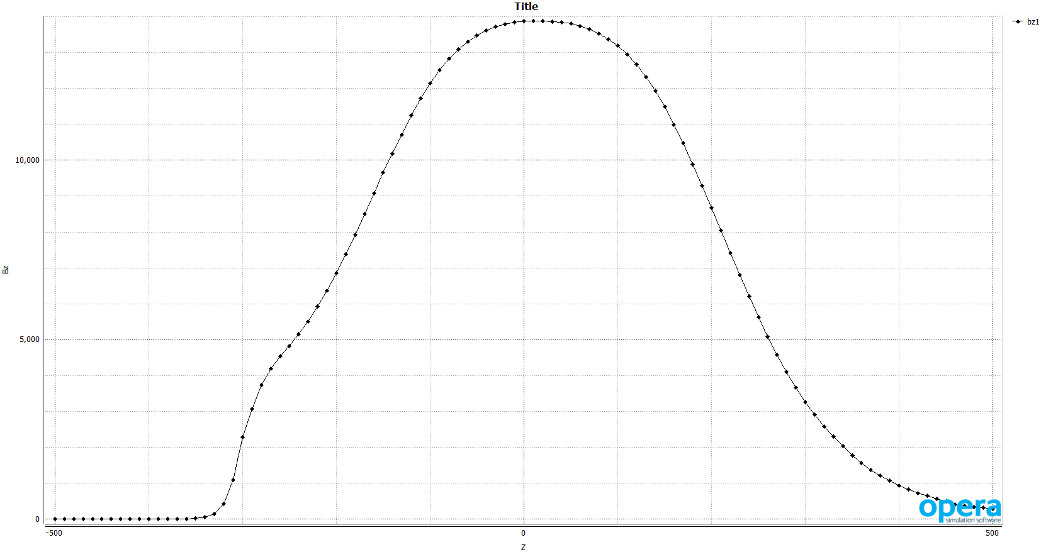
Bz om axis no Hcal iron B(000) 1.4 T ( same)

Slide 9
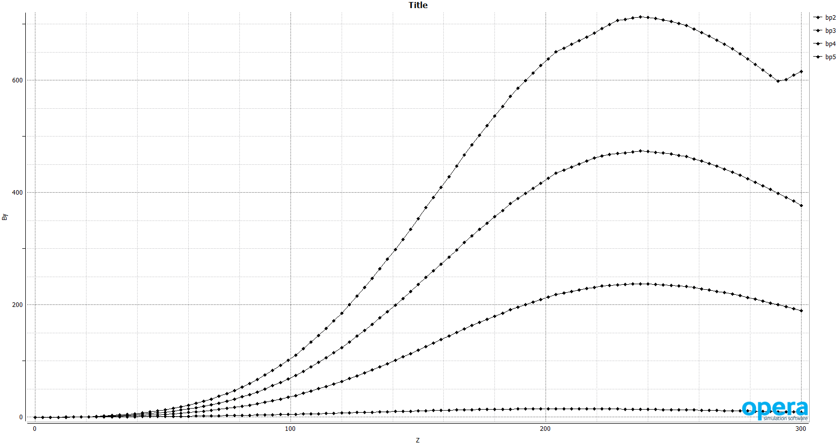
Bperp near axis no iron in Hcal slight improvement

Slide 10
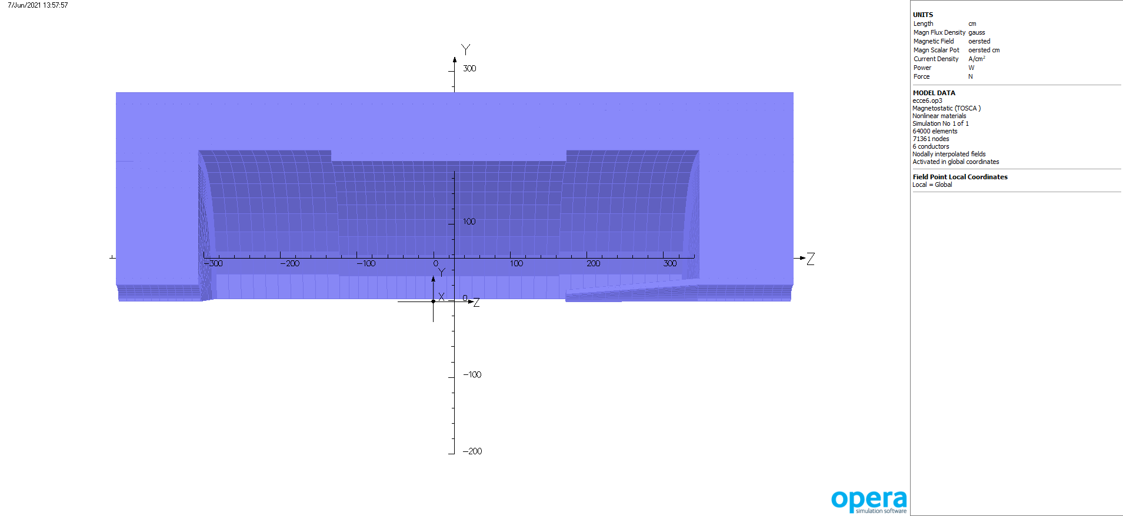
Model with conic piston regular iron

Slide 11
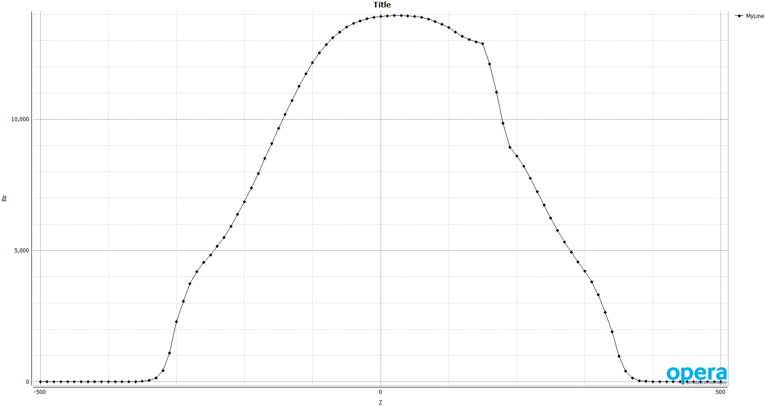
Bz on axis with conic piston

Slide 12
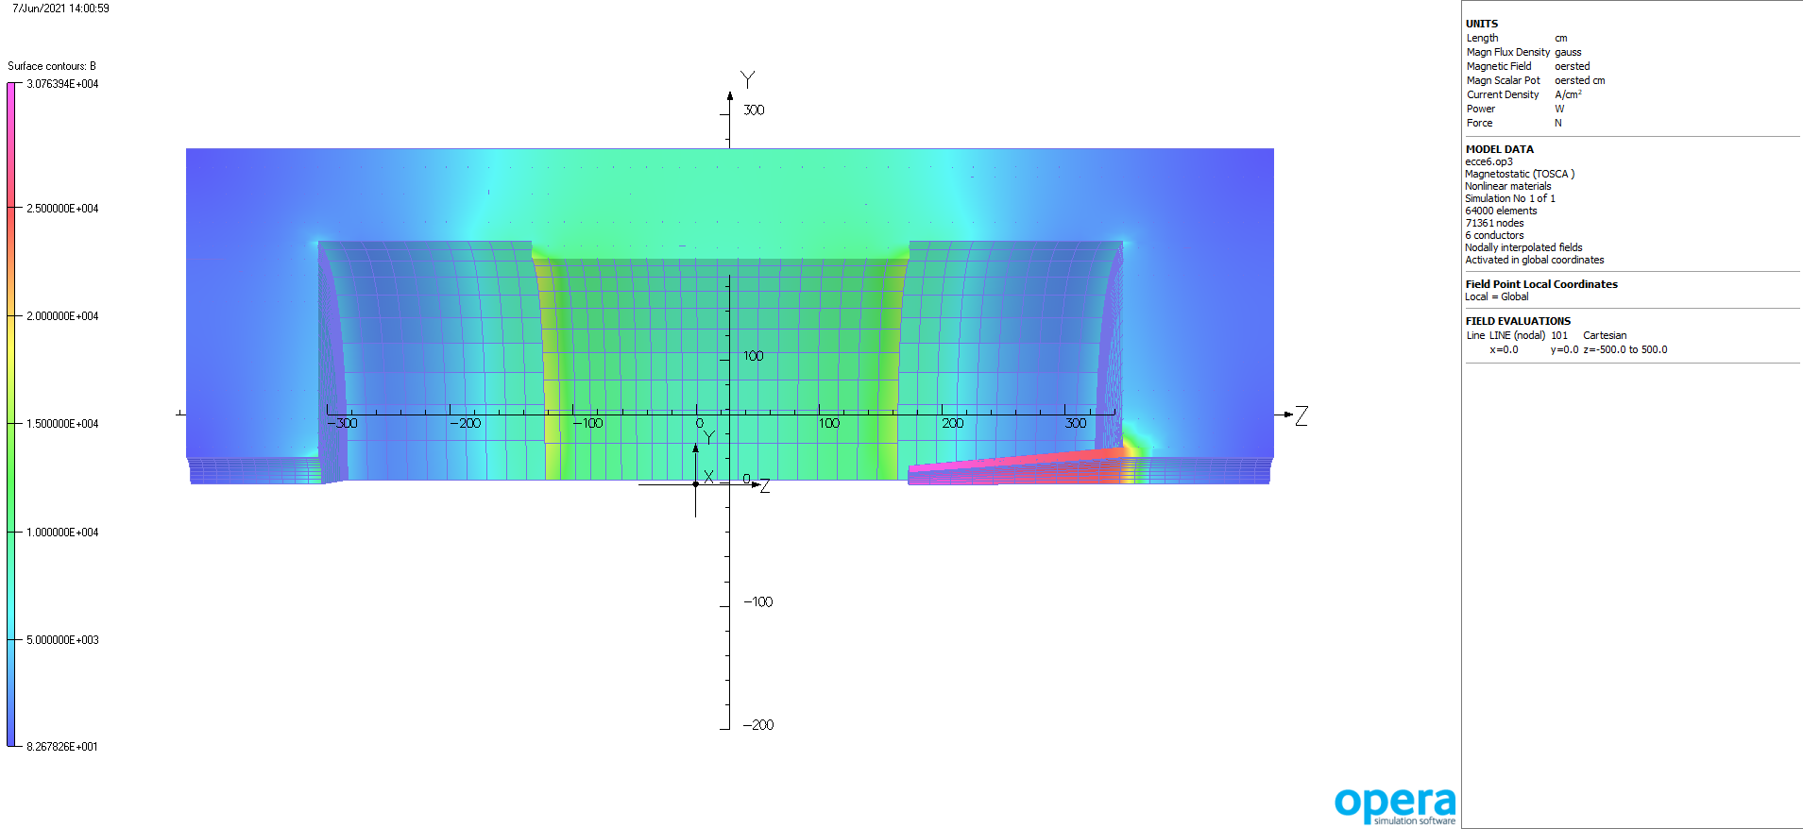
B in iron with piston

Slide 13
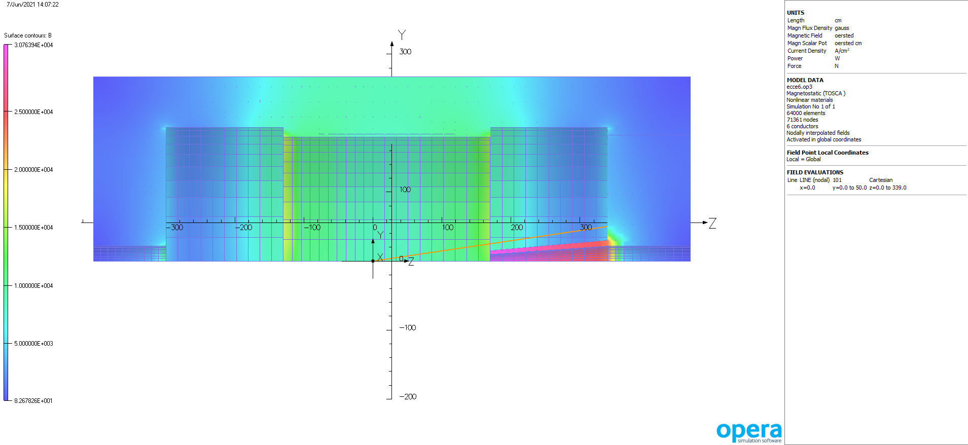
Model with ray @ 8.4

Slide 14
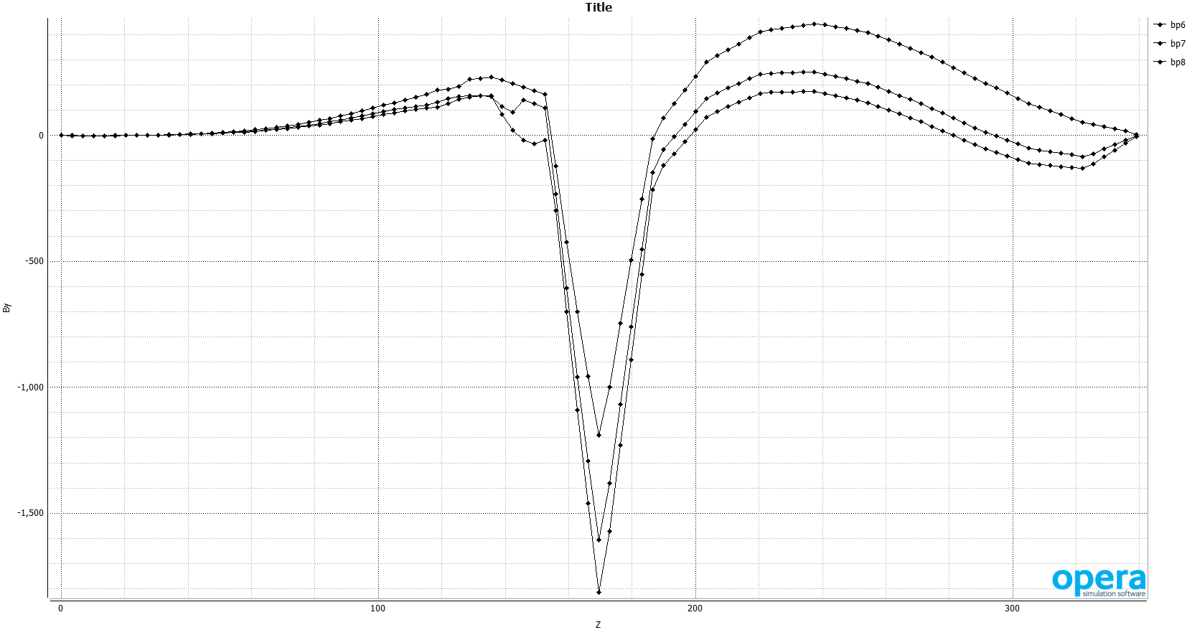
Bperp near conic piston

Slide 15
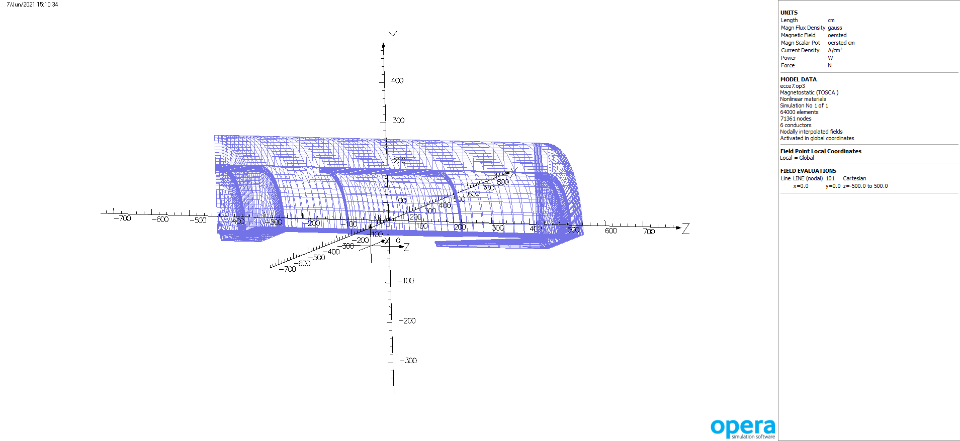
Model with iron pulled out to 440/460

Slide 16
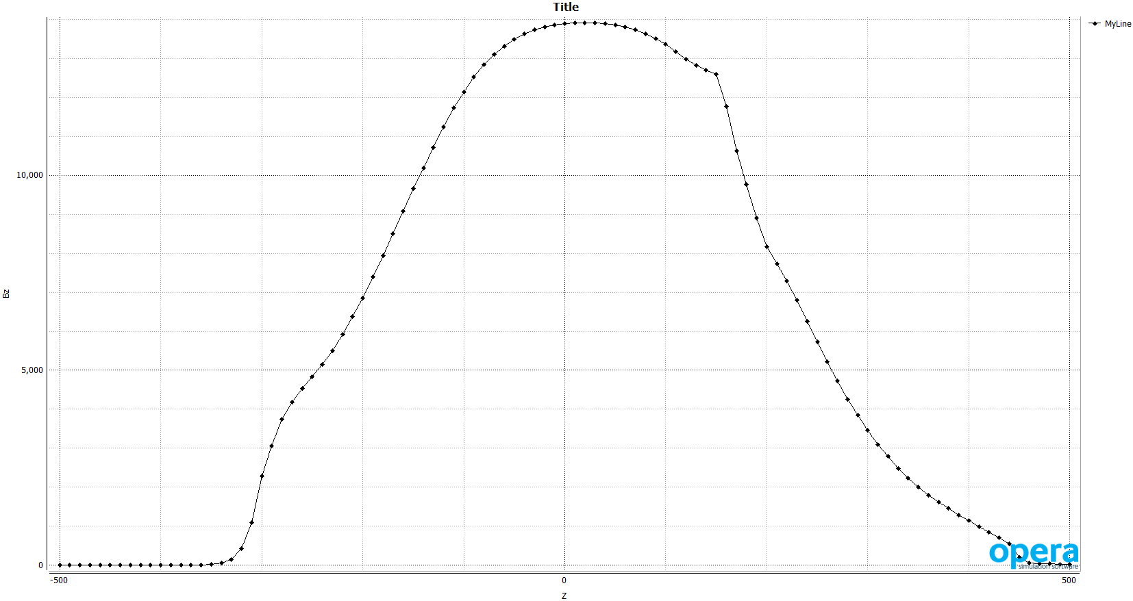
Bz with iron at 440/460

Slide 17
Comments
Hcal at 50 %, 10 %, no iron and iron outside have little effect on B(000)
Field does change shape near coil end.
Bperp near axis sees slight improvement with less to no iron
First look at using the “piston” to get more Bperp near axis – this needs more work.

