Slide 1
Annual Review HW Questions
How are procurements managed? Do you have a procurement management plan?

Slide 2
Q1: Procurement Management
We hold a weekly sPHENIX procurement meeting with the sPHENIX PPM liaison, a Physics Dept Business Ops person, Project Management Center rep and sPHENIX Management rep. We have held these weekly meeting for the last 4.5 years.
We discuss the status of all reqs pending in PPM and any upcoming high priority reqs.
There is an updated sPHENIX procurement spreadsheet created each week.
sPHENIX Management also submits a separate spreadsheet of the highest priority procurement reqs (typically 3-5 reqs) to the Project Management Center each month and it gets discussed with the head of PPM along with all the other high priority BNL reqs at the monthly Project Oversight Board meeting run by the Deputy Lab Director.
Each sPHENIX req is overseen by the sPHENIX requisitioner, typically the L2, L3 manager, cognizant engineer or lead technician. The Project Director handle the university contracts.
The BNL Peoplesoft system allows us to track all active contracts and procurement.
Procurements are included in the sPHENIX P6 file. Major procurements keyed on price point or importance have a P6 procurement string.

Slide 3
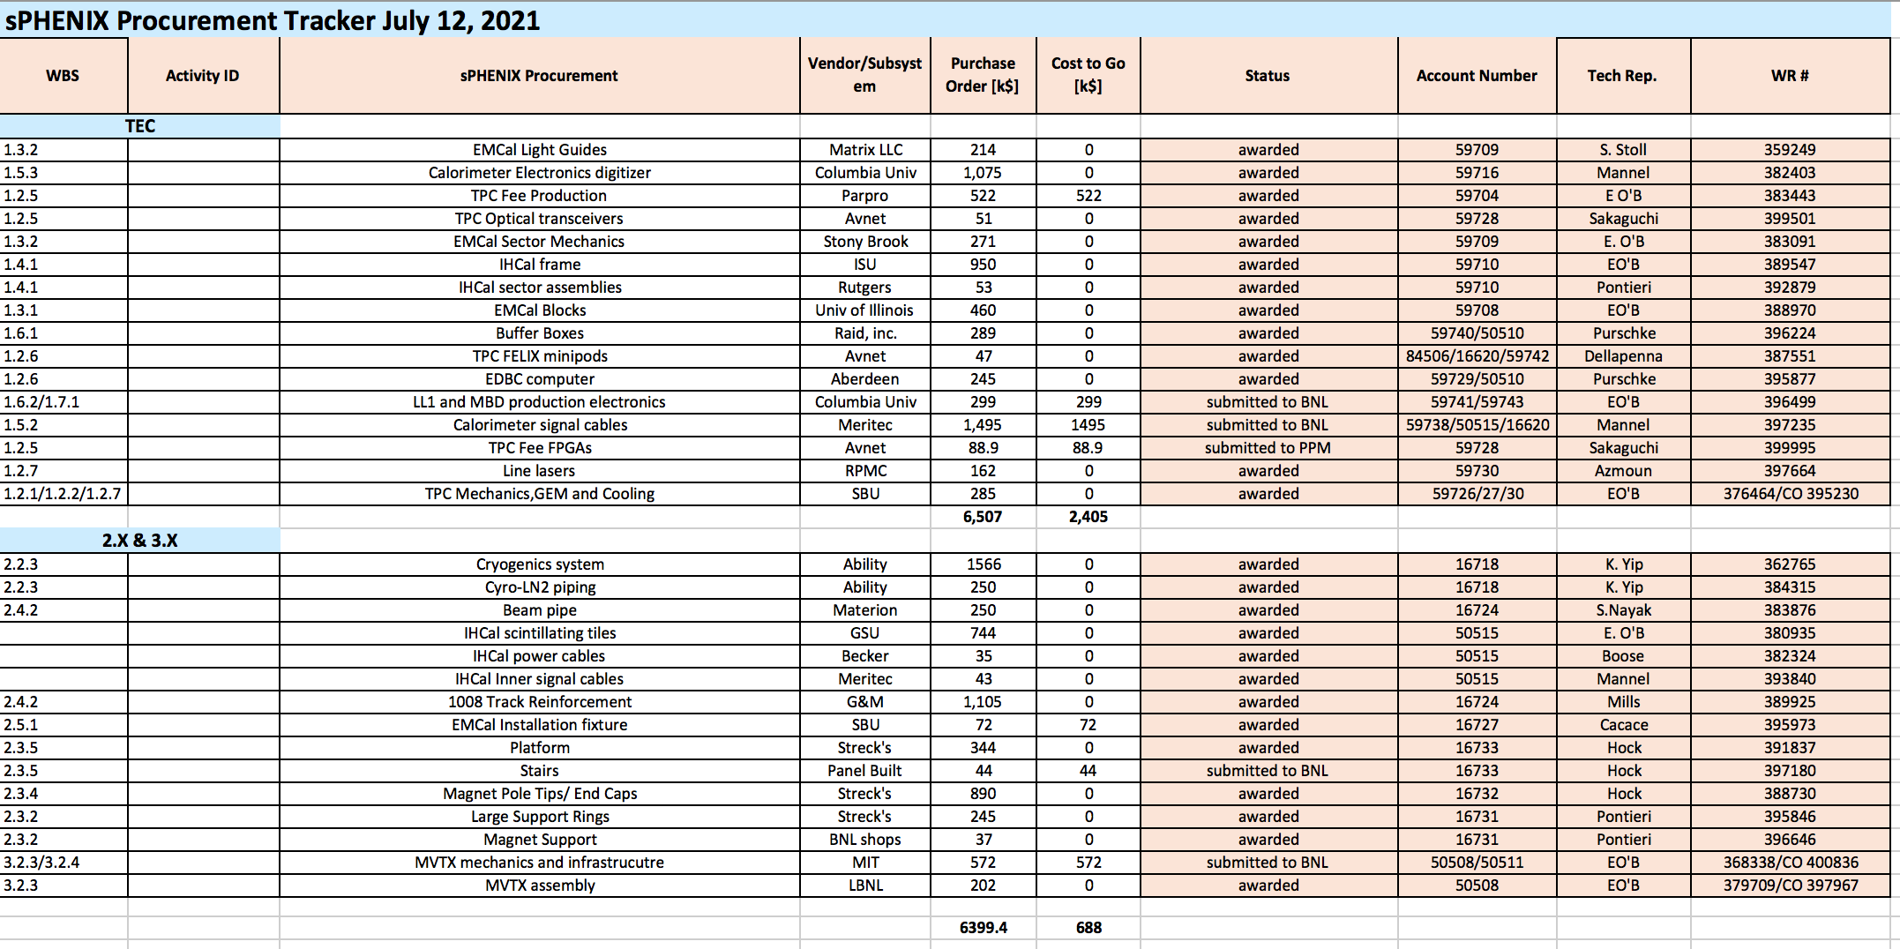
Q1: Procurement Management

Slide 4
Annual Review HW Questions
We have noticed that the installation schedule is very tight. What is the float to the hand-off date for installation, especially for the items that will be significantly delayed? When could these items (i.e. cables, digitizers) impact the installation schedule?

Slide 5
Q2:MIE to Installation Links in P6
Links from detector assembly (MIE) to detector installation (I&F) are embedded in P6 for:
  TPC
  EMCal
  OHCal
  MBD (and the off-project detectors IHCal, INTT, MVTX, and all magnet items)
Links were put in P6 for availability of parts during detector construction, e.g.:
  SiPMs, W-powder, scintillating fibers, scintillating tiles
  SiPM daughtercards, preamps, interface cards and internal cables for the EMCal & OHCal (and the IHCal, in effect)
  GEM foils, SAMPA chips and FEE cards for the TPC
  These “parts activities” are largely complete, so these sub-assembly links served their purpose

Slide 6
Q2: MIE to Installation links in P6 (2)
We can determine the time between expected finish for a given item and when it is needed for installation
This is shown on the two charts included
The lead time for in particular digitizers and signal cables (and crates and a few other items) was left implicit when we baselined in 2019
  We can perform relay-rack installation on the carriage only after the OHCal, SC magnet, and the platforms are in place
  We have to give priority to cryogenics/controls/magnet PSU & quench detector at that time since they are labor-intensive and critical-path to turning on the magnet
  We cannot in any case mass-power electronics until we roll sPHENIX in to 1008-IR because we do not have adequate AC power in the Assembly Hall
  BUT, we do want to proceed with signal-cables on a time-available basis just to get it done

Slide 7
Q2:MIE to Installation links in P6 (3)
The earliest we can install signal cables is Week 5 of 2022. The latest that we’d like to be installing them is around Week 35 when TPC installation and cabling is concluding, at which point we want to start powering lots of the detector together.
  Prior to this we’ll be checking individual sectors with a portable test stand
We expect signal cables to appear in batches from the vendor, possibly as soon as this Fall, at which point we can test them and store them pending installation. We can install in batches on a time-available basis, possibly on evening shift since day shift needs to give priority to crane and surveying operations. Delivery from the cable vendor is likely to persist for months.
We could thus “survive” a 1-year (!!!) delivery schedule from the vendor, but are pressing for 6-7 months

Slide 8
Q2:MIE to Installation links in P6 (4)
The earliest we can install digitizers en masse is perhaps Week 17 of 2022, right after sPHENIX roll-in to 1008 IR.
We already have 20% of them produced and in test crates currently in use to test and burn-in sectors. The above refers to the bulk installation.
Again, we want all the digitizers in place by Week 35 of 2022 so we can start mass power-ups.
The DAQ/Trigger/Timing systems were linked in P6 to the ability to operate the full detector, which is after Week 35 of 2022
  We already use a subset of the DAQ/GL1 trigger/Timing as well as basic DAQ software, all now in hand, for testing detector assemblies and sectors as they are being built, so we did not add that logic to P6

Slide 9
Q2:OuterHCal and EMCal Installation
Charge Question 5
 | Fabrication Complete | Installation Date | Delta (wk)
OHCal Sector 1 & Splice Plates | Week 8, 2021 | Week 25, 2021 | (done)
OHCal Sector 13 | Week 5, 2021 | Week 36, 2021 | 31
SC Magnet Coil | 2018 (testing at BNL) | Week 39, 2021 | >100
OHCal Sector 14 | Week 5, 2021 | Week 43, 2021 | 38
OHCal Sector 32 | Week 17, 2021 | Week 48, 2021 | 31
EMCal Sector 1 | Week 14, 2020 | Week 1, 2022 | 91
EMCal Sector 32 | Week 30, 2021 | Week 5, 2022 | 27
EMCal Sector 59 | Week 52, 2021 | Week 10, 2022 | 10
EMCal Sector 64 | Week 5, 2022 | Week 11, 2022 | 6

Slide 10
Q2:TPC and Electronics Installation
Charge Question 5
 | Fabrication Complete | Installation Date | Delta (wk)
TPC | Week 4, 2022 | Week 28, 2022 | 24
OHCal Cabling | Week 3, 2022 (?) | >Week 5, 2022 | 2 ?
EMCal Cabling | Week 3, 2022 (?) | >Week 5, 2022 | 2 ?
Digitizers | Week 4, 2022 | > Week 17, 2022 | 13
Trigger & Timing Systems | Week 4, 2022 | > Week 17, 2022 | 13
Beampipe | Week 8, 2022 | Week 32, 2022 | 24
TPC, EMCal and OHCal on-detector electronics are installed as part of detector fabrication
Digitizer, Trigger and Timing installed after roll-in during April 2022
EMCal & HCal cabling starts only after Upper Platform in placed and essential cryogenics work is underway

Slide 11
Annual Review HW Questions
In general, what are the main external schedule risks to off-MIE deliverables (e.g. John mentioned in his talk the dependence of DAQ and electronics commissioning on the availability of the online software. Also, off-project detector components.)?

Slide 12
Q3:External schedule risks
IHCAL
INTT
MVTX
Online and offline software
Infrastructure and Facilities (I&F) projects
  Track reinforcement
  Cryo installation
  Magnet mapping
  Beam pipe
  Power distribution and safety systems
  Rack construction

Slide 13
Q3:IHCAL
Risk to MIE due to IHCAL delay
  Instrumentation of the IHCAL if off-MIE, but the IHCAL structure itself in its role of supporting the EMCAL is part of the MIE
  Delay in the construction of the IHCAL would delay the EMCAL installation
Probability and mitigation
  IHCAL mechanical components have begun to be delivered to BNL
  The IHCAL tiles are almost complete at Uniplast (ordered: 6360, needed: 6144, tested at Uniplast: 6134, delivered to GSU: 4360)
  The team that installed the tiles in the OHCAL is poised to do the same for the IHCAL
  The IHCAL must be installed before roll-in, which would necessitate mapping the magnet without the EMCAL (not so bad itself, but then requiring the EMCAL to be installed after the magnet mapping), pushing out TPC/beam pipe/MVTX/INTT installation)
From Saif Ali, GSU, 2021-07-06

Slide 14
Q3:MVTX and INTT
Risk to MIE due to MVTX and/or INTT delay
  The MVTX and INTT are almost the last detectors to be installed; only the MBD is waiting for their installation to complete
  The tracking system is unlikely to achieve the design momentum resolution without the MVTX and INTT, so are a necessity to begin Run 23
Probability and mitigation
  MVTX and INTT detector components are far along in construction and not needed at BNL until TPC installation is complete
  The beginning of Run 23 would have to be delayed to complete the installation of the MVTX/INTT and MBD

Slide 15
Q3: Online and offline software
Risk to MIE due to online and offline software
  Problems with online and offline software can delay operation, testing, and commissioning of detectors
    Note that since we are planning offline event building, runs that need data from multiple detectors require offline software for analysis
  Problems with inconvenient or slow online software can make taking commissioning data slow and onerous
Probability and mitigation
  Part of online software have been tested under detector commissioning conditions, and another year of development is ahead
  The chain and slice tests are essential testbeds for this development
  Additional users, postdocs, and students will contribute to the development as detector installation begins

Slide 16
Q3: Track reinforcement and cryo
Risk to MIE
  The track reinforcement and cryo work between Run 21 and 22 (now) is necessary to allow sPHENIX roll into the IR after Run 22
Probability and mitigation
  The track reinforcement in the Assembly Hall went quite well, but problems with contracts or unexpected problems in the IR could delay the roll-in of the detector and delay the magnet mapping and all subsequent detector installation
  Very important that we not allow this to happen

Slide 17
Q3: Magnet mapping
Risk to MIE
  The TPC/beam pipe/MVTX/INTT installation is contingent on the completion of the magnet map
Probability and mitigation
  We will need to lock in the plan for mapping by fall; if the CERN group cannot do the map, we could be forced to consider simpler alternatives
  It is important to turn on the magnet and make field measurements even if we cannot measure a comprehensive map

Slide 18
Q3: Beam pipe
Risk to MIE
  If the beam pipe isn’t ready when needed for MVTX and INTT installation, MVTX/INTT and MBD installation will have to wait
Probability and mitigation
  Modification of the beam pipe is running late, but looks to be back on track
  NEG coating at BNL could cause further delays, but this technology is necessary to BNL in the future
  Need time to bake out pipe prior to INTT, MVTX installation

Slide 19
Q3: Carriage, Platforms and Pole Tip Doors
Risk to MIE
  If there are delays to the installation of the sPHENIX superstructure and/or pole tip doors
    Racks, cabling and water piping can not be installed and detector commissioning will be delayed
    sPHENIX can not go into IR until all this work is done…delaying downstream MIE work
Probability and mitigation
  Procurement of the carriage and platform structures, and the pole tip doors is well underway
  Assembly of these structures can occur in parallel with iHCAL and EMCAL installation. If iHCAL or EMCAL is delayed the techs can work on this installation work.
  Need sufficient tech staffing and possible 2nd shift work to fully run this work in parallel with iHCAL and EMCAL install.

Slide 20
Q3:Power distribution, safety systems, racks
Risk to MIE
  If the power distribution and racks are not available, it will delay the commissioning of the affected detectors
Probability and mitigation
  Rack construction and the control and safety system are making good progress, so we can expect at least large parts of it to be functional soon after roll-in
  We may need to work around individual missing racks
  Additional Electrical Techs and/or electricians may be needed

Slide 21
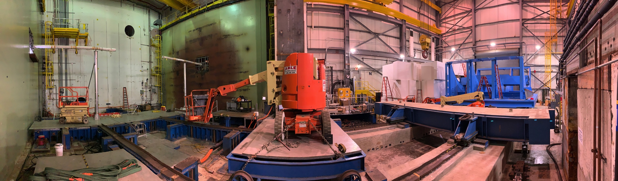
IR and AH 2021-07-14

Slide 22
Annual Review HW Questions
Cost & Schedule sub-Committee:
  a) Current status: As mentioned during Irina’s talk, Elmie and I would like to see the status through June 2021. I did a filter on the schedule and there are quite a few activities that were supposed to start and finish in June. We do understand that the June status is ‘draft’ and that’s okay. Please post the P6 schedule, plus the baseline schedule, and then the CPR for June 2021. (COMPLETED)

Slide 23
Annual Review HW Questions
b) EAC process: We would still like to understand the EAC process the project is following. The answer that was provided wasn’t quite clear to us. Please provide us with a further explanation of how the EAC is developed and how often the EAC is updated.
See the answer to recommendation #2 in the Annual Review 2020 Review Response document posted on the Indico Review page

Slide 24
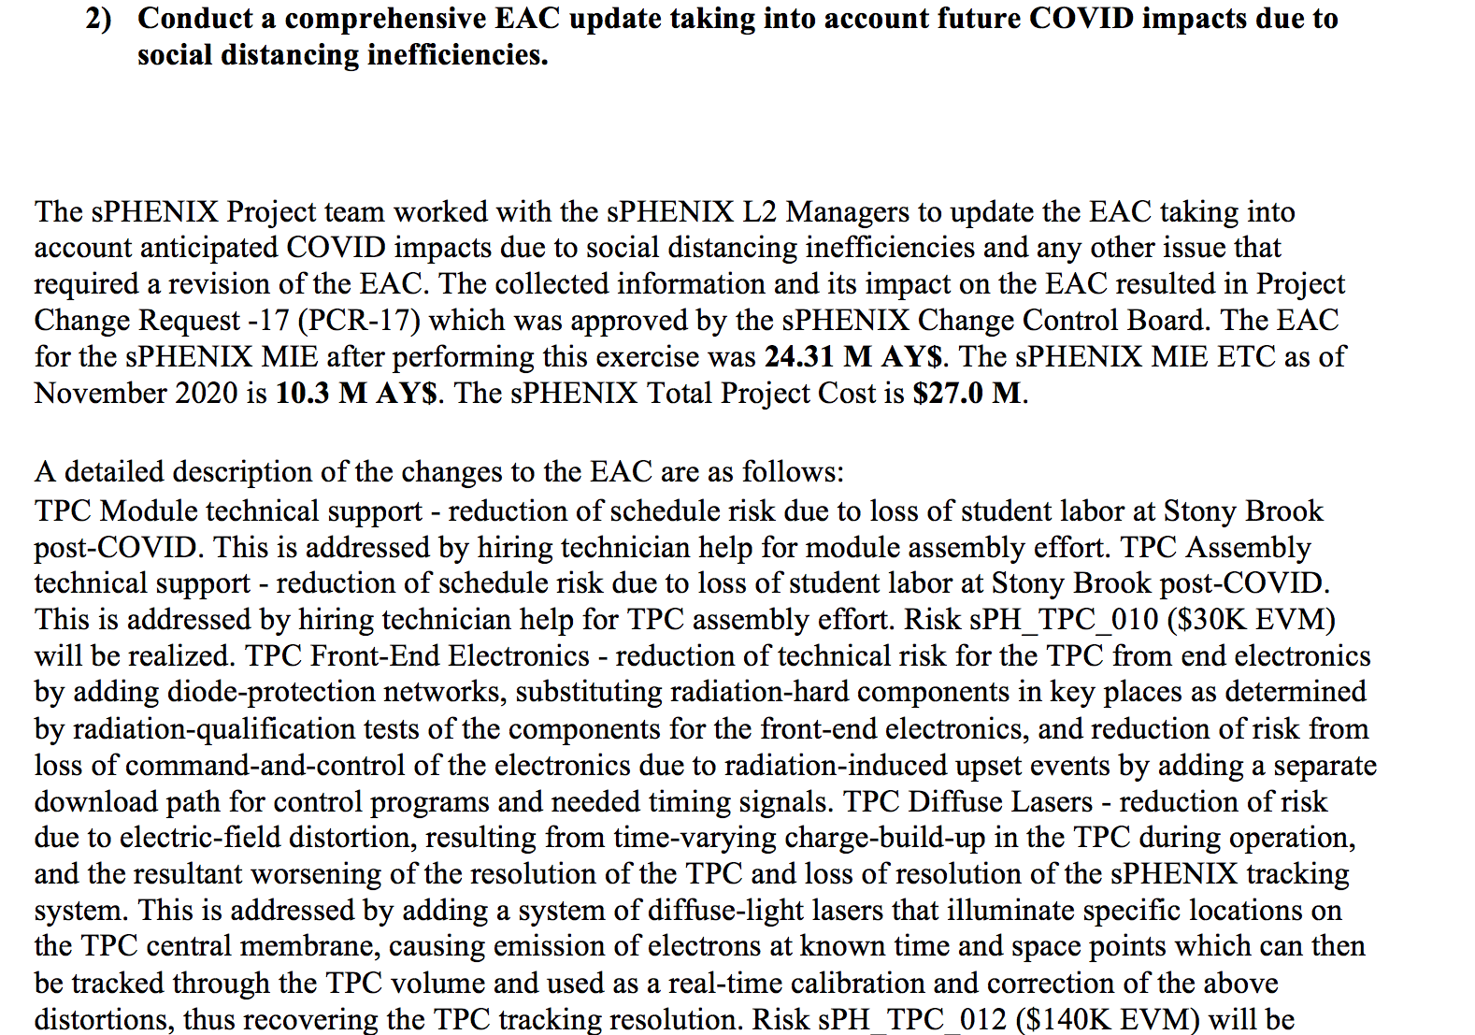
Q4b: EAC

Slide 25
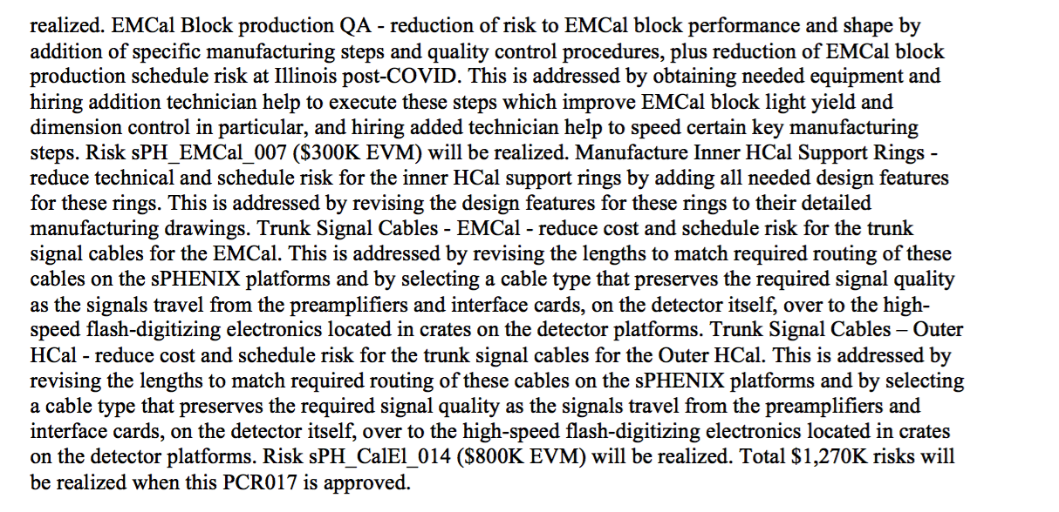
Q4b: EAC

Slide 26
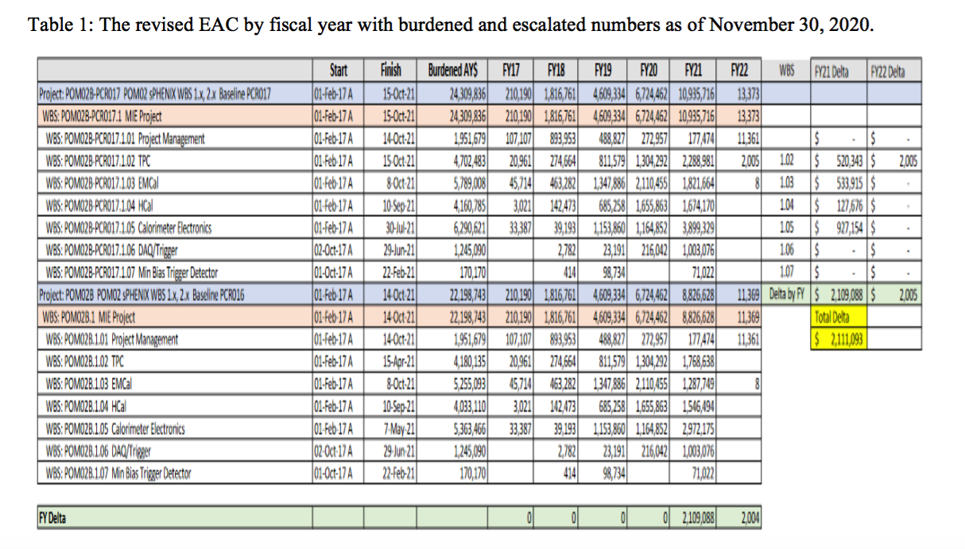
Q4b: EAC

Slide 27
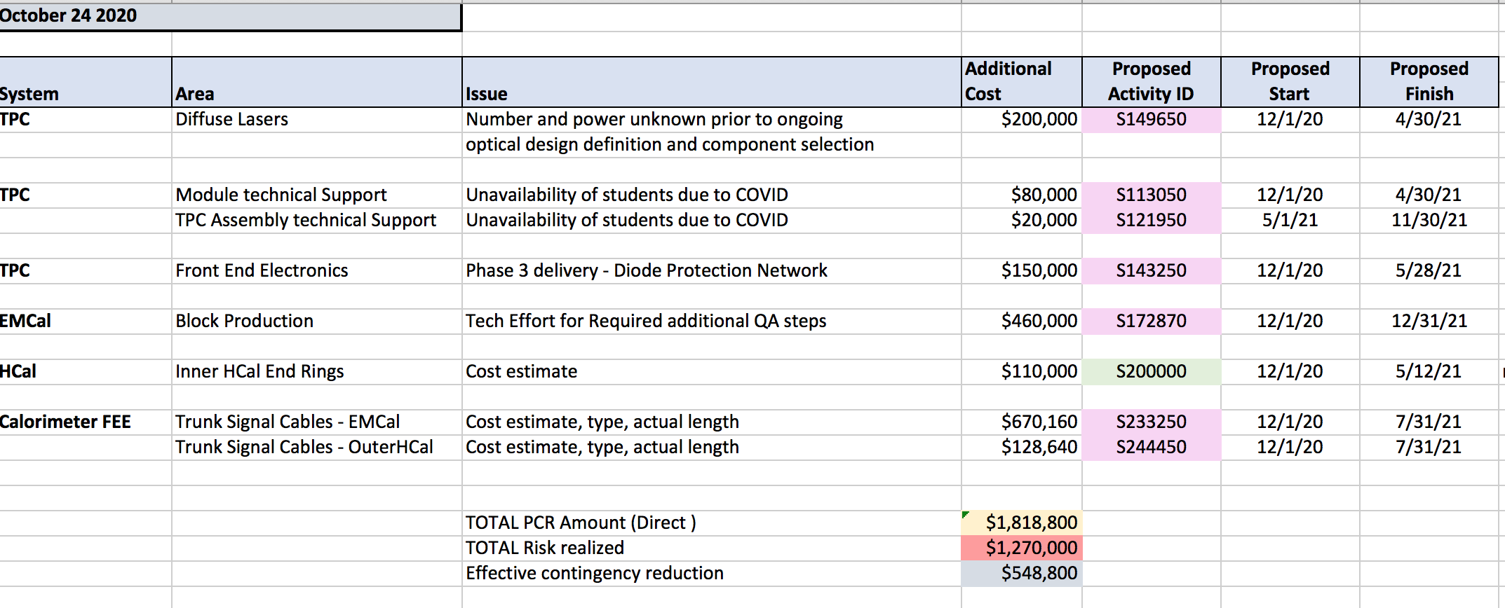
Q4c: EAC
PCR that resulted from the EAC exercise
Fully burdened call on contingency is $2.11M

Slide 28
Annual Review HW Questions
  c) Delays: We would like to discuss the schedule with Glenn in a bit more detail to better understand how the delays impact the project and how the schedule forecast is being done. As an example, during Glenn’s talk, he mentioned on slide 18 that there is upwards of a 9-12 month delay in obtaining parts for the digitizers. How does this impact the project? Glenn

Slide 29
Q4c: In-Progress PCR for I&F (WBS 2.x)
We have a draft of an update to P6 for the I&F which will incorporate several items left open in 2019
  Doing this is a Recommendation from the April 2021 I&F Review
  Revised roll-in date to 1008 IR (one month later than planned – RHIC schedule)
  IHCal detector construction
  Relay-rack construction and installation (and population)
  Better-understood assembly sequence for platforms, pole-tip doors, beampipe and the two silicon detector subsystems
First draft says we actually gain some float for EMCal installation
  The TPC is installed about one month later since it must await roll-in and some essential magnet steps and initial operation
Builds back a small schedule reserve for the MIE

Slide 30
Q4c: Digitizer Delay in P6 Progress File
We presently (as of June progress) have a bit over 8 months assumed as the delay on the digitizers (March 20, 2021 baseline finish vs November 3, 2021 expected finish in the June 2021 P6 Progress file)
Recent news on electronics parts delivery is mixed – more parts keep appearing, but lead times are not particularly improving
Ten months delay puts the digitizers delivery January 20, 2022, a week before the revised Early Finish date for the MIE
Twelve months delay puts the delivery date to March 20, 2022, making the digitizers the critical path item for the MIE

Slide 31
Q4c: Side Remark on Parts for TPC FEE
We went ahead some months ago and procured the complex parts for the TPC FEE
The board and assembly contract requires the assembler to buy the simple, low-cost items (R, C, diodes)

Slide 32
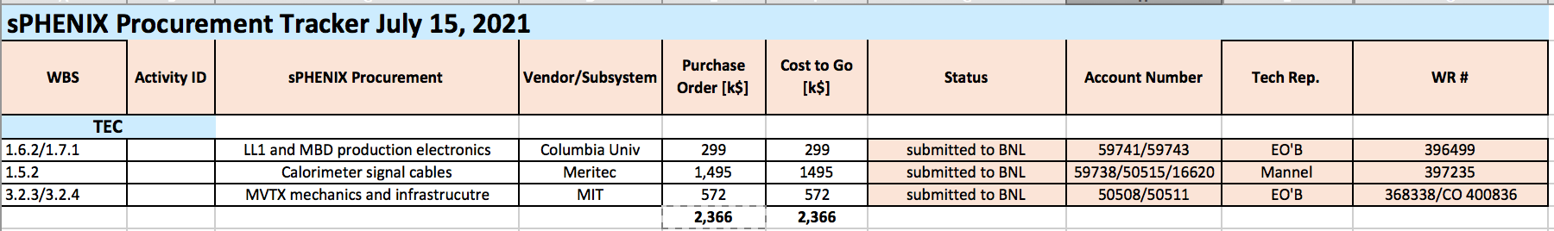
Annual Review HW Questions
  c) Delays – continued. Additionally, for the procurements that are delayed, what is the value of those total procurements? Which are critical?
These three procurements are delayed. All are critical
Two are MIE procurements, one is MVTX

Slide 33
Annual Review HW Questions
  d) Standing Army: What is the standing army cost for the project?
  The sPHENIX MIE is only 10% labor. Our burdened standing army costs are $50-$60k/mo. The personnel from Physics Dept and CAD are technical staff supported by RHIC Ops.

Slide 34
Annual Review HW Questions
  e) Resource needs: What resources are required going forward that the project does not currently have? This would include any recently identified resources that have not started physically working at this time.
    We are looking to temporarily bring on a Mech Tech to get us through the next 6 months. This person would be charged to project funds.
    We are in the process of hiring 1 postdoc on research funds. A second postdoc would be invaluable to our efforts.

Slide 35
Annual Review HW Questions
  f) Forecast schedule question: Demonstrate the current schedule (June 2021) has been updated to reflect any and all delays the project is aware of to show the true impact of delays. (Updating expected finish dates in forecast file).
  The latest forecast date for the June close is for EMCal Sector completion on 2/3/2022. See attached file.

Slide 36
Annual Review HW Questions
  g) Explain more concretely how you are coming up with percent complete to status?
The project is 90% M&S and 10% Labor
Progress for most of the P6 tasks is derived from value of M&S orders received or in the case of the University contracts, the percentage of components produced.
M&S for example:
The TPC detector counts progress based on % of all GEMS framed
The TPC Fee has a spreadsheet of electronics parts order/delivered and their costs
The TPC calibration has the cost of the laser system delivered or the cost of the gas system components.
UIUC bases EMCal progress on the number of blocks produced.
EMCal progress is also measured against the value of the mechanics delivered or light guides received.
HCal takes progress against the value of tiles delivered or mechanics delivered.
The Calorimeter electronics takes progress against the value of the boards, or LVPS or cables delivered.
DAQ/Trigger takes progress against the value of servers, switches, trigger boards delivered.
Labor:
Up until 2021 the labor has been LOE and was only Project Management.
For R&D/Preproduction work at Universities the L2’s estimated % complete against the value of the contract

Slide 37
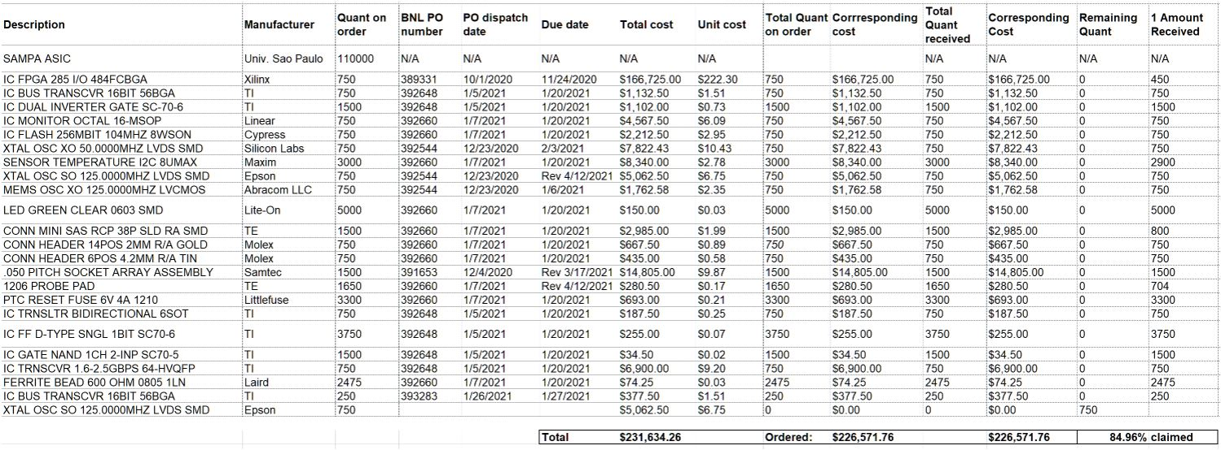
TPC FEE Production Components

Slide 38
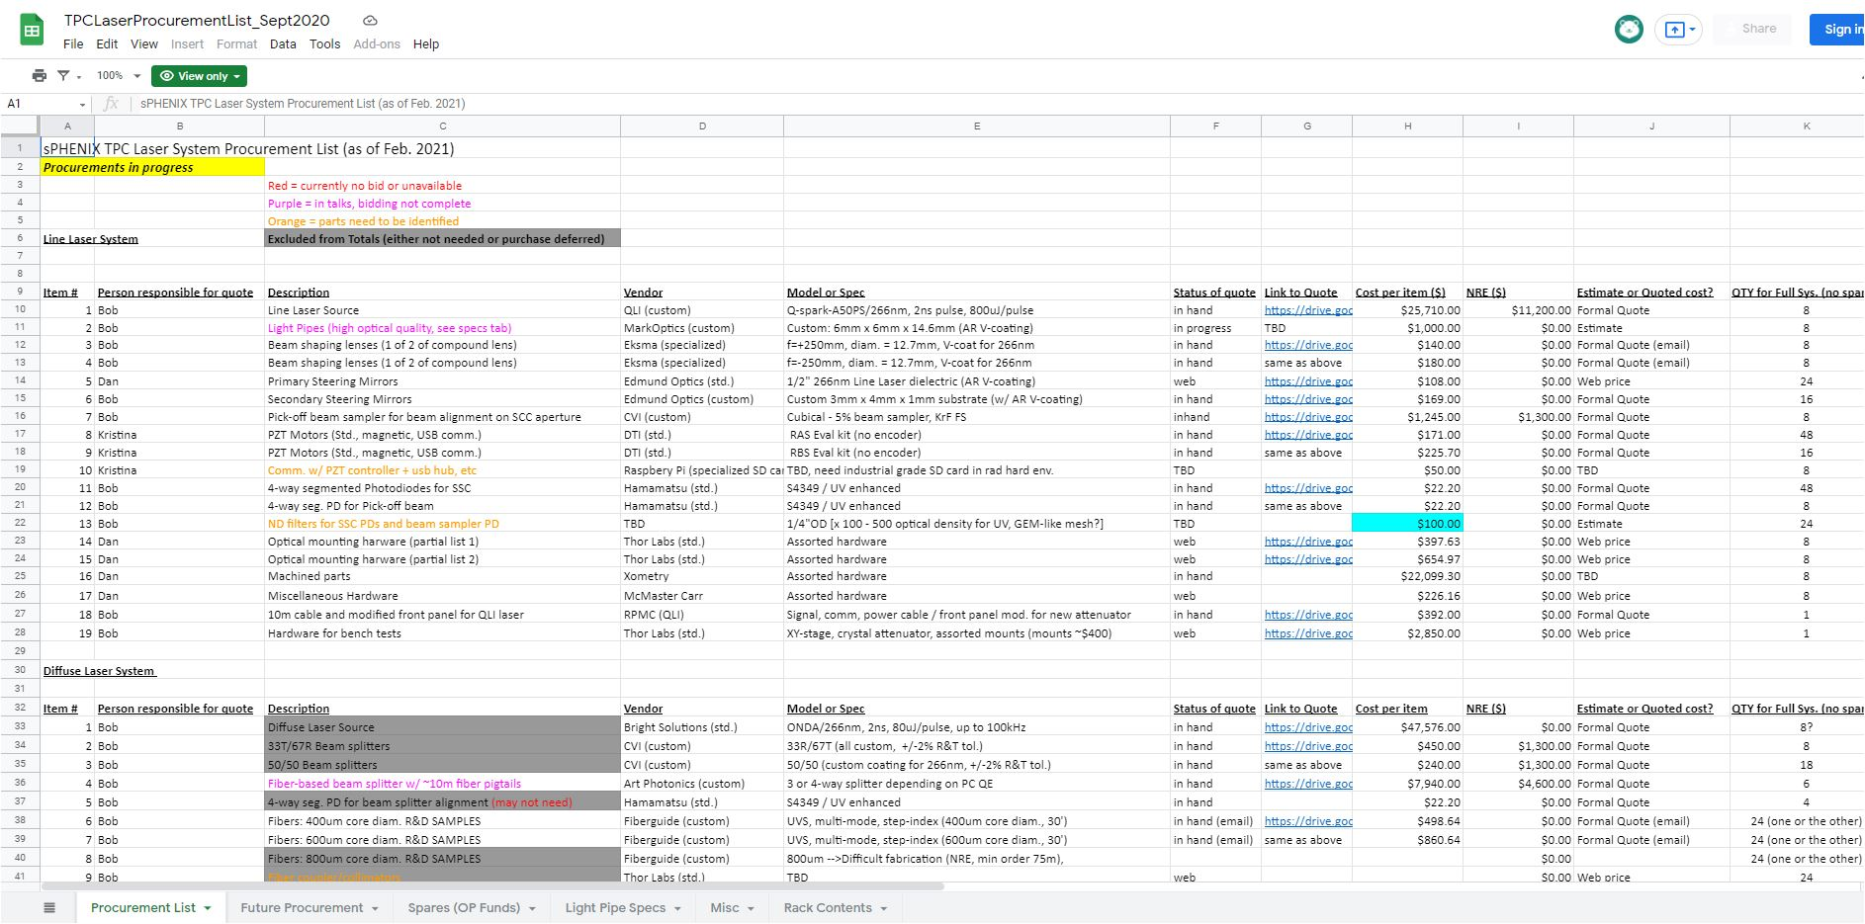
TPC Diffuse Lasers

Slide 39
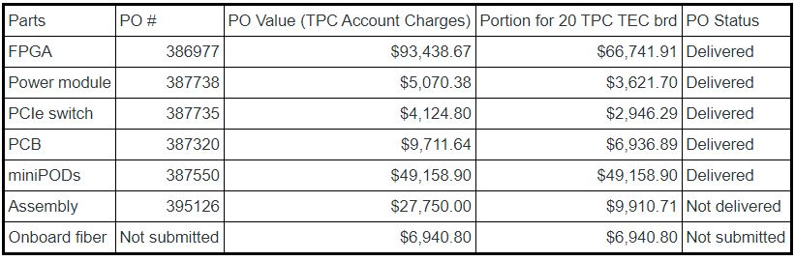
Procure TPC DAM Felix 2.0 Boards

Slide 40
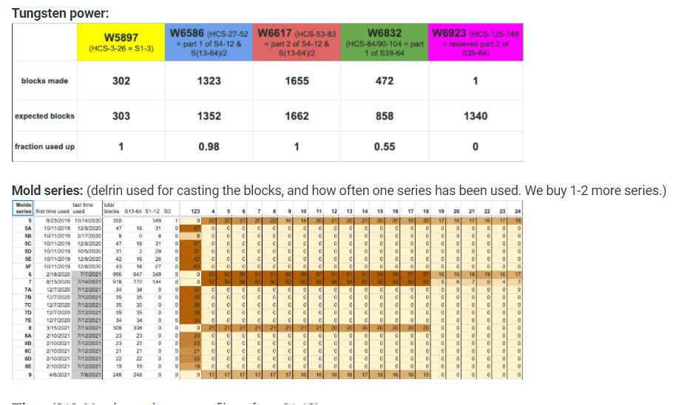
EMCal Tungsten Powder

Slide 41
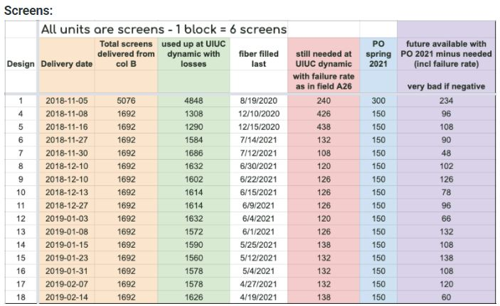
EMCal Screens

Slide 42
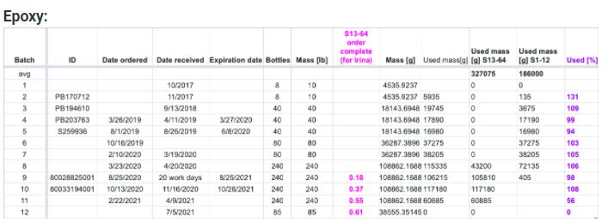
EMCal Epoxy

Slide 43
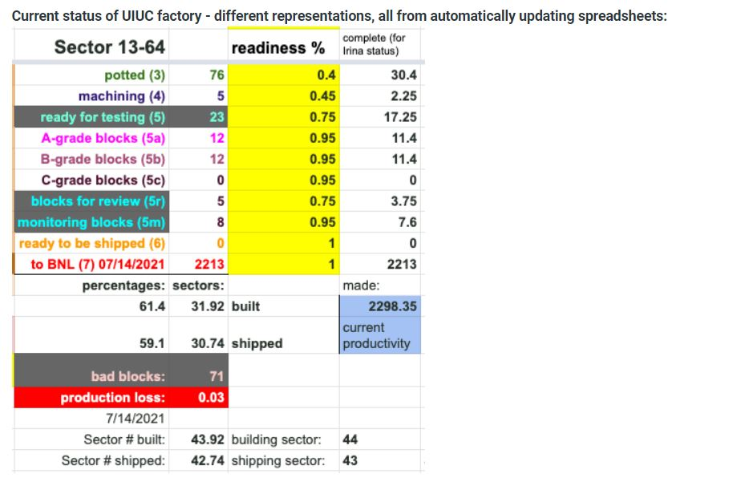
EMCal Block Accounting

Slide 44
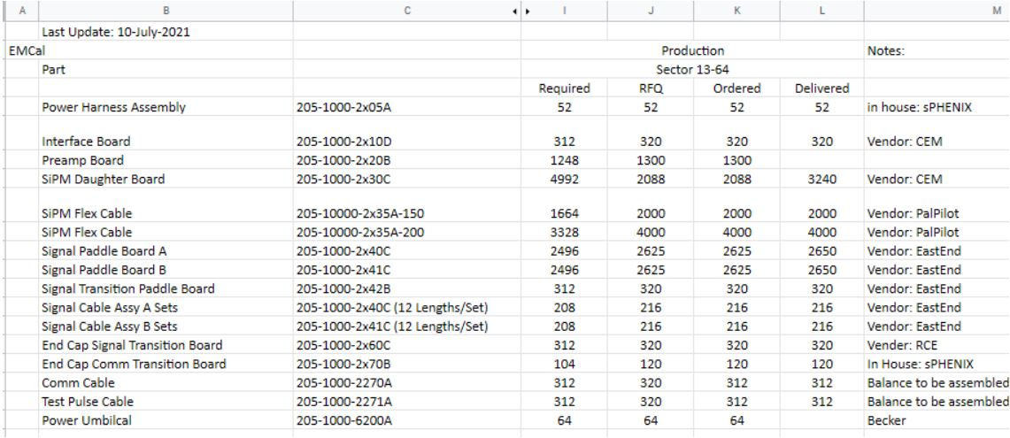
Calorimeter Front End Electronics

