Slide 1
sPHENIX MIE Annual Review ESH/QA
Lori Stiegler
July 14-15, 2021
BNL

Slide 2
sPHENIX ES&H
Topics
COVID-19 impacts and controls
Environment, Safety, and Health (ESH) Organization
Accident Reporting and Statistics
Integrated Safety Management
Hierarchy of Controls
Risk Analysis Methodology
Hazards Update
Work Planning
Steps to Operation

Slide 3
COVID-19 Impact
BNL started Min-Safe March 13, 2020
Currently in Phase 2 of Return to Operations
Assembly and testing resuming
Work instructions/procedures were updated with COVID restrictions
Maximum teleworking
Meetings are virtual

Slide 4
COVID-19 Prevention
Signs have been installed in buildings which list the COVID best practices and room occupancy limits (the limit of 10 staff meeting indoors is a ROOP requirement)
Floor markings have been installed in areas where staff, visitors, and users might need to wait in line (TFCU, micro mart, Guv Center, etc..)
Wellness screens have been installed at locations where frequent interactions occur (Badging, housing, Guv Center, HR, etc..).
Staff and supervisor training for COVID-19
Daily self-check prior to coming on-site
Custodial staff have increased disinfection of frequently touched surfaces

Slide 5
COVID-19 Prevention
F&O has pre-staged cleaning supplies in common areas.
Hand sanitizer stations have been installed in buildings across the site.
Evaluation of work stations where possible (e.g., moving of work stations, staggering of schedules, etc.)
Installed voluntary temperature monitoring stations throughout site.
Modified building operations in accordance with ASHRAE guidance for facilities
Staff that choose to validate their vaccination status at the Occupational Medicine Clinic do not have to wear face coverings. A special lanyard and badge are provided
Possible increase in allowable on-site personnel starting end of July – pending DOE approval

Slide 6
ESH Organization
sPHENIX Project Director
E. O’Brien
sPHENIX ESH Liaison
L. Stiegler
Assigned from ESH Directorate
C-AD ESH Manager
F. Craner
Physics Dept ESH Manager
A. Franz
BNL Subject Matter Experts
L2 and L3 Managers

Slide 7
ESH Liaison Responsibilities
ESH Liaison from BNL oversees project
Interfaces with BNL safety Subject Matter Experts
Ensures that all work is planned and reviewed
Evaluates safety of designs at engineering, design and procurement readiness reviews
Conducts incident investigations and reports findings
Maintains the Hazard Analysis Report (HAR)
Performs other duties as required by project management and safety organizations

Slide 8
QA Organization/Responsibilities
QA Representative (Chuck Gortakowski) is assigned to sPHENIX from BNL Central QA organization
The sPHENIX QA Representative through a matrixed model is responsible for:
Ensuring that a quality system is established, and maintained in accordance with the QA Plan.
Providing oversight and support to the project participants to ensure a consistent quality program.

Slide 9
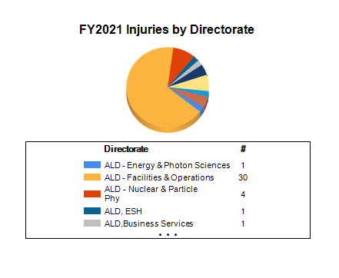
Safe Working
Vision – All Injuries are Preventable
Physics is included in NPP directorate
3 injuries in NPP C-AD department
1 first aid injury in Physics department, but not with sPHENIX project
No injuries reported in FY20 or FY21 to date for sPHENIX project at BNL or other institutions
Notes:
First injury was cut to finger from stripping cable, Second was cut finger from swatting at wasp in parking lot.

Slide 10
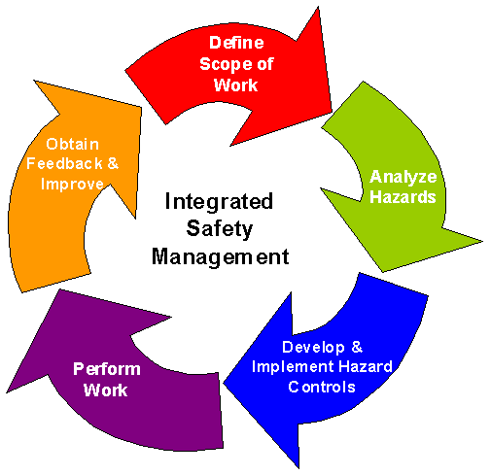
ISMS Implementation
Integrated Safety Management System (ISMS)
Environmental Management System - ISO 14001
sPHENIX project follows the Physics, C-AD, and other
Department and BNL program requirements
7 Guiding Principles of ISM:
Worker and Line Managers responsible for safety
Clear roles & responsibilities
Personnel Experience, Knowledge and skills
Balanced priorities
Identify ESH standards
Tailor controls to hazards
Operations authorization

Slide 11
Hierarchy of Controls
Whenever possible, the hierarchy of controls is implemented at the earliest work planning phase
Elimination – removing the hazard
Substitution – replacing with something less hazardous
Engineering Controls – isolate people from hazards
Administrative Controls – time limits, procedures, training
Personal Protective Equipment – safety glasses, safety shoes, respirators

Slide 12
Identification of Hazards
Hazard questionnaire
BNL work evaluated through Experimental Safety Review (ESR) Forms, Work Plans, and other work planning, depending on local requirements
Collaborating institutions analyze hazards according to their ESH programs
sPHENIX ESH liaison available to assist in analyzing hazards that may be unfamiliar
Compliance with safety standards is required
Documented in Hazard Analysis Report (HAR)
Hazards updated and delineated separately for MIE, Infrastructure and Facility Upgrade

Slide 13
Hazard Analysis
Work at BNL
Different methods of work planning – based on department policies and risk ranking (ESR, Job Risk/Safety Assessment, Work Permit)
Risk ranking is determined based on probability and consequence
Consequence→ Probability↓ | Multiple Deaths | Death | Serious Injury | Minor Injury
Very likely | High | High | Moderate | Negligible
Possible | High | Moderate | Low | Negligible
Unlikely | Moderate | Low | Low | Negligible
Rare | Low | Low | Negligible | Negligible

Slide 14
Example of Hazards Identified in sPHENIX HAR
Hazard – residual risk with controls | Typical Task / Initiator | Controls
Radiation | Use of sealed sources or radiation generating devices for testing, assembly in 1008 during RHIC run | Compliance with Radiological Control Program, dosimetry
Hazardous/Toxic materials | Cleaning/degreasing, epoxy | Safety Data Sheets, proper storage and handling
Electrical /arc flash | Testing electrical and electronic assemblies. Installing new electrical service | Compliance with BNL and institutional electrical safety and LOTO programs
Compressed Gas | Component testing Possible gases during operation | Compliance with pressure safety requirements, Training, proper PPE

Slide 15
Example of Hazards Identified in sPHENIX HAR
Hazard | Typical Task / Initiator | Controls
Cryogens/ODH | Component testing LHe during operation | Training, proper PPE, ODH evaluation, monitoring
Material Handling and Rigging | Moving large components, installation | Proper use of cranes, forklifts, hoists. Training, medical clearance, PPE
Working at Heights | Testing and installation of large components | Fall restraint/arrest systems, scaffolding, training
Fire | Use of open flames, improper storage of equipment | Proper storage of materials, HSSD, sprinklers, Fire Hazard analysis
Waste and Environment | Component testing | NEPA evaluation, proper storage of materials and waste Environmental Mgmt System/ISO 14001 certification

Slide 16
Work Planning
Work at BNL - Work Control Coordinators / Principal Investigators oversee work at BNL, and use BNL Work planning processes
C-AD Design Review Questionnaire
BNL Lab ESH Committee (LESHC) Review
Safe Work Plans
ESRs

Slide 17
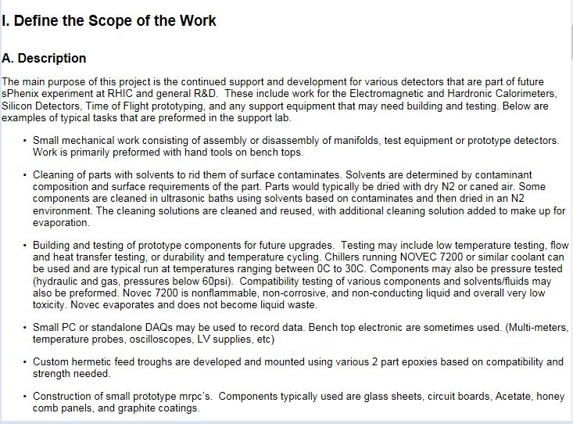
Experiment Safety Reviews
Physics Department - ESRs:
Evaluates tasks in BNL electronic ESR system
Each ESR has a Principal Investigator in charge of overall work/safety
Lists tasks, controls, training required
Reviewed annually for changes and feedback

Slide 18
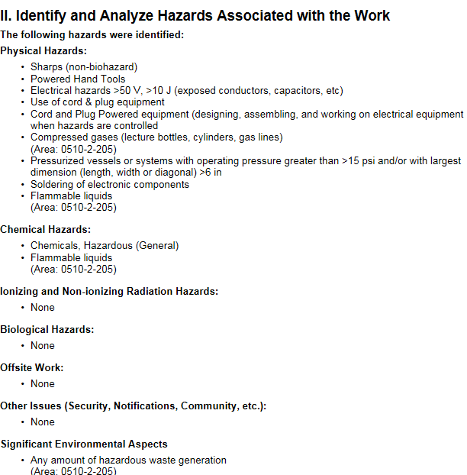
Experiment Safety Review
PI and ESH Identify and Analyze the Hazards
PI and ESH Develop and Implement Controls
Workers work within Controls and Give Feedback on annual ESR review

Slide 19
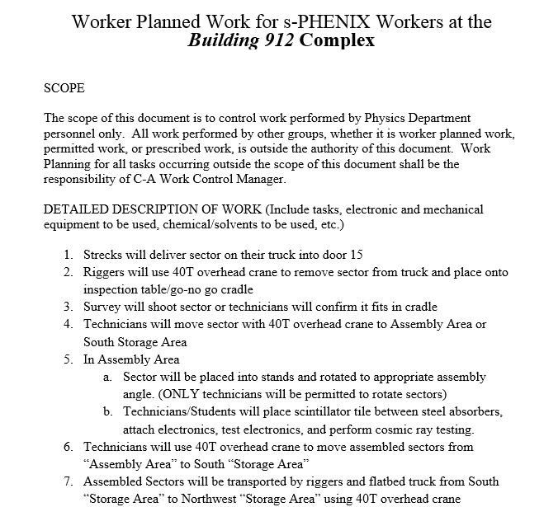
Work Planning
C-AD Job Risk Assessments, Work Permits, Procedures
Job Risk Assessments (JRA), Work permits, procedures
JRAs for worker planned common tasks (noise, compressed gas, etc)
Procedures for complex or repetitive tasks
Work permits and lifting plans for high hazard/complex tasks (material handling for large components)
C-AD Experiment Safety Review Committee Reviews of subsystems and installations

Slide 20
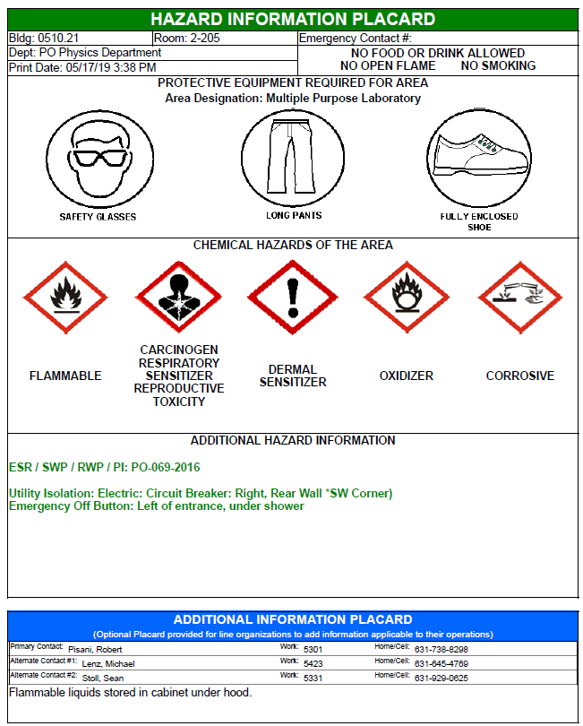
Area Hazard Placards
Each room/area is placarded with area designation, hazards in the area, required PPE, and contact information.

Slide 21
QA Program
The sPHENIX QA Plan was developed to align with the BNL Quality Assurance (QA) Program
Establishes the QA requirements and defines
How the requirements will be implemented into the project using the graded approach
Fully addresses the ten (10) QA criteria of DOE Order 414.1D.
Provides QA requirements applicable to all collaborating laboratories and universities
Encompassing all activities including, but not limited to:
o Design, Fabrication, Testing, Inspection, Calibration, Integration and Installation at BNL

Slide 22
Quality Assurance- Procurement
Controls are implemented to ensure purchased items meet project needs and comply with applicable quality requirements
Processes ensure suppliers are evaluated and selected on the basis of specified criteria
Procurement requirements are in compliance with ESH&Q risk requirements for purchased items
The need for inspection and acceptance testing is determined based on the graded approach
Unacceptable items are identified, controlled and corrected, and documented in the non conformance reporting (NCR) process
All BNL procurements must follow BNL Supplier Quality Assurance Requirements (BNL QA 101) – Referenced in SOW or Spec. as part of Contract Documentation

Slide 23
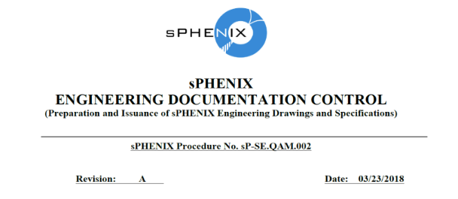
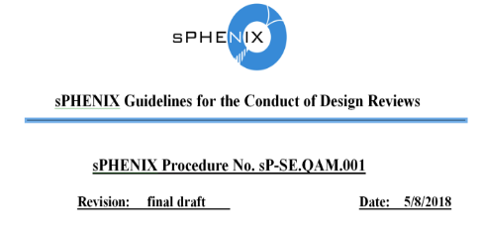
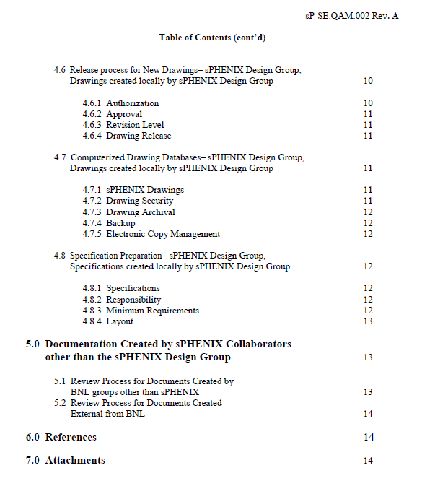
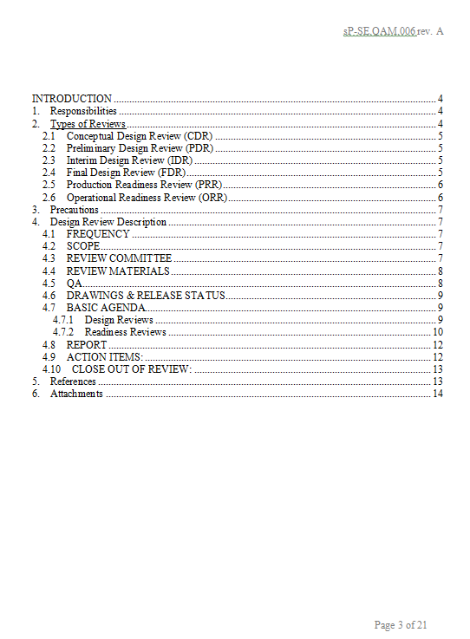
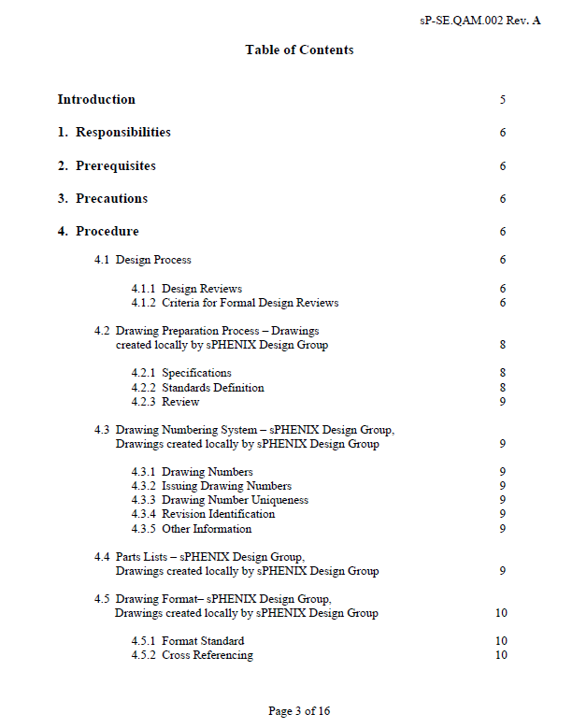
QA Procedures
sP-SE.QAM.001 | sPHENIX Procedure Preparation Guidelines
sP-SE.QAM.002 | sPHENIX Engineering Documentation Control
sP-SE.QAM.003 | sPHENIX Configuration Management
sP-SE.QAM.004 | sPHENIX Work Planning
sP-SE.QAM.005 | sPHENIX Safety Awareness Training
sP-SE.QAM.006 | sPHENIX Design Review Guidelines
sP-SE.QAM.007 | sPHENIX Quality Assurance Plan
sP-SE.QAM.008 | Quality Assurance plan for EMCalorimeter Block Production
sP-SE.PM.001 | sPHENIX Procurement Guidelines
sP-DS.OHC.001 | Outer HCal Factory Workplan

Slide 24
ESH/QA Summary
Hazards and risks are well known at BNL and in the accelerator community and have been updated as needed
All residual risks are low or negligible
QA program is in place and integrated into organization
All materials and parts are tested in accordance with QA plans
Charge Question: Are the ES&H/QA requirements being properly addressed given the project’s current state of development? Yes

Slide 25
Back Up

Slide 26
Risk Analysis Methodology
Risk Approach is based on Probability and Consequence.
Consequence→ Probability ↓ | Cause multiple deaths or serious injury > 100 rem to an individual > $1,000,000 damage or 4 mos facility downtime | Cause death or serious injury > $250K damage, 3 wk to 4 mons program downtime Public impact that closes experiment | Cause multiple moderate injuries > 5rem to an individual 4 days to 3 weeks program downtime Adverse public attention, public impact | Cause minor injuries, < 2 rem to an individual < 50,000 damage, 4 days program downtime
Very Likely (>50%) | High | High | Moderate | Negligible
Possible (< 50%) | High | Moderate | Low | Negligible
Unlikely (< 10%) | Moderate | Low | Low | Negligible
Rare (<1%) | Low | Low | Negligible | Negligible

Slide 27
Bio Sketch of ESH Liaison
Lori Stiegler, Brookhaven National Laboratory (ESH Liaison)
Technical and management experience relevant to the Project
NSLS-II NEXT Project ESH Manager
NSLS-II ABBIX Project ESH Manager
NSLS-II BDN Portfolio ESH Manager
7 years as ESH Operations Group Manager at NSLS-II
29 years in ESH at Brookhaven National Lab
Directly reporting to SHSD Program Manager – assigned to NSLS-II, sPHENIX, ATLAS HL-LHC, and EIC projects

