Slide 1
sPHENIX Annual MIE Review
Technical Status and Commissioning Plan
John Haggerty
July 14-15, 2021
BNL

Slide 2
Technical status
Progress on construction of detector components will be covered in subsystem talks
Hadronic and electromagnetic calorimetry
  Cosmic ray testing and characterization
Tracking
  Electronic testing and GEM testing
DAQ capable of 15 kHz
  Slice and chain tests that will scale up to operation
DAQ computing environment being installed
  Providing platform for software development

Slide 3
Outer HCAL
Scintillating tiles tested and characterized at GSU after delivery from Uniplast
Shaper amplifiers, Interface Boards, Control boards installed and burned in (room temperature)
LED and TP data
Cosmic ray muons on all sectors
Inner HCAL sectors will be done the same

Slide 4
EMCAL
Blocks tested and characterized at UIUC and Fudan before delivery to BNL
Testing during sector construction at BNL to avoid need for surgery after completion
LED and TP data over a wide amplitude range
Cosmic ray muons after rotation

Slide 5
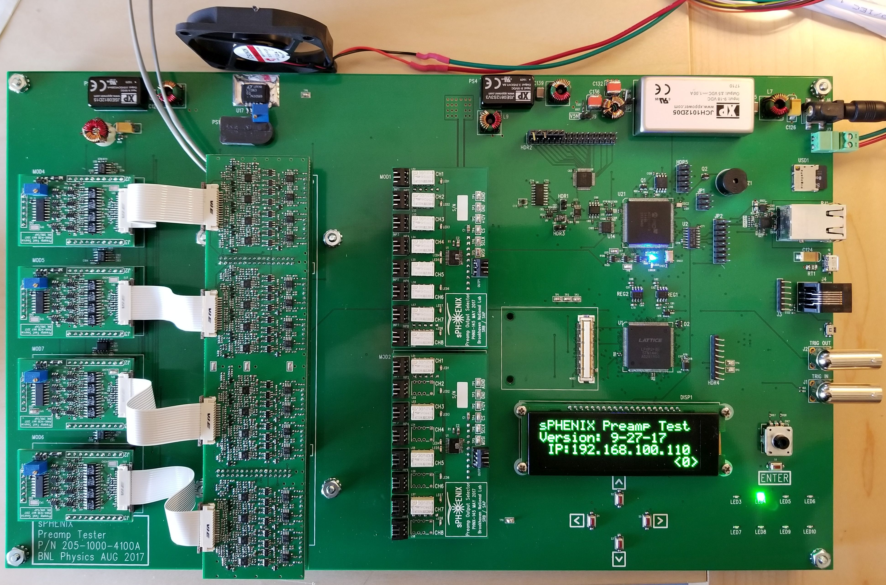
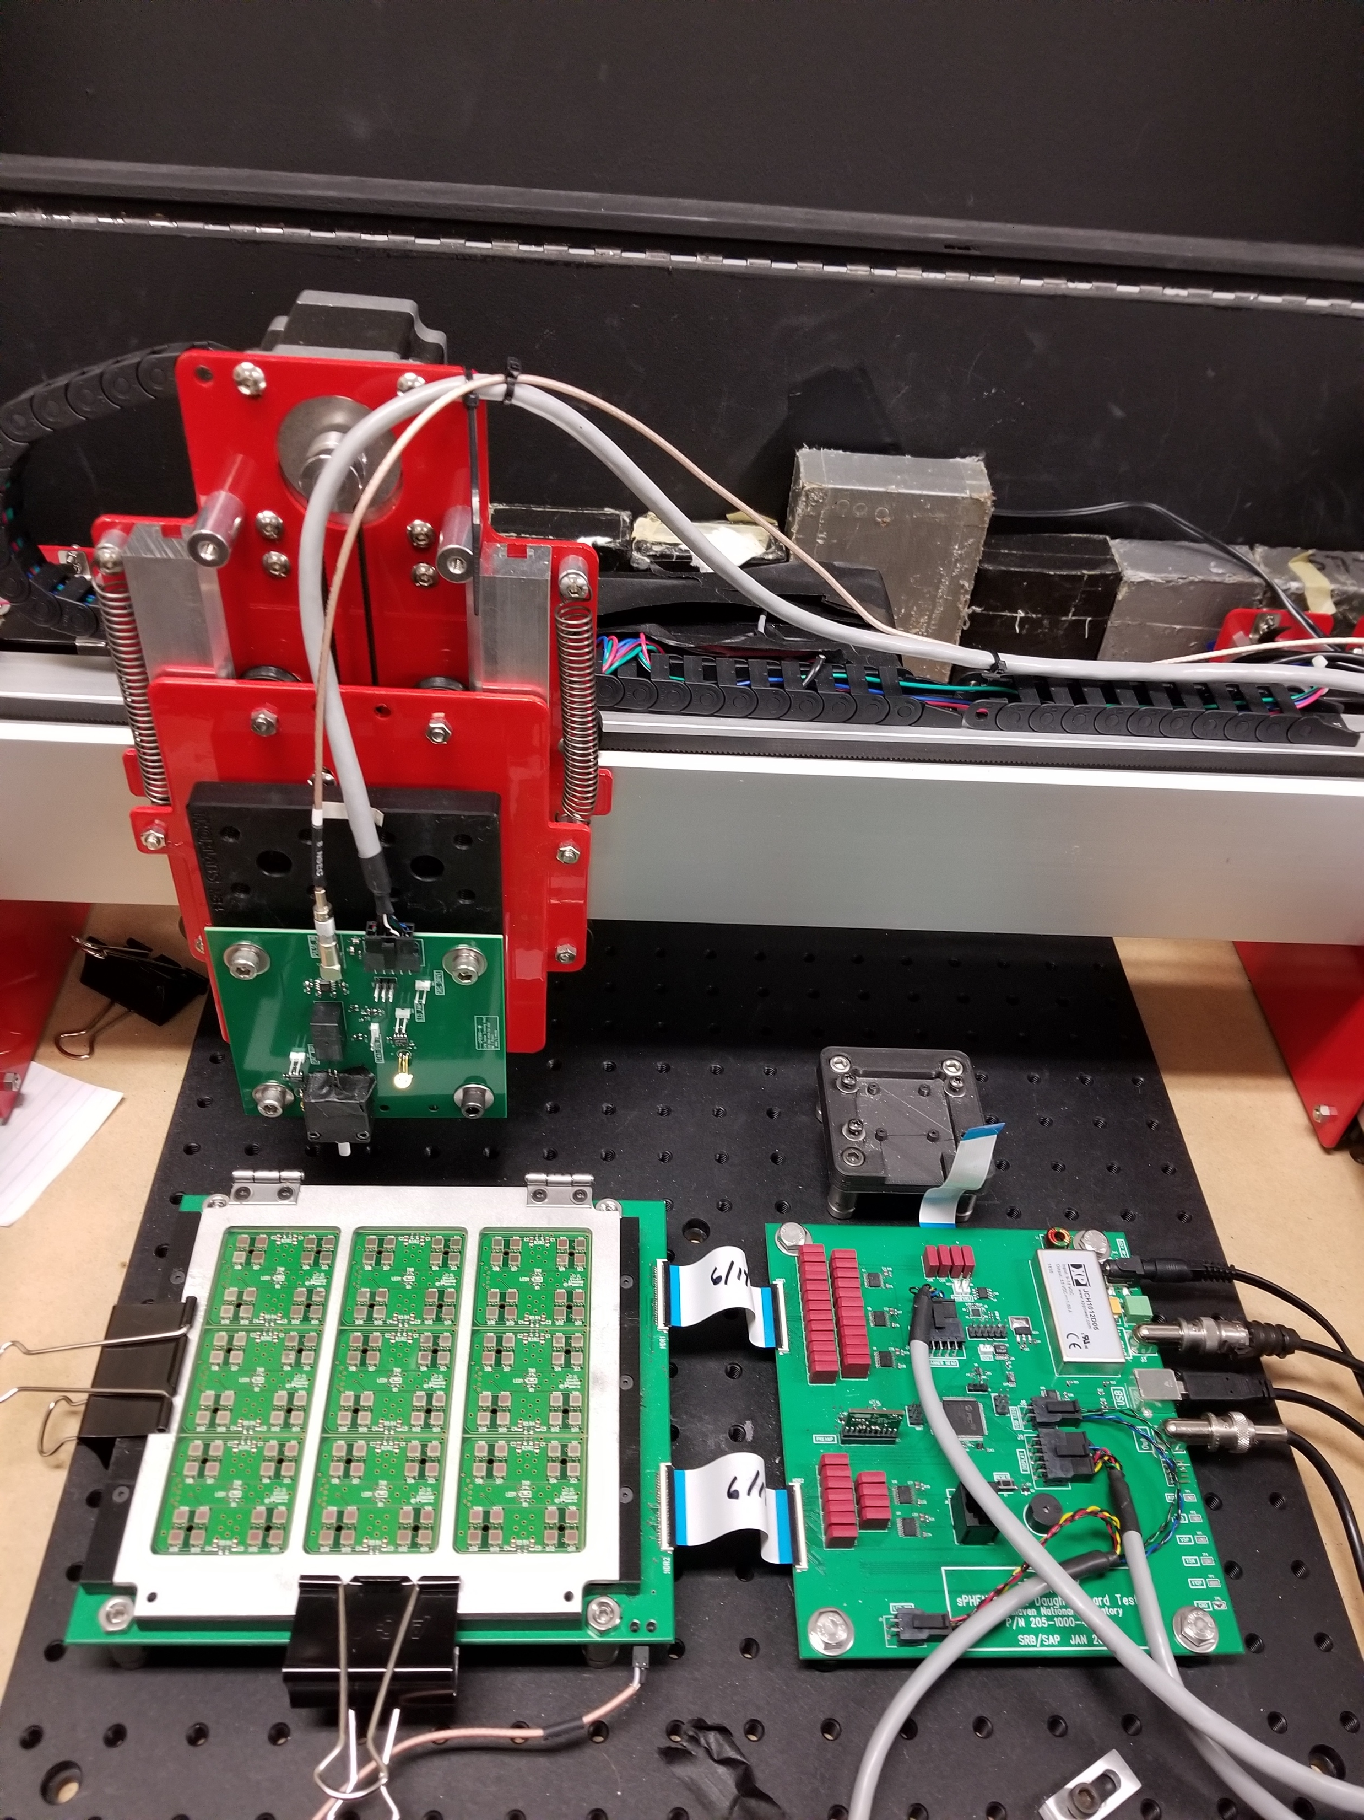
Calorimeter Electronics
Tested before installation, then tested during construction of EMCAL, HCAL
Burn-in electronics as long as feasible to weed out infant mortality

Slide 6
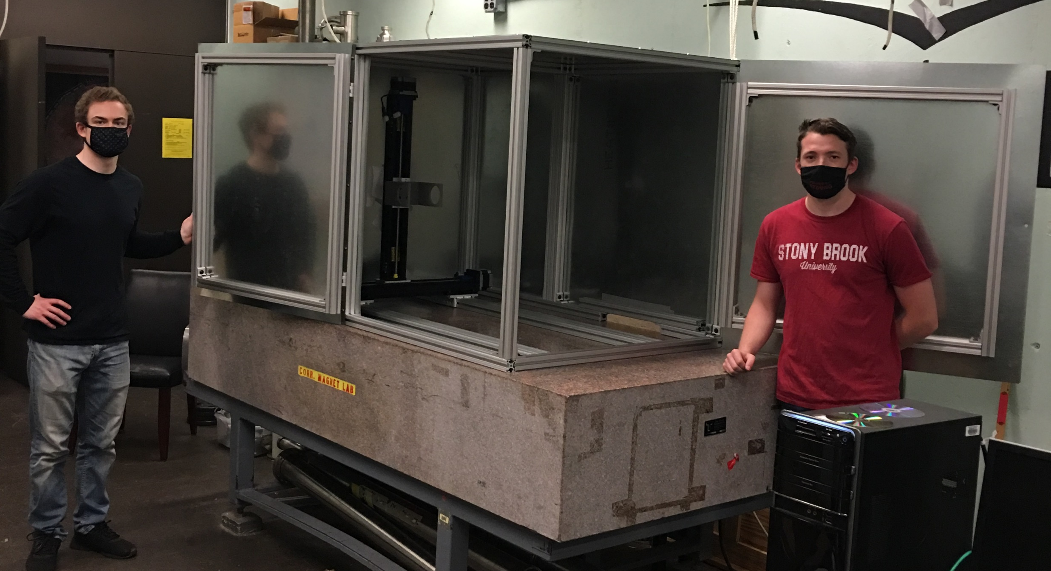
TPC module and FEE testing
X-ray test stand to characterize completed modules
  2-D stage on a track gives 3D control over x-ray gun
  Can check module gain as a function of position, stability, leaks, etc.
Module consists of 4-GEMs, a pad plane, and strongback
Test chambers assembled, DAQ setup in progress
Testing of modules at SBU
  Few hour X-rath bath
  Same as ALICE
FEE testing at BNL
SAMPA5 pedestals (1 board)
Granite flat table

Slide 7
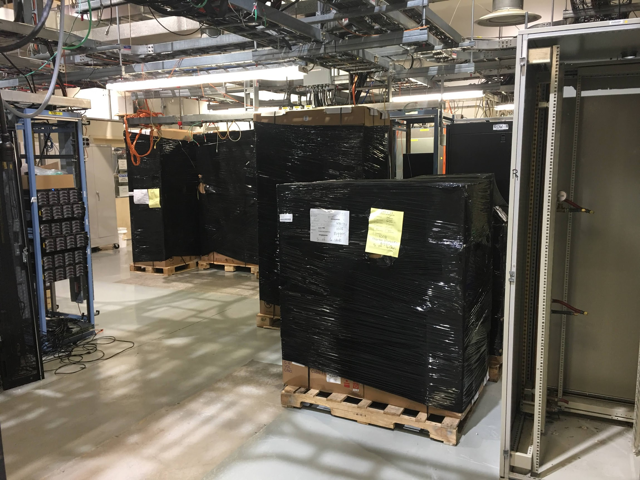
DAQ and online computing
Production computing and networking has been arriving in 1008 and is being configured
Timing and trigger system based on PHENIX concepts is completing development and testing
  Test of synchronization of GL1/GTM and ADC’s

Slide 8
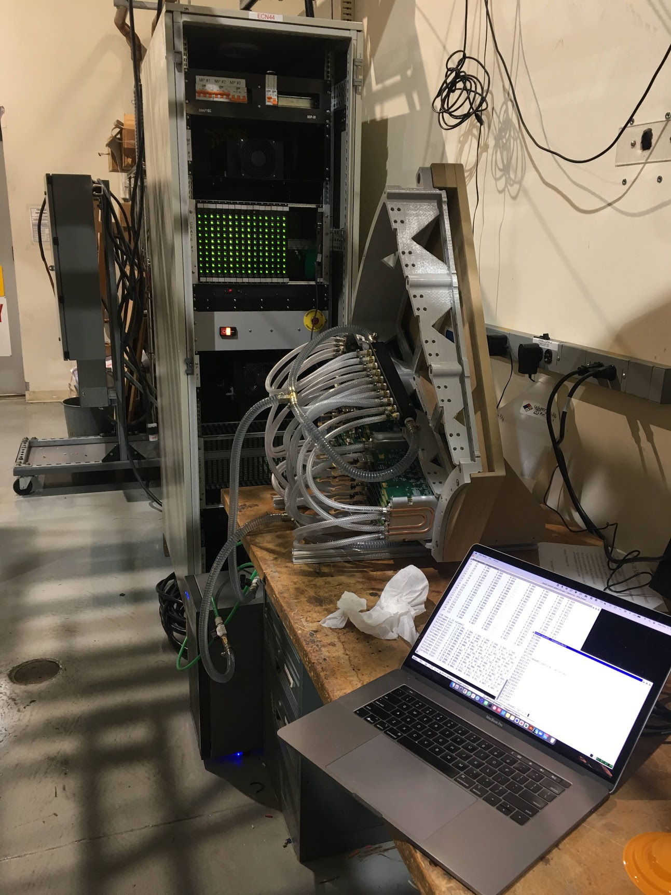
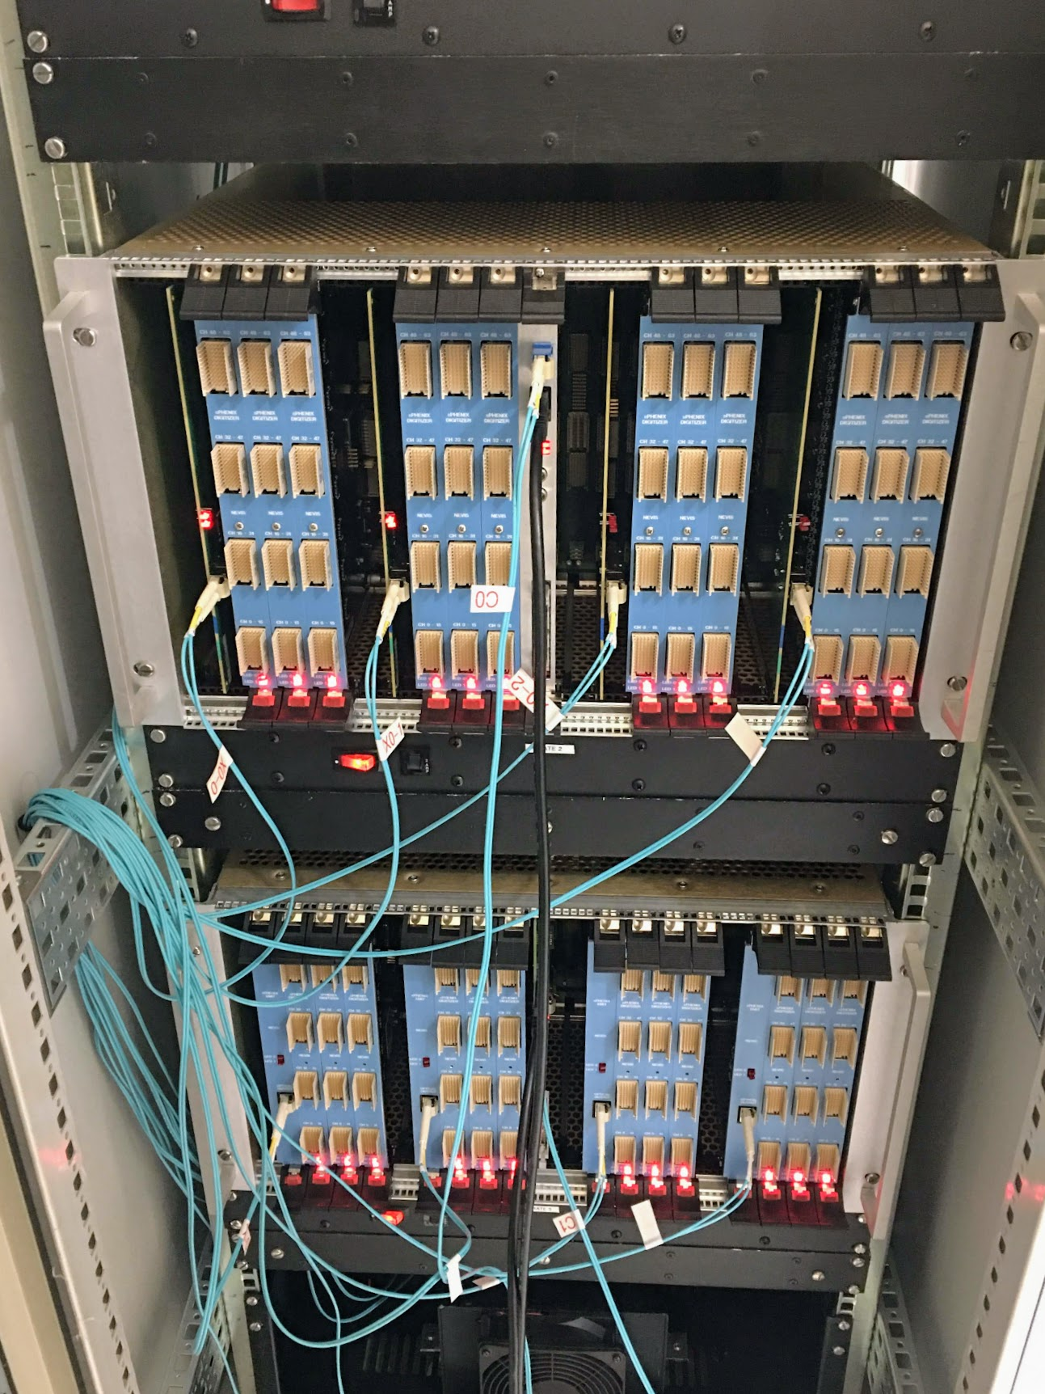
Slice and Chain Tests
1536 channels of waveform digitizer
1/16 EMCAL, or 1 HCAL
1/24 TPC (6656 channels)

Slide 9
Commisioning Task Force
The collaboration formed a Commissioning Task Force which began business in May, 2021
The 2020 and 2021 Beam Use Proposals sketched a scenario for beginning operations with beam

Slide 10
Commissioning stages and components
Commissioning stages
Commissioning components
Pre-installation commissioning and testing
Installation commissioning
Post-installation commissioning
Magnet commissioning
DAQ and Electronics Commissioning and Installation
Full detector commissioning (essentially DAQ and computing commissioning)
Trigger commissioning
Cosmic ray running
Beam operation
TPC
EMCAL
OHCAL
IHCAL
MBD
Computing
Trigger/Timing
DAQ
Control and Monitoring (AC/LV/HV/safety)
Magnet and cryo
Non-MIE
  INTT
  MVTX

Slide 11
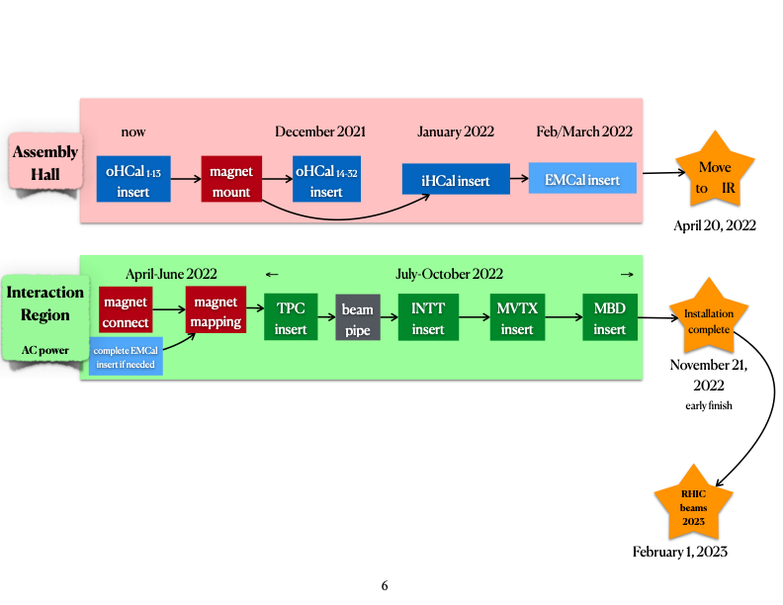
Overview of commissioning

Slide 12
Slice and chain tests
Single FEE tests
  1 TPC FEE + 1 FELIX + GL1GTM NIM-to-optical
  1 XMIT group + 1 DCM/JSEB + GL1GTM NIM-to-optical
  Test multievent buffering as GL1GTM firmware available; random triggers; data integrity
  Performance measurements (livetime vs rate)
Develop and implement zero suppression for CAL and TPC
  Desirable to have zero suppressed formats early in order to work with data as we plan to take it
Development of data logger (sPHENIX Data Logger)
  100% software development (up to a point)
  Performance measurement—requires network switch + high performance Buffer Box
  Log data from Single FEE tests via network to data logger
Joint TPC/CAL test
  1 TPC FEE + 1 XMIT group + GL1GTM + SDL
  Test of trigger synchronization with dissimilar systems
Two FEE tests
  2 TPC FEE + 1 FELIX + GL1GTM
  2 XMIT group + 1 DCM/JSEB + GL1GTM
  Tests of synchronization between FEE
  Standalone event recording followed by SDL
CAL Slice test
  A full rack of digitizers is 16 fibers == 2 DCM’s
  Start with a half-rack, take data with all 8 ports of DCM
    Measure livetime/rate for random triggers; assess data integrity
  Expand to full rack, 2 DCM groups, 2 JEB machines
  Connect to SDL
  By this time, it should be possible to use sPHENIX grade zero suppression
TPC Slice Test
  A full sector of TPC FEE (26)
  Test with 1 FELIX to start, then break down into 2
  SDL
CAL + TPC Slice Test
  Combine the above tests with SDL
  At this point, the DAQ could be said to be “working”
  Measure performance for random triggers
  Milestone Review
  Note that this step must be complete by April 2022 in order to support the installation schedule

Slide 14
ES&H
Organized a full suite of reviews of all aspects of the detector with the C-AD Experimental Safety Review Committee (ESRC) so that all safety aspects of the detector will have been reviewed by the end of 2021
Mar 4, 2021, 10:00 AM | Dry-Run of ESRC Review of sPHENIX cradle/carriage/OHCAL/solenoid installation
Mar 15, 2021, 10:00 AM | ESRC Review of sPHENIX cradle/carriage/OHCAL/solenoid installation
Apr 12, 2021, 10:00 AM | Dry-Run of ESRC Review of sPHENIX Safety Systems and Electrical Power Distribution
Apr 19, 2021, 10:00 AM | ESRC Review of sPHENIX Safety Systems and Electrical Power Distribution
May 3, 2021, 10:00 AM | Dry-Run of ESRC Review of sPHENIX Solenoid
May 17, 2021, 10:00 AM | ESRC Review of sPHENIX Solenoid
Jun 7, 2021, 10:00 AM | Dry-Run of ESRC Review of sPHENIX TPC
Jun 21, 2021, 10:00 AM | ESRC Review of sPHENIX TPC
Jul 12, 2021, 10:00 AM | Dry-Run of ESRC Review of sPHENIX Calorrimeters
Jul 26, 2021, 10:00 AM | ESRC Review of sPHENIX Calorimeters
Sep 13, 2021, 10:00 AM | Dry-Run of ESRC Review of sPHENIX Inner Detector Installation
Sep 27, 2021, 10:00 AM | ESRC Review of sPHENIX Inner Detector Installation
Oct 4, 2021, 10:00 AM | Dry-Run of ESRC Review of sPHENIX Minimum Bias Detector and Beam Pipe
Oct 18, 2021, 10:00 AM | ESRC Review of sPHENIX Minimum Bias Detector and Beam Pipe
Nov 1, 2021, 10:00 AM | Dry-Run of ESRC Review of sPHENIX MVTX and INTT
Nov 15, 2021, 10:00 AM | ESRC Review of sPHENIX MVTX and INTT

Slide 15
Issues and concerns
We are approaching the part of the project which necessitates a large on-site contingent of faculty members, postdocs, and students
  Their ability to work at BNL is critical to the success of sPHENIX

Slide 16
Charge question #1
Project scope: Is the project executing its technical baseline in a manner to deliver the science? Is the fabrication progress appropriate for this stage of the project? Are all interfaces properly understood?
The baseline detectors are being tested in as realistic a fashion as we can devise
Fabrication of all components is very far along, some have begun installation or storage in preparation for installation.

Slide 17
Charge question #5
Preparation for installation: Is the hand off to installation properly planned? Are the tests of equipment and interfaces properly understood?
The collaboration has formed a Commissioning Task Force with full participation from the project.
Testing of all components of the detectors has been baked into the schedule from the beginning.

Slide 18
Summary
Detector components are far along their fabrication trajectory
Detectors and electronics are tested at multiple points in the construction, and burned in for as long as practical
A Commissioning Task Force has been set up as a joint project/collaboration effort to plan the startup
  Bi-weekly meetings since May

Slide 19
Back Up

Slide 20
Beam operation (BUP 2020/2021)
It’s good to start with a few 6 bunch stores, then transition to low intensity 110 bunch stores
Possible startup plan:
  6 bunch, zero crossing angle, 5 stores
  110 bunch, zero crossing angle, 5 stores
  6 bunch, 2 mr crossing angle, 5 stores
  110 bunch, 2 mr crossing angle 1 kHz/5 kHz/10 kHz/15 kHz 20 stores
Timing of MBD
  MBD-only data-taking
Trigger development with beam
  If we start with A+A, calorimeter trigger development could be parasitic
It may be possible to have detectors timed together so that detectors are all “close” in time at turn-on
At the end of this 11.5 week commissioning plan, the detector should be ready to take data from all detectors

