Slide 1
Jet/HF/EW/BSM
Weekly meetings: Tuesday’s starting at 13:30 EDT
Indico: https://indico.bnl.gov/category/367
Mailing list: https://lists.bnl.gov/mailman/listinfo/eic-ip6-phys-jet-hq-l
Miguel Arratia – Miguel.Arratia@ucr.edu
Brian Page – bpage@bnl.gov
Stephen Sekula – ssekula@smu.edu
Ernst Sichtermann – EPSichtermann@lbl.gov
ATHENA Conveners Meeting, June 4th 2021

Slide 2
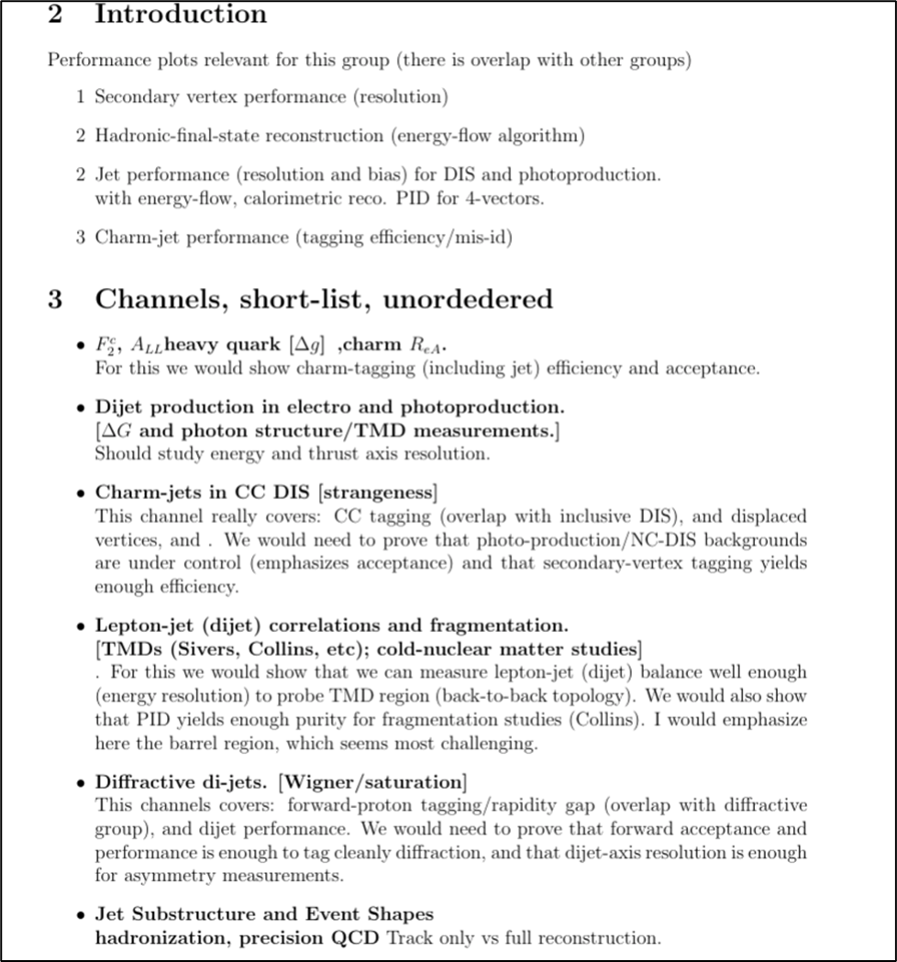
Golden Physics Channels
Golden Channel = Important results that we need to demonstrate that we can measure well
We have identified several golden channels – obviously not all of these can make it into proposal plots, but we need to prove we can do them and describe any issues in the proposal text
None of these have been studied yet with full ATHENA simulation – some YR examples

Slide 3
Golden Physics Channels
Golden Channel = Important results that we need to demonstrate that we can measure well
We have identified several golden channels – obviously not all of these can make it into proposal plots, but we need to prove we can do them and describe any issues in the proposal text
None of these have been studied yet with full ATHENA simulation – some YR examples

Slide 4
Golden Physics Channels
Golden Channel = Important results that we need to demonstrate that we can measure well
We have identified several golden channels – obviously not all of these can make it into proposal plots, but we need to prove we can do them and describe any issues in the proposal text
None of these have been studied yet with full ATHENA simulation – some YR examples

Slide 5
Golden Physics Channels
Golden Channel = Important results that we need to demonstrate that we can measure well
We have identified several golden channels – obviously not all of these can make it into proposal plots, but we need to prove we can do them and describe any issues in the proposal text
None of these have been studied yet with full ATHENA simulation – some YR examples

Slide 6
Golden Physics Channels
Golden Channel = Important results that we need to demonstrate that we can measure well
We have identified several golden channels – obviously not all of these can make it into proposal plots, but we need to prove we can do them and describe any issues in the proposal text
None of these have been studied yet with full ATHENA simulation – some YR examples

Slide 7
Golden Physics Channels
Golden Channel = Important results that we need to demonstrate that we can measure well
We have identified several golden channels – obviously not all of these can make it into proposal plots, but we need to prove we can do them and describe any issues in the proposal text
None of these have been studied yet with full ATHENA simulation – some YR examples

Slide 8
‘Low-Level Plots’ – What We Really Need to Show?
Plots showing performance of golden channels

