Slide 1
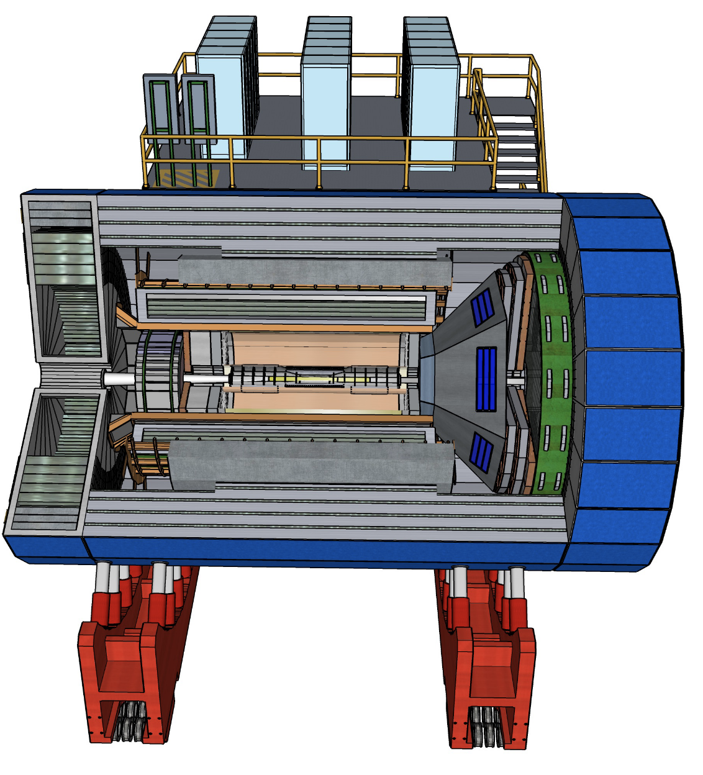
ECCE Updated Detector Concept

Slide 2
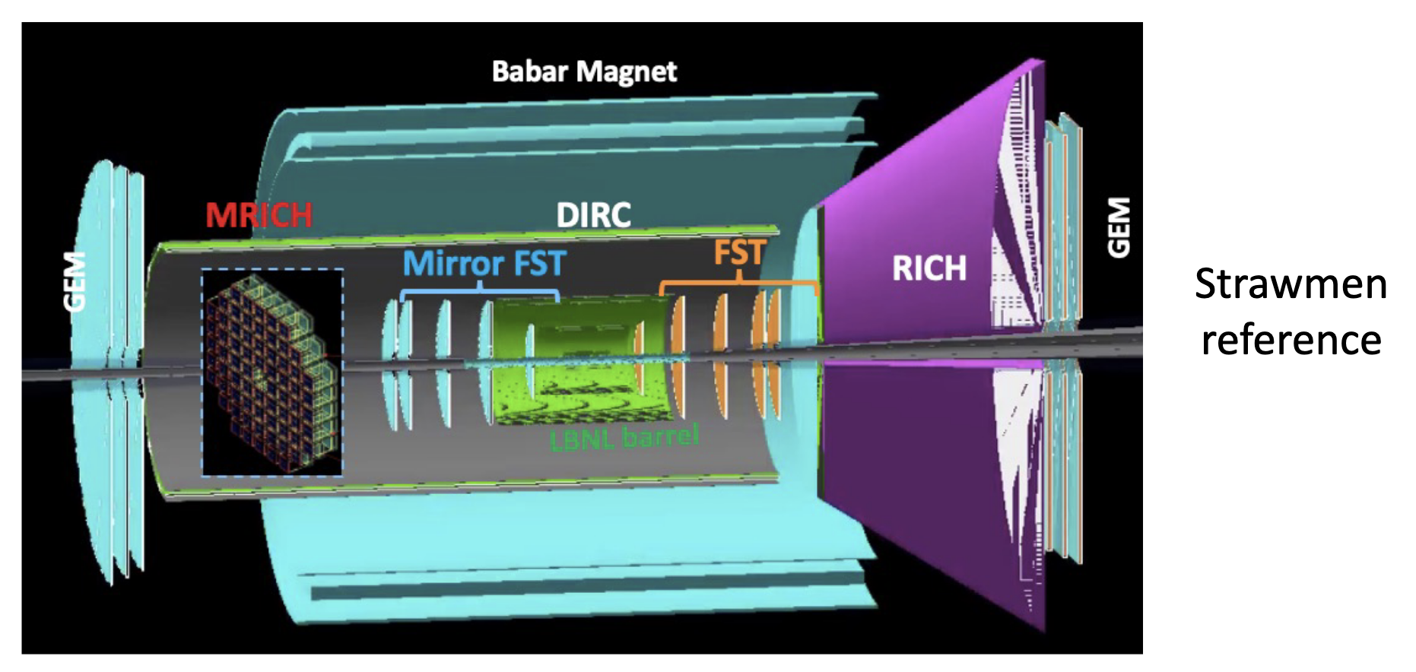
ECCE Tracking
https://indico.bnl.gov/event/12079/contributions/50495/attachments/35148/57178/ECCE_DWG_20210610_v1.pdf
Monolithic Active Pixel Sensor (MAPS) for Vertexing and Electron & Hadron Endcaps
Following the LBNL Layout (implemented in fun4all)
Additional Studies On-going
Outer Layer AC-LGAD (position & TOF)
Large area uRWELL (instead of GEMs) forward & back
Also agreed to add uRWELL around DIRC volume.

Slide 3
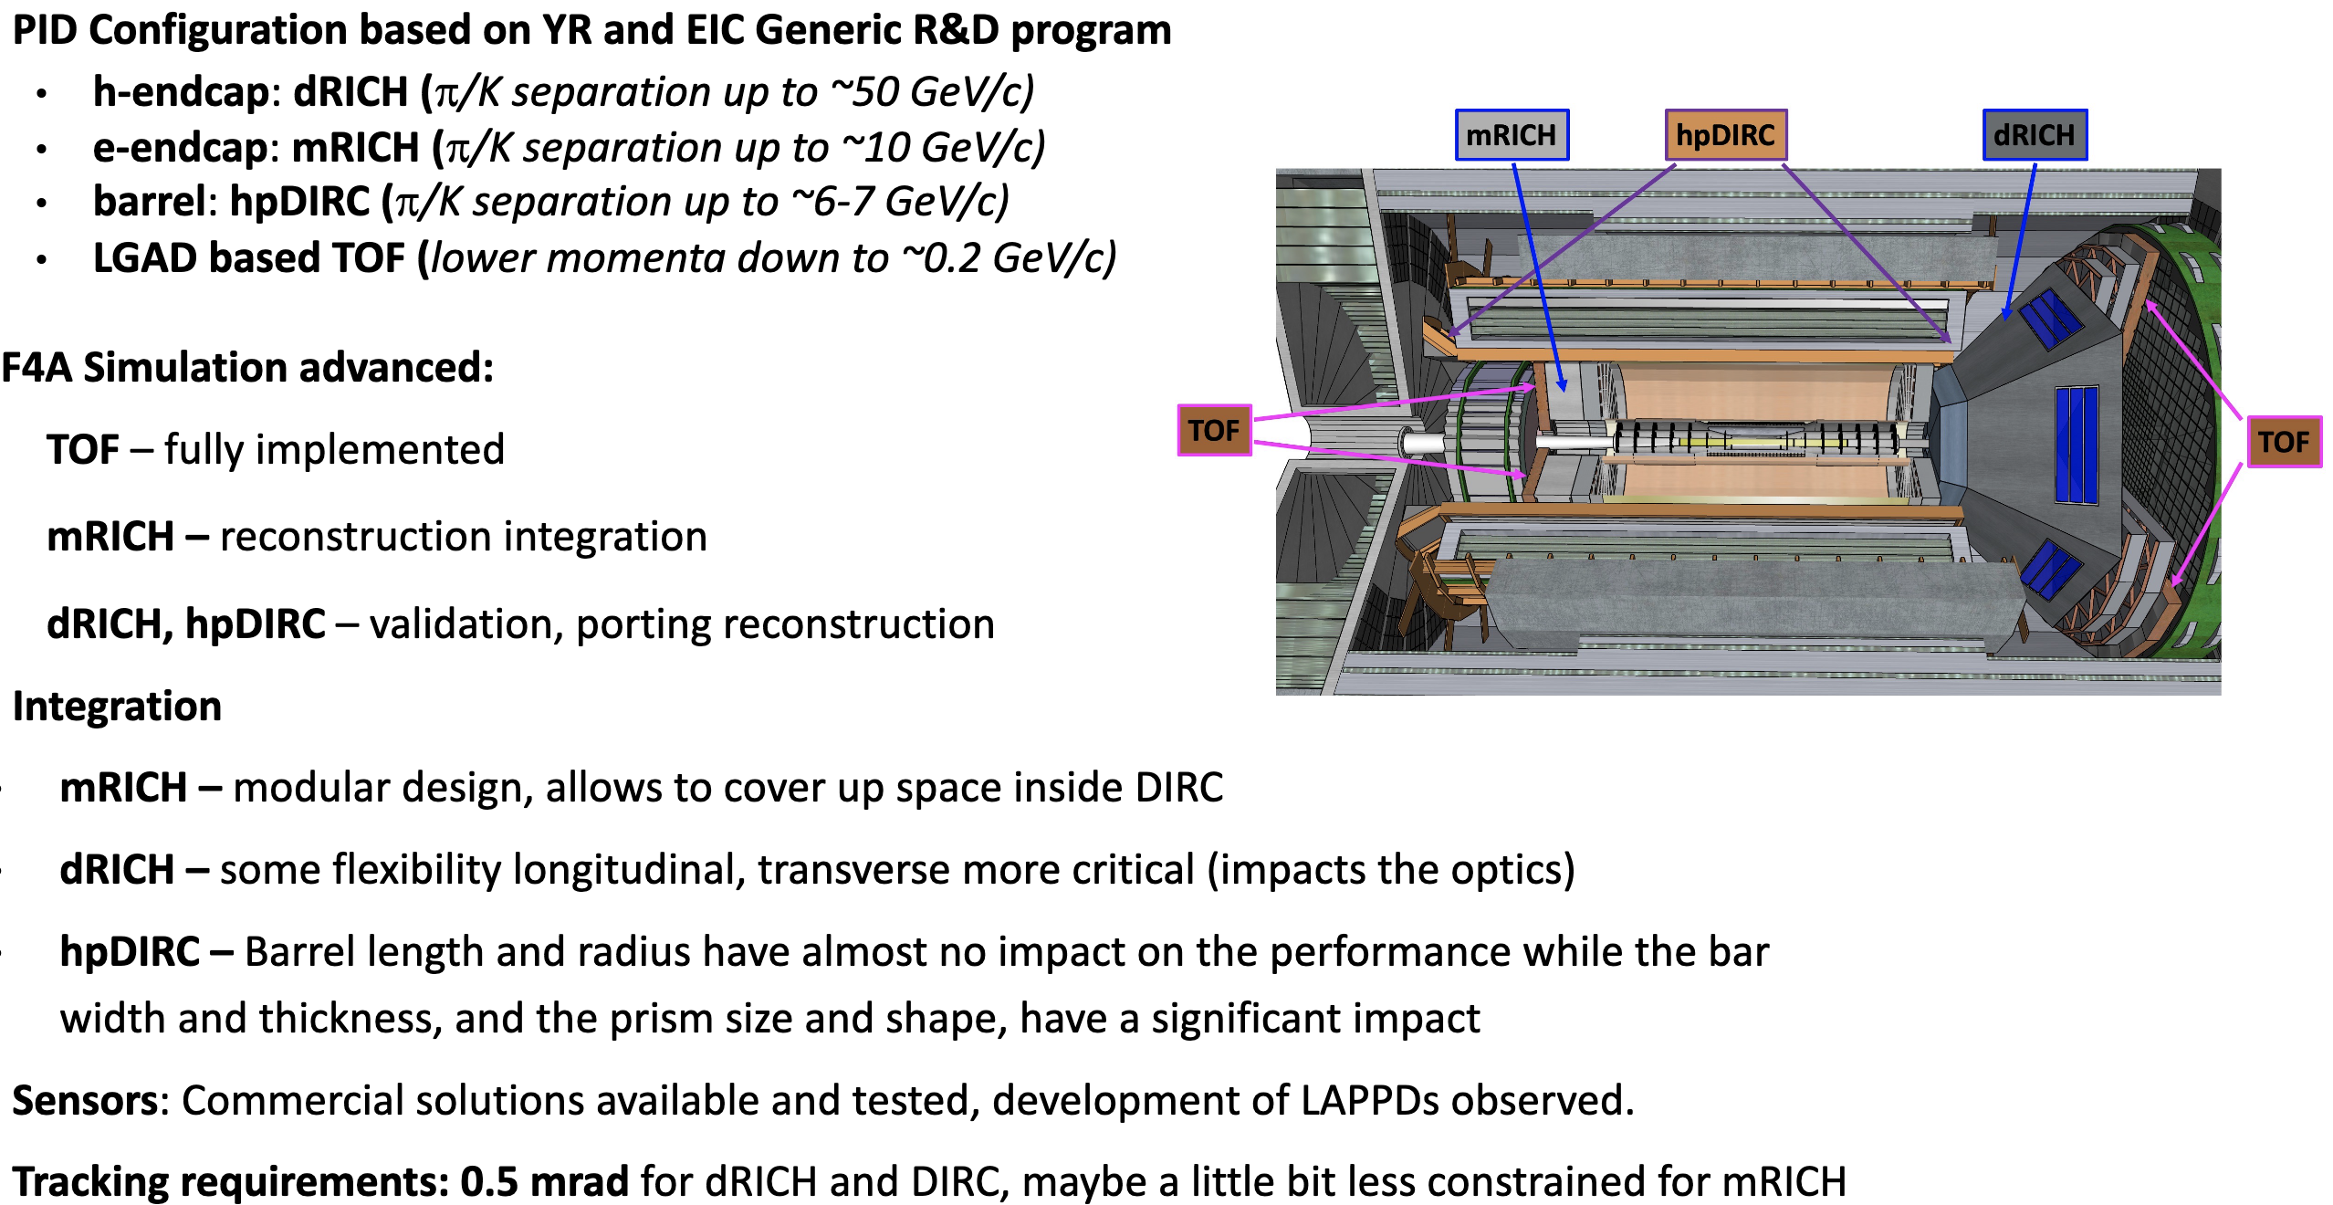
ECCE Particle Identification
https://indico.bnl.gov/event/12079/contributions/50496/attachments/35163/57268/20210609-PID%40ECCE-Greg.pdf

Slide 4
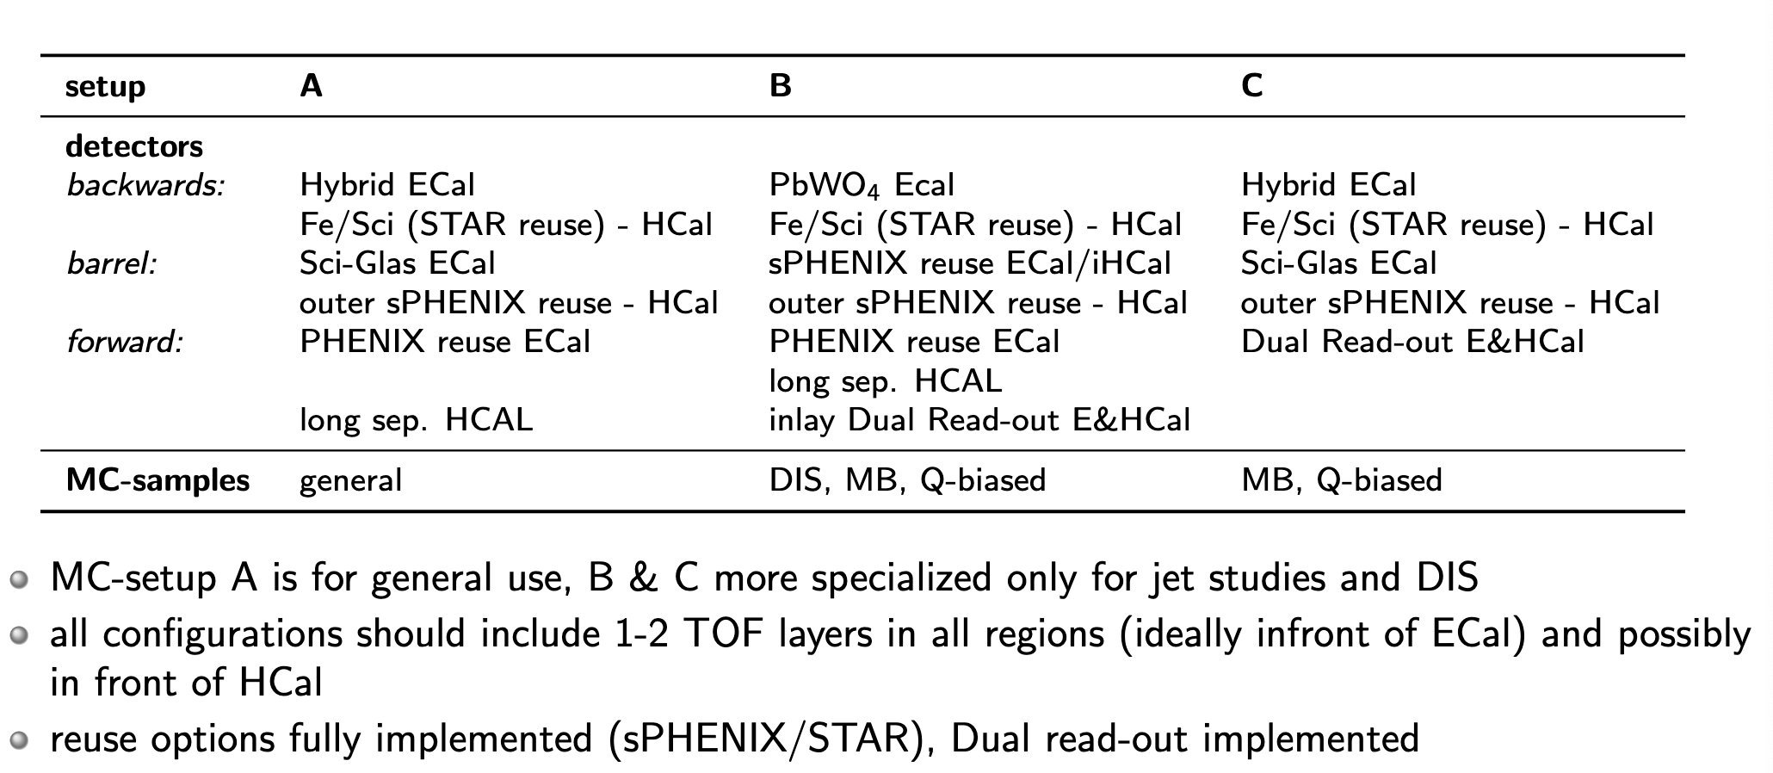
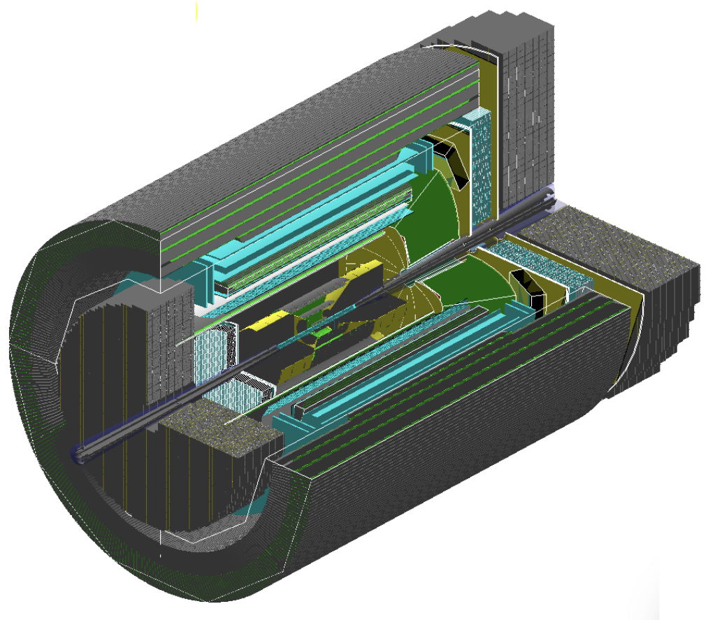
ECCE Calorimetry
https://indico.bnl.gov/event/12079/contributions/50497/attachments/35194/57260/ECCE_Ornl_DetectorMeeting-CaloInput.pdf

Slide 5
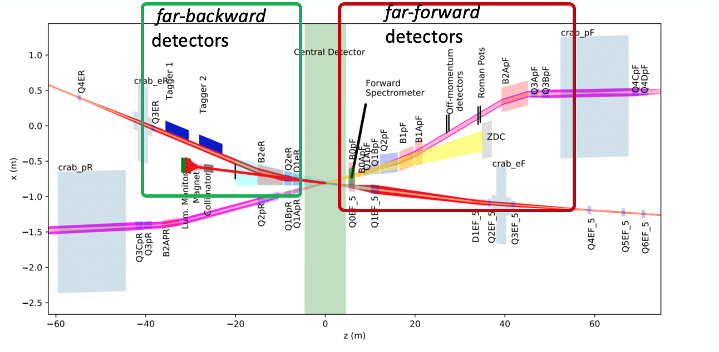
ECCE Detector – far forward/backward
https://indico.bnl.gov/event/12079/contributions/50499/attachments/35151/57170/FarForwardBackwardDetectors_10Jun2021.pdf
Currently we have a first implementation of ZDC and B0.
ZDC based on PbW04 and W/Si W/scintillator (Quan Wang, Shima Shimizu)
Currently EM section too deep but this is easy to modify
Also plan to add 1 timing layer
Working on photon/neutrons reconstruction.
For B0 PbW04 (Quan Wang)
For Roman Pots plan on copying TOTEM CMS-PPS
Off momentum detectors based on silicon planes
Just starting with low Q^2 tagger (Dhevan Gangadaren)
Ran into a problem with the far forward beamline in fun4all.

