Slide 1
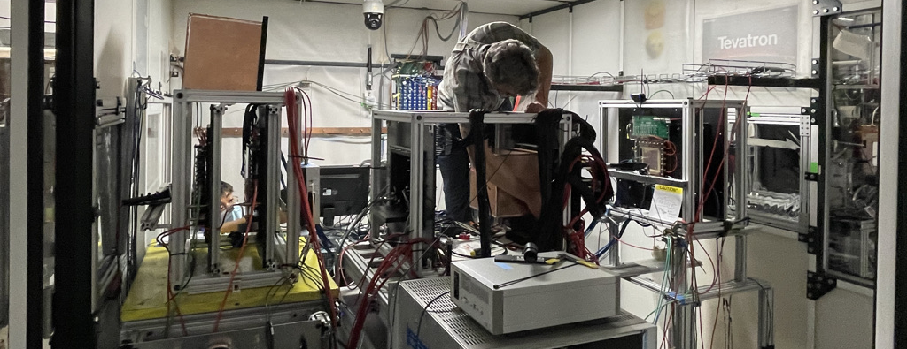
mRICH+LAPPD Test Fermilab from May 25 to June 16, 2021
Xiaochun He, GSU, for
Teams: BNL, ANL, Stony Brook, GSU, FAMU, Howard Univ, Texas Southern, Incom

Slide 2
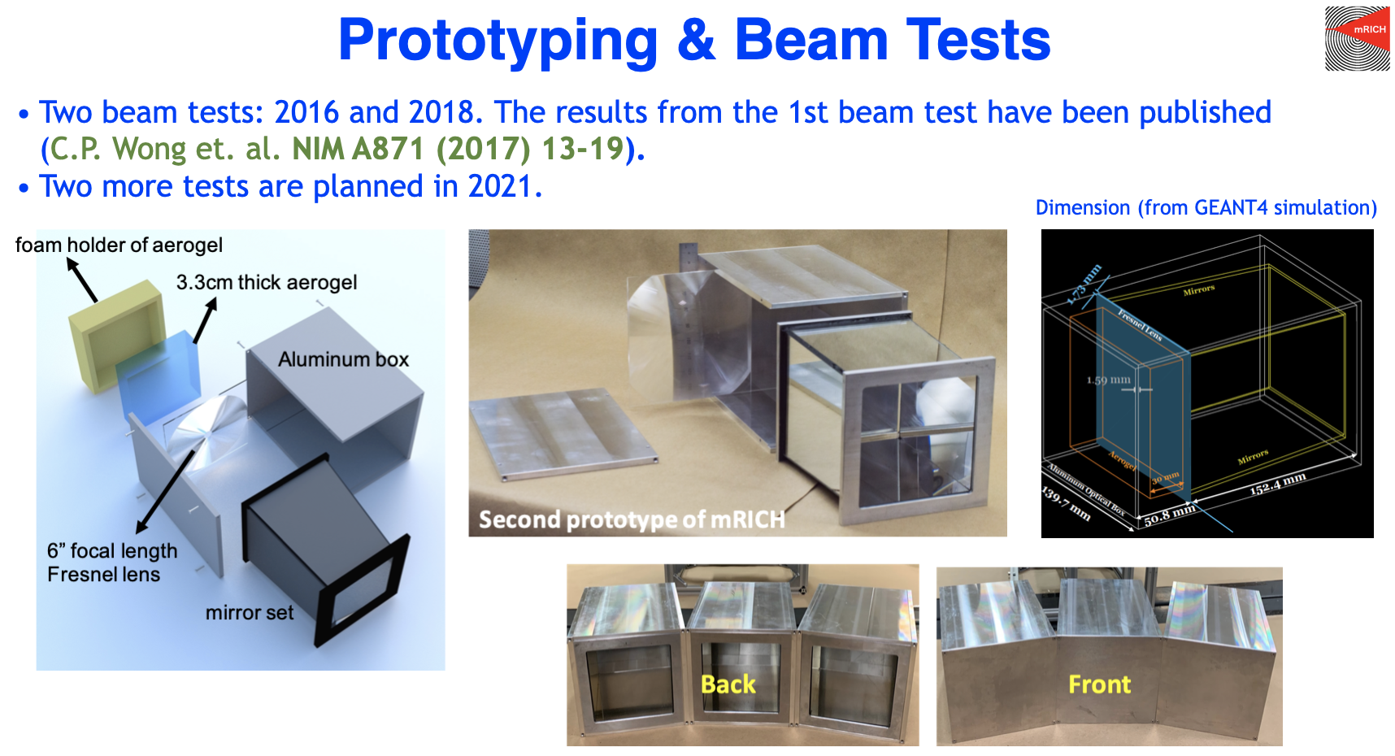

Slide 3
Led by Murad Sarsour

Slide 4
RICH-based PID detectors for EIC need single-photon capable photosensors with good position resolution and working in magnetic field

Slide 5
Goals
This is the third mRICH test at Fermilab
New photosensor test for mRICH -> LAPPD
Test and optimize the location of the photosensor plane for mRICH
First test of mRICH performance with tracking capability

Slide 6
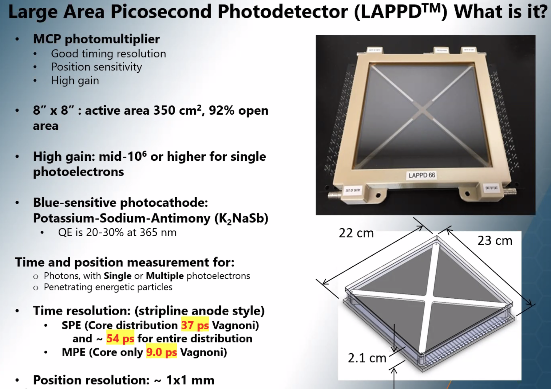
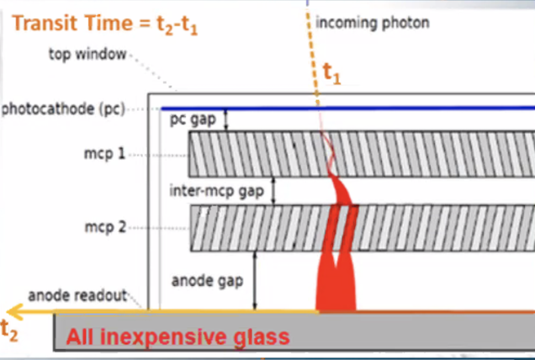
LAPPD – Large Area Picosecond Photodetector

Slide 7
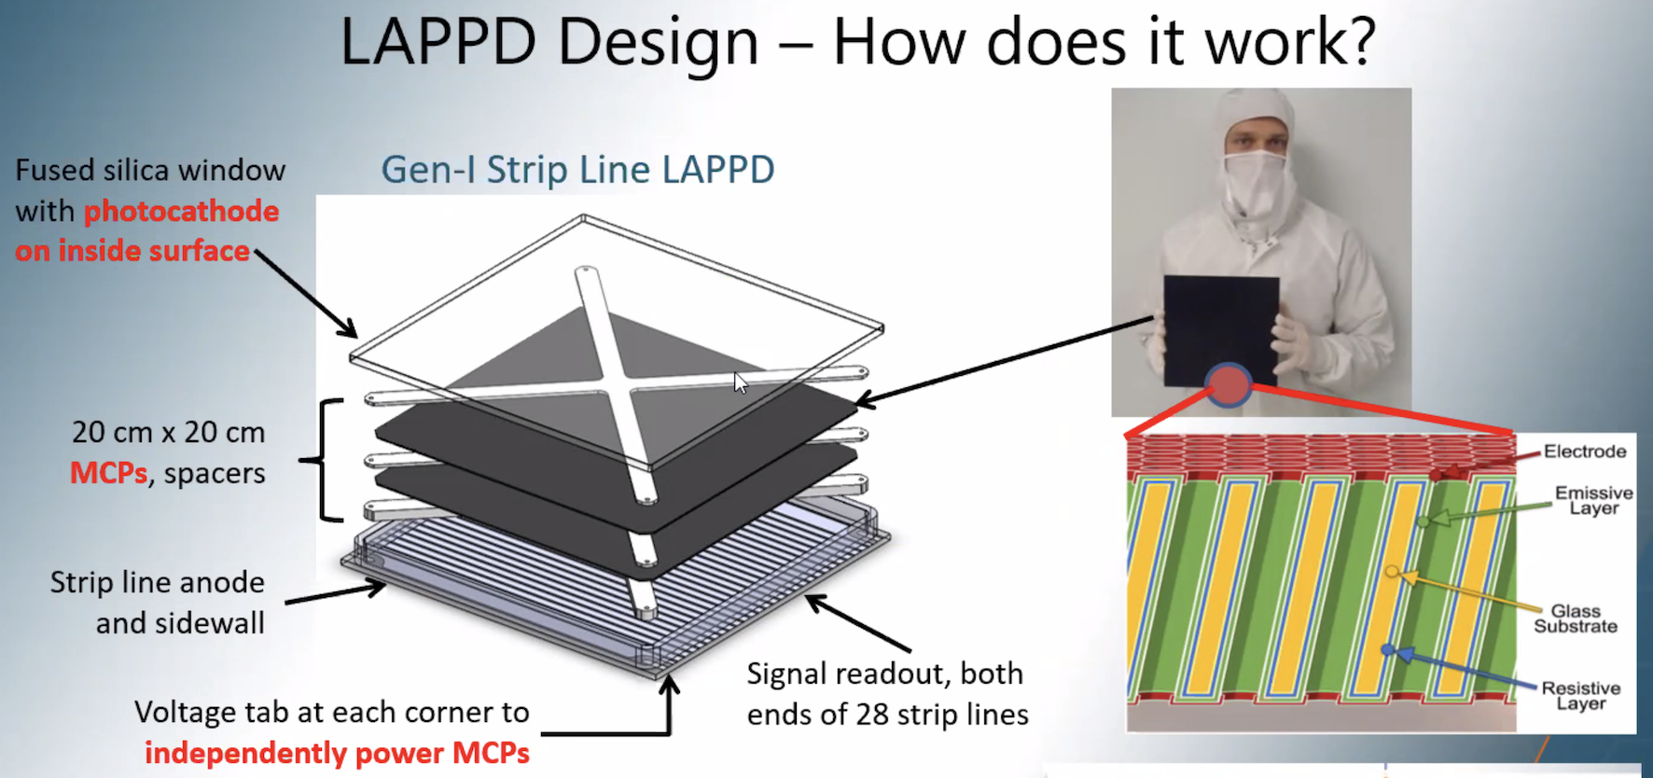

Slide 8
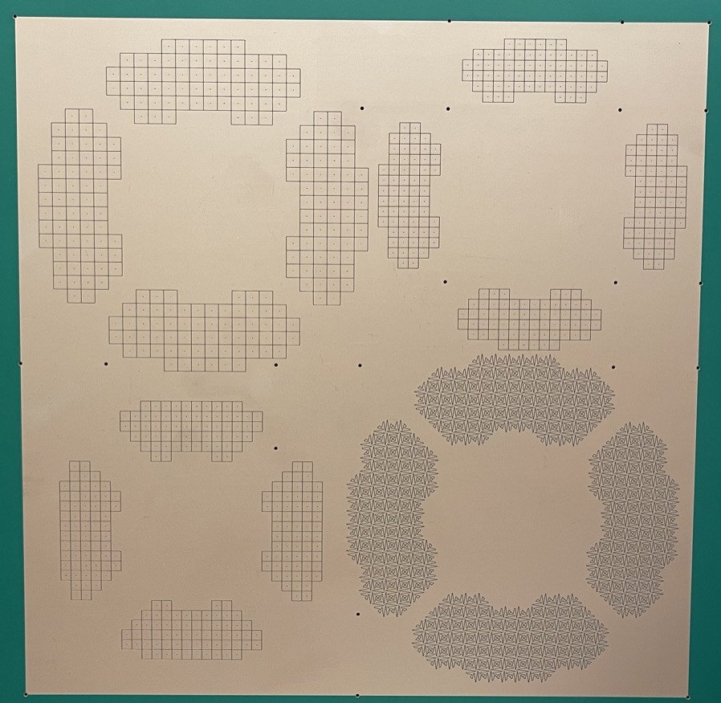
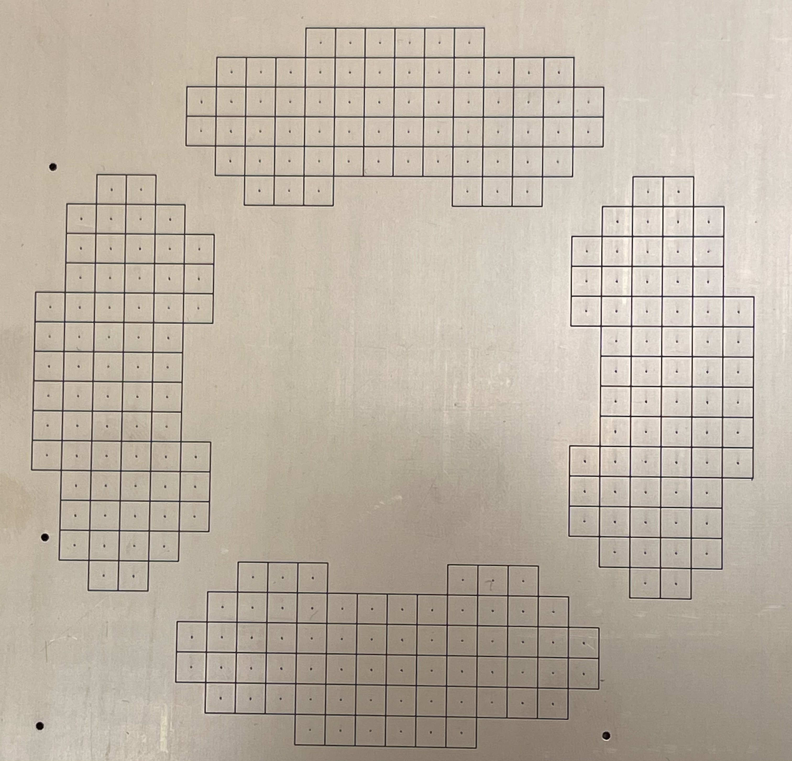
Pixelated Readout Design – Unique in This Test
3mm x 3mm pixel
4mm x 4mm pixel

Slide 9
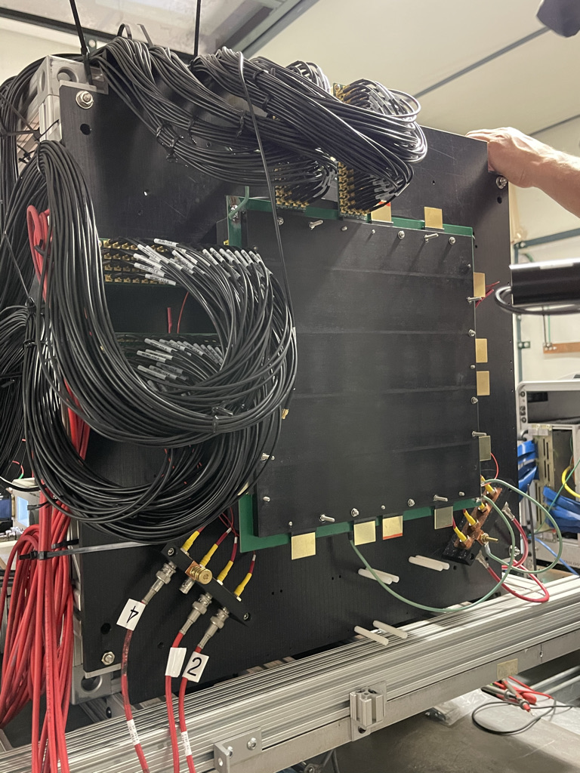
Pixelated Readout Design
Lots of cables
3mm x 3mm pixel

Slide 10
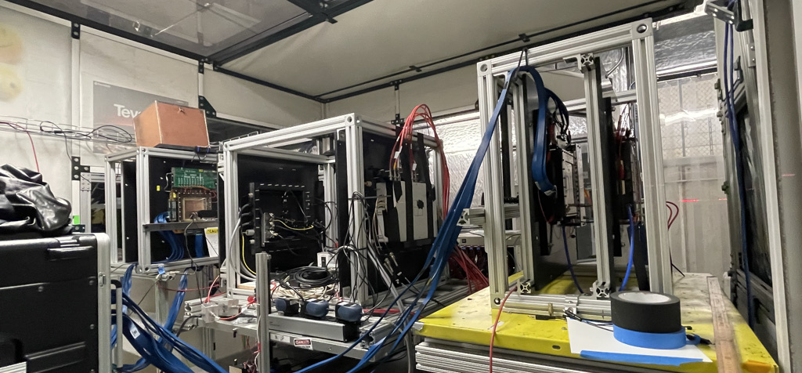
Back GEM tracker
LAPPD Setup
MCP-PMT
Front GEM tracker
The front GEM tracker will be sent to JLab for another test in late August

Slide 11
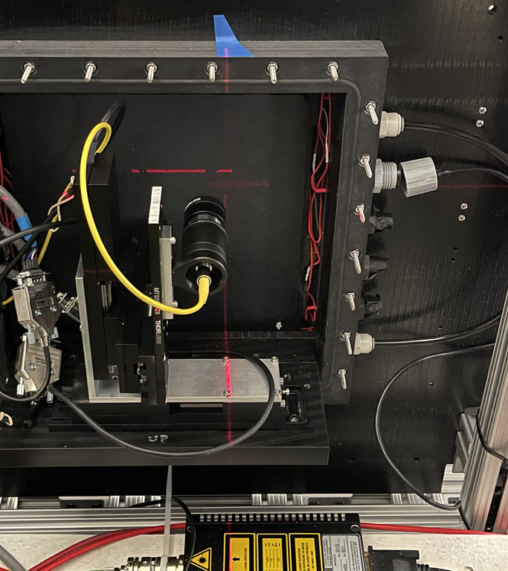
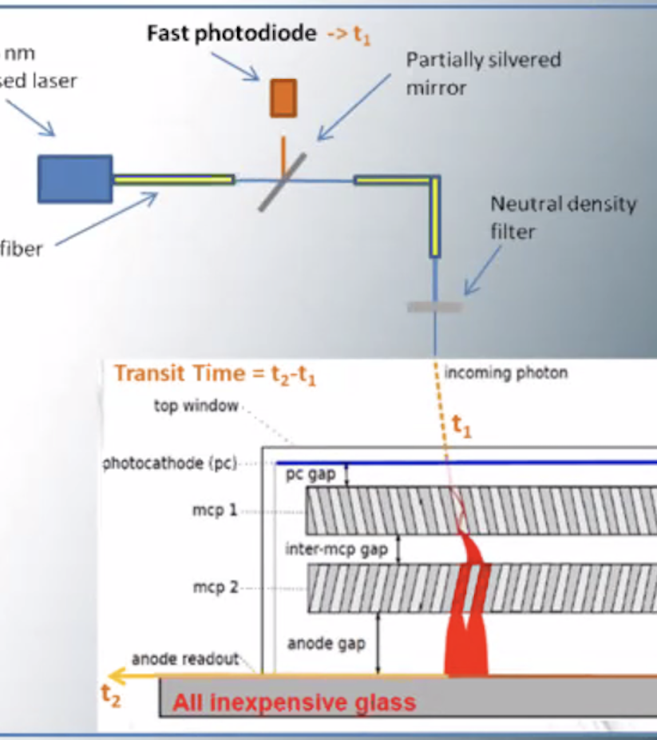
Laser Scan # Pixel response # Channel Map

Slide 12
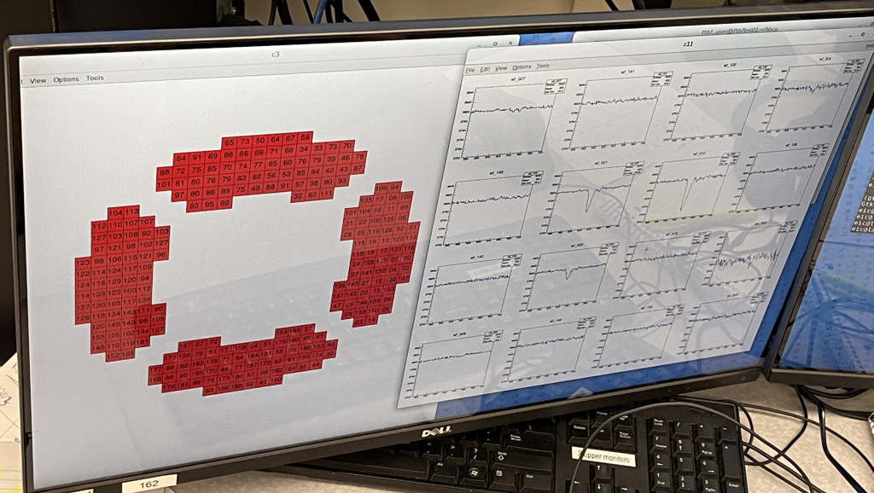
Signal waveform recorded by CAEN digitizer

Slide 13
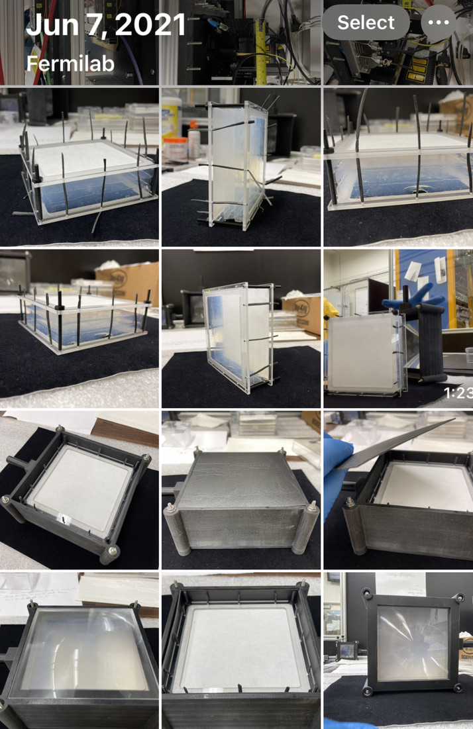
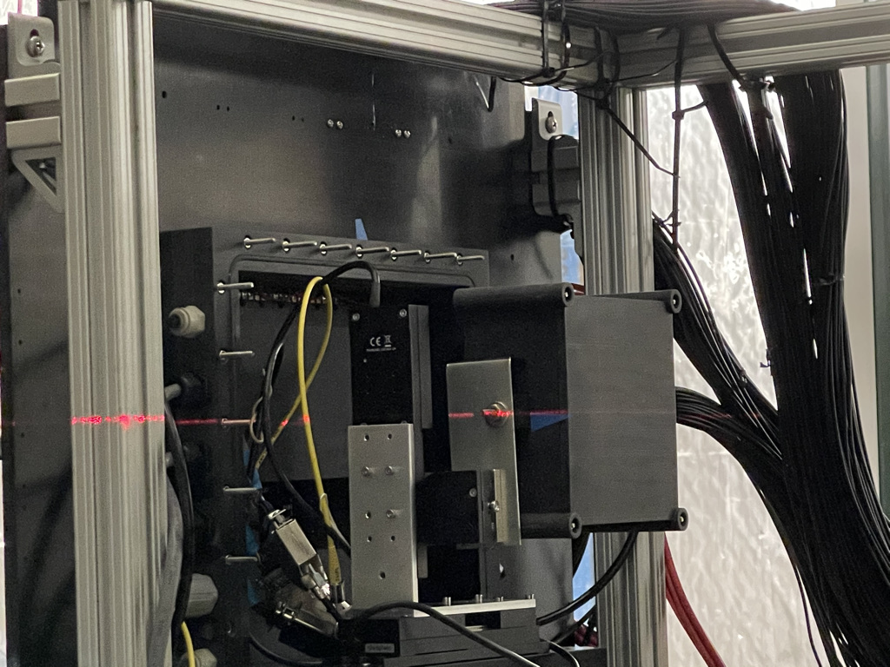
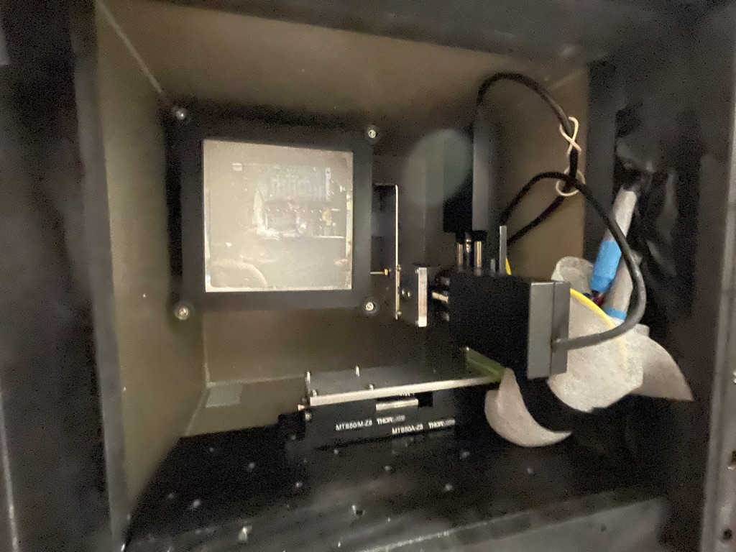
mRICH-like Test Setup
View from LAPPD side
Aerogel + lens holder assembly

Slide 14
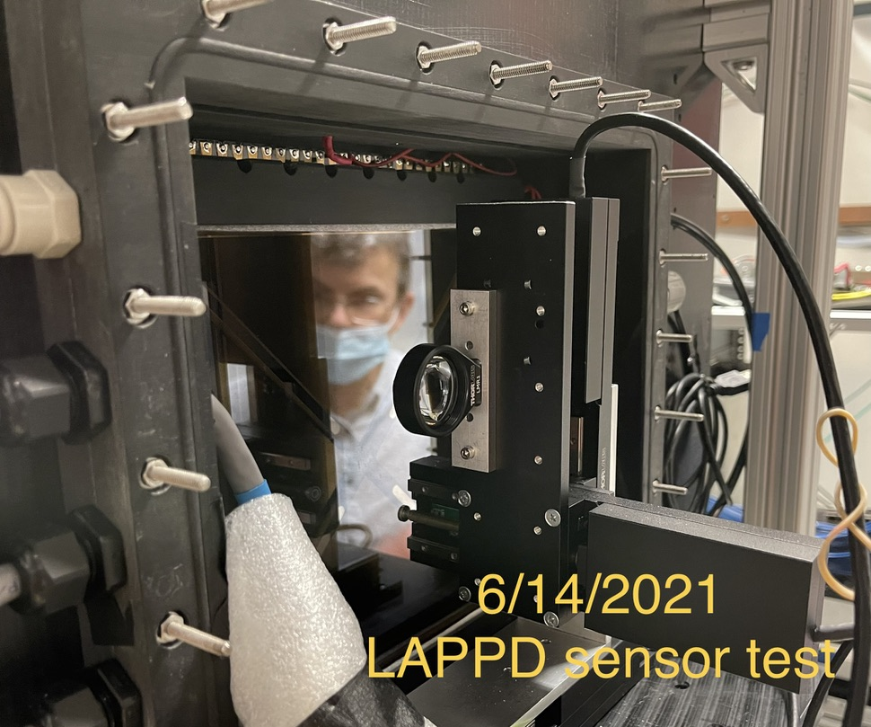
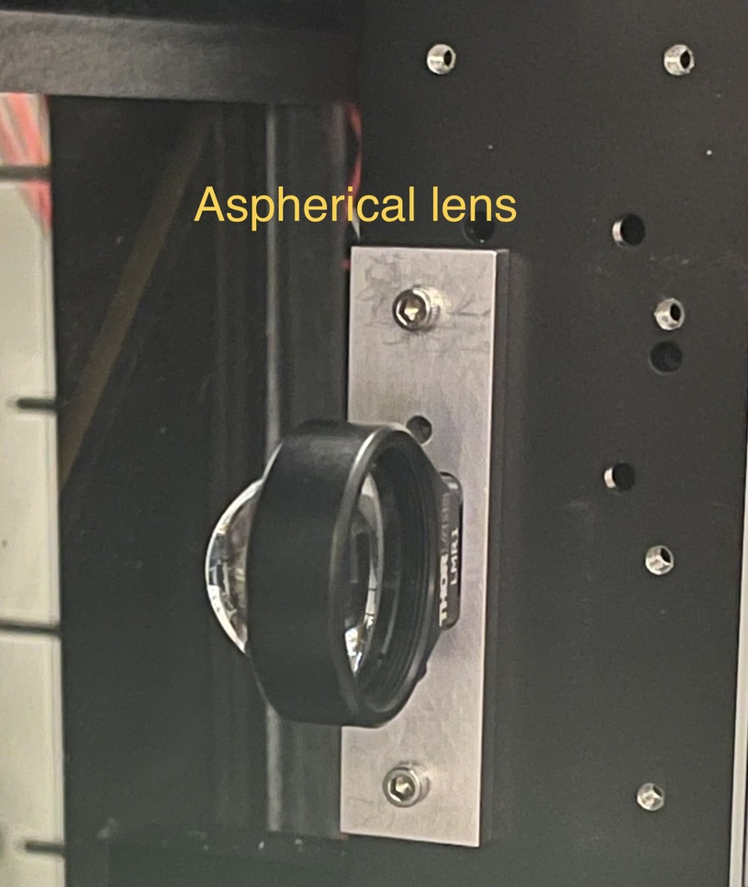
Another Single Photo Source – Aspherical Lens

Slide 15
Unique and Flexible Setup (not to scale)
LAPPD
beam
Cherenkov light from lens reflected from its back and reach to LAPPD

Slide 16
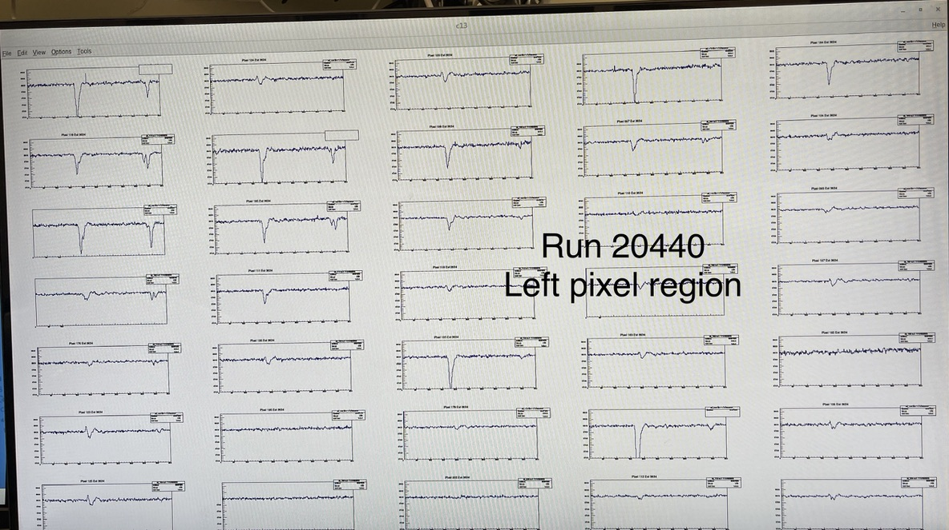
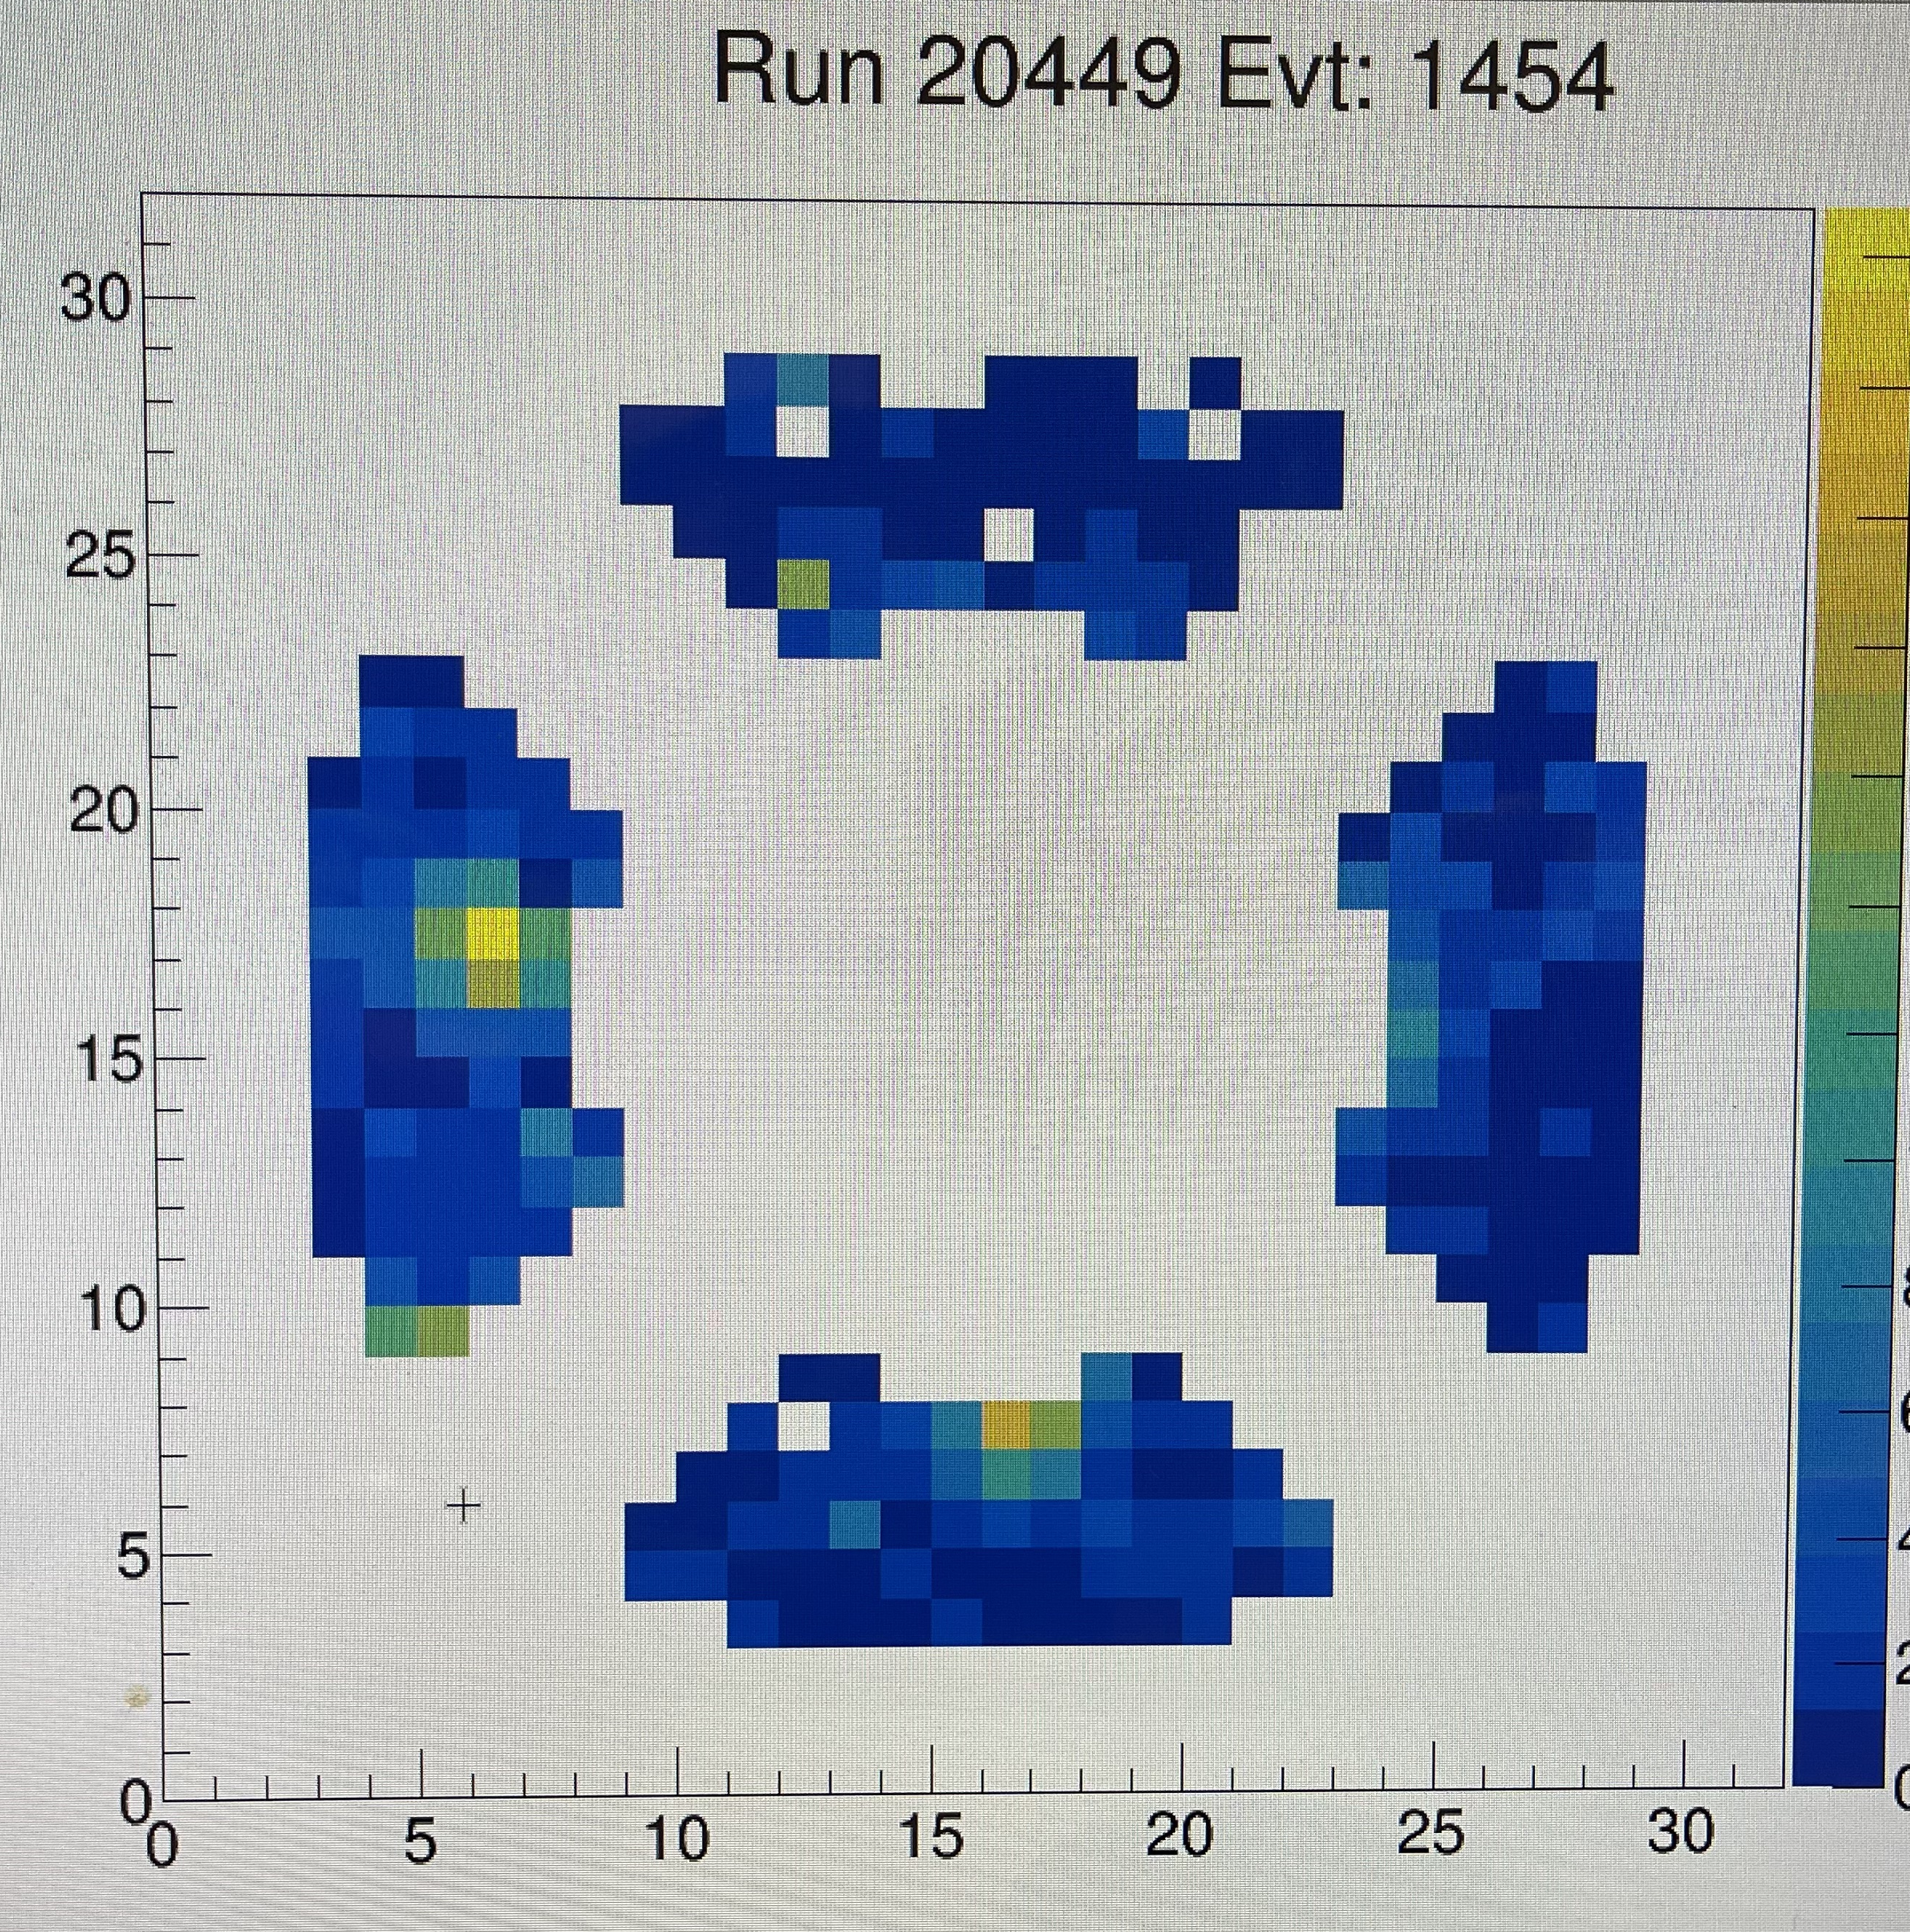
Snap Shots from Online Monitoring (an example)
Recorded by my phone
Likely a single-photon hit

Slide 17
Brief Summary
We had a first beam test of a LAPPD from Income, mainly led by BNL team.
Several photon sources have been used during the test: laser, photons from LAPPD glass window, Aerogel (mRICH like), aspherical lens, for characterizing the LAPPD property.
We had an issue of synchronizing waveform digitizers in our readout which may prevent us from getting quantitative results from this test.
We didn’t get a chance to integrate the GEM tracker in our readout.
We didn’t get a chance take low energy beams (~ 8 GeV/c).
Data analysis continues led by Mickey Chiu with a group of students.
Future test of LAPPD will be needed to verify its performance for EIC RICH-based PID detectors.

Slide 18
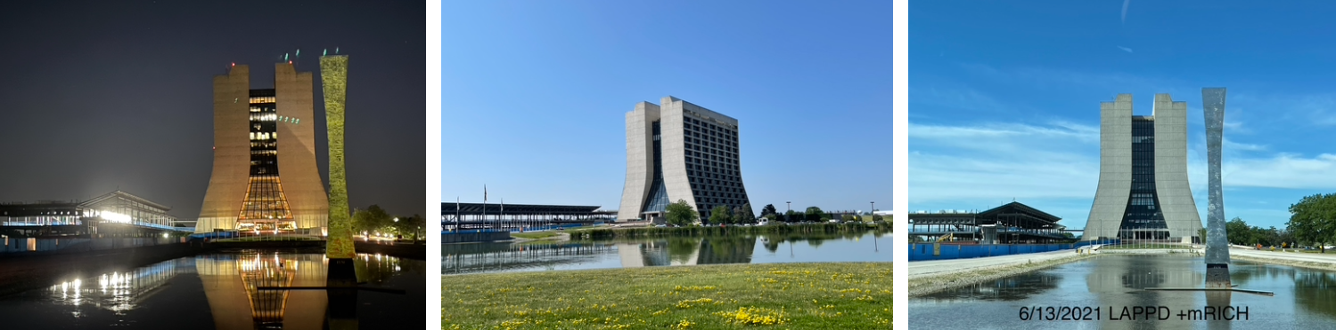
Thanks go to Fermilab for continuing providing the service of beam tests!

Slide 19
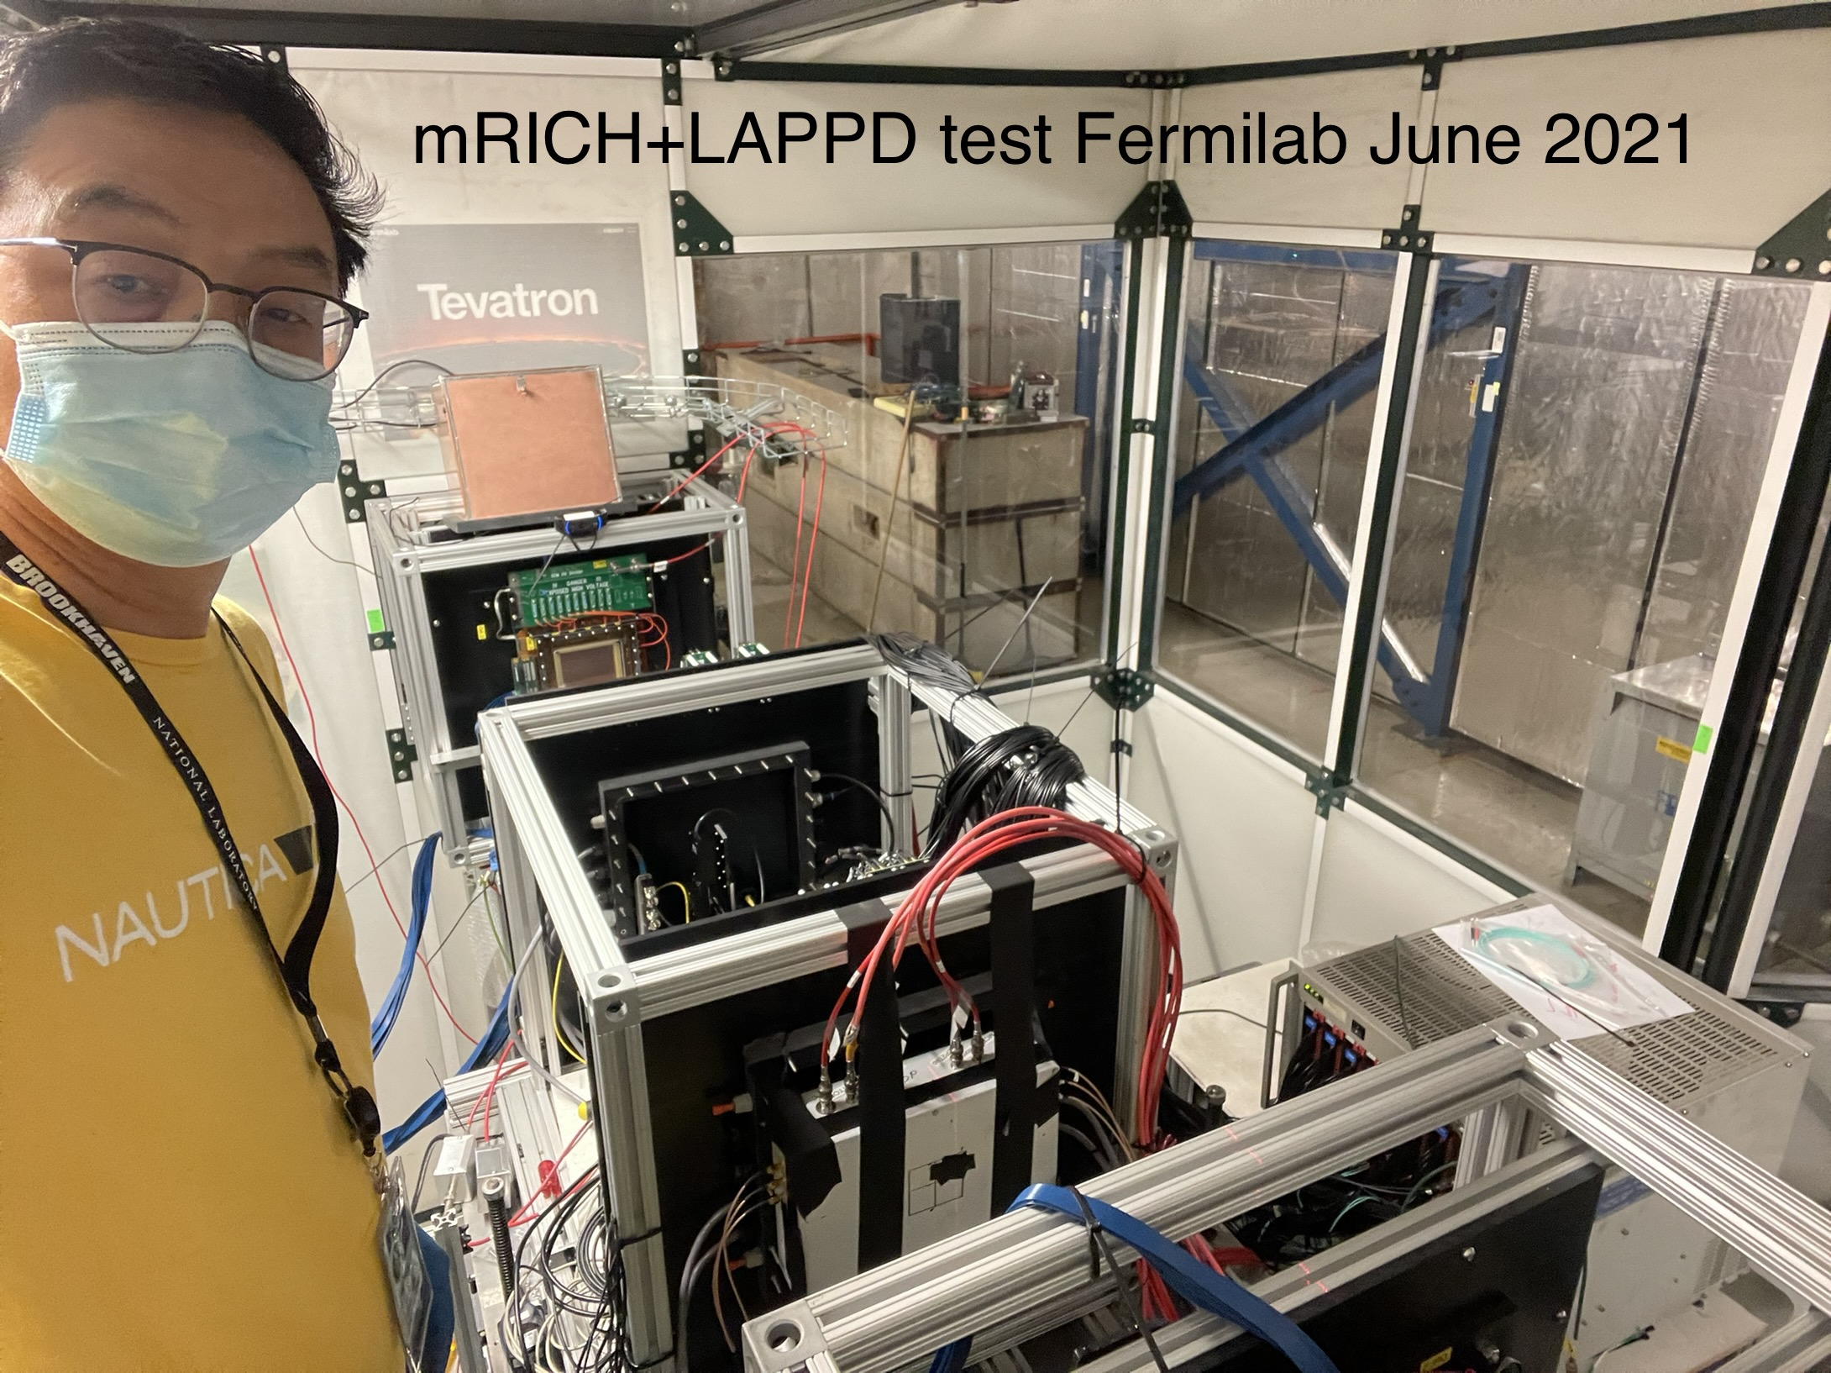
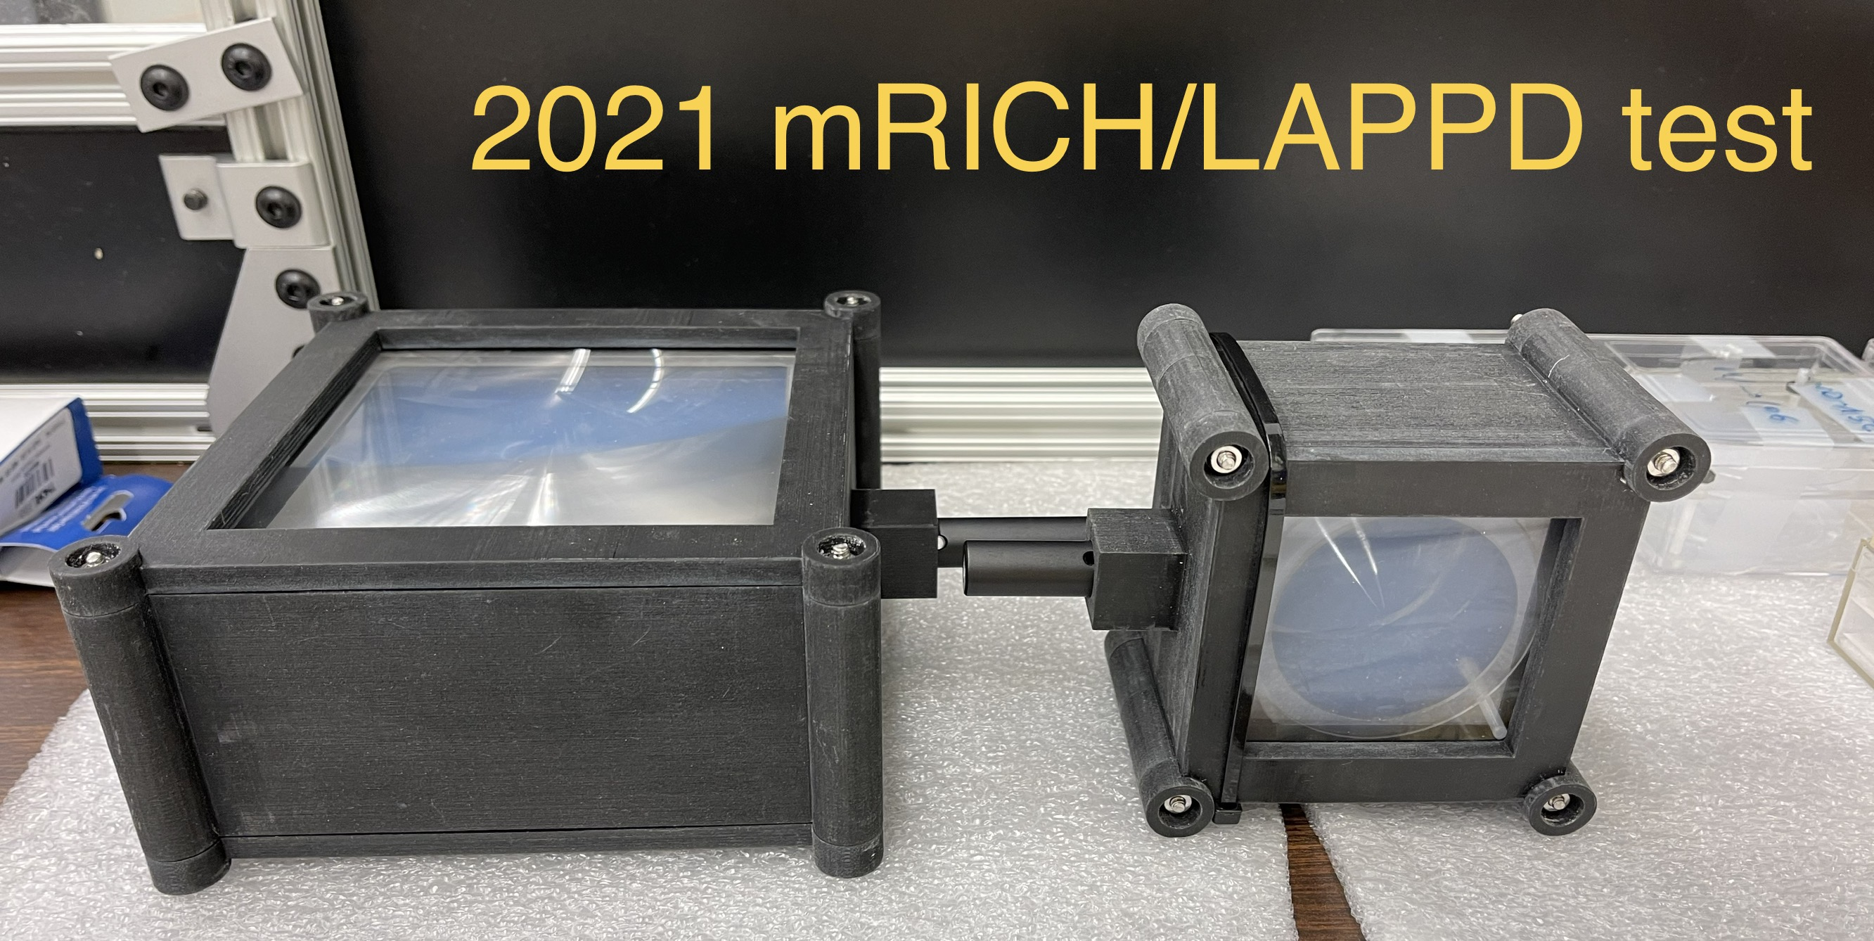
Setup
GEM tracking stations
LAPPD test stand
Aerogel + Fresnel lens to be mounted inside of the LAPPD test stand

Slide 20
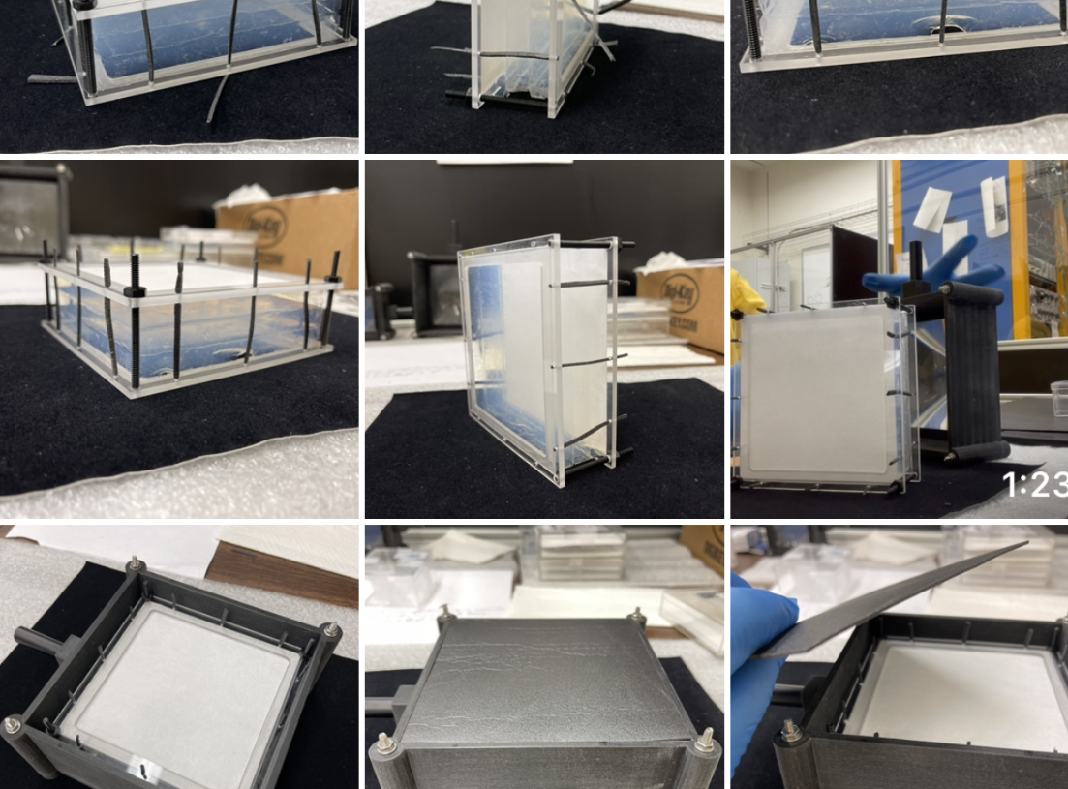
Aerogel
+
Lens
Assembly
At Fermilab

