Slide 1
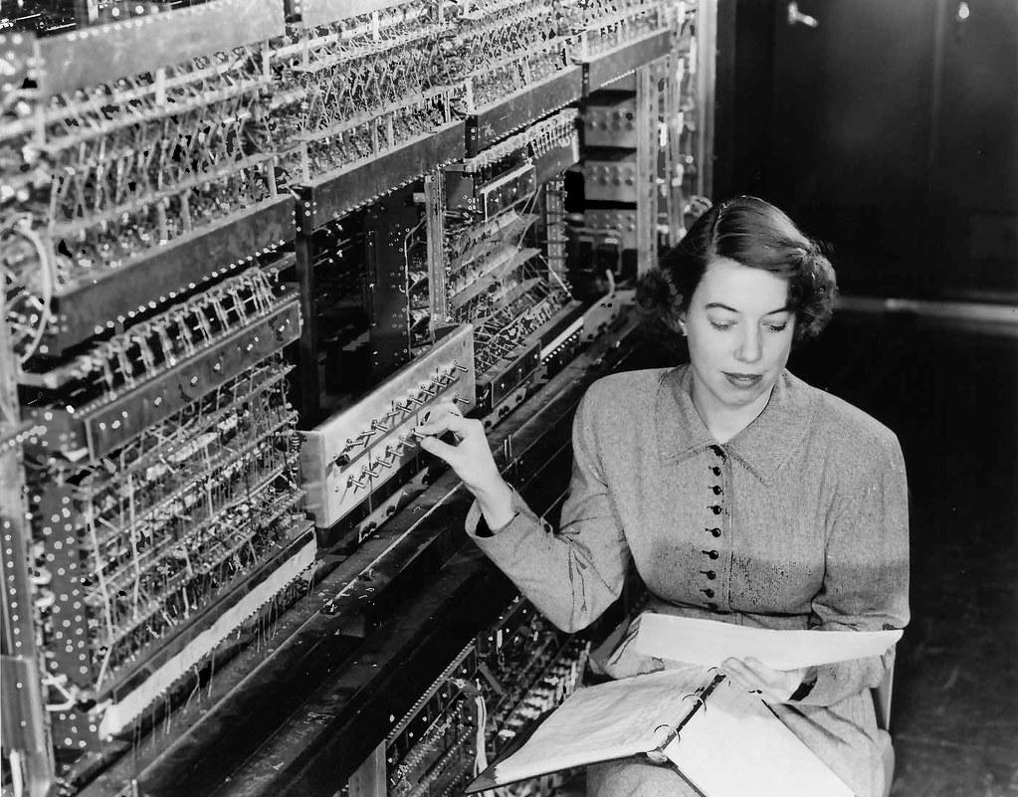
S&C Meeting Thursday 2021-06-17
The Software and Computing WG Conveners: Andrea Bressan (University of Trieste and INFN) , Dmitry Romanov (Jefferson lab) , Sylvester Joosten (Argonne National Laboratory) , Whitney Armstrong (Argonne National Laboratory) , Wouter Deconinck (The University of Manitoba)

Slide 2
Simulation status

Slide 3
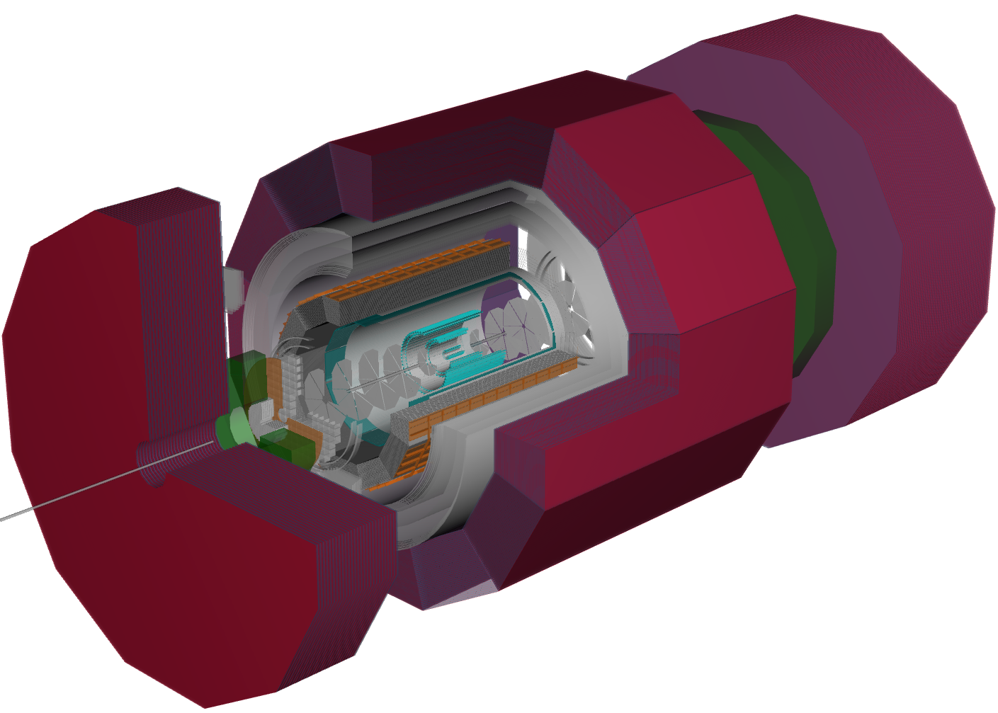
Calorimetry WG
Realistic HCAL
Almost ready to study impact of magnet on HCAL performance:
✅ Realistic HCAL geometry
✅ Solenoid material
❌ Helmholtz option to be added soon
✅ HCAL clustering and energy calibration
ECAL system well-developed:
Barrel ECAL:
✅ Barrel SiW imaging calorimeter
🚧 Barrel hybrid calorimeter
Electron-endcap ECAL:
✅ Crystal calorimeter
🚧 Glass calorimeter
Ion-endcap ECAL
✅ Shashlik calorimeter
✅ Reconstruction (2D, 2+1D and 3D clustering)
Forward shashlik calorimetry
BECAL with support
Hybrid electron endcap calorimeter with crystal (implementation of glass calorimeter ongoing)
Calorimetry delegate: Vladimir Berndnikov
S&C WG contacts: Wouter Deconinck & Sylvester Joosten

Slide 4
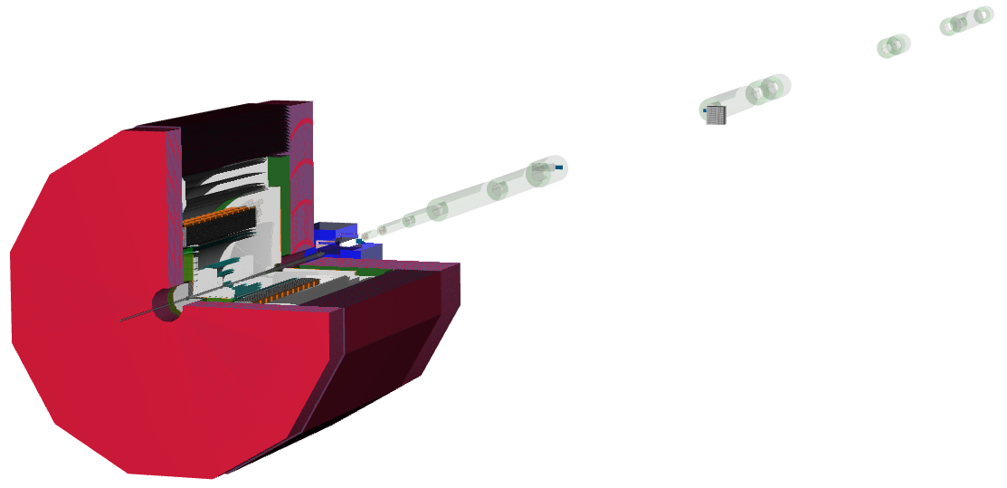
Far-forward & Far-backward WGs
FF (met with Alex Jentsch on Tuesday)
Magnets and detectors based on old design study
Alex Jentsch will update detectors and magnets based on latest design
Will add realistic beam-pipe model
FB
Need to work with WG to add geometries
Simplified B0 tracker
Simplified Roman Pots
Simplified off-momentum tracker
Realistic FOCAL-style ZDC
FF delegate: Alex Jentsch
FB delegate: TBD
S&C WG contact: Whitney Armstrong

Slide 5
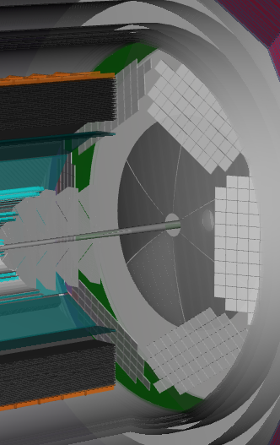
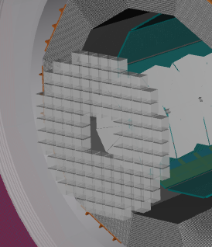
PID WG
gas-RICH starting point for dRICH implementation
dRICH
✅ functioning fuzzy-K ring-clustering
❌ need reference geometry from WG (ongoing conversation with Roberto)
✅ have field maps for both magnet setups
mRICH
✅ received baseline realistic geometry (implemented in fun4All) from Murad
❌ implement realistic detector in DD4hep
DIRC
✅ simplified geometry
❌ need reference geometry from WG (who to talk to?)
TOF
🚧 LGAD implementation with realistic services ongoing (Zhenyu)
LGAD implementation ongoing (Zhenyu)
mRICH geometry
DIRC needs the most work
PID delegate: TBD
S&C WG contact: Dmitry Romanov

Slide 6
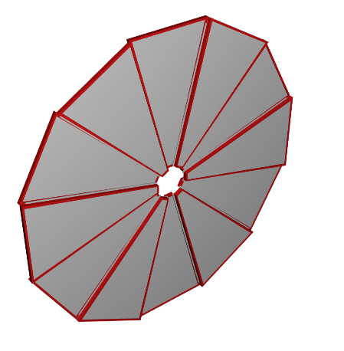
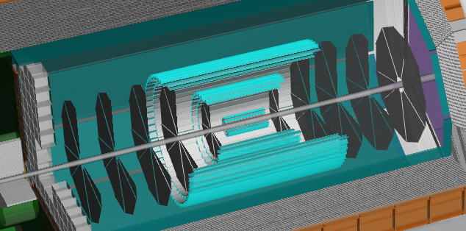
Tracking WG
Realistic µRWELL tracker with support
✅ silicon tracker
✅ barrel MPGD
✅ GEM
Reconstruction:
✅ geometries fully functional with ACTS
🚧 updating algorithms for ACTS v8.2 (tracking benchmarks ongoing)
❌ revisit data model in light of different stages of reconstruction
Realistic GEM implementation with frame (Matt)
Realistic silicon tracker (using all-silicon geometry) with services in current baseline geometry
Tracking delegate: Matt Posik
S&C WG contact: Sylvester Joosten

Slide 7
Physics WGs
DAQ WG
Exclusive & Tagging: TBD
S&C WG contact: Sylvester Joosten & Whitney Armstrong
Inclusive delegate: TBD
S&C WG contact: TBD
✅ Generic (unvalidated) afterburner
❌ Update afterburner based on the presentation by Brian Page last meeting
🚧 Collect physics analysis portfolio
Jets, HF & EW-BSM: Brian Page
S&C WG contact: Wouter Deconinck
SIDIS delegate: Christopher Dilks
S&C WG contact: TBD
❌ Assign SWG contact for DAQ WG
DAQ delegate: TBD
S&C WG contact: TBD

Slide 8
Jets, HF & EW-BSM
Generator benchmarks
✅ Pythia8 DIS CC and NC Samples ran through entire chain, from G4 to digi/reco, clustering.
🚧 Efficient filter for events
Detector benchmarks
🚧 Calorimetry resolutions under study
❌ HCAL sensitivity
Reconstruction benchmarks
✅ ECAL clustering
✅ HCAL clustering
✅ Jet reconstruction (calorimetric)
❌ Energy flow (requires tracking)
Jets, HF & EW-BSM: Brian Page
S&C WG contact: Wouter Deconinck

Slide 9
Reconstruction Status and examples of using DD4hep for physics benchmark studies

Slide 10
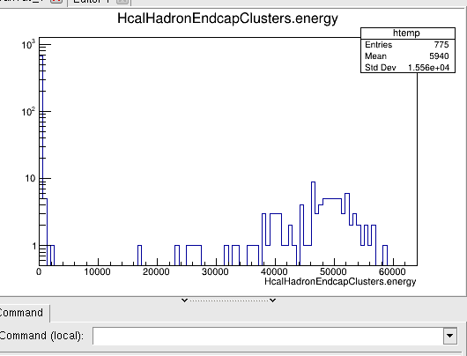
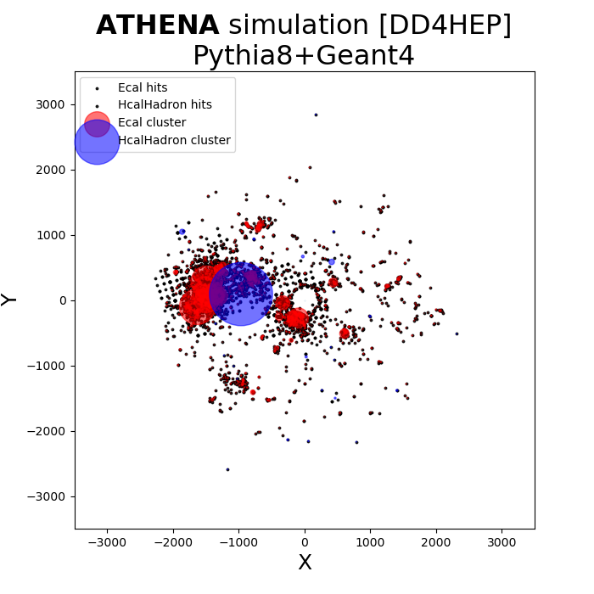
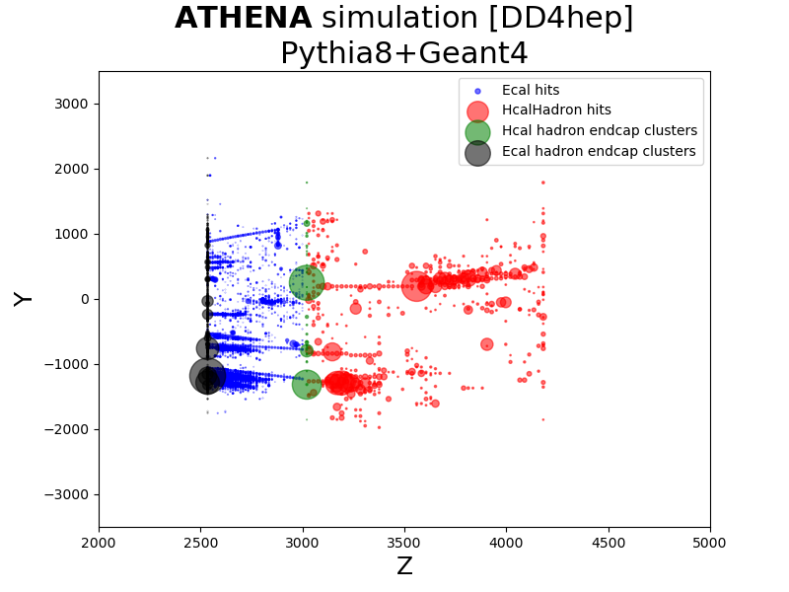
Calorimetry Clustering fully functional
50 GeV pions in forward HCAL:
Pythia8 DIS events:

Slide 11
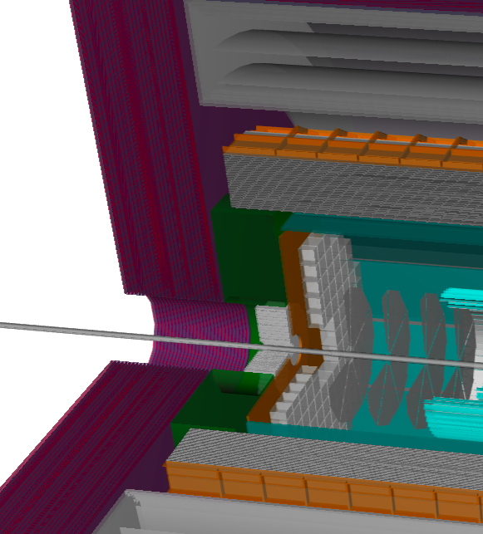
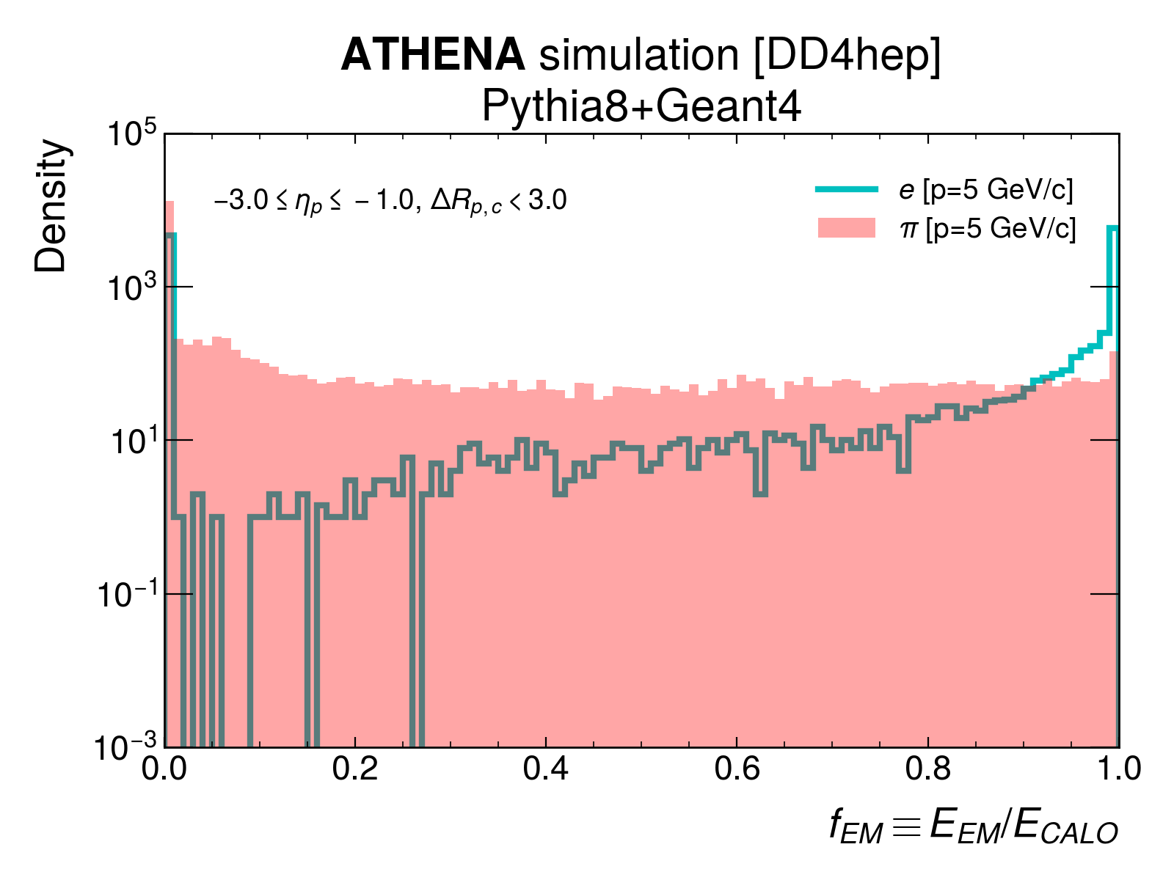
Electron-pion separation With HCAL

Slide 12
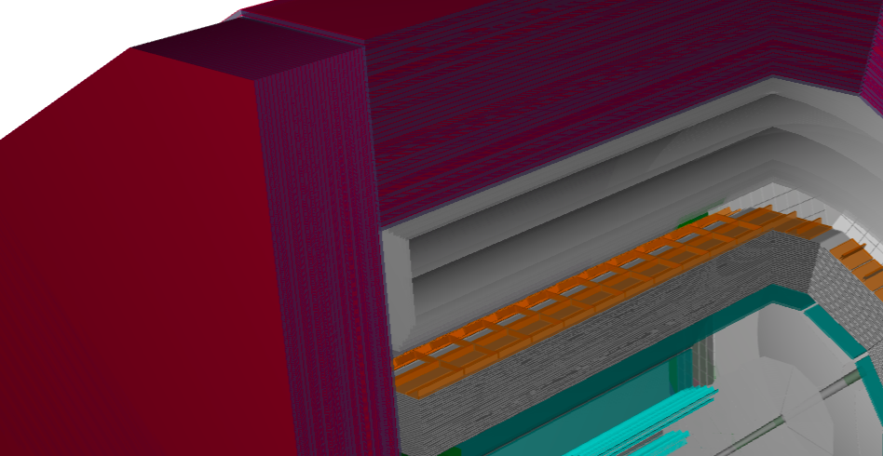
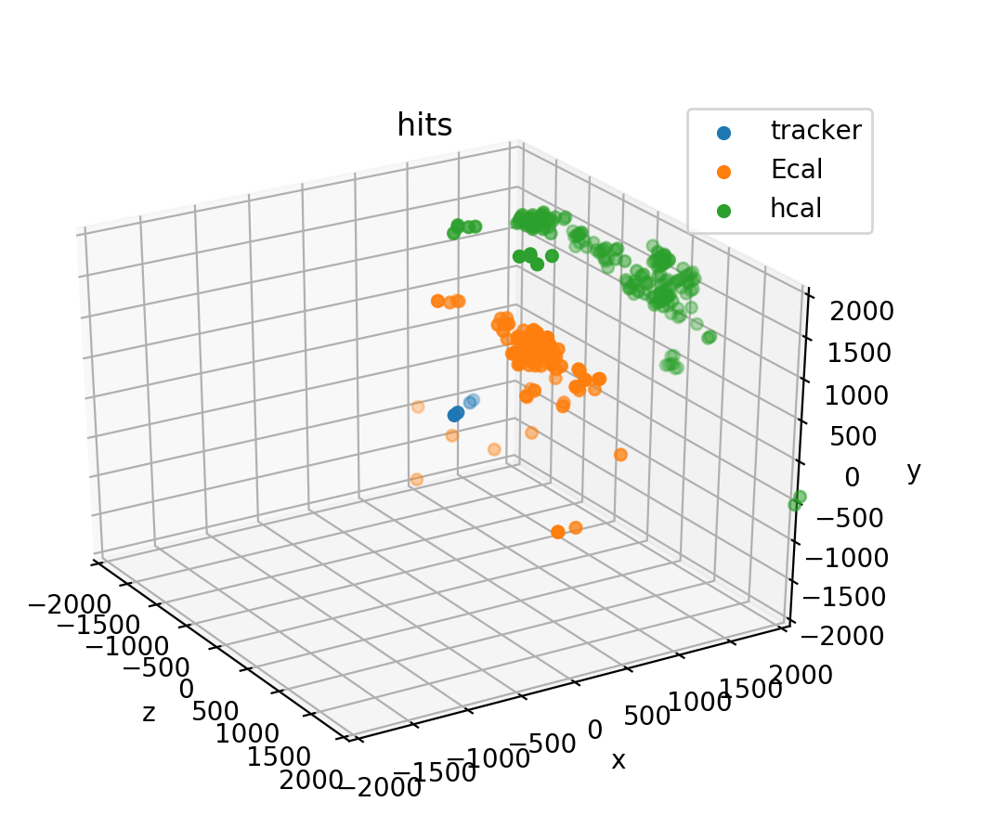
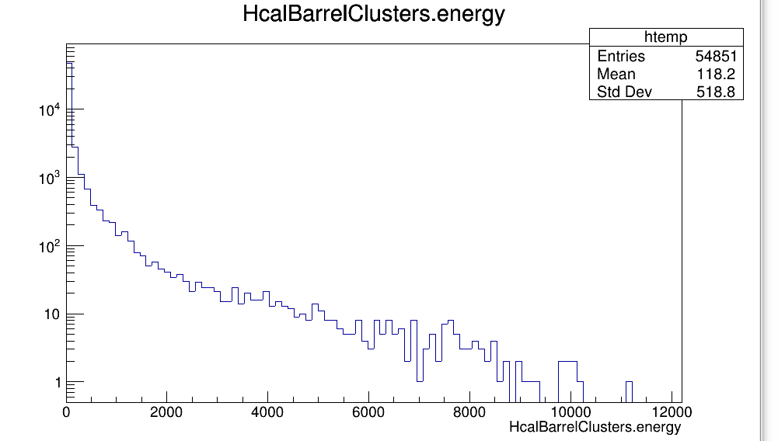
Impact of magnet on barrel HCAL
10 GeV neutron
MeV

Slide 13
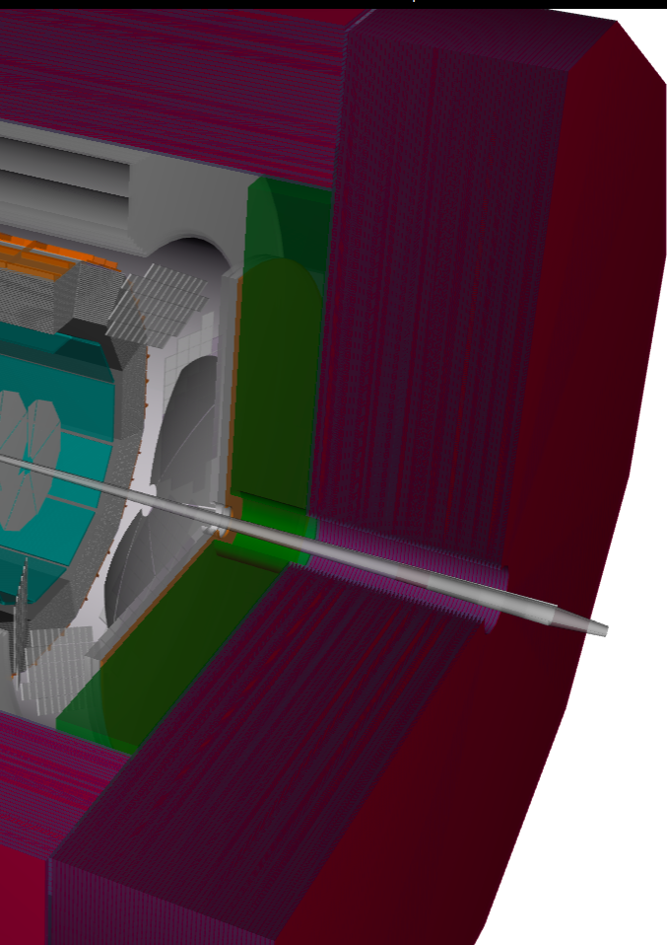
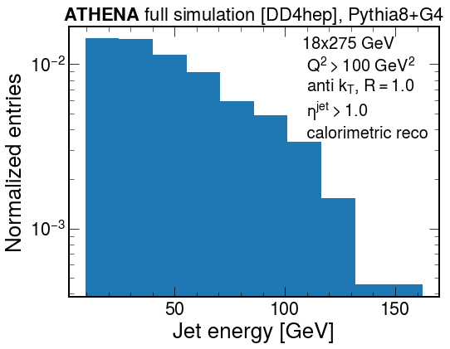
Jet reconstruction
With forward calorimeter system

Slide 14
Computing Update

Slide 15
First large-scale data production
Input: 4 x 1M Pythia8 DIS events with beam angle/divergence/crabbing
5x41 GeV, 18x275 GeV; # tracks about 30% higher in 18x275 GeV, i.e. looks like logo:
25 mrad, 35 mrad crossing angle
HepMC files on S3 under ATHENA/EVGEN/JETS/crossDivNrgCrab/
Full simulation with current detector model, all bells and whistles:
Typical: 0.25 to 3.0 s/event, <500MB RAM RSS, 30 kB to 750 kB output size/event
ROOT files on S3 under ATHENA/FULL/JETS/crossDivNrgCrab/2021-06-16/
Reconstruction
Focus on full calorimetry clustering (Ecal and Hcal)
ROOT files will be on S3 under ATHENA/RECO/JETS/crossDivNrgCrab/2021-06-10/
Full simulation: ~weekly repetition; reconstruction: every few days
Written to work on any slurm batch system; performed at Compute Canada
Data storage on S3 seems to work fine (still not working at JLab)

Slide 16
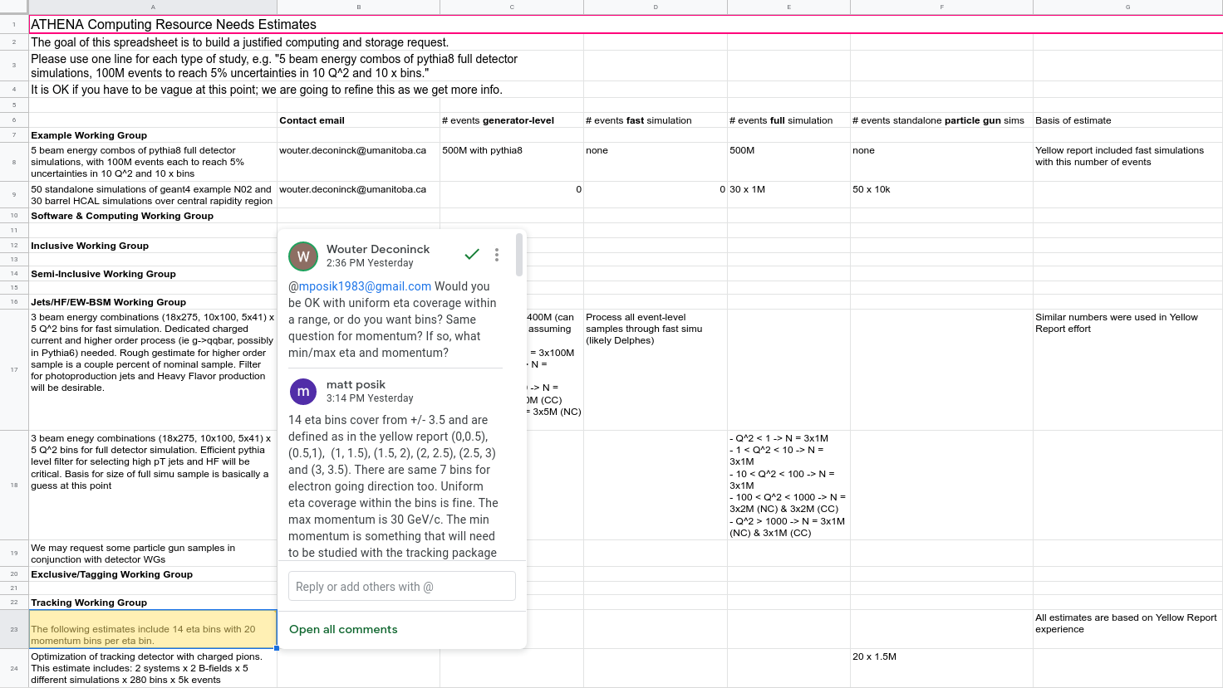
Requests
Fill out the computing resource request spreadsheet: https://docs.google.com/spreadsheets/d/1FpzI20WqMaIhbOqeGEiJMsXRwAvzisWRjCMfOHasUz0/edit#gid=0
Please identify WG contact person to the Software & Computing WG and let us know ASAP.
Notes:
Purchase of new nodes/disks to arrive August must be justified now.
Synergies will be coordinated by Software & Computing WG.
Particle gun = single particle / event

Slide 17
Computing Resource Analysis
Single particle simulations with General Particle Source CPU time per core, event size: both scale empirically as E^{0.85}
pi+: 20 ms/ev · E^{0.85}, 3.4 kB/ev · E^{0.85}
neutron: 20 ms/ev · E^{0.85}, 2.2 kB/ev · E^{0.85}
gamma: 17 ms/ev · E^{0.85}, 5.7 kB/ev · E^{0.85}
pi0: 17 ms/ev · E^{0.85}, 6.1 kB/ev · E^{0.85}
Multi-particle simulations: Pythia8, DIS Q² > 10 GeV²
25 mRad, 5x41 GeV: 28.4 tracks/ev, 666 ms/ev, 186.1 kB/ev
25 mRad, 18x275 GeV: 38.8 tracks/ev, 3010 ms/ev, 566.1 kB/ev
This information allows for making some estimates:
E.g. tracking wants 18 bins in p from 150 MeV to 20 GeV, 5k events in each of 14 η bins
150 MeV bin: 20 seconds
20 GeV bin: 1,280 seconds
Logarithmic momentum sequence requires 12 core-hours total for all η bins

Slide 18
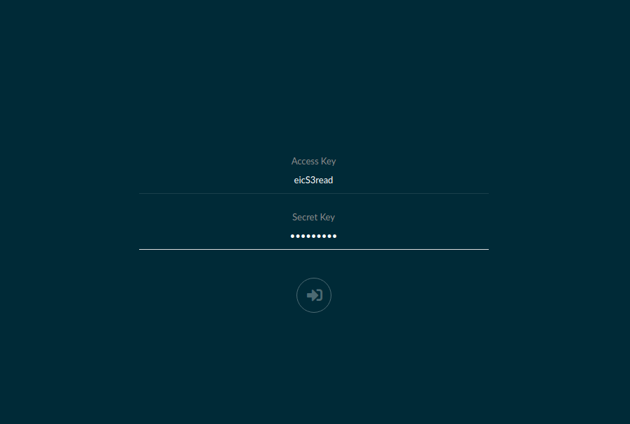
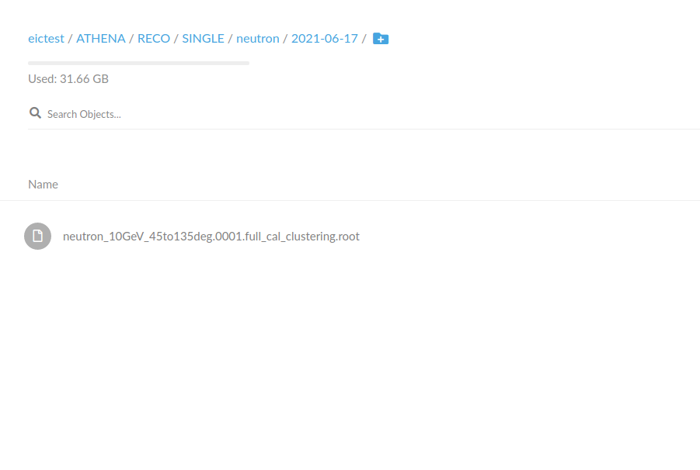
Accessing Large Data Productions: From the Web
https://dtn01.sdcc.bnl.gov:9000/minio/login

Slide 19
Accessing Large Data Productions: Command Line
Download the Minio client:
wget https://dl.min.io/client/mc/release/linux-amd64/mc
Register your S3 instance:
./mc config host add S3 https://dtn01.sdcc.bnl.gov:9000 $u $p
Copy files (recursively):
./mc cp -r S3/eictest/ATHENA/RECO/SINGLE/neutron/2021-06-17 .
Full docs: http://doc.athena-eic.org/en/latest/howto/s3_file_storage.html

Slide 21
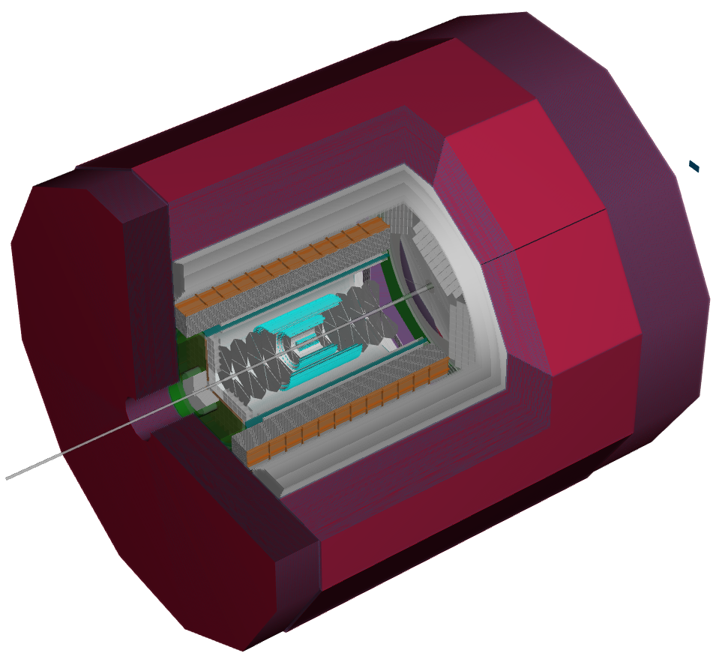
Software & Computing WG
Bi-weekly software meeting: Thursday 12:00pm EDT
Software & Computing Conveners:
Whitney Armstrong, Andrea Bressan(*), Wouter Deconinck, Sylvester Joosten, Dmitry Romanov (*)- liaison to EICUG software group
Day 0 WG support:
Kolja Kauder, Miguel Arratia, Stephen Sekula, Dmitry Romanov, Yulia Furletova, Andrea Bressan
Full simulation/reconstruction team
Whitney Armstrong, Miguel Arratia, Wouter Deconinck, Sylvester Joosten, Jihee Kim, Chao Peng, Tomas Polakovic, Dmitry Romanov, Marshall Scott, Zhenyu Ye, Ziyue Zhang, Maria Żurek
...and a rapidly growing amount ATHENA collaborators!
Documentation portal: doc.athena-eic.org
Full simulation tutorials
eic-ip6-software-I@lists.bnl.gov #software-helpdesk on Slack
ATHENA central detector

