Slide 1
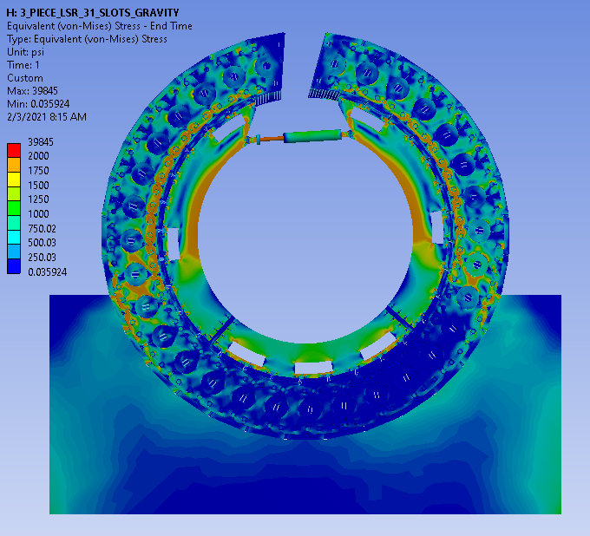
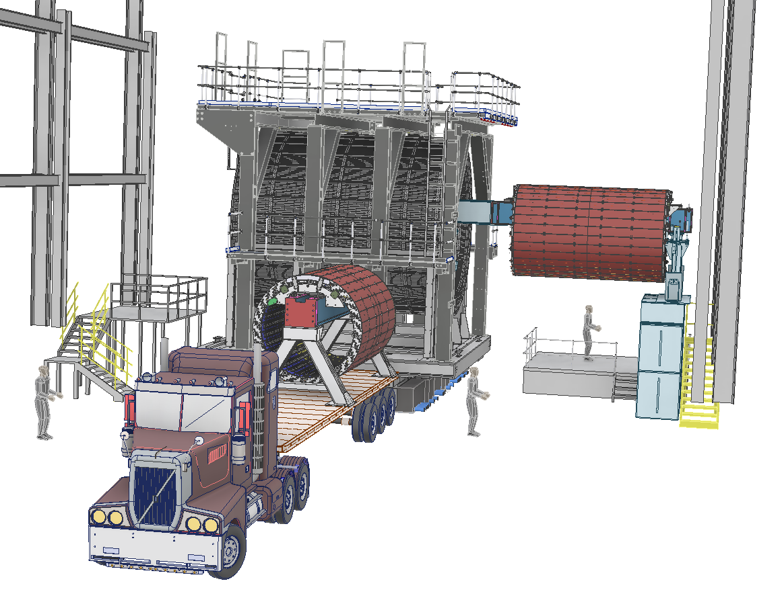
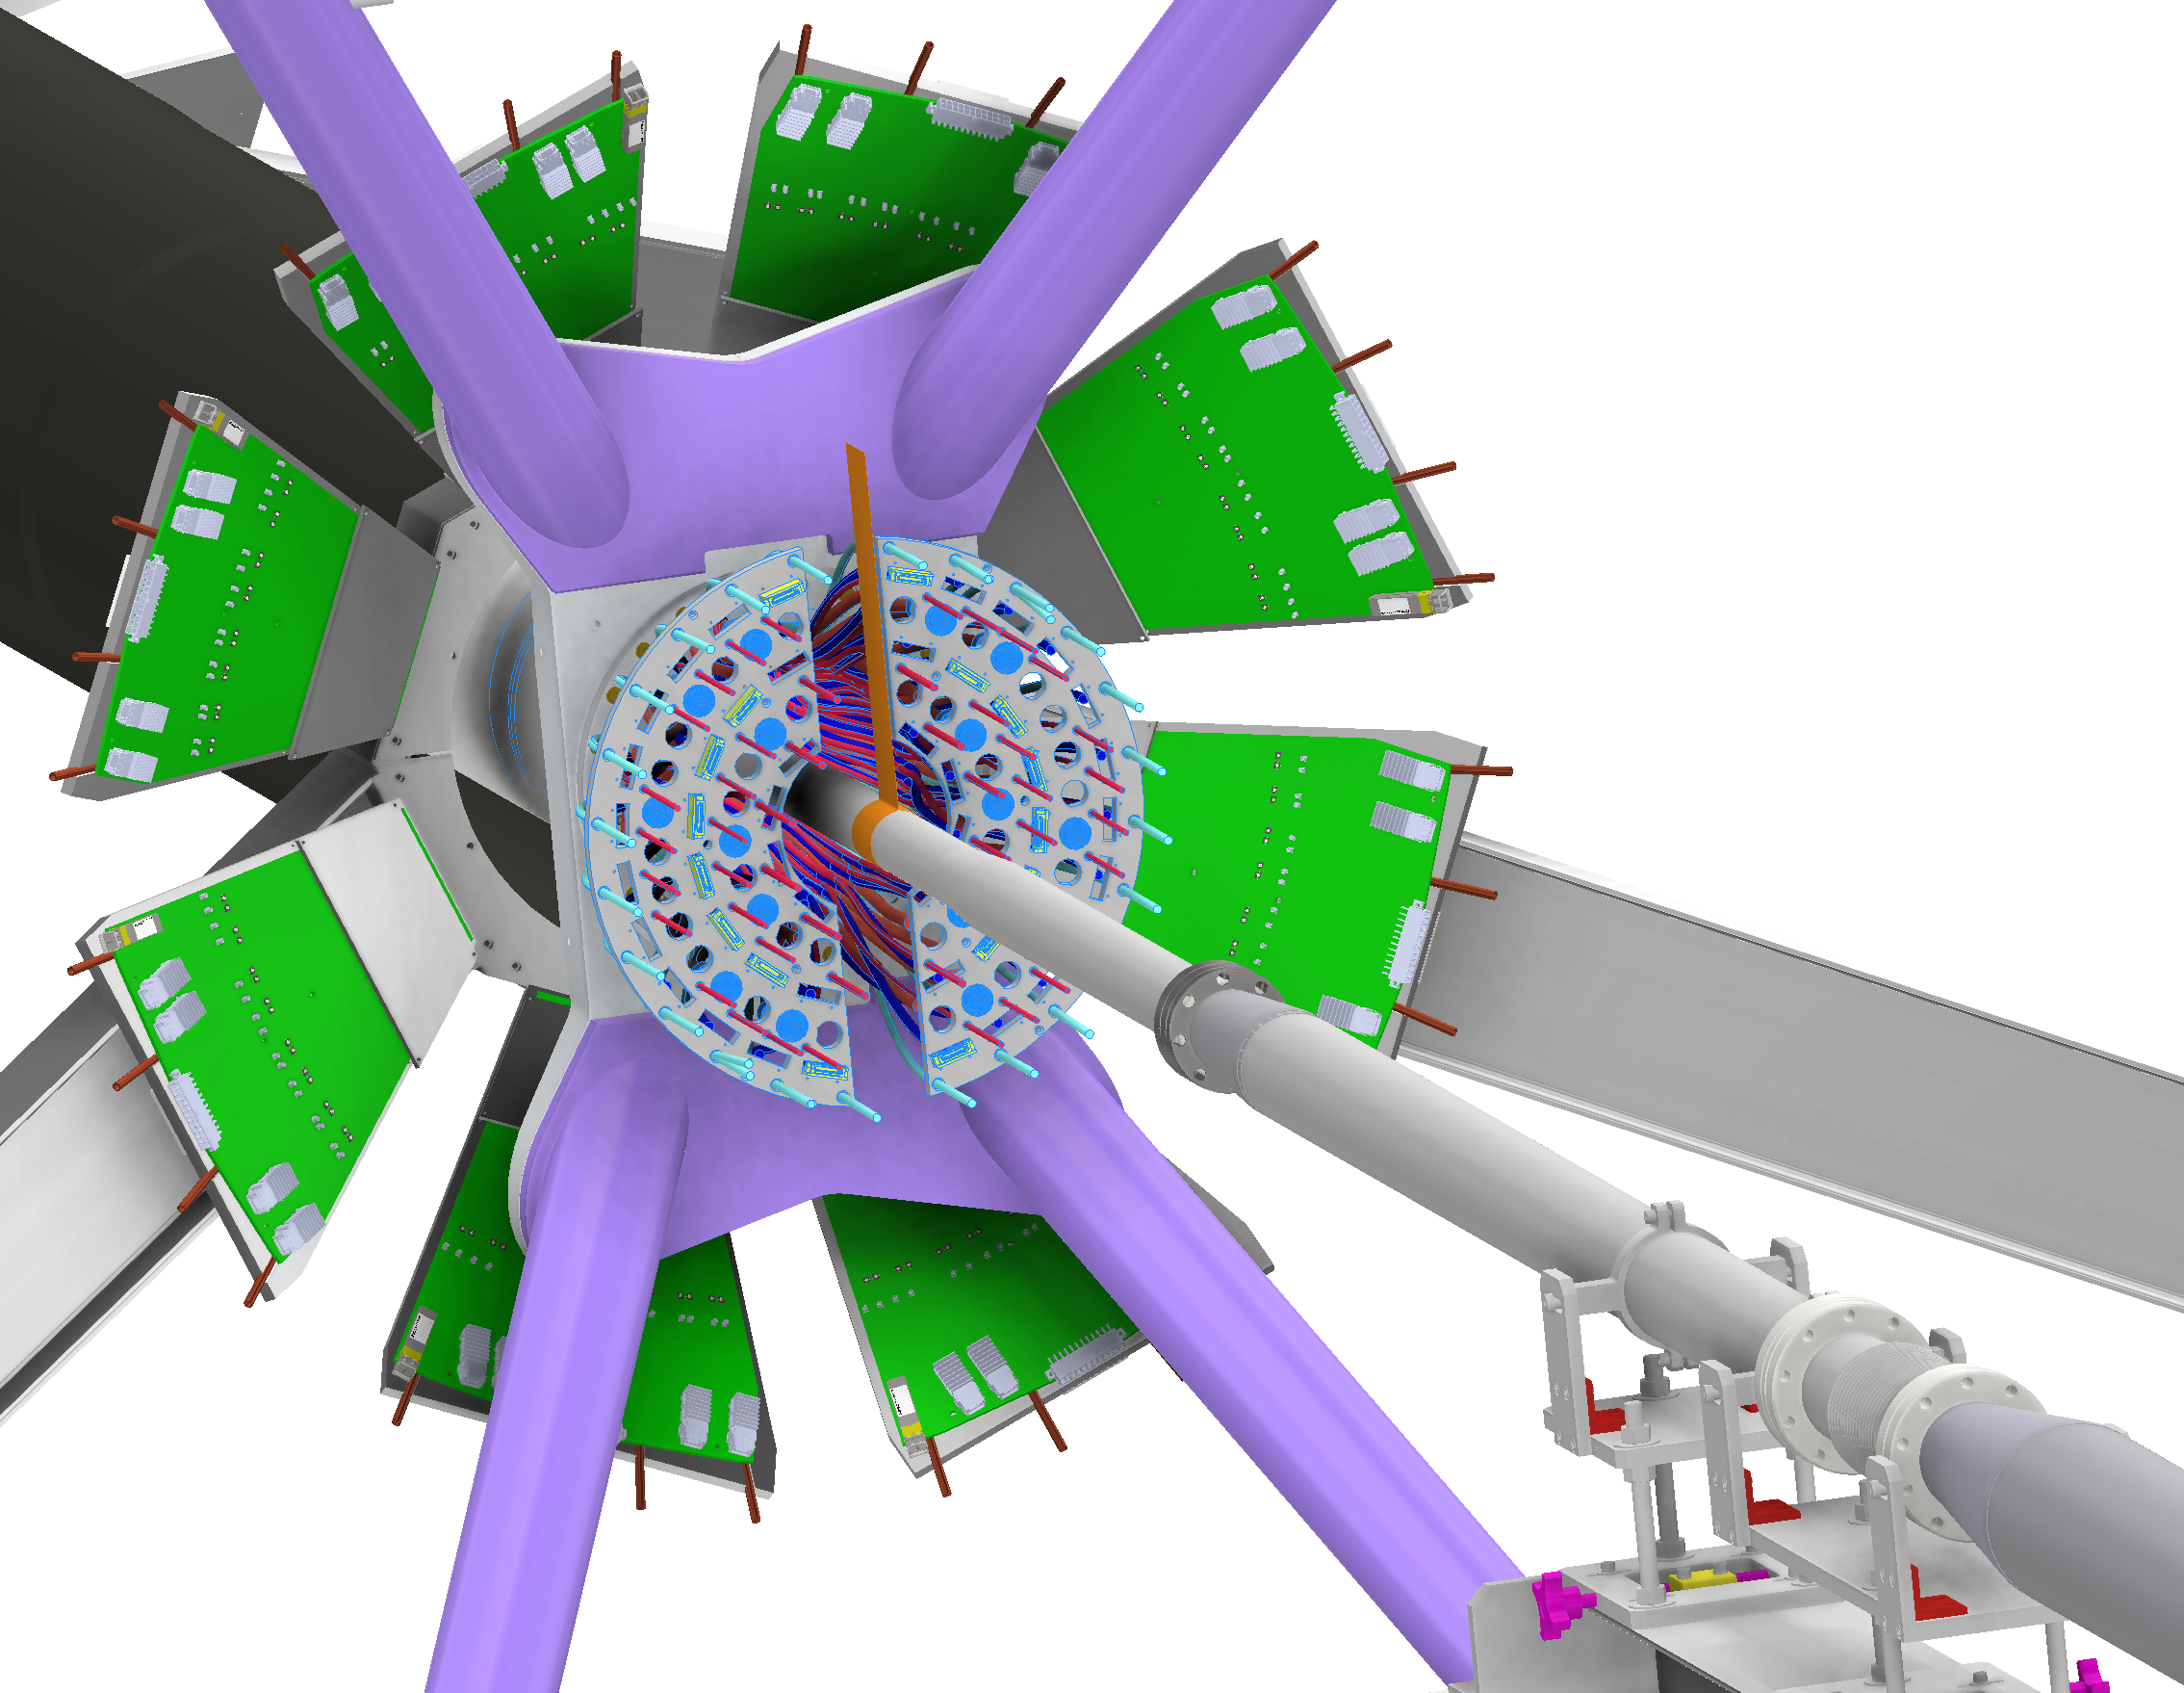
sPHENIX PMG Remaining sPHENIX engineering work
Russell Feder July 8, BNL
oHCAL construction engineering
iHCAL installation choreography
INTT-MVTX-Beam Pipe Integration

Slide 2
sPHENIX design and field engineering support
sPHENIX construction has started but there is desk-based design and project engineering work to complete.
Most remaining design engineering scope is for detector installation. There is also design work for water and gas piping design and analysis, cable routing and cable trays, and other infrastructure.
Project engineering scope includes managing procurements and fabrication work, developing and managing work planning packages, and coordinating work in the “factories”. Significant time is also needed for design, safety and project review prep and attendance.
There is also field engineering work for construction in and around 1008.
Work planning package and technical scope owners are present in 1008 to coordinate assembly and testing
As sPHENIX is put together there are missed details, as-built issues, and fabrication defects that comes up. Adequate engineering staffing is needed to handle all this unknown scope.
sPHENIX gets important engineering contributions from CA-D and ATRO staff. Continued support will be needed in many areas through FY22.
iHCAL Barrel Fabrication and Installation, and TPC Installation design engineering is more difficult and is taking longer than planned.
Engineering resources from ATRO and Magnet Division have been added to accelerate and complete this work
Requisitions for the iHCAL barrel fabrication and large installation structures are starting this week. We will understand the delivery schedule in 3-4 weeks once bids are received. A final design review for the iHCAL stanchions will be held in late August and procurement underway in September.
A final design review for the TPC supports will be held in late August. We are working with the TPC team to complete the TPC installation design engineering by October.

Slide 3
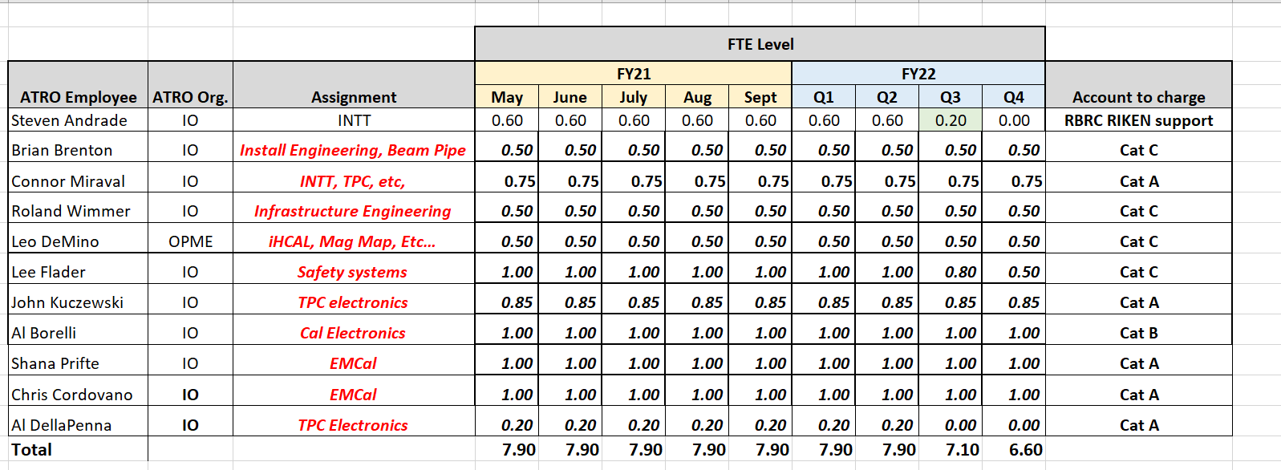
sPHENIX engineering and technician staff from other BNL organizations
This is a detailed staffing plan for ATRO personnel
We have signed MoUs with CAD and SMD with the scope in those MoU's captured in our P6 file that we update monthly. The resource needs and schedule have evolved over time and the P6 file has been updated accordingly. The deliverables, especially as it applies to the CAD MoU are unchanged though specified in more detail now than they were in 2018.

Slide 4
Remaining sPHENIX design and project engineering, on-carriage scope
 | Remaining design and procurement | Status of remaining work | Personnel
Cradle-Carriage-Platforms-Pole Tip-Seismic restraints-access stairs | IR Seismic restraints IR Stairs install and support Platforms, Pole Tip, and stairs procurement Platforms, Pole Tip, and stairs work planning package(s) | FDR August 2021 | Jon Hock - CA-D Jim Mills – CA-D
oHCAL | None | None | None for design engineering
Magnet | Magnet Support Procurement and Work Planning Package | Magnet supports and LSRs with BNL shop and Streck’s. All parts due by late September Work planning packages will be issued in early August | Chris Pontieri - sPHENIX
Large Support Rings | LSR Procurement and Work Planning Package |  | Chris Pontieri - sPHENIX
iHCAL | iHCAL install stanchions and stanchion install tools iHCAL sector procurement, iHCAL factory set up, and Work Planning Package | Barrel fabrication and large install structures procurement started 7/7/21 Stanchions FDR Late August 2021 | John Scheblein - sPHENIX Russell Feder – sPHENIX Chris Pontieri – sPHENIX Leo Demino - ATRO
EMCAL | EMCAL install lift fixture procurement EMCAL factory support EMCAL install work planning package | EMCAL install lifting fixture in production at SBU. Ready by late August for testing. | Dan Cacace - sPHENIX
TPC | TPC installation and supports TPC laser calibration system TPC fab at SBU TPC install structures procurement TPC install work planning package | Supports FDR Late August 2021 Install FDR Sept-Oct 2021 | Connor Miraval - ATRO Rich Ruggiero – sPHENIX Dan Cacace - sPHENIX Chris Runyan – ATRO-AM John Cozzolino – ATRO-AM

Slide 5
Remaining sPHENIX design and project engineering, on-carriage scope
 | Remaining design and engineering | Status of remaining work | Personnel
INTT | INTT installation and supports INTT lab fab support | Common FDR later this calendar year | Cacace – sPHENIX Connor Miraval - ATRO
MVTX | MVTX installation and supports | FDR ~XX/2021 | MIT Bates team Brian Brenton – ATRO Dan Cacace - sPHENIX
Beam pipe and general IR installation platforms | Beam pipe installation and perm supports General install platforms | PDR ~XX/2021 FDR ~ XX/2022 | Brian Brenton – ATRO Rich Ruggiero – sPHENIX Russ Feder – sPHENIX Chris Pontieri - sPHENIX
 | Beam pipe bake and temporary supports |  | Chris Runyan – Magnet Division Sumanta Nayak – CA-D
 | Beam pipe downstream components Beam Pipe Procurement support |  | Rich Ruggiero - sPHENIX Sumanta Nayak – CA-D Russell Feder – sPHENIX Jim Mills – CA-D
sEPD | New. Recently funded… | FDR ~XX/2021 | Need to assign, Feder holding prelim design meetings

Slide 6
Remaining sPHENIX design and project engineering, on-carriage scope
 | Remaining design and engineering | Status of remaining work | Personnel
Magnet mapping | Mapper installation and operation | Finalize design with CERN team | Le DeMino – ATRO Russ Feder - sPHENIX
Cable and cable tray | Cable routing design Cable tray design and procurement | ?? | Peter Hamblen – sPHENIX Dan Puleo – CA-D
Water and piping supports | Hydraulic analysis Piping design and P&ID diagram Pipe supports design | In preliminary design PDR Sept-Oct 2021 FDR late 2021 | Russell Feder – sPHENIX Chris Runyan – ATRO-AM Andy Marone – ATRO-AM Need experienced water piping engineer and/or designer
Gas distribution | Gas piping and patch panels | FDR ??? | Rob Pisani – sPHENIX Joe Curran – sPHENIX contractor
Racks | Rack factory work support | In production | Joel Vasquez - sPHENIX Lee Flader – ATRO Jermaine Jones – sPHENIX contractor Joe Curran – sPHENIX contractor

Slide 7
Remaining sPHENIX design and project engineering, off-carriage scope
 | Remaining design and procurement | Status of remaining work | Personnel
IR Cryo upgrades | Various piping procurement | Ongoing | Paul Orfin – CA-D Roberto Than – CA-D
IR HVAC | Air handler upgrade design Chiller procurement support | FDR early Fall 2021 | Brian Streckenbach – CA-D Dave Chan – CA-D
DAQ Room Mods and HVAC | DAQ room ducting |  | Brian Streckenbach – CA-D
IR cooling water system | Reconfig west wall piping and connect to sPHENIX systems | FDR mid Fall 2021 | Brian Streckenbach – CA-D Dave Chan – CA-D
Gas house and gas pad | Reconfigure for sPHENIX use Update sPHENIX P&IDs | FDR mid Fall 2021 | Rob Pisani – sPHENIX Joe Curran – sPHENIX contractor Brian Streckenbach – CA-D
Control room mods | Reconfigure for sPHENIX use |  | Joel Vasquez – sPHENIX Lee Flader - ATRO Designer - TBD

Slide 8
Remaining sPHENIX electrical design engineering 1 – On and off carriage infrastructure
 | Remaining design and engineering | Status of remaining work | Personnel
Line electric power | AC power design AC power procurement Work planning for install |  | Joel Vasquez Jermaine Jones Brian Streckenback – CA-D Dennis Donaldson – CA-D
Magnet power and control | Misc design and procurement Operating procedure |  | Carl Schultheiss – CA-D Kin Yip – CA-D Pablo Rosas – CA-D Brian Streckenbach – CA-D
Detector safety systems | Joel email |  | Joel Vasquez – sPHENIX Lee Flader - ATRO Designer - TBD

Slide 9
sPHENIX field engineering support 1
 | Install Status | Work planning and construction managers | Engineering Staff Assignment
AH and IR floor and track reinforce | AH complete, IR starting | Russ Feder Jim Mills Chris Pontieri Joel Vasquez Brian Streckenbach Rich Ruggiero | Jim Mills tech rep for contract
Cradle-carriage-platform-pole tips – seismic restraints- stairs | Base complete, all other work to go |  | Jon Hock George Mahler Brian Brenton
oHCAL and iHCAL 912 factories and 1008 install | One oHCAL installed as of 7/8/21 Have eight iHCAL sectors in-hand and will start iHCAL factory prep |  | Chris Pontieri Leo DeMino John Scheblein
EMCAL 510 factory and 1008 install | Sector 28 of 64 complete EMCAL install after iHCAL install |  | Dan Cacace Sean Stoll Rob Pisani
Magnet install, map, and test | Start in September 2021 |  | Kin Yip Carl Schultheiss Pablo Rosas …and many other ATRO-AM depending on work Leo DeMino - ATRO
Cryo systems installation and test | Start late July once IR is open |  | Paul Orfin Roberto Than Tom Tallerico …and others depending on work

Slide 10
sPHENIX field engineering support 2
 | Install Status | Work planning and construction managers | Engineering Staff Assignment
TPC |  | Russ Feder Jim Mills Chris Pontieri Joel Vasquez Brian Streckenbach Rich Ruggiero | Connor Miraval Dan Cacace John Cozzolino Chris Runyan
INTT |  |  | Connor Miraval Dan Cacace
MVTX |  |  | MIT-Bates team support Brian Brenton Dan Cacace
MBD |  |  | Brian Brenton Dan Cacace
sEPD |  |  | TBD
Beam Pipe |  |  | Sumanta Nayak Chris Runyan Brian Brenton
Racks and on-carriage line electric install |  |  | Joel Vasquez Lee Flader Jermaine Jones Joe Curran
Cable tray and cable routing |  |  | Peter Hamblen Dan Puleo
Water and gas piping

Slide 11
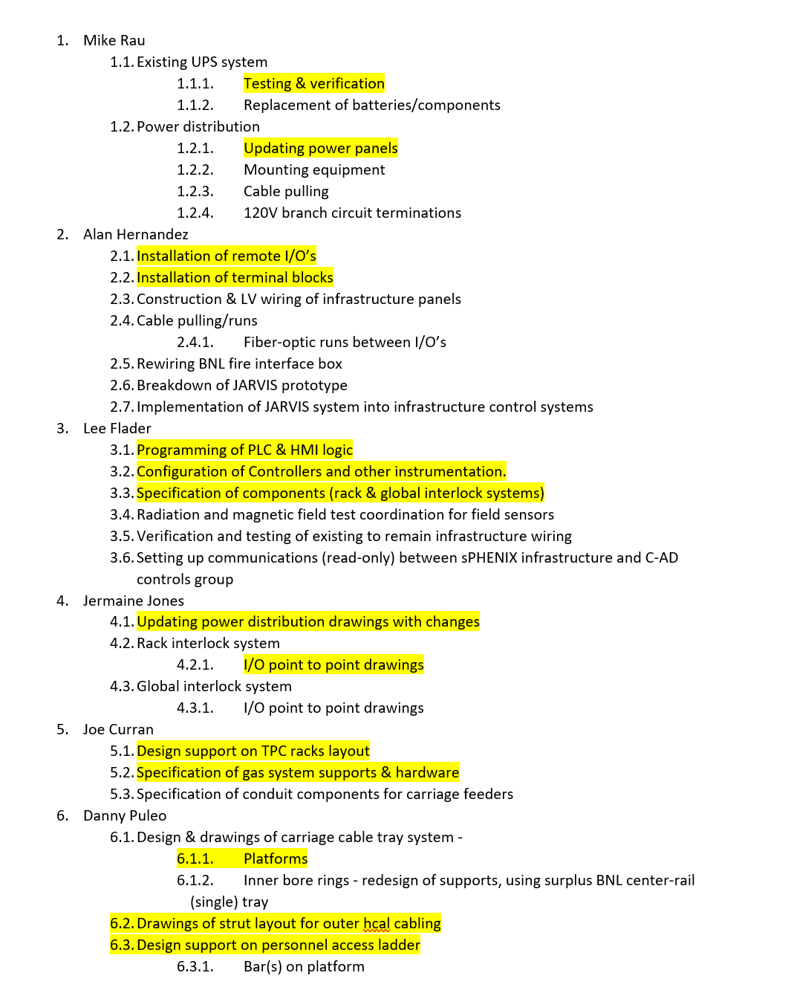
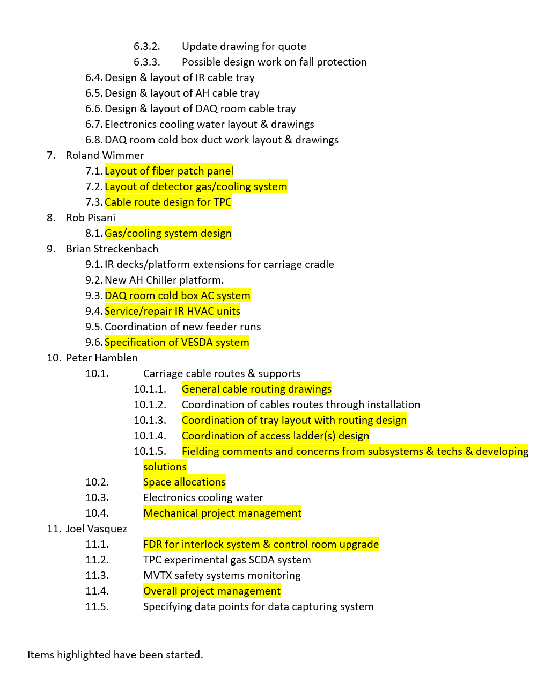
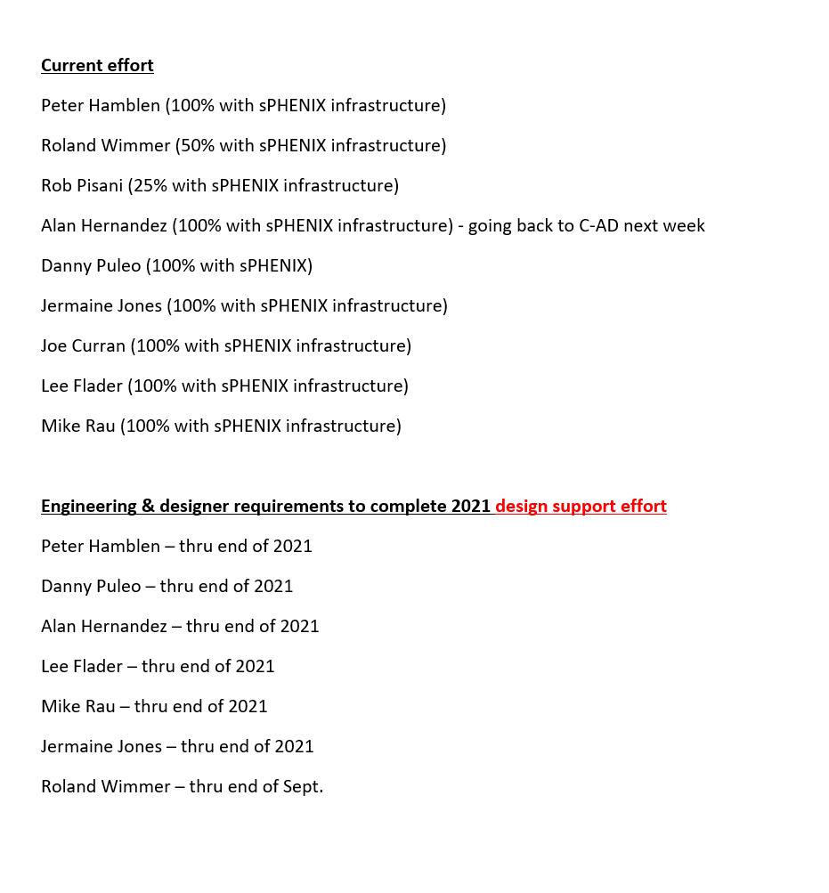
Joel Vasquez Infrastructure needs

