Slide 1
sPHENIX Installation Schedule with RHIC Run 22 Ending April 4 2022
Glenn Young
July 8, BNL

Slide 2
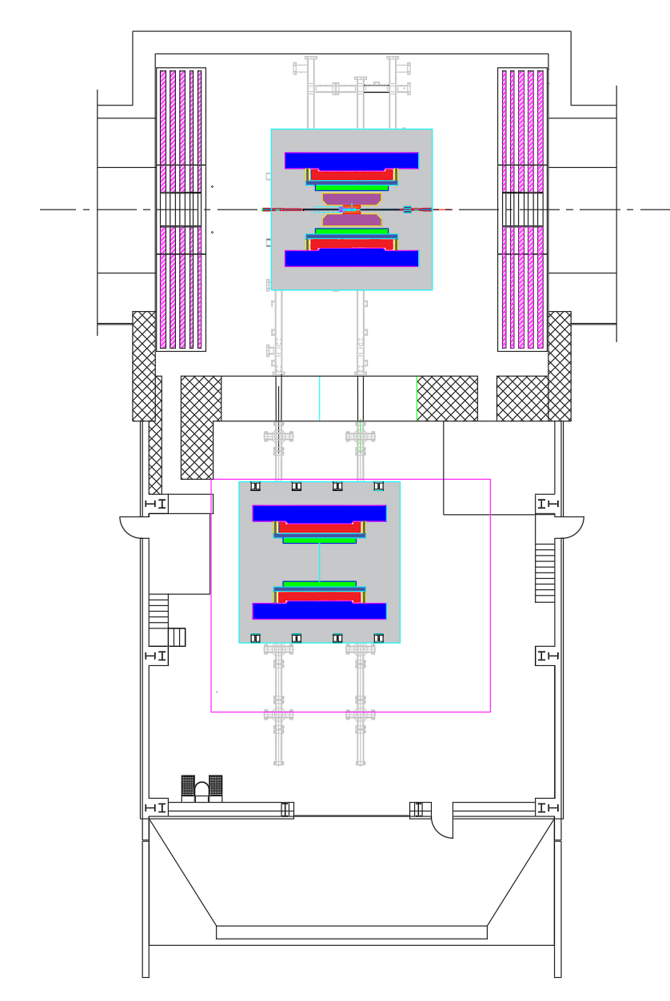
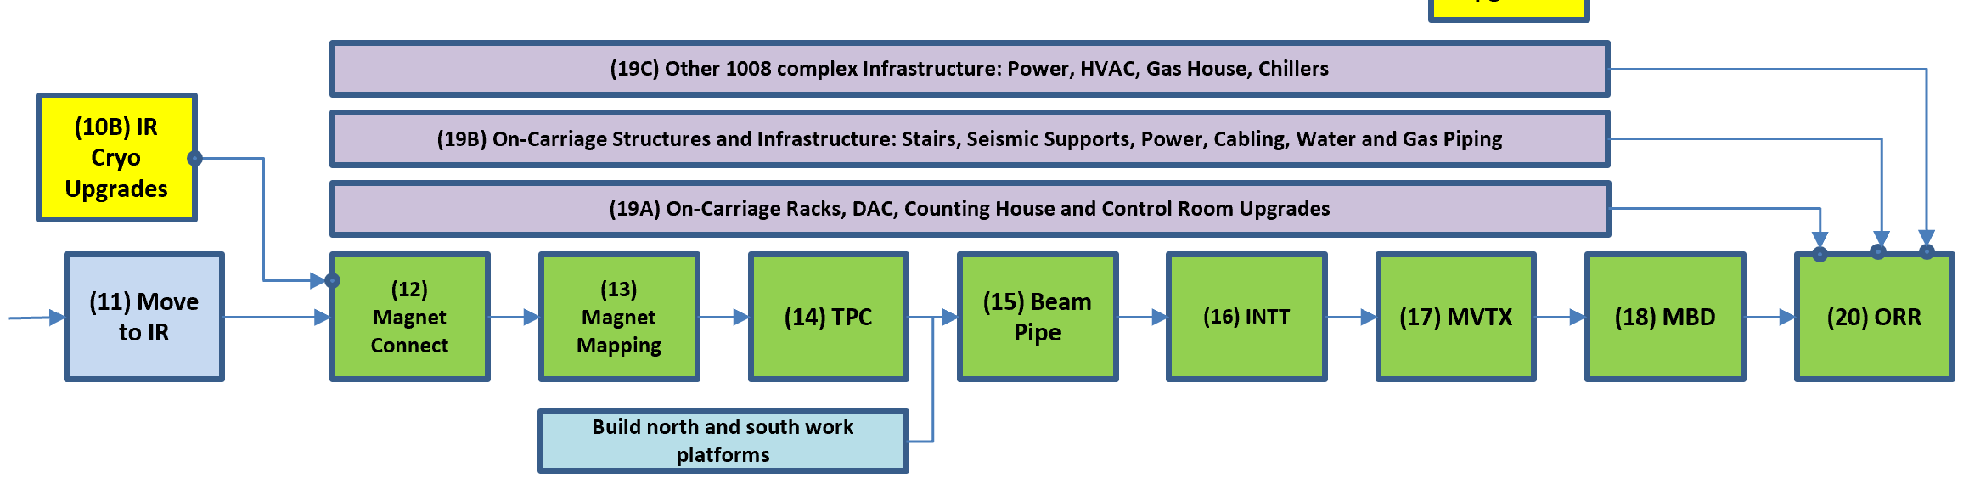
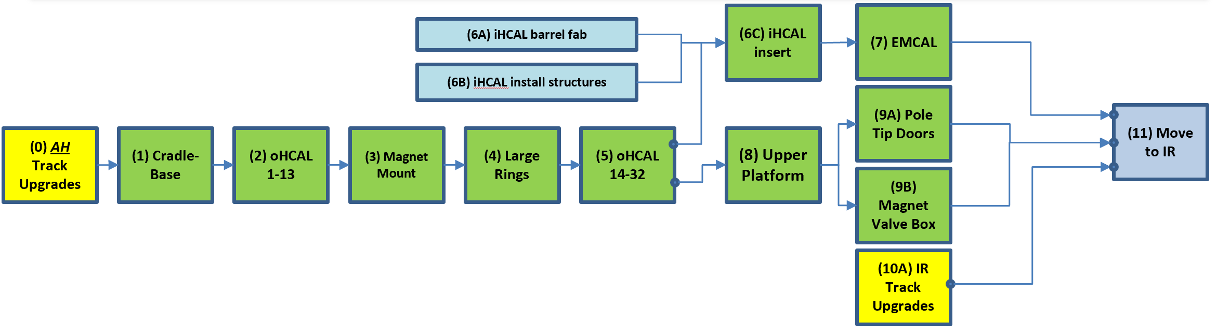
sPHENIX Assembly Sequence
(II) IR Hall Work
April-22’ to Oct-22’
(I) Assembly Hall Work
May-21’ to April-22’
Complete
Complete
AH work through end of CY 21’
You are here

Slide 3
sPHENIX Roll-in Date to 1008 IR
Roll-in date, from 2019 I&F Baselining, is March 22-28, 2022
  Plan has been to remove shield wall earlier in February-March 2022
  Co-ordination with EMCal installation is required
Shift of Run 22 end date to Monday April 4, 2022, requires some re-planning – have to add time to remove shield wall
  Analysis of effort for removing shield wall, making any adjustments to tracks, and actual roll-in suggests that 15 days are needed
  Result is a 4 week shift later in arrival of sPHENIX in position in the IR
  Connection of cryogenics jumpers (U-tubes) and power bus has to await completion of this step
  Magnet cool-down necessarily awaits completion of the above

Slide 4
Work Post Roll-in & Contingency
Baseline had ORR performed 9/14/2022 – 10/12/2022
  Contingency is 71 work days before a Run 23 start on 1/30/2023
Revised schedule puts ORR 10/19/2022 – 11/21/2022
Work subsequent to roll-in includes
  Cryogenic, power-bus, control line hookup for magnet
  Magnet pumpdown, cooldown, power-up, mapping
  Installation of TPC, beampipe (w/bakeout), INTT, MVTX, MBD
  ORR for all of sPHENIX plus addressing any action items

Slide 5

sPHENIX AH Installation Schedule
Dates from April 21’ I&F review
Actual AH starts
Sequential Build Steps | Locate | Start | End | J-21 | F-21 | M-21 | A-21 | M-21 | J-21 | J-21 | A-21 | S-21 | O-21 | N-21 | D-21 | J-22 | F-22 | M-22 | A-22 | M-22
AH Track Upgrades (started 3/1) | AH | 3/1/21 | 5/3/21
 |  | 3/1/21 | 5/14/21
Cradle-Base | AH | 5/4/21 | 6/2/21
 |  | 5/17/21 | 6/25/21
Outer HCAL 1-13 | AH | 6/4/21 | 8/25/21
 |  | 6/28/21
Secure Magnet in oHCAL, Tests | AH | 8/26/21 | 9/29/21
Large Support Rings | AH | 9/30/21 | 10/6/21
Outer HCAL 14-32 | AH | 10/7/21 | 12/10/21
Inner HCAL Barrel Install | AH | 1/10/22 | 1/28/22
EMCAL | AH | 2/7/22 | 3/21/22
Carriage, Platforms, Cable Tray and Pipe Supports, Pole Tips | AH | 11/15/21 | 3/28/22
LN2/Helium Line Infrastructure | IR | 7/15/21 | 11/15/21
IR Track Upgrades | IR | 7/15/21 | 11/15/21
Magnet Valve Assembly | AH | 3/28/22 | 4/5/22
Move sPHENIX to IR | AH to IR | 4/6/22 | 4/20/22
Magnet Cryo and Electric Connect | IR | 4/6/21 | 6/13/22
Current Status
Shield Wall Removal
sPHENIX = ~200 tons
ohCAL sector factory
Magnet supports
Shield Wall Install
sPHENIX = ~650 tons
LSR Procurement
Install structures procure
If EMCAL not done, resume in IR before magnet map start
iHCAL factory and barrel fab
EMCAL sector factory
Install tool procure and fab
`
Platform procurement
Pole Tip procurement`
Shield Wall Remove
sPHENIX = ~870 tons
RHIC Run FY21
1/30/21 to 7/15/21
RHIC Run FY22
11/15/21 to 4/3/22

Slide 6
sPHENIX IR Installation Schedule
Sequential Build Steps | Locate | Start | End | M-22 | A-22 | M-22 | J-22 | J-22 | A-22 | S-22 | O-22 | N-22 | D-22 | J-23 | F-23 | M-23 | A-23 | M-23 | J-23 | J-23
Move sPHENIX to IR | AH to IR | 4/6/22 | 4/20/22
Magnet Cryo and Electric Connect | IR | 4/6/22 | 6/13/22
Complete EMCAL (if needed, not in P6) |  | 4/6/22 | 6/13/22
Magnet Mapping | IR | 6/14/22 | 7/6/22
TPC | IR | 7/11/22 | 7/22/22
Platforms, INTT Support, Beam Pipe Install and Bake | IR | 8/1/22 | 8/30/22
INTT | IR | 8/31/22 | 9/22/22
MVTX | IR | 9/23/22 | 10/18/22
MBD And Final Beam Pipe Supports | IR | 9/8/22 | 10/18/22
Carriage Stairs and Seismic Supports | IR | 4/20/22 | 6/26/22
Racks | IR | 4/20/22 | 10/18/22
Carriage Infrastructure (continued) | IR | 4/20/22 | 10/18/22
Other 1008 Infrastructure | IR | 4/20/22 | 10/18/22
ORR (Early Finish) | IR | 10/19/22 | 11/21/22
CERN team arrival
Eqpt set up
TPC install structures set up
BNL NEG coating
Contingency
RHIC Run FY22
11/15/21 to 4/3/22
RHIC Run FY23
Model (Jan to June)

Slide 8
OuterHCal and EMCal Installation
 | Fabrication Complete | Installation Date | Delta (wk)
OHCal Sector 1 & Splice Plates | Week 8, 2021 | Week 25, 2021 | 17
OHCal Sector 13 | Week 5, 2021 | Week 36, 2021 | 31
SC Magnet Coil | 2018 (testing at BNL) | Week 39, 2021 | >100
OHCal Sector 14 | Week 5, 2021 | Week 43, 2021 | 38
OHCal Sector 32 | Week 17, 2021 | Week 48, 2021 | 31
EMCal Sector 1 | Week 14, 2020 | Week 1, 2022 | 91
EMCal Sector 32 | Week 26, 2021 | Week 5, 2022 | 31
EMCal Sector 59 | Week 52, 2021 | Week 10, 2022 | 10
EMCal Sector 64 | Week 5, 2022 | Week 11, 2022 | 6

Slide 9
TPC and Electronics Installation
 | Fabrication Complete | Installation Date | Delta (wk)
TPC | Week 4, 2022 | Week 28, 2022 | 24
OHCal Cabling | Week 3, 2022 | Week 5, 2022 | 2
EMCal Cabling | Week 3, 2022 | Week 5, 2022 | 2
Digitizers | Week 44, 2021 | Week 17, 2022 | 25
Trigger & Timing Systems | Week 4, 2022 | Week 17, 2022 | 13
Beampipe | Week 8, 2022 | Week 32, 2022 | 24
TPC, EMCal and OHCal on-detector electronics are installed as part of detector fabrication
Digitizer, Trigger and Timing installed after roll-in during April 2022
EMCal & HCal cabling starts only after Upper Platform in placed and essential cryogenics work is underway

