Slide 1
Bi-weekly Meeting, June 24th 2021
(WAITING FOR A LOGO …)
ATHENA NEWS
Athena Coordination Committee
Silvia Dalla Torre, Abhay Deshpande, Olga Evdokimov, Yulia Furletova,
Barbara Jacak, Alexander Kiselev, Franck Sabatie, Bernd Surrow
ATHENA bi-weekly Meeting, 24 June 2021
S. Dalla Torre

Slide 2
Bi-weekly Meeting, June 10th 2021
(WAITING FOR A LOGO …)
AGENDA
ATHENA news, Silvia Dalla Torre
ATHENAS logo news, Yulia Furletova
Update on ATHENA Charter and election plans, Olga Evdokimov
Magnet studies reports:
PID WG, conveners
tracking WG, conveners
summarizing towards a response to Elke's 3T, discussion
Present current list of golden physics channels identified so far by presenting preliminary versions of the plots:
inclusive WG, conveners
semi-inclusive WG, conveners
Jets/HF/EW-BSM WG, conveners
exclusive/tagging WG, conveners
Discussion about the golden channels: what is missing? Modification? detector perspectives vs the proposed golden channels? discussion
ATHENA bi-weekly Meeting, 24 June 2021
S. Dalla Torre

Slide 3
EIC agenda
(WAITING FOR A LOGO …)
monthly joint EIC project meetings between the Project management and the representatives of the proto-collaborations
next meeting on July 1st
Agenda:
Status of the IP-6 0.5 meter shift
Status of IP-8
Q&A session
"CD-1 DOE ESAAB" meeting on June 28th
→ so announcement of CD-1 for EIC expected on June 28th or about
ATHENA bi-weekly Meeting, 24 June 2021
S. Dalla Torre

Slide 4
EICUG agenda
(WAITING FOR A LOGO …)
Annual EICUG meeting, August 2-6, 2021, some preliminary information
Co-Organized by Virginia Union University (Narbe Kalantarian) and the University of California, Riverside (Miguel Arratia)
Day 1 session
EICUG Welcome
EIC project status updates
3 High-level physics presentations: Spin, Mass, High density gluons
Presentations from funding agency and community representatives
DOE, NSF, CERN, NUPECC, Other funding agencies?
Included in the following days
EIC accelerator design updates
EIC detector proposal initiatives
2nd IR studies, Summary of Junior Day (**),
announcement of election results and change of EICUG leadership WG summaries
Parallel: Computing / Software / Detector R&D / Physics / Polarimetry (Parallel)
IMPORTANT (**)
Junior Day (self-organized by junior colleagues)
an EXTREMELY interesting new initiative: follow it!
ATHENA bi-weekly Meeting, 24 June 2021
S. Dalla Torre

Slide 5
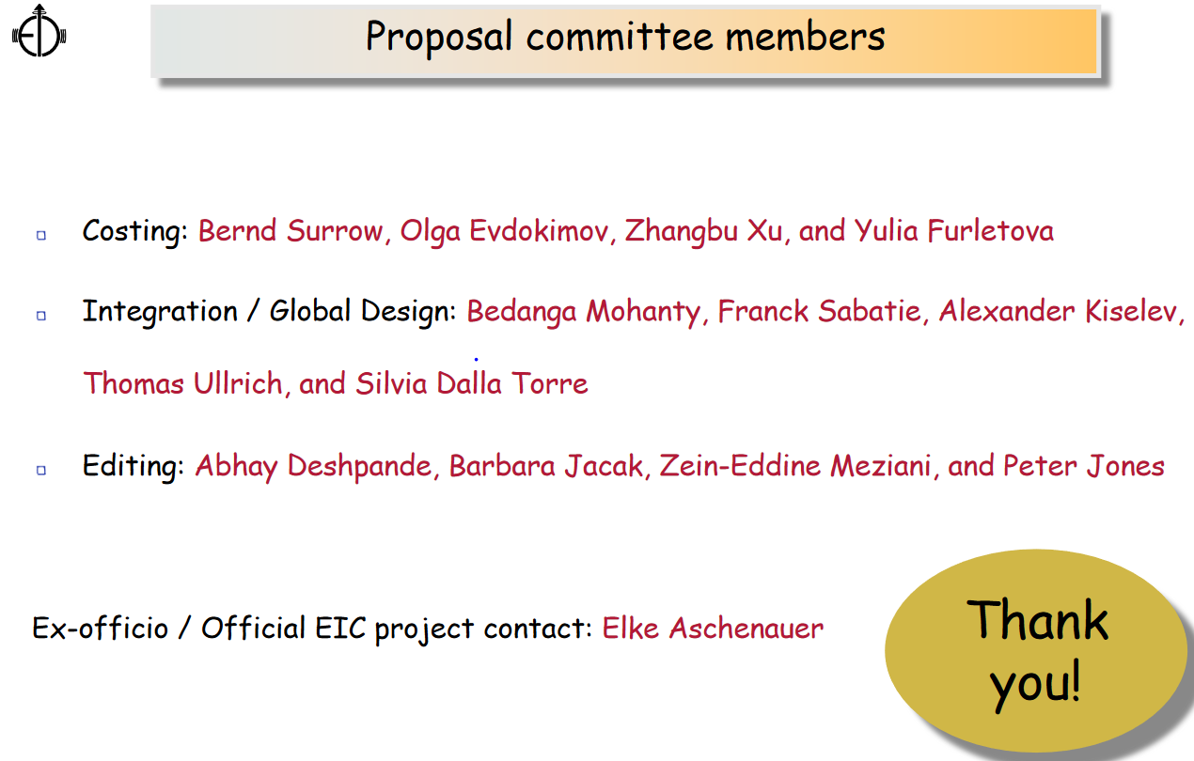
First meeting of the Proposal Committee
(WAITING FOR A LOGO …)
RIMINDER:
The proposal Committee will have its kick-off meeting TOMORROW
Main goal: get organized to start working
Document sharing systems/utilities to be agreed upon
Then, after the kick-off, the role of WGs in this activity will be major
ATHENA bi-weekly Meeting, 24 June 2021
S. Dalla Torre

Slide 6
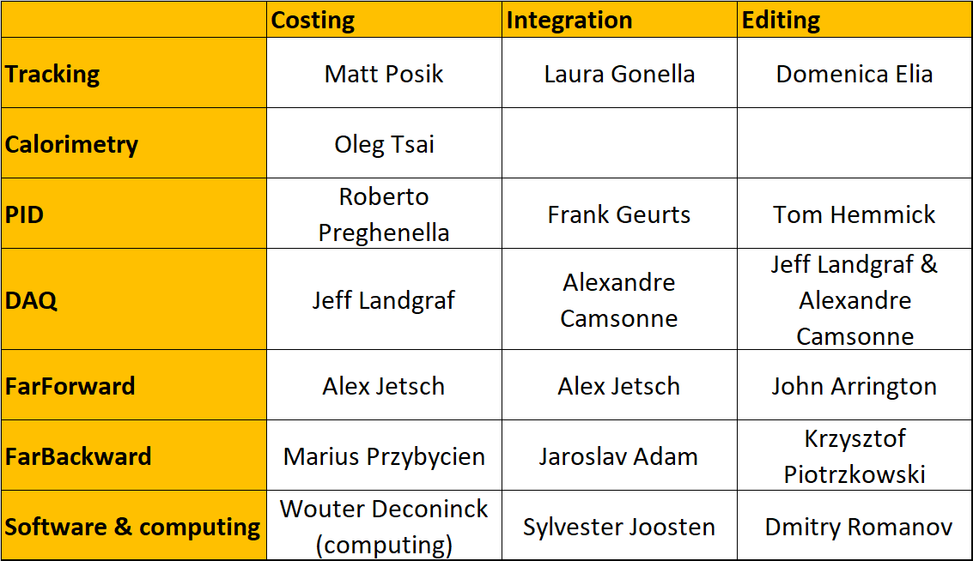
WGs contacts - Proposal Committee
(WAITING FOR A LOGO …)
Contact of Physics WGs for Editing being defined
ATHENA bi-weekly Meeting, 24 June 2021
S. Dalla Torre

Slide 7
Proposal Committee – news from COSTING
(WAITING FOR A LOGO …)
Bernd Surrow, Olga Evdogimov, Zhangbu Xu, Yulia Fulertova
So far, two meetings of costing group to identify and prepare initial steps
Currently preparing templates for WGs to be filled in
WG contact persons to the cost subgroup have been identified
Planning to have a joint meeting with contact persons to explain what is needed and to show/navigate through the template form
ATHENA bi-weekly Meeting, 24 June 2021
S. Dalla Torre

Slide 8
(WAITING FOR A LOGO …)
ATHENA bi-weekly Meeting, 24 June 2021
S. Dalla Torre

Slide 9
Proposal Committee – news from INTEGRATION
(WAITING FOR A LOGO …)
Bedanga Mohanty, Frank Sabatie, Alexander Kiselev, Thomas Ullrich, Silvia Dalla Torre
Meetings on Friday at 9.30 am (EDT)
First meeting on June 18th
Decisions and actions:
Until an advanced design of the global detector is accomplished, we will need input and close collaboration with the following WGs: tracking, PID, calorimetry. Therefore, in this initial phase, we are going to ask all conveners of these 3 WGs for close interaction/collaboration with us.
We are going to ask the software WG to implement in collaboration with the detector working groups an initial minimum central detector (baseline) for the first round.
This will certainly not be the final configuration but will serve as a baseline for further improvements and will allow the PWG to setup their validation scheme so that further iterations can proceed in a timely fashion. Once accomplished, we will add/change components to evaluate improvements. The list of the baseline detector will circulated after reviewing it together with tracking, PID, calorimetry on next Friday.
ATHENA bi-weekly Meeting, 24 June 2021
S. Dalla Torre

