Slide 1
ECCE Simulations
Status Report Cameron Dean and Jin Huang
06/23/2021 Software and Computing Meeting

Slide 2
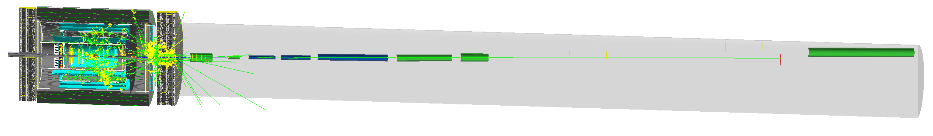
Detector Status
First ECCE detector is ready (for beta testing)!
June 2021 concept is now our default macros branch
Many coresoftware, fun4all_eicdetector and fun4all_eiccalibrations updates to match
https://github.com/ECCE-EIC/macros/tree/June-2021-Concept-v0.1
To-do:
Patch memory leaks (one repeating source in EventEval, one fix fixes all!)

Slide 3
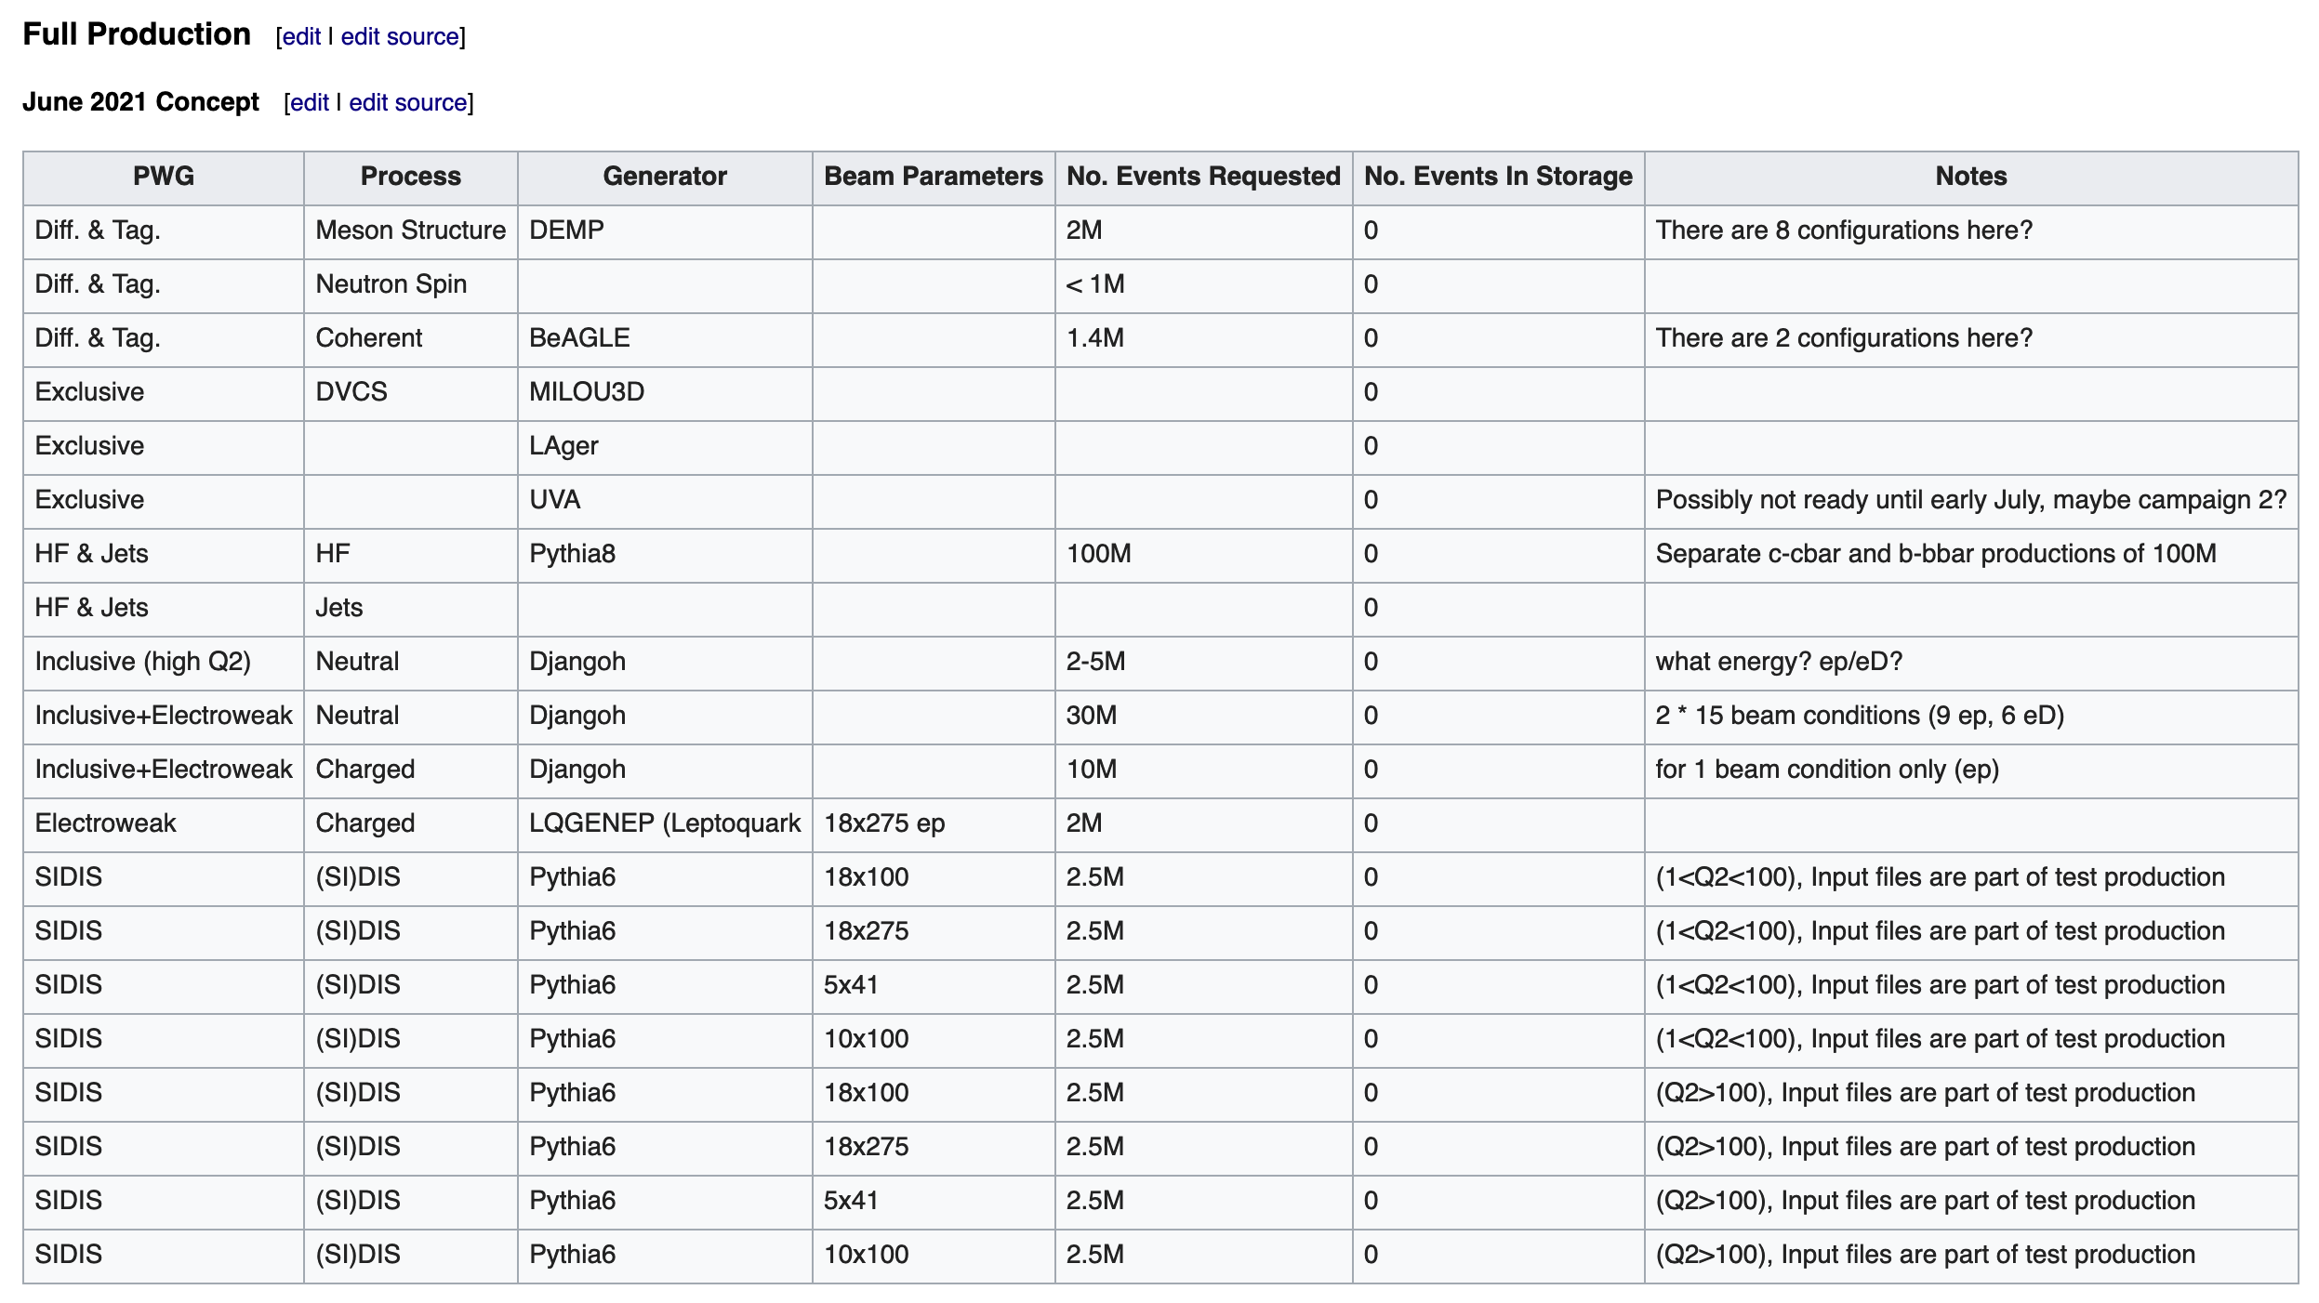
Physics Status
Physics WG meeting on Monday, many teams presented their wish list
We started populating a table on our wiki
PWG conveners have been asked to check and add to it

Slide 4
Production Status
Top-level scripts were completed and tested by Monday
BNL reduced our CPU slots by 40% at end of the working day yesterday
Summary: Farm batch slots repartitioning
Duration: Effective immediately for one month
Description:
We would like to inform you that upon request from NPP, a queue/slot re-partitioning will take effect shortly on the batch farm providing a temporary major resource increase to the STAR experiment. This followed a DOE request that STAR must complete its blinded analyses of the 2018 Isobar data by the end of the current fiscal year (this target was made as part of a notable Performance Evaluation and Measurement Plan from DOE ONP). In order to meet the deadline, the reallocation (a proportional reduction of slots from several groups by -40%) needs to remain in effect for the coming month and this may cause some impact to the throughput of other jobs, including those of STAR non-Isobar related analysis and data production as well as those from ATLAS T3, EIC, PHENIX and sPHENIX.
If during this period, you need additional resources, please contact us, we will try to find ways to accommodate your request.

Slide 5
Production Status
Workaround to reduction: Use OSG from BNL
SDCC were testing our simulation mechanism through SUMS
They successfully generated 1000 events with some hard coding
I started work on integrating SUMS submission into our top-level scripts
Step | Status
Can autogenerate xml files that run | Complete
Can transfer shell scripts and generator files to OSG | Complete
Can get our macros and generate events | Complete
Can transfer files from OSG to S3 | Not started (but David has a script for this)

Slide 6
Production Status
Next steps:
Finish memory leak check on ECCE configuration
This was launched yesterday but idled with our batch system reduction
Launch test productions
10M particle gun events, doesn’t need an input file
10M SIDIS events. All files were transferred to S3 yesterday, any production site can copy them out
My thought is to run 5M low q2 and 5M high q2 at different sites
Input files: mc ls S3/eictest/ECCE/ProductionInputFiles/SIDIS/pythia6/ep_18x100

Slide 7
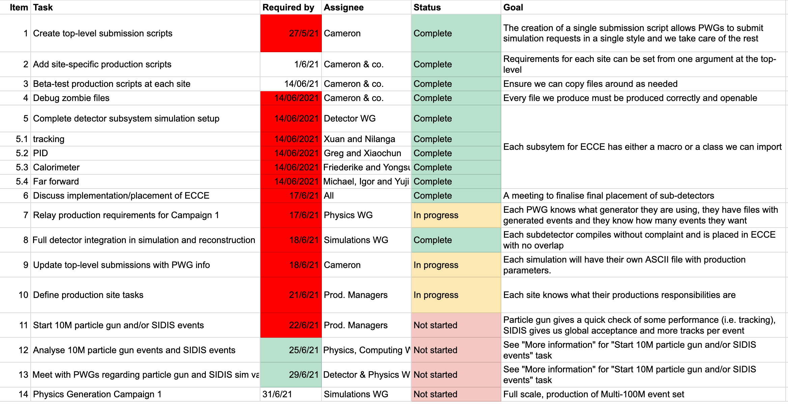
Production Status

