Slide 1
IR Meetings across
Proto-Collaborations
E.C. Aschenauer (BNL)
R. Ent (JLab)
Co-Associate Directors for the Experimental Program
July 12th, 2021

Slide 2
0.5 m Shift at IR-6
During Yellow-Report it became clear that 4.5 m at outgoing hadron beam side is not enough space for the detector
  Request to increase space by 0.5 m
  now detector space at IP-6: -4.5 m to 5.0 m → same at 2nd IR @ IP-8
move by
0.5 m

Slide 3
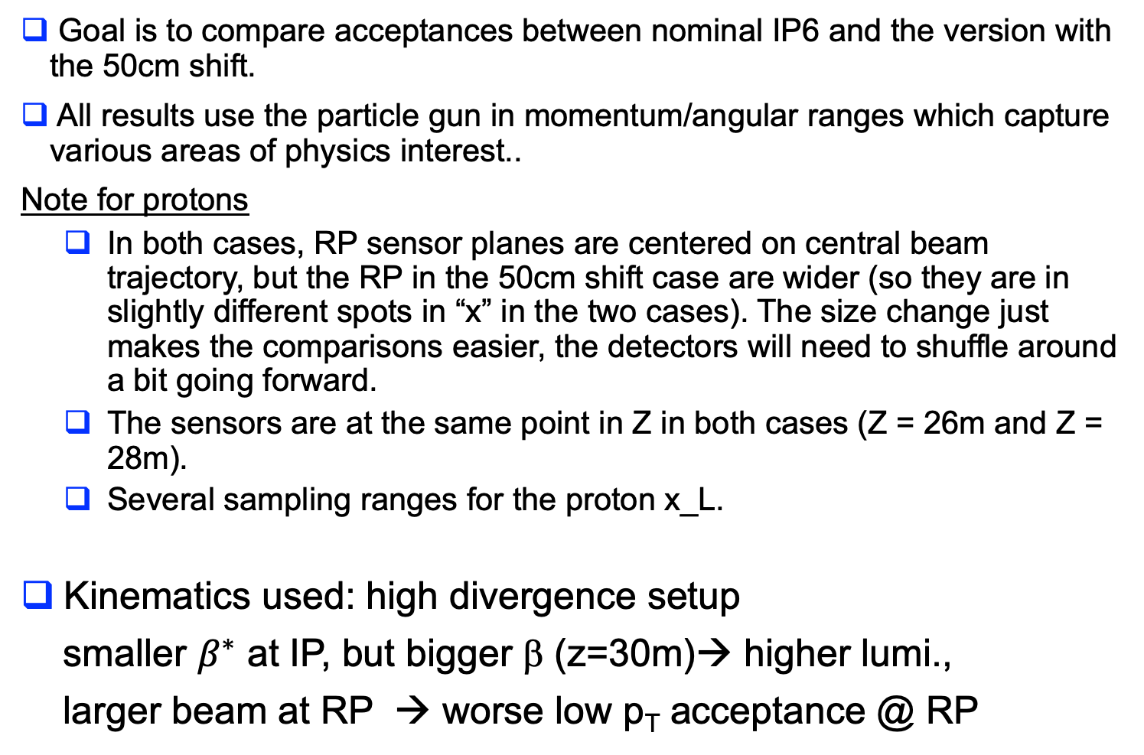
Simulation Setup
Goal is to compare acceptances between nominal IP6 and the version with the 50cm shift.
All results use the particle gun in momentum/angular ranges which capture various areas of physics interest..
Note for protons
  In both cases, RP sensor planes are centered on central beam trajectory, but the RP in the 50cm shift case are wider (so they are in slightly different spots in “x” in the two cases). The size change just makes the comparisons easier, the detectors will need to shuffle around a bit going forward.
  The sensors are at the same point in Z in both cases (Z = 26m and Z = 28m).
  Several sampling ranges for the proton x_L.
Kinematics used: high divergence setup
smaller $β^{∗}$ at IP, but bigger β (z=30m)→ higher lumi.,
larger beam at RP → worse low p_{T} acceptance @ RP

Slide 4
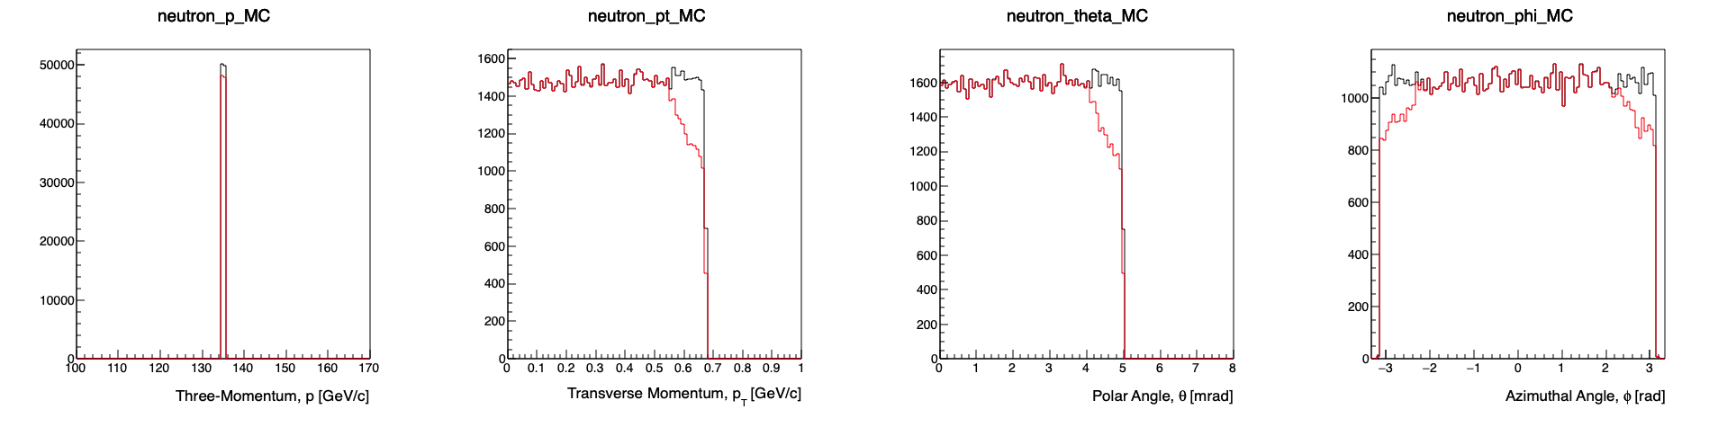
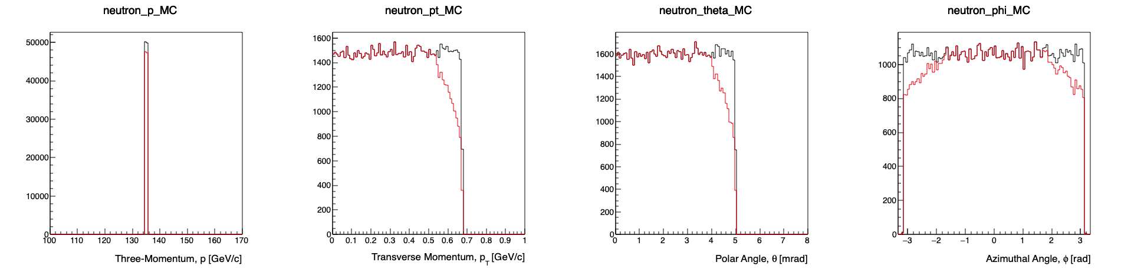
Neutron Acceptance
Before shift
Generated
Accepted
After shift

Slide 5
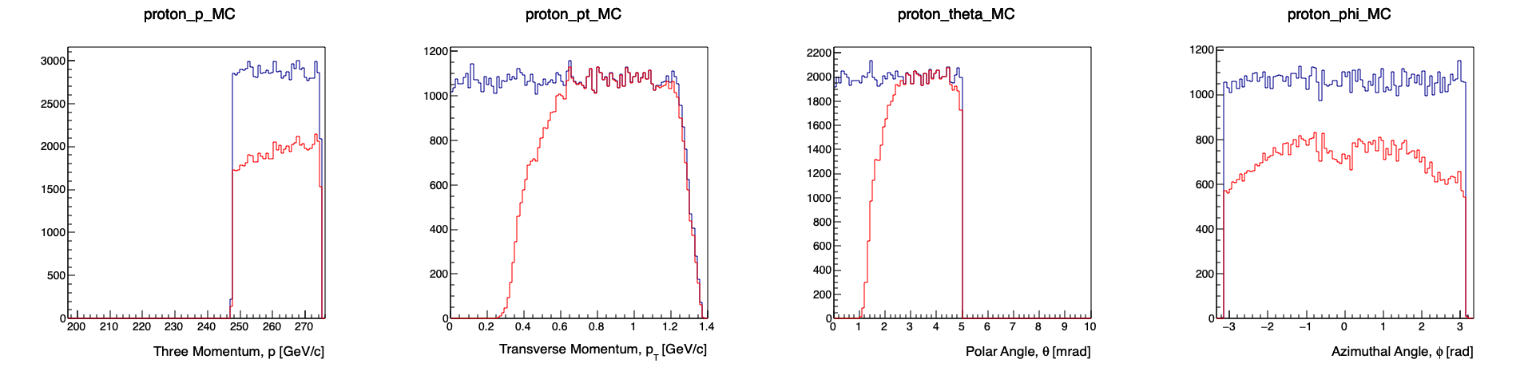
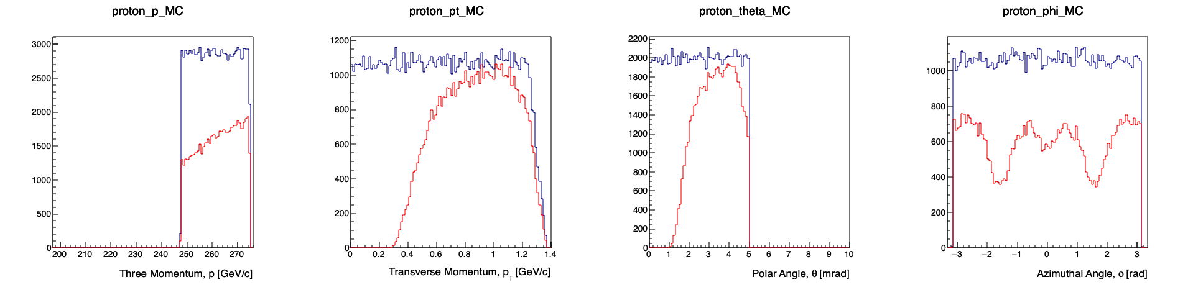
Proton acceptance
0.0 < theta < 5.0 mrad
247.5 < p < 275 GeV/c
0.9 < xL < 1.0
Momentum
Transverse Momentum
Polar Angle
Azimuthal Angle
Before shift
Generated
Accepted
Nominal
After shift
50cm shift

Slide 6
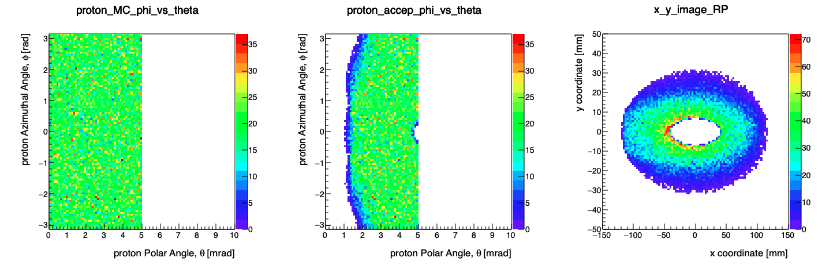
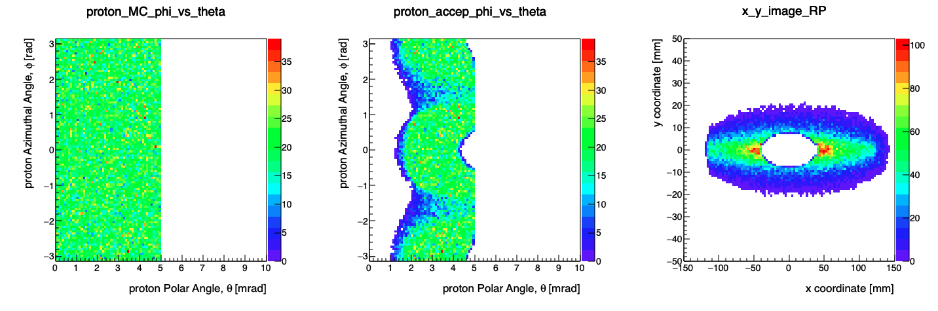


Proton acceptance
Top row: nominal
Bottom row: 50cm shift
0.0 < theta < 5.0 mrad
247.5 < p < 275 GeV/c
0.9 < xL < 1.0
Generated
𝜙 vs. 𝜃
Accepted
RP Sensor Occupancy
$$σ_{x}\left(nominal\right)=\text{4.11308 }\text{mm}$$
$$σ_{y}\left(nominal\right)=\text{0.705337 }\text{mm}$$
Generated
𝜙 vs. 𝜃
Accepted
RP Sensor Occupancy
$$σ_{x}\left(50cm\right)=\text{4.03571 }\text{mm}$$
$$σ_{y}\left(50cm\right)=\text{0.787401}\text{mm}$$

Slide 7
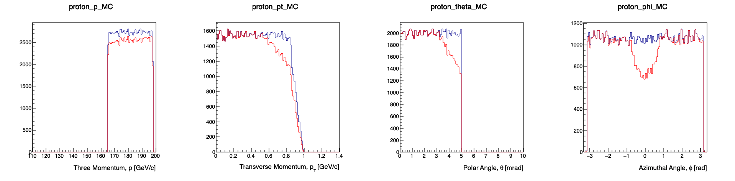
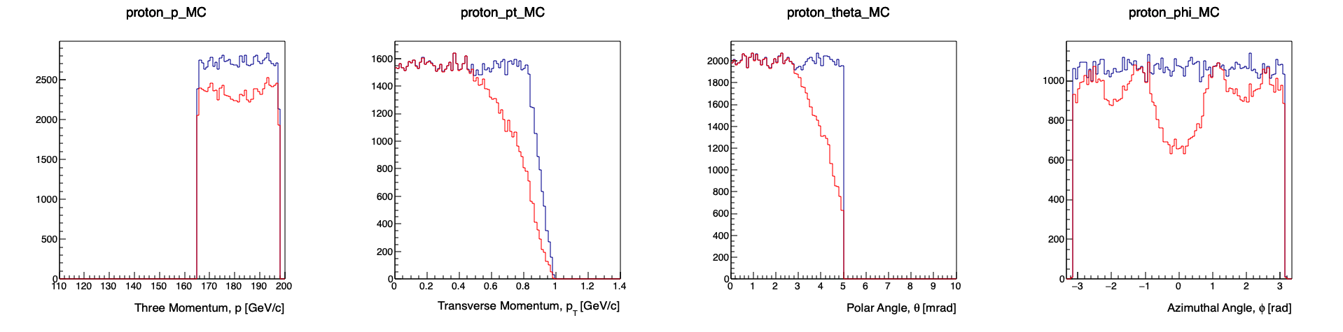
Protons (0.60 < x_L < 0.72)
165 < p < 198 GeV/c
0 < theta < 5 mrad
Generated
Accepted
Before shift
After shift

Slide 8
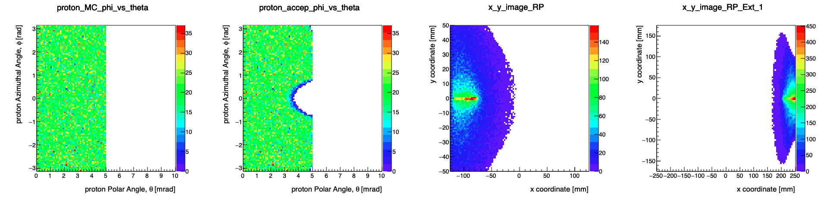
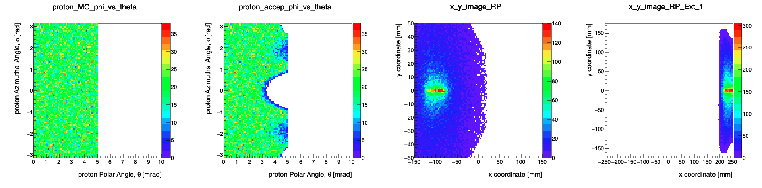
Protons (0.60 < x_L < 0.72)
OMD acceptance becomes more important.
165 < p < 198 GeV/c
0 < theta < 5 mrad
Generated
Accepted
Hits on sensor plane (local sensor coordinates)
Before shift
Roman Pots
Off-Mom. Det.
After shift
Off-Mom. Det.
Slightly larger Roman Pots needed
in 50cm shift case.

Slide 9
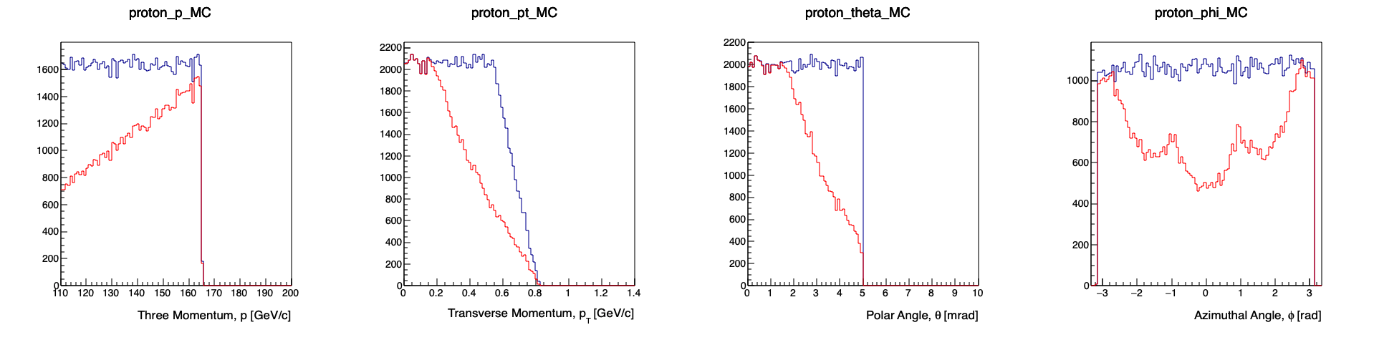
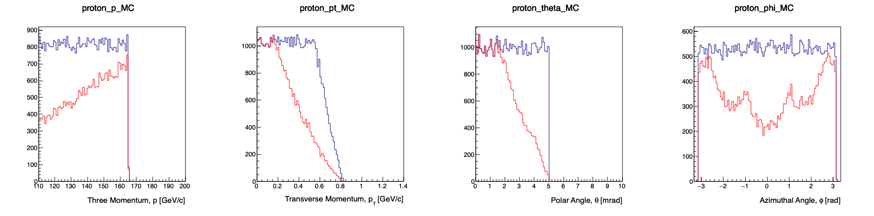
Protons (0.40 < x_L < 0.6)
110 < p < 165 GeV/c
0 < theta < 5 mrad
Before shift
Generated
Accepted
After shift

Slide 10
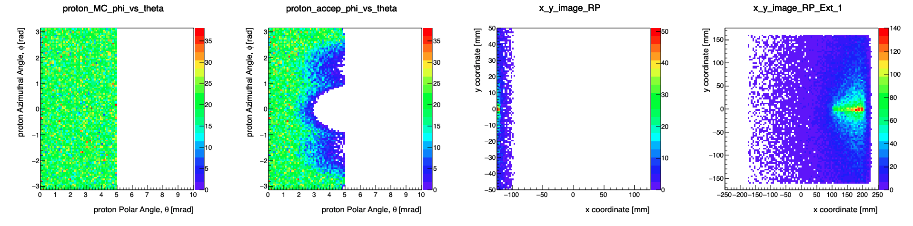
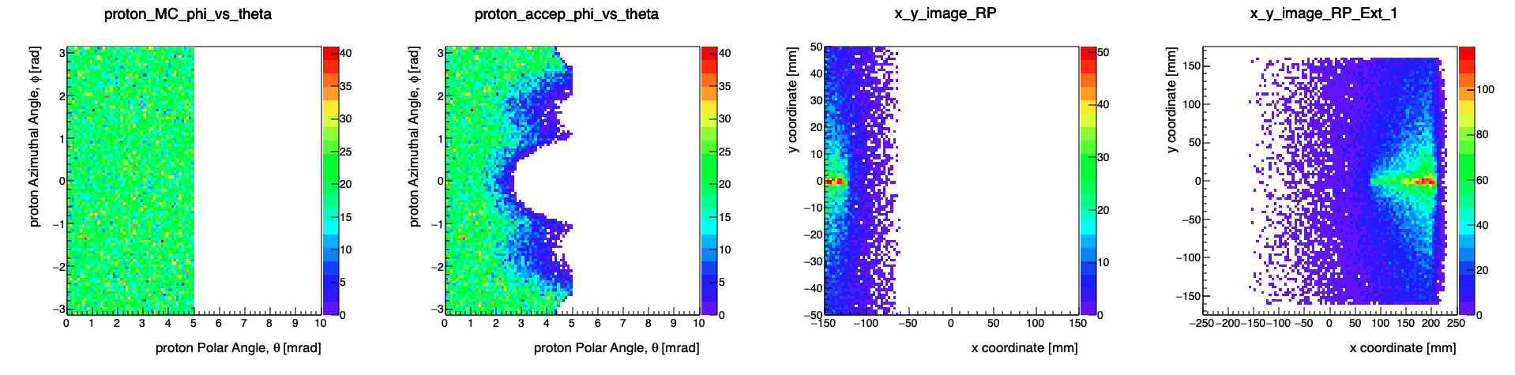
Protons (0.40 < x_L < 0.6)
110 < p < 165 GeV/c
0 < theta < 5 mrad
OMD acceptance dominates.
Generated
Accepted
Hits on sensor plane (local sensor coordinates)
Off-Mom. Det.
Before shift
Roman Pots
After shift
Slightly larger Roman Pots in 50cm shift case.

Slide 11
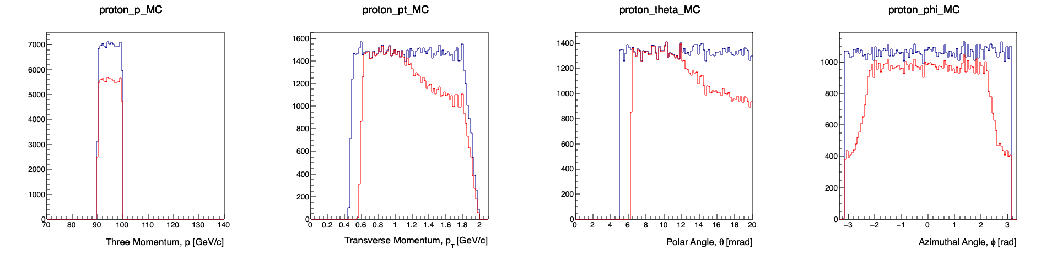
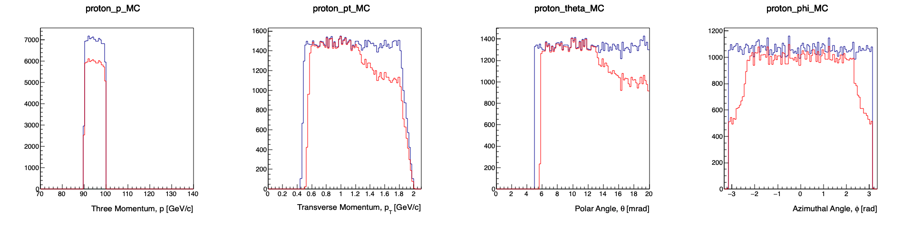
Protons in B0
90 < p < 100 GeV/c
0 < theta < 20 mrad
Lower cutoff determined by beam pipe size.
Before shift
Generated
Accepted
After shift

Slide 12
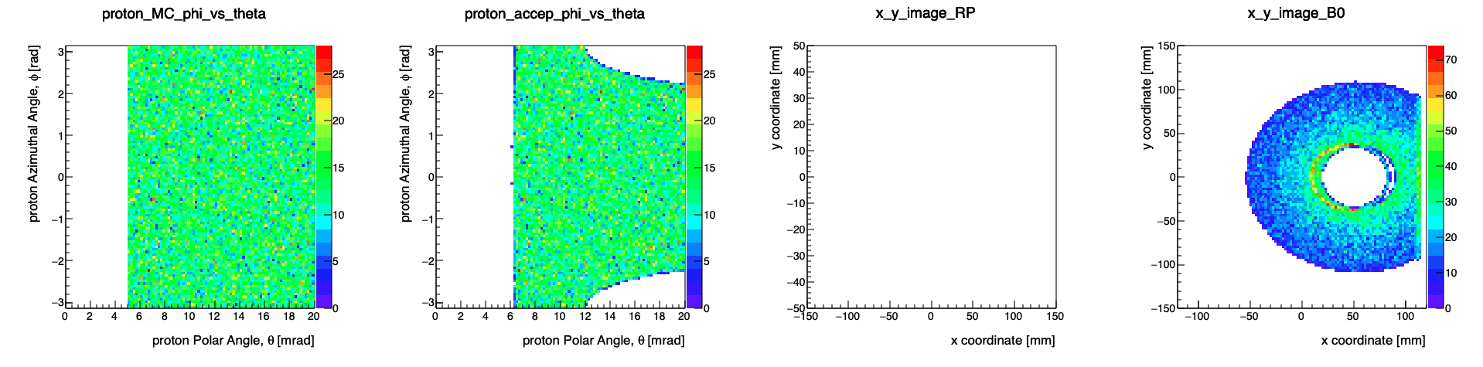
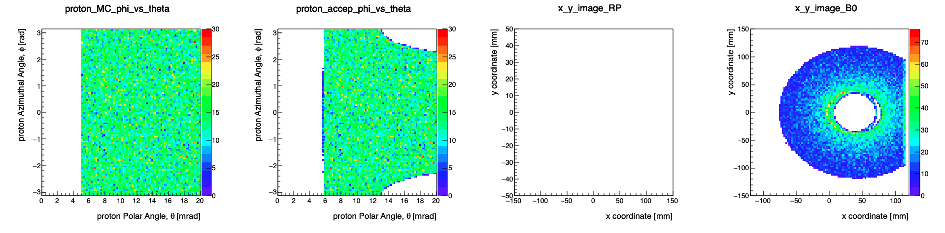
Protons in B0
90 < p < 100 GeV/c
0 < theta < 20 mrad
Assuming a beam pipe with diameter of 7.2 cm.
Generated
Accepted
Hits on sensor plane (local sensor coordinates)
Before shift
Roman Pots
B0 Det.
After shift
Roman Pots
B0 Det.

Slide 13
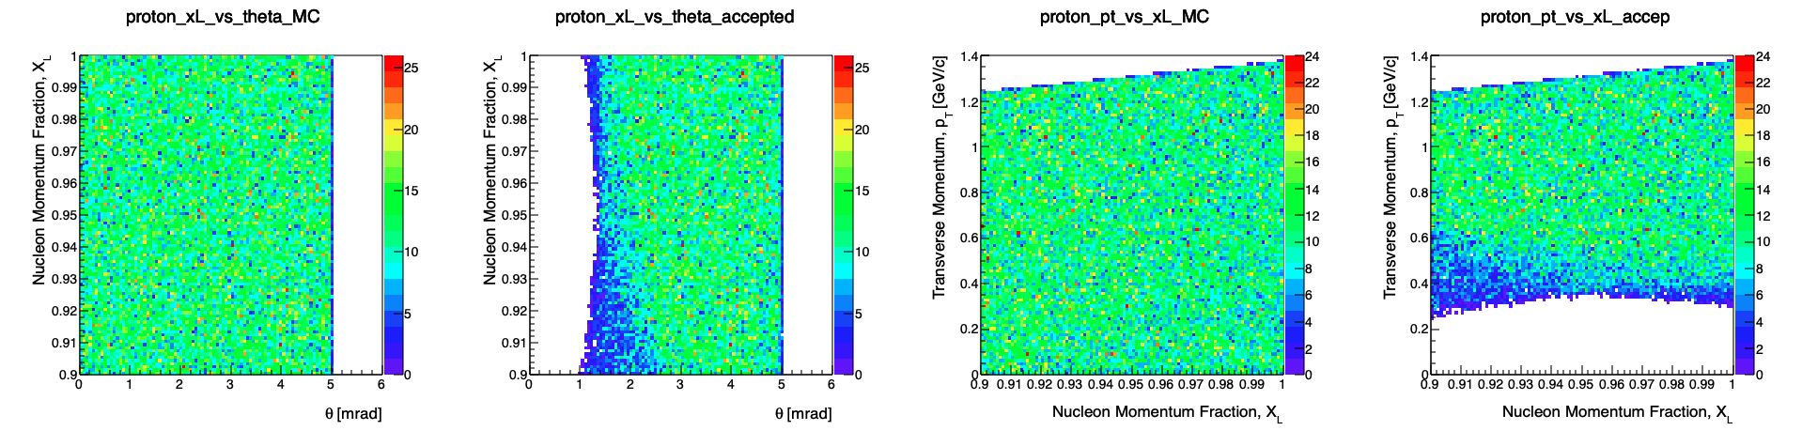
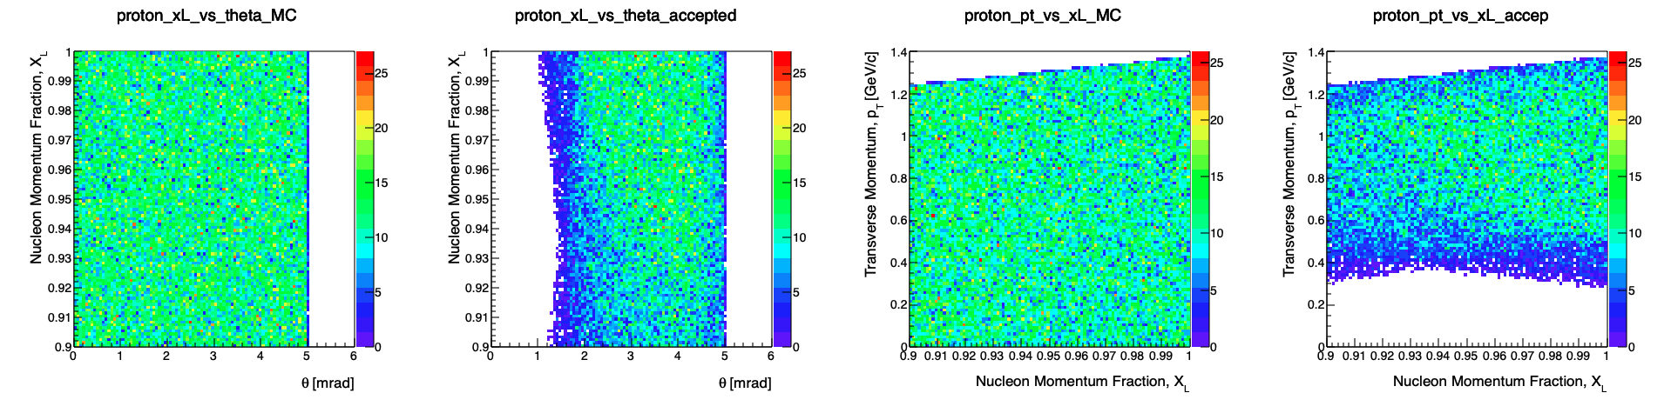


Top row: nominal
Bottom row: 50cm shift
0.0 < theta < 5.0 mrad
247.5 < p < 275 GeV/c
0.9 < xL < 1.0
$$σ_{x}\left(nominal\right)=\text{4.11308 }\text{mm}$$
$$σ_{y}\left(nominal\right)=\text{0.705337 }\text{mm}$$
$$σ_{x}\left(50cm\right)=\text{4.03571 }\text{mm}$$
$$σ_{y}\left(50cm\right)=\text{0.787401}\text{mm}$$
Generated
x_{L} vs. 𝜃
Accepted
Generated
p_{T} vs. x_{L}
Accepted
Generated
x_{L} vs. 𝜃
Accepted
Generated
p_{T} vs. x_{L}
Accepted

Slide 14
Summary
All material to simulate physics at 5x41, 5x100, 10x100 and 18x 275 will be posted today at https://indico.bnl.gov/event/10974/contributions/51260/
  Detailed Read-Me how to use all the provided information
At the same location files with the SR photons will be posted, so one can estimate the background / occupancy
The additional alignment of the magnets will further improve the acceptance. will provide update if this is done
An optimization of detector locations together with beam pipe is also still not finalized.

Slide 15


Slide 16

Complementarity for 1st-IR & 2nd-IR
Since CD-1 we made significant progress in the preliminary design for the 2nd IR with a focus on complementarity
1st IR (IP-6)
2nd IR (IP-8)
Geometry:
ring inside to outside
ring outside to inside
tunnel and assembly hall
are larger
Tunnel: ⦰ 7m +/- 140m
tunnel and assembly hall are smaller
Tunnel: ⦰ 6.3m to 60m then 5.3m
Crossing Angle:
25 mrad
35 mrad
secondary focus
different blind spots
different forward detectors and acceptances
different acceptance of central detector
Luminosity:
more luminosity at lower E_{CM}
optimize Doublet focusing FDD vs. FDF
→ impact of far forward p_{T} acceptance
Experiment:
1.5 Tesla or 3 Tesla
different subdetector technologies

