Slide 1
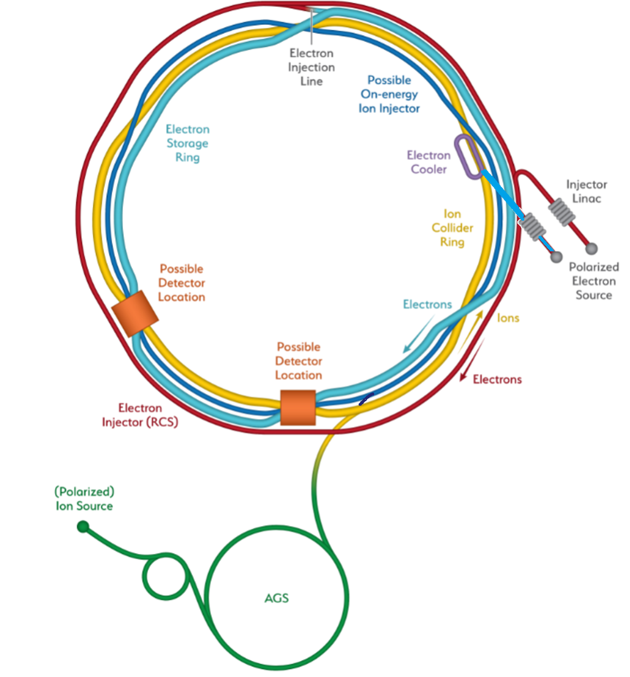
EIC – IR-6 Coordinate System
EIC-coordinate system:
positive z in hadron beam direction
hadron beam is going counterclockwise
y is pointing up → +x is pointing to ring inside
Hera had +z & +η also along hadron beam
At IP6:
hadron beam goes from ring inside to ring outside
electron beam goes ring outside to ring inside
Problem:
the IR picture always shown is confusing as it needs
to be flipped around the line indicated on the plot
to make all consistent
x
z
y
Backward
Hadron Storage Ring
Electron Storage Ring
Electron Injector Synchrotron
Possible on-energy Hadron
injector ring
Hadron injector complex
p/A beam
electron beam
Forward

Slide 2
EIC – IR-6 Coordinate System
Please find below the finally corrected picture of the IR-6 in a right-handed coordinate
system and the most up-to-date detector setup
Note: the same right-handed coordinate system applies for IR-8

Slide 3
0.5 m Shift at IR-6
During Yellow-Report it became clear that 4.5 m at outgoing hadron beam side is not enough space for the detector
Request to increase space by 0.5 m
now detector space at IP-6: -4.5 m to 5.0 m → same at 2nd IR @ IP-8
Such change requires to approval by EIC change control board, Change initiated after CD-1 Review
move by
0.5 m

Slide 4

0.5 m Shift at IR-6
Requirements:
Leave magnet apertures unchanged
match into the arcs is possible
synchrotron radiation is still reasonable
beam optics is okay
are magnets still buildable
far forward particle acceptance is not impacted to much
details in the following

Slide 5
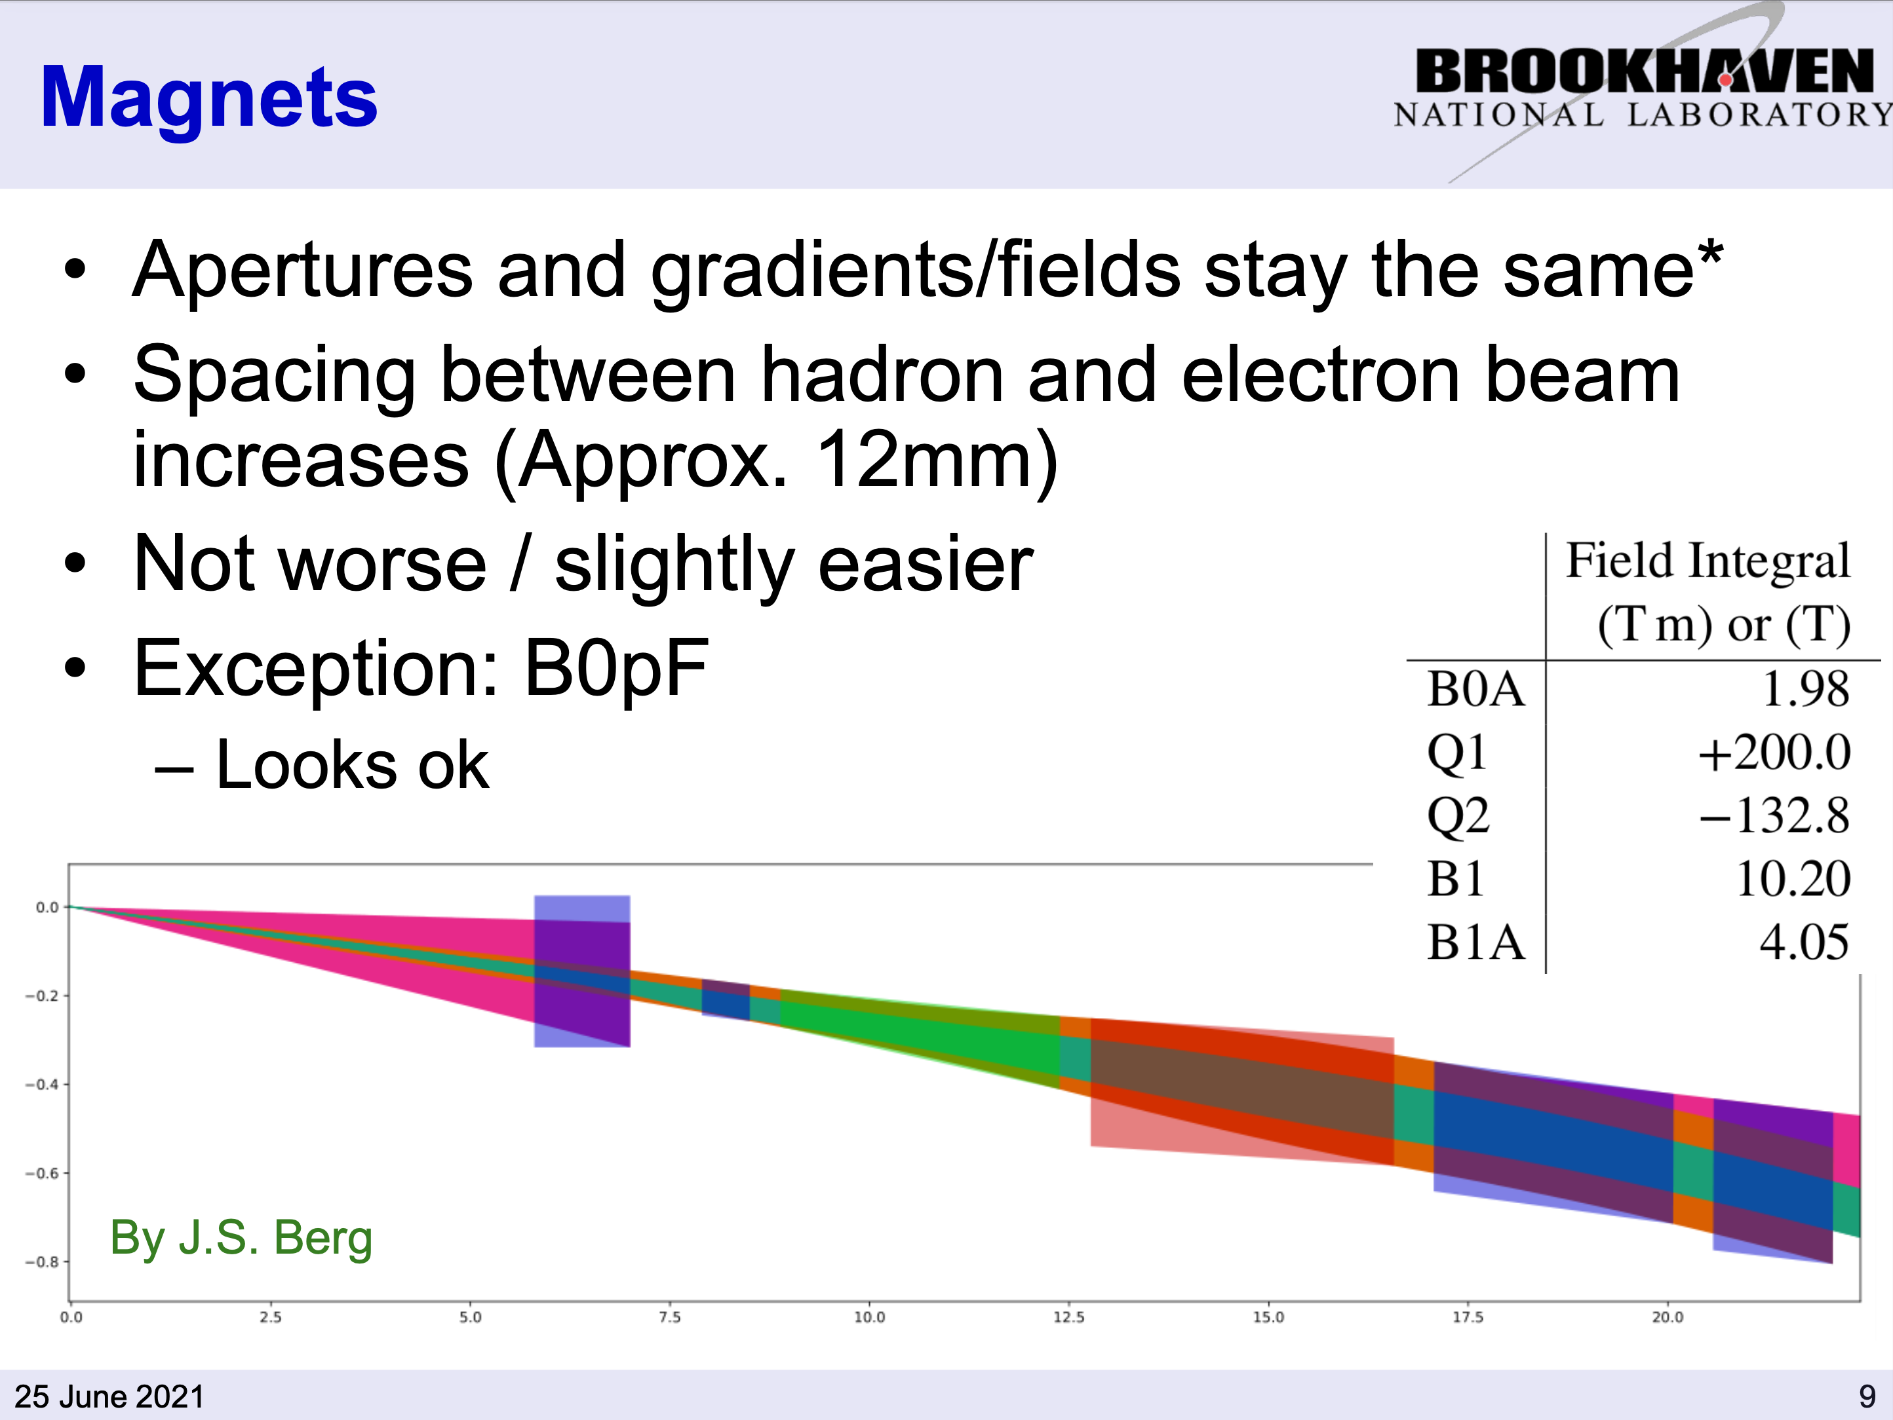
0.5 m Shift at IR-6

Slide 6
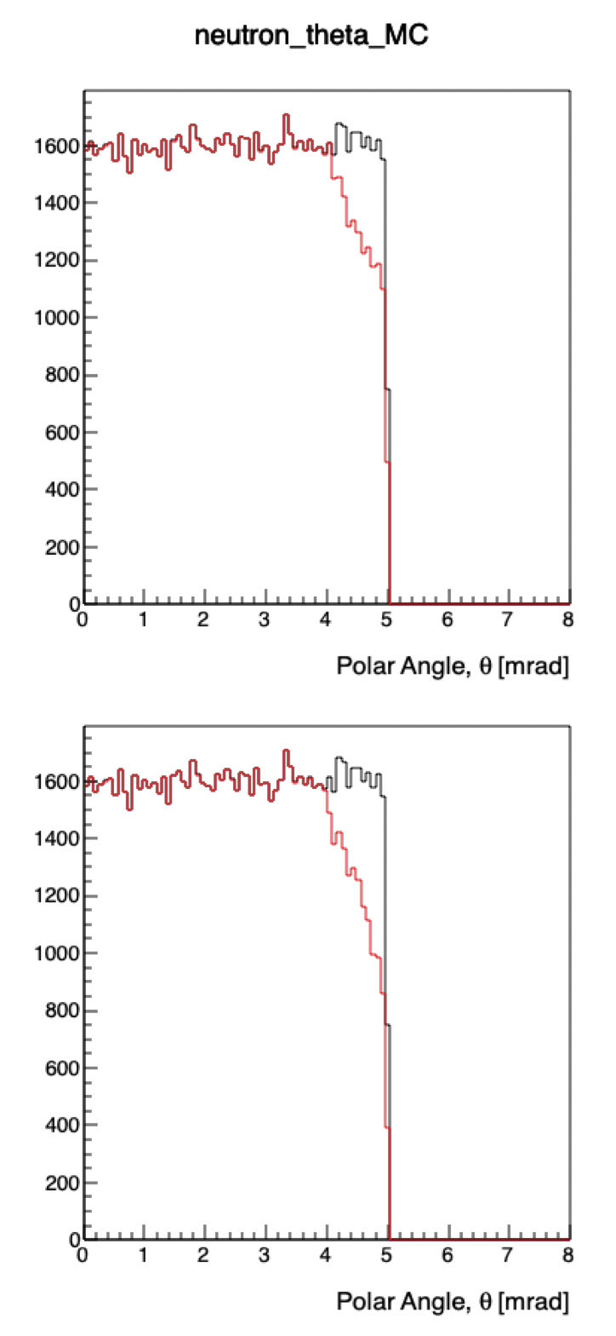
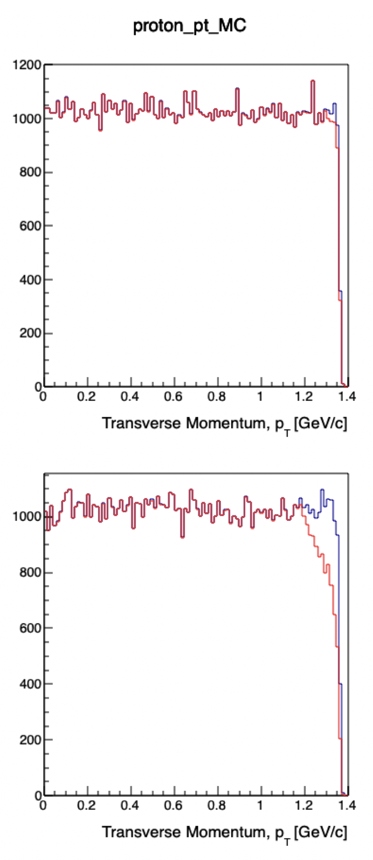
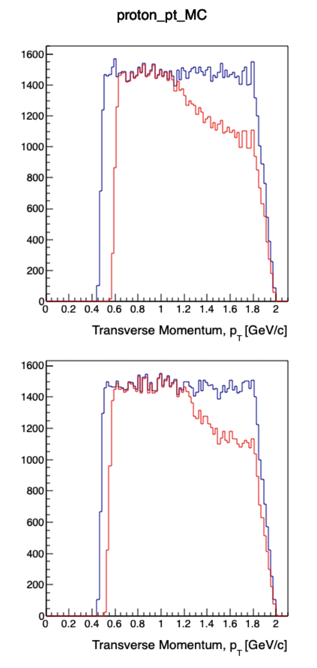
0.5 m Shift at IR-6
Acceptance for far-forward particles
270 < p < 275 GeV/c
0 < theta < 5 mrad
Roman Pots
90 < p < 100 GeV/c
0 < theta < 20 mrad
Trackers in B0
ZDC
Before shift
After shift

Slide 7
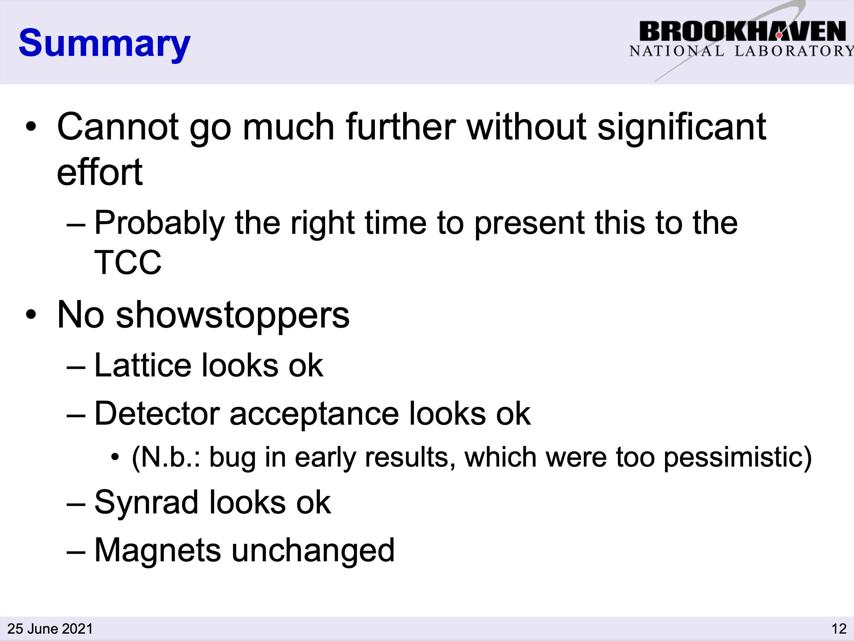
0.5 m Shift at IR-6
from H. Witte @ EIC IR-Meeting
Thanks to the hard work of many of the EIC accelerator project team change request initiated → will be successful

Slide 8
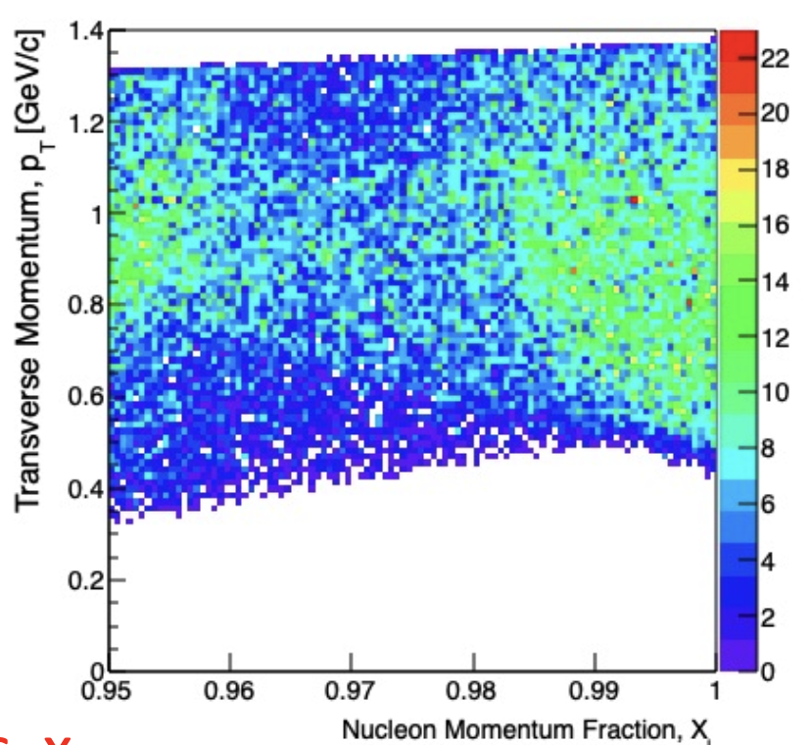
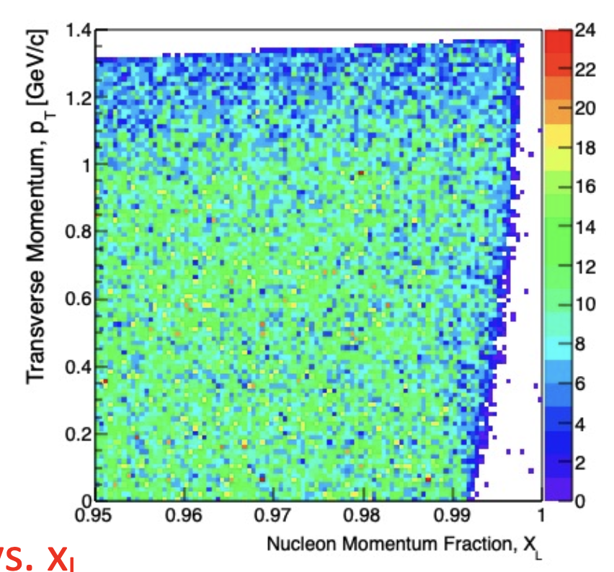
Status of IR-8
All material to simulate physics at 18 GeV x 275 GeV has been posted at https://indico.bnl.gov/event/10974/contributions/51160/
Detailed Read-Me how to use all the provided information
x_{L} acceptance at IP-8:
the most recent optics info was used
Standard RPs
2nd Focus RPs

