Slide 1
Status of Track Finding and fitting using ACTs in juggler analysis framework
erhtjhtyhy
Chao Peng
Argonne National Laboratory
For Athena Software Working Group
07/27/2021

Slide 2
Athena Software
https://eicweb.phy.anl.gov/EIC/detectors/athena
Simulation with DD4hep
Subdetector plugins for Athena detector
Data model: EICD
Built upon PODIO
Flat data structure, connect tracks, hits, clusters with indices
Analysis framework: Juggler
Built upon GAUDI framework
Algorithms and tools for digitization, clustering, tracking, …
https://eic.phy.anl.gov/eicd
https://eicweb.phy.anl.gov/EIC/juggler

Slide 3
Acts for Tracking
Acts is a particle track reconstruction toolkit that is widely used in high energy physics
Common algorithms for track propagation and fitting, seed finding, and vertexing
Independent of tracking detectors
Actively developing and well maintained
Native support for geometry description using DD4hep

Slide 4
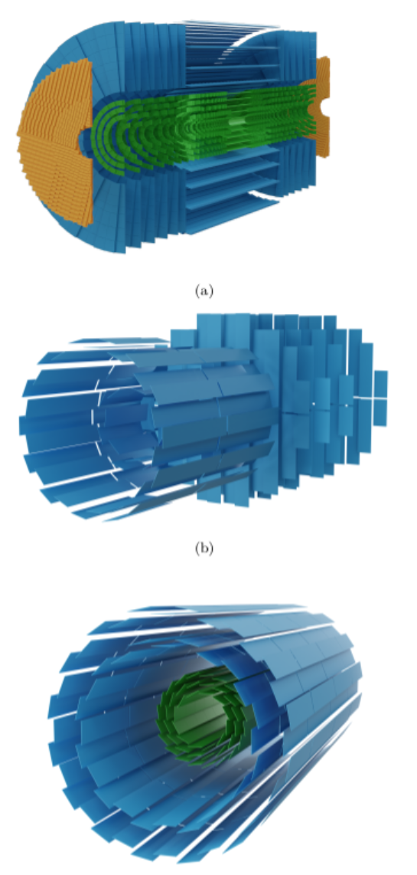
Acts for Tracking
ATLAS ITk
Acts is a particle track reconstruction toolkit that is widely used in high energy physics
Common algorithms for track propagation and fitting, seed finding, and vertexing
Independent of tracking detectors
Actively developing and well maintained
Native support for geometry description using DD4hep
PANDA silicon detector
sPHENIX silicon trackers

Slide 5
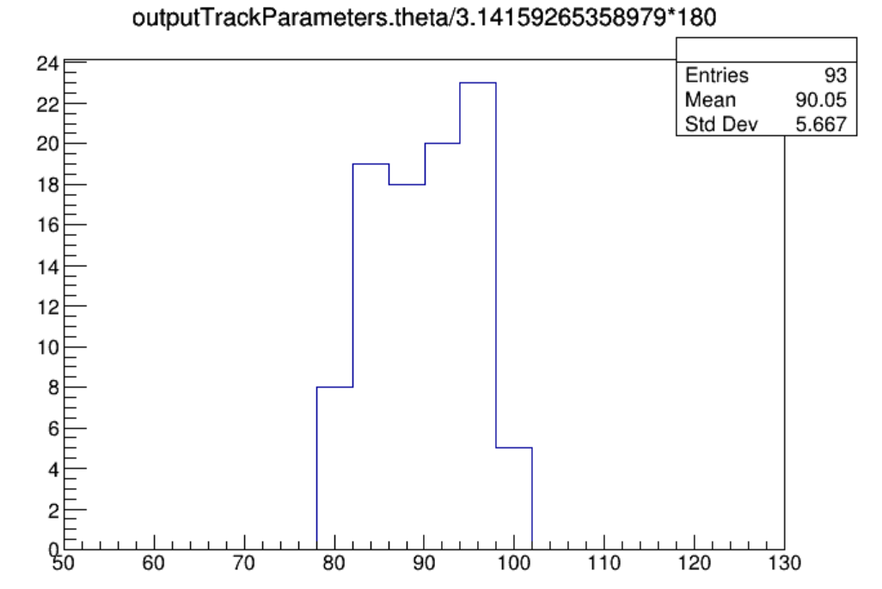
Acts Tracking with DD4hep and Juggler
Acts is now working in Athena software
Simulation output from DD4hep
Digitization, track finding and fitting with Acts::CKF in Juggler framework
Implemented example algorithms from Acts in Juggler (W. Armstrong)
Tested truth seeding and track finding/fitting with Combinatorial Kalman Filter
CKF with barrel trackers give reasonable results
https://eicweb.phy.anl.gov/EIC/juggler/-/tree/master/JugTrack

Slide 6
Tracking with DD4hep and Juggler
Known issues in the software
Geometry issue with endcaps and outer barrel, Acts cannot determine the container volume for Barrel + Endcaps
Might be due to missing information to Acts or just typos
Ongoing works
Debugging the geometry issue
Testing more algorithms from Acts Example (vertexing, seeding from clusters, …)
Finalizing data model for tracking outputs

Slide 7
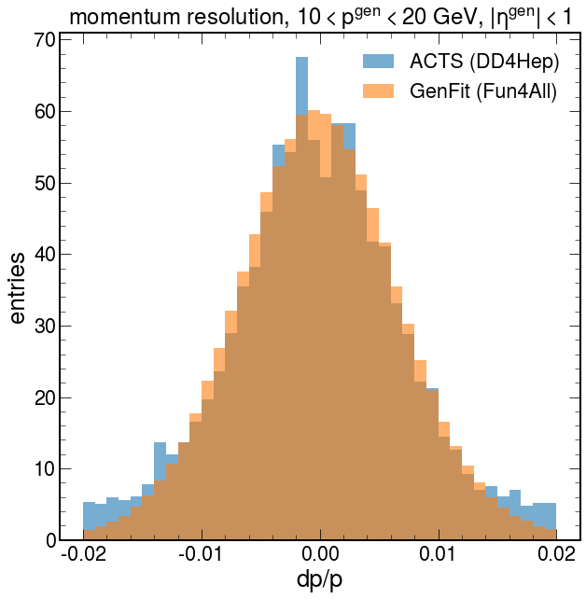
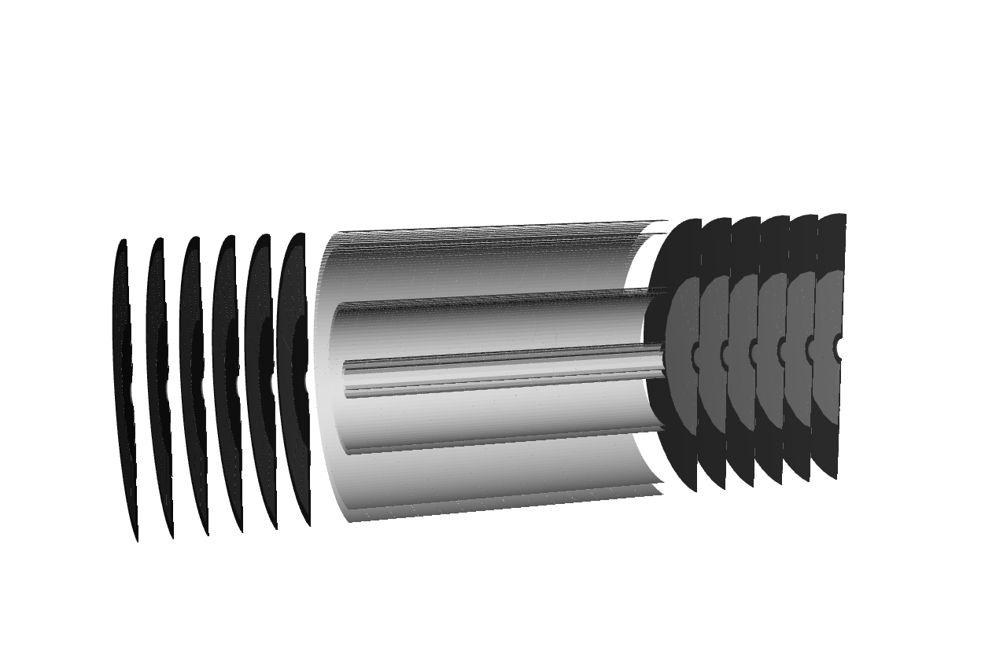
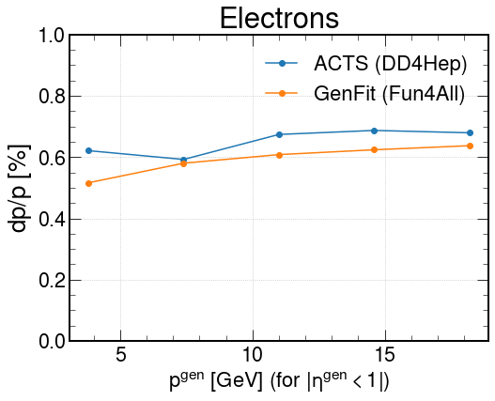
Some Tests
Tracking tests from Miguel Arratia, Wouter Deconinck, and Reynier Cruz Torres
DD4hep detector (modified OpenDataDetector from Acts Examples)
Acts with Juggler
Modified OpenDataDetector
Plots courtesy of Miguel Arratia

Slide 8
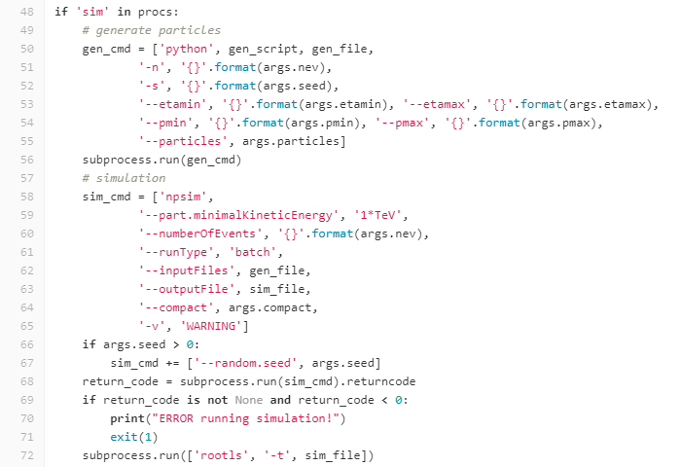
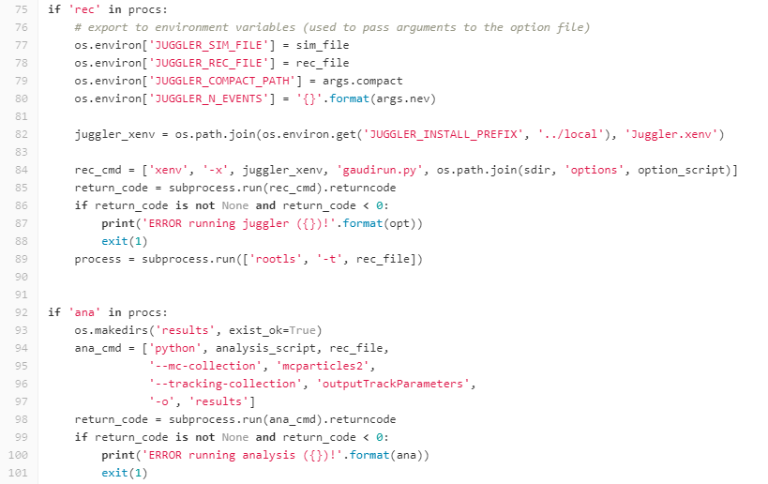
A Working Example
Using barrel trackers of the current Athena implementation
run_tracking_benchmarks.py
https://eicweb.phy.anl.gov/EIC/benchmarks/reconstruction_benchmarks/-/tree/master/benchmarks/tracking
Simulation (particle gun)
Reconstruction (digi. + tracking) and analysis

Slide 9
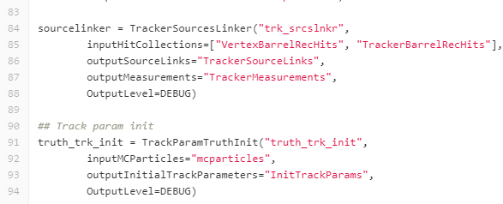
A Working Example
Source link: prepare data to feed Acts. Link measurements (rec_hits) to Acts surfaces (geometry information)
Seeding: truth seeding from MC particles Other seeding algorithms from Acts are migrated but not thoroughly tested yet.
Reconstruction option file
call algorithms developed in Juggler
options/truth_seeded_tracking.py
Digitize: simulation hits -> readout signals. noise, resolution smearing, time jitters could be added here.
Reconstruct: Readout signals -> hits Only readout unit info is available here (position, signal strength, timing). “calibration” could be implemented here.
Tracking: Track finding and fitting with CKF Combinatorial Kalman Filter from Acts.

Slide 10
A Working Example
Run the example
Install EIC container
mkdir $HOME/eic && cd $HOME/eic
curl https://eicweb.phy.anl.gov/containers/eic_container/-/raw/master/install.sh | bash
Run EIC container
./eic-shell
Get Reconstruction benchmarks
git clone https://eicweb.phy.anl.gov/EIC/benchmarks/reconstruction_benchmarks.git
cd reconstruction_benchmarks
Setup environment variables needed by the run script
source /opt/detector/setup.sh export DETECTOR_PATH=/opt/detector/share/athena
export JUGGLER_DETECTOR=athena
export JUGGLER_INSTALL_PREFIX=/usr/local
Run benchmark
python benchmarks/tracking/run_tracking_benchmarks.py --etamin=-3 --etamax=3 -n 100

Slide 11
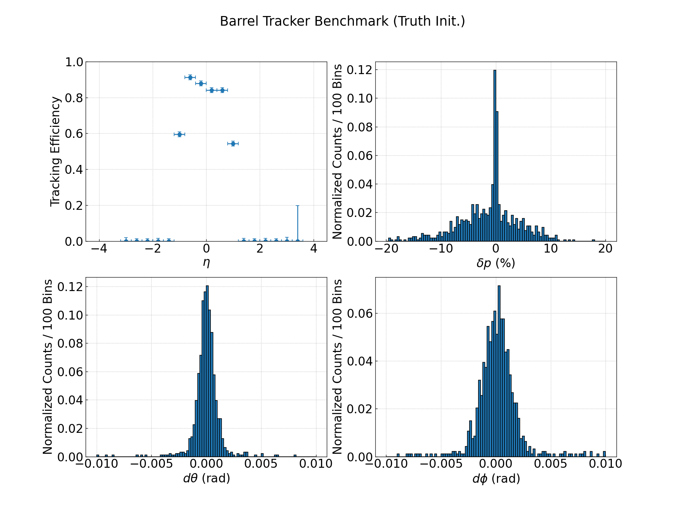

Slide 12
Developing
Develop based on the example (after “run the example”, assumed in container)
Install Athena detector
cd $HOME/eic
git clone https://eicweb.phy.anl.gov/EIC/detectors/athena.git && cd athena mkdir build && cd build
cmake .. -DCMAKE_INSTALL_PREFIX=$ATHENA_PREFIX make -j install
export DETECTOR_PATH=$ATHENA_PREFIX/share/athena
cd $HOME/eic
git clone https://eicweb.phy.anl.gov/EIC/detectors/ip6.git && cd ip6
mkdir build && cd build
cmake .. -DCMAKE_INSTALL_PREFIX=$ATHENA_PREFIX make -j install
cp –r ../ip6 $DETECTOR_PATH/
Modify/adding detector
See software tutorial https://eic.phy.anl.gov/tutorials/eic_tutorial/part1/simple_detector https://eic.phy.anl.gov/tutorials/eic_tutorial/part2/adding_detectors

Slide 13
Developing
Develop based on the example (after “run the example”)
Install Juggler
cd $HOME/eic
git clone https://eicweb.phy.anl.gov/EIC/juggler.git && cd juggler && git checkout v1.8.0 mkdir build && cd build
cmake .. -DCMAKE_INSTALL_PREFIX=$ATHENA_PREFIX make -j install
export JUGGLER_INSTALL_PREFIX=$ATHENA_PREFIX
Modify/adding algorithms
See software tutorial
https://eic.phy.anl.gov/tutorials/eic_tutorial/part3/running_juggler
Run benchmark with modified detector and Juggler
cd $HOME/eic/reconstruction_benchmarks
python benchmarks/tracking/run_tracking_benchmarks.py --etamin=-3 --etamax=3 -n 100

