Slide 1
ATF UED Current Capabilities and Experimental Options
Mikhail Fedurin, Marcus Babzien, Mark Palmer
August 17, 2021
The Accelerator Test Facility

Slide 2
Introduction

Slide 3
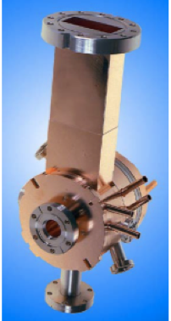
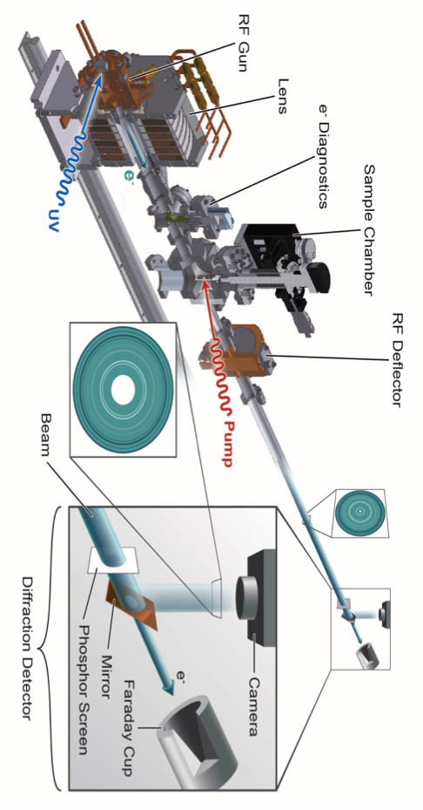
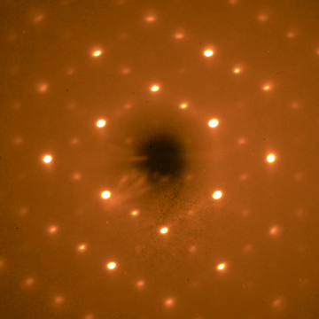
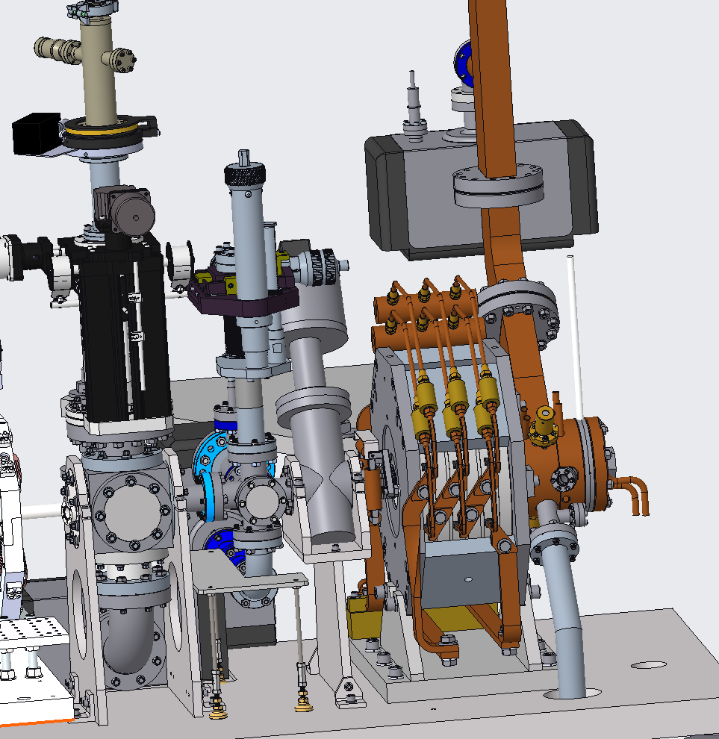
ATF MeV UED Beam Parameters & Comparison
 | BNL | SLAC | MSU
Beam energy, MeV | 3 | 3.68 | 0.03
N e⁻ per pulse | 1.25 E+6 | 3.8E+5 | 500
Temporal resolution, fs | 180 | 102 | 300
Beam size diameter, μm | 300 (100 best) | 400 (10 best) | 20-40
Max repetition rate | 48 | 120 (180 best) | 1,000
N e⁻ per sec per μm² | 880 | 360 | 400
Advantage | short bright pulse | short bright pulse | DC (no jitter)

Slide 4
UED Facility at BNL B912
UED and Laser Room

Slide 5
Facility Updates Currently in Progress

Slide 6
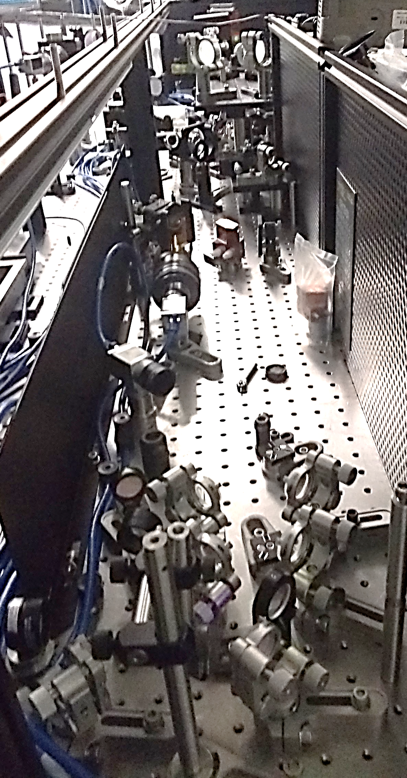
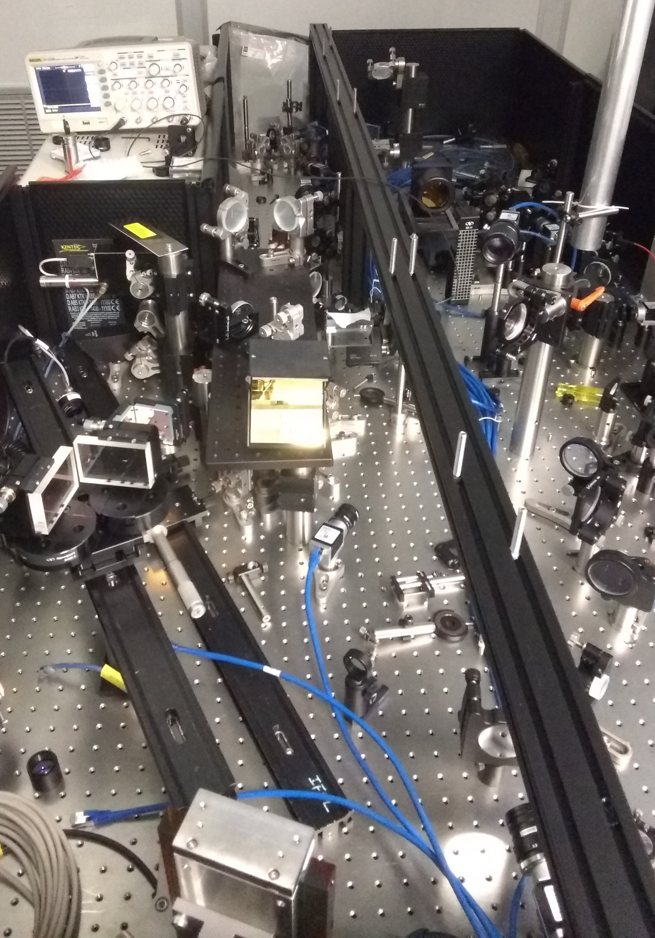
Upgrade to New OPA Pump Laser with UE103/105
Goal: Support mid-IR pump-probe materials science
Approach: Optical Parametric Amplifier to access the desired range of MidIR to LWIR wavelengths
Requirements: To achieve OPA output energy levels of ~100 mJ at λ=1-11 μm requires an energetic pump pulse from a new Ti:sapphire booster amplifier
Hardware: SpectraPhysics Topas HE OPA partially commissioned Modifications to optical delivery implemented
Seed input from laser room
λ/2
Pol
To LE
L
Output
L
L
Ti:Sa
L
L
Grating
L
BS
Pol
Nd:YAG output
λ/2

Slide 7
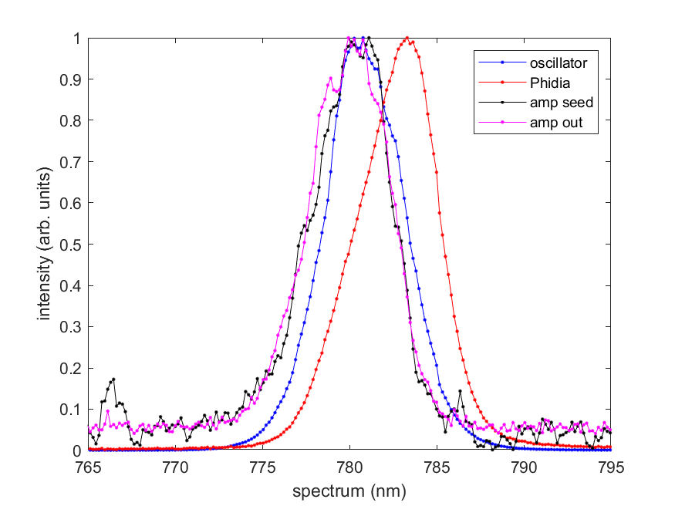
Support for Tunable Pump Wavelength
Booster amplifier assembled tested
Achieved over 20 mJ, <250 fs a close to anticipated specification
Further optimization of pulse duration may be possible (TBWP~0.6)
OPA installation and testing impacted significantly by COVID
Parallel optical trombones for synchronization and transport optics still to be installed
Final commissioning targeted for late CY2021
Amplified Beam Profile
Autocorrelation
Spectra Through MOPA Chain

Slide 8
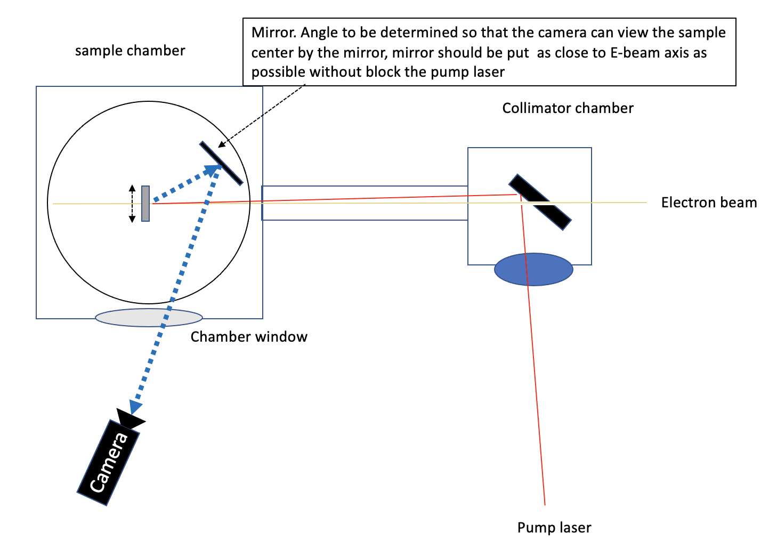
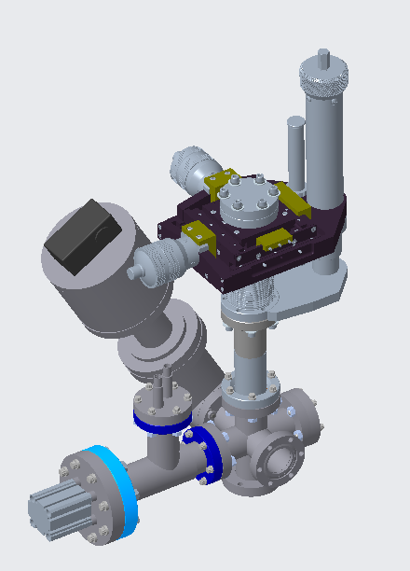
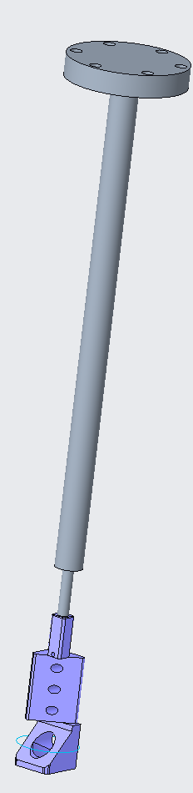
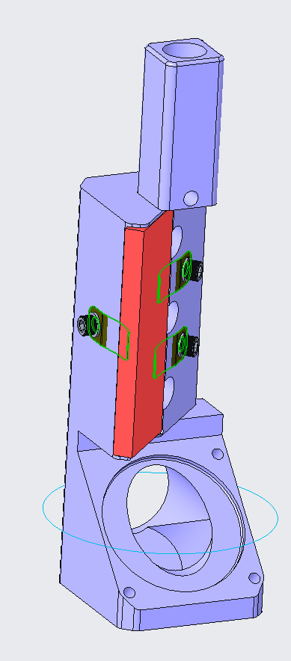
Updated Collimator and In-Vacuum Mirror Hardware Installed Spring 2021

Slide 9
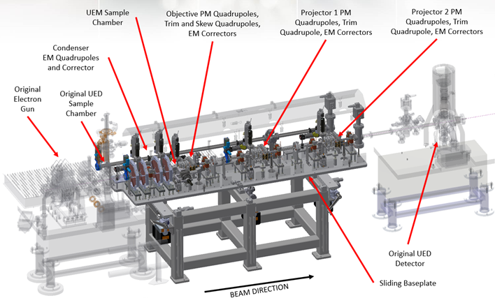
Support Flexible UED and UEM Studies (UE97)
Quick change design to switch between UEM and UED baseline drift tube configuration

Slide 10
Real-Time Diagnostics with UE110/117
Diagnostic Beamline Extension Provide real-time beam diagnostic at the end of beamline will include spectrometer magnet for shot-to-shot energy fluctuations, Faraday cup for charge fluctuations

Slide 11
Other Facility Improvement Efforts

Slide 12
Summary List of Other Efforts
Photocathode Improvements
Water chiller upgrades
Low-Level RF stability improvements
Drive laser pulse shortening
Bunch length diagnostic
Repetition rate increase

Slide 13
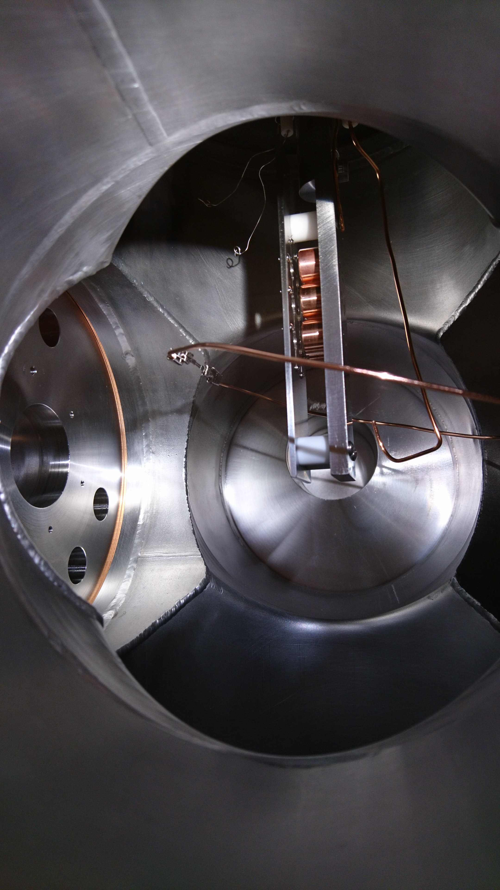
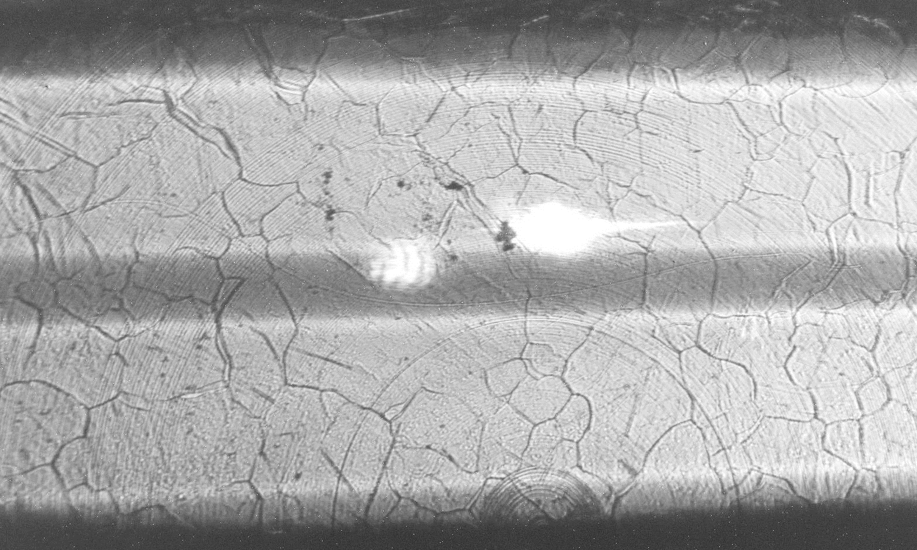
Photoinjector Refurbishment
Steps Taken to Improve Dark Current Performance
Cathode re-polishing process updated & validated
Gun opened and cathode backplate re-polished
Laser delivery improved by removal of secondary entrance/exit windows
Vacuum level improved by replacement of pumps/gauges/seals
Results
QE only ~50% than before polishing without laser
Much improved ratio of photocurrent to dark current
No indication of multiple bunches
Before
UV images of cathode surface
After

Slide 14
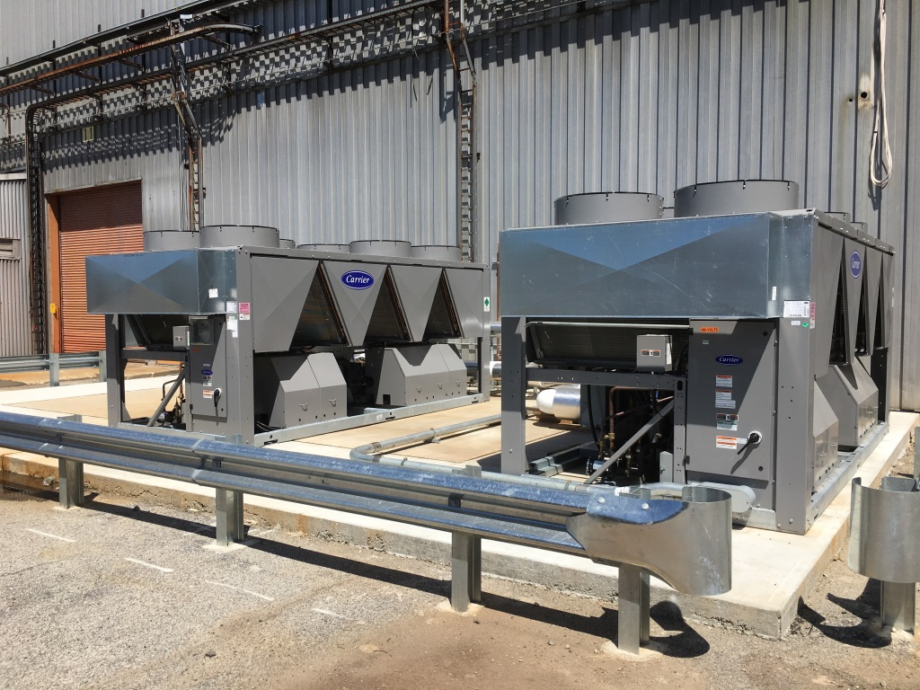
Redundant Chiller System at B912
2 redundant high-capacity outdoor chiller units in service
Chilled water cooling distribution system operational
UED Cleanroom operating on new high capacity chilled water supply
Previous dedicated chiller in place as backup unit
Facility operation now possible independent of weather conditions
Additional laser power supply cooling loop being installed with dedicated heat exchanger to replace old refrigeration unit

Slide 15
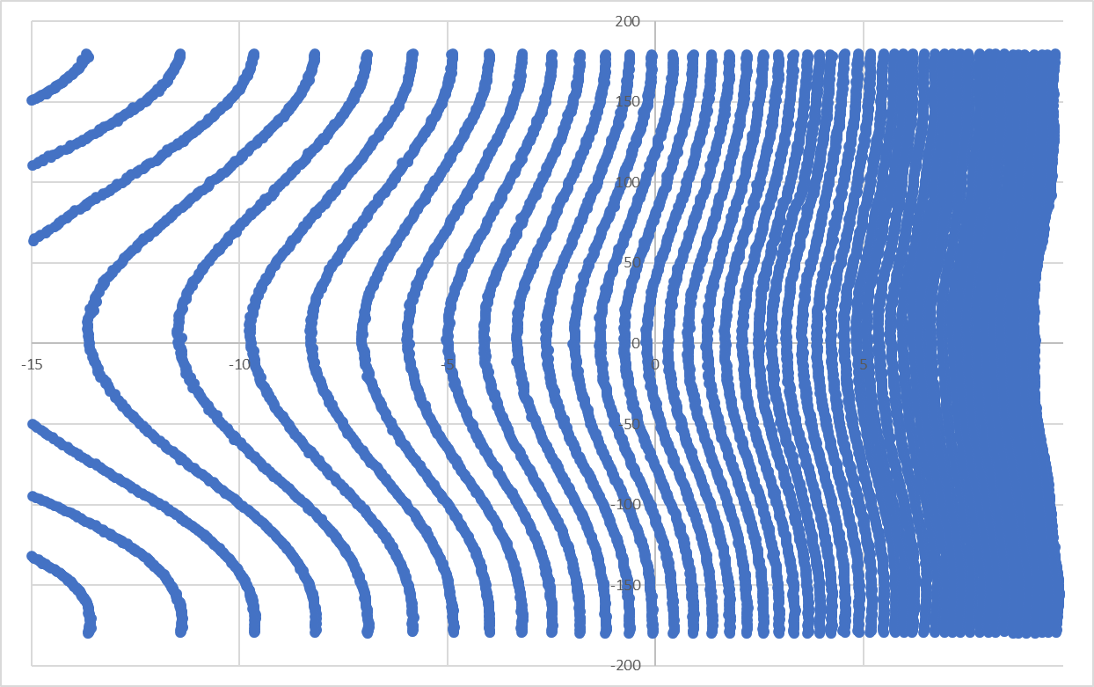
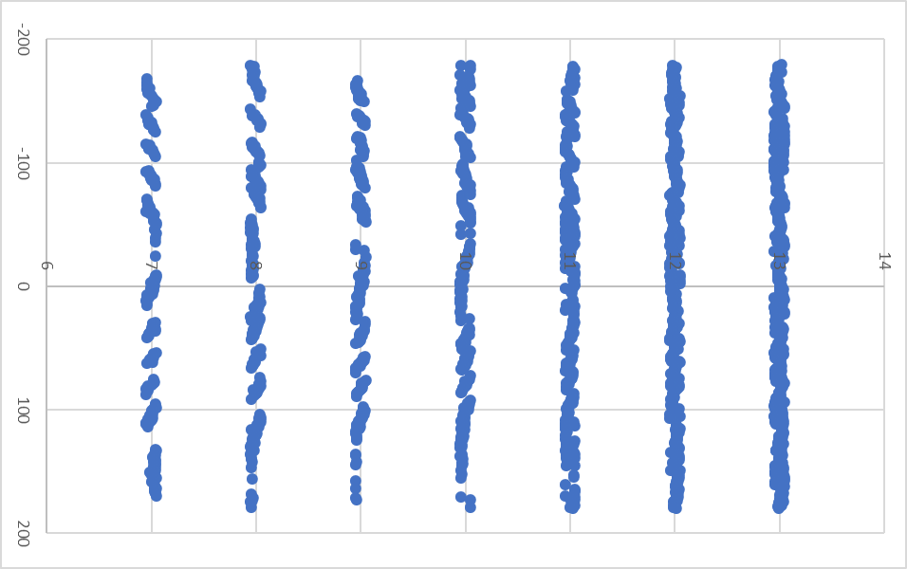
LLRF Improvements
Added slow phase control loop with independent phase measurement and software feedback to overcome drift that degraded long-integration time experiments
Beam setup and tuning enhanced by improving IQ modulator calibration
Provides a much larger range of usable & orthogonal phase and amplitude adjustment to operators
Original Calibration
During Optimization
φ
Power

Slide 16
RF Stability Study with UE81
From 2019 ATF User Meeting presentation

Slide 17
Drive Laser Pulse Shortening
Original drive laser produced ~250 fs pulses for UED sample pumping. (e- probe is typically shortened via compression)
Drive laser amplifier stretcher/compressor/optics are designed for bandwidth supporting down to 50 fs pulses, and the current 160 fs oscillator does not produce a chirped pulse long enough to completely optical avoid damage at nominal output energy
16 nm bandwidth oscillator seed pulse provides improved temporal resolution similar to that available at other UED facilities

Slide 18
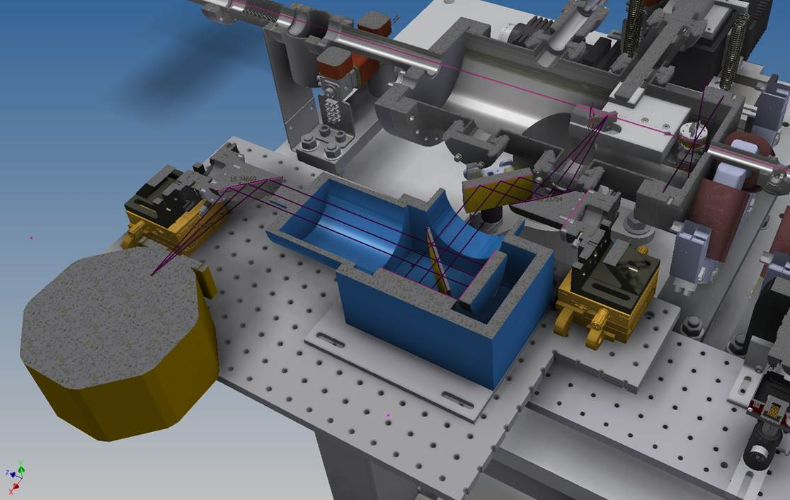
Bunch Length Diagnostic with UE81 Team
CTR Interferometer & Detector commissioned by UE81 team
A more compact version was planned with the goal:
Test downstream at UED screen
Move upstream to UED sample location for routine use

Slide 19
Repetition Rate Increase
Goal: Minimize sensitivity to long scanning times
Limits sensitivity to machine drift in B912
Minimizes need for repeated parameter scans during data-taking
Approach: RF system modified for up to 48 Hz operation
System rep rate now can be easy adjusted from 0 Hz to 48 Hz

Slide 20
Conclusions
Significant upgrades to the UED facility have been completed in past years
Both instrument operating parameters and operational efficiency have been improved
Near term upgrades underway
UED will continue to evolve as a productive facility
 | BNL | SLAC | MSU
Beam energy, MeV | 3 | 3.68 | 0.03
N e⁻ per pulse | 1.25 E+6 | 3.8E+5 | 500
Temporal resolution, fs | 180 | 102 | 300
Beam size diameter, μm | 300 (100 best) | 400 (10 best) | 20-40
Max repetition rate | 5 (will be 50) | 120 (180 best) | 1,000
N e⁻ per sec per μm² | 88 (will be 880) | 360 | 400
Advantage | short bright pulse | short bright pulse | DC (no jitter)

Slide 21
Thank you!

