Slide 1
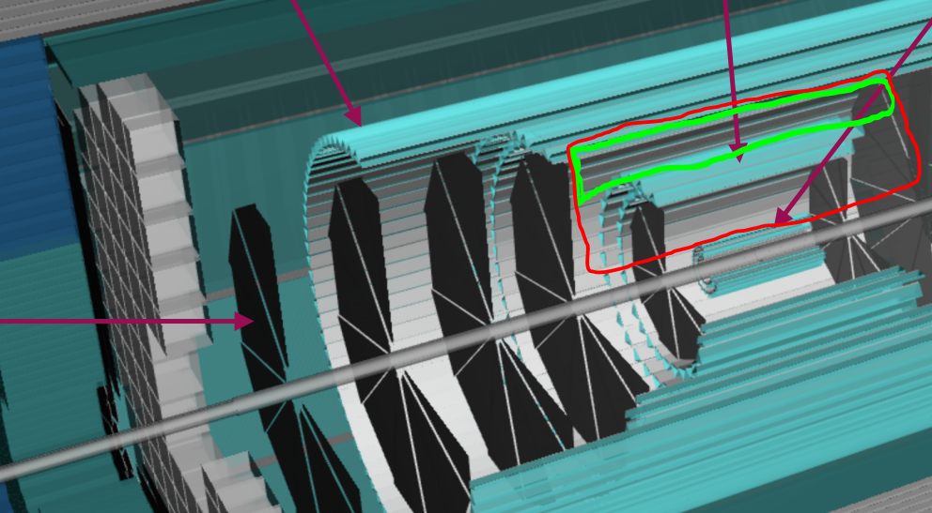
2 Versions:
Minimal Low momentum
Radii:
Inside of Silicon layer 5
Outside of Silicon layer 4
Zed:
Look at Zed of 1st large disk
Go inside of this.
No side effect
Maximal Low Momentum
Radii:
Inside of Silicon layer 5
Outside of Silicon layer 2
Zed
Look at Zed of 1st large disk
Go inside of this.
Side effect:
Kills layer 3,4
7 chips?
90% efficiency
Chip loc TBD
TimePIX4
28.16 x 24.64 mm²
512 x 448 pixels
(55 x 55 μm)
200 psec σ_{t}
160 GB/sec
Live area: 1.4 x 1.4cm
Chip area: 1.4 x 1.6cm
Test Beam: 1.4 x 2.1cm
256 x 256 pixels
(55 x 55 μm)
High Momentum Device:
Specifications
Radii:
Outside of layer 6
Inside of DIRC
Walls 1 inch
Zed:
Look at eta coverage of Silicon layer-5

