Slide 1
Compton polarimeter possible FAC DAQ for EIC
Alexandre Camsonne
JLab
July 14th 2021

Slide 2
Outline
eRHIC beam parameters
Signals with FADC
Histogramming
Conclusion

Slide 3
eRHIC
High luminosity
560 MHz RF
1320 bunches
10 ns between bunches
Electron current up to 2.4 A
Ion current up to 0.92 A
Lower luminosity
560 MHz RF
330 bunches
33 ns between bunches
Electron current up to 1.2A
Ion current up to 0.46 A
High luminosity polarized electrons on polarized and unpolarized ions
For electron beam asymmetry measurements polarization can be the dominating error.
Aiming for 1% or better electron polarization accuracy
3

Slide 4
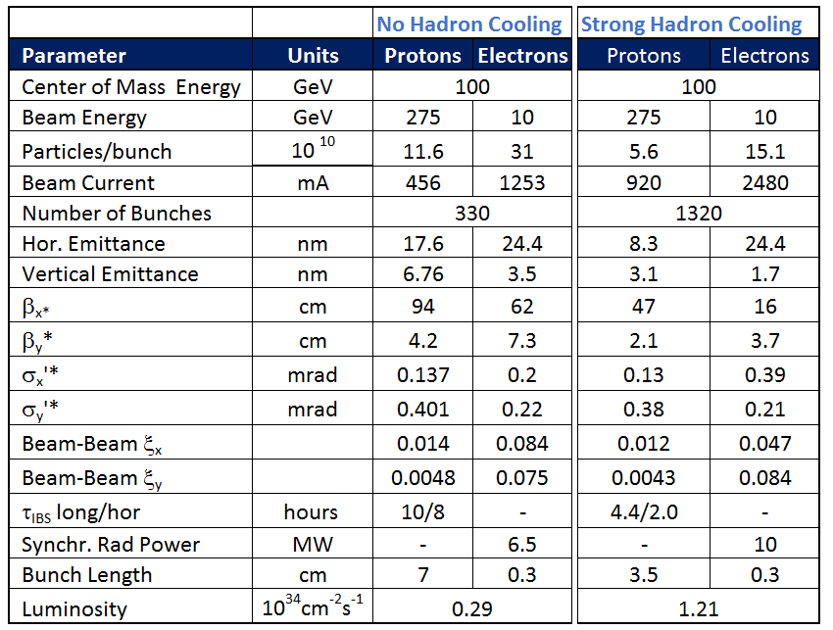
Main Parameters eRHIC ring-ring for Maximum Luminosity
E_{p} = 275 GeV, E_{e}= 10 GeV
New eRHIC ring ring design : beam interaction frequency going from initial RHIC 10 MHz to 30 MHz with 330 bunches and 100 MHz with 1320 bunches in a 3.8 km ring
Bunch replacement 2 Hz
1 turn = 3.8 km / c = 12.6 us or 13.2 us
39682 revolutions / 0.5s
Time to replace all bunches in ring : 660s = 11 mins
4

Slide 5
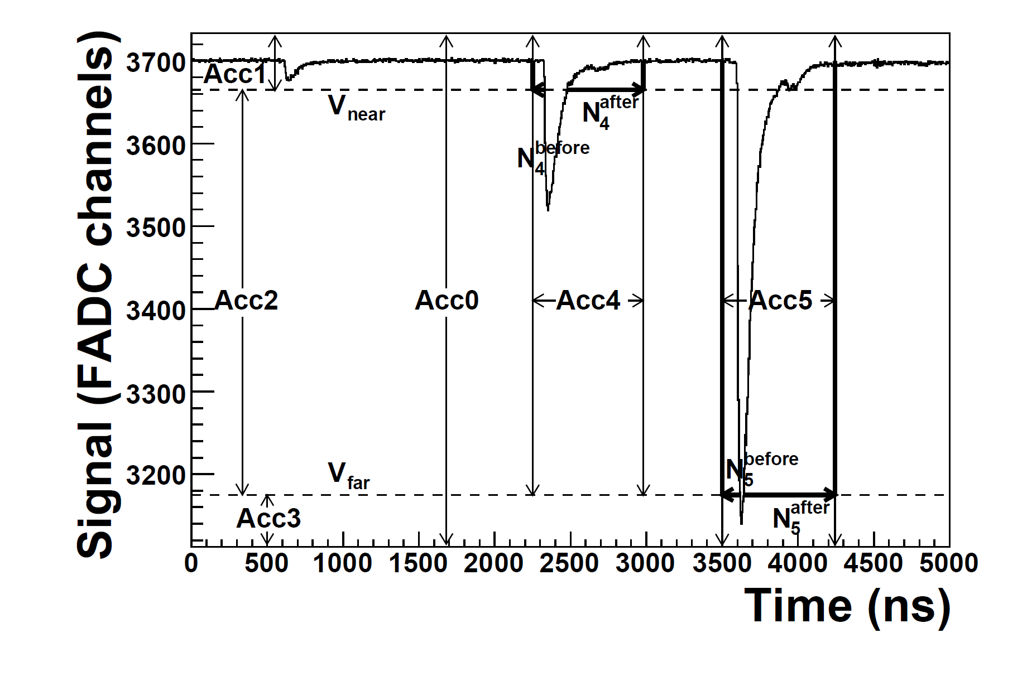
Hall A FADC
250 MHz 12 bit FADC
Digital integration over time window , CAEN or Alphacore 1 GHz 10 bits

Slide 6
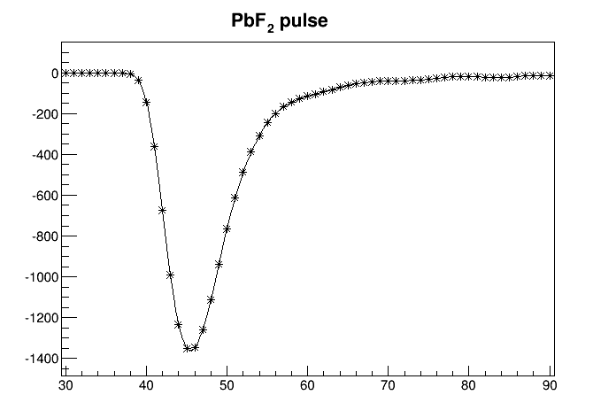
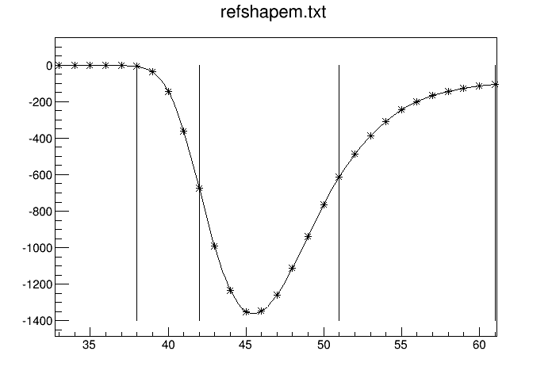
PbF2 pulses from DVCS
1 GHz sampling 128 ns
PbF2
Hamamatsu R5900
Pure Cerenkov

Slide 7
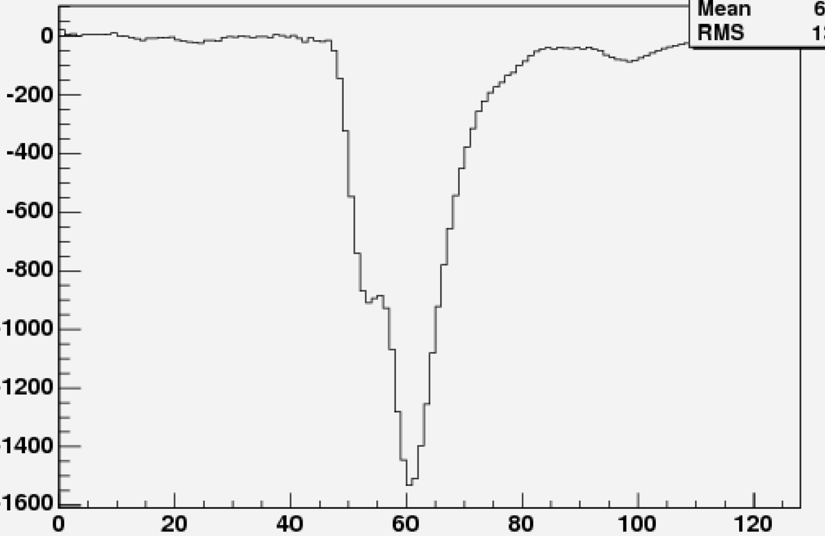
PbF2 pile-up event

Slide 8
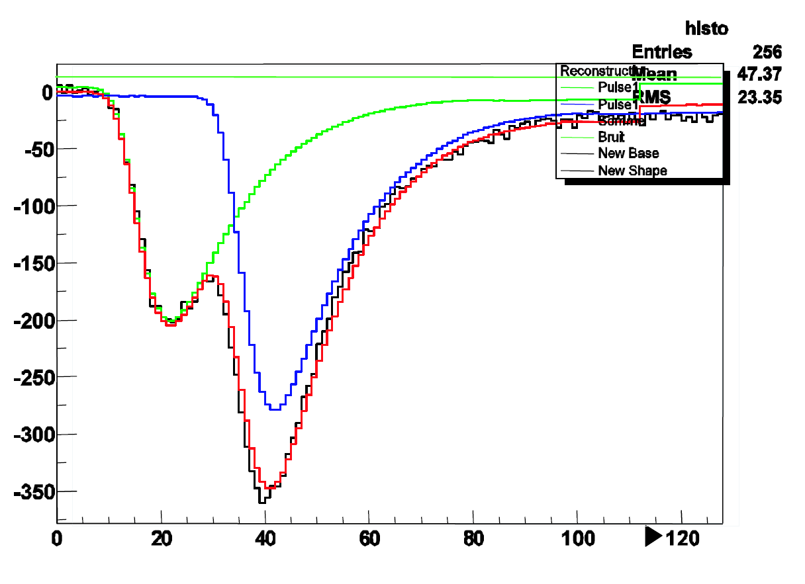
Scintillator pile-up event

Slide 9
Histogramming electron
Photon detector
1320 histograms (200 bins x32 bits) x 2 ( laser polarization ) fill with pulse amplitude
2 histograms saved and resets every 0.5 s when bunch replaced = 200 x 32 x 2 / 0.5 = 25.6 kBytes/s per channel
Could increase by factor 10 or 100 to monitor polarization during different time of fill
Electron detector
1320 histograms x 2 ( laser polarization )

Slide 10
Histogramming proton
Photon detector
1320 histograms x 2 ( laser polarization)
2 histograms saved and resets every 0.5 s when bunch replaced
Electron detector
1320 histograms x 2 ( laser polarization )

Slide 11
Event by event
1GHz x 10 bit = 10 Gbit /s per channel
Need to check rate after zero suppression
Prescale for correction on histogramming

Slide 12
Luminosity monitor
Photon detector
1320 histograms
2 histograms saved and resets every 0.5 s when bunch replaced
1320 x 10 ns integral
Is signal DC or pulses ?

Slide 13
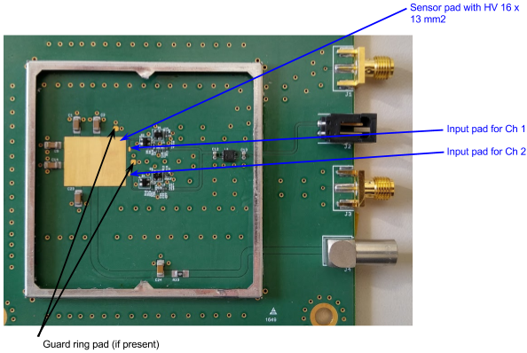
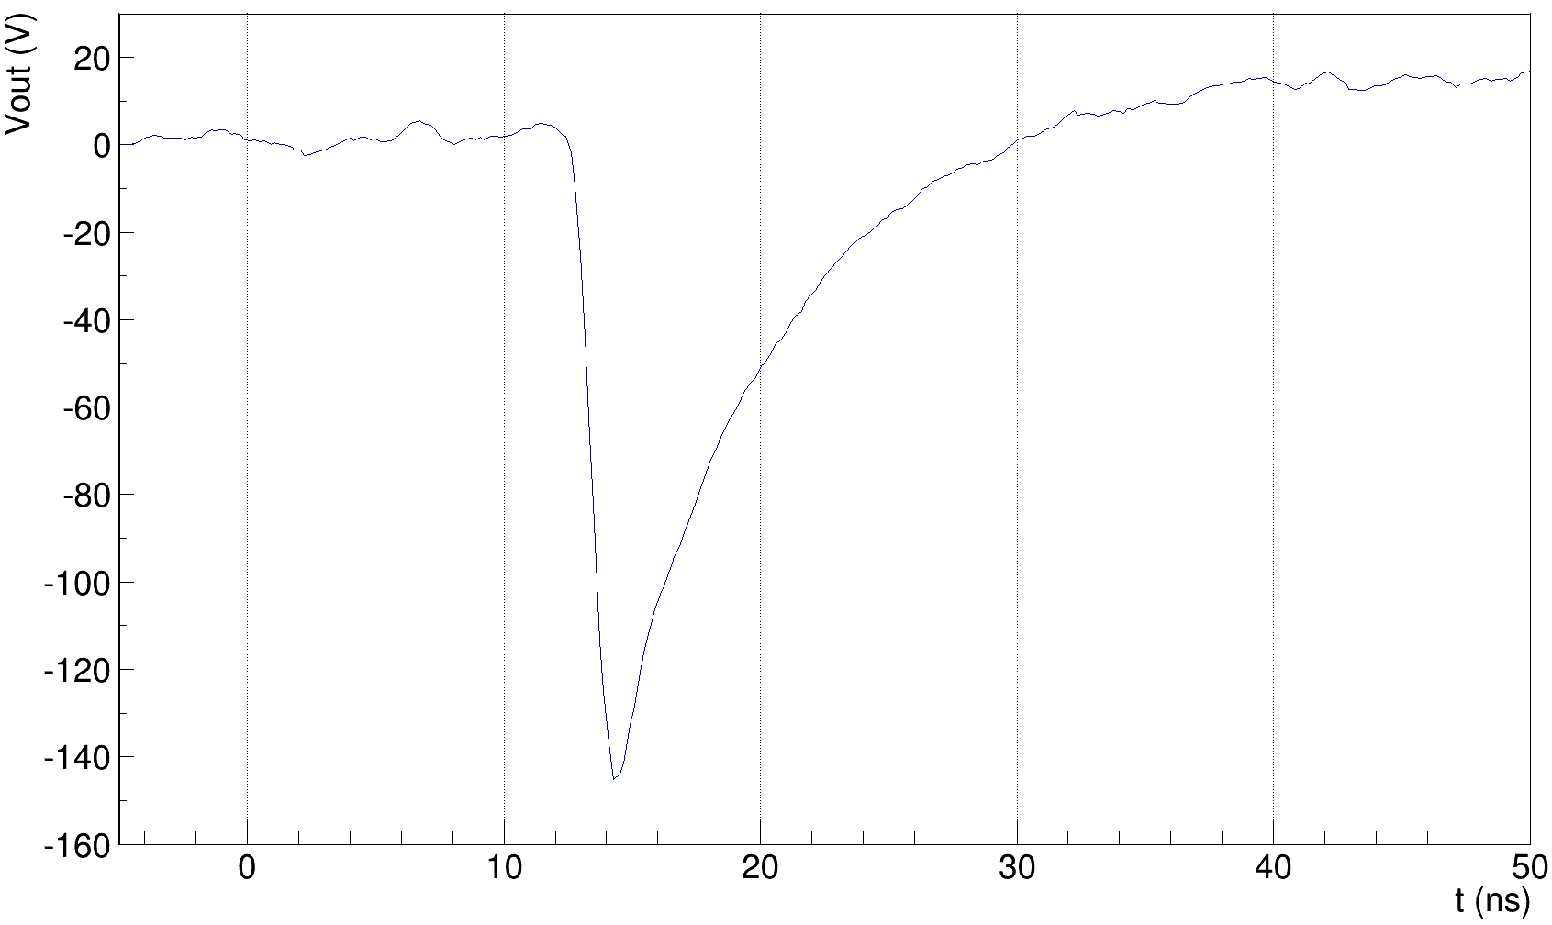
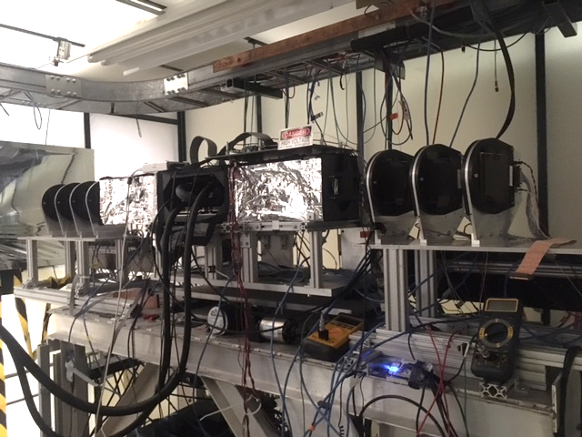
Electronics for very fast detectors
TOTEM electronics designed by Kansas University
A two channels board was designed and manufactured for the characterization of different solid state detectors.
Sensors up to 16x13 mm² can be glued and bonded.
The components can be easily adapted to accommodate:
Diamond sensors: ~1 nA bias current, both polarities, small signal
Silicon sensors: ~100 nA bias current, small signal
UFSD ~100 nA bias current, ~ larger signal
SiPM: ~ 5 uA bias current, large signal
3x3 mm² UFSD
MIP beam test @ Fermilab
The board was optimized to achieve a good time precision with different sensors, however it can be modified to have an output signal shorter (but less precise)
~40 ps measured time precision
Test of Ultra Fast Silicon Detectors for Picosecond Time Measurements with a New Multipurpose Read-Out Board

Slide 14
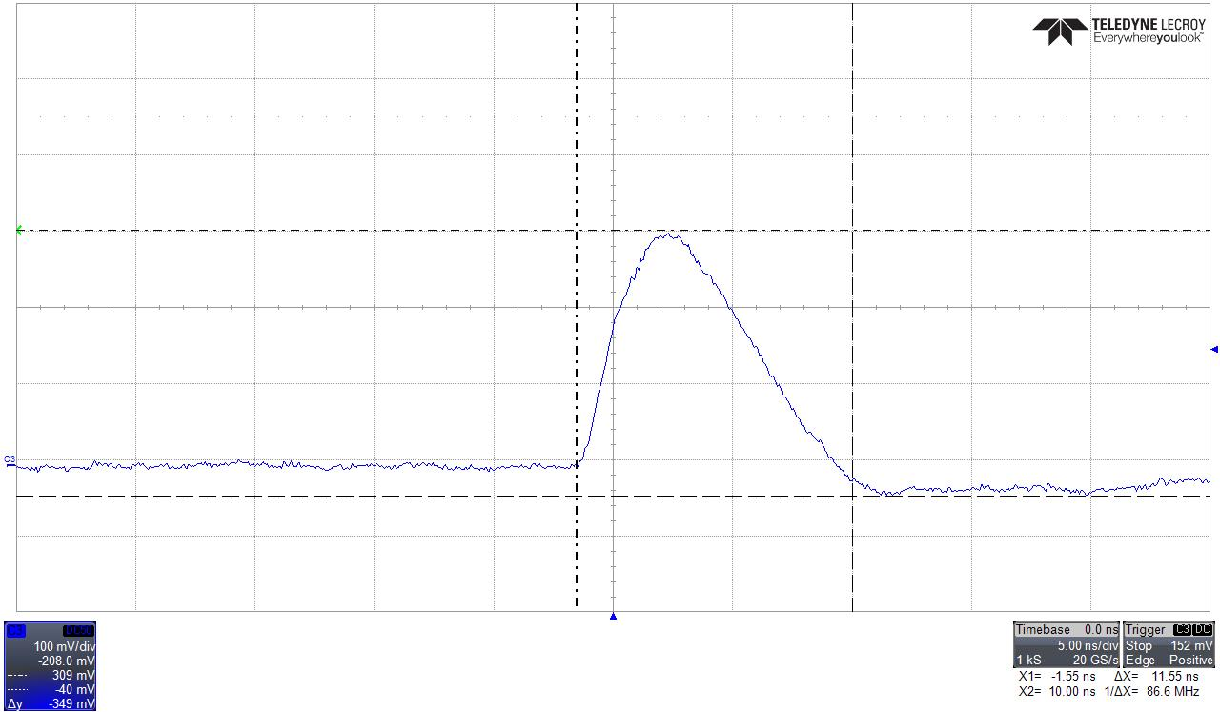
Silicon pulsed with laser at 10 MHz
100 ns
12 ns
Amplifier with silicon detector fast enough to separate successive sources for eRHIC Linac Ring at 10 MHz
(New proposal for up to 476 MHz )

Slide 15
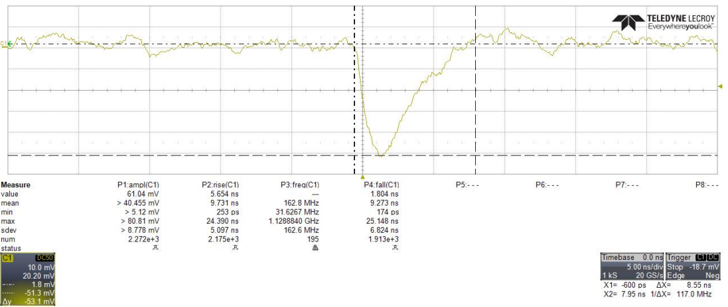
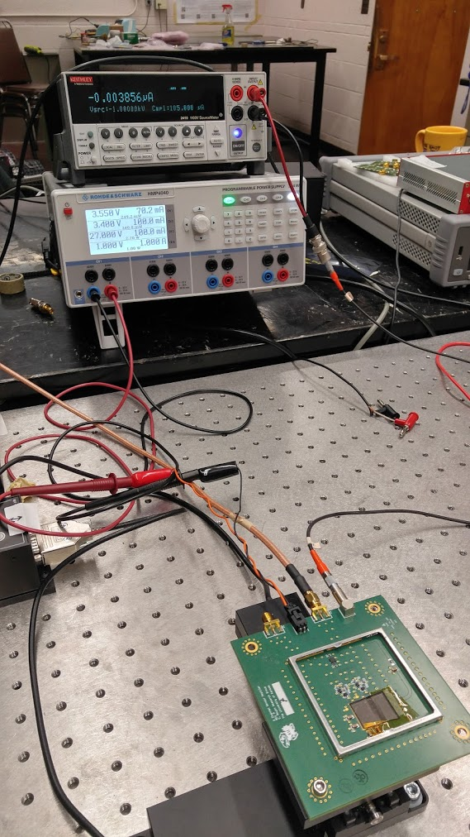
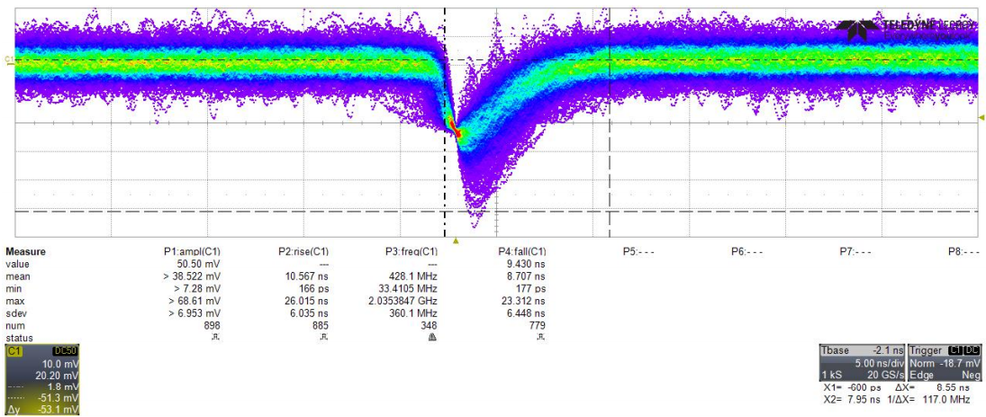
Electronics for very fast detectors
This board was also used to test the performance of a diamond sensor using a Sr⁹⁰ β⁻ source.
8.55 ns
500 μm pcCVD diamond

Slide 16
Conclusion/question
1 to 2 GHz FADC seems good to resolve 10 ns beam structure
Histogramming reduces amount of data vastly, is it ok to average over several turns ?
How much event of event data needed
PbF2 seems to be fast enough for 10 ns bunch structure
Diamond or silicon with Kansas preamp might be fast enough for 10 ns beam structure ( Other detectors / preamps ? )

