Slide 1
Electromagnetic probes in strong-field QED
Koichi Hattori
Online seminar for BNL, Aug. 3, 2021
koichi.hattori@yukawa.kyoto-u.ac.jp
Notes:
Abstract: After some introduction to the strong-field QED, I discuss effects of strong magnetic fields on the photon refractive index in vacuum. Nontrivial modifications of the refractive index could only occur at the quantum level since photons are not directly coupled with each other. I elaborate on the mechanism that leads to the vacuum birefringence and the vacuum dichroism, putting an emphasis on the fermion spectrum in magnetic fields. I also mention potential experimental feasibility with the strong magnetic field induced by the ultraperipheral heavy-ion collisions.

Slide 2
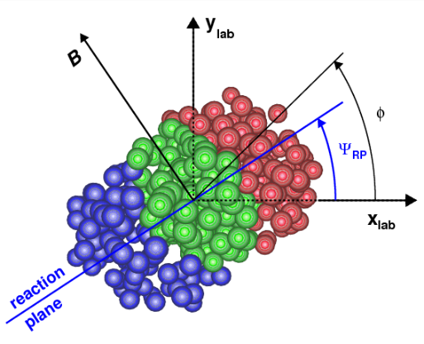
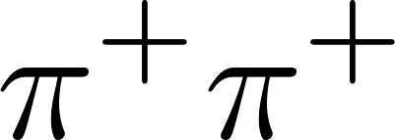
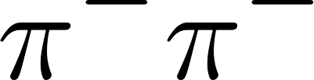
Peripheral collisions
Ultraperipheral collisions
B
B
Z
Z
Z
Z
QGP
Z
Z
Z
Z
Novel transport phenomena in QGP
Chiral magnetic effect
magnetohydrodynamics
thermal radiations in B
etc.
“Strong-field QED” without QGP
--- Vacuum physics in strong fields
Photon-photon interactions
Vacuum fluctuations in B
etc.
PRL103
STAR, PRL (2021)

Slide 3
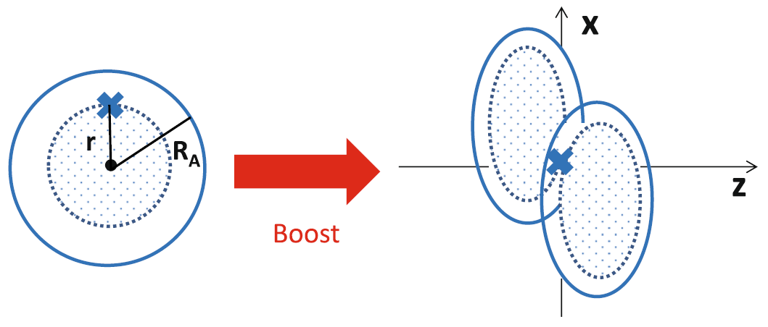
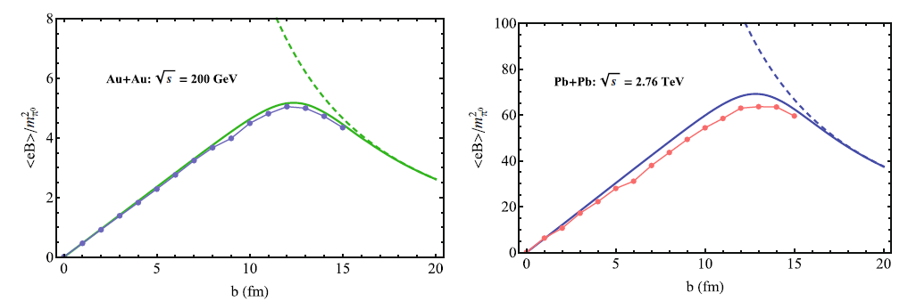
Strong magnetic fields from Lorentz-boosted Coulomb fields
B
Z
Z
Z
Z
Large atomic number: Z ~ 80
＋
Large velocity: ｖ > 0.9999 c
Static Coulomb field
Boost → Lienard-Wiechert potential
Point-like Z charges
Free streaming
HIJING
Collision effects
Finite size
Central coll.
Peripheral coll.
Numerical results from Deng & Huang (2012)
KH & Huang [1609.00747]

Slide 4
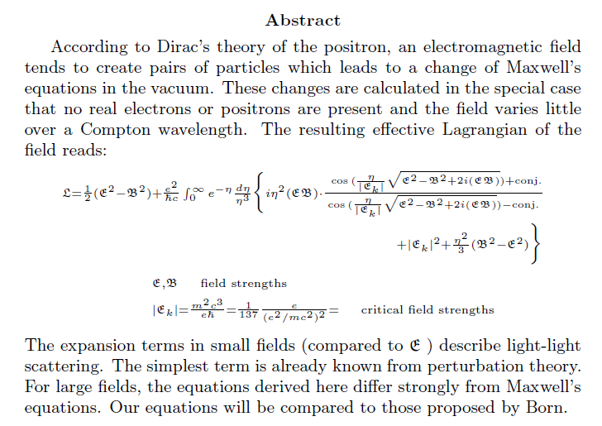
Photon-photon interactions
Vacuum fluctuations in external strong fields
--- Effective nonlinear interactions in Abelian theory
Consequences of Dirac’s Theory of the Positron
W. Heisenberg and H. Euler (1935)
Resummation wrt the number of external legs
=
＋
＋
＋
＋ ・・・

Slide 5
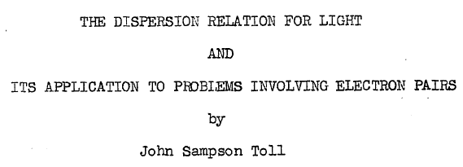
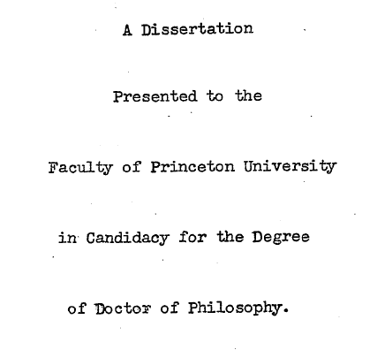
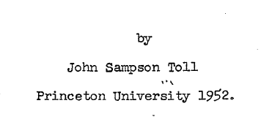
What happens when photons go through strong fields?
Vacuum fluctuations play a role.
Resuumed vacuum polarization diagram
=
＋
＋
＋
＋ ・・・

Slide 6
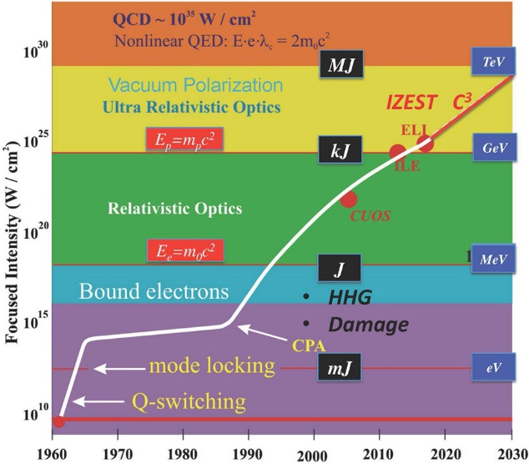
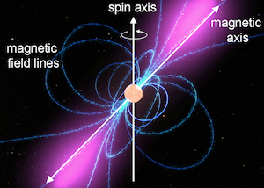
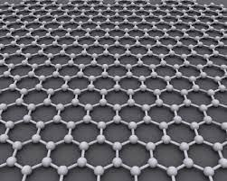
Strong fields in laboratories and nature (other than HIC)
Magnetospheres of neutron stars/magnetars
High-intensity laser field
2021
Dipole strength estimated from the intervals of the pulsation.
Mourou&Strickland (2018 Nobel laureates)
https://www.nobelprize.org/prizes/physics/2018/mourou/lecture/
Supercritical Coulomb fields
Transient high-Z atoms (once studied at GSI)
Renewed interests realized with graphene; “Atomic collapse”
See an anecdotal review “Probing QED Vacuum with Heavy Ions” Rafelski, Kirsch, Mueller, Reinhardt, and W. Greiner [1604.08690]
v << c → Larger effective α.
→ Kinetic energy << Coulomb potential

Slide 7
Table of contents
0. Introduction
- Brief historical overview
- Strong magnetic fields in laboratories and nature
1-1. Photon propagation in a magnetic field (at zero T and μ)
- Vacuum birefringence and (real) photon decay
- (Diagrammatic technique by the proper-time method)
1-2. Differential dilepton spectrum in a magnetic field
- (Ritus basis formalism)
- “Helicity suppression” in the ratio of di-electron yield to di-muon yield
2. Summary

Slide 8
(1) Refractive index of photon in strong B-fields
- Old but unsolved problem
Perturbation breaks down and resummation is required.
Has not been confirmed experimentally.
KH and K.Itakura, “Vacuum birefringence in strong magnetic fields”:
(I) Photon polarization tensor with all the Landau levels,” (2013);
(II) Complex refractive index from the lowest Landau level,” (2013).

Slide 9
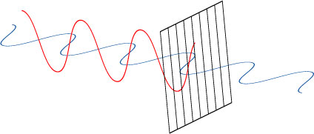
Photon propagation in magnetic fields
(in four dimensions)
Lorentz & gauge symmetries → n ≠ 1 in general
Preferred orientation provided by an external B
``Vacuum birefringence”
Strong B
Polarizer
Cyclotron motion in B field

Slide 10
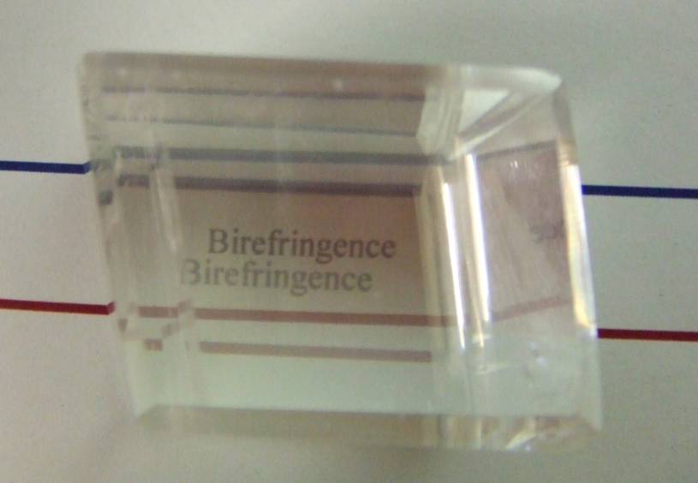
What is birefringence？
Response of electrons to incident lights
Structured ions
→ Anisotropic spring constants
Birefringence = Polarization-dependent refractive indices
Polarization 1
Polarization 2
Birefringent substance “Calcite”
Lesson: The fermion spectrum is important for the photon spectrum.

Slide 11



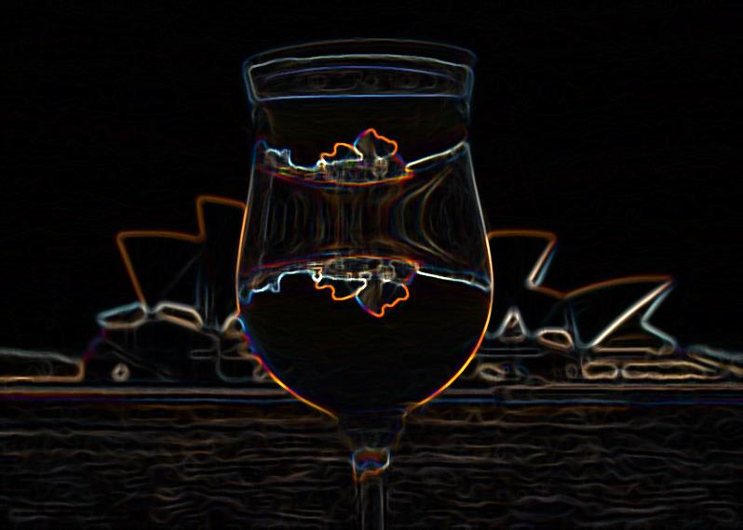

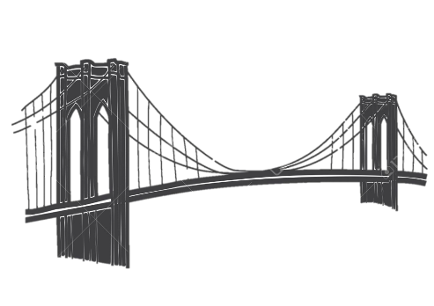
Complex refractive indices
Resuumed vacuum polarization diagram
Optical theorem for the imaginary part
=
＋
＋
＋
＋ ・・・
=
Both sides of a coin
Dispersion integral
Photon refraction
Di-fermion production

Slide 12

Rotating polarizations of transmitted ray
Inborn polarization
in photon sources
(Possibly unpolarized as well)
Acquired polarization due to the birefringence
Some of photons decay into fermion pairs
Cf. Cotton-Mouton effect, Faraday effect, etc in optics

Slide 13
Vacuum birefringence
from the resummed vacuum polarization tensor

Slide 14
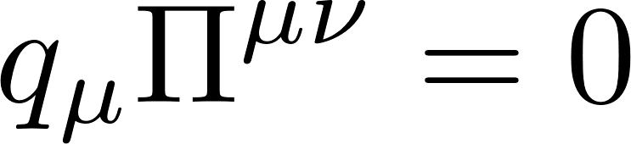

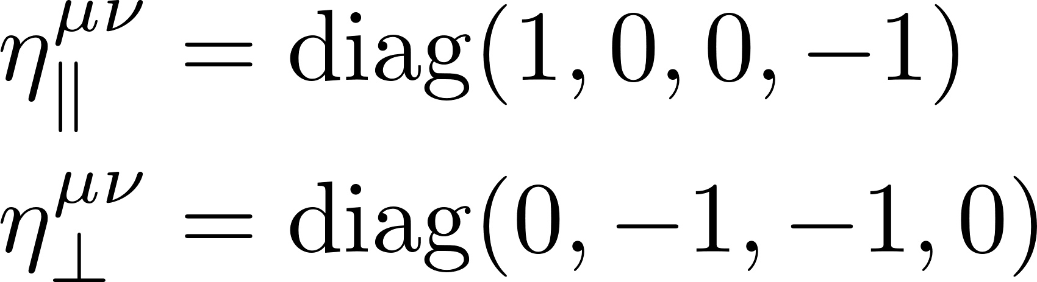
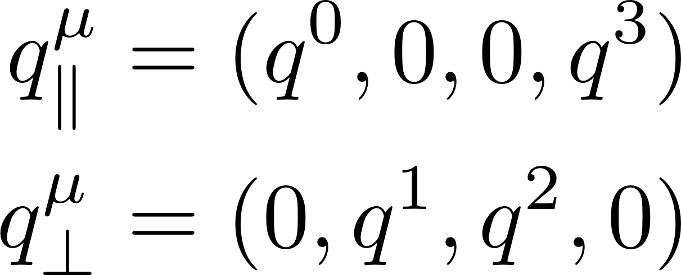
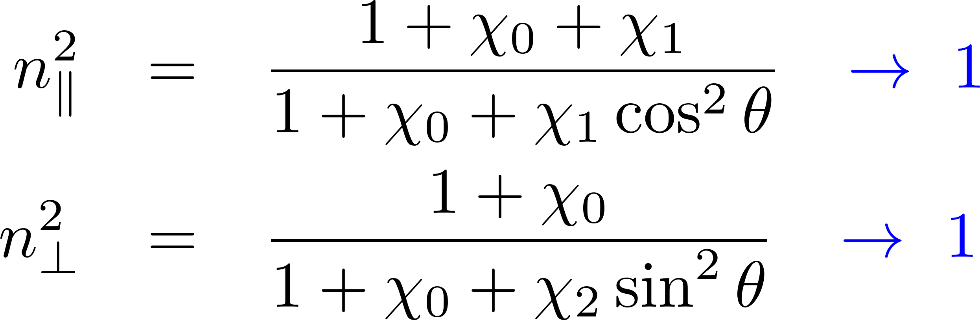
Maxwell eq. w/ quantum corrections:
U(1) gauge symmetry constrains
possible tensor structures
Preferred orientation in B
B-induced structures
(Boost invariance along B)
Refractive indices from the Maxwell eq.
Two (physical) polarization modes in || and ⊥ to B.
Direct consequence of the gauge symmetry and the breaking of one spatial rotational symmetry.
Vanishing B limit:

Slide 15
Resummation for external-field insertions
Resummed propagator
eB
eB
eB
eB
eB
eB
eB
eB
eB
eB
eB
eB
eB
=
＋
＋
＋ ・・・
＋ ・・・
Resummed polarization tensor
=
＋
＋ ・・・
＋ ・・・
Furry’s theorem: The odd-order diagrams cancel in the C-even systems.
＋
＝ ０
Charge flows

Slide 16
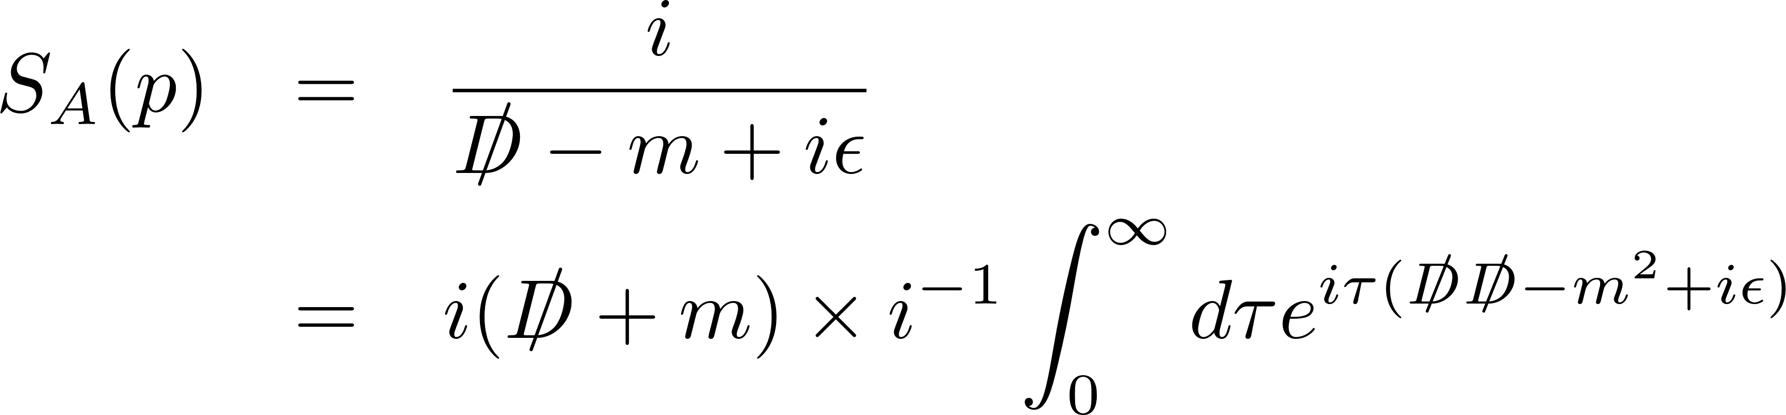

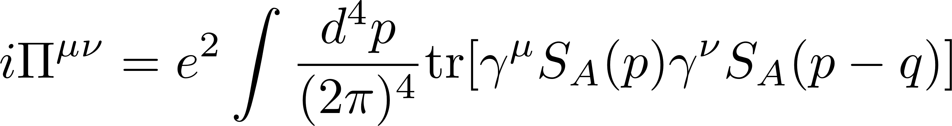

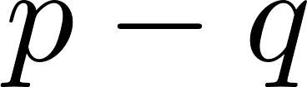
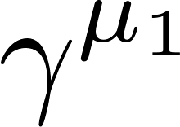
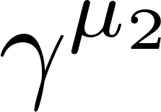
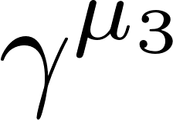
Proper-time method
Fock (1937), Schwinger (1951)
No p and A in the denominator → Gaussian form
Nonlinear wrt the external fields
eB
eB
eB
eB
eB
eB
eB
eB
Technically demanding.
Ex) One needs to perform the Dirac trace with an “infinite” number of gamma matrices.
eB
eB
eB
eB
・・・・・・
Peskin & Schoeder tell us only tr[γ γ γ γ] or a little more…

Slide 17
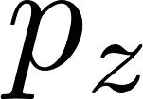
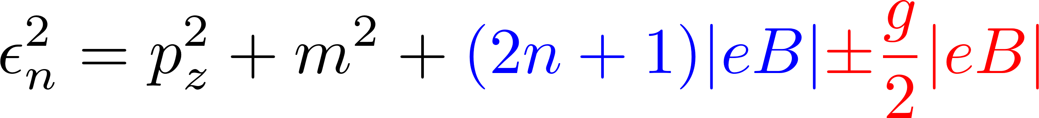
Fermion spectrum in a magnetic field
Remember the lesson: Photon spectrum depends on the fermion spectrum.
Landau quantization
Landau degeneracy
Classical motion
B_{z}
B_{z}
No effects on the longitudinal motion
Cyclotron motion ～ Harmonic oscillation
Spin polarization (Zeeman effect)
No energetically favored position.
→ Degeneracy
Energy spectrum

Slide 18
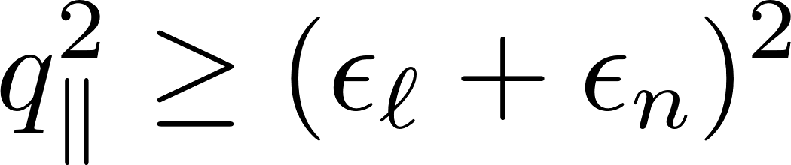
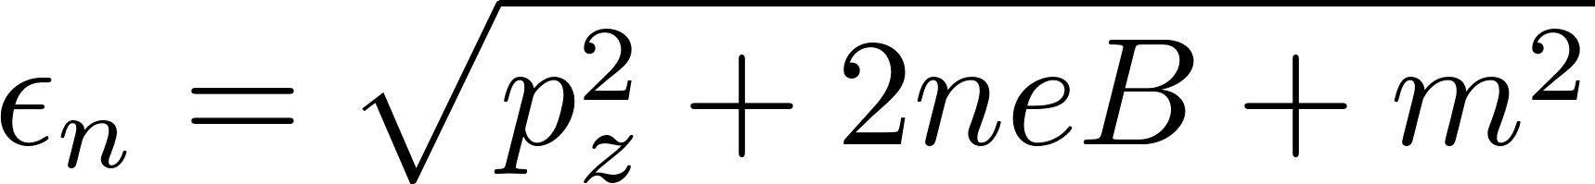
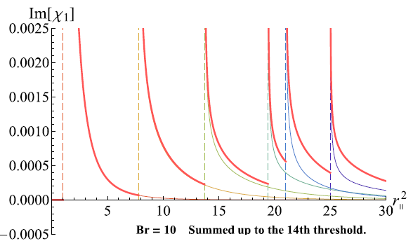
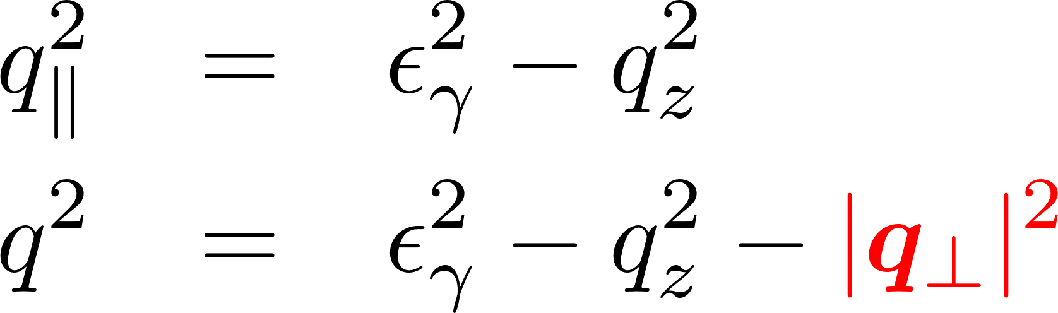
Fermion pair spectrum in the imaginary part
--- Thresholds at the Landau levels
Only one possible source of the imaginary part:
Polarization tensor acquires an imaginary part when
Threshold condition
The integers are identified with the Landau levels.
Photon transverse momentum works
like a “photon mass” in the (1+1)-d kinematics.

Slide 19
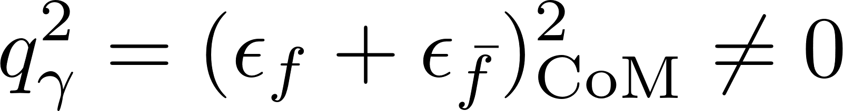

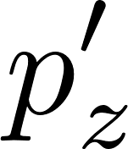
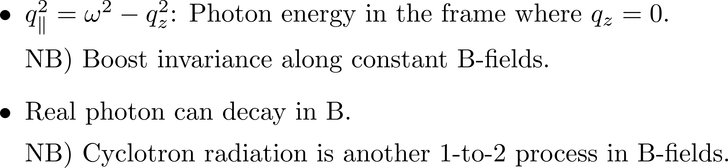
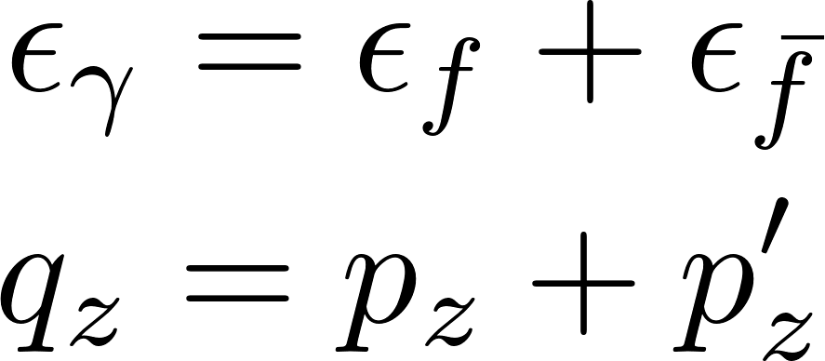
Kinematics w/o magnetic fields
Not compatible with each other without B.
E-m conservation
Massless on-shell condition
Kinematics with the Landau levels
Fermion transverse momentum is NOT a good quantum number.
No transverse momentum conservation between fermions and photons
(due to momentum supply from external B-fields).
In B-field,

Slide 20
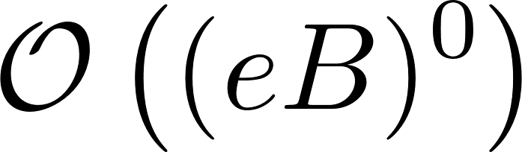
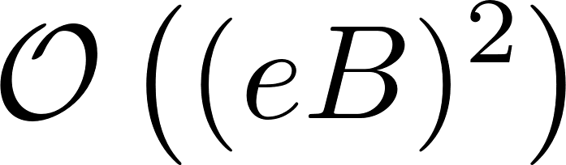


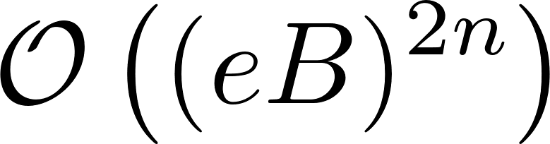
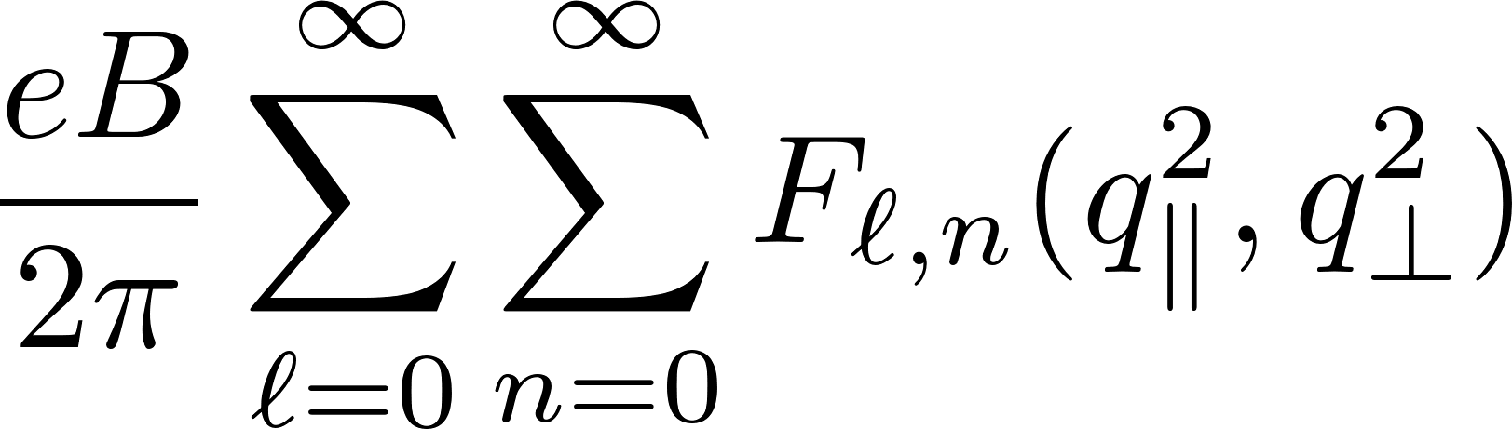
Vacuum polarization tensor in two different series representations
1. Naïve perturbative series when eB is small.
Naïve perturbation breaks down when eB is large!
=
＋
＋
＋ ・・・
＋
Weak-field approximation
Adler, etc.
No modification
2. Landau level representation
Lowest Landau approximation
(ℓ = n = 0) when eB is large.
=
KH&Itakrua [1209.2663, 1212.1897]
Cf. For the Landau level representation of the HE effective action,
see KH, Itakura, Ozaki [2001.06131].

Slide 21
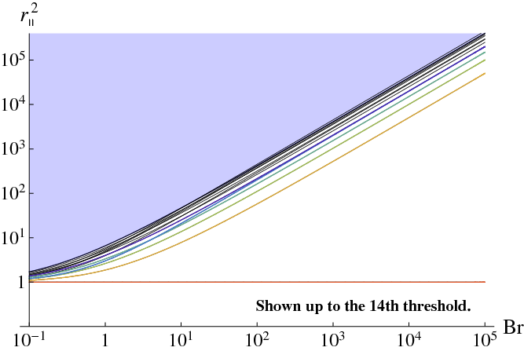
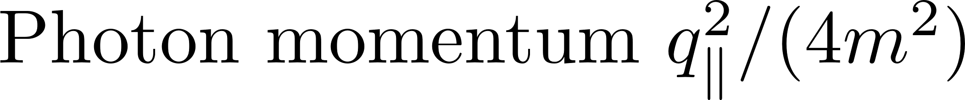
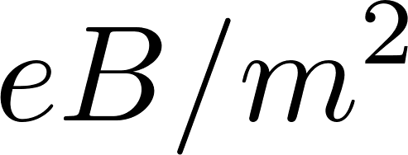
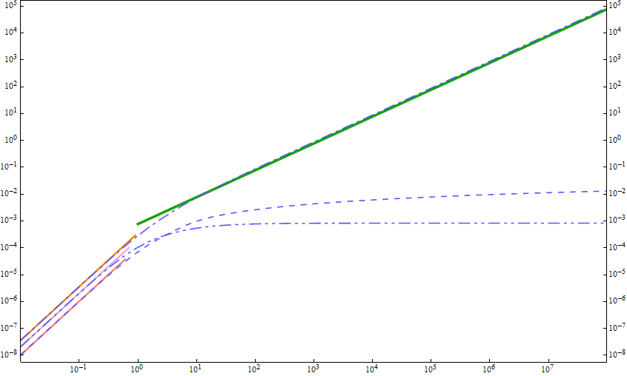
Summary of relevant scales and preceding calculations
Narrowly spaced Landau levels
Strong field limit (LLL approx.)
(Tsai&Eber; Shabad; Gusynin, Miransky, Shovkovy; Fukushima; KH&Itakrua, etc.)
Lowest Landau level →
No imaginary part→
Soft photon & weak field limit (Adler, etc.)
Numerical computation
below the LLL threshold (Kohri and Yamada)
Numerical computation
in the soft photon regime
Strong field limit (LLL approx.)
Soft photon & weak field limit

Slide 22
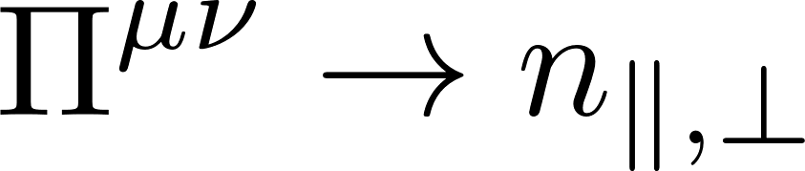
Refractive indices and decay rate

Slide 23
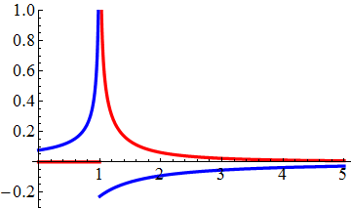
Refractive indices with the LLL fluctuations
Refractive indices at the LLL(ℓ=n=0)
(1+1)-dimensional fluctuations
Polarization excites only along the magnetic field
``Vacuum birefringence’’
B
← No modification in the ⊥ mode

Slide 24
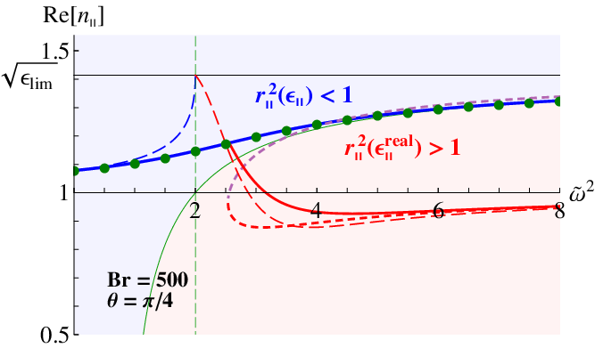
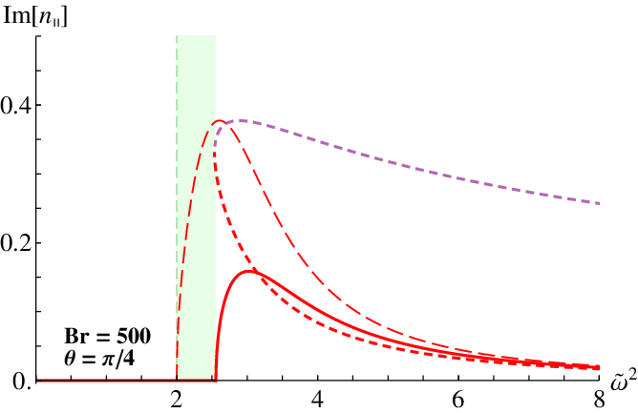



Complex refractive indices
$$ω^{2}/4m^{2}$$
≈ Magnetar << UrHIC
Final results shown by solid lines
$$ω^{2}/4m^{2}$$
cf. air n = 1.0003, water n = 1.3, prism n = 1.5
Refraction
Difermion production

Slide 25
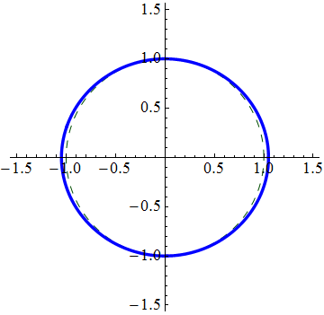
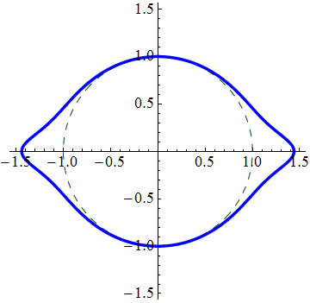



Anisotropy of the refraction index
Angle : Direction of the photon propagation
Radius : Magnitude of the refraction index
Real part
B
Photon energy ω
Threshold
Imaginary part
No imaginary part below the threshold

Slide 26


“Mean-free-path” of photons in B-fields
When the refractive index has an imaginary part,
“Mean-free-path”
λ (fm)
Even real photons decay
in a microscopic scale!
[Real photons never decay in
ordinary vacuum without B-field.]
Smaller mfp for a larger energy ~ 1/ω

Slide 27
Implications
Neutron star magnetosphere
Ultraperipheral heavy-ion collisions
Macroscopic scale ≳ 10 – 100 km
Z
Z
・・・
Soft (coherent)
Z
Hard
・・・
Z
✘ Difficult to measure high-energy photon polarizations.
✔ One could analyze the dilepton angle-distribution.
Imaginary part of the refractive index
= Total cross section.
Timokhin & Harding, ApJ (2019)
Differential dilepton cross-section may be useful.

Slide 28
Differential dilepton spectrum
--- Better accessibility than the photon polarization
KH, Hidetoshi Taya, Shinsuke Yoshida, “Di-lepton production from a single photon in strong magnetic fields: vacuum dichroism”, [2010.13492]

Slide 29



Pair production in a magnetic field
LO w/ B-fields
LO w/o B-fields
No kinematical window for
a single on-shell photon when B = 0.
→ Starts only from 2 photons
Nonperturbatively dressed fermions
Both on-shell and off-shell photons can decay in B.
E.g., Breit-Wheeler process

Slide 30




Ritus basis formalism
= Perturbation theory with the fermion wave functions in B-fields.
See a review part in [2010.13492]
Free Dirac eq. → Plane wave solutions
Dirac eq. in B-field → Localized wave functions
Mode expansion with the eigen-basis in B-fields
→ Ritus-basis Feynman rule
Fermion propagator (= Inverse of D) is given in a simple form.
Price: The vertex function is no longer a simple delta function.
Cf. Photon wave function is still a plane wave
→ Convolution of different bases at the vertices.

Slide 31



Pair production rate for general kinematics
Fermion pair in the Landau levels
One-shell/off-shell photon
Differential information includes
Photon polarization (ε^{μ})
Photon momentum (q^{μ}) with a general direction and invariant mass
Landau levels (n, n’) and continuous momentum (p_{z}, p_{z}’) along B
Consistency checks done: Ward identity, etc.

Slide 32

















Muon-pair excess over electron pairs
KH, Taya, Yoshida [2010.13492]
“Helicity suppression” in pion decay
The LLL (= soft photon)
PDG
Opposite momentum
Opposite spin
along B-field
Opposite spin
Same helicity
Same helicity
Opposite chirality
→ Needs chirality mixing by finite mass.
Opposite chirality
Especially, R neutrino (L antineutrino) does not exist at the QCD scale.
(However, this is not an essential reason for the helicity suppression.)

Slide 33

Feasibility with HIC?
Ideal set-up
Inborn polarization in photon sources
(Possibly unpolarized as well)
Acquired polarization due to the birefringence
Some of photons decay into fermion pairs
UPC events
What is a photon source and what is a strong B field in HIC?
Z
There is no a priori difference: Both are Coulomb electric fields in the nucleus rest frame.
The photon source has a momentum distribution: Fourier transform of the charge distribution, e.g., the Woods-Saxon profile.
The hard and soft components of the distribution may be regarded as “photons” and a “magnetic field”.
Needs quantitative estimates with a separation scale.
Z
・・・
Soft (coherent)
Z
Hard
・・・
Z

Slide 34
Summary
Vacuum birefringence (polarization-dependent refractive indices)
γ→ ee for both on-shell and off-shell photons
Differential di-lepton spectrum
→ “Helicity suppression” in the electron/muon
Prospects for the UPC
Needs convolution with the photon distribution function
Time dependence of a magnetic field
KH, Xu-Guang Huang, Hidetoshi Taya, Shinsuke Yoshida, In progress.

Slide 35
Back-up slides

Slide 36
Strong magnetic fields induced by relativistic heavy-ion collisions
B
Z
Z
Z
Z
Static Coulomb field
Boost → Lienard-Wiechert potential
Free streaming
HIJING
Central coll.
Peripheral coll.
Deng & Huang; KH & Huang [1609.00747]

Slide 37





Lifetime of the B-field after the collisions
B(t)
A longer lifetime due to the Lenz’s law?
Tuchin
E
Time dependent B induces E.
E induces J if QGP is conducting.
→ Induced J sustains B.
Important to know the conductivity of QGP in magnetic fields. KH & Satow; KH, Li, Satow, Yee; Fukushima & Hidaka
McLerran & Skokov
Isobaric collisions will help us to understand the backgrounds
and to extract the magnetic-field effects.
Cf. Deng, Huang, Ma, Wang for recent estimates

Slide 38
Analytic and numerical estimates of the strong B
-- Impact parameter dependences
t = 0 (at the collision)
W.-T. Deng & X.-G. Huang, KH and X.-G. Huang

Slide 39


Time dependences
KH and X.-G. Huang
Collision-energy dependences
V. Voronyuk, et al. (2011)
KH and X.-G. Huang

Slide 40








Kinematics in the massless LLL
Linear dispersion relations in the lowest Landau levels
R handed
L handed (when eB>0)
Perturbative vertex does not mix the R and L.
Kinematics in the massless limit is satisfied only in the “collinear limit.”
⇒ No coupling to the transverse photons.

Slide 41




Canonical quantization in B-field
See a review part in [2010.13492]
Ritus basis: Eigenspinor in B-field
Spin up and down states are degenerated except for n = 0.
Mode expansion can be performed in this basis.
Fermion propagator gets simplified.
Price: Convolution of the wave functions at the vertex gets complicated. Fermion wave functions are not orthogonal to photon wave function. (Photon wave function is a plane wave.)

Slide 42




Resummed polarization tensor
Gauge symmetries lead to a tensor structure,
Integrands with strong oscillations
B
Exponentiated trig-functions generate
strongly oscillating behavior with
arbitrarily high frequency.
Proper time integrals on the two fermion lines
Schwinger, Adler, Shabad, Urrutia,
Tsai and Eber, Dittrich and Gies
Vanishing B limit:

Slide 43
Decomposing exponential factors
Contains arbitrarily higher harmonics
Linear w.r.t. τ in exp.
1st step: “Partial wave decomposition”
Linear w.r.t. τ in exp.
2nd step: Getting Laguerre polynomials
Associated Laguerre polynomial
Linear w.r.t. τ in exp.

Slide 44


All terms fall in one of three elementary integrals.
Integers specify the fermion spectrum encoded in the photon spectrum.
(Remember the lesson in introduction)
eB
eB
eB
Invariant mass:
Fermion-antifermion spectrum
Square of the decay amplitude
(Optical theorem)

Slide 45


Renormalization
=
+
+
+
・・・
Log divergence
Term-by-term subtraction
Finite
Ishikawa, Kimura, Shigaki, Tsuji (2013)
Re
Im
Taken from Ishikawa, et al. (2013)

