Slide 1
STAR Isobar Situation:
Completion of the Isobar analysis by the end of FY21 was set as a benchmark in the “Notable Performance Evaluation and Measurement Plan” by DOE ONP
Understanding the centrality definition to the needed precision took more time than expected
Despite bi-weekly status updates that the analysis was behind schedule DOE would not relax the requirement
June 22nd it was clear that we were in danger of missing this goal and the decision was made at the department level to re-allocate more resources to STAR for one month
STAR has been making every effort to make effective use of the additional resources

Slide 2
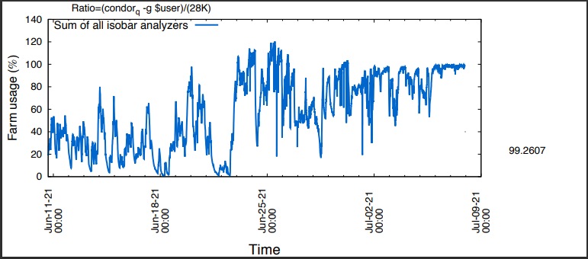
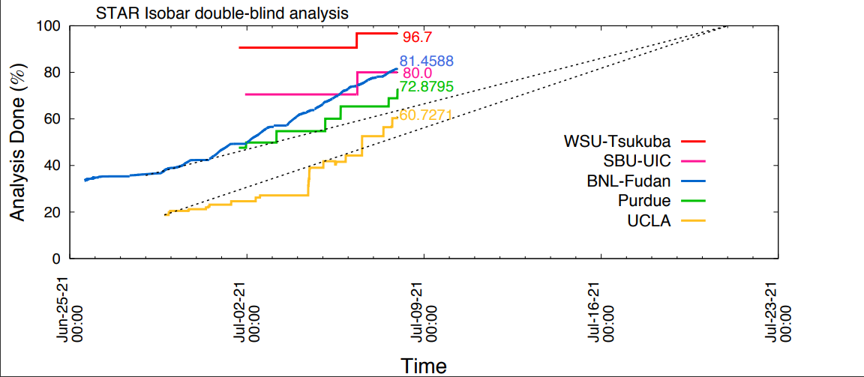
Status:

Slide 3
Thank you!
  Thank you for setting up the reallocation
  Thank you for debugging
  Helping our groups optimize analysis
  Thank you for the sacrificed resources

