Slide 1
SIDIS WG Status
Marco Radici (INFN Pavia), Anselm Vossen (Duke & Jlab)
Athena bi-weekly meeting, 7/8/2021

Slide 2
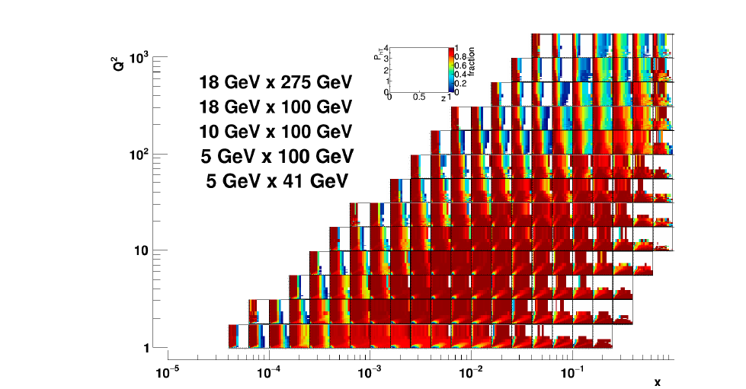
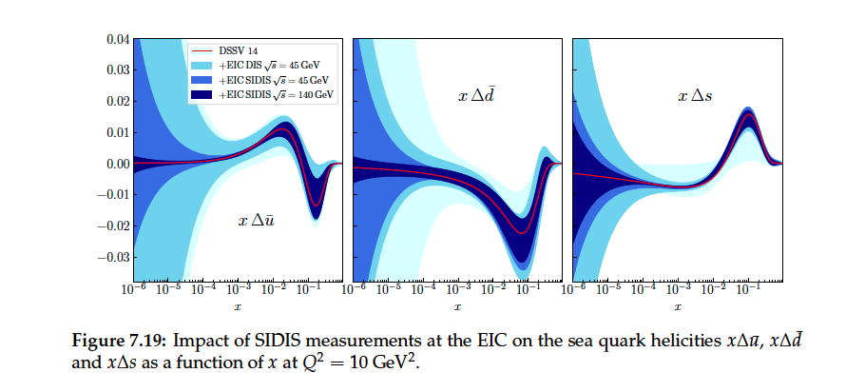
Impact Plots Candidates
SIDIS coverage → Emphasize unexplored phase space
Sivers & TMD Evolution → Golden Channel, high impact of Athena data
Transversity →Silver measurement
Sea quark helicities → Golden measurements, highlight PID
Suppression in $eA$ →Golden channel, highlight acceptance
$(Λ$ program)

Slide 3
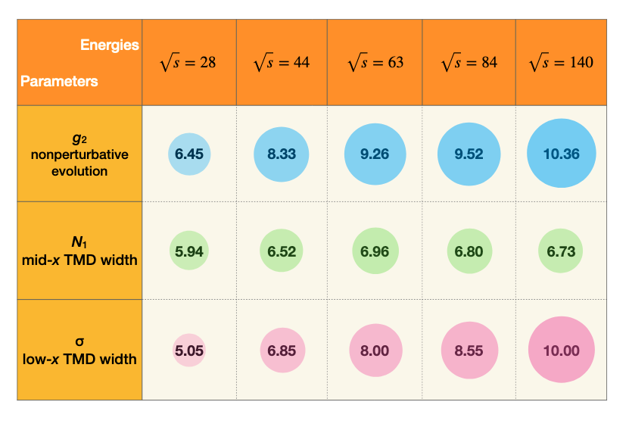
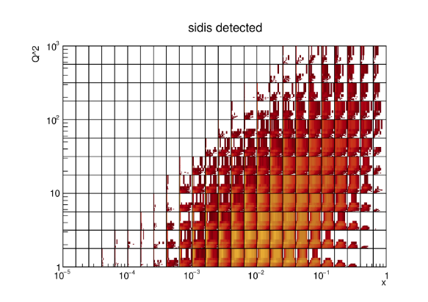
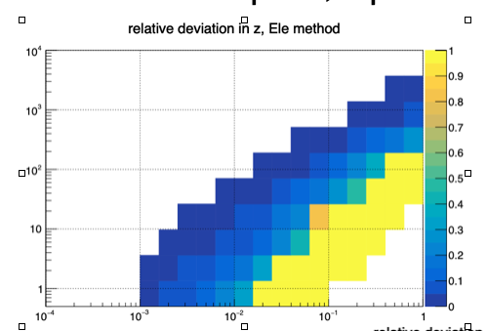
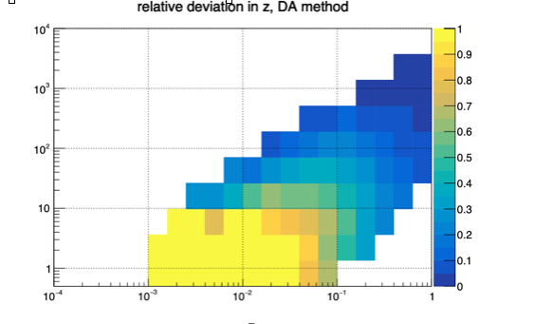
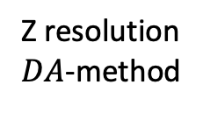
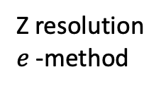
Progress so far
Marco Radici (INFN Pavia)
Fruitful discussions with PID and tracking groups
Impact plots/theory support
Sivers/TMD evolution: Pavia extraction
Sea quarks: JAM (Filippo Delcarro) and Borsa et al
Nuclear suppression: Liang Zheng & Bowen Xiao
Fast simulations:
First fast simulations (with beam effects) performed
Studied reconstruction performance of SIDIS variables with hadronic final state
Full Simulation:
First studies of full simulations underway
Focus on tracking and PID performance
Tracking group did zero-order evaluation of tracking with far replaced vertices
Duane Byer(Duke)
Z resolution $e$-method
Z resolution $DA$-method
Connor Pecar (Duke)

Slide 4
Near Term Plans
Full simulations
Focus for the next few weeks to validate our first fast simulations results (as full simulation becomes available)
Follow up on $Λ$ performance studies
Fast Simulations
Generate pseudo-data for azimuthal asymmetries and $A_{LL}$
Study smearing/PID
Systematics
Azimuthal asymmetries: smearing, PID →Unfolding? Difference between smeared, non-smeared?
$A_{LL}:$detector performance, lumi.. →take HERA systematics?
Saturation studies tbd
Meeting with our ECCE counterparts 7/13 9:15
First iteration of Impact plots (from fast simulations?)

