Slide 1
Bi-Weekly Meeting Weekly meeting 7/08/2021
Abhay Deshpande
For
Silvia Dalla Torre, Olga Evdokimov, Yulia Furletova, Barbara Jacak, Alexander Kiselev, Franck Sabatie, Bernd Surrow

Slide 2
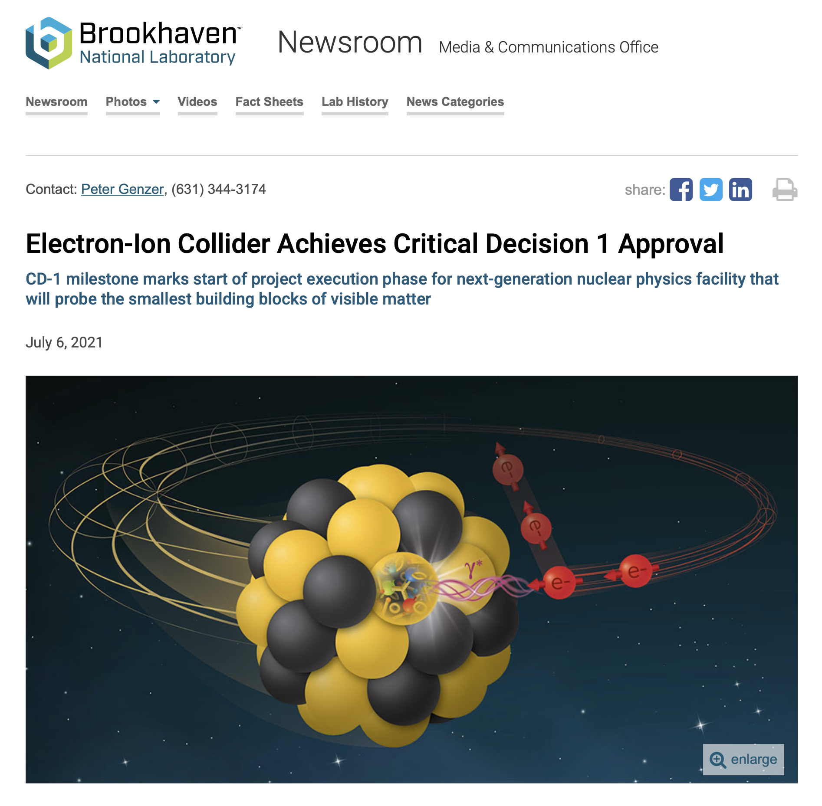
Project Management + Proto-Collaborations + EICUG SC 7/01/2021
EIC has CD1 as of 6/28. Congratulations! Press Release 7/6.
Aiming for CD2 & CD3A (potentially together) in September 2023
CD1 helps DOE/NP outreach to international funding agencies
Proto-Proposal selection: Chairs identified, committee final by end-July. Will be made public ~ August 2021.
IP6 design: +0.5m on the hadron going side seems feasible: see the Indico site on EICUG/EIC project (https://indico.bnl.gov/event/10974/contributions/)
Generic R&D and directed R&D for EIC detectors: situation to be clarified in the next few months (when budgets are known). Target date for money October 1, 2021 (but with uncertainties and caveats.

Slide 3
ATHENA Logo Competition Result THANK YOU ALL FOR PARTICIPATING Working with “artists” to beautify it further
Option 1
Option 2
Option 3
43%
33%
22%

Slide 4
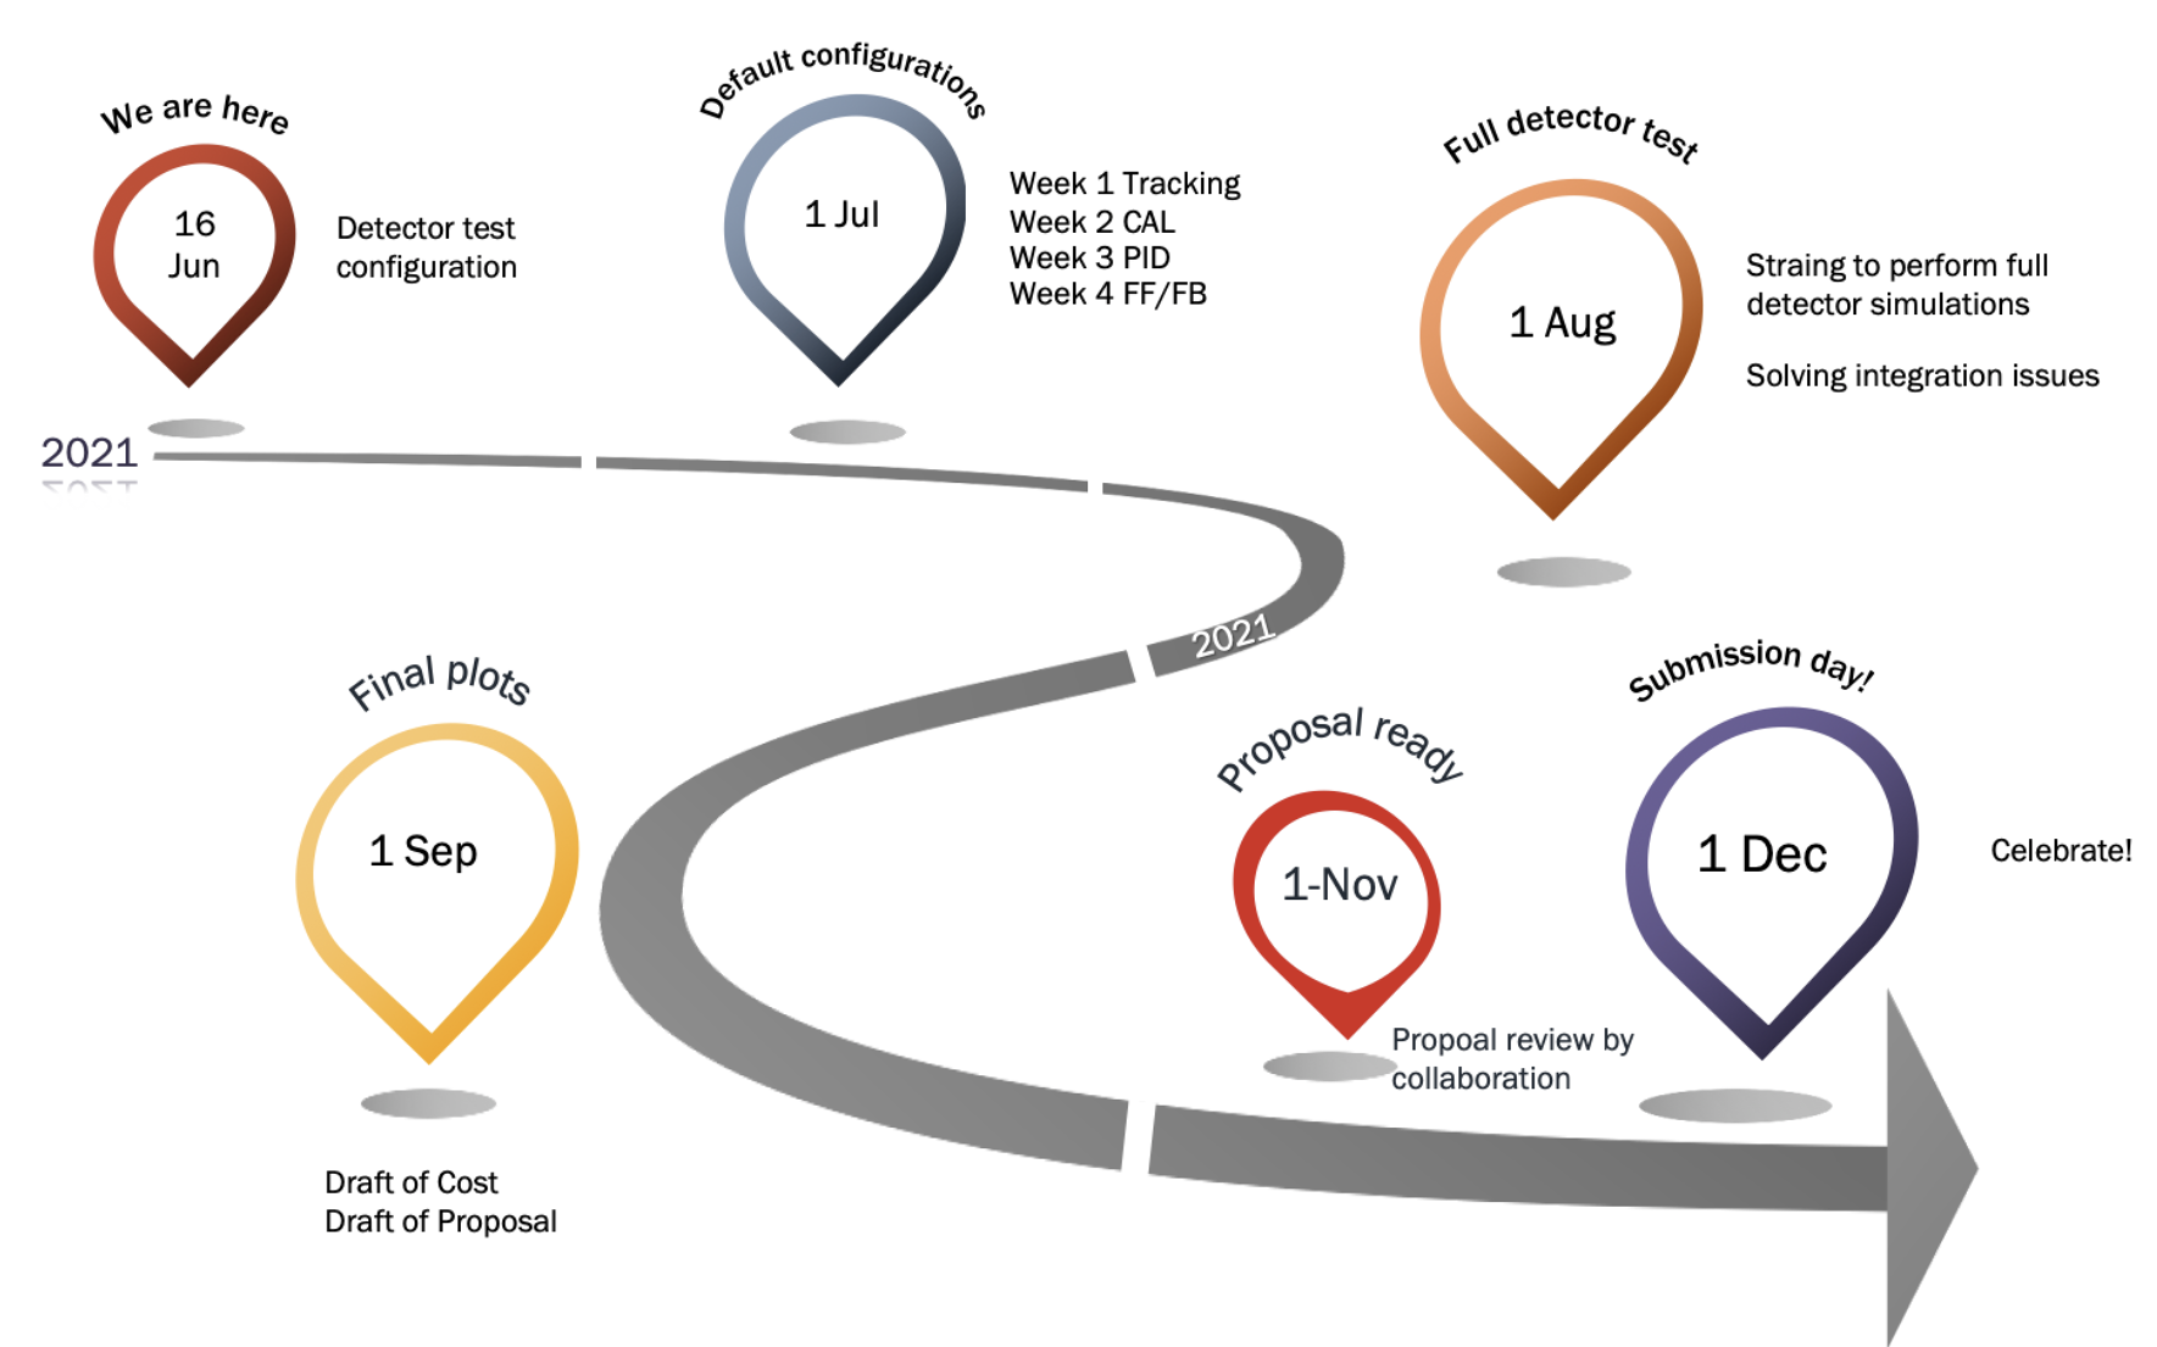
You are here
Yulia Furletova

Slide 5
In view of the timeline shown before….
DAQ initial strategy & evolving theme
Software Update
Incorporating detector systems in software
Do you think we will be able to do full simulations by 1st week of August
Detector Update
Incorporating detector systems in software
Do you think we will be able to do full simulations by 1st week of August
Physics WG
Golden channels : identification, presentation, strategy
Is there a need for theory support at any time? Have you approached theorists?
AOB
Today would be the last of the meetings in which all WGs asked to present. The mode will shift to focused topical discussions starting from the future Bi-Weekly meetings.

Slide 6
News from the Proposal Committee
Committee Members:
Costing: Bernd Surrow, Olga Evdokimov, Zhangbu Xu and Yulia Furletova
Global design and integration: Bedanga Mohanty, Franck Sabatie, Alexander Kiselev, Thomas Ullrich, and Silvia Dalla Torre
Editing: Abhay Deshpande, Barbara Jacak, Zein-Eddine Meziani, and Peter Jones
Ex-Officio/Project contact: Elke Aschenauer
Organization and Kickoff:
Proposal committee met, Document sharing planned, Contact persons from each WG to the proposal committee identified, weekly meetings of the Proposal Committee’s sub-groups have begun.

Slide 7
WG Contacts to the Proposal Committee
 | Costing | Integration | Editing
Tracking | Francesco Bossu | Laura Gonella | Domenica Elia
Calorimetry | Oleg Tsai | Paul Reimer | Vladimir Berdnikov
PID | Roberto Preghenella | Frank Geurts | Tom Hemmick
DAQ | Jeff Landgraf | Alexandre Camsonne | Jeff Landgraf & Alexandre Camsonne
FarForward | Alex Jetsch | Alex Jetsch | John Arrington
FarBackward | Marius Przybycien | Jaroslav Adam | Krzysztof Piotrzkowski
Physics Working Groups
Inclusive |  |  | Paul Newman
Semi-Inclusive |  |  | ??
HQ/Jet |  |  | Stephen Sekula
Exclusive |  |  | ??

Slide 8
EIC Users Group Meeting August 2-6, 2021 Co-Organized by: Virginia Union University & UC Riverside
Preliminary Information
Day 1
EICUG Welcome
EIC project status
High level physics presentations: Spin, Mass, High density gluons
Presentations from funding agencies: DOE, NSF, CERN, NUPECC, Other?
Following Days
EIC detector design updates
EIC detector proposal initiatives
Studies and status of the 2nd IR at the EIC
Announcements on EICUG Elections status and changes to EICUG leadership
Parallel Sessions: Computing, Software, Detector R&D, Physics, Polarimetry
Highlight : a new initiative
Junior day (self-organized by junior colleagues): an extremely interesting new initiative

Slide 9
Thank you.

Slide 10
Proposal Committee: news from Editing Group
Members: Abhay Deshpande, Barbara Jacak, Zein-Eddine Meziani and Peter Jones
1st meeting two weeks ago, will meet every Thursday
Setting up an OverLeaf document outline: (in discussion)
Define chapters describing ATHENA detector concept – to be fleshed out with the Integration committee
Outline a chapter on subsystem performance, with 2-3 figures & text from detector WGs
Setup physics performance chapter around 2-3 golden channels, and some challenging measurements: define figures and text from physics WG conveners
Chapter for Collaboration organization
Chapter for Costing

