Slide 1
Athena DAQ: Planning and Strategy

Slide 2
Components and Terminology:
Clock Distribution
Front End Boards
(on/near detector)
Front End Processors
(Electronics in DAQ room)
DAQ Network /
Computing (COTS)
Tape (SDCC)
Detector
Front End Boards
(on/near detector)
Detector
Front End Boards
(on/near detector)
Detector
(etc…)
SDCC /
DAQ/
Software
Detector /
DAQ
DAQ
Detectors
DAQ

Slide 3
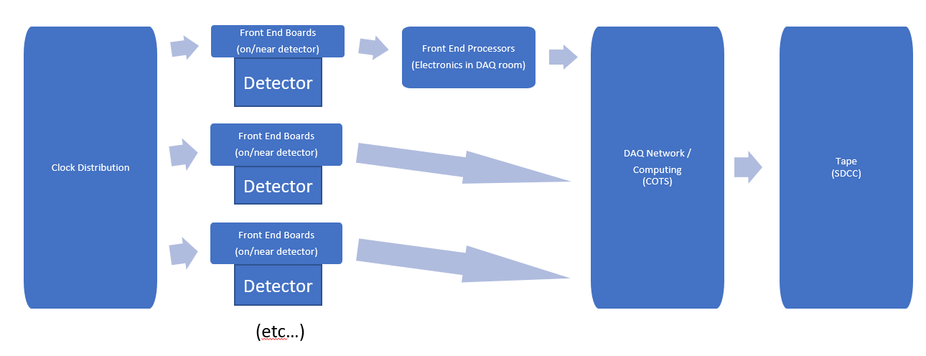
Clock Distribution:
Consists of:
Custom boards
Optical links (e.g. lpGPT ecosystem)
Function:
distribute clock,
synchronize detector timing with bunch structure,
synchronize BX (and hence events) between detectors
share other information between detectors
bunch polarization
“prescaling”
Attainable specs:
100Mhz clock rate (variable within reasonable parameters due to beam energy)
1ps clock jitter
Specialized solutions for detectors needing better clock jitter?
Interfaces:
EIC
Front End Boards (FEB)

Slide 4
Front End Boards (FEB):
Consists of:
Specific to detector
Integrated + boards near detector
SiPM + FPGA &/or ASICS near / on detector
ASICS on detector
Function:
ADC conversion
Zero-suppression / other data compression
Multiplex channels
Assemble time frames
Attainable Specs:
Capable of streaming “maximum luminosity” in normal mode
Not, in general, capable of streaming black events
Need better definition than this!
Interfaces:
Clock Distribution
DAQ computing &/or Front End Processors (FEP)
eg lpGPT ecosystem, up to 20gbps
Run mode configuration &/or slow controls

Slide 5
Front End Processors (FEP):
Consists of:
Custom Electronics in DAQ room
FPGA based boards
Function:
Data Compression
Event finding / selection
Tradeoffs:
Interesting Ideas
FPGAs are well suited to Neural Nets / ML algorithms
May be capable of very high performance
But… complex
Custom electronics which becomes quickly obsolete
Harder to program and adapt
ML algorithms can be tricky to verify
Likely need capability to run in passthrough mode
Can be mimicked in CPUs
We need a model for cost vs performance for FEP vs CPU based solutions to determine which detectors might benefit from or need FEP capabilities, and to determine whether they are a requirement or a luxury

Slide 6
FEB/FEP interface to DAQ:
Consists of:
Physical Level
Fiber protocol (eg lpGPT ecosystem)
Logical Level
Headers to define data source, time frames, and data types?
do we specify meaning of time frames?
synchronize time frames?
This interface needs to be well defined before any FEB/FEP electronics designs can be finalized

Slide 7
DAQ Network and Computing:
Consists of:
Commercial Off-the-shelf Hardware / Networks
Function:
Transport data
Additional data compression
Format data
System control and configuration
Track datafiles and configuration information
Event Selection and tagging and accounting (HLT)
QA
Monitoring
Logging
Interfaces:
FEB/FEP
Software and Computing
Events?
Combine same time regions for all detectors in specific files?
Time regions in multiple files split by detector?

Slide 8
DAQ Network and Computing:
Other Related Components:
Scalers
Slow Controls
Beam Parameters for analysis <-> feedback to collider from detectors

