Slide 1
Nuclear Data for Space Exploration – Part 1
Lee Bernstein
Department of Nuclear Engineering
UC-Berkeley
Nuclear Science Division
Lawrence Berkeley National Laboratory
August 17, 2021

Slide 2
About me
Ph.D. in Nuclear Physics from Rutgers University (1994)
LLNL Post-doc → Staff (1994-2016)
Worked at the intersection of basic and applied science
Joint Faculty Scientist at the UC Berkeley Dept. of Nuclear
Engineering and the LBNL Nuclear Science Division.
I am the Bay Area Nuclear Data Group Leader where I lead a group
of 16 researchers and students who work to address the nuclear data
needs of the applied and basic science community.
Background in low energy nuclear structure, nuclear reactions and plasma physics
I’ve been part of a nuclear data outreach effort to the nuclear energy, isotope production, counterproliferation and space communities through a series workshops and meetings including NDNCA (2015)¹, NDREW (2018)² and WANDA (2019, 2020, 2021) ³
As a new NSAC member I was asked to “provide expert advice in the field of nuclear science, as it relates to nuclear data needs of the applied and basic science and engineering with specialization in measuring low-energy nuclear properties and cross sections”
¹ https://bang.berkeley.edu/events/ndnca
² https://info.ornl.gov/sites/publications/Files/Pub111600.pdf
³ https://nucleardata.berkeley.edu/wanda/index.html

Slide 3
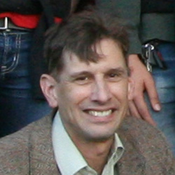
We decided that a “tag team” approach is the best way to show the way that RHIC can address nuclear data needs for space exploration
Introduction:
The space environment and the role of shielding
Dose and the importance of stopping powers
The nuclear data evaluation process
Particle Transport:
The transport code universe
Reaction modeling from 10⁻³ – 10¹⁰ eV
The role of the US Nuclear Data Program
The role of RHIC
The STAR fixed target station
The type of data that can be provided
How RHIC can help provide the high-energy “Source term” for space shielding applications
UC/LBNL Nuclear Data Group Leader
National Nuclear Data Center Group Leader
Lee Bernstein
(UC/LBNL)
Dave Brown
(BNL)
STAR fixed target program leader
Dan Cebra
(UC Davis)

Slide 4
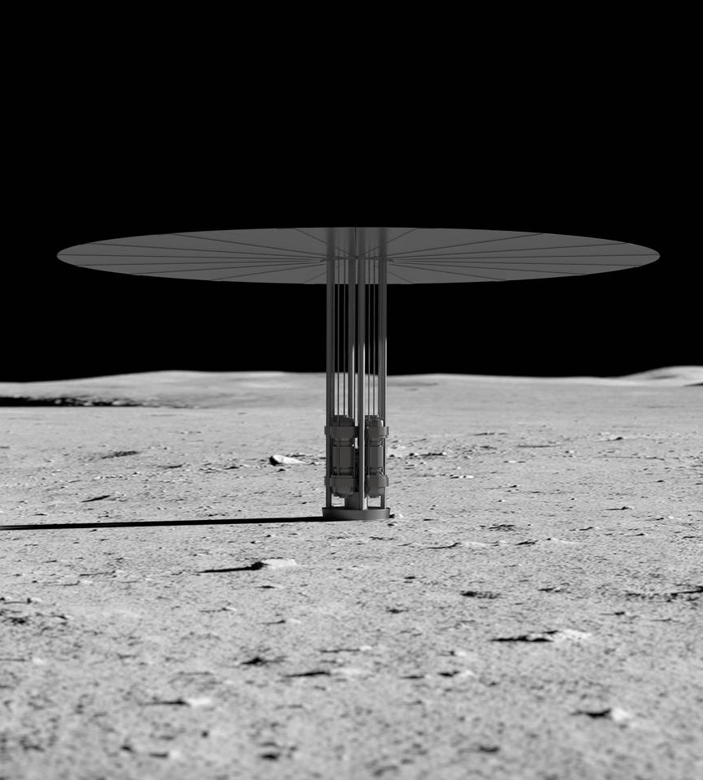
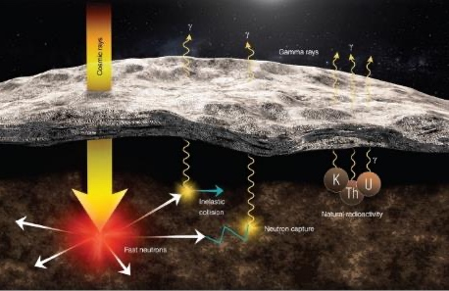
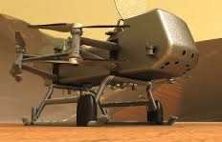
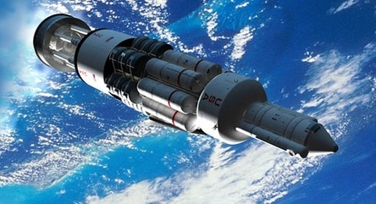
Nuclear Data is central to Space Exploration
Dose/Shielding Calculations for
Electronics⁴ and Humans⁵
Energy Production
Elemental ID using neutron-induced γ-rays^{3,4}
Passive (n,xγ)
Cosmic rays
KRUSTY¹
Fast neutrons
Natural
Radioactivity
Nuclear Data
Active (DT) γ-rays
TOPAZ²
¹https://www.nasa.gov/directorates/spacetech/kilopower
²Thermionics Quo Vadis? an assessment of DTRAs advanced thermionics research and development program. Washington, D.C. National Academy Press. (2001).
³C. Romano et al., WANDA 2020 Final Report. ORNL/TM-2020/1617 (2020).
⁴P. Peplowski (JHUAPL) numerous
Nuclear Propulsion

Slide 5
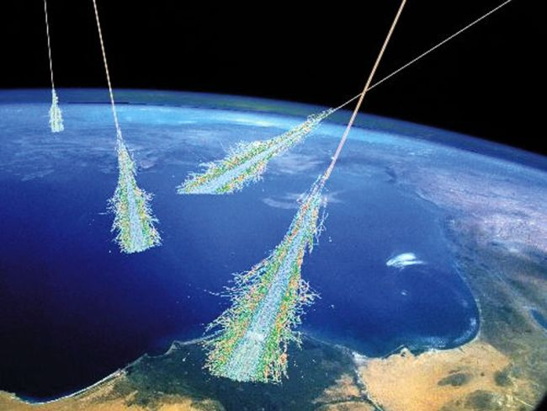
We are shielded from the Galactic Cosmic Ray Background by our atmosphere and the earth’s magnetic field
What is this Galactic Cosmic Ray Background comprised of?
Daniel Gomez Toro. Temporal Filtering with Soft Error Detection and Correction Technique for Radiation Hardening Based on a C-element and BICS. Micro and nanotechnologies/Microelectronics. Télécom Bretagne; Université de Bretagne Occidentale, 2014. English. tel-01191520

Slide 6
The GCR background spans a huge mass and energy range covering virtually all of Nuclear Physics
The GCR includes nuclei as heavy as ⁵⁶Fe and E/A up to 50 GeV
For reference, E_{binding}(⁵⁶Fe) ≈0.5 GeV
The range of 1 GeV proton in Al is > 1 m.
It’s even worse near the gas giants where their magnetic field meets the solar wind.
These high-energy particles create cascades of hundreds of secondary, tertiary etc. particles
The shielding itself can contribute to the variety of secondary particles produced.
Charged secondary particles deposit a portion of their energy more locally than neutrons
The solar system beyond the atmosphere and the earth’s magnetic field is a tough neighborhood!
T.C. Slaba et al.
Life Sciences in Space Research 12 (2017) 1–15
Space exploration requires appropriate shielding over a wide range of energy

Slide 7
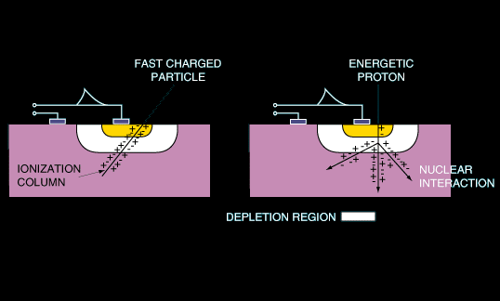
What is the effect of the GCR on electronics?
GCRs can cause single event upsets (SEU) in transistors that can cause temporary or permanent failures.
The likelihood of an SEU increases with dose density.
GCR heavy ions cause a local, dense ionization column
Secondary protons and neutrons can induce a nuclear reaction that creates a recoiling residual nucleus
The imparted dose depends on the stopping power of the recoiling nuclei.
M. Lauriente, A. L. Vampola, "Spacecraft anomalies due to radiation environment in space," NASDA/JAERI 2nd International Workshop on Radiation Effects of Semiconductor Devices for Space Applications, Tokyo, Japan, March 1996.

Slide 8
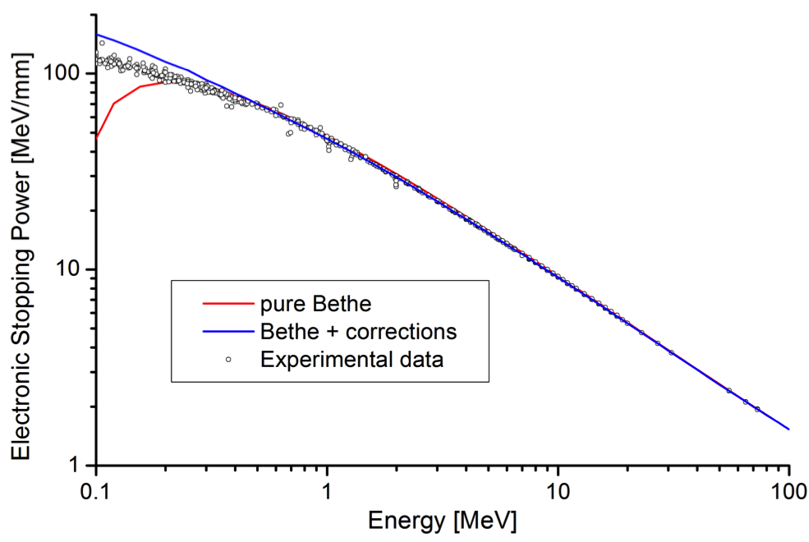
Ion stopping powers at higher energies are given by the Bethe-Bloch Formula
$$\frac{dE}{dx}=\left(\frac{e^{2}}{4πε_{0}}\right)\frac{4πZ^{2}N_{A}Z_{target}ρ_{target}}{m_{e}c^{2}β^{2}A_{target}}\left(ln\left(\frac{2m_{e}c^{2}β^{2}}{I\left(1−β^{2}\right)}\right)−β^{2}\right)$$
Ionization potential (energy loss to electrons)
Poor Agreement
$\frac{E}{A}<0.1−1.0\frac{MeV}{amu}$
Good Agreement
$\frac{E}{A}>0.1−1.0\frac{MeV}{amu}$
E (MeV/u)
…the credibility of SRIM (the primary stopping power code used) predictions may decrease dramatically in regions of the Z, Z_{target}, E parameter space that is unsupported by experimental data.
P. Sigmund, A. Schinner. NIMB 382 (2016) 15–25

Slide 9
Energy deposition from charged particles in a material
is quantified by the Linear Energy Transfer (LET)
Linear Energy Transfer (LET) is the ratio of energy transferred by a charged particle (dE_{local}) to target atoms along its path (dx). Units are energy/thickness, e.g., MeV/cm or MeV/mg/cm²
Energy loss in Si
LET (MeV/mg/cm²
As the energy of an ion → 0 the stopping power increases, leading to a Bragg Peak where the highest dose is deposited
Higher-Z ions have shorter ranges and higher dose in their Bragg Peaks
LET (MeV/mg/cm²
“…the credibility of SRIM (the primary stopping power code used) predictions may decrease dramatically in regions of the Z, Z_{target}, E parameter space that is unsupported by experimental data.”*
Energy (MeV/u)
*P. Sigmund, A. Schinner. NIMB 382 (2016) 15–25

Slide 10
Recently Osheroff et al., showed that the LET in AlGaN electronics is dominated by recoiling high mass nuclei
J.M. Osheroff et al. IEEE Transactions on Nuclear Science Volume: 68, Issue: 5, May 2021

Slide 11
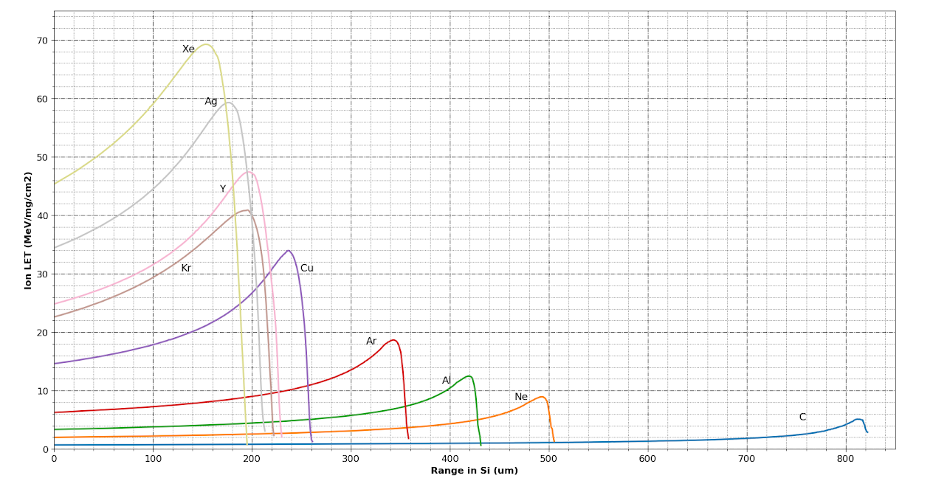
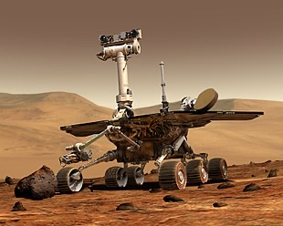
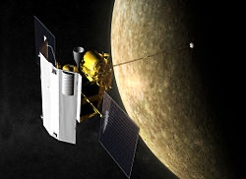
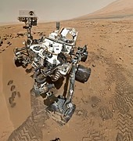
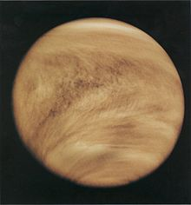
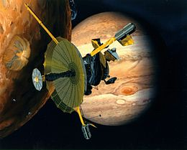
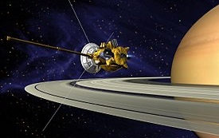
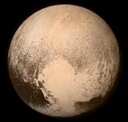
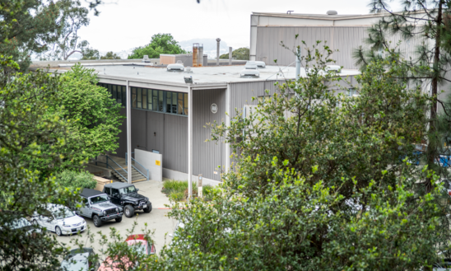
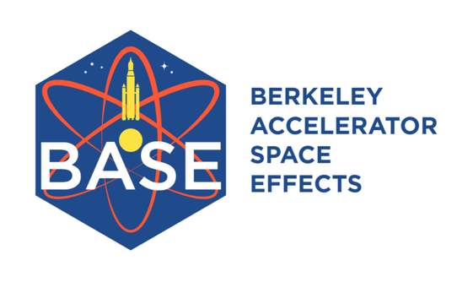
NASA uses “Cocktail” beams of multiple heavy-ions to uniformly dose electronics to test their radiation hardness for use in spacecraft
70
60
50
40
30
20
10
0
Mercury Messenger
Curiosity, Spirit & Opportunity Rovers Mars)
Ion LET (MeV/mg/cm²)
E/A=20 MeV
0 100 200 300 400 500 600 700 800
Range in Si (µm)
Pioneer (Venus)
Galileo (Jupiter)
Cassini/Huygens (Saturn/Titan)
New Horizons (Pluto )
The LBNL 88-Inch cyclotron*
These are integral tests and don’t add to our understanding of the GCR or the secondary particles it creates
* https://cyclotron.lbl.gov/base-rad-effects

Slide 12
Human radiation damage depends on Dose Equivalency
$$Dose (D)=\frac{energy deposited}{mass of material}$$
$Dose Equivalent =D×Q (REM)$
$$Q_{γ−rays}=1, Q_{α}=20$$
$$1 Sievert=100 REM$$
Normal Background Dose/day on earth: 10 µSv
Lowest annual dose linked to cancer: 100 mSv
DOE Limit for Life Saving activities: 250 mSv
Acute dose causing symptoms: 400 mSv
10 minutes next to the Chernobyl Core: 50 Sv

Slide 13
The effects of shielding* for projectile-like fragments (Z>8)
Adding shielding decreases dose from heavy ions
Life saving activities
Link to cancer
ρ_{Al}=2.7 g/cm³
ρ_{PE}=0.97 g/cm³
*T.C. Slaba et al. Life Sciences in Space Research 12 (2017) 1–15

Slide 14
The effects of shielding* from neutrons and ions
“Variation in model results… is mainly a result of differing nuclear reaction and fragmentation cross sections, affecting both primary and secondary ion transport”*
…but adding shielding increases the dose from neutrons!
Life saving activities
This large variation necessitates expensive margins in shielding
Link to cancer
ρ_{Al}=2.7 g/cm³
ρ_{PE}=0.97 g/cm³
*T.C. Slaba et al. Life Sciences in Space Research 12 (2017) 1–15

Slide 15
The effects of increasing the lateral size of the shields
Thicker lateral dimension leads to proportionally fewer “hard”, forward-focused neutrons
e.g., dσ/dω matters too
0.3 mm H₂O
Life saving activities
Link to cancer
(ρr)_{Al} =60 g/cm²
ρ_{Al}=2.7 g/cm³
ρ_{PE}=0.97 g/cm³
*T.C. Slaba et al. Life Sciences in Space Research 12 (2017) 1–15

Slide 16
30 cm of tissue self-shielding* from neutrons and ions
“Variation in model results… is mainly a result of differing nuclear reaction and fragmentation cross sections, affecting both primary and secondary ion transport”*
dσ/dθ
matters
too
_{±25%}
30 cm H₂O
This large variation necessitates expensive margins in shielding
Life saving activities
Link to cancer
(ρr)_{Al} =60 g/cm²
ρ_{Al}=2.7 g/cm³
ρ_{PE}=0.97 g/cm³
*T.C. Slaba et al. Life Sciences in Space Research 12 (2017) 1–15

Slide 17
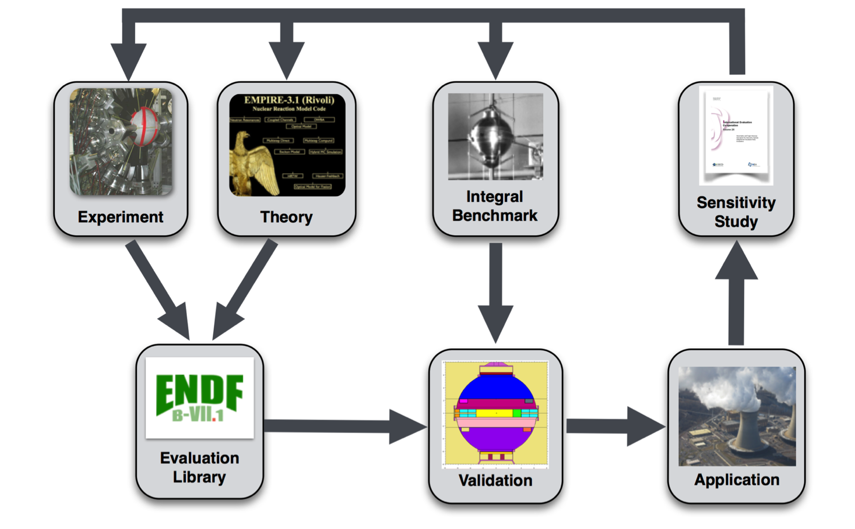
The nuclear energy community have addressed nuclear data needs via experiment-guided modeling called evaluation
A sensitivity study is performed for a specific application performs to determine what new experiments are needed.
Published experimental data (including uncertainties) are compiled into databases (EXFOR).
Physics-based theoretical models are adjusted to best reproduce differential measurements (cross section vs. energy, fission yields etc.) and produce an evaluated data library
These values are used to model integral benchmarks (critical assemblies etc.) for validation.
Compilation
Compilation
NASA has already started this process!

Slide 18
Norbury et al.* have shown that large gaps exist in experimental data needed for shielding optimization
This work contains 64 plots showing the total, charge-changing, elemental and isotopic cross sections needed
“All” projectiles signify He, C, O, Si, Fe
This is where STAR @ RHIC can really help!
And now onto Dave…
*J.W. Norbury et al.
Radiation Measurements 47 (2012) 315e363

