Slide 1
sPhenix Leads - Electrical Breaks
6/9/15
PO

Slide 2
Electrical Breaks
There are 6 electrical breaks attached to the electrical leads, 3 per side. There are 4 leads within the valve box and 2 outside.
The electrical breaks need to be tested.
  Mechanical
    Visual inspection – no cracks or damage seen
    Pressure testing – to be conducted for all piping
  Electrical
    Potential difference (no shorts) – test parameters needed
Feedback is needed to confirm that these break are still safe to operate for low and high field tests.
  Develop a test plan and document results

Slide 3
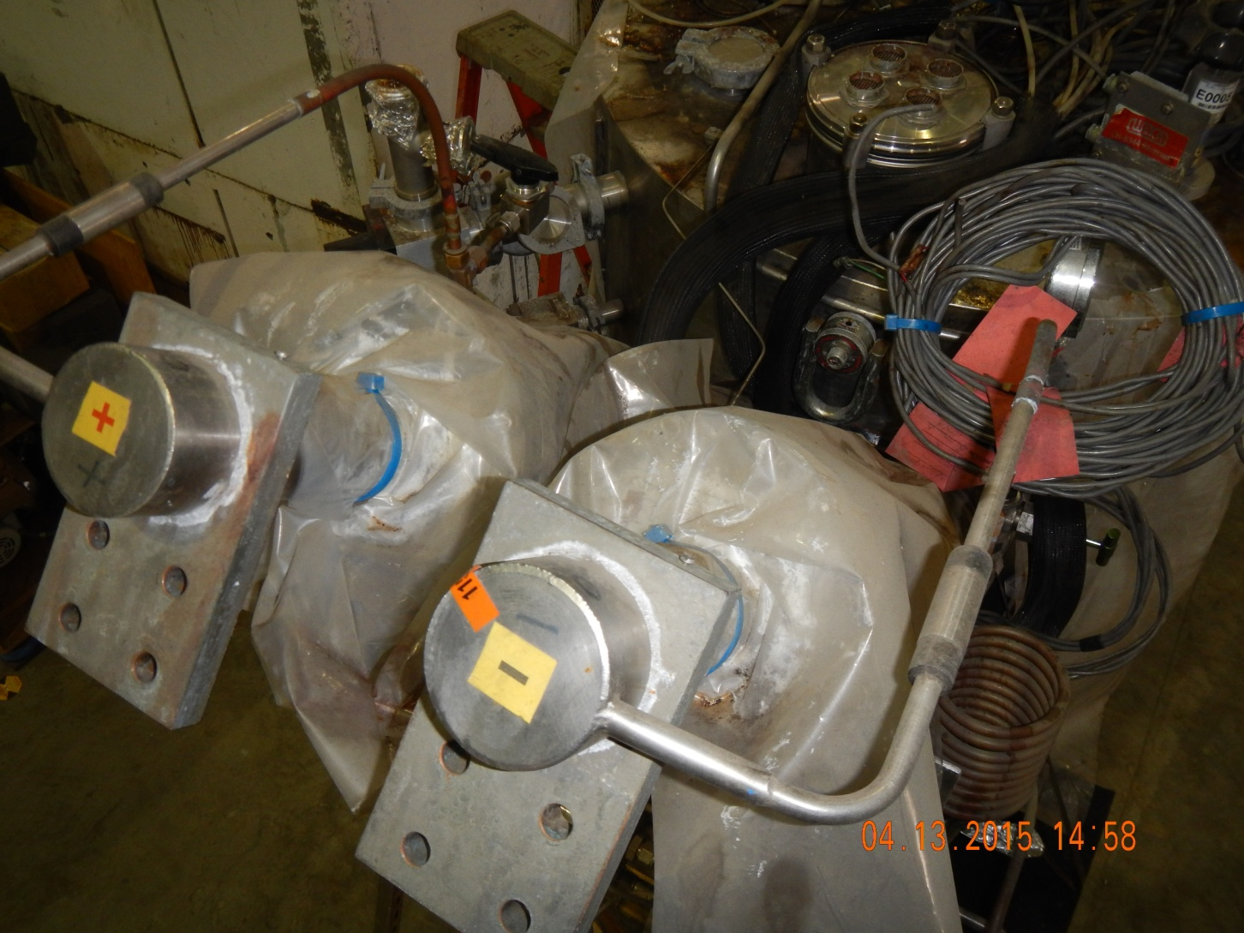
External Electrical Breaks

Slide 4
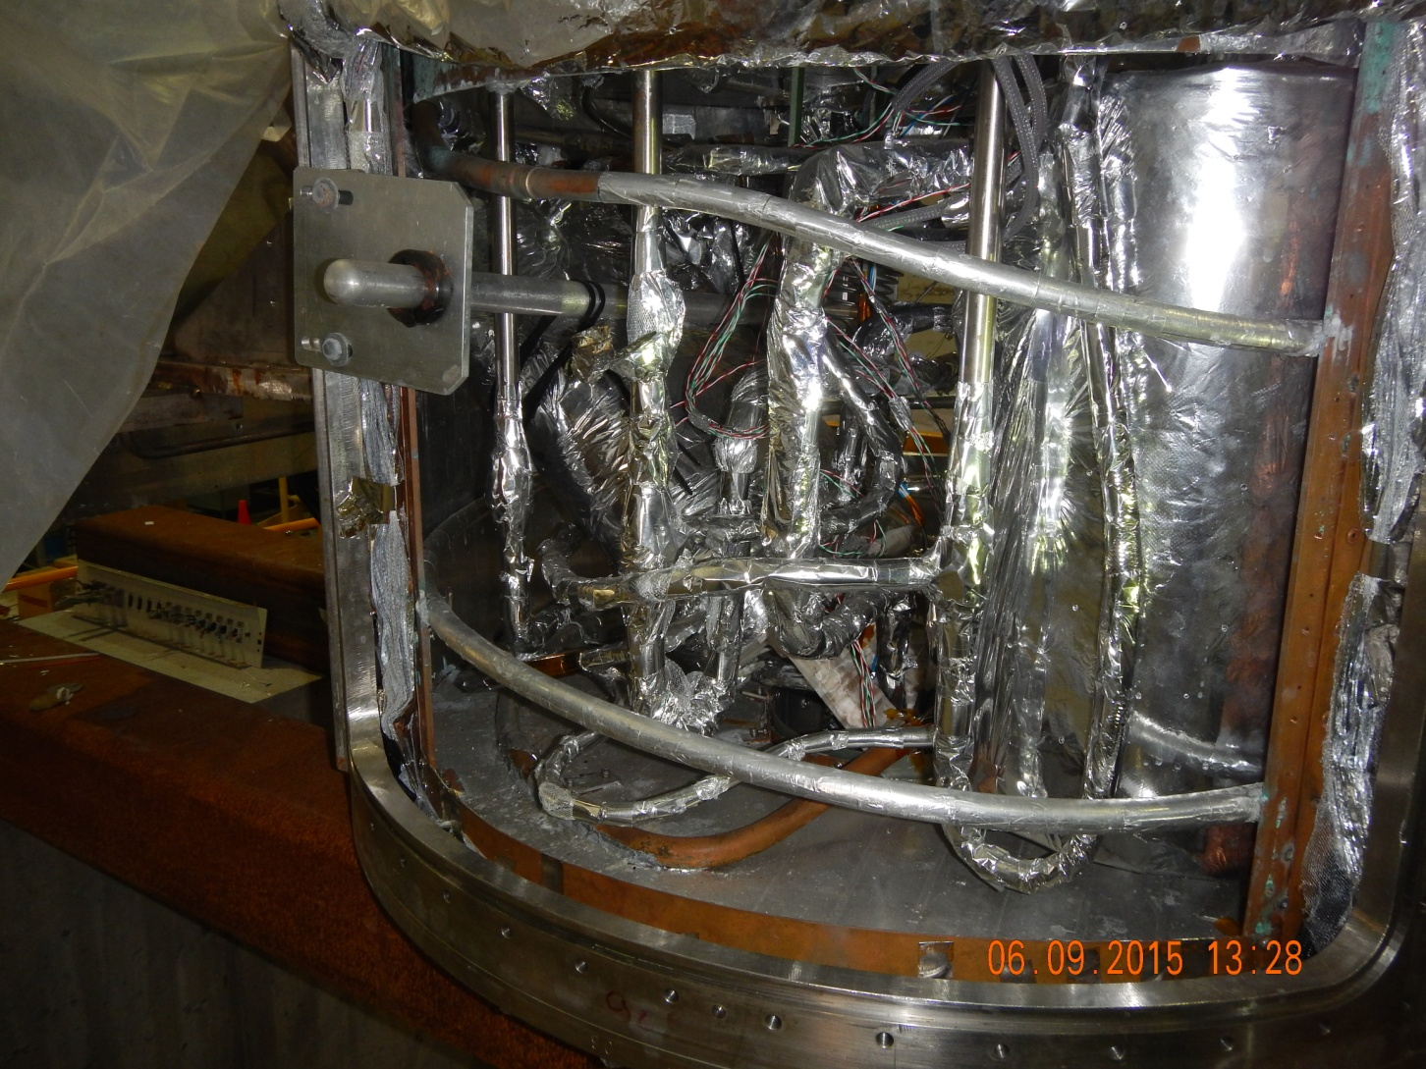
Negative lead side

Slide 5
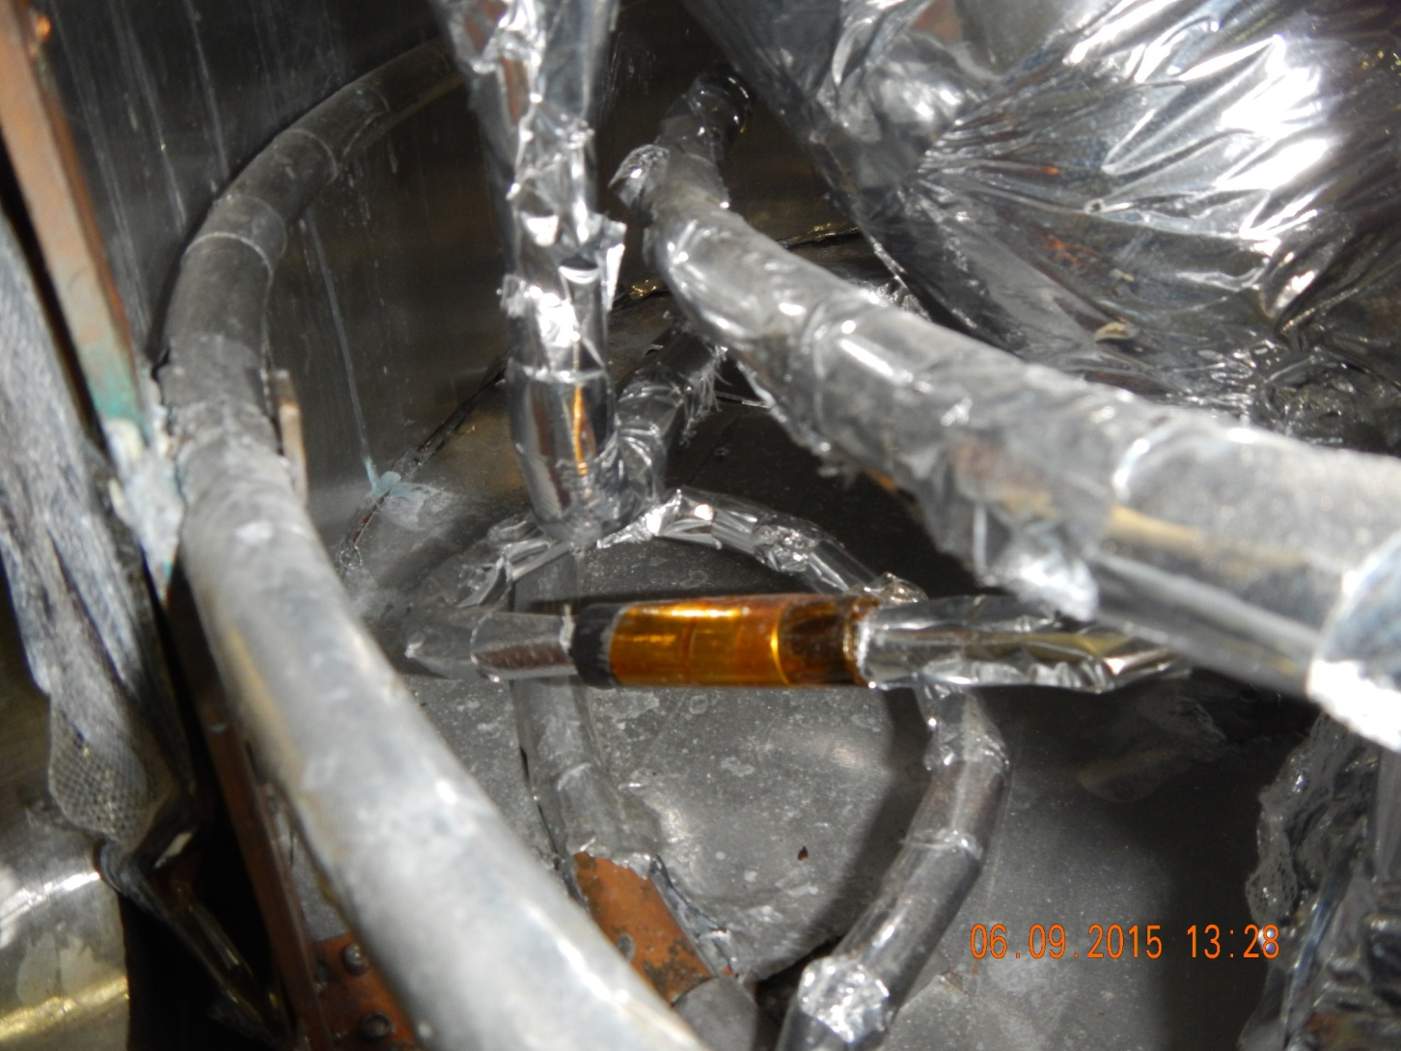
Negative lead side – Lower Break

Slide 6
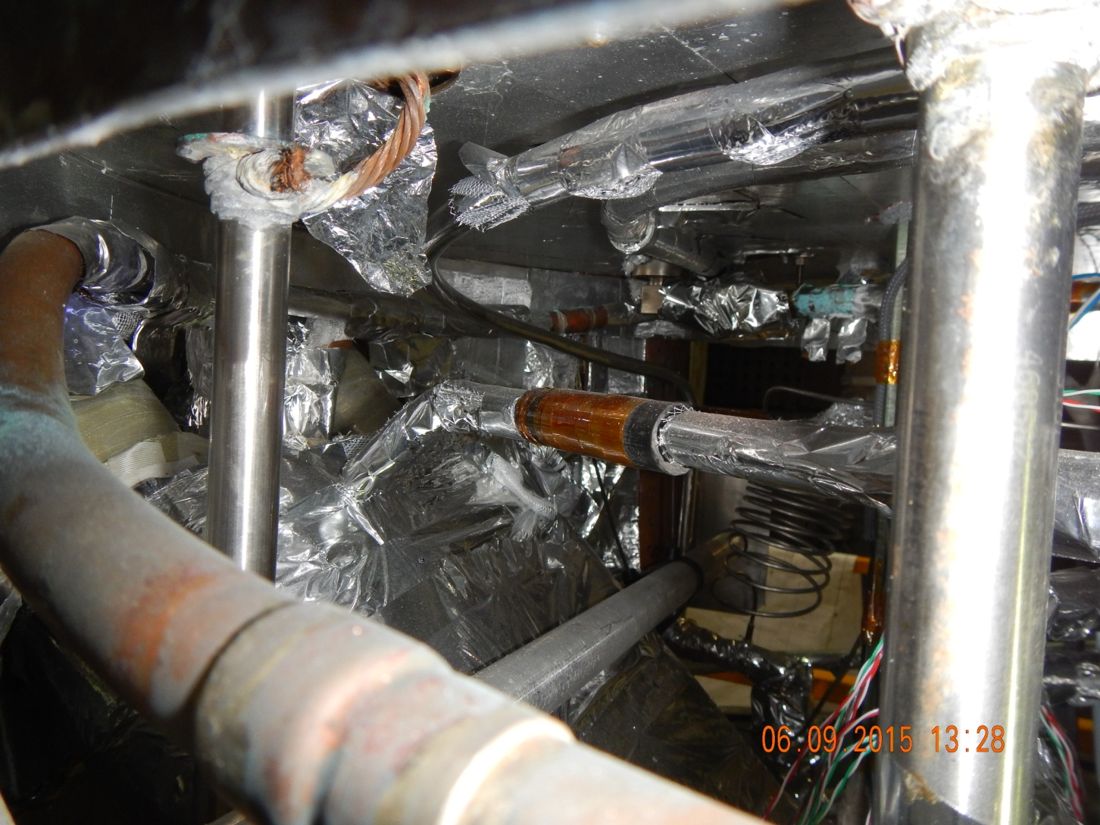
Negative lead side – Upper Break

Slide 7
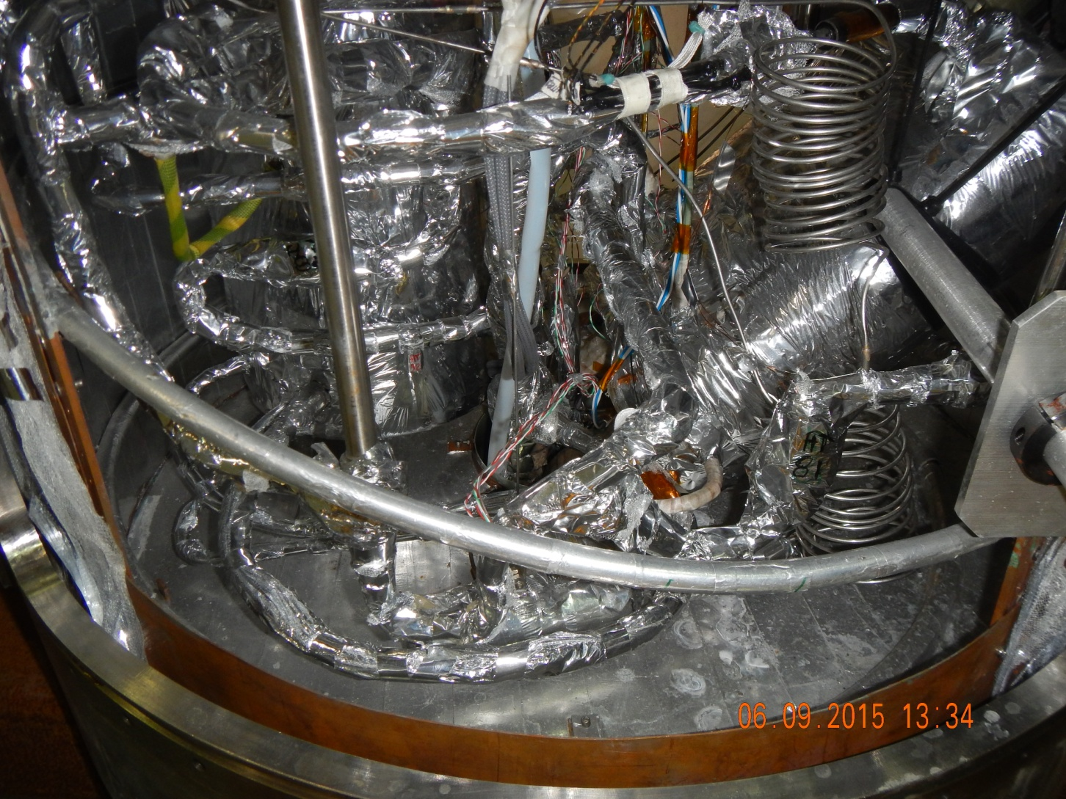
Positive lead side
Behind line
(hidden)

Slide 8
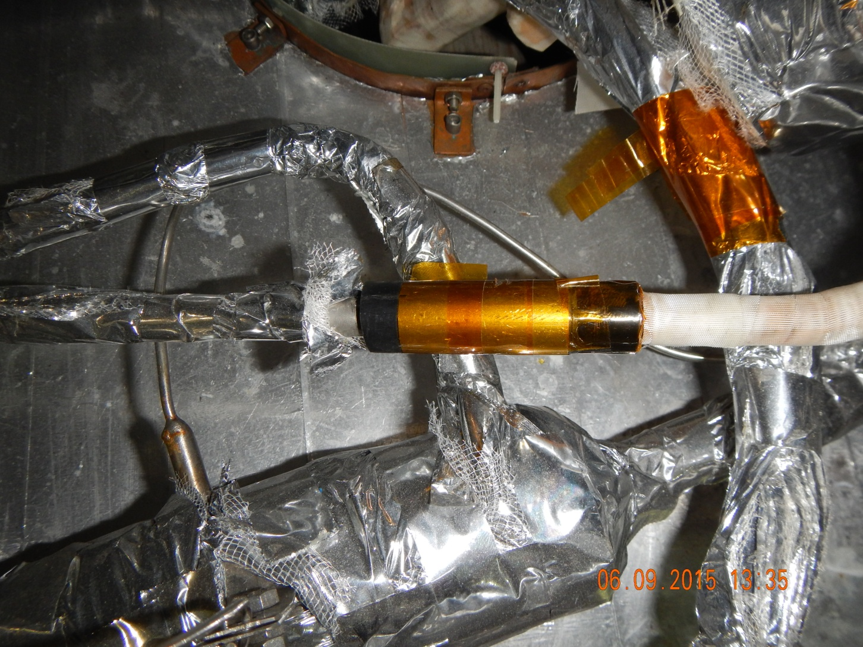
Positive lead side – Lower Break

Slide 9
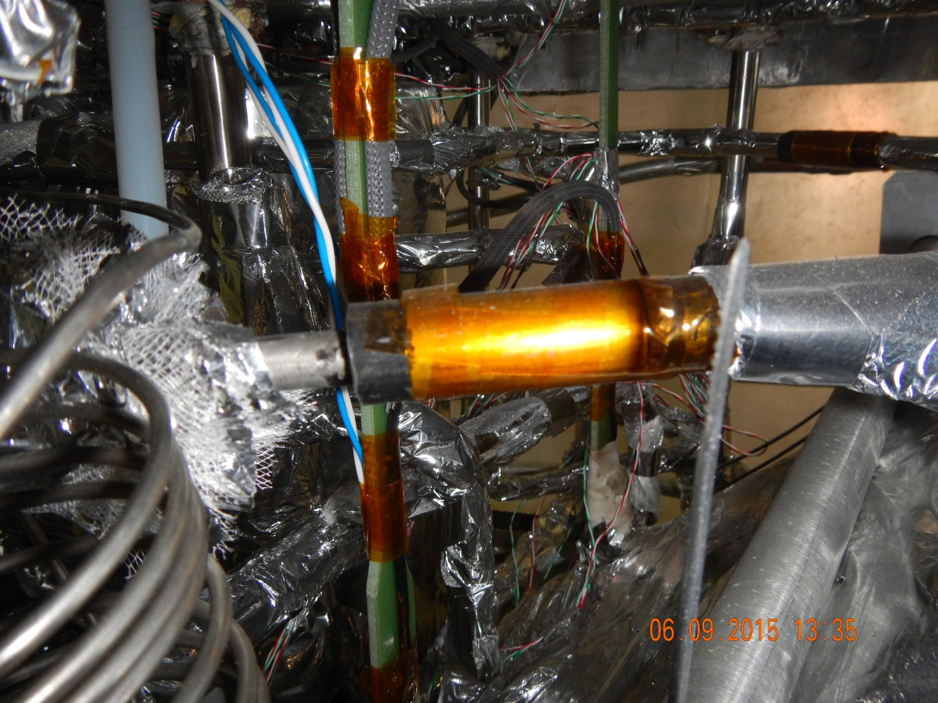
Negative lead side – Upper Break

