Slide 1
ECCE Simulations
Production Status Cameron Dean, for the simulations team
07/26/2021 Physics Team Meeting

Slide 2
Data Produced
BNL, JLab and Bates are all producing data
Software stack tag = prop.2, macros repo branch/hash = production/c131177
From production requests, campaign 1 is about 160M events
We’ve completed:
5M single pion events (on S3)
5M single electron events (on S3)
2x5M Pythia8 events at ep of 5x41 and 10x100 GeV (all on S3)
5.6M DJANGOH events
4x20M Pythia6 events (20M on S3, other 58M pending transfer, 2M just finishing)
Diff & Tag and Exclusive are also running/setting up local productions through our framework
In total, > 100M events have been produced out of 160M
Files stored on S3 under: eicS3/eictest/ECCE/MC/prop.2

Slide 3
Production notes
Job efficiency seems high:
Single particle production was 99.94% successful
JLab saw 89% of jobs succeed
OSG saw 98.8% of jobs succeed (need to investigate difference)
We saw crashes from the event evaluator
Due to accessing cross section info from generators that don’t save this
Since been patched
Other crashes appeared in jet evaluator
Crashes occurs when comparing 2 particles
Not patched but under more investigation
Current solution: Event and Jet evaluators are disabled in production
A second pass on the DSTs will be performed with the required patches

Slide 4
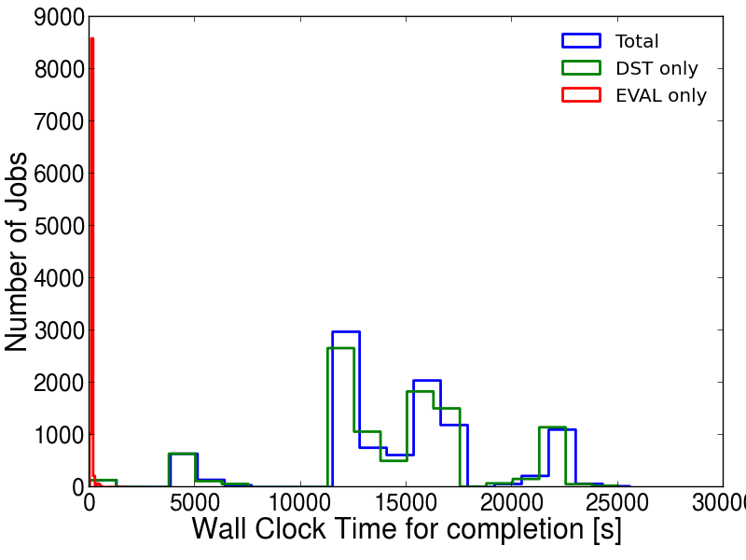
Timing plot from Bates
DST production dominates timing, evaluators are negligible
Event and Jet evaluator production will be fast when we kick them off

