Slide 1
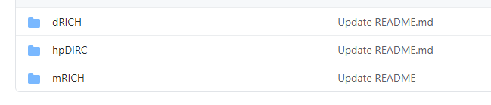
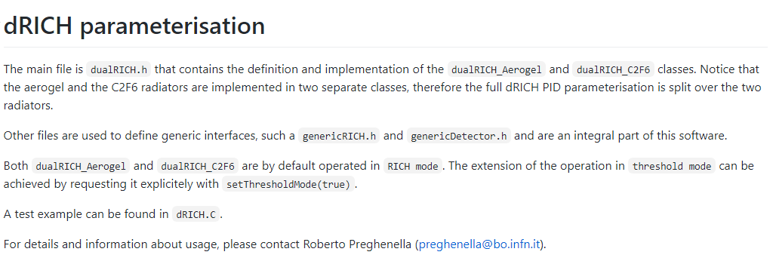
(Hadron) PID in simulations
PID parametrizations:
https://github.com/ECCE-EIC/ecce-detectors/tree/master/FastPID
These functions can be used with 1st campaign data (using momentum and direction of tracks)
Will be implemented in the output of Fun4All in the 2nd campaign (TBC)

Slide 2
Calorimetry analyses
Improved calorimeter clustering code:
https://github.com/FriederikeBock/AnalysisSoftwareEIC
Event Evaluator Afterburner:
https://github.com/FriederikeBock/AnalysisSoftwareEIC/blob/master/treeAnalysis/treeProcessing.C
Some documentation will/might appear here:
https://ecce-eic.github.io/tutorials_EventEvaluatorAfterburner.html

