Slide 1
Interactive Computation
During and After Experiments
Daniel Allan
Data Science and Systems Integration, NSLS-II

Slide 2


Slide 3
"Serve Users"
Two layers of users
  Beamline Scientists (also called Instrument Scientists)
    Build and maintain the beamline
    Help Visiting Users make productive use of the beamline
    And use the beamline themselves for their own research
  Visiting Users
    May be experts
    May be using the beamline as a commodity
On site or remote
  Camping here for a week or so
  Logging in from cramped University office or the McDonald's down the block
  Mailing in samples

Slide 4
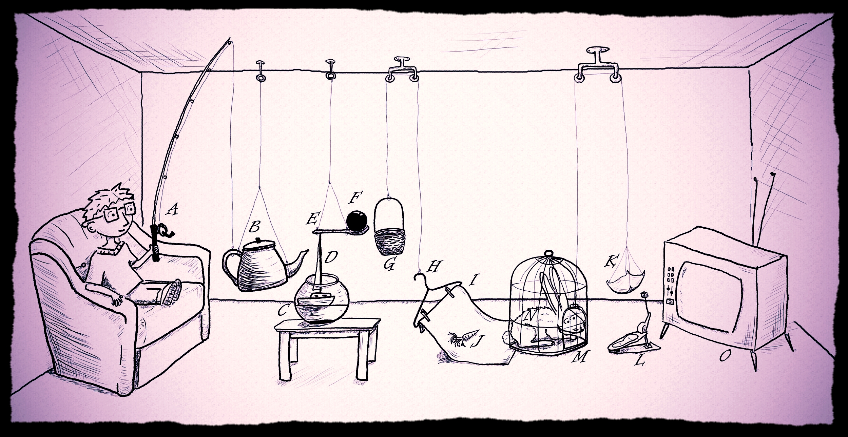
"Do Experiments"
Assembly line batch processing
Open-ended exploration

Slide 5
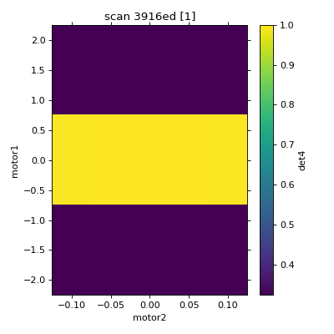
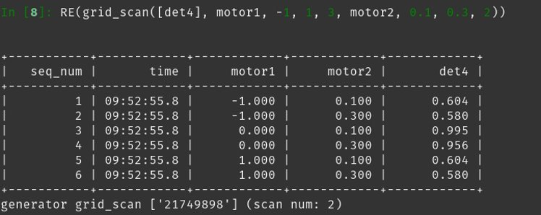
Users taking data at NSLS-II are typically looking at a streaming, preconfigured representation of their data

Slide 6
Next Step: a way to interactively interrogate the results using a mixture of established and improvised techniques

Slide 7
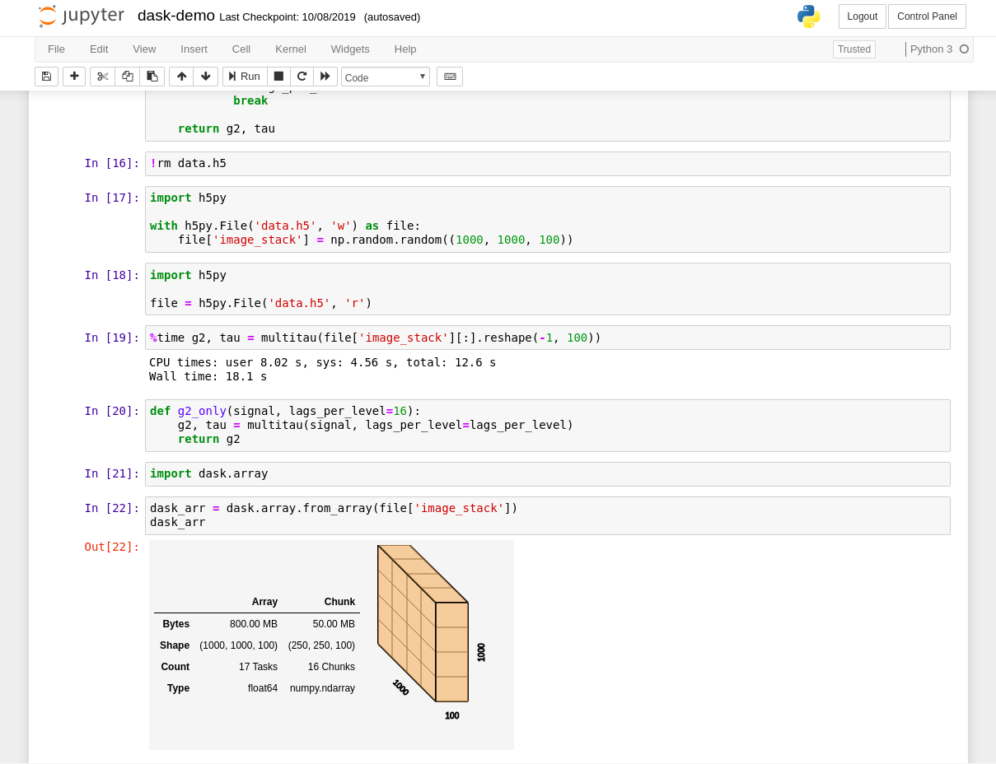

Jupyter
Mix executable code and results with text, equations, images
Runs in the web browser
Inspired by Wolfram Mathematica...
...but with open-source technology
Approachable to non-experts

Slide 8
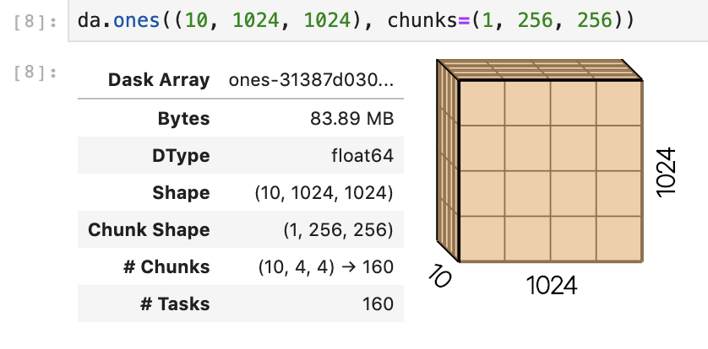
Visual Representations of Code and Data

Slide 9
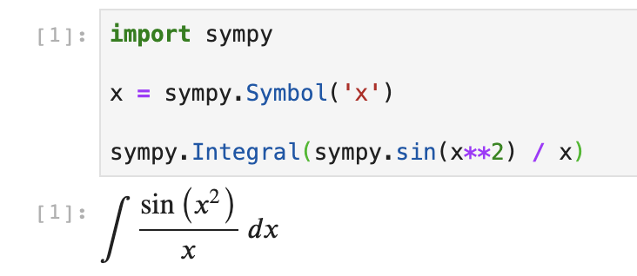
Visual Representations of Code and Data

Slide 10

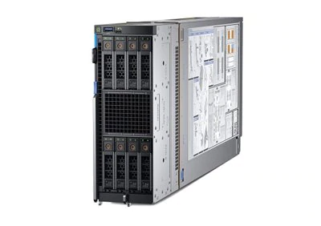

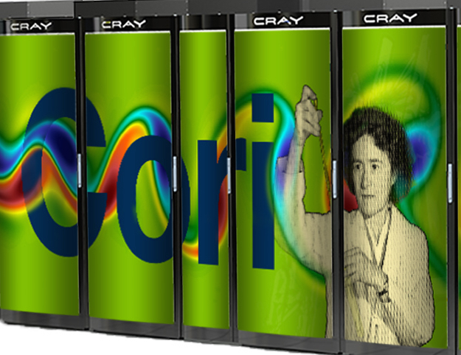
Jupyter ≠ Notebooks
Jupyter == Interactive “human in the loop” computing
Consistent user experience interacting with…
  Local laptop
  Local large server
  Remote HPC cluster
  Remote cloud resources

Slide 11
The pitch to Users
“Run code on the server / cluster / cloud from a web browser or desktop IDE!”
Nothing to install
No large data to download
User experience:
  Go to a URL and log in
  Click to spawn a web application (e.g. JupyterLab)
  Or click for a token to copy/paste in your desktop application [1]
[1] https://blog.jupyter.org/connect-to-a-jupyterhub-from-visual-studio-code-ed7ed3a31bcb

Slide 12
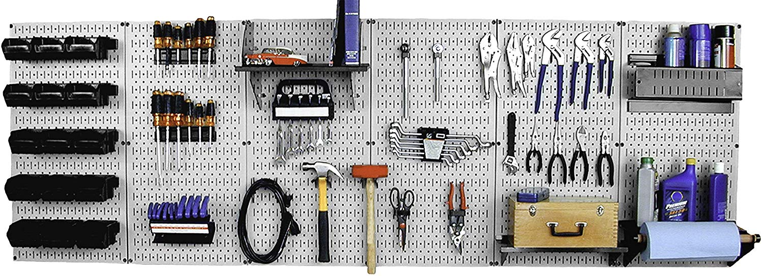
Jupyter has many separately useful pieces
Users in the open-source community assemble these in many ways.

Slide 13
An Incomplete Survey of Jupyter
JupyterHub provides a multi-user Jupyter deployment
Jupyter Widgets link client-side interactions to server-side computation
Voila generates dashboards from notebooks
JupyterLab provides a high-performance IDE in the browser and (just recently) Google Docs-style multi-user editing via CRDTs
Papermill executes a large number of computations with reports
Repo2Docker creates an OCI image from git repository
NBviewer provides a library of shared notebooks
Dask's JupyterLab extension provides visibility into parallel computation

Slide 14
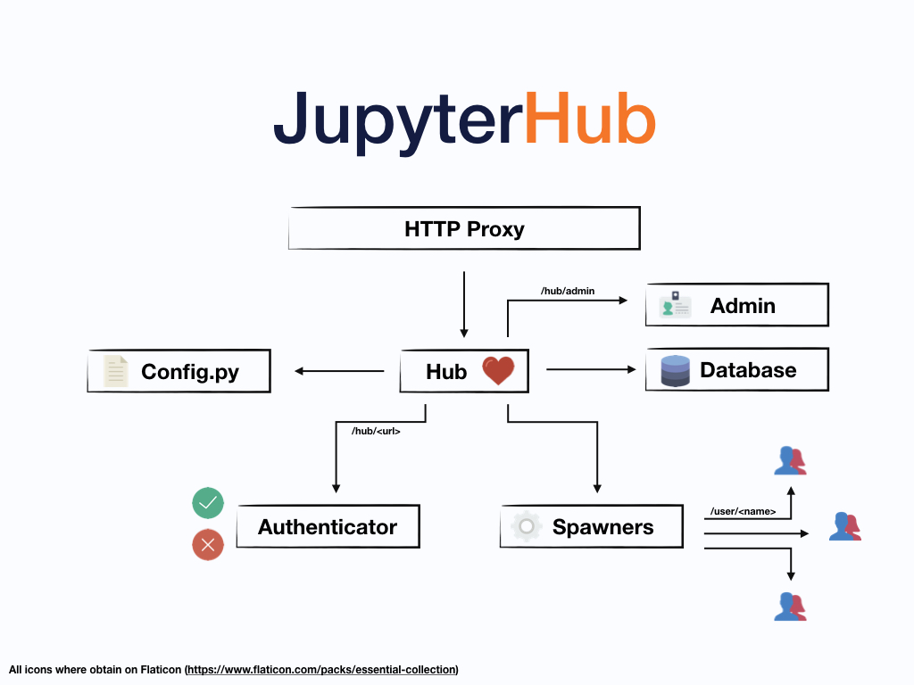
JupyterHub: deploy single-user web applications

Slide 15
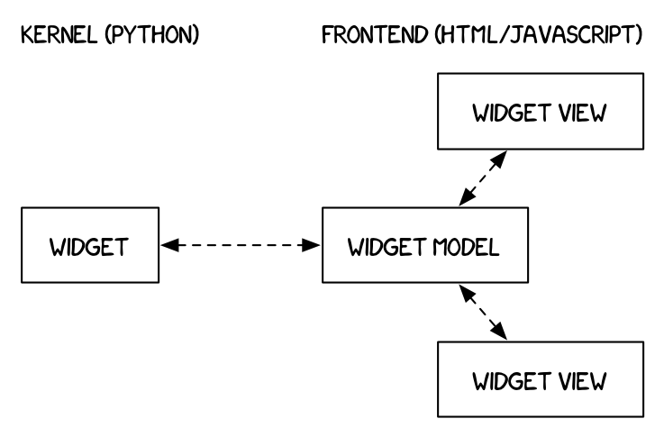
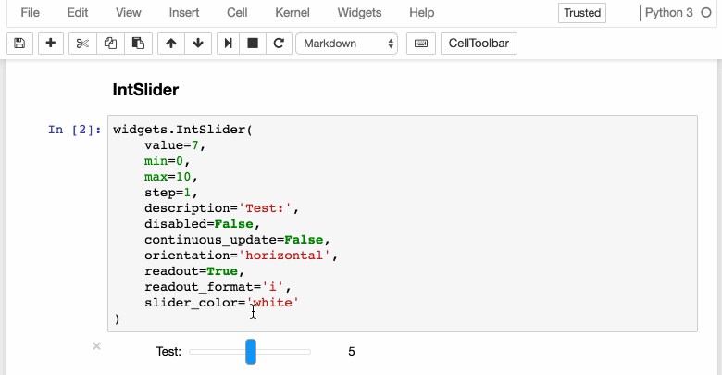
Jupyter Widgets: graphical interactions to run code

Slide 16
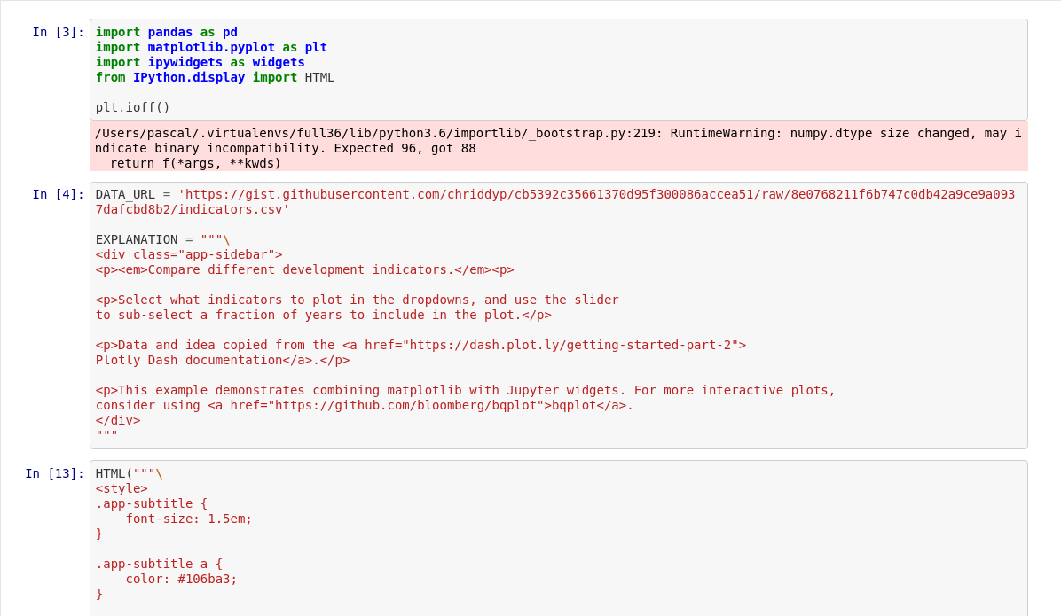
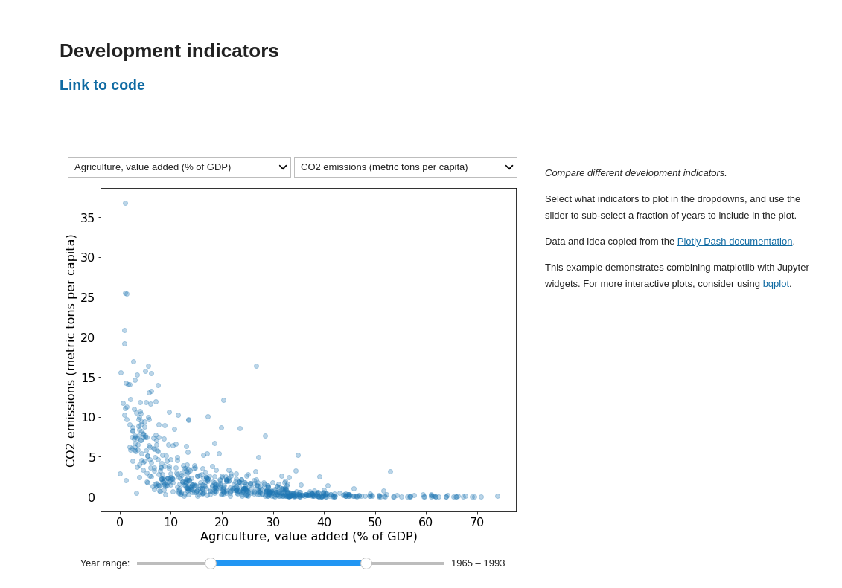
Voila: Build Dashboard from Notebooks

Slide 17
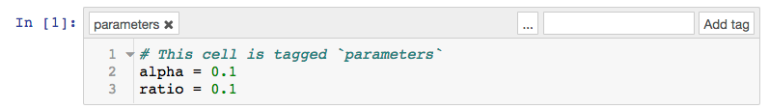
Papermill: Batch execute parameterized notebooks

Slide 18
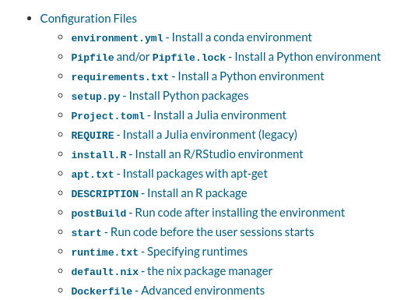
Repo2Docker: Generate reproducible computation environments from Code Repositories

Slide 19

NBViewer: Share Static Views of Notebooks

Slide 20
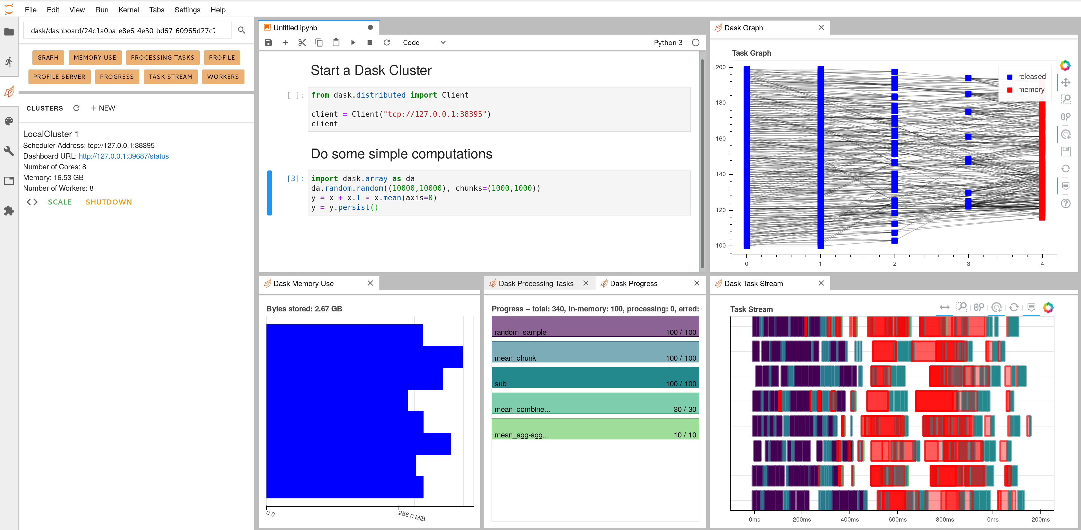
Dask JupyterLab Extension: Observe Parallel Code Execution on a Distributed Cluster

Slide 21
How this works at NSLS-II
User navigates to jupyter.nsls2.bnl.gov
  N.B. This currently restricted to NSLS-II staff and a short list of early users.
User chooses from a list of execution environments
  Software (specified for repo2docker e.g. github.com/NSLS-II/scipy-binder/)
  Computational resources
  Data resources (for now)
Spawning a Jupyter server starts a Singularity container
Users' home directory in /nsls2/users/$USER is their working directory
Storage per proposal will be available soon (weeks)
HTTP or ASGI interface to data
  MongoDB with metadata and small data
  Large array data stored as HDF5, TIFF, etc.

