Slide 1
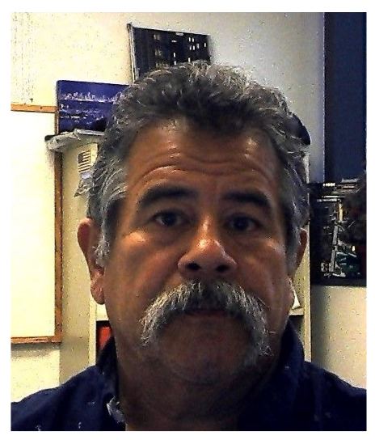
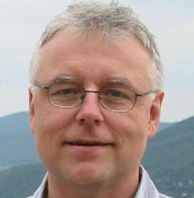
ECCE Detector meeting -- DAQ
Chris Cuevas (JLAB) and Martin L Purschke (BNL)
Thank you for your patience with the scheduling process… People kept moving meetings into our time slot that I couldn’t afford to miss
Chris
Martin

Slide 2
DAQ Roadmap
Different from many previous experiments, ECCE has the electronics lumped together with the DAQ “group”
It struck us as unusual at first, but -
It’s clear that there will be a close collaboration with the detector groups
It might foster the adaptation of fewer (common) solutions
Not just for hardware, also firm- and software
In addition to that part, there will be the common DAQ items, such as DAQ machines, high-speed network switches, slow controls networks, file servers, and so on
Also things like clock distribution (traditionally called ”timing system”) and the entire infrastructure behind it

Slide 3

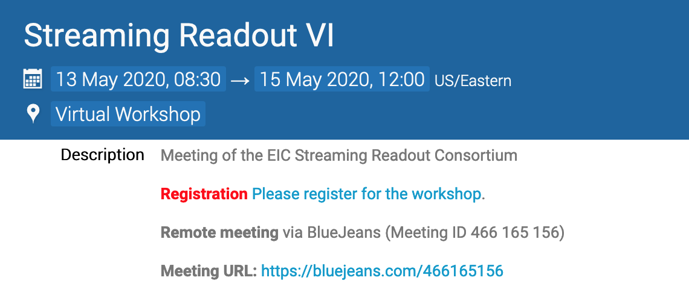
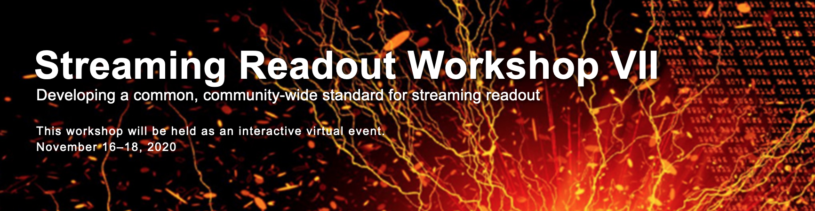
Streaming Readout, please!
We have a near-perfect overlap of players in this space and the former Yellow Report DAQ group
There, no one – not a single person – was ready to make the case for a traditional triggered readout.
So we believe that we will go with SRO.
A lot of workshops/discussion/R&D already – incidentally organized by people is this very orbit

Slide 4
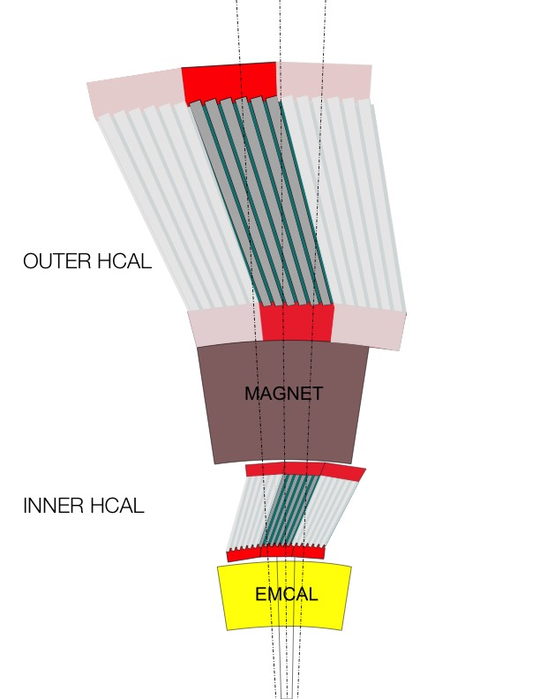
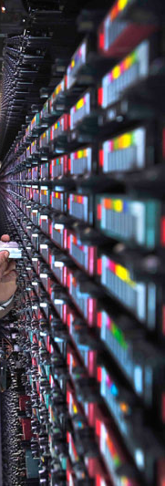
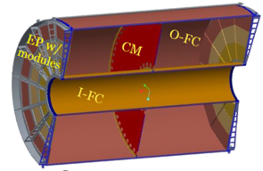
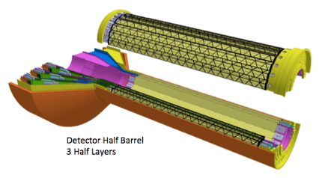
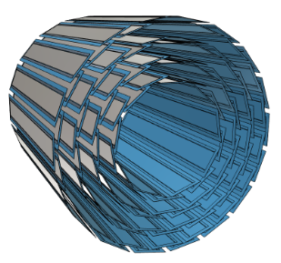
sPHENIX’s DAQ breakdown
FEM
DCM
DCM2
DCM
DCM
DCM
DCM
Network
Switch
FEM
DCM
SEB
Buffer Box
DCM
DCM
DCM2
DCM
DCM
DCM
FEM
DCM
SEB
Buffer Box
DCM
DCM
DCM
DCM2
DCM
SEB
Calorimeters, MBD
DCM
Buffer Box
To the
SDCC/HPSS
DCM
FEE
Buffer Box
DCM
DCM
FELIX
EBDC
TPC, MVTX, INTT
DCM
Buffer Box
FEE
DCM
DCM
FELIX
EBDC
DCM
Buffer Box
FEE
DCM
FELIX
EBDC
DCM
DCM

Slide 5
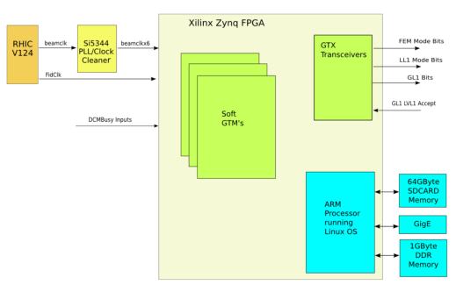
sPHENIX’s DAQ breakdown
FEM
DCM
DCM2
DCM
DCM
DCM
DCM
Network
Switch
FEM
DCM
SEB
Buffer Box
DCM
DCM
DCM2
DCM
DCM
DCM
FEM
DCM
SEB
Buffer Box
DCM
DCM
DCM
DCM2
DCM
SEB
Calorimeters, MBD
DCM
Buffer Box
To the
SDCC/HPSS
DCM
FEE
Buffer Box
DCM
DCM
FELIX
EBDC
TPC, MVTX, INTT
DCM
Buffer Box
FEE
DCM
DCM
FELIX
EBDC
DCM
Buffer Box
FEE
DCM
FELIX
EBDC
DCM
DCM
“Detector”
“DAQ”
Local Level 1
Global Level 1
Timing System
Slow control system
Timing system

Slide 6
What we’ll do
We have already started to talk to individual groups about their needs, some in detail
Several detector design are still enough in flux so it’s “too soon to call”
But it’s a good start
There is a spreadsheed (by Chris) out that we ask each detector convener to populate – uploaded to this meeting’s header
Expect us to pester you really soon
We are trying to have a very rough cost estimate /channel or other unit by Friday (meeting later)

