Slide 1
Run 16 Plans: Au-Au
Xiaofeng Gu
Notes:
30 slides

Slide 2
Outline
Run Plan and Projected Au-Au Luminosity
Lattice Requirement
Intensity and emittance
56 MHz and CeC PoP
Time in store
Summary

Slide 3
2016 Run Plan
PAC recommendations (in order of priority):
Run-16 (last run for PHENIX, sPHENIX in ≥ 2012)
Au+Au at 100 GeV, 10 weeks 56 MHz SRF, further increase in bunch intensity
Au+ph (or ph+Au or d+Au) at 100, 31.2, 20, 10 GeV/nucleon, 5 weeks PHENIX / STAR protection, minimization of setup time
ph+ph at 31.2 GeV, 2 weeks
Au+Au at 31.2 GeV, up to 4 weeks

Slide 4
2014 Integrated luminosity compared to projections
Parameter | Run16 Au-Au | Run14 Au-Au
# of bunches | 111 | 111
Intensity in Store [1e9] | 2.5 | 1.8
β* [m] | 0.7→0.4 | 0.7 → 0.5
Emittance [μm] | 15 → 5 | 15 → 5
Peak luminosity [10²⁶cm⁻²s⁻¹] | 120 | 90
Avg. store luminosity [10²⁶cm⁻²s⁻¹] | 80 | 50
Luminosity per week [μb⁻¹/week] | 2900 | 2000
Run length [weeks in physics] | 10 | 13.3
Time in store [% of calendar time] | 70 | 68
Goals for Run16: L_{ave} = 80x10²⁶ cm⁻²s⁻¹ (0.4m β*, 2.5 ions/bunch), 70% time at store.

Slide 5
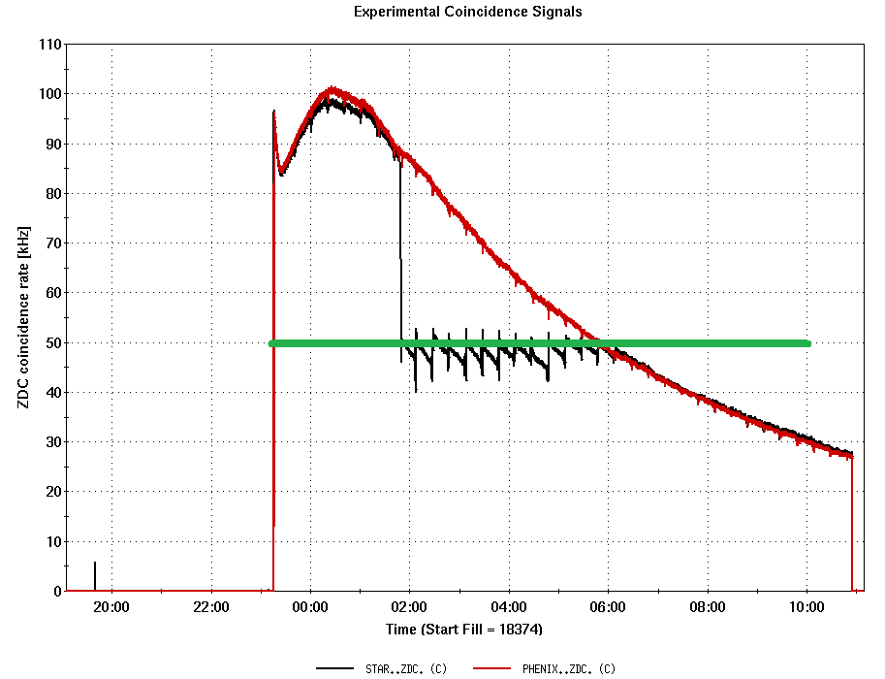
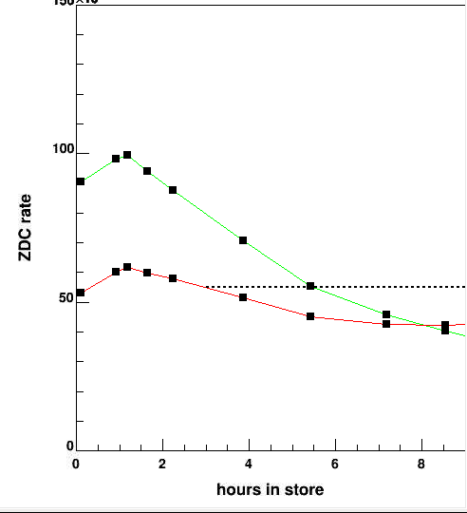
Star Luminosity Leveling
Star Luminosity Leveling:
Start leveling from the beginning of store
Vertical separation is used for the beginning of store because of SC cooling;
Dynamic beta* squeeze is used after the vertical separation is removed (0 again).
Initial Beta* at IP8 should be defined first (1.1 m?): Star prefers to use dynamic squeeze method.

Slide 6
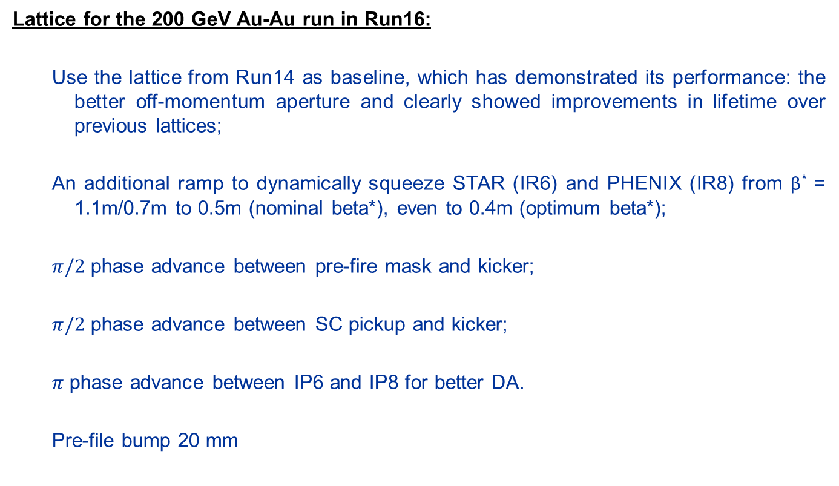
Lattice Requirement
Lattice for the 200 GeV Au-Au run in Run16:
Use the lattice from Run14 as baseline, which has demonstrated its performance: the better off-momentum aperture and clearly showed improvements in lifetime over previous lattices;
An additional ramp to dynamically squeeze STAR (IR6) and PHENIX (IR8) from β* = 1.1m/0.7m to 0.5m (nominal beta*), even to 0.4m (optimum beta*);
$π/2$ phase advance between pre-fire mask and kicker;
$π/2$ phase advance between SC pickup and kicker;
$π$ phase advance between IP6 and IP8 for better DA.
Pre-file bump 20 mm

Slide 7
Lattice Parameters
Energy | 100 GeV
No of Bunches | 111
Ions/bunch | 1.8E9
Working Point | 28.229/29.215
No of Collisions | 2
Beta* IP2 | 5 m (CeC PoP)
Beta* IP4 | Free (56 MHz)
Beta* IP6 | 0.7 m -> 0.5 m -> 0.4 m
Beta* IP8 | 0.7 m/1.1 m -> 0.5 m -> 0.4 m
Beta* IP10 | Free (E-lens)
Beta* IP12 | 5m
 | (Pre-fire Mask)
 | (SC Cooling)
 | (Collision Points)
Pre-fire bump | 20 mm
Beta* requirement:
Beta* Base Line (2014): 0.7 m/0.7 m (for IP6/IP8)
Beta* Leveling: 1.1 m for IP6
Nominal Final Beta*: 0.5 m
Optimum Final Beta*: 0.4 m
DA tracking with high intensity and low beta*

Slide 8
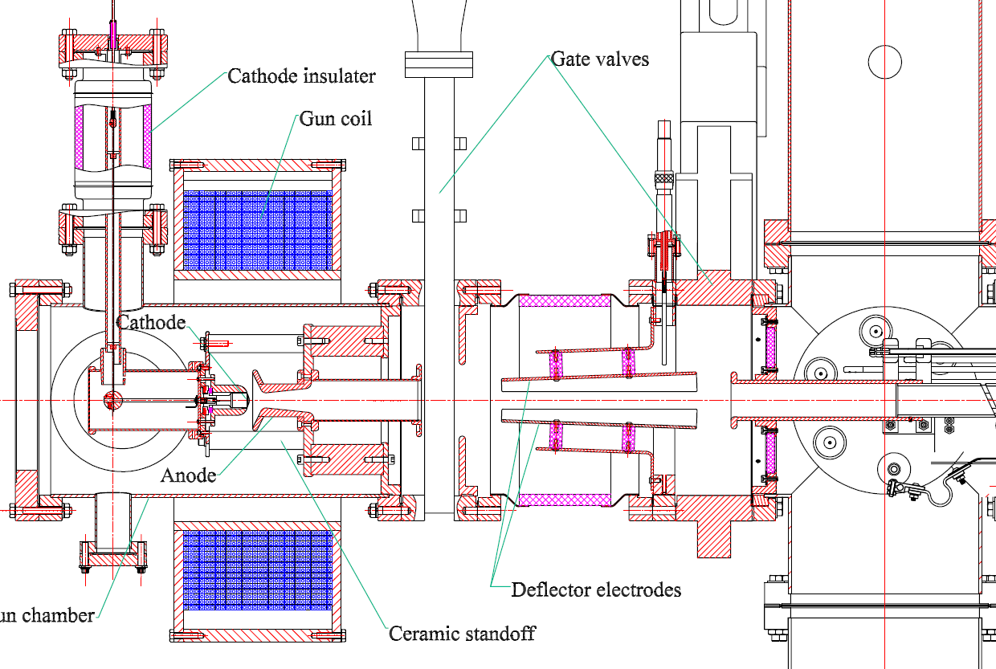
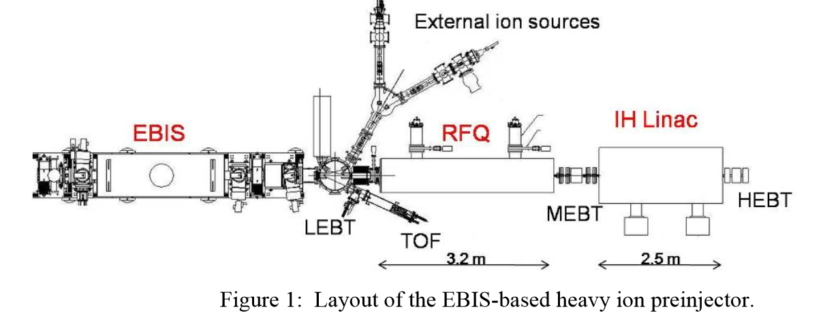
More Intensity from EBIS and Linac
Intensities from EBIS and the RFQ/Linac: extremely important in order to achieve luminosity goals;
EBIS electron gun and electrostatic deflector (Likely, but how much?):
Gun modification: May give us a chance to increase the electron beam current and hopefully the ion intensity.
An electrostatic deflector in a low magnetic field: To clear the oscillating and slow electrons from the trap.
EBIS, RFQ and Linac transmission optimization:
EBIS to RFQ transmission study (end of NSRL run, Li+3)
Transmission through RFQ and linac: Are in agreement with simulation (TRACK) within errors

Slide 9
More Intensity from AGS to RHIC (K. Zeno )
The bunch merge and more intensity from AGS to RHIC:
8->4->2 merge in AGS (Operation mode)
12->6->2 merge in AGS (Solution 1: ~50% more intensity, same RHIC injection time)
AGS cycle length need to be 7.2 sec instead of 5.2 sec.
2 different Booster users with lightly different merge porch energies to satisfy the PPMR constrains
EBIS needs to provide 12 pulses per AGS cycle (Could do this)
6->3->1 merge in AGS (Solution 2: ~50% more intensity, twice RHIC injection time, Tested)
50% or less intensity, but double RHIC injection time and more emittance growth
But more Booster loads/transfers are merged into one bunch, less beam fit into the main h=12 buckets, more loss from squeeze ramp, more loss from bank transfer.
The solution is to alleviate these problems is to make the bunch injected into the AGS smaller/short.

Slide 10
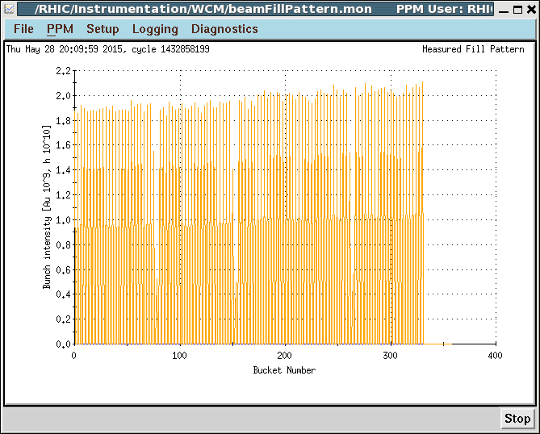
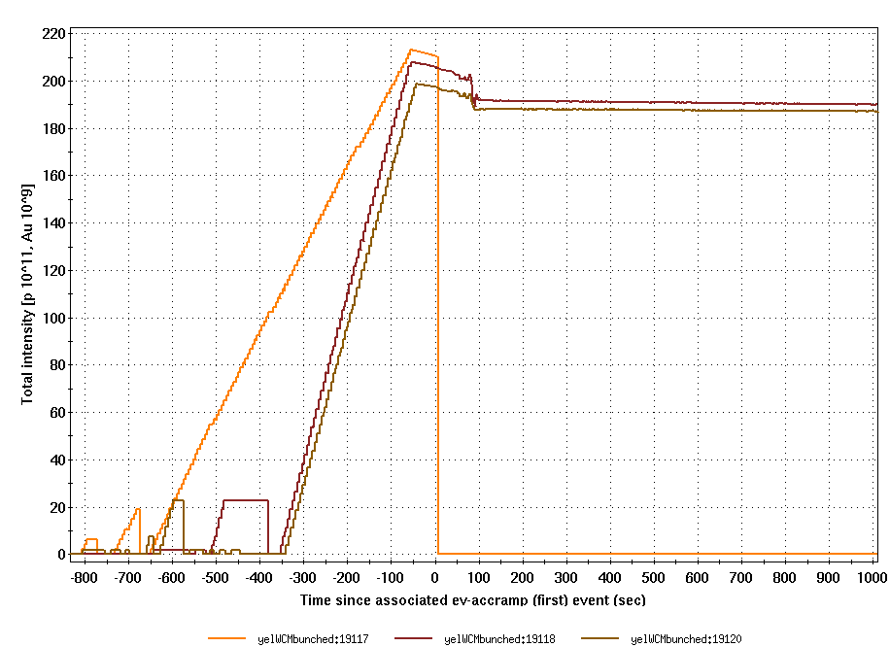
Test 6->3->1 merge in AGS (2015)
FillNO. | Intensity E9 | Emittance eVs / n | Pattern
19116 | 1.96 | 0.58 | 011/011 | 6->3->1
19117 | 1.97 | 0.58 | 111/111 | 6->3->1
19118 | 1.86 | 0.5 | 111/56 | 8->4->2

Slide 11
Emittance – Booster to RHIC (K. Zeno )
Two major longitudinal emittance growths from Booster to RHIC:
1 During Booster RF capture (2.5~4.6 time)
Possible Solution: Extend more time to RF capture would help to reduce this growth.
2 During AGS acceleration (1.44~1.55 time): after the flattop bank to the pulsed bank for the AGS main magnet.
Reason: Most likely associated with beam radius oscillation/ or phase associated with the RF try to cope with the oscillations in the main magnet field when on the pulsed bank.
Possible Solution: If it is due to the main magnet voltage ripple, the best change is to use AC phase loop (tested already) and the lower voltage tap simultaneously.
Transverse emittance: (?)
Booster space charge simulation for PP.

Slide 12
Time in Store
Time in Store [70% of calendar time]:
Dry Run: Helps a lot, need to check out carefully, could miss some items;
Startup: Operations Coordinator team => need a even better performance!
APEX : Implement all relevant changes coming from past APEX data analysis (BBA, optics correction, …). To submit a list of estimated changed parameters;
Maintenance: ~12 hours without physics during maintenance day.
Machine Setup : ~40 min for 200 GeV Au-Au
Machine development: dynamic beta* squeeze, 56M cavity, CeC PoP
Communication: call without any hesitates; mitigate different MCRs ?
Hardware failure: how to prevent this before it happens.

Slide 13
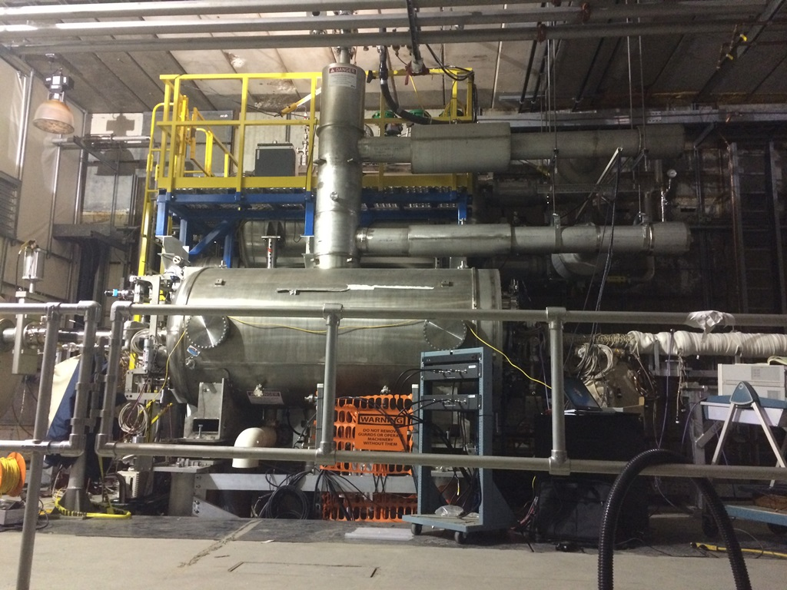
56 MHz Cavity
RHIC subsystems:
A 56MHz 2MV passive superconducting RF (SRF) storage cavity will be full operational in RHIC for the start of Run 16.
The purpose of this cavity, common to both Blue and Yellow rings, is to provide a very large RF bucket, reducing longitudinal diffusion from IBS during Au stores and generating as much as a 30% improvement in integrated luminosity. (Run 14 RHIC retreat)

Slide 14
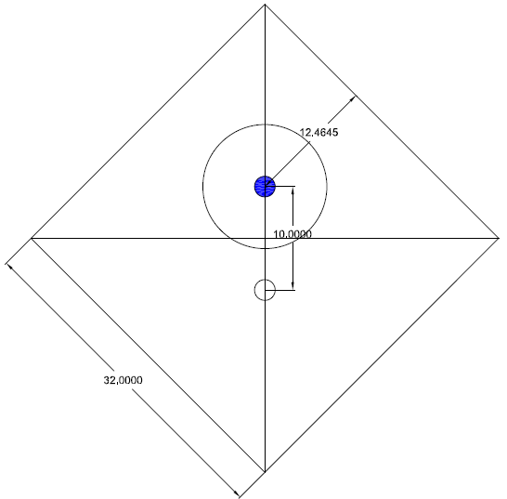
CeC PoP
eRHIC subsystems commissioning:
The CeC PoP will start to commissioning in RHIC tunnel during the Run 16.
The purpose of CeC PoP is to demonstrate the mechanism of coherent electron cooling for our future, eRHIC.
The electron beam commissioning could be parasitic with physics store within abort gap (single shot or low frequency? ).
Avoid beam loss in IP2 area, to protect the wiggle from radiation damage (beam loss for pre-fire case, loss monitor).
Co-propagate with yellow beam for CeC PoP experiment; anti-propagate with blue beam for beam-beam study
Smaller Aperture: 32 mm, monitoring transition vacuum.
Some Parameters:
Ion beam: ~40 GeV
Electron beam: 21.95 MeV
Frequency: 1 Hz~78 kHz
Interaction: One bunch
Length: 8.4 m
Minimized beta*: 4.2 m (5m)
Injection beam size: ~1. 0 mm
Dipole strength < 0.157 mrad (Full Length), but has opposite dipole to correct this kick.

Slide 15

Summary
Our Goal 2016 100 GeV RHIC Au-Au run:
Average Lumi = 80x10²⁶ cm⁻²s⁻¹
Beta* = 0.4m β*
Intensity = 2.5 ions/bunch (emittance)
Store time = 70% time
56 MHz Cavity = 30%
Need help from all of you.
Team Work

