Slide 1
IP2 Instrumentation Move
a.k.a.
Sector 1 Instrument Relocation for LEReC
RHIC Run 15 Retreat
D. Gassner July 28, 2015
Outline
LEReC layout
Devices to be moved, destinations & champions
Allotment drawings, before & after
Sector 1, 2 & 12
Device Descriptions
Cost and Status
Summary

Slide 2
Sector 1 Instrument Relocation for LEReC
About 25m of RHIC transport (from 39-64m from IP2) needs to be cleared out
soon after Run15 ends so the LEReC beam lines can be installed.
39m
64m
Courtesy A. Fedotov

Slide 3
Sector 1 Instrument Relocation for LEReC
July 28, 2015
Systems in the LEReC Region (39m - 64m) to be Relocated
8 assemblies in Sector 1 New Location Champions Approved
ARTUS Kickers Sector 2, Vert, Horiz Drees Drees/Mernick
Ionization Profile Monitors Sector 12, Vert, Horiz Tepikian Tepikian/Minty
Moveable BPM & LF Schottky Sector 1 (closer to Q4) Brown/Blaskiewicz Brown/Blaskiewicz
BBQ Kicker & Quad Pick-up Sector 2 Marusic Minty/Mernick
Triple Purpose Pick-Up Sector 2 Minty/Marusic/Blaskiewicz Mernick/Blaskiewicz
Hybrid Kicker Sector 2 Minty Mernick/Minty
Cable Tray Waterfall
Systems to be Removed (no longer needed)
Electron Detectors (8) Zhang/Blaskiewicz Zhang/Fischer/Blask…
Luminescence Monitor Cross at B02 53.1m Minty Minty
Stochastic Cooling Ceramic Pick-Ups [6-9 GHz] sector 1 & 2 Mernick/Brennan/Blaskiewicz Mernick/Blaskiewicz
Relocation plan based on:
Machine lattice
Available space
Minimizing cable lengths
Remove unneeded devices
All electronics remain in 1002 except for the 2 IPMs moving to sector 12 (1012)

Slide 4
Next six slides are the Allotment Drawings
Sector 1 Blue before and after
Sector 1 Yellow before and after
Sector 2 Before Relocation
Sector 2 After Relocation
Sector 12 Before Relocation
Sector 12 After Relocation
Drawings courtesy of Vito De Monte

Slide 5
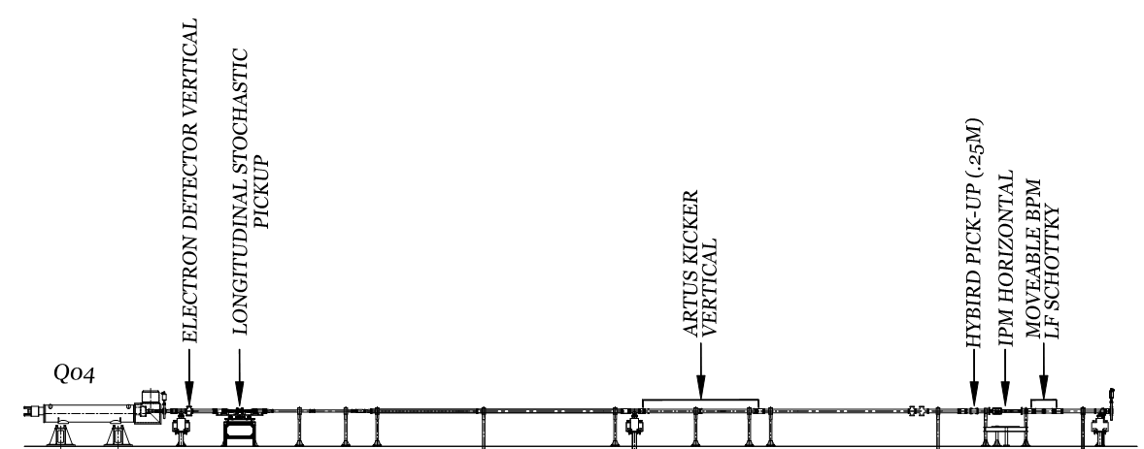
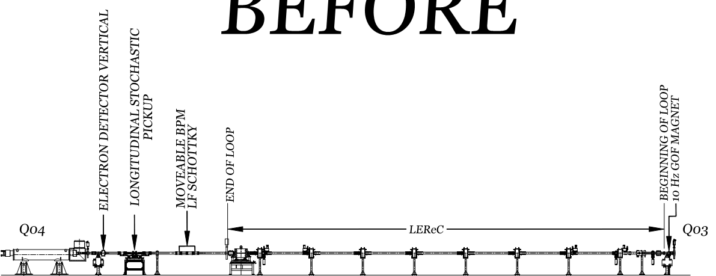
Sector 1 Blue (BI1) Before & After
Stochastic Cooling
Ceramic PU removed
IPM Horizontal
Moved to sector 12
Hybrid kicker
Moved to sector 2
ARTUS V Kicker
Moved to sector 2
Q3
Moveable BPM & LF Schottky
Moved towards Q4

Slide 6
Sector 1 Yellow (YO2) Before & After
These devices
moved to sector 2
IPM Vertical
moved to
sector 12
Q3

Slide 7
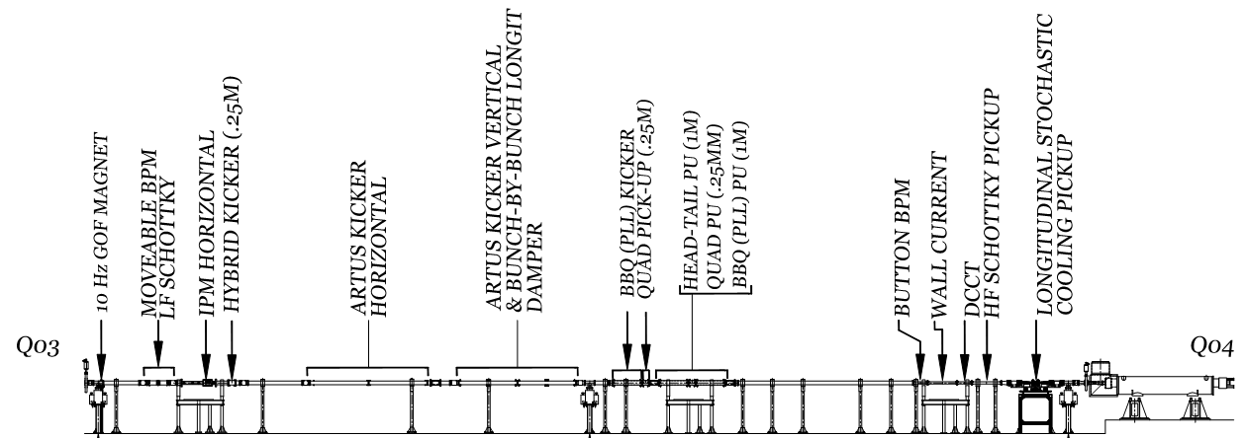
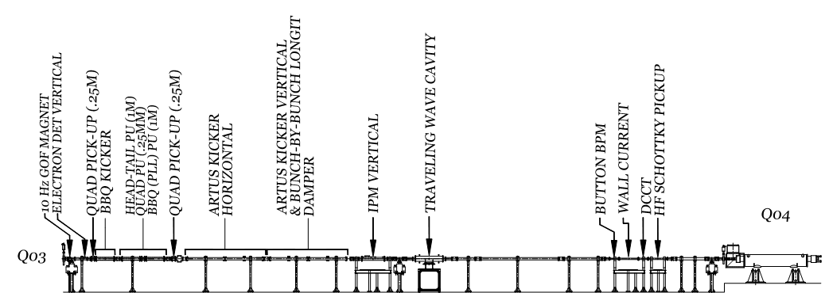
Sector 2 Before Relocation
Existing ARTUS
V Kicker
Use open space for BBQ Kicker, Quad PU & Moveable Pick-ups
Open
space
Open
space
ARTUS Kickers - Proposed new locations adjacent to existing ARTUS Kickers
Stochastic Cooling
Ceramic PU removed
Open space for
Hybrid Kicker
Open
space
Remove Unused Luminescence monitor cross for ARTUS V Kicker

Slide 8
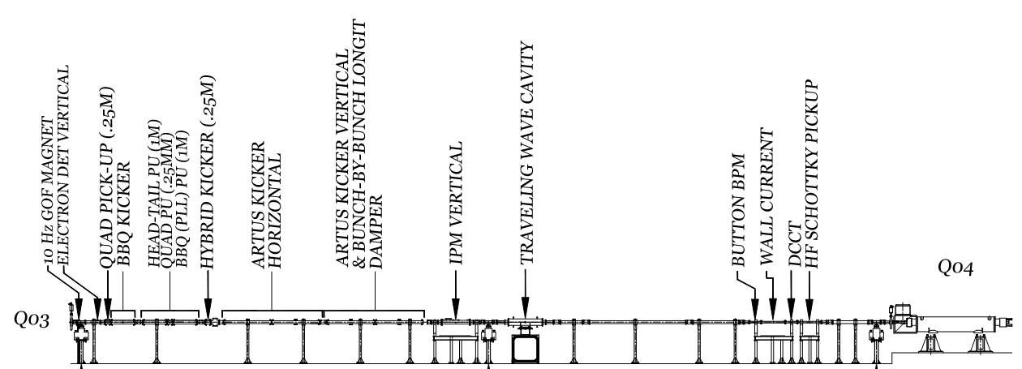
Sector 2
After
Hybrid kicker moved
from Sector 1
BBQ Kicker, Quad Pick-up &
Moveable Pick-ups
ARTUS Kickers moved from Sector 1

Slide 9
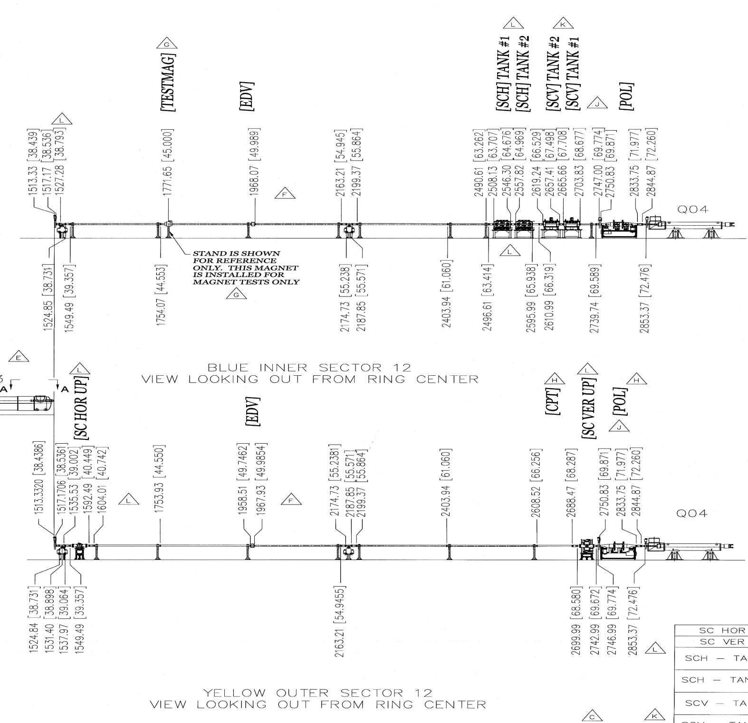
Sector 12 Before Relocation
Horiz IPM
Q3
Open
space
IPM Proposed
locations, as close to
Q3 as possible
Vert
IPM
Q3
Open
space

Slide 10
Sector 12
After
cable tray
IPMs moved from
Sector 1,
Slightly offset to allow space
for stands

Slide 11
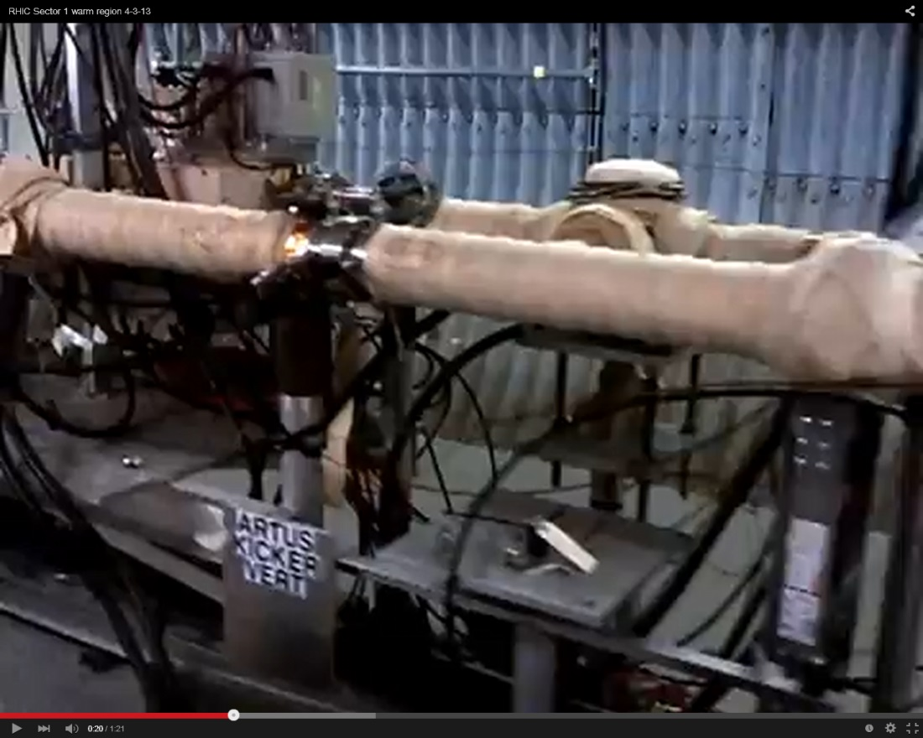
ARTUS Kickers
1 Horizontal kicker
1 Vertical kicker
- Each Assembly consists of two sets of 2 meter long strip lines
- 7/8” and 3/8” Heliax cables
Move to Sector 2, adjacent to existing ARTUS kickers
Their location is not very beta function sensitive
need to choose new associated BPM pick-ups
Multi-use Striplines:
Tune Meter Kickers
Longitudinal Damper
Injection Damper
Gap Cleaning
Champion: Drees/Mernick

Slide 12
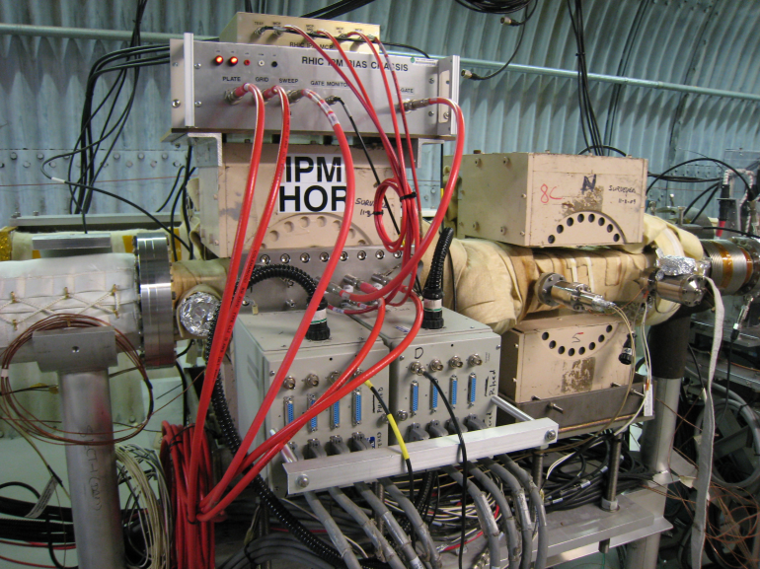
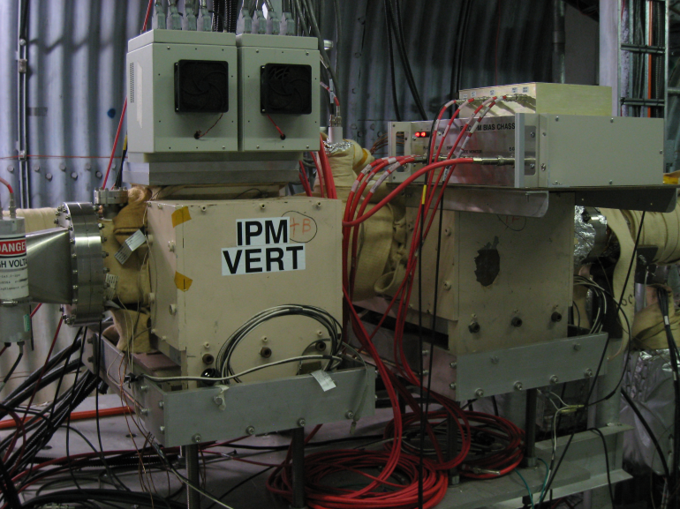
Ionization Profile Monitors
Michiko evaluated 2 options for the relocation of BH and YV IPMs (sector 2 or 12):
- OK to move into sector 2 for LEReC and 100 GeV p+p
- but need to be located into sector 12 in order to resolve profiles for 250 GeV p+p.
After consultation with Wolfram (03/16/15), IPMs will be relocated to sector 12
as close to Q3 where the beta function is largest.
Horizontal IPM
Vertical IPM
Disadvantage of moving to sector 12 is the need to
bake stochastic cooling kickers & pick-ups.
J. Fite
Champion:
Tepikian/Minty

Slide 13
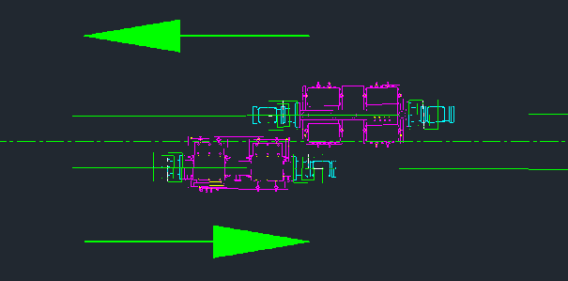
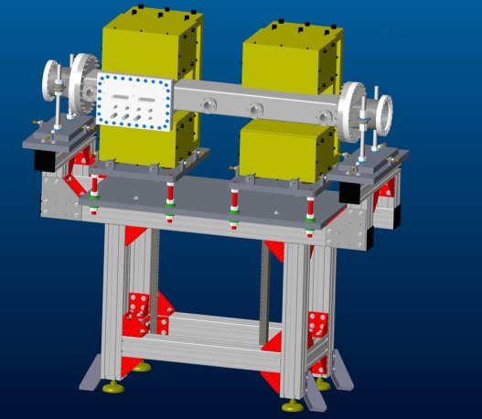
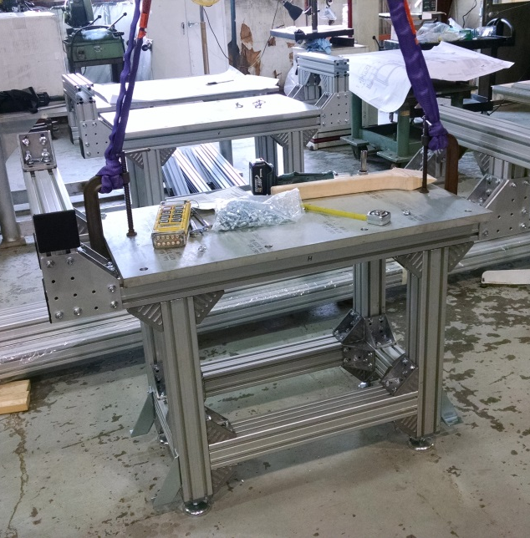
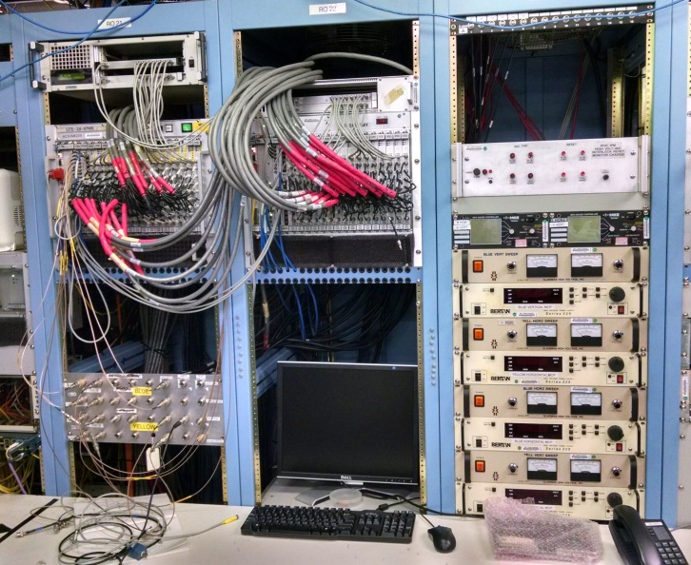
Ionization Profile Monitors
Q3
Separate IPM stands needed with the enough offset for clearance.
J. Fite
New IPM stand design
Stands being fabricated in 919B
Horizontal IPM
Vertical IPM
Each IPM has ~30 cables,
length will be reduced from 375’ to 275’
when moved from sector 1 to 12
Electronics will be split up in 1002, half will be moved to 1012
Champion:
Tepikian/Minty

Slide 14
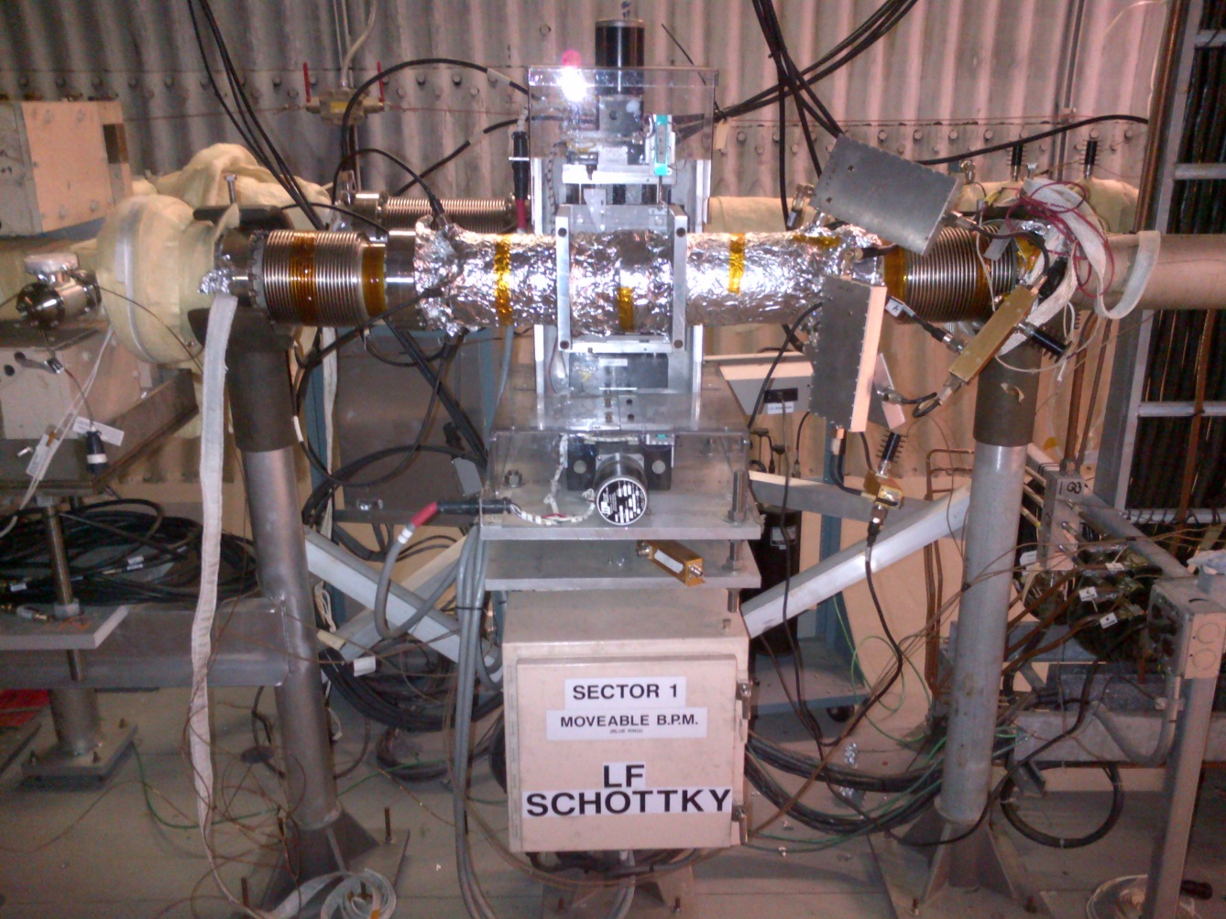
Moveable BPM & LF Schottky
Move from BI1 41m (from IP2) to 65m (closer to Q4)
¼” heliax cables and X-Y stepper motion control
Champions: Brown/Blaskiewicz

Slide 15
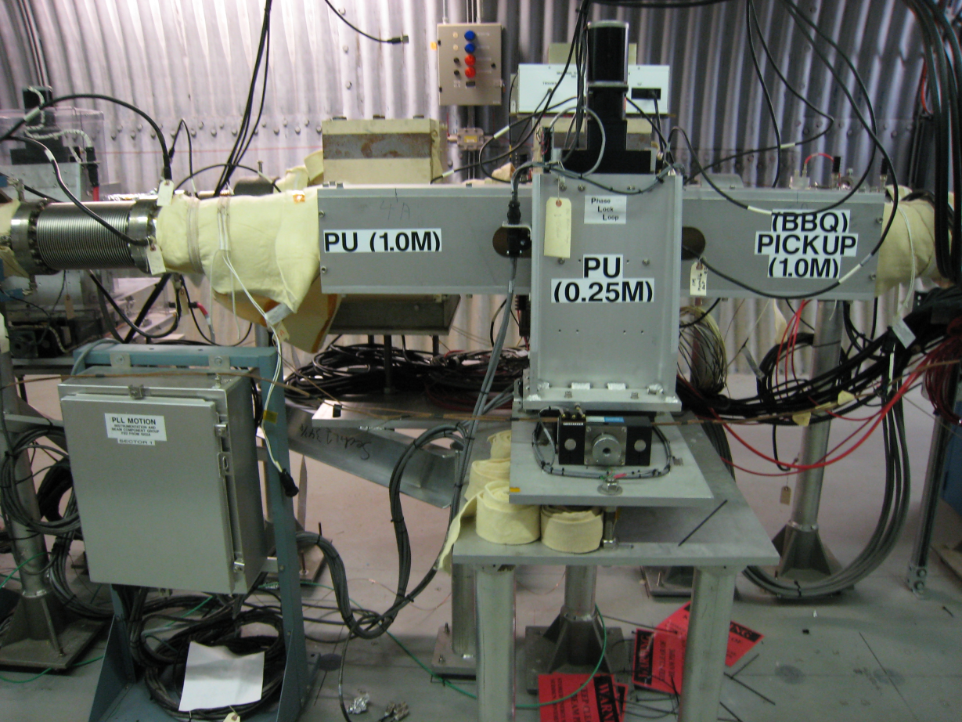
Triple Pick-up Assembly
Move from YO1 42m to YI2 59m
BBQ stripline pick-up (1m)
Quad pick-up (0.25m)
Head-Tail pick-up (1m)
Moving to YI2 allows shorter cable lengths from 1002A than moving towards YO1 Q4
¼” heliax cables and X-Y stepper motion control
Champions: Minty/Marusic/Blaskiewicz

Slide 16
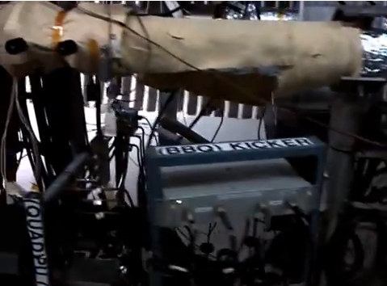
BBQ Kicker (1m strip line) & Quad Pick-Up (0.25m)
BBQ Kicker & Quad Pick-up move together from ~YO1 40m to ~YI2 56m
Base-Band Tune Stripline Kicker
Moving to YI2 allows shorter cable lengths from 1002A than moving towards YO1 Q4
3/8” heliax cables
Champion: Mernick/Minty/Marusic

Slide 17
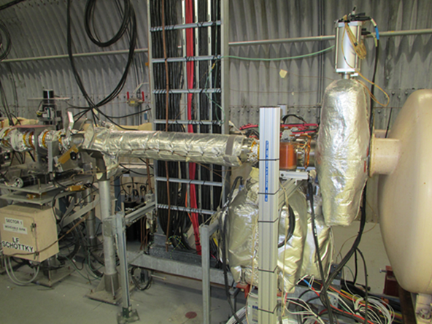
Cable Tray Waterfall (Sector 1, near Q3)
Cables will be rerouted in new tray
- Power supply
- Vacuum
- Instrumentation
- Cryo
Dave Phillips working on placing two trays: one against the triplet on the inside of the ring and one against the DX inside of the ring.
Q3

Slide 18
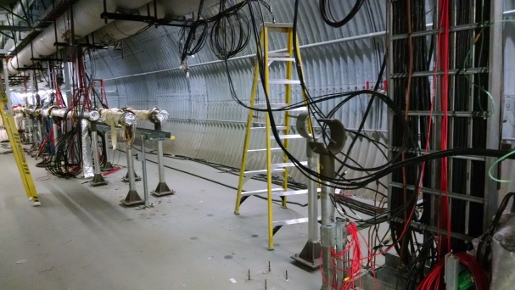
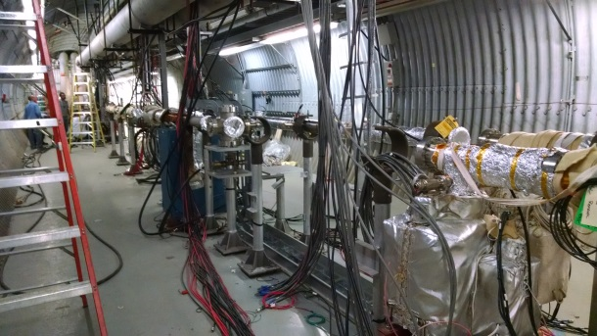
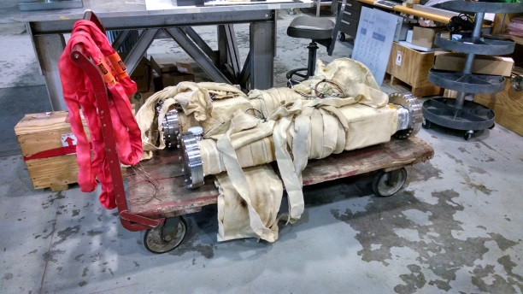
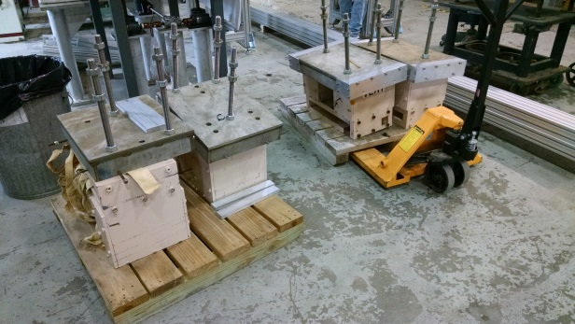
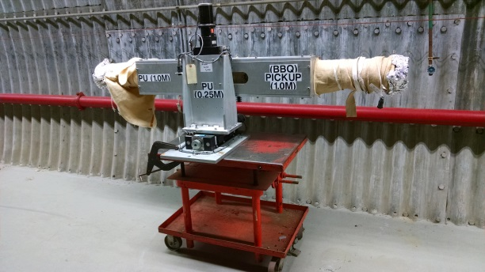
Cost & Status
Materials cost:
Stand costs:
IPMs $15k
~$10-20k? for other stand parts (elevation changes)
Sector 12 & 1 beam height is 50”, Sector 2 beam height 68”
Cables:
Majority of cables will be reused, otherwise removed, except for 7/8 heliax.
~$6k for new 7/8” heliax cables for the ARTUS system in sector 2.
< $10k for remaining cables and connectors.
Status:
Good progress with sector 1 beamline disassembly.
Vacuum group (Dan W.) working on chambers, bellows, transitions designs, etc…
IPMs removed (will get new MCPs), IPM electronics being reconfigured, stands being fabricated.
Cable tray water fall effort is underway, many groups involved.
As technicians and parts are available, remaining devices will be moved.
Open spaces in sector 1
Open spaces in sector 1
IPM chambers in 919B
IPM magnets in 919B
Triple pick-up moved to sector 2

Slide 19
Summary
Relocation underway
Good progress so far
Bake-outs needed in sectors 12, 1 & 2
Time for check-out and recommissioning (with beam) of relocated equipment needed before next run.
Wiki page available for relocation details:
http://www.cadops.bnl.gov/Instrumentation/InstWiki/index.php/Instrumentation_Relocation

