Slide 1
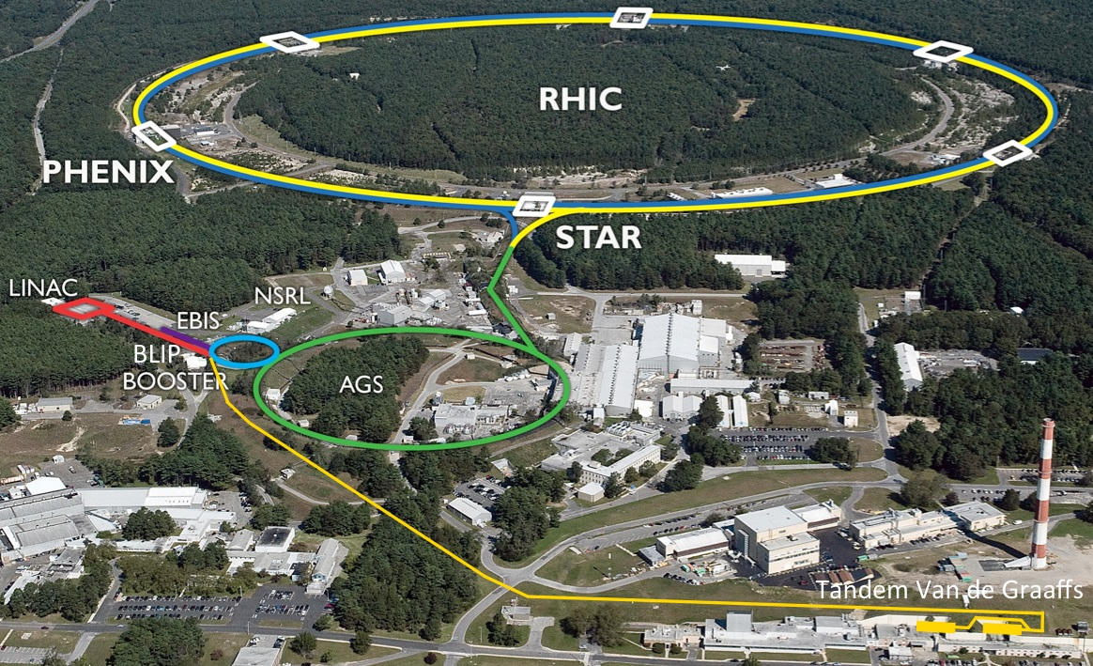
Projections for Run-16/17 Wolfram Fischer
27 July 2015
RHIC Retreat, BNL
Notes:
27 July 2015, 09:50, 20 min (incl. questions)

Slide 2
Contents
Recent performance
Upgrades
Run-16 and Run-17

Slide 3
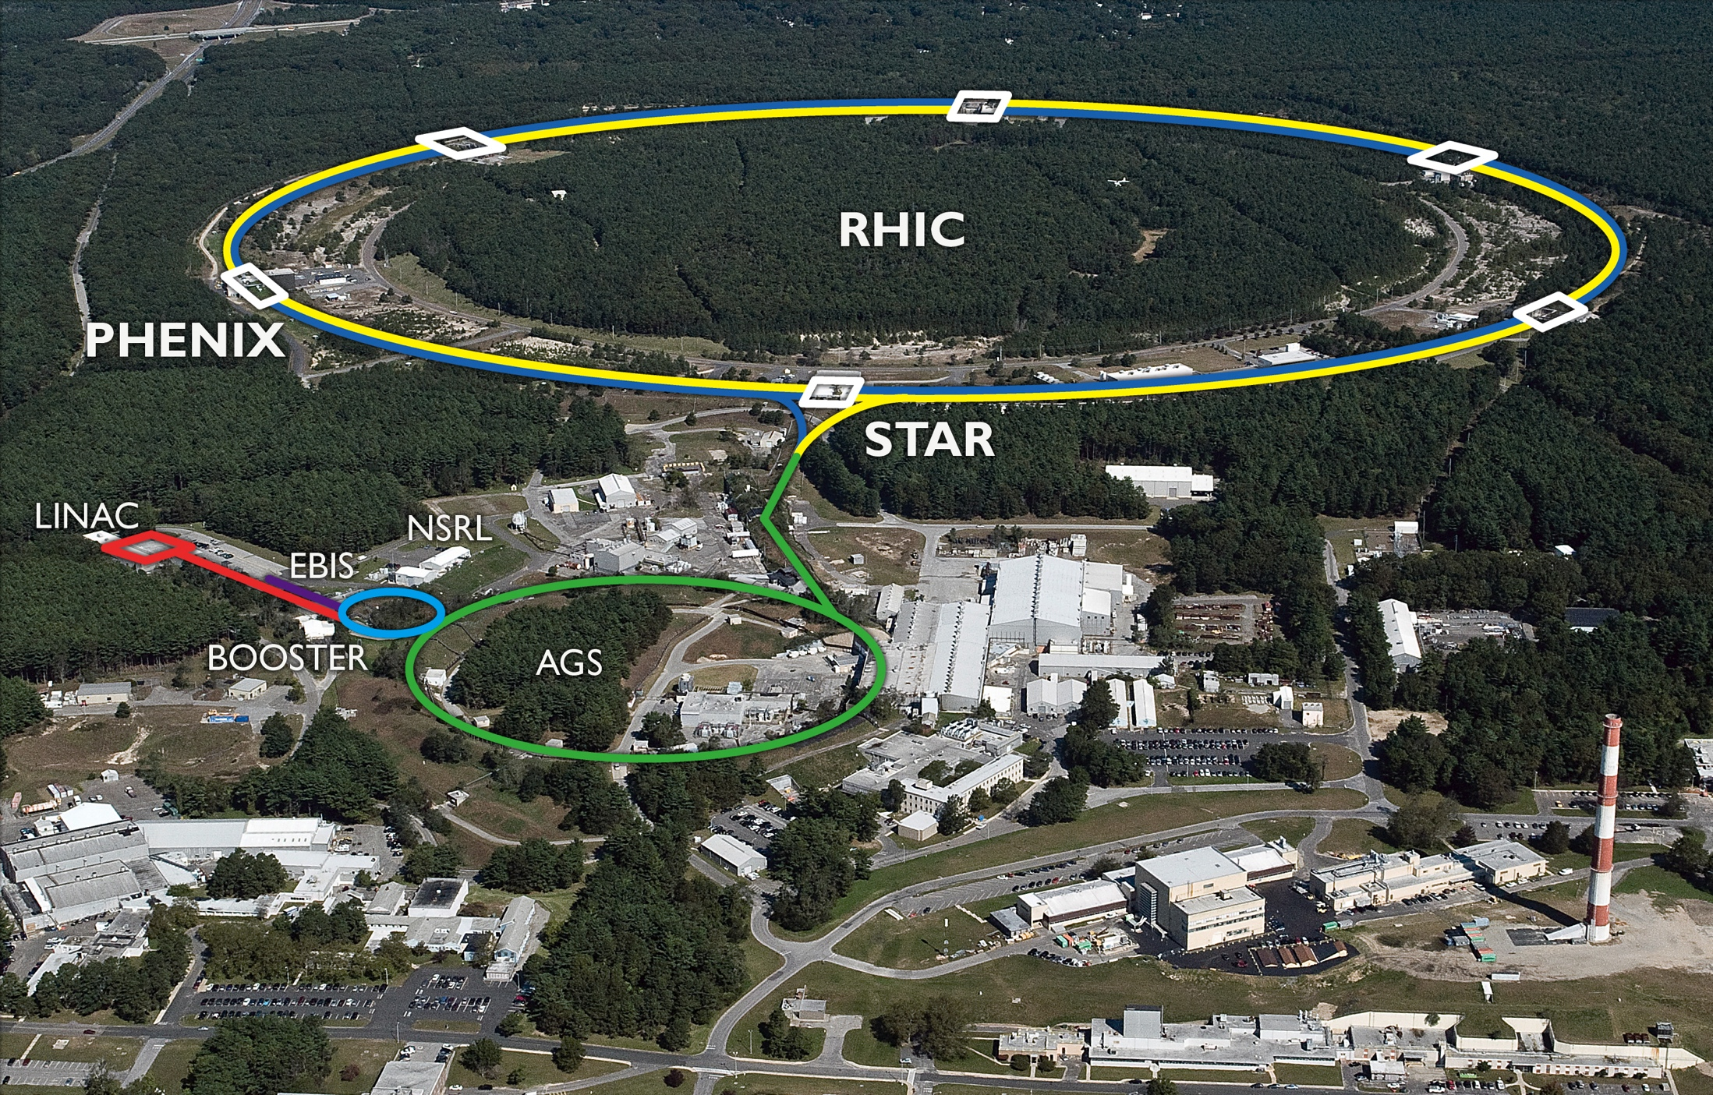
RHIC Run-15
3 operating modes:
ph+ph at 100 GeV, 11 weeks head-on beam-beam compensation: new lattice + first operational use of e-lenses higher bunch intensities
ph+Au at 100 GeV/nucleon, 5 weeks DX dipoles moved RHIC ramp between injections
ph+Al at 100 GeV, 2 weeks Al intensity
h/g
h/f
p
p
h
p
Au
h
p
Al

Slide 4
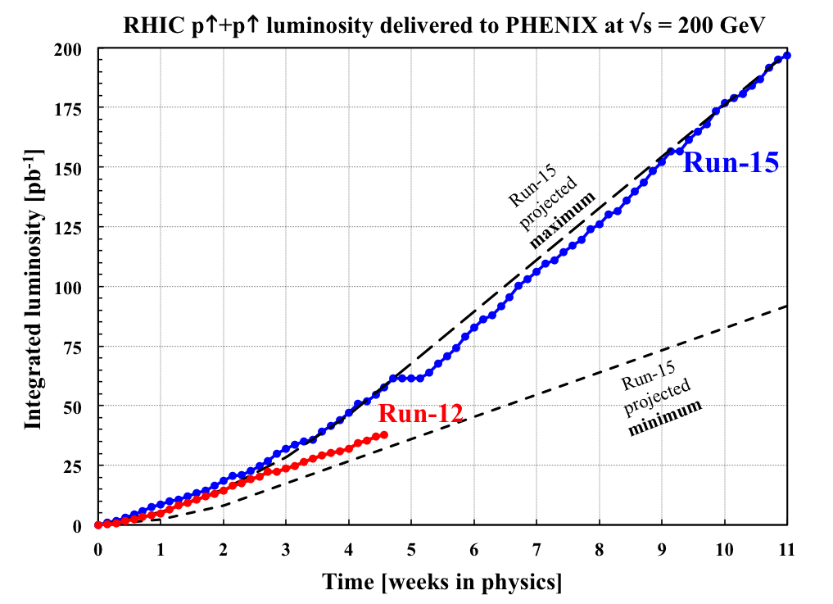
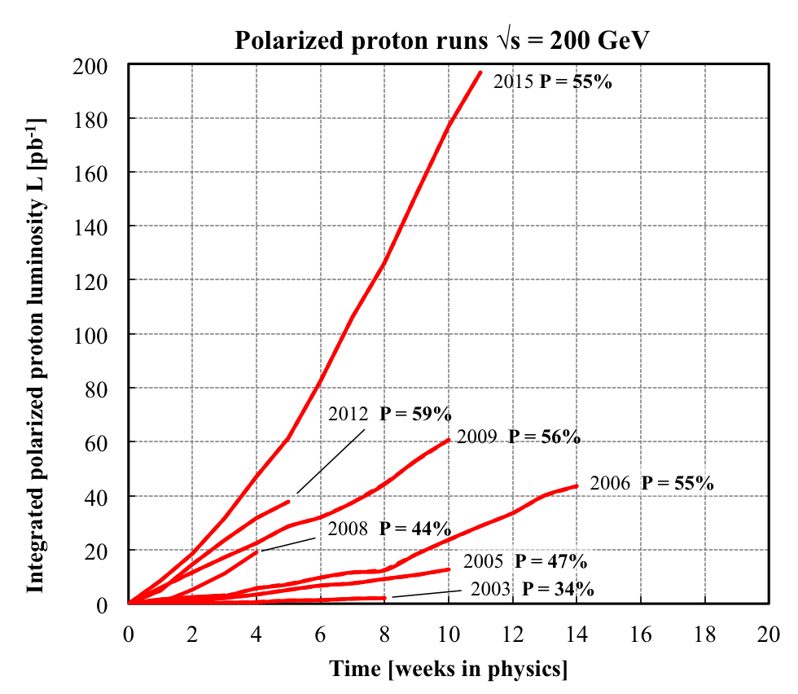
Run-15 ph+ph at 100 GeV Integrated luminosity
Run Coordinator: Vincent Schoefer
L = 25 pb⁻¹/week (2.7× 2012)
Run-15 integrated luminosity at √s = 200 GeV exceeds sum of all previous runs
P_{avg} = 55%
Run-15
2/3 of liquid He inventory evaporated after power outage – 3 days for re-liquefaction

Slide 5
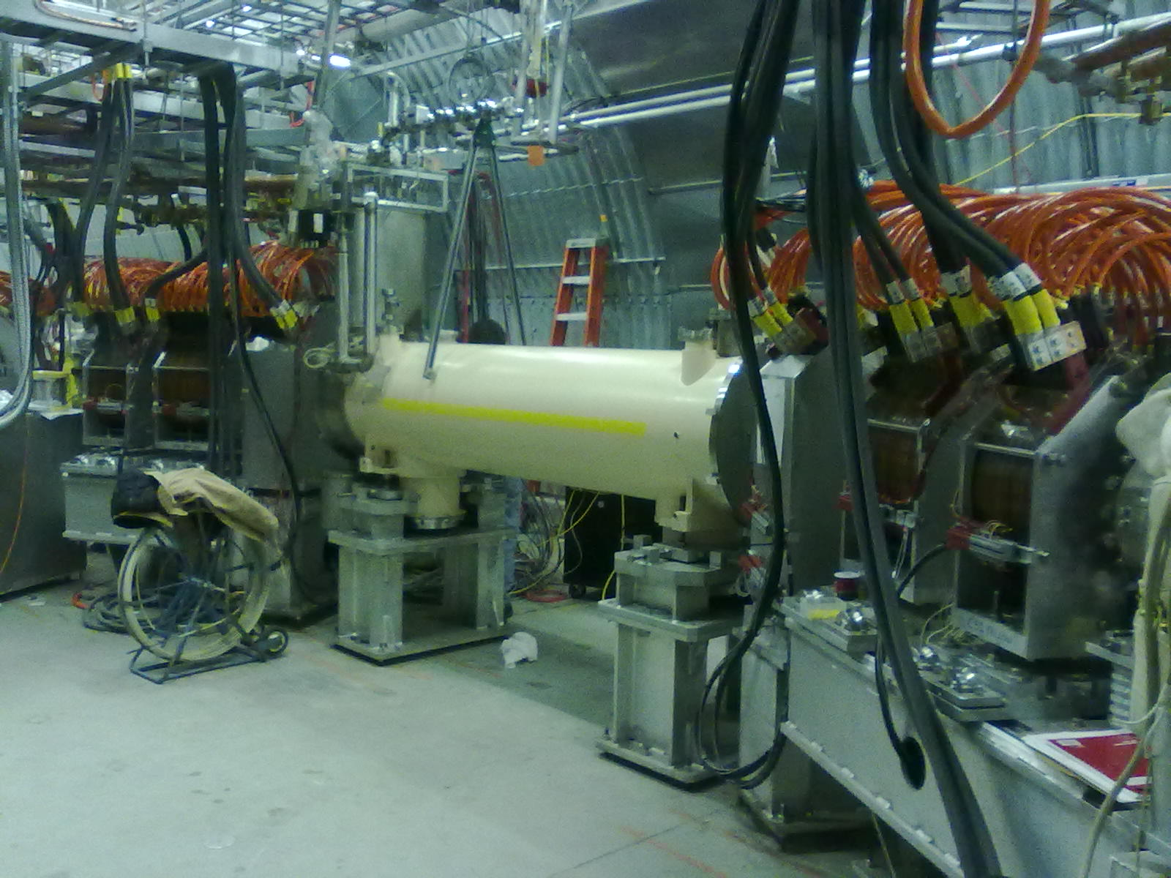
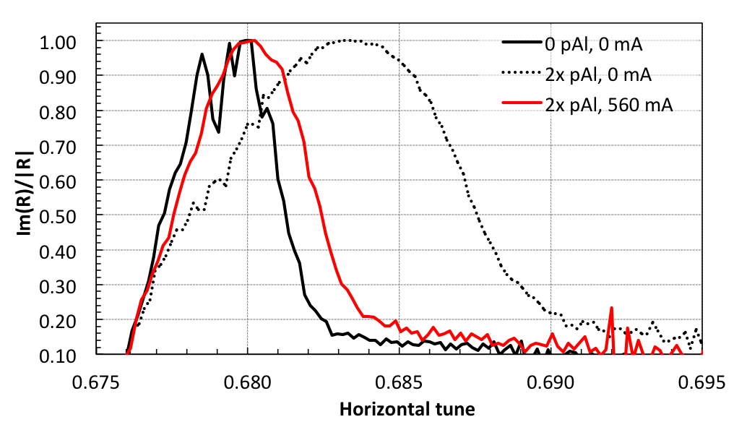
Run-15 ph+ph at 100 GeV Beam-beam compensation
First hadron collider with head-on beam-beam compensation: lattice + e-lenses
New lattice (ATS type, S. White) – phase advance kπ between IP8 and e-lens minimizes beam-beam resonance driving terms
Yellow e-lens
Electron lenses – reduce beam-beam induced tune spread
Tune width measurement: imaginary part of complex beam transfer function (BTF); p+Al – no coherent bb modes
ΔQ reduction from e-lens
New lattice has larger off-momentum dynamic aperture and accommodates higher beam-beam parameter ξ
2x bb
no bb

Slide 6
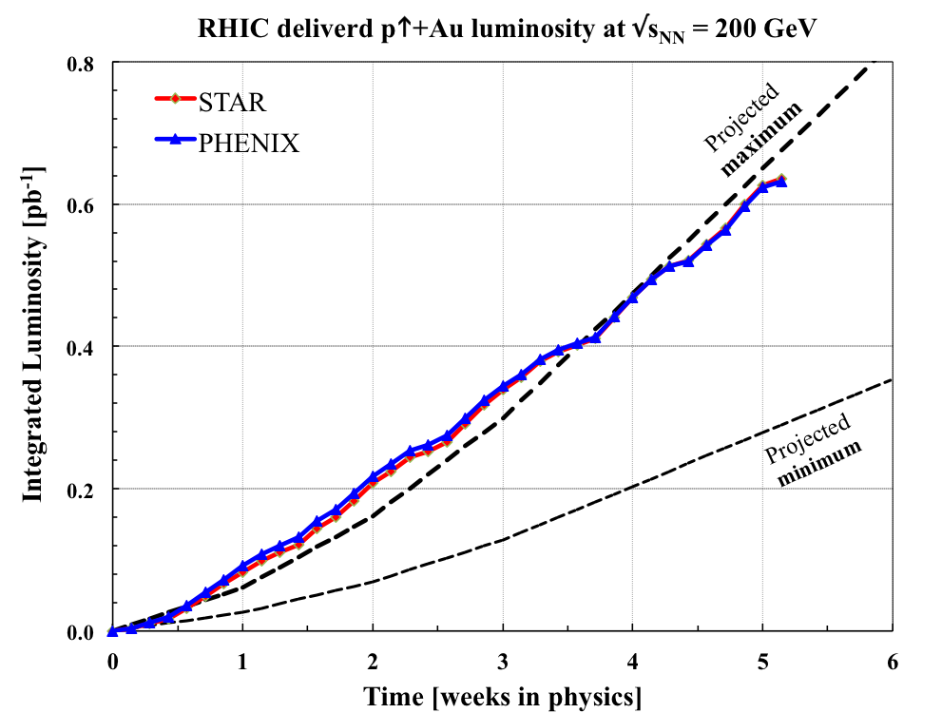
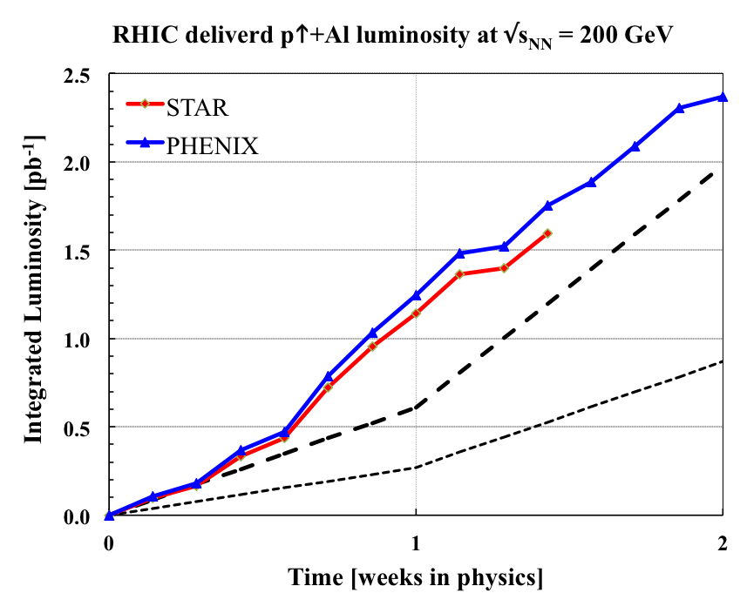
Run-15 ph+Au/Al 100 GeV luminosity and polarization
Run Coordinator: Chuyu Liu
2 new (asymmetric) operating modes – met or exceeded luminosity goals
h
h
p
Au
p
Al
P_{avg} = 60%
P_{avg} = 54%
Inspection found hot STAR main magnet transformer that needed replacement insufficient time for completion before run end

Slide 7
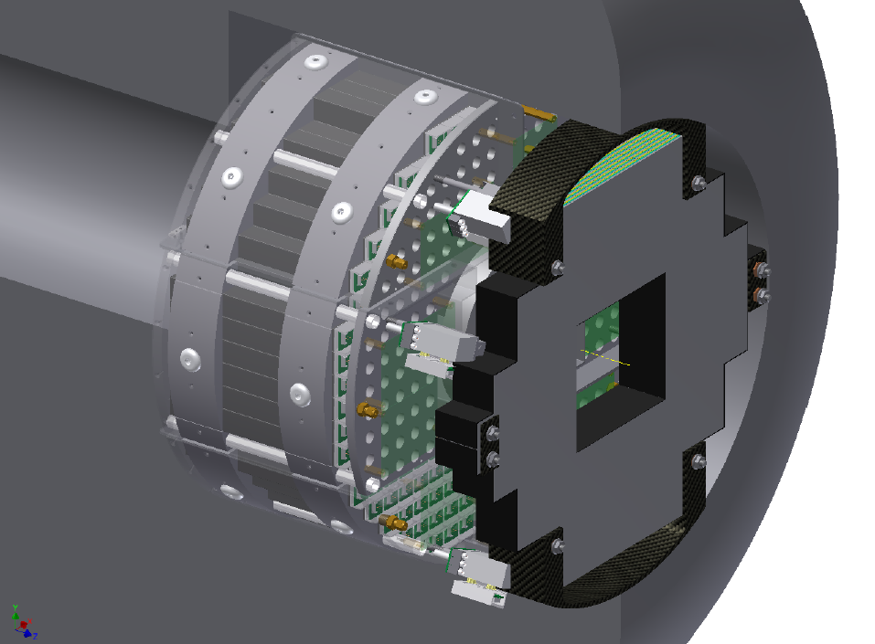
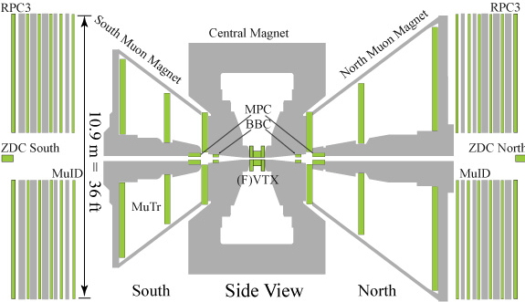
Run-15 ph+Au 100 GeV PHENIX MPC (and VTX) damage after Yellow abort kicker pre-fire
MPC has experienced >100 pre-fires since installation in 2006
Yellow pre-fire made MPC unusable in 2 events (May 2012, Cu+Au; June 2015 p↑+Au)
Secondary particles after beam loss near MPC (especially in DX magnet) create over-current in MPC amplifiers
Energy of a 1.5 Au ions at 100 GeV/nucleon (if fully converted into light) sufficient to damage a pixel
For pre-fire protection installed large orbit bumps in arcs 2014, and new masks in 2015
For PHENIX only one arc between Yellow abort system and detector
Higher risk for asymmetric species since less aperture in DX magnets
PHENIX/STAR/C-AD Task Force created to re-evaluate experimental protection for Run-16 and sPHENIX
MPC
20 mm horizontal arc orbit bump
mask to intercept beam after abort pre-fire
beginning of run
after Yellow pre-fire 05/11/15
after Yellow pre-fire 06/01/15
M. Purschke

Slide 8
RHIC – all running modes to date Run-1 to Run-15
Run-15

Slide 9
RHIC ultimate luminosity and polarization goals
parameter | unit | achieved |  | goals
Au-Au operation |  | 2014 |  | ≥ 2021 56 MHz SRF + AGS + 9 MHz RF
energy | GeV/nucleon | 100 |  | 100
no colliding bunches | … | 111 |  | 111
bunch intensity | 10⁹ | 1.6 |  | 2.0
avg. luminosity | 10²⁶ cm⁻²s⁻¹ | 50 |  | 100 2× achieved
p↑-p↑ operation |  | 2015 |  | ≥ 2021 OPPIS + 9 MHz RF + e-lenses
energy | GeV | 100 | 255 | 100 | 255
no colliding bunches | … | – 111 – |  | – 111 –
bunch intensity | 10¹¹ | 2.25 | 1.85 | 3.0 | 3.0
avg. luminosity | 10³⁰ cm⁻²s⁻¹ | 63 | 160 | 175 2.8× achieved | 600 3.8× achieved
avg. polarization* | % | 55 | 52 | 60 | 55
*Intensity and time-averaged polarization as measured by the H-jet. Luminosity-averaged polarizations, relevant in single-spin colliding beam experiments, are higher.

Slide 10
Operational efficiency
Availability (as reported to DOE)
Set-up time
Store-to-store time
Time-in-store (primary internal efficiency measure)

Slide 11
Operational efficiency availability reported to DOE
Facility Operations | FY2002 | 2003 | 2004 | 2005 | 2006 | 2007 | 2008 | 2009 | 2010 | 2011 | 2012 | 2013 | 2014 | 2015
Research (physics, machine development) | 1379 h | 1238 | 1611 | 2282 | 1920 | 1117 | 1198 | 1352 | 2194 | 1563 | 1752 | 1290 | 2116 | 1909
Beam Studies (APEX) | 58 h | 92 | 136 | 158 | 129 | 104 | 103 | 163 | 173 | 64 | 118 | 75 | 90 | 112
Setup/Tuning | 739 h | 2111 | 1439 | 1422 | 775 | 820 | 1228 | 1639 | 1163 | 1486 | 1202 | 1291 | 852 | 1368
Total Operating Hours | 2176 h | 3441 | 3186 | 3862 | 2824 | 2041 | 2529 | 3154 | 3530 | 3113 | 3072 | 2655 | 3060 | 3389
Failure | 461 h | 975 | 791 | 696 | 699 | 882 | 516 | 773 | 721 | 762 | 526 | 517 | 466 | 485
Availability (%) | 82.5% | 77.9 | 80.1 | 84.7 | 80.2 | 69.8 | 83.1 | 80.3 | 83.0 | 76.3 | 85.4 | 83.7 | 86.6 | 87.5
Scheduled shutdown (maintain cool-down) | 252 h | 378 | 287 | 803 | 509 | 604 | 158 | 273 | 451 | 262 | 301 | 187 | 195.3 | 254.8
Injectors/RHIC Beam Operations | 17.2 wks | 28.5 | 25.4 | 31.9 | 24.0 | 21.0 | 19.3 | 25.0 | 28.0 | 25.5 | 26 | 20.0 | 22.1 | 25
Cryogenic Operation | 17.0 wks | 30.4 | 26.7 | 31.4 | 21.2 | 18.4 | 19.0 | 22.0 | 27.1 | 24.4 | 22.9 | 17.0 | 22.0 | 22.4
Availability = beam time / scheduled beam time (denominator excludes scheduled maintenance)
Availability goal: 80%
Typical times:
50K to 4K cool-down : 1 week
Initial set-up : 2 weeks
Changing species : 1 week
Beam studies (APEX): 16h / 2 weeks
Maintenance : 14h / 2 weeks
Warm-up : 0.5 weeks
FY2015 with highest availability to date

Slide 12
Operational efficiency setup time
Setup time: - for 1st species in run: from both rings cold to 1st physics store - for following species: from beginning of setup to 1st physics store
Run-15
~2 weeks for p↑+p↑
~1 weeks for p↑+Au
1 day for p↑+Al
TRANSPARENT: low energy
BLUE: heavy ion runs
INTRANSPARENT: high energy
RED: polarized proton runs

Slide 13
Operational efficiency store-to-store, time in store
Run-15
Time in store = store time / calendar time (denominator includes scheduled maintenance, failure, setup, beam experiments)
Time in store goal: 60%
TRANSPARENT: low energy
BLUE: heavy ion runs
INTRANSPARENT: high energy
RED: polarized proton runs

Slide 14
RHIC Upgrades Overview
Linac reliability Upgrade
RHIC 9 MHz RF Upgrade
Low-Energy RHIC electron Cooling
Accelerator Development Technical Infrastructure Upgrade

Slide 15
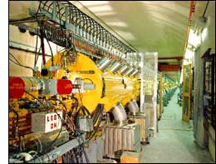
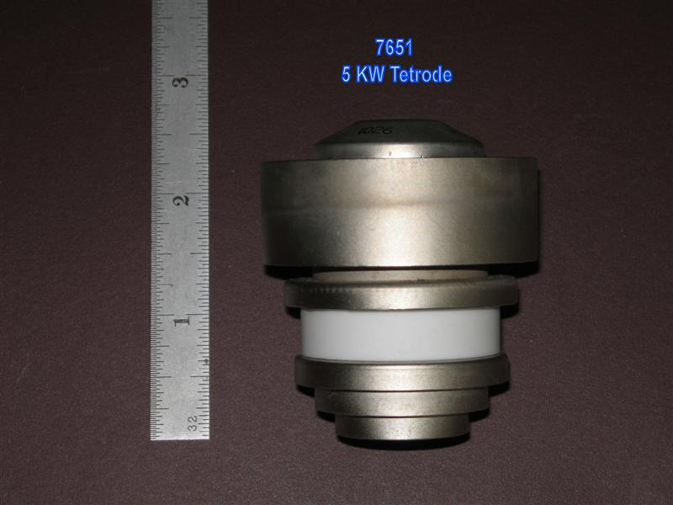
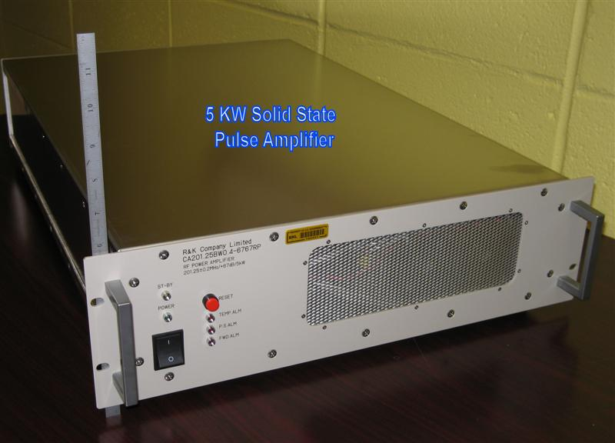
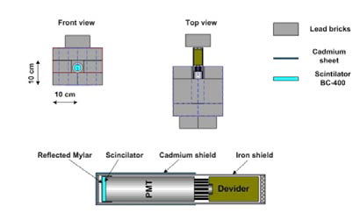
Linac reliability upgrade Capital Project
D. Raparia
Scope
5 kW solid state amplifiers replace (1 of 6 tube types)
new low-level RF (common C-AD platform)
instrumentation upgrades (BPMs, loss monitors)
Cost and funding Schedule
started: 08/2013
planned completion: 12/2016
Status
5 kW amps operational
loss monitors (sensitive to low energy losses) installed
LLRF next
presently on track for completion as planned
FY2013 | 2014 | 2015 | Total
$475k (A) | 525k (A) | 500k (A) | 1.5M
5kW tetrode 7651
5 kW solid state amplifier
Notes:
6 tube amplifiers in operation:
7651: 1 per tank, 5 kW pulsed power, need about 15/year (total $35k/year w/o overhead)
4616: 1 per tank, 200 kW pulsed power, need about 4/year (total $135k/year w/o overhead)
7835: 1 Per tank, 2.5 MW pulsed power, need about 4/year (total $520k/year w/o overhead)
8616: 1 Per tank, ?? kW pulsed power, need about 9/year (total $80k/year w/o overhead)

Slide 16
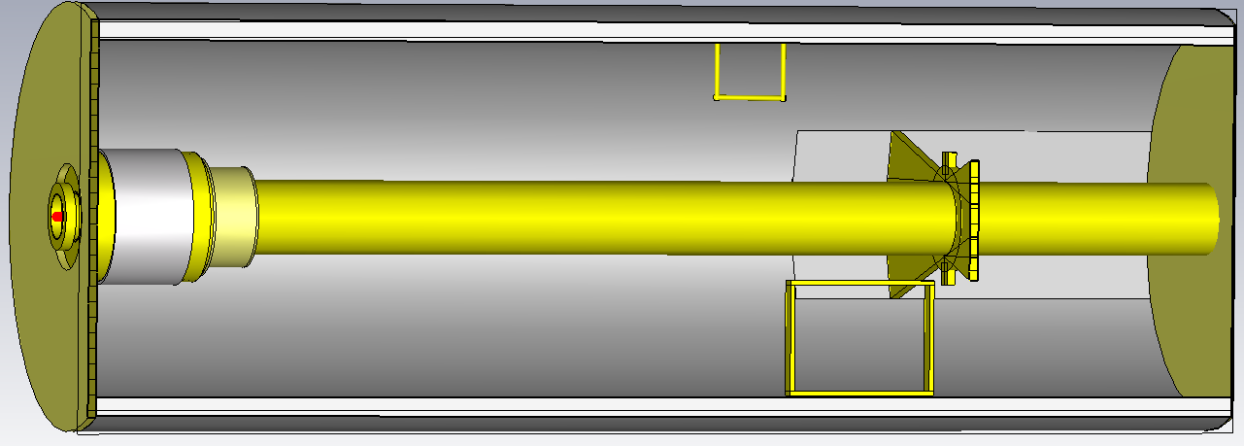
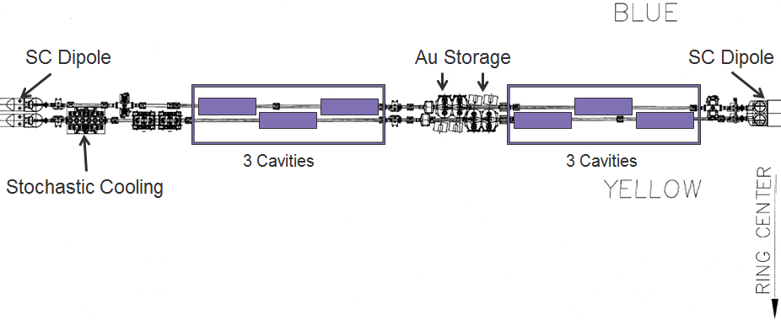
RHIC 9 MHz RF Upgrade Capital Project
A. Zaltsman, S. Polizzo
Scope
3 cavities per ring (60 kV per cavity) [existing 9 MHz RF: 22 kV (p↑+p↑)]
3 areas of benefit:
Larger bucket and ramp speed for protons (avoids squeeze out on early part of ramp, faster crossing of spin resonances)
Lower peak current for transition crossing (increase in bunch intensity)
Operation with long bunches at low energy ions (enhancement to LEReC)
Cost and funding
Schedule
started: 08/2013
planned completion: 10/2017 (begin of beam commissioning)
Status
first article demonstrated design voltage in RHIC ring 07/2015
presently on track for completion as planned
FY2014 | 2015 | 2016 | Total
$675k (A) | 700k (A) | 625k (A) | 2.0M
Notes:
Mar-2015: install first article in RHIC ring
Nov-1016: complete installation in RHIC
Oct-2017: start commissioning with beam

Slide 17
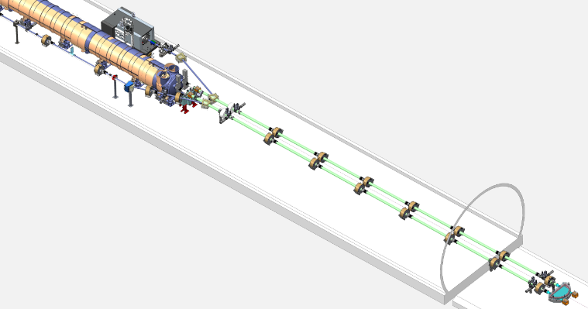
Low Energy RHIC electron Cooling (LEReC) Phase-I AIP
A. Fedotov
Scope electron cooler (1.6 and 2.0 MeV) for 4x luminosity increase
Inj/Ext.
Dipoles
Cooling sections
64 meters
From IP2
180º return
Dipole

Slide 18
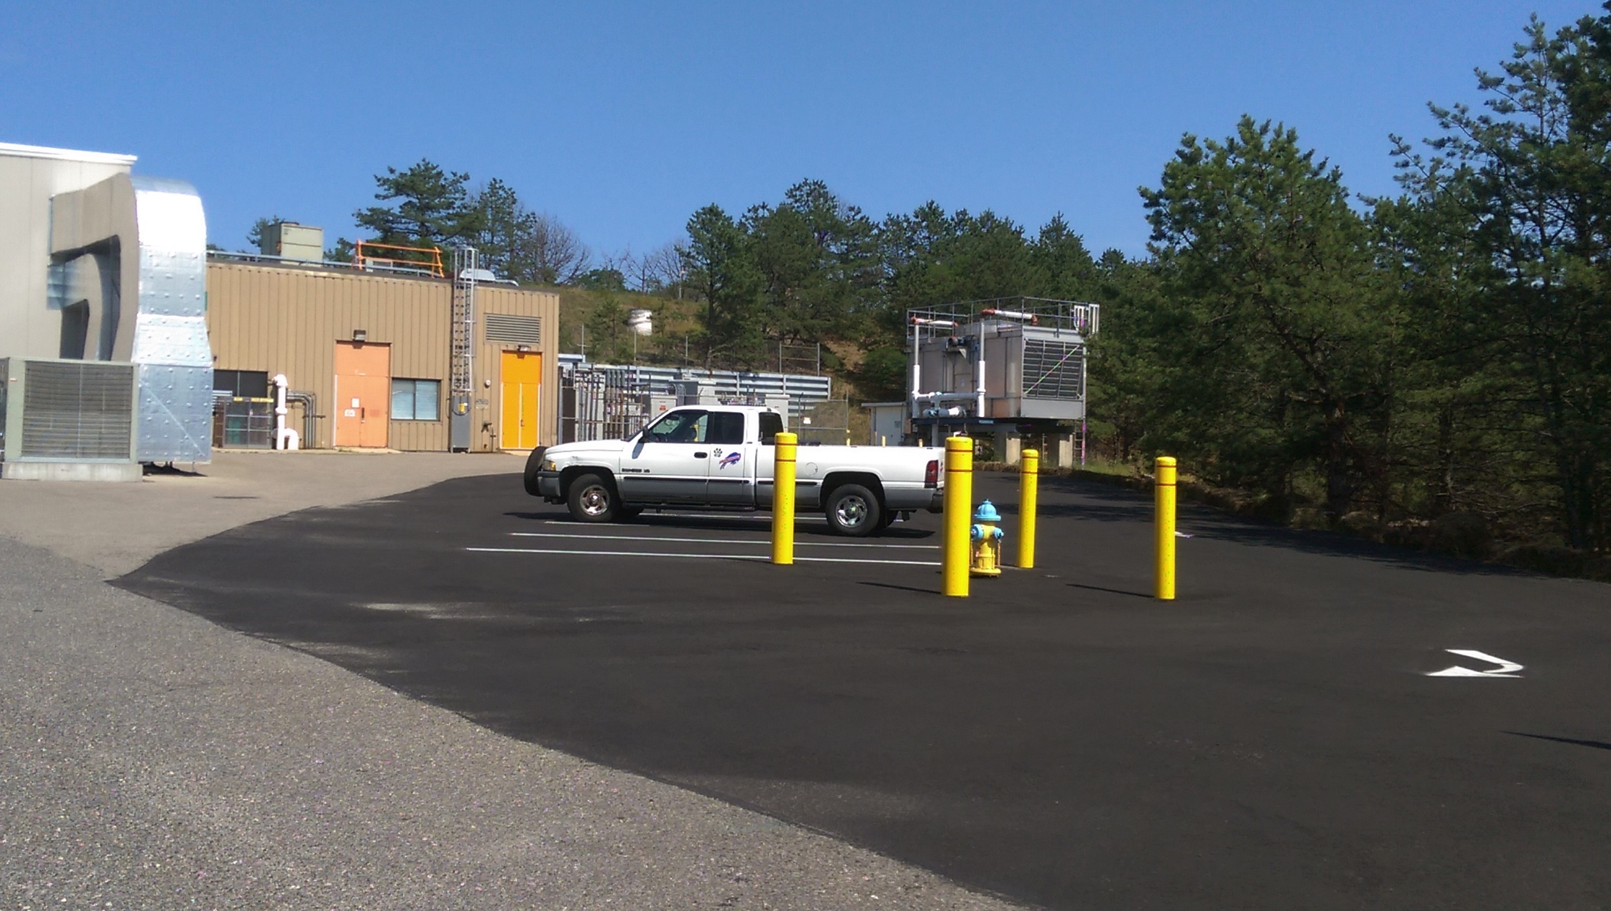
RHIC Accelerator Development Technical Infrastructure Upgrade
C. Folz
Scope
upgrade of buildings, tunnel, and technical infrastructure in RHIC Interaction Region 2 (electrical, water, and cryogenic distribution, access controls)
Cost and funding
Schedule
started: 03/2015
planned early completion: 12/2016
Status
presently on track for for completion as planned
FY2014 | 2015 | 2016 | Total
$1.0M (A) | − | 0.5M | 1.5M
New parking lot at IR2 provided by lab

Slide 19
Outlook RHIC Run-16 and Run-17
PAC recommendations (in order of priority):
Run-16 (last run for PHENIX, sPHENIX in ≥ 2012)
Au+Au at 100 GeV, 10 weeks 56 MHz SRF, further increase in bunch intensity
Au+ph (or ph+Au or d+Au) at 100, 31.2, 20, 10 GeV/nucleon, 5 weeks PHENIX / STAR protection, minimization of setup time
ph+ph at 31.2 GeV, 2 weeks
Au+Au at 31.2 GeV, up to 4 weeks
Run-17
ph+ph at 255 GeV, ≥ 11 weeks leveled luminosity (50% of demonstrated peak, ~30% of potential)
Ru+Ru and Zr+Zr (A = 96 in both cases) Ru-96 source material
ph+ph at energies matching p+Au (d+Au) energy scan

Slide 20
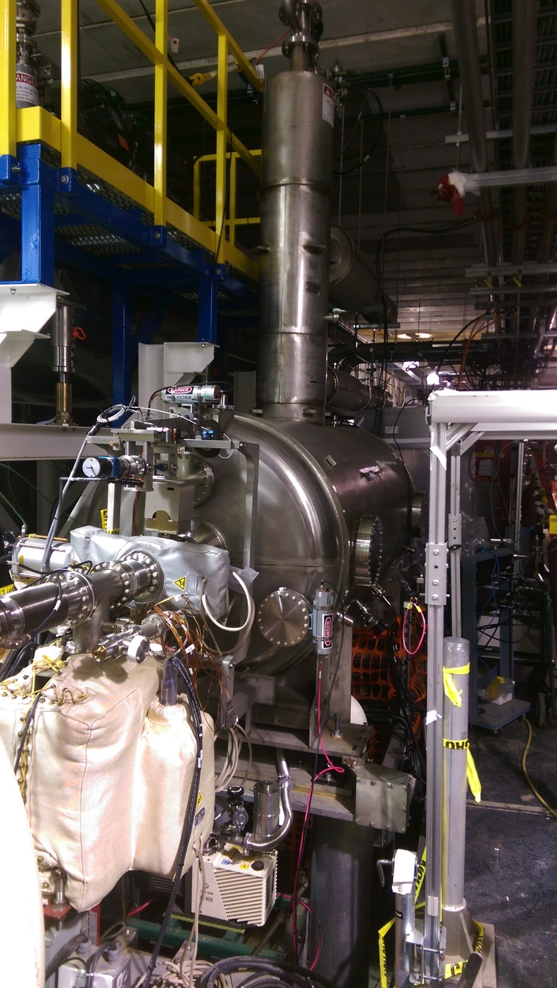
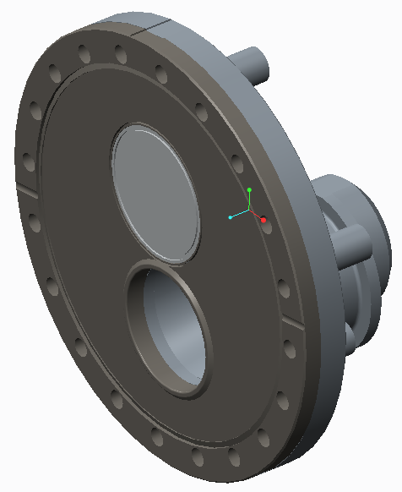
Run-16 Au+Au at 100 GeV
Run Coordinator: Xioafeng Gu
L +40%
Upgrades:
56 MHz SRF operational reached 1.5 MV with amplifier and low cryo load (reached 2.1 MV pulsed; 2 MV design) will install 2 new HOM dampers made by JLab
increases in bunch intensity upgraded beam dump window in 2014 upgrade AGS sextupole circuits in 2015
Notes:
Get new 56 MHz SRF picture (full installation)

Slide 21
Run-17 ph+ph at 255 GeV (STAR)
Run Coordinator: Vahid Ranjbar
STAR requested level luminosity at 1.3×10³² cm⁻²s⁻¹ (0.9 events per bunch-bunch crossing, ≈ 50% of Run-13 max, ≈ 30% of Run-17 expected max)
Possible methods for leveling: Dynamic β* change during store (used for Au+Au Run-14) Changing transverse offset with electron lens (needs study)
New operating mode, goal of L_{avg} ≈ 90% L_{peak}
Need Run-17 also for high-luminosity test for sPHENIX era
PHENIX
Run-13 luminosities (17491)
STAR
Run-17 leveled luminosity request

Slide 22
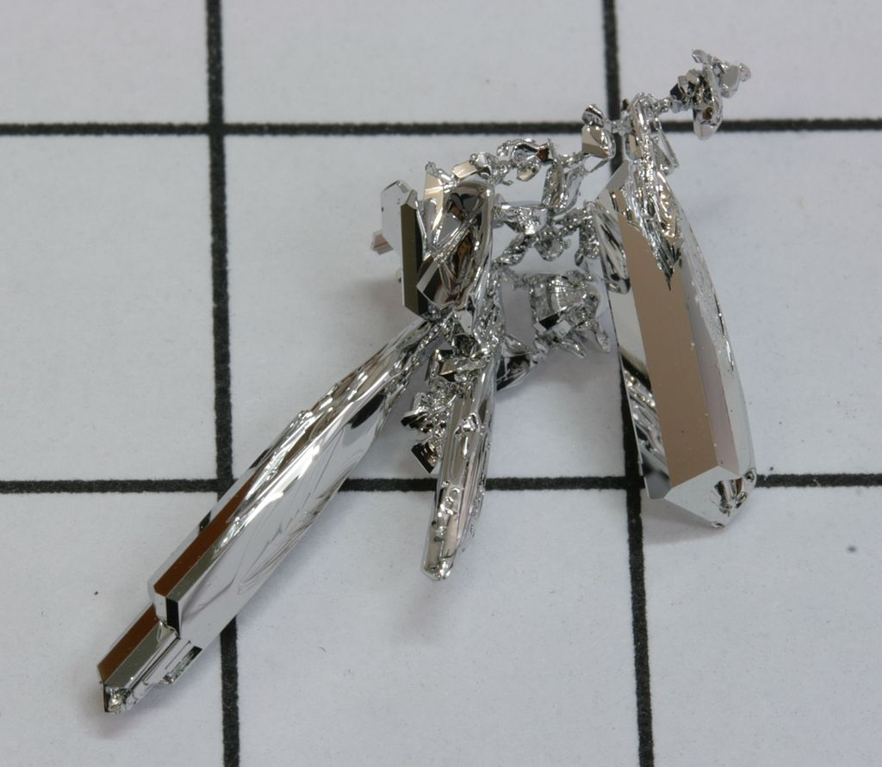
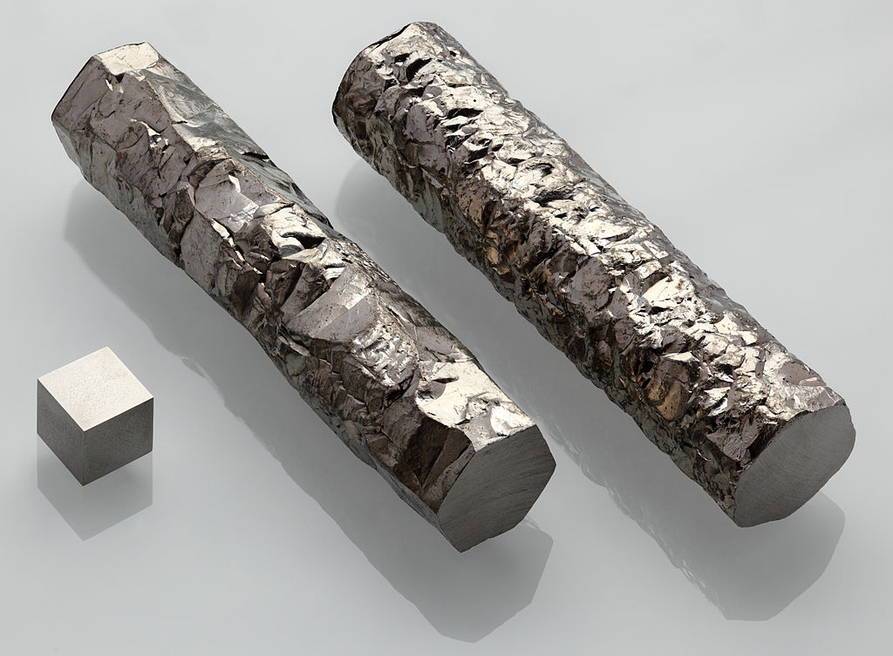
Run-17 Ru+Ru and Zr+Zr Run-17 at 100 GeV (STAR)
Request for Ru-96 and Zr-96
Full intensity: Ru, Zr charge per bunch ≥ Au charge per bunch
Need enriched source material for laser ion or hollow cathode source Ru-96 natural abundance: 5.52% Zr-96 natural abundance: 2.78%
Enriched Zr-96 available in metallic form => can run at full intensity
Enriched Ru-96 not available from any source, still searching ... need ≈ 1 g for operation, have 40 mg in hand (97.92% enriched) 400 mg target material at GSI (not available to us) => can likely run at 5% of full intensity without enriched material Need test low intensity operation in Run-16
ruthenium grown out of gas phase (Wikipedia)
zirconium (Wikipedia)

Slide 23
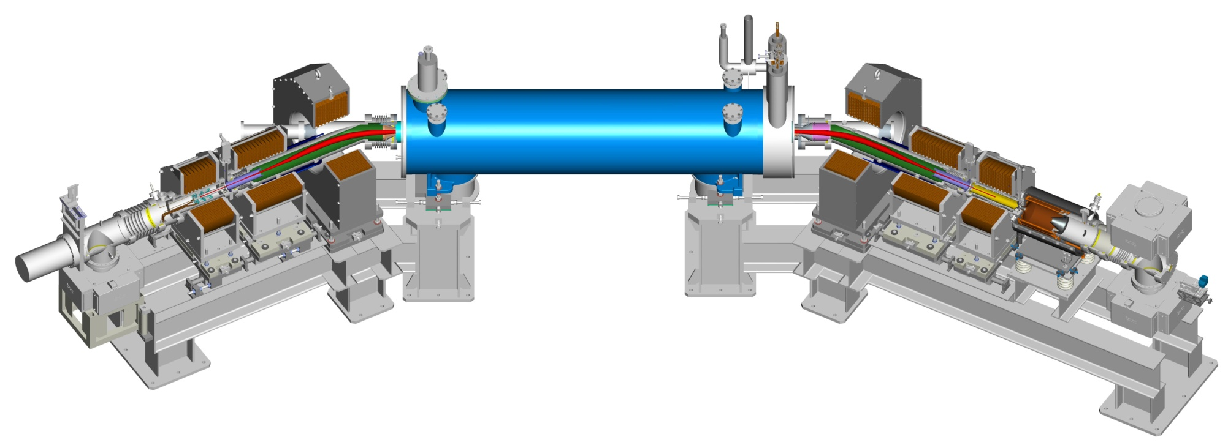
Summary
Run-15 p↑+p↑ at 100 GeV first collider with head-on beam-beam compensation using e-lenses record luminosities, L_{week} = 2.7× Run-12 L_{int} larger than all previous runs combined at 100 GeV period of low Blue polarization with spin rotators p↑+Au/Al at 100 GeV new modes, met max luminosity goals P_{avg} = 60% / 55% PHENIX MPC detector damage after Yellow abort pre-fire Maintained high operational efficiency 87.5% availability (highest to date, goal: 80%), 64% of calendar time in store (goal: 60%)
Preparation for next runs Run-16: Au+Au, Au+p↑ or d+Au at 100 GeV (+ other) Ops use of 56 MHz SRF, L +40% rel. to Run-14, experimental protection Run-17: p↑+p↑ at 255 GeV (+ other) Luminosity leveling at 1.3×10³² cm⁻²s⁻¹ at STAR (≈ 30% of L_{peak})
Main upgrades Linac reliability (CP) and RHIC 9 MHz RF (CP) RHIC Low-Energy electron Cooling (LEReC, AIP) RHIC Accelerator Development Technical Infrastructure Upgrade (RADTIU, AIP)
p↑+p↑ at √s = 200 GeV P_{avg} = 55%
Run-15

Slide 25
RHIC proposed run plan

Slide 26
Run-15 ph+ph at 100 GeV Polarization
Run Coordinator: Vincent Schoefer
period of low Blue beam polarization

Slide 27
Max beam-beam parameter with and w/o e-lens in operation
APEX demonstration: Δξ ≈ +30% (30 bunches, brightness limited)
ξ/IP_{max} (2015, w e-lenses)
additional gain from e-lens: Δξ ≈ +15% (ΔL ≈ +35%)
ξ/IP_{max} (2015, w/o e-lenses)
PRELIMINARY
gain from lattice: Δξ ≈ +35% (ΔL ≈ +85%)
ξ/IP_{max} (2012)
beam-beam parameters ξ/IP
L ~ ξ²
Time [hh:mm]
determination of ξ/IP_{max} (2015, w/o e-lenses) only possible with limited APEX data in operation would need ~1 week w/o e-lenses, or frequent e-lens failures with Q adjustments (had no failures)
Injectors provided higher intensity and brightness than in 2012 APEX studies to maximize ξ were still limited by available N_{b}/ε_{n} i.e. higher ξ possible with injector upgrade
higher ph intensity and brightness from AGS
Notes:
Fillno 18917

Slide 28
Low Energy RHIC electron Cooling (LEReC) Phase-I AIP
Cost and funding
Schedule
started: 05/2015
planned completion: 12/2018
Status
presently within cost (so far no contingency use)
presently on track for completion as planned
FY2014 | 2015 | 2016 | 2017 | Total
$2.8M (A) | 2.3M (A) | 1.9M | 1.3M | 8.3M
06/2015
Expect to make up in manufacturing
Magnet also became diagnostic tool

