Slide 1
PHENIX Run-15
Douglas Fields
University of New Mexico
For the PHENIX Collaboration

Slide 2
Run-15 BUP
p+p @ 200 GeV with transverse polarization for 9 weeks [Physics driven goal is 50 pb⁻¹ recorded within |z| < 40 cm and <P> = 60%]
p+Au @ 200 GeV with transverse polarization of the proton for 5 weeks [Physics driven goal is 190 nb⁻¹ sampled within |z| < 40 cm and <P> = 60%.]
p+Al @ 200 GeV with transverse polarization of the proton for 2 weeks [Physics driven goal is 450 nb⁻¹ sampled within |z| < 40 cm and <P> = 60%]

Slide 3
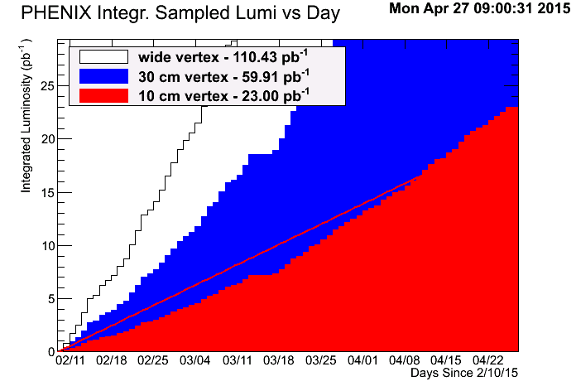
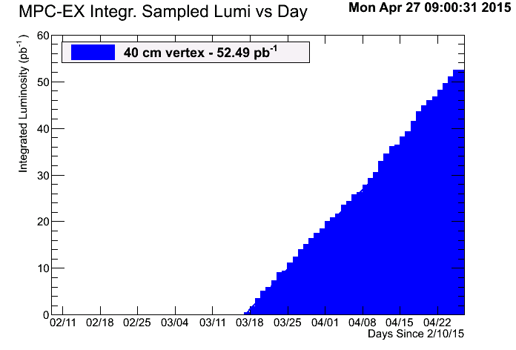
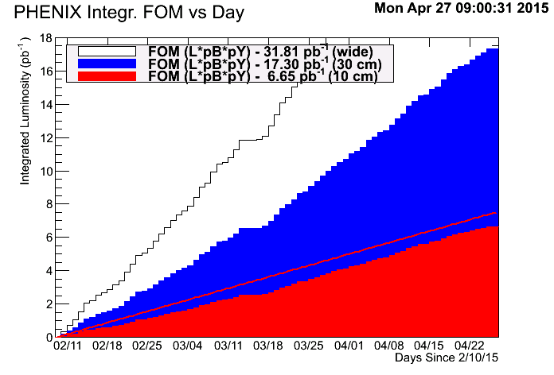
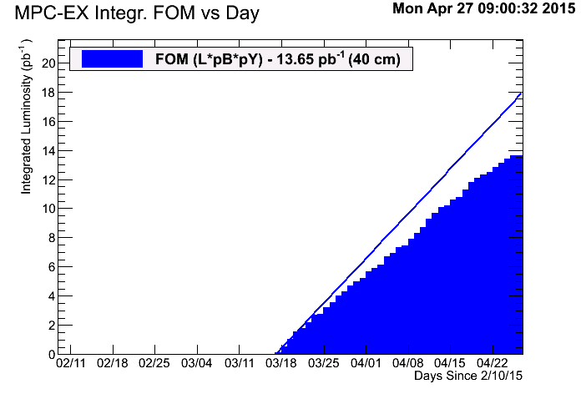
p+p Luminosity and FoM Goals
…it was the epoch of incredulity…
Lumi
FoM

Slide 4
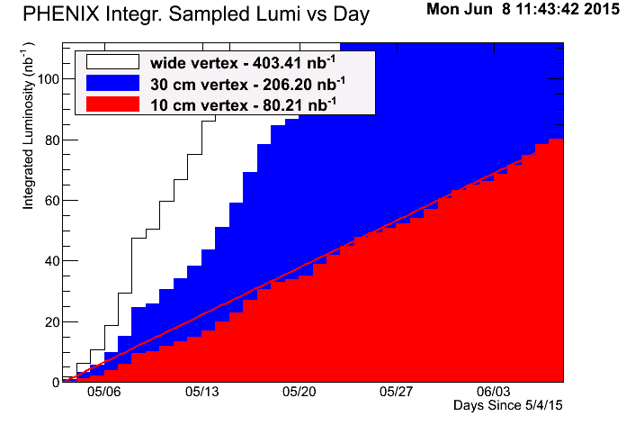
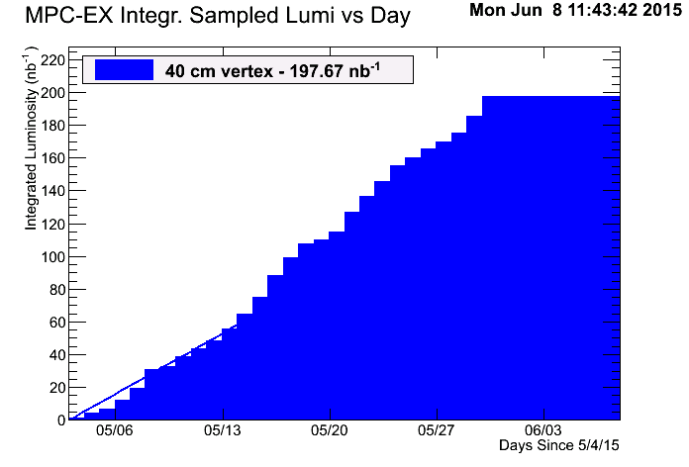
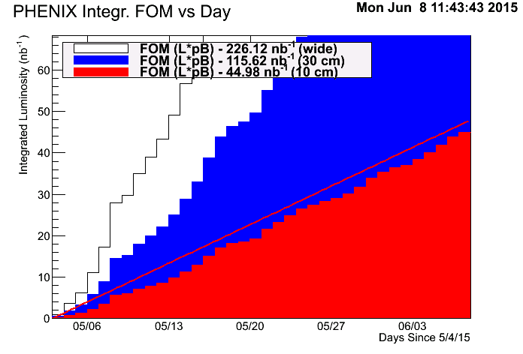
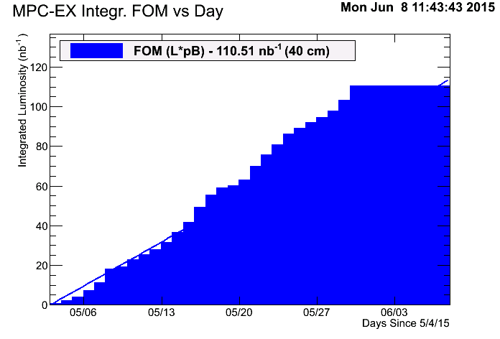
p+Au Luminosity and FoM Goals
Lumi
MPC damage
FoM

Slide 5
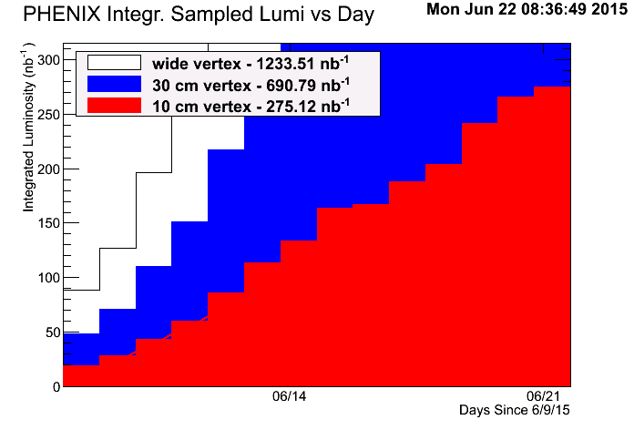
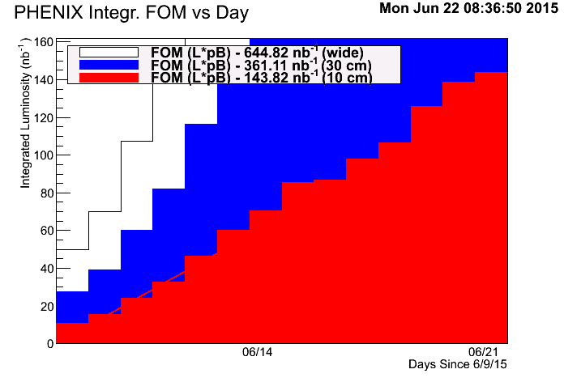
p+Al Luminosity and FoM Goals
Lumi
FoM

Slide 6
Yellow Pre-fires, etc.
Store 18969?, April 30 - ???
  Tripped LV/HV in MPC-EX, 20% increase in bias current, MPC was off.
Store 19050, May 11 - Pre-fire 111x111
  MPC South mostly gone, MPC North damaged
Store 19116, May 28 - Pre-fire 12x12 store
  No additional damage
Store 19118, May 28 - Pre-fire 111x111
  No additional damage
Store 19134, June 1 - Pre-fire 111x111
  Killed remaining MPC both sides
Store 19139, June 2 - ???
  Tripped 3 out of 4 MPC-EX LV modules and all HV
Matin L. Purschke

Slide 7
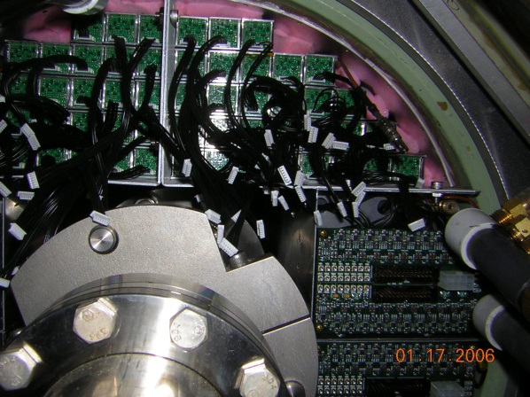
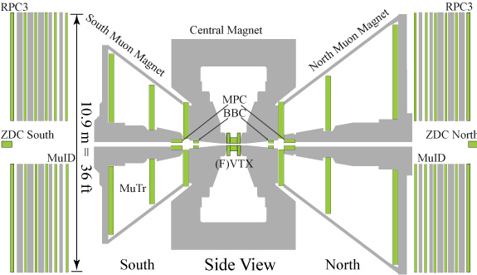
MPC

Slide 8
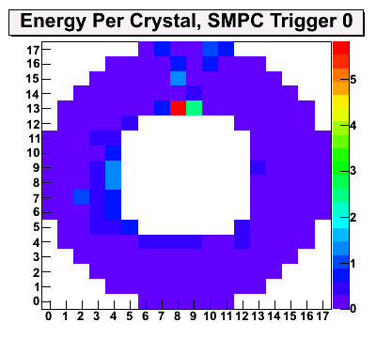
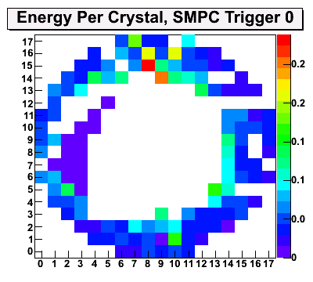
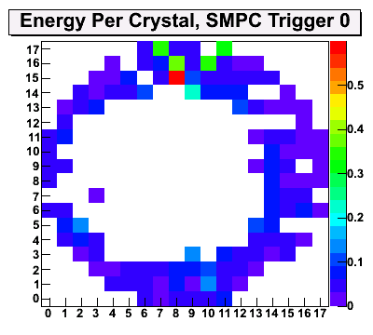
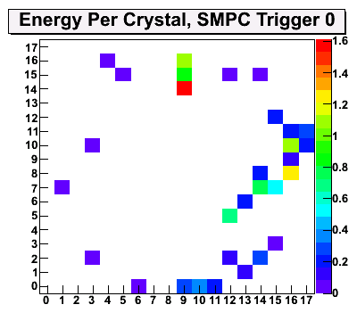
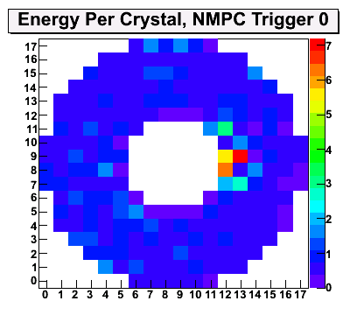
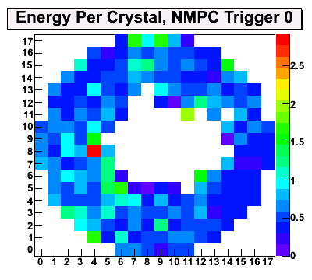
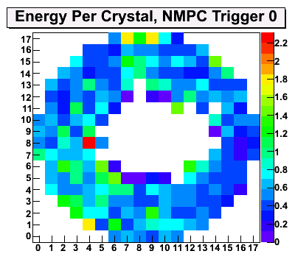
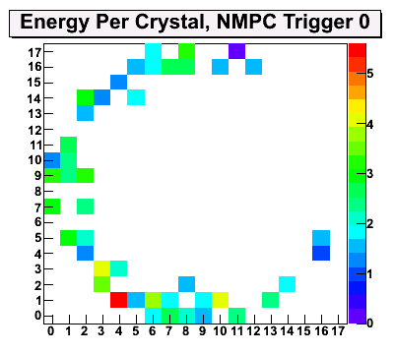
MPC Damage
Store
19050
May 11
Damaged South
Impacted North
19116/18
May 28
We got lucky
No addt’l damage
19134
June 1
The end of the
MPC in Run 15
South
North
Matin L. Purschke

Slide 9
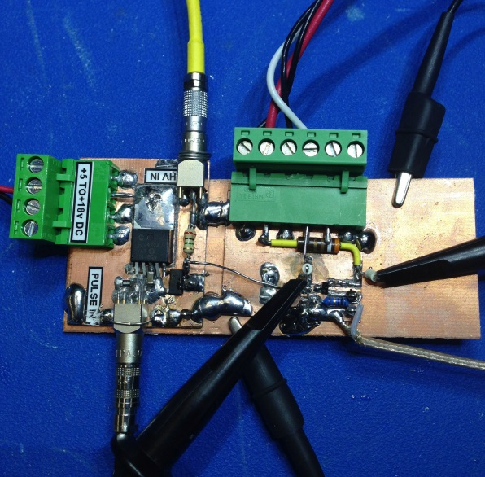
MPC Preamp Failures
Update:
Built JFET “stress test” jig.
Testing confirms that the published “absolute max” gate current of 10mA holds true even for very short current pulses.
Assuming normal operation of the APD this corresponds to roughly 0.5mW of optical power seen by the APD.
Next we will test some possible protection circuits.

Slide 10
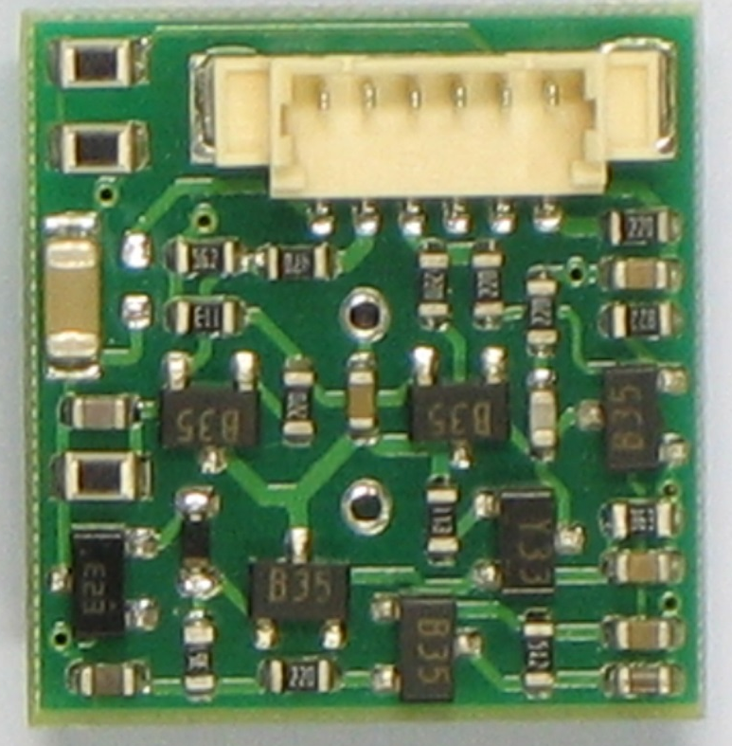
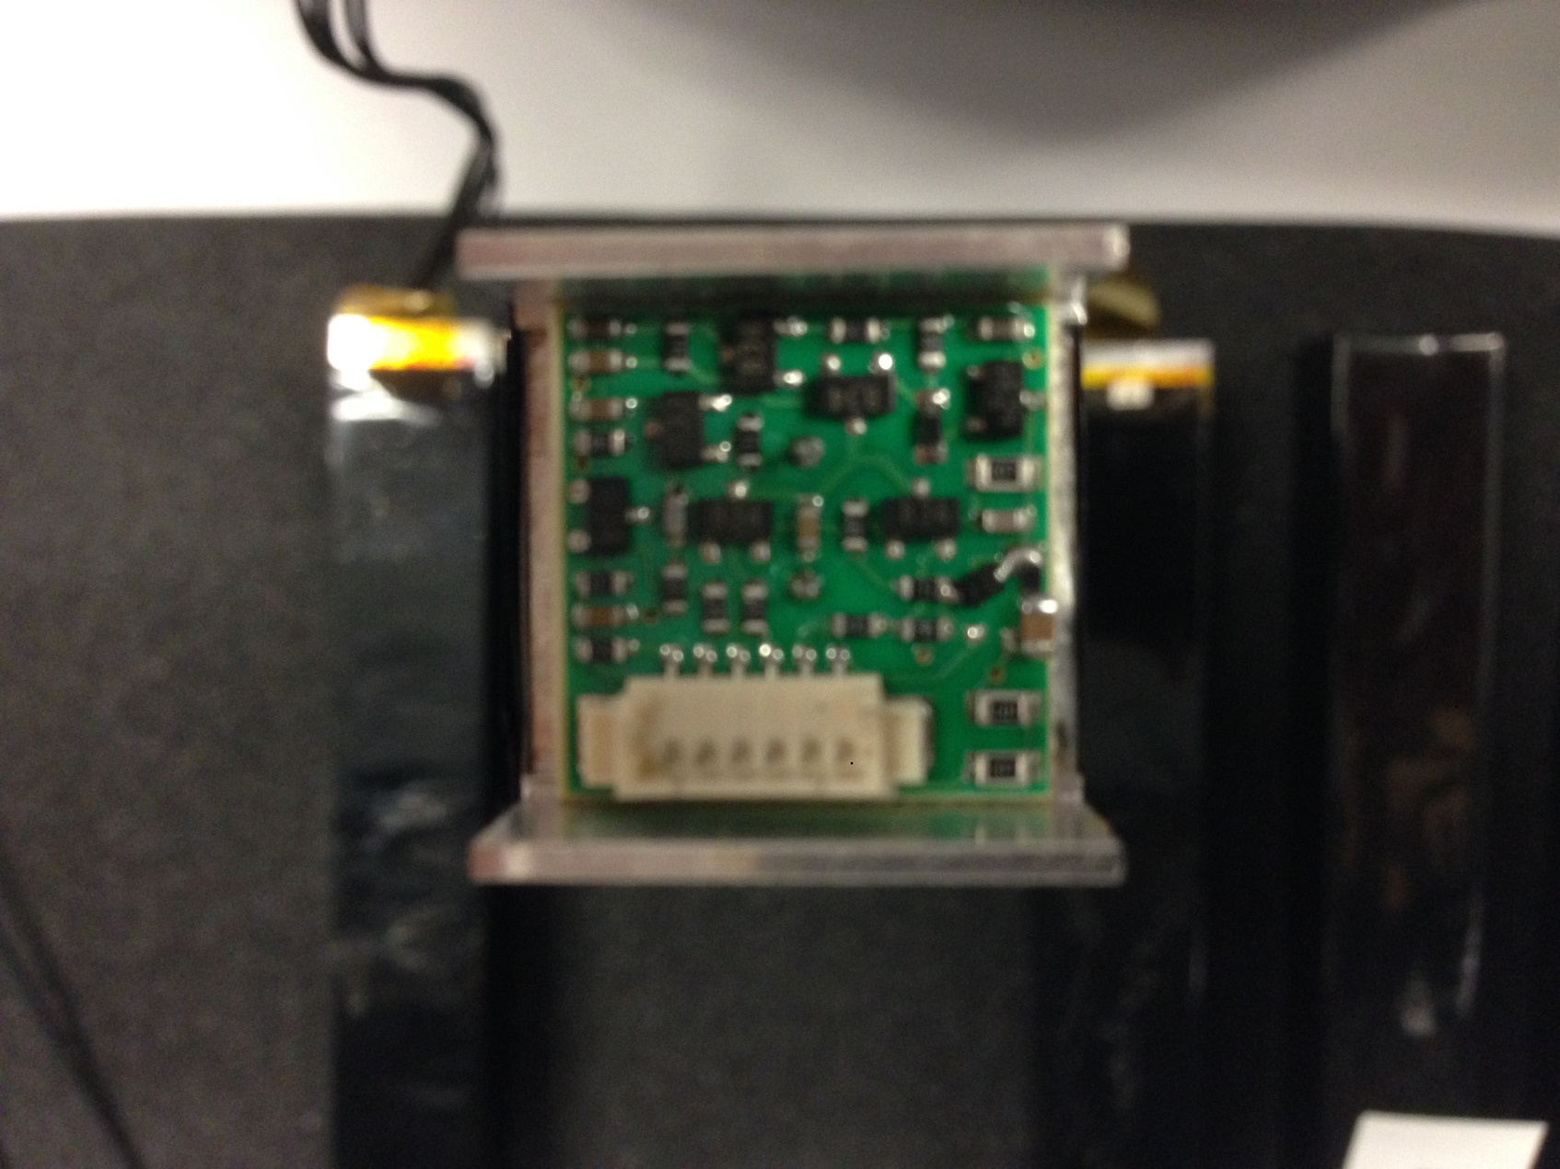
MPC Repair and Modification
Replacing JFET 2SK932 seems to repair the preamp (no APD damage).
  So far 6/6 successful
Also tested new protection circuit using BAS416 diode and resistor in series
  Compared to last trials in 2012, the BAS416 has 1000x lower leakage current, seems to do the trick
  Noise increases a little, and amplitude drops a little. Noise proportional to resistor value, but increases protection.
  Should handle at least 400x more light (0 ohm resistor) to full-scale (100 ohm)

Slide 11
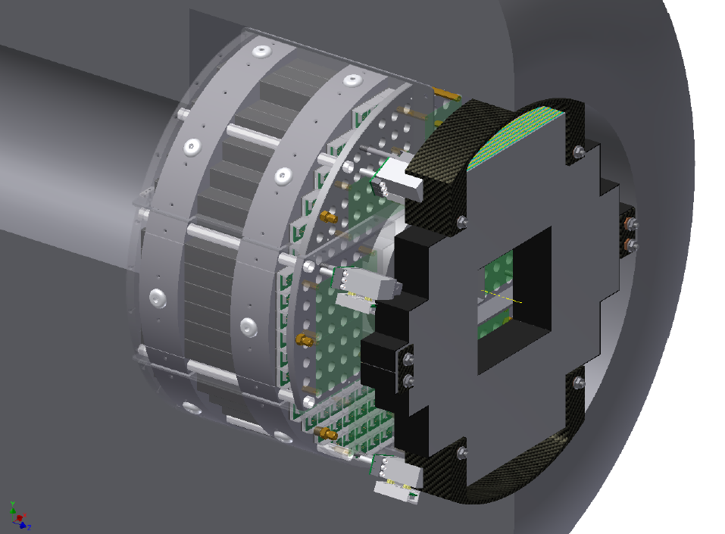
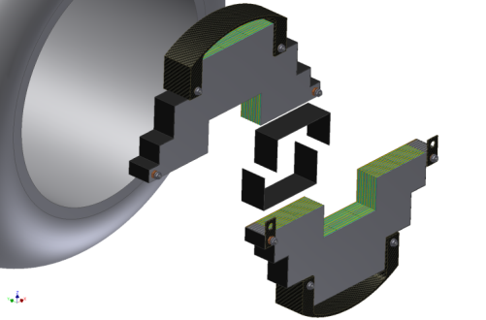
The MPC-EX Detector
A combined charged particle tracker and EM pre-shower detector – dual gain readout allows sensitivity to MIPs and full energy EM showers.
π⁰ rejection (direct photons)
π⁰ reconstruction out to >80GeV
Charged track identification
3.1<η<3.8

Slide 12
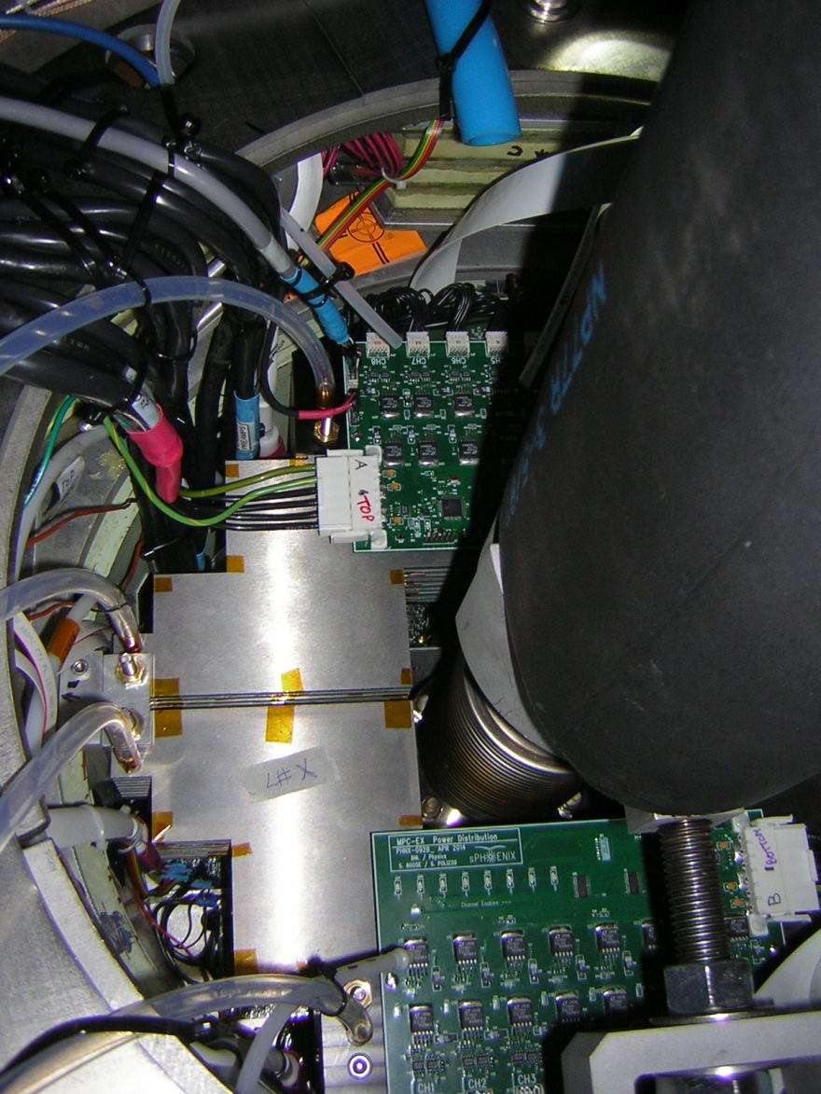
MPC-EX in Run 15
Both North and South MPC-EX detectors were installed a few weeks before the run began.
Work on the readout continued into the second half of the p+p run.
Successfully began collecting data on March 17.
Offline analysis is on-going.
LV Distribution Boards

Slide 13
MPC-EX LV Distribution Controller
Communication Failure
Update:
We now have all active components and cable for retrofit in hand.
A small pc board for mounting the connector is on order.
We will inspect / test the three functioning controllers and do post mortem on the failed one as soon as they become available.
New boards will be made with these new components.
We will then run control cables to the ADAM relays in the bridge racks and modify the LV GUIs.

Slide 14
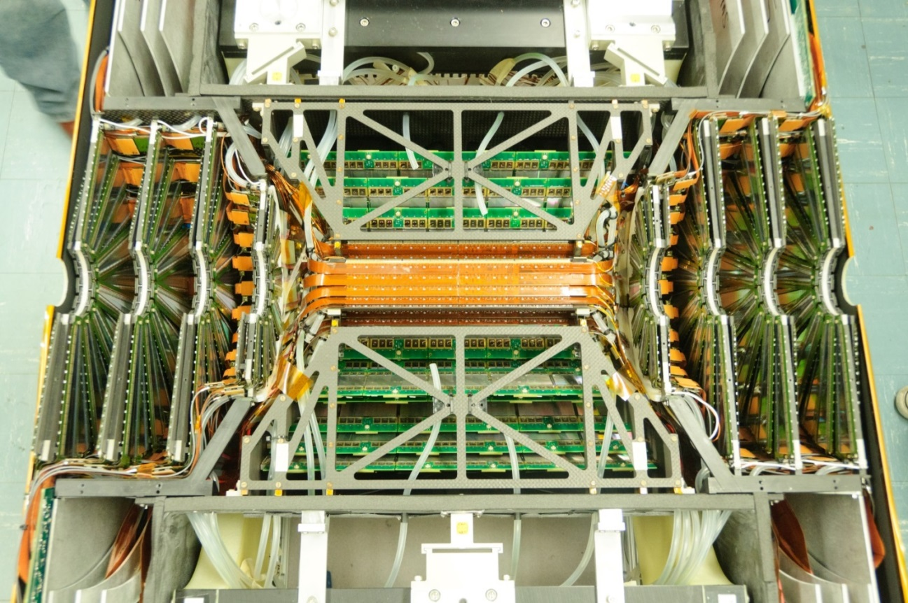
Refurbished F/VTX
VTX pixels and Strip-pixels were refurbished for Run 14.
Improved cooling, environment containment, etc.
FVTX ran well for Run 15.
Together, provides heavy flavor program in PHENIX (DCA).
And…

Slide 15
FVTX Multiplicity Trigger
Slide from Wei Li, Rice University

Slide 16
FVTX Multiplicity Trigger
Online Coarse Track
~ 3/4 active wedges
Trigger : #track > Threshold

Slide 17
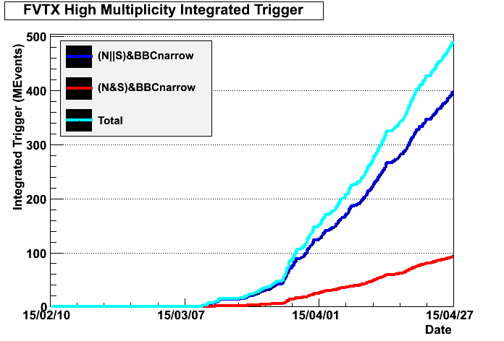
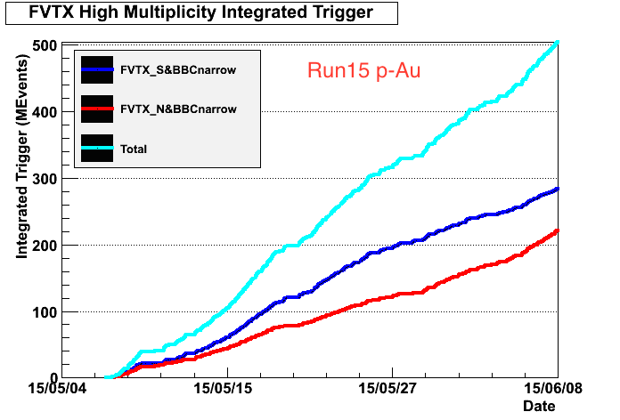
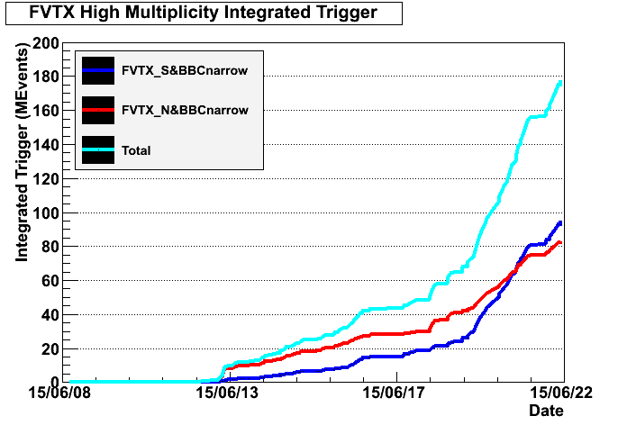
Run15 Integrated FVTX Trigger
pp
pAu
 | pp (AND+OR) | pAu (South) | pAl (South)
# Trigger | 500M | 300M | 90M
Purity | 0.10 | 0.8 | 0.60
# of High Mult Event | 50M | 240M | 54M
pAl

Slide 18
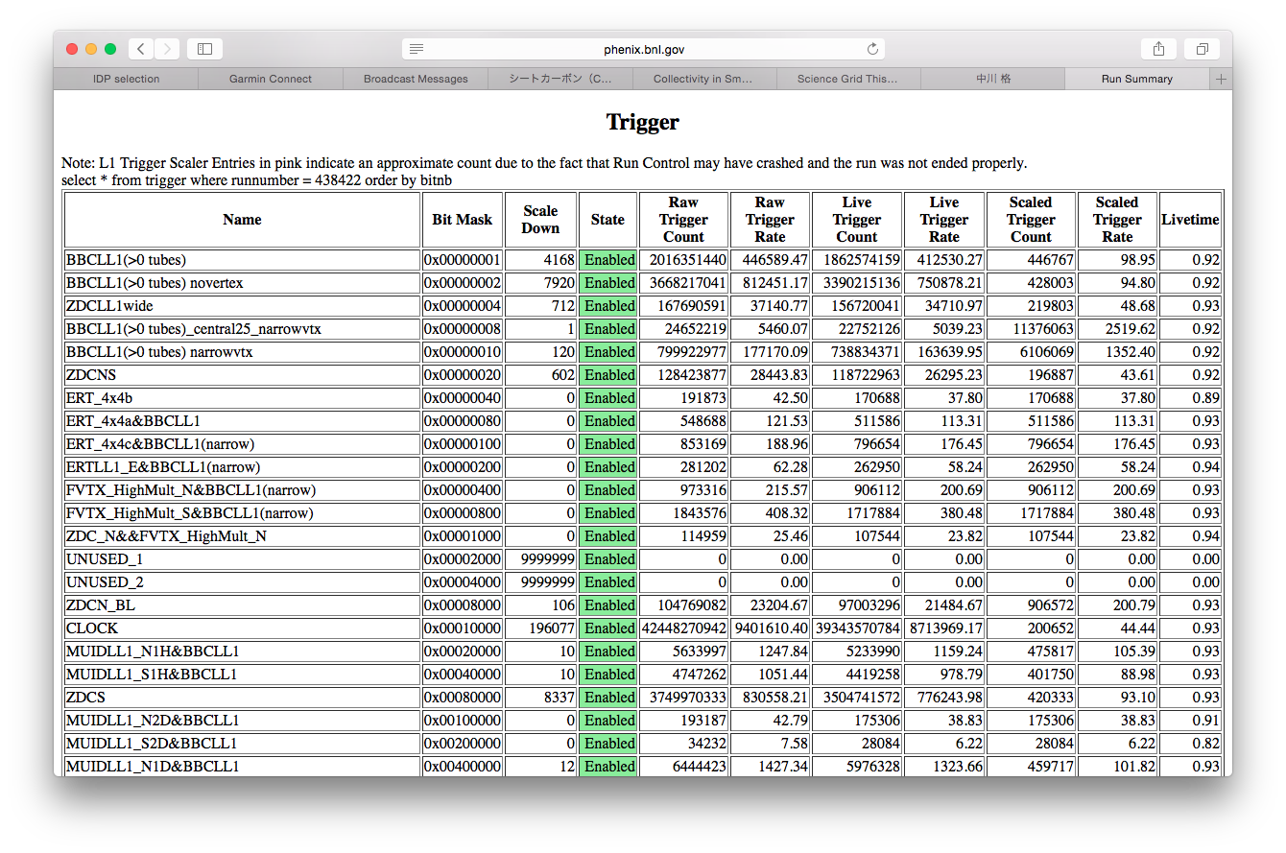
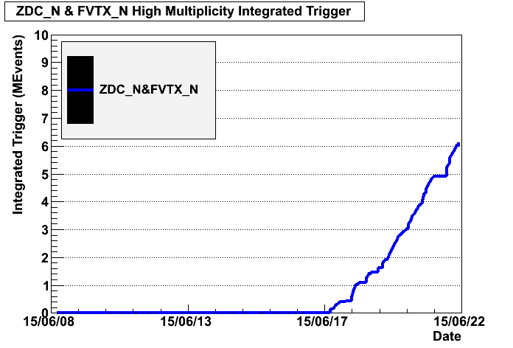
ZDC_N&FVTX_HighMult Trigger
Implemented in the middle of pAl run to explore multiplicity dependence of forward Neutron Asymmetry.
A
p/n/A
FVTX
π⁺
p
n
ZDC

Slide 19
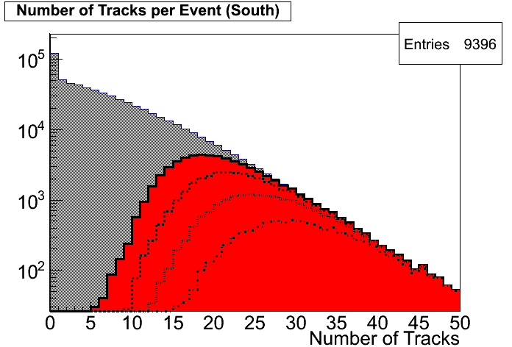
FVTX Multiplicity Trigger
Run 15 p+Au
Au-going direction
MB
Has the ability to tune for rejection and purity.
Collected sufficient triggers in p+p, p+Au and p+Al.
≥12
≥14
≥16
≥18
Run 15 p+p
Run 15 p+p
Run 15 p+Au

Slide 20
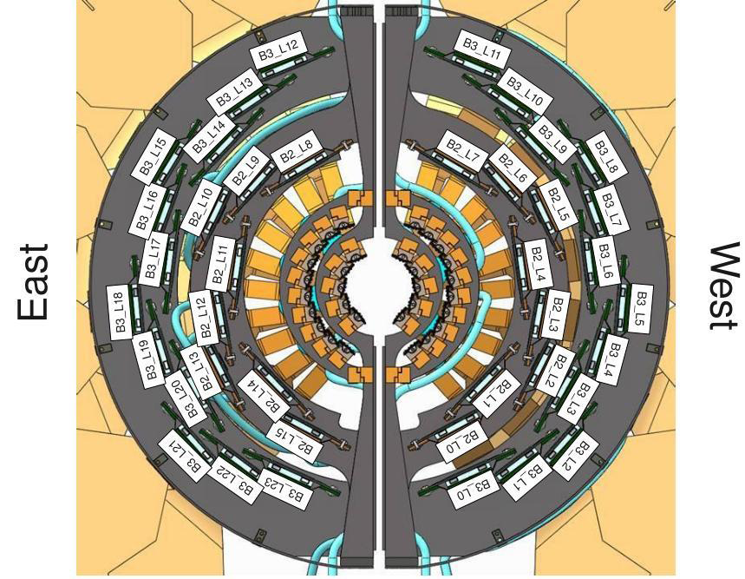
Silicon
Barrel 2 ladders 4,7,8,9,10, and 11 have been impacted
Consistent with a hit in the upper-east quadrant
W
E
After a further event, we have turned off the FVTX and VTX…
Matin L. Purschke

Slide 21
Barrel: B3
7/26/2015
rachid.nouicer@bnl.gov
Notes:
21
21

Slide 22
Status: VTX-Stripixel: WEST-B3
Outline
Ladder/Module |  | Module #1 | Module #2 | Module #3 | Module #4 | Module #5 | Module #6
00 | B3L00
01 | B3L01
02 | B3L02
03 | B3L03
04 | B3L04
05 | B3L05
06 | B3L06
07 | B3L07
08 | B3L08
09 | B3L09
10 | B3L10
11 | B3L11
Good Module
50% Dead Module
bad Module
Notes:
22
Le plan de l’expose se presente de la manière suivante :

Slide 23
New Configuration : VTX-Stripixel: WEST-B3
Outline
Ladder/Module |  | Module #1 | Module #2 | Module #3 | Module #4 | Module #5 | Module #6
00 | B3L00
01 | B3L01
02 | B3L10
03 | B3L11
04 | B3L04
05 | B3L05
06 | B3L06
07 | B3L07
08 | B3L08
09 | B3L09
10 | B3L03
11 | B3L02
Good Module
50% Dead Module
bad Module
Notes:
23
Le plan de l’expose se presente de la manière suivante :

Slide 24
Status: VTX-Stripixel: EAST-B3
Outline
Ladder/Module |  | Module #1 | Module #2 | Module #3 | Module #4 | Module #5 | Module #6
12 | B3L12
13 | B3L13
14 | B3L14
15 | B3L15
16 | B3L16
17 | B3L17
18 | B3L18
19 | B3L19
20 | B3L20
21 | B3L21
22 | B3L22
23 | B3L23
Good Module
50% Dead Module
bad Module
Notes:
24
Le plan de l’expose se presente de la manière suivante :

Slide 25
New Configuration: VTX-Stripixel: EAST-B3
Outline
Ladder/Module |  | Module #1 | Module #2 | Module #3 | Module #4 | Module #5 | Module #6
12 | B3L17
13 | B3L18
14 | B3L19
15 | B3L15
16 | B3L16
17 | B3L20
18 | B3L21
19 | B3L14
20 | B3L13
21 | B3L12
22 | B3L22
23 | B3L23
Good Module
50% Dead Module
bad Module
Notes:
25
Le plan de l’expose se presente de la manière suivante :

Slide 26
Barrel: B2
7/26/2015
rachid.nouicer@bnl.gov
Notes:
26
26

Slide 27
Status: VTX-Stripixel: WEST-B2
Outline
Ladder/Module |  | Module #1 | Module #2 | Module #3 | Module #4 | Module #5
00 | B2L00
01 | B2L01
02 | B2L02
03 | B2L03
04 | B2L04
05 | B2L05
06 | B2L06
07 | B2L07
Good Module
50% Dead Module
bad Module
Notes:
27
Le plan de l’expose se presente de la manière suivante :

Slide 28
New Configuration: VTX-Stripixel: WEST-B2
Outline
Ladder/Module |  | Module #1 | Module #2 | Module #3 | Module #4 | Module #5
00 | B2L01
01 | B2L03
02 | B2L02
03 | B2L00
04 | B2L04
05 | B2L14
06 | B2L06
07 | B2L05
Good Module
50% Dead Module
bad Module
Notes:
28
Le plan de l’expose se presente de la manière suivante :

Slide 29
Status: VTX-Stripixel: EAST-B2
Outline
Ladder/Module |  | Module #1 | Module #2 | Module #3 | Module #4 | Module #5
08 | B2L08
09 | B2L09
10 | B2L10
11 | B2L11
12 | B2L12
13 | B2L13
14 | B2L14
15 | B2L15
Good Module
50% Dead Module
bad Module
Notes:
29
Le plan de l’expose se presente de la manière suivante :

Slide 30
New Configuration: VTX-Stripixel: EAST-B
Outline
X
Ladder/Module |  | Module #1 | Module #2 | Module #3 | Module #4 | Module #5
08 | B2L08
09 | B2L09
10 | B2L10
11 | B2L11
12 | B2L12
13 | B2L13
14 | B2L07
15 | B2L15
  4 silicon modules from B2-east may be used to improve B2-west
Notes:
30
Le plan de l’expose se presente de la manière suivante :

Slide 31
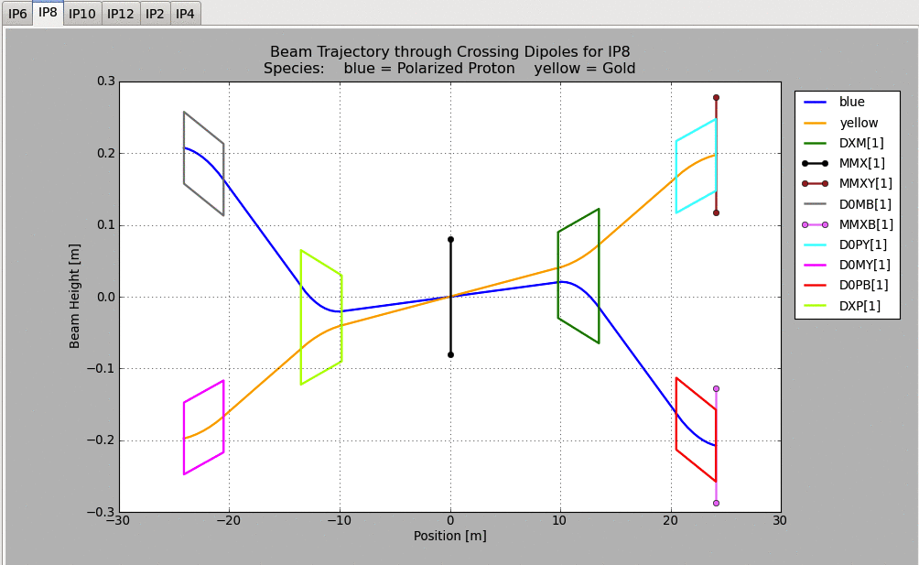
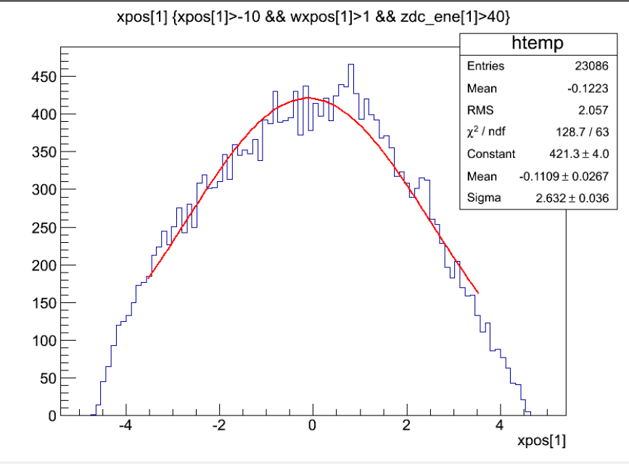
Local Polarimeter
p
ZDC
Analysis by Minjung Kim (SNU/RIKEN)
n
Blue beam angle : 1.66 mrad (3.6mrad in physics runs)
Angle btwn Blue and Yellow : 2mrad
6.5cm
Nicely centered!
3cm

Slide 32
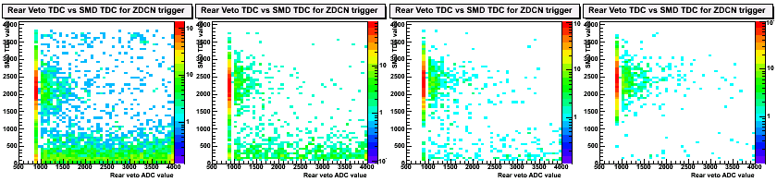
Dedicated runs
Neutrons from collision
1st Attempt (May 21st)
SMD TDC
SMD Channel from Left to Middle
Charged backgrounds from Yellow beam
Rear Veto ADC
2nd Attempt (June 5th)
SMD Channel from Left to Middle
Charged backgrounds are relatively smaller !!

Slide 33
Summary
Run 15 p+p was very successful, despite a delayed start with our new detector MPC-EX.
Run 15 p+Au was also successful, despite the loss of the MPC South early in the run and both MPCs later.
We took data from Run 15 p+Al, but without the MPC/EX physics.

