Slide 1
RHIC Electron Lens
Team: X. Gu, Z. Altinbas, E. Bajon, M. Bannon, E. Beebe, M. Blaskiewicz, I, Blackler, S. Binello, D. Bruno, M. Costanzo, W.C. Dawson, A.K. Drees, W. Fischer, D.M. Gassner, K. Hamdi, M. Harvey, J. Hock, K. Hock, P. Ingrassia, J. Jamilkowski, P. Kankiya, R. Lambiase, C. Liu, Y. Luo, M. Mapes, G. Marr, A. Marusic, K. Mernick, C. Mi, J. Mi, M. Minty, R. Michnoff, T.A. Miller, C. Montag, S. Nemesure, W. Ng, M. Okamura, R. H. Olsen, S.R. Plate, A.I. Pikin, D. Phillips, D. Raparia, P. J. Rosas, G. Robert-Demolaize T. Samms, P. Sampson, J. Sandberg, V. Schoefer, T. C. Shrey, A. Steszyn, Y. Tan, R. Than, C. Theisen, P. Thieberger, J. Tuozzolo, S.M. White, W. Zhang …
I am sure this is not a complete list, which should include all help from physics, (pulsed) power supply, control, instrumentation, vacuum, cryo, electrical, mechanical, EBIS and operation group.
Notes:
30 slides

Slide 2
Acknowledgements
Brookhaven National Laboratory
M. Anerella, M. Bai, C.D. Dawson, A.K. Drees, B. Frak, G. Ganetis, D.M. Gassner, R.C. Gupta, P. Joshi, K. Hock, L. Hoff, P. Kovach, R. Lambiase, K. Mirabella, M. Mapes, A. Marone, A. Marusic, K. Mernick, M. Minty, C. Montag, J. Muratore, S. Nemesure, S. Plate, G. Robert-Demolaize, L. Snydstrup, S. Tepikian, C.W. Theisen, J. Tuozzolo, P. Wanderer, W. Zhang
STAR and PHENIX experiments – supported e-lens commissioning
Institutions
FNAL: TEL experience, beam-beam experiments and simulations
US LARP: beam-beam simulation
CERN: beam-beam experiments and simulations
Individuals
H.-J. Kim, V. Shiltsev, T. Sen, G. Stancari, A. Valishev, G. Kuznezov, FNAL; G. Kuznezov, BINP; X. Buffat, R. DeMaria, J.-P. Koutchouk, T. Pieloni, F. Schmidt, F. Zimmermann, CERN; V. Kamerdzhiev, FZJ; A. Kabel, SLAC;
P. Goergen, TU Darmstadt

Slide 3
Outline
E-lens HBBC (Head-on beam-beam compensation) and UPP (Ultimate Performance Parameters)
E-lens commissioning (Progresses, Lessons and Achievements)
  2012 (Beam instability)
  2013 (Field and Field Measurement)
  2014 (Beam Profile)
E-lens Operation (2015)
  Electron Beam
  Emittance & Beam Loss
  Tune spread compensation
  Luminosity
  Resonance driving terms compensation

Slide 4
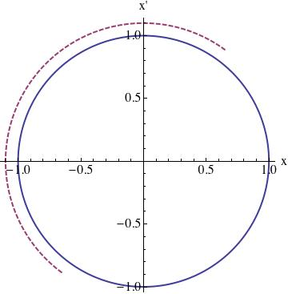
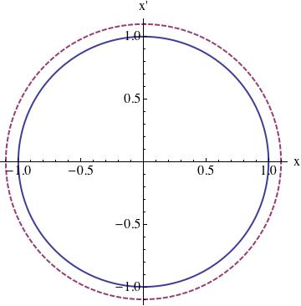
Head-on beam-beam compensation (Physics) Phase space
p-beam lens defocuses
e-beam lens focuses
Tune spread compensation
=> e-p has same amplitude dependent force as p-p
=> provided by electron lens
Resonance driving terms compensation
=> phase advance between p-p and e-p is Δψ = k π
=> provided by lattice (new lattice in 2015, based on ATS – S. White)

Slide 5
Ultimate Performance Parameters (e-lens project)
A minimum main solenoid field of 5 T with the completed magnet.
A maximum deviation of the main solenoid field lines from a straight line of ±50 mm after correction (measured in the final tunnel location, in both transverse planes, at a main field of 4 T, and over a range of at least ±800 mm)
A stable DC electron beam current of 0.9 A with a turn-to-turn current ripple of ≤0.1%
A Gaussian transverse beam profile as verified by at least one of the two installed profile monitors (either YAG screen or pin hole detector)
An increase in the average store luminosity by 60% in polarized proton operation with a beam energy of 100 GeV.

Slide 6
Outline
E-lens HBBC (Head-on beam-beam compensation) and UPP (Ultimate Performance Parameters)
E-lens commissioning (Progresses, Lessons and Achievements)
  2012 (Beam instability)
  2013 (Field and Field Measurement)
  2014 (Beam Profile)
E-lens Operation (2015)
  Electron Beam
  Emittance & Beam Loss
  Tune spread compensation
  Luminosity
  Resonance driving terms compensation

Slide 7
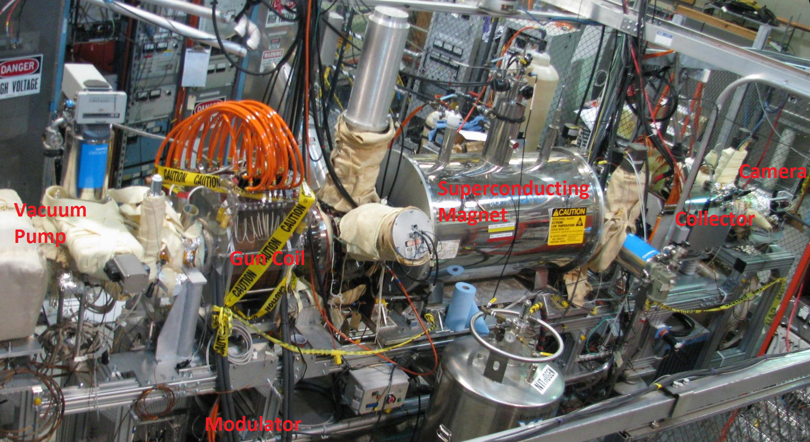
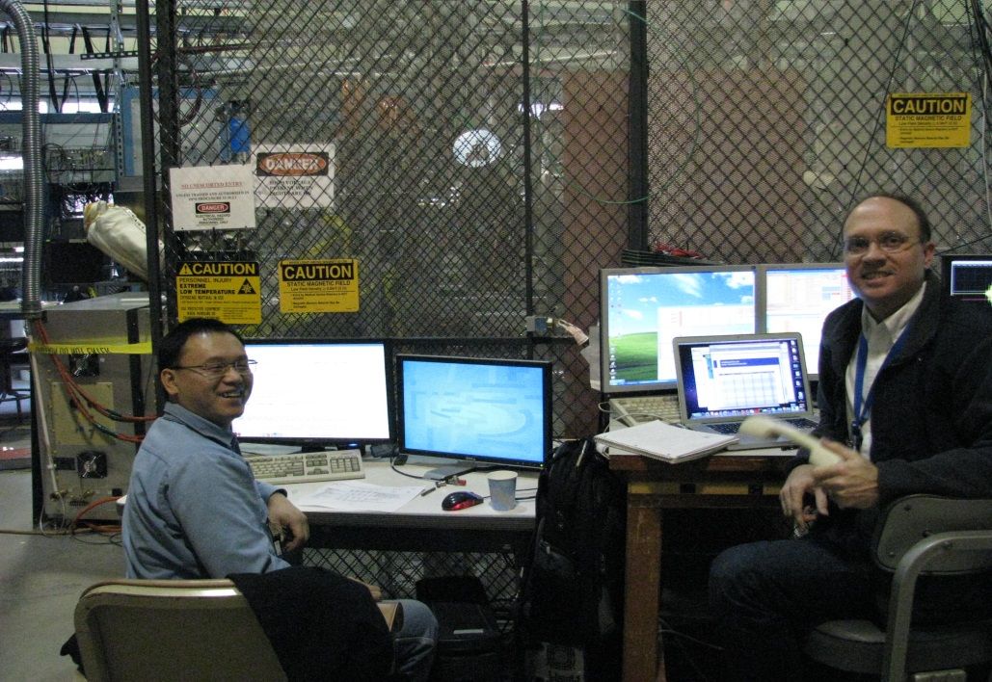
E-lenses 2012
E-gun & Collector
YAG & Pinhole, CTs
Cathode heater PS
Pulse and DC beam (1A)
Profile
Modulator
MPS
Timing
Cathode and PS Protection
YAG Screen Protection
Gun Assembling

Slide 8
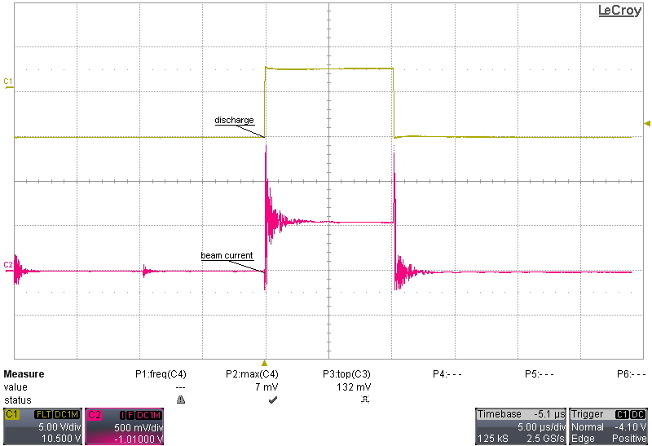
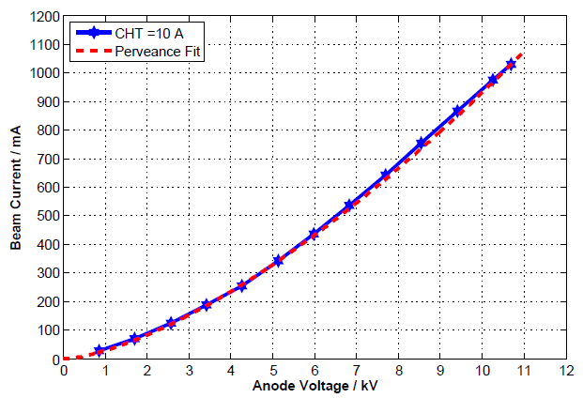
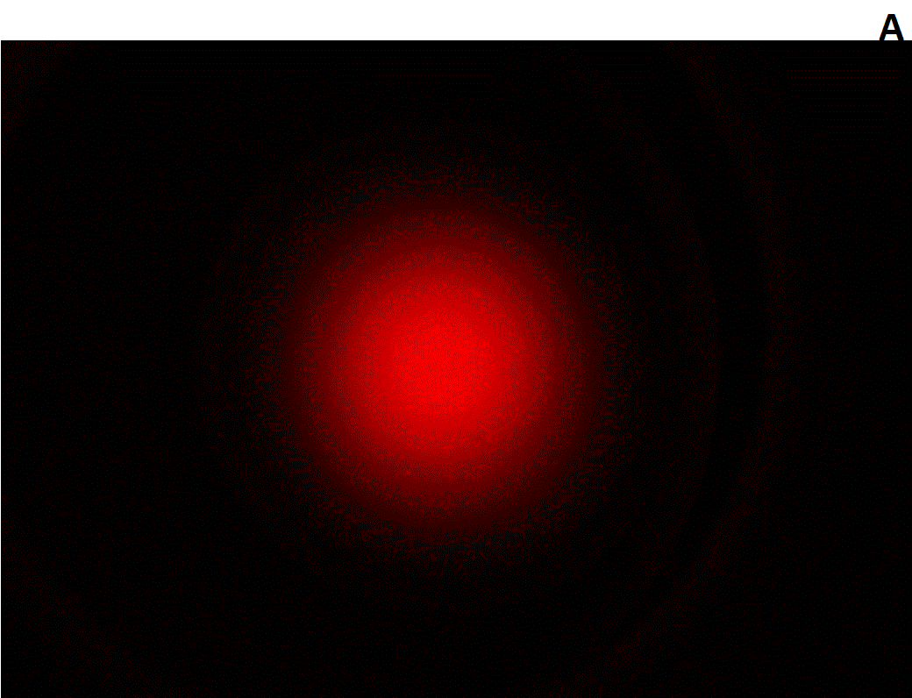
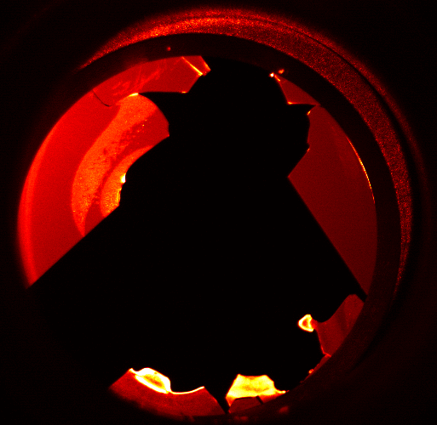
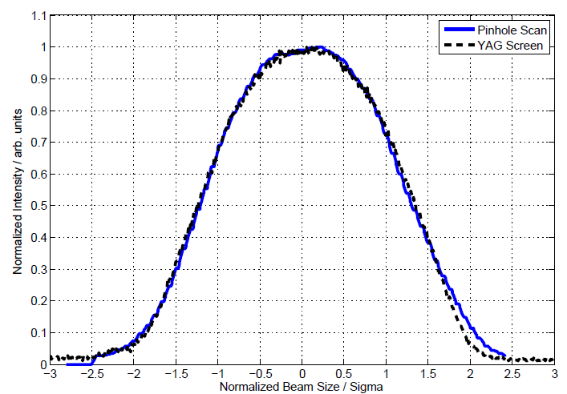
E-lenses 2012

Slide 9
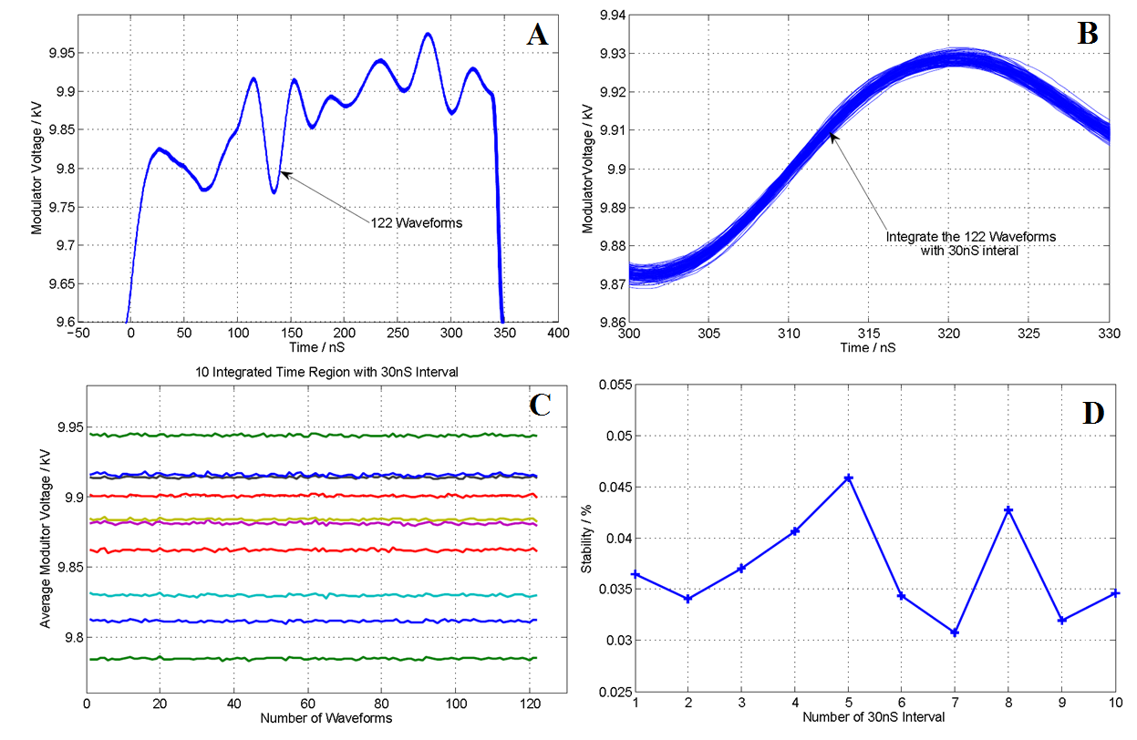
UPP (3) - demonstrated
3) A stable DC electron beam current of 0.9 A with a turn-to-turn ripple of ≤0.1%
Ripple is less than 0.075%;
Measured anode voltage via 78 kHz pulse mode, which the pulse itself has more noise than DC;
Took 122 waveforms. Each waveform is divided to 10 intervals with 30 ns length;
Average each 122 waveforms for these ten intervals; The total force seen from e-beam;
Change voltage ripple to current ripples with 1.5 times;
Current is 950 mA
30 ns length

Slide 10
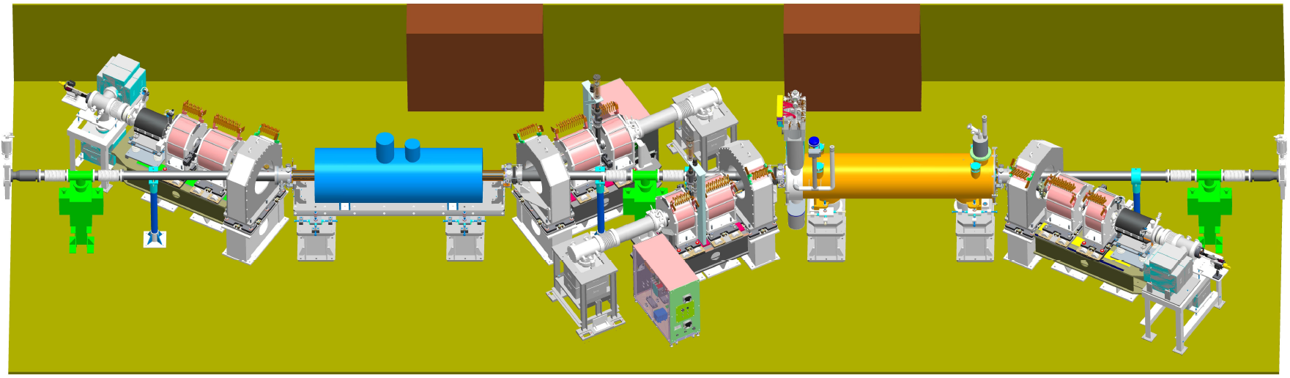
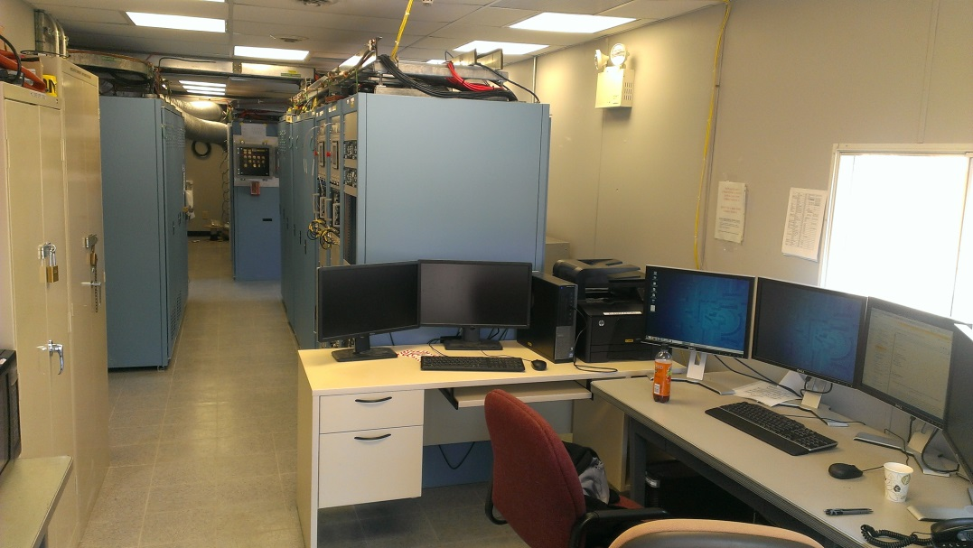
E-lenses 2013
Tested With Beam
Horizontal Test
EBIS Spare
SOLENOID 1
Warm Solenoids and PS
Magnets and Field measurement
Proton Beam Orbit
Lattice
HV Power supplies (Blue)
Field Measurement (Laser and Crystal)
Collector PS trip

Slide 11
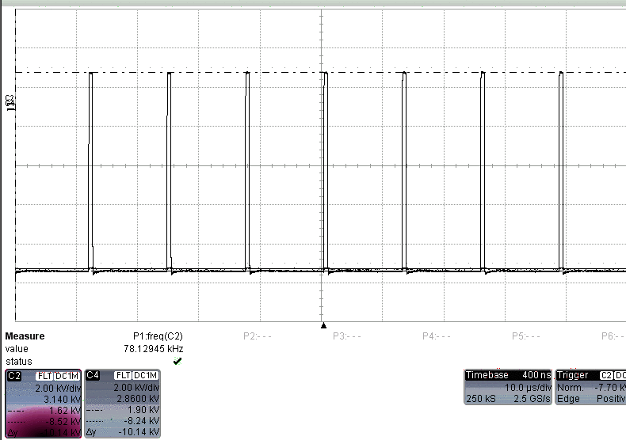
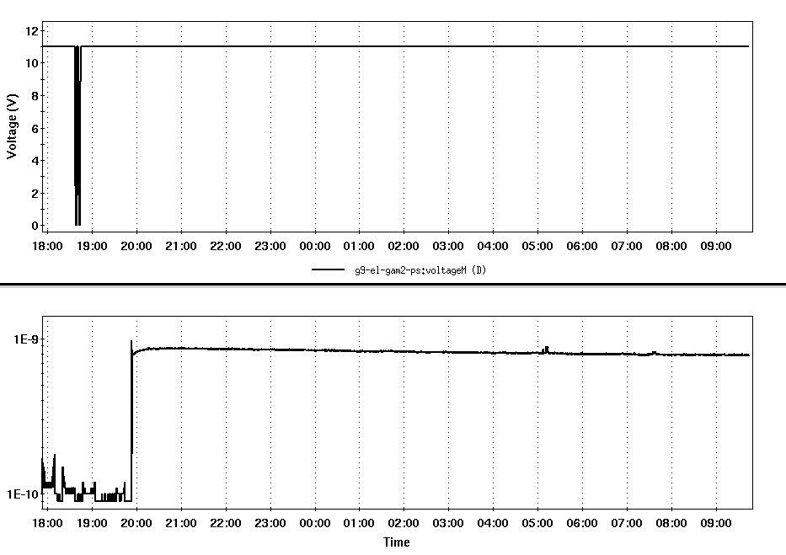
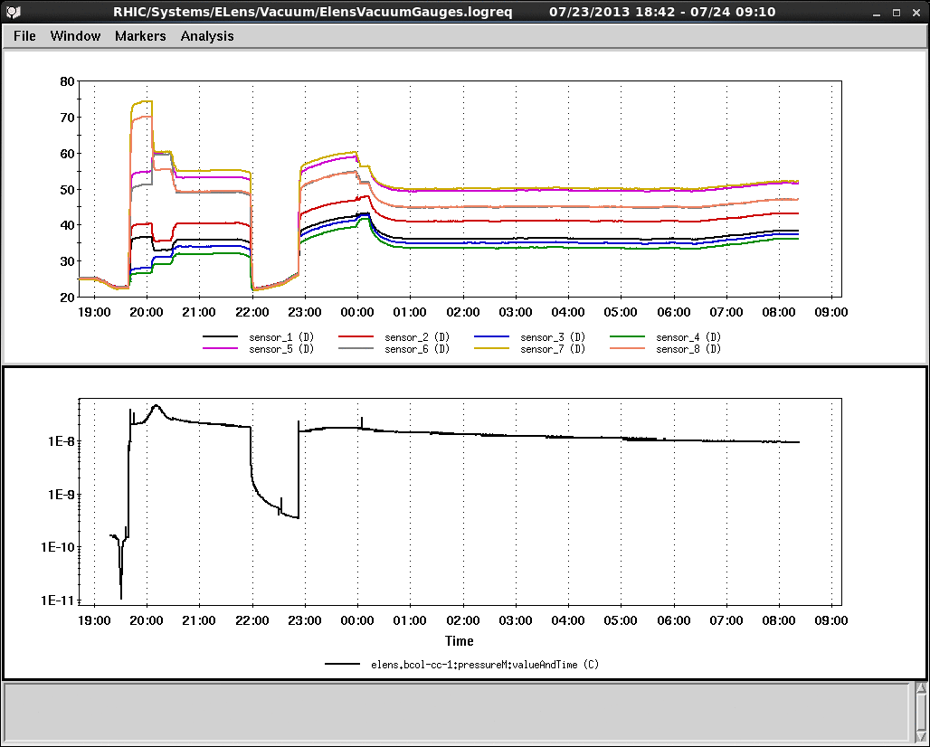
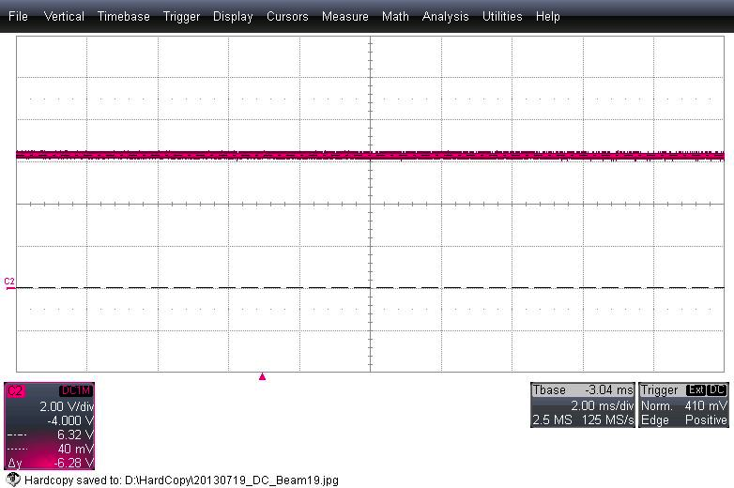
Parasitic and DC mode
Anode Voltage
78k Hz beam = 1A (1014V).
14 hours
Collector Temperature
Vacuum in Collector
Vacuum
9.5 hours
DC beam = 1.256 A (6.28V * 0.2A/V)

Slide 12
UPP (2) Blue horizontal - demonstrated
2) A maximum ±50 μm deviation of the main solenoid field lines within ±800 mm
Tolerance ± 50 μm
Three different fields
±1000 mm good field
Without correction
With warm magnets

Slide 13
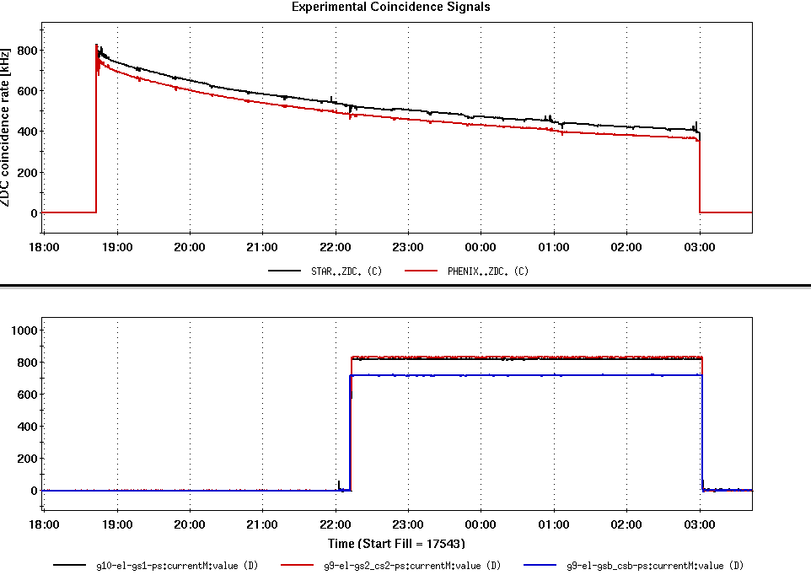
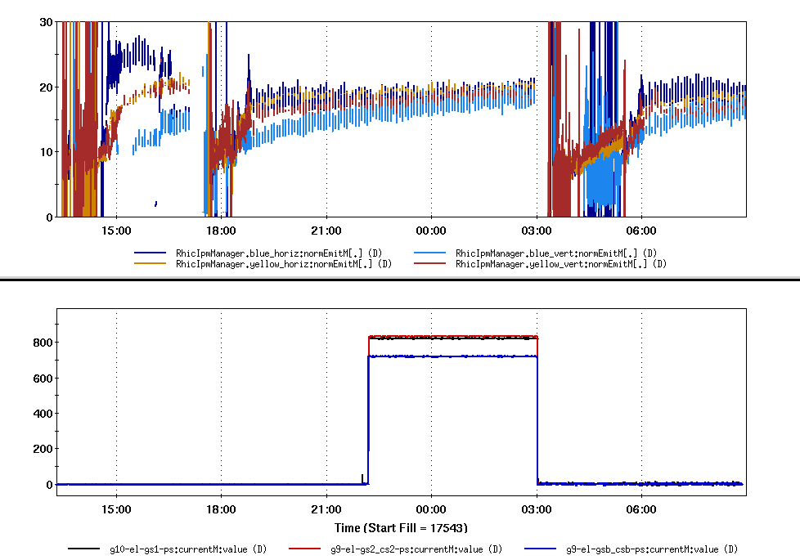
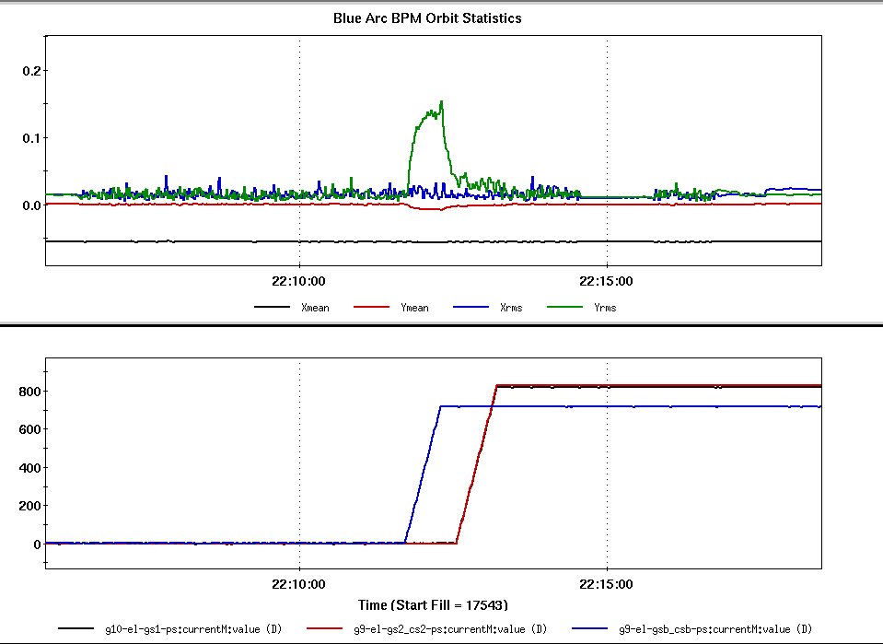
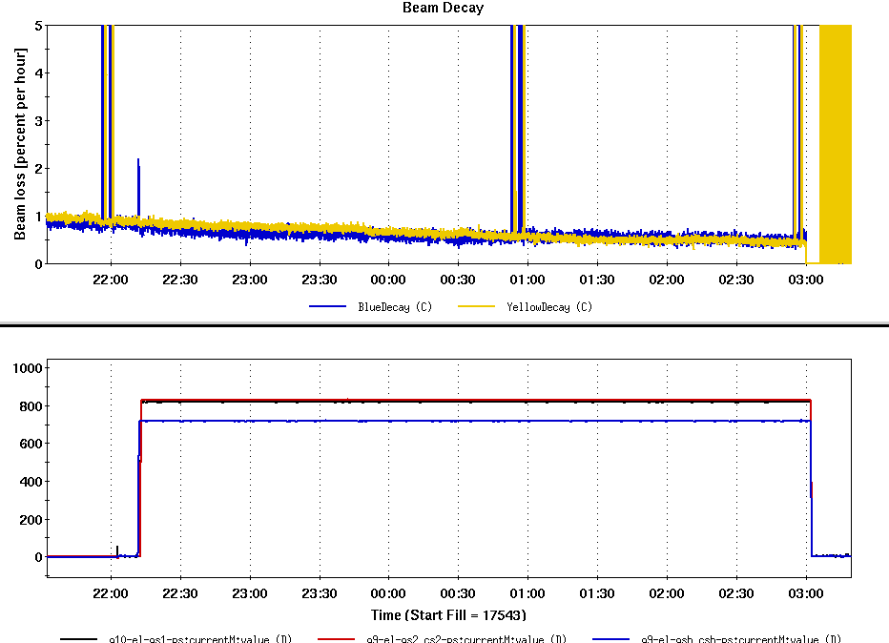
E-lens Warm Magnets & Proton Store
ZDC Signal
Emittance
E-lens Magnets
E-lens Magnets
Orbit
Beam Loss
E-lens Magnets
E-lens Magnets
Some effects on Y-orbit with warm magnets.
Didn’t find visible effects on beam with orbit feedback on.
No effects with tune & orbit feedback with 0.6T solenoid #1 and 3T EBIS spare.

Slide 14
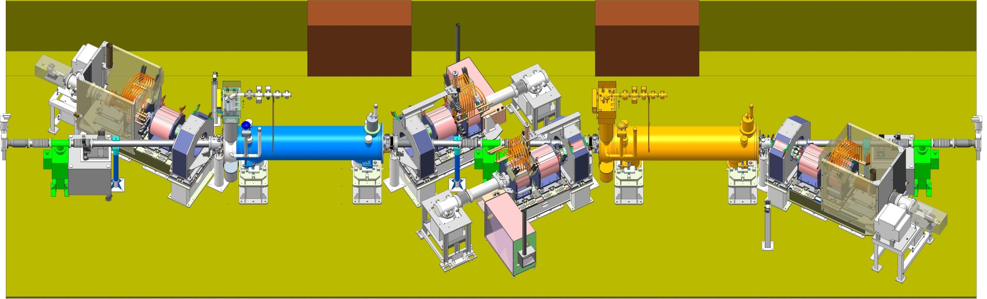
E-lenses 2014
All Magnets & All PSs (B & Y)
Parasitic with Ion Beam
Alignment (BPMs, eBSD, Drift tubes, Lisa)
Synoptic display
APEX (BB Instability, tune, emittance growth)
Documentation
Parasitic mode and E-cloud
Blue eBSD was melted
Blue YAG screen
Blue BPM2
Current between anode and cathode

Slide 15
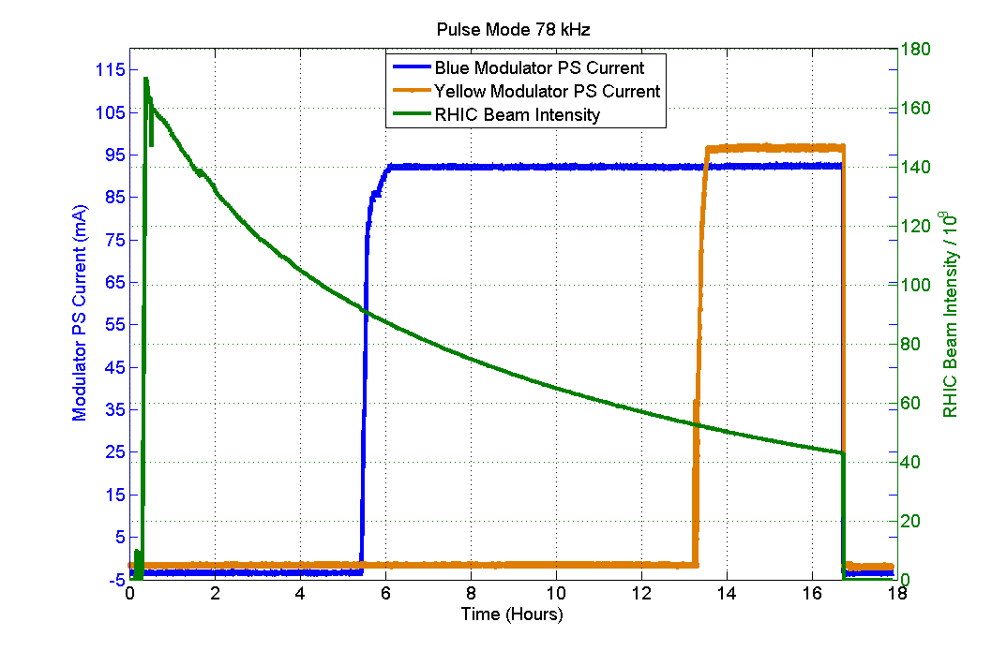
E-lenses 2014 -- Parasitic Mode
Modulator current indicates 78 kHz is running.
Blue and Yellow were running 78 kHz pulse mode with 1A simultaneously within RHIC beam abort gap;
Parasitic to RHIC beam provides more commissioning time;
Blue e-lens 78 kHz was running for 14 hours during 2013;
Blue 78 kHz 1A electron beam
Yellow 78 kHz 1A electron beam
RHIC ion beam

Slide 16
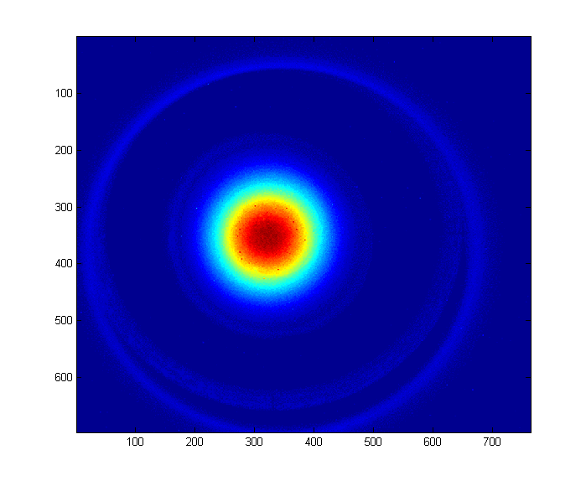
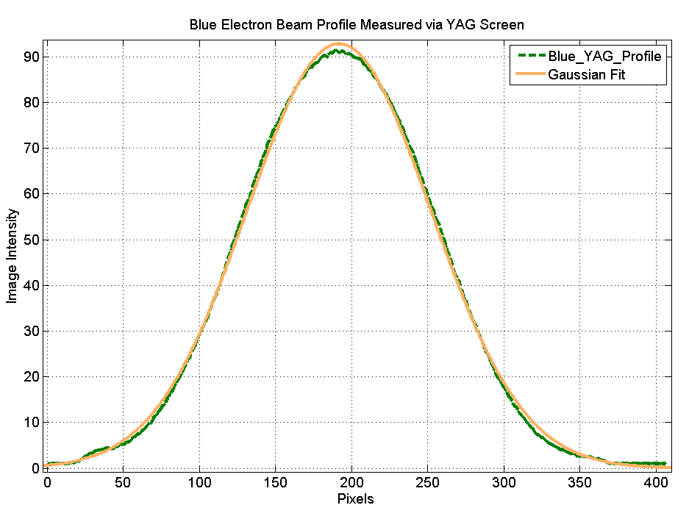
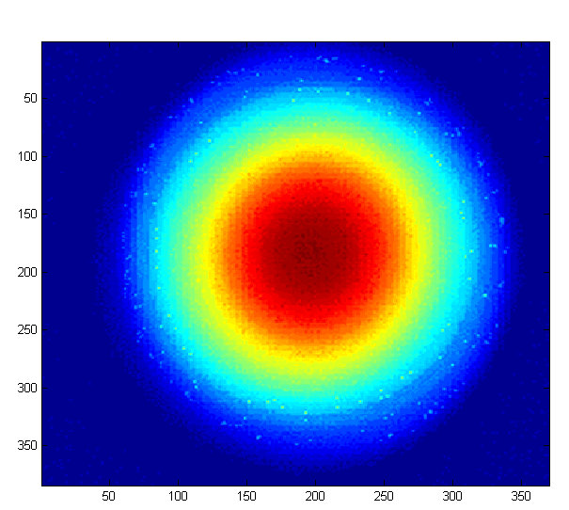
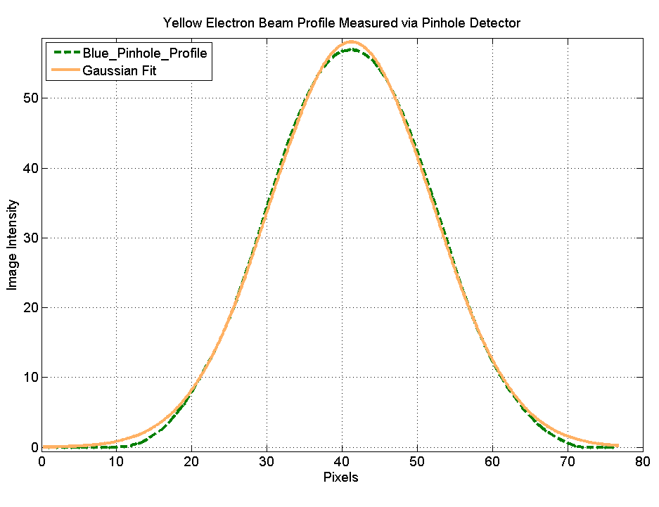
UPP (4) Blue Gaussian Profile -- demonstrated
4) A Gaussian transverse beam profile as verified with one of detectors
Current 70 mA
Beam profile from YAG is a Gaussian
Profile does not change with current
Current 1150 mA.
Pinhole profile is
Gaussian
YAG screen
Pinhole Detector

Slide 17
E-lenses 2014 -- Transverse Alignment
BPMs in both lenses to bring e- and A- beam in proximity (transverse electron beam position for blue and yellow, electron beam angle steering for yellow)
1) BPMs and electron beam; 2) BPMs and ion; 3) eBSD and ion beam;\
backscattered electron detector to maximize overlap
P. Thieberger, BIW12, IBIC2014
BPMs, E-beam, E-lens
eBSD, ion beam and Lisa

Slide 18
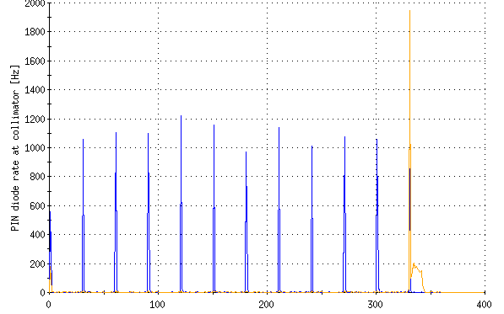
Electron Beam – Beam-beam driven instabilities
Last bunch only
Field from 3T to 1T;
Beam is stable;
Will re-do it again if it is possible.
Notes:
Test on 05/07/2014

Slide 19
Outline
E-lens HBBC (Head-on beam-beam compensation) and UPP (Ultimate Performance Parameters)
E-lens commissioning (Progresses, Lessons and Achievements)
  2012 (Beam instability)
  2013 (Field and Field Measurement)
  2014 (Beam Profile)
E-lens Operation (2015)
  Electron Beam
  Emittance & Beam Loss
  Tune spread compensation
  Luminosity
  Resonance driving terms compensation

Slide 20
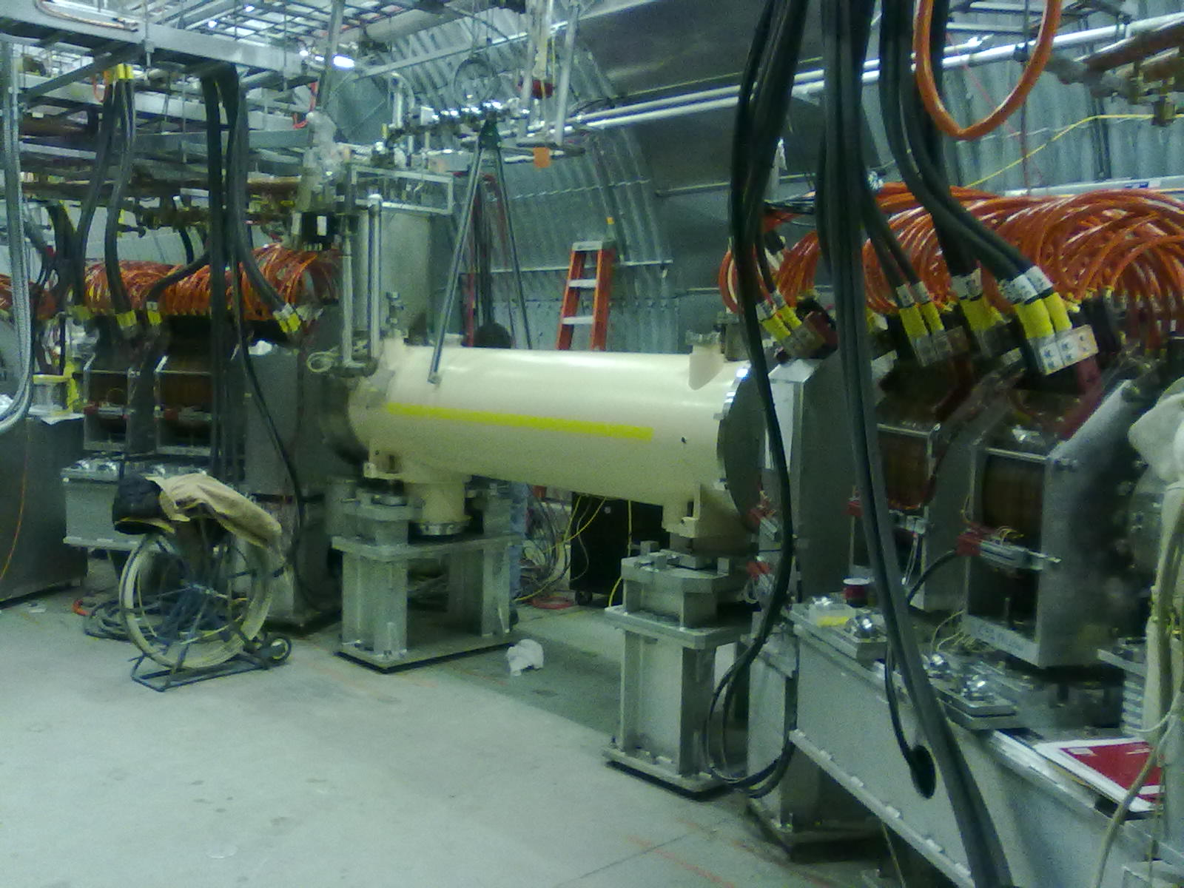
E-lenses 2015
New larger cathode and PS
New Lattice based on ATS optics
RHIC Operation e-lens compensation (first)
Reached 6T field for both B&Y
APEX (tune shift, tune compensation, emittance)

Slide 21
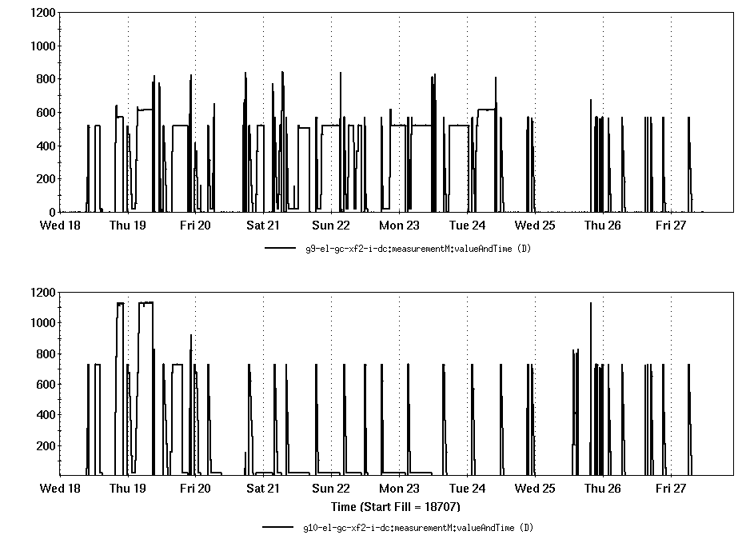
Electron beam current
Blue e-beam current - DC 600 (400) mA
Yellow e-beam current – DC 1100 (700) mA
With the pulsed mode, both blue and yellow electron currents can reach 1 A.
For a DC beam, the yellow e-lens can reach 1.1 A.

Slide 22
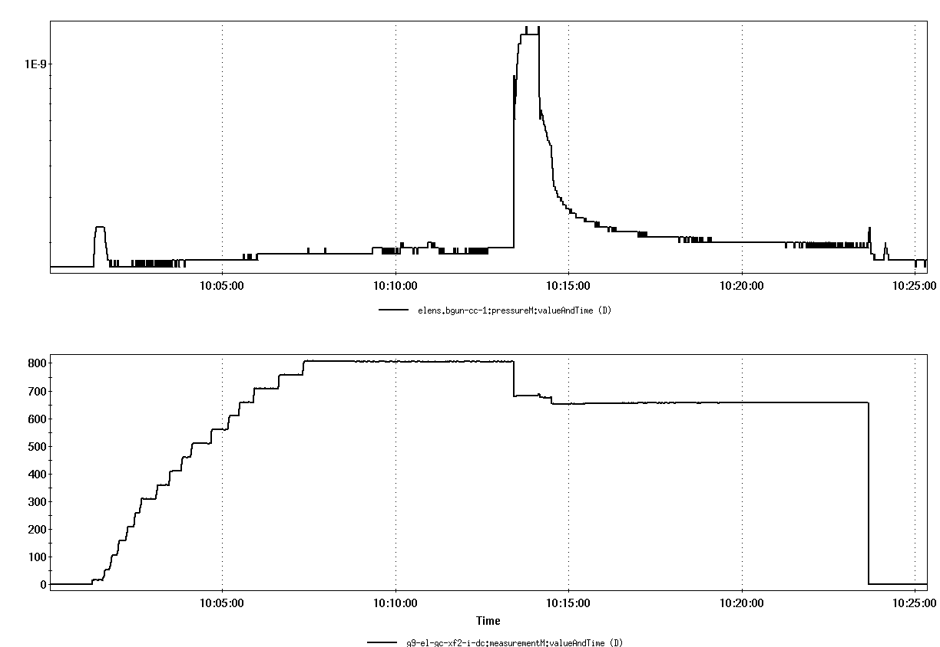
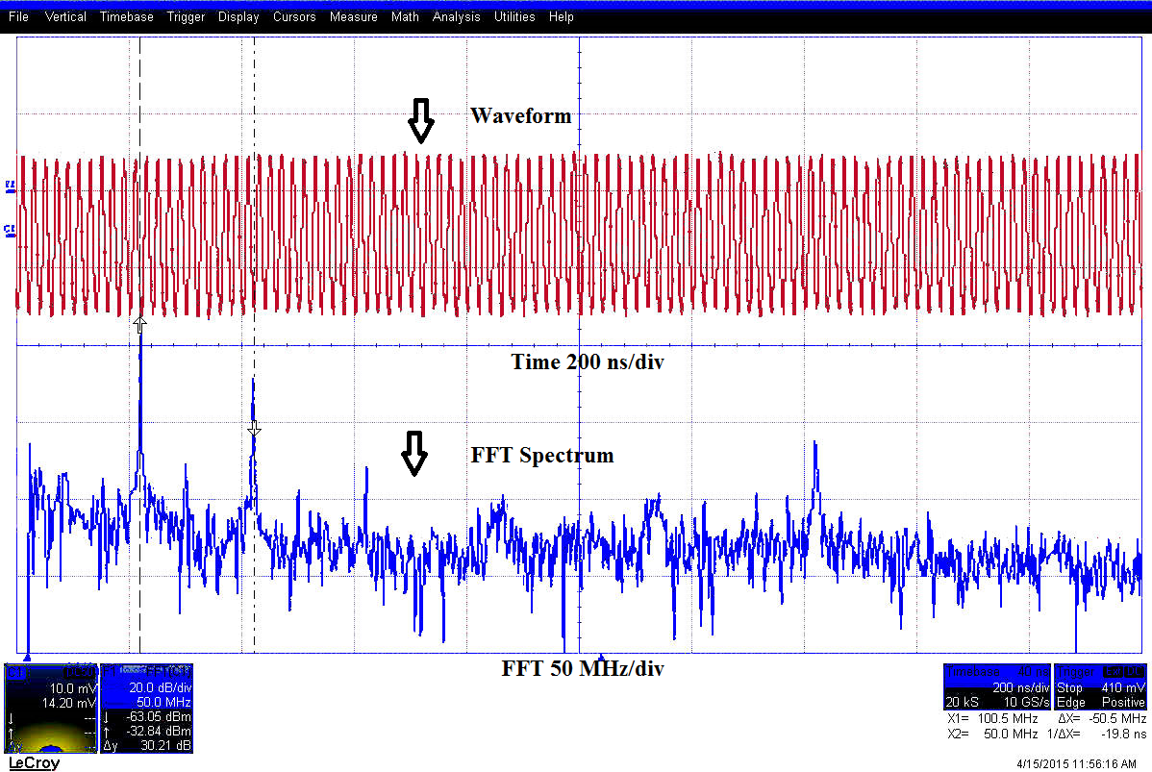
Blue e-beam current instability with ~800 mA
Phenomenon:
E-beam current dropped
Can cause beam loss even with 5 mm separation
Can be impressed via higher collector voltage
Didn’t happened with 1A during p-Al for a short while.
Reasons:
Reflected electron beam from collector (30 mm vs 22 mm ID)
Ion accumulation (ion collector transmitter failures)
Cathode/gun and collector contamination (high-pot vacuum spikes).
Blue gun vacuum
Blue e-beam current

Slide 23
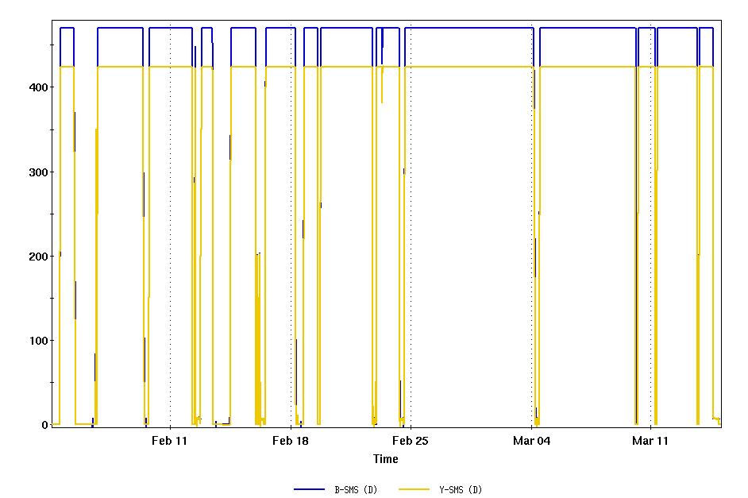
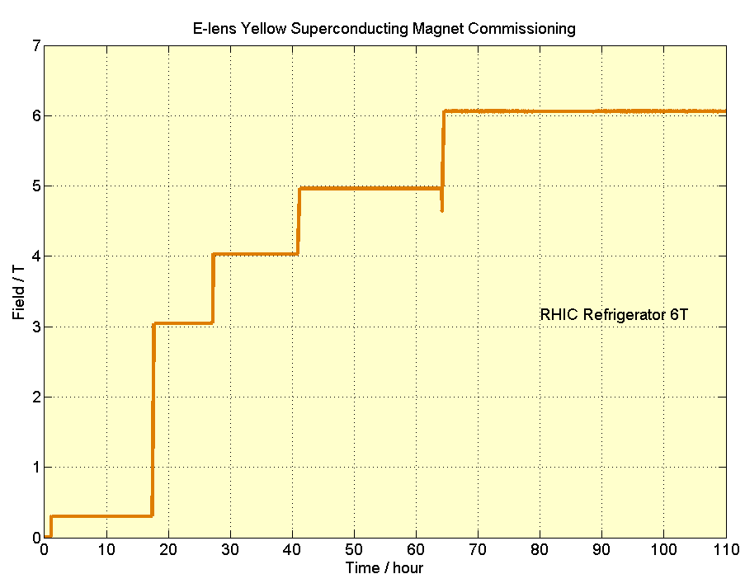
UPP (1) 6T field- demonstrated
A minimum main solenoid field of 6 T with the completed magnet.
Yellow and Blue Solenoid 6T with RHIC refrigerator;
Yellow solenoid is the second solenoid; it has better performance than the first solenoid which is the blue one.
Ramp up with 0.2A/s to 5T, ramp up with 0.1A/s from 5T to 6T
Blue was ~5T last year

Slide 24
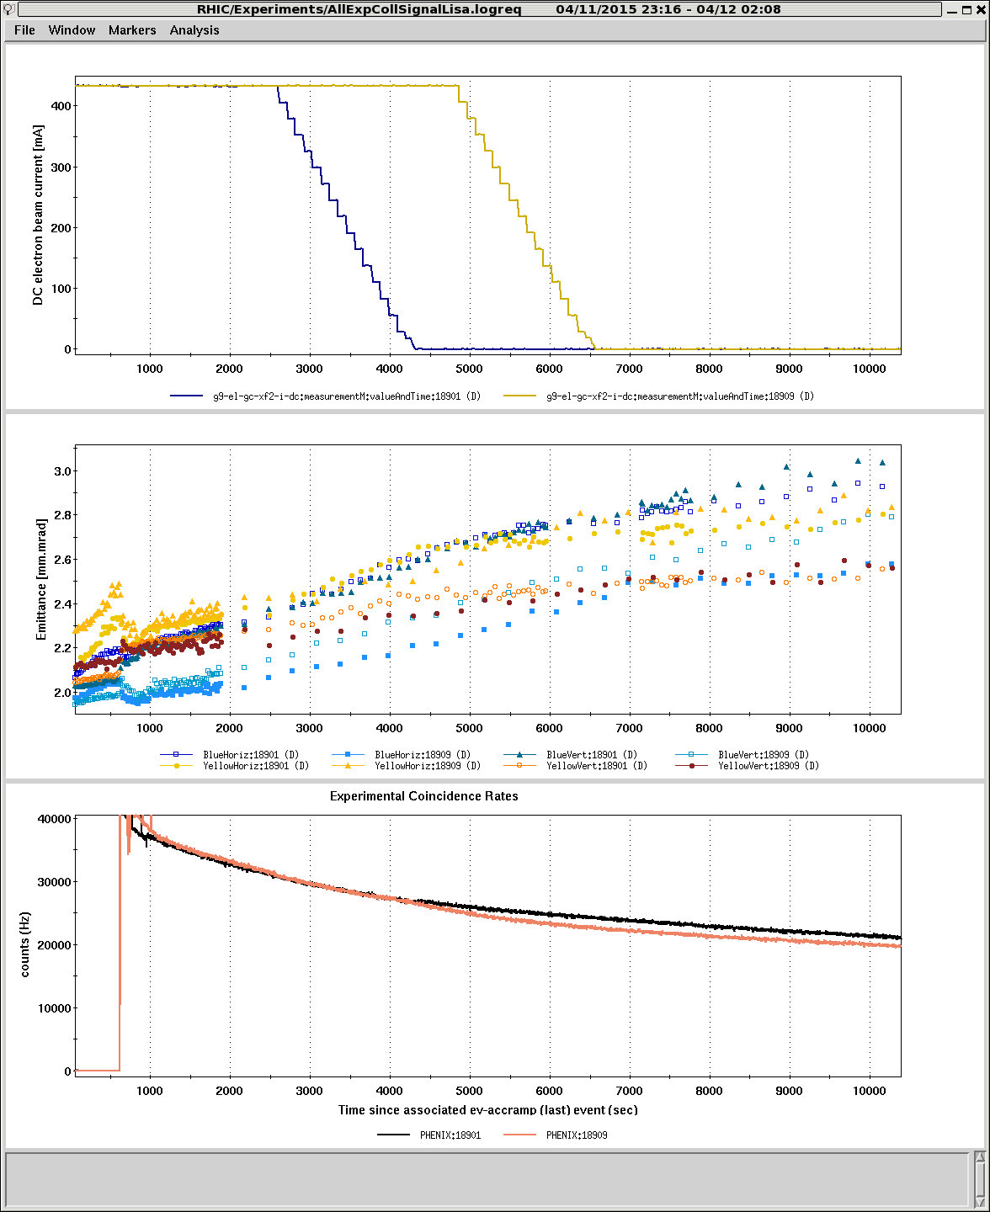
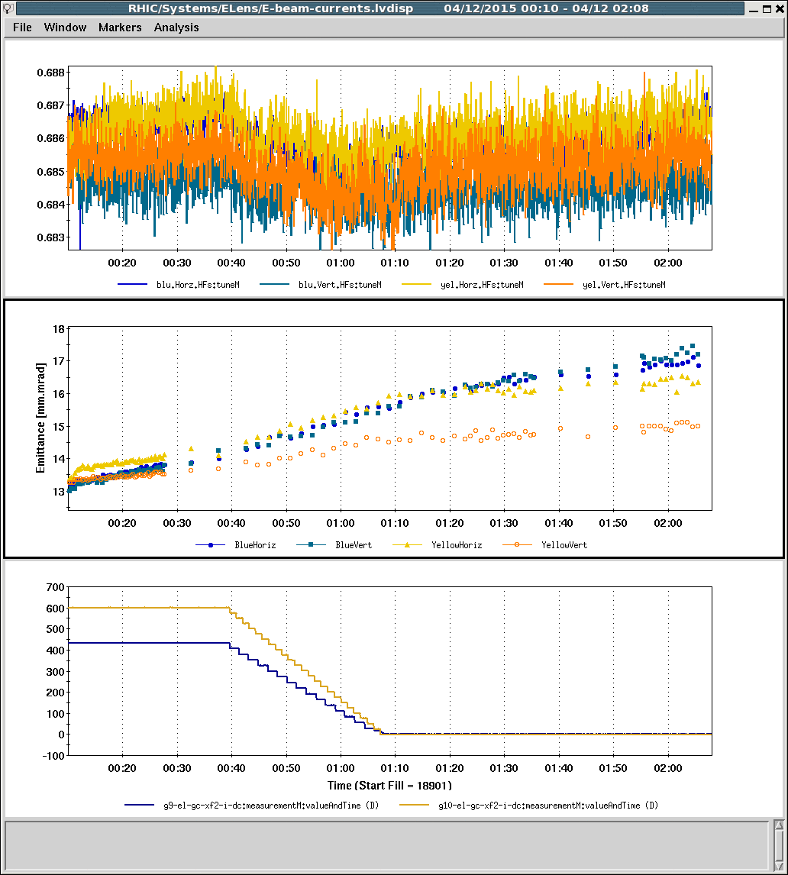
RHIC Operation with E-lens
E-beam current
Tune
Emittance (IPM)
Emittance (IPM)
E-beam current
Intensity
Turned on for every store (45~60 min.)
High reliability: available for all stores after running

Slide 25
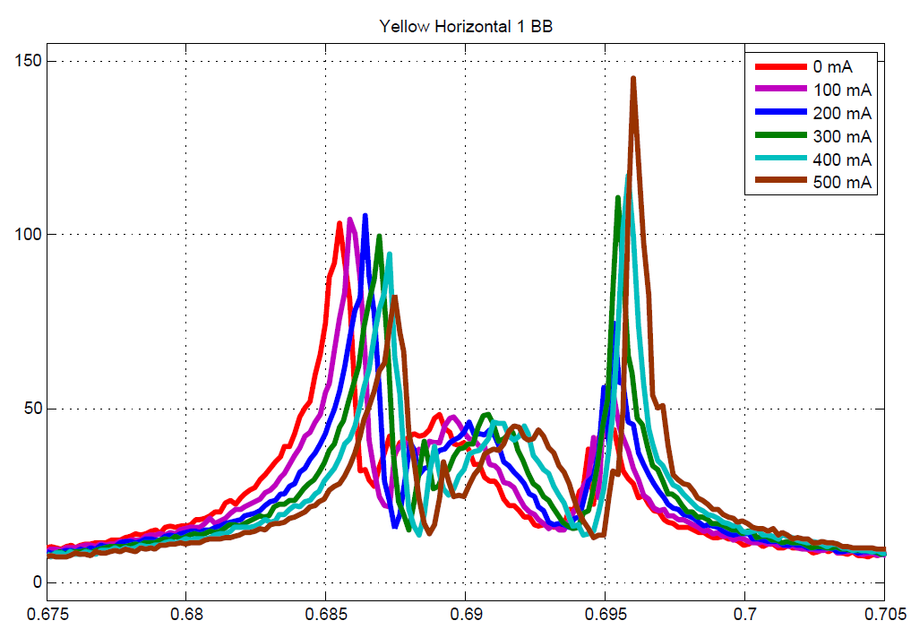

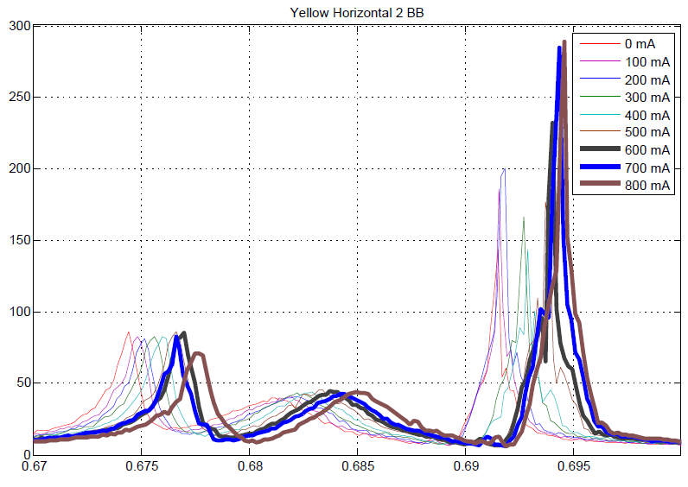

RHIC BTF with coherent modes for PP collision
Coherent
σ- and π-modes
in all BTF
(amplitude response)
Prevent extraction
of incoherent
tune spread
(imaginary part of
complex BTF)

Slide 26
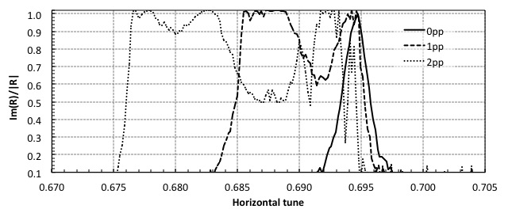
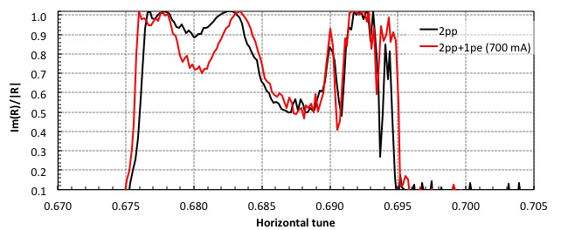
Tune spread with 0, 1, 2 pp collisions, + e-lens
⬅ 0, 1, 2 pp
without
e-lens
ΔQ = 0.024 given by σ- and π-modes
⬅ 2 pp
without
and with
e-lens
change due to e-lens but
incoherent distribution
cannot be determined

Slide 27
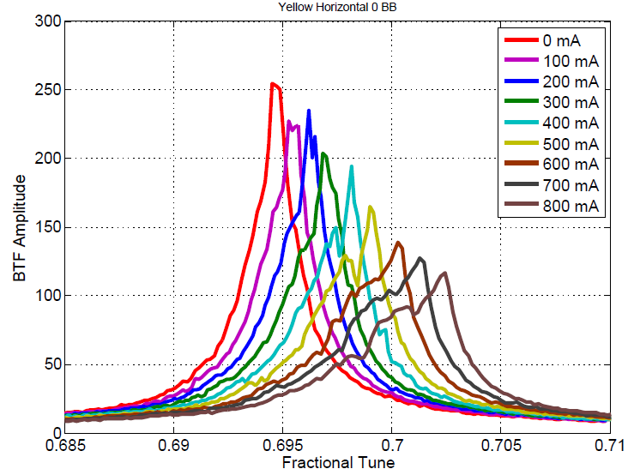
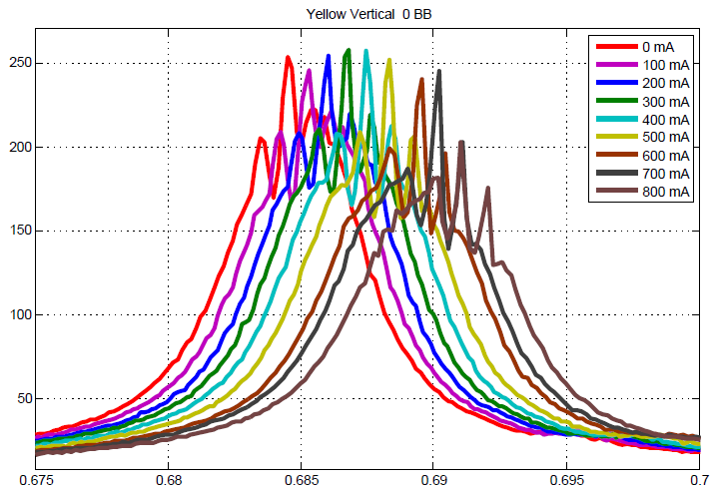
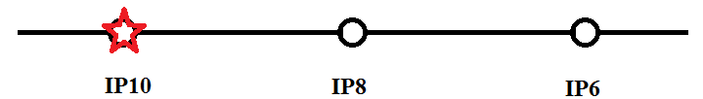
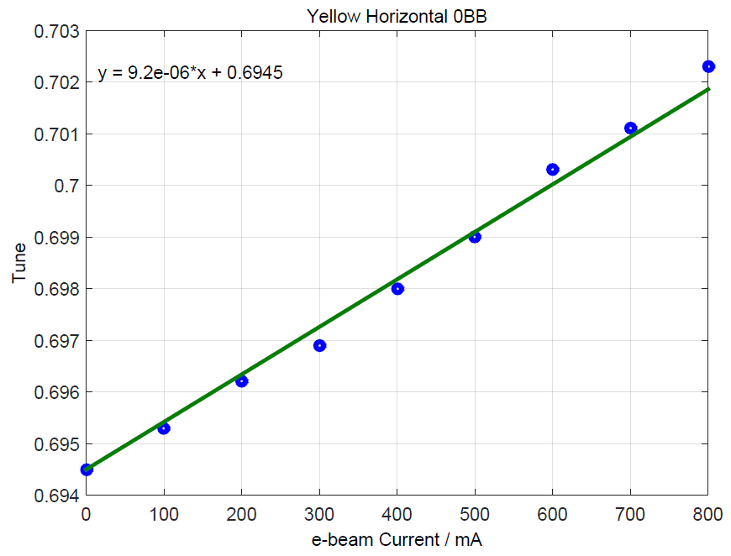
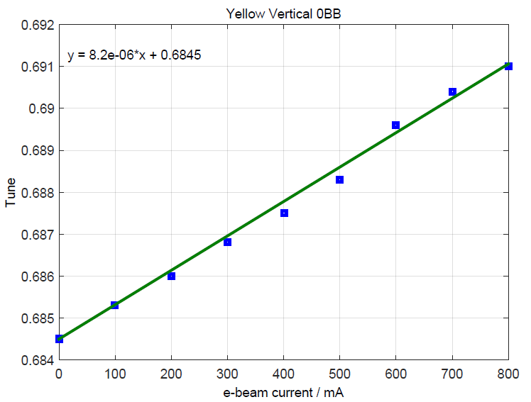
Tune spread and tune shift with 0BB from e-lens (PP run)
Y&H 0BB
Y&V 0BB
Linear Tune Shift vs Current
Linear Tune Shift vs Current

Slide 28
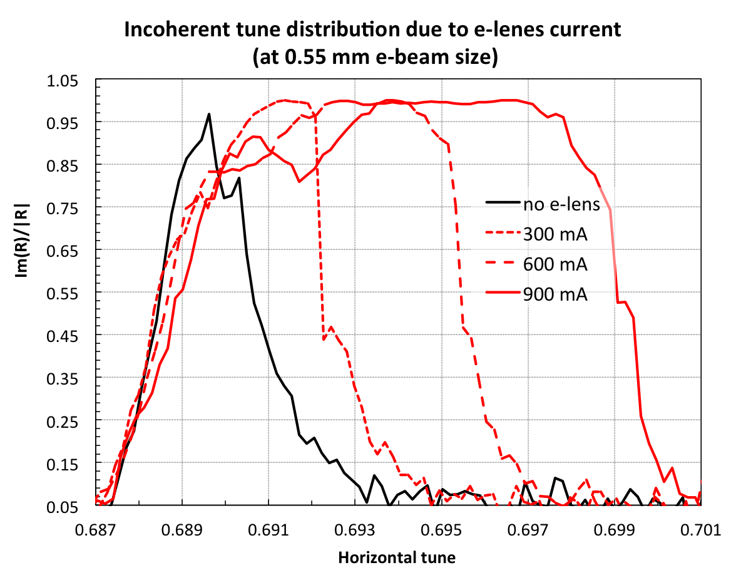
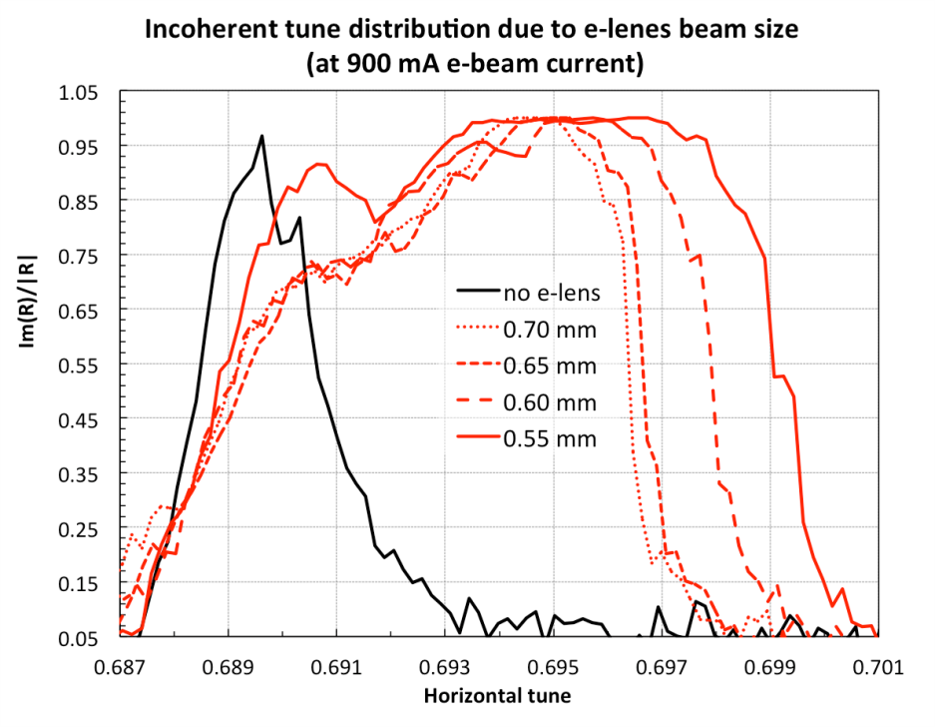
Tune spread Compensation with 0BB from e-lens (PP run)
e-p collision, no p-p
Incoherent tune vs e-beam current
Incoherent tune vs e-beam size
e-lens creates as much ΔQ = 0.013 as one beam-beam collision
ΔQ = 0.013

Slide 29
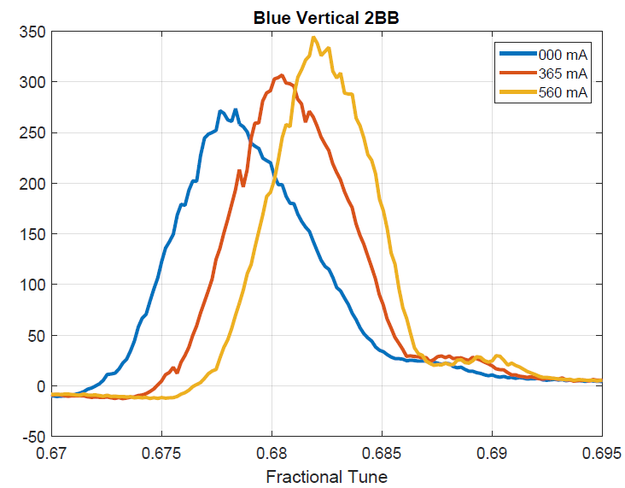
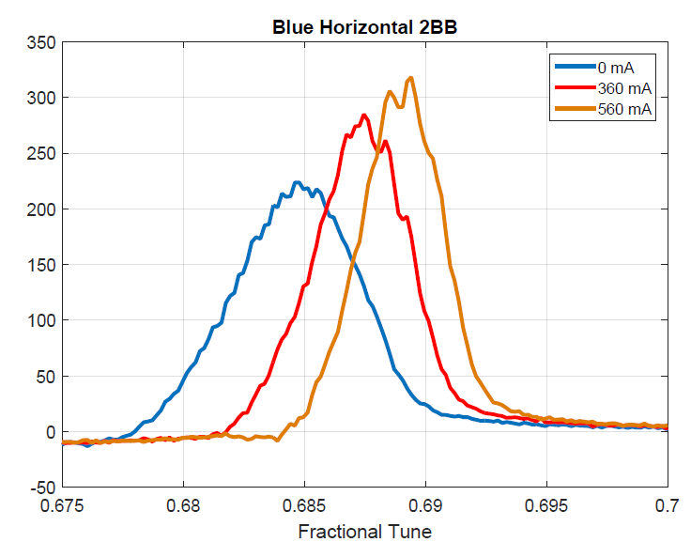
Tune spread compensation with 2BB from e-lens P-Al
1 e-p p-Al p-Al
2 No Coherent Mode
3 Incoherent tune spread compensation

Slide 30
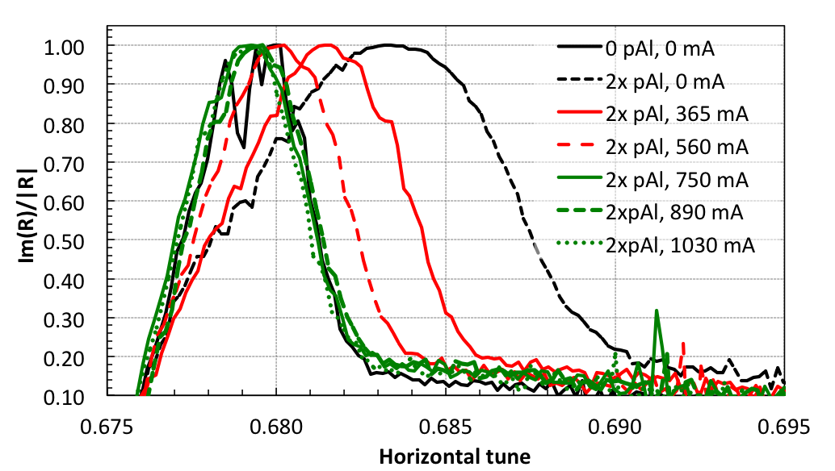
HBBC (1) Tune spread compensation - demonstrated
tune spread without bb and without e-lens
2. tune spread expands with bb
3. tune spread contracts again with bb and e-lens, but only up to ~750 mA (first such direct observation)
4. tune spread is only compressed to the value without bb, even with e-currents up to 1030 mA

Slide 31
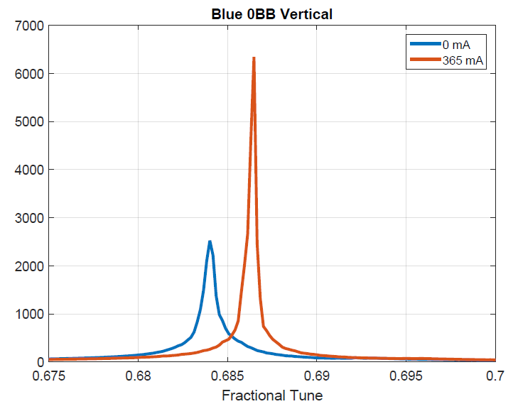

Tune spread – One Mystery
Y&V 0BB
Y&H 0BB
B&V 0BB
B&H 0BB

Slide 32


Additional emittance growth from e-lens
No visible additional emittance growth for 400mA
Additional emittane growth with 700mA
current noise threshold or optimize machine ?
1. with optimal e-p alignment: perform tune scans with/without e-lenses - first diagonal, then 2D -may be that will show that you have bigger WP space with elenses ?
2: study later in stores (say, 5-6 hrs in stores, for some 1-2 hours): see emittance growth with only one lens ON (B , then in another store -Yellow)
3. possible operational studies over many stores (in packs of 7-10 stores): full e-currents in B and Y; 1/2 currents in B and Y, no elenses- correct tunes all the times.

Slide 33



E-lenses 2015
linear tune comes with incoherent tune compensation
Tune during bump collapse (H_IP10 vs V_IP6&8);
More current for blue and more store for tune setup?
Beam size and beam loss;

Slide 34
100 GeV pp stores in 2012 and 2015 (typical good)
2012
2015
300
12
intensity
bb parameter +50%
4
5
rms emittance
140
peak luminosity +120%
[2012: 9 pb⁻¹/week 2015: 25 pb⁻¹/week]

Slide 35

Max beam-beam parameter with and w/o e-lens in operation

Slide 36


Towards to Resonance driving terms compensation
Can’t measure it directly
Need simulation ?
Second Order Chrom;
Blue: slight improvement
Yellow: significant improvement (H)
Phase advance between IP8 and IP10:
Model: (176, 184)
Measurement 1: (177, 187)
Measurement 2: (183, 185)

Slide 37

Summary – progress towards demonstrating HBBC
Head-on beam-beam compensation scheme in operation in 2015,
consisting of new lattice (RDT compensation) + e-lenses (DQ compensation)
L_{peak} +150% L_{avg} +90% => demonstrated
Beam-beam tune spread compensation without additional emittance growth (<400mA), and small additional loss rate (1−2%/h) => demonstrated
3) Resonance driving terms compensation ? => TBD
4) Higher ξ/IP possible, presently constrained by injectors
(potential for ~2× L in future runs) => demonstrated
More studies for emittance growth with high current (2017)
=> TBD

Slide 38
Summary – progress towards demonstrating UPPs
A minimum main solenoid field of 6 T with the completed magnet.
=> demonstrated in Blue and Yellow with RHIC refrigerator
A maximum deviation of the main solenoid field lines from a straight line of ±50 mm after correction (measured in the final tunnel location, in both transverse planes,
at a main field of 4 T, and over a range of at least ±800 mm)
=> demonstrated in Blue and Yellow, hor and ver
A stable DC electron beam current of 0.9 A with a turn-to-turn current
ripple of ≤0.1%
=> demonstrated
A Gaussian transverse beam profile as verified by at least one of the two installed profile monitors (either YAG screen or pin hole detector)
=> demonstrated with YAG screen and pin hole detector
An increase in the average store luminosity by 60% in polarized proton operation with a beam energy of 100 GeV.
=> demonstrated in Run-15

Slide 39
E-lens Future Plan
2D tune footprint
Emittance growth study
Beam Loss during bump collapse
Transverse instability (1T field, with 250 GeV)
Any 100 or 250 GeV asymetery run with proton beam
Space charge compensation ?
More … ?

