Slide 1
Simulating spin polarized electron beam production
Ambar C. Rodríguez Alicea, Physics, University of Puerto Rico, Mayaguez, PR 00680
July 1st, 2021

Slide 2
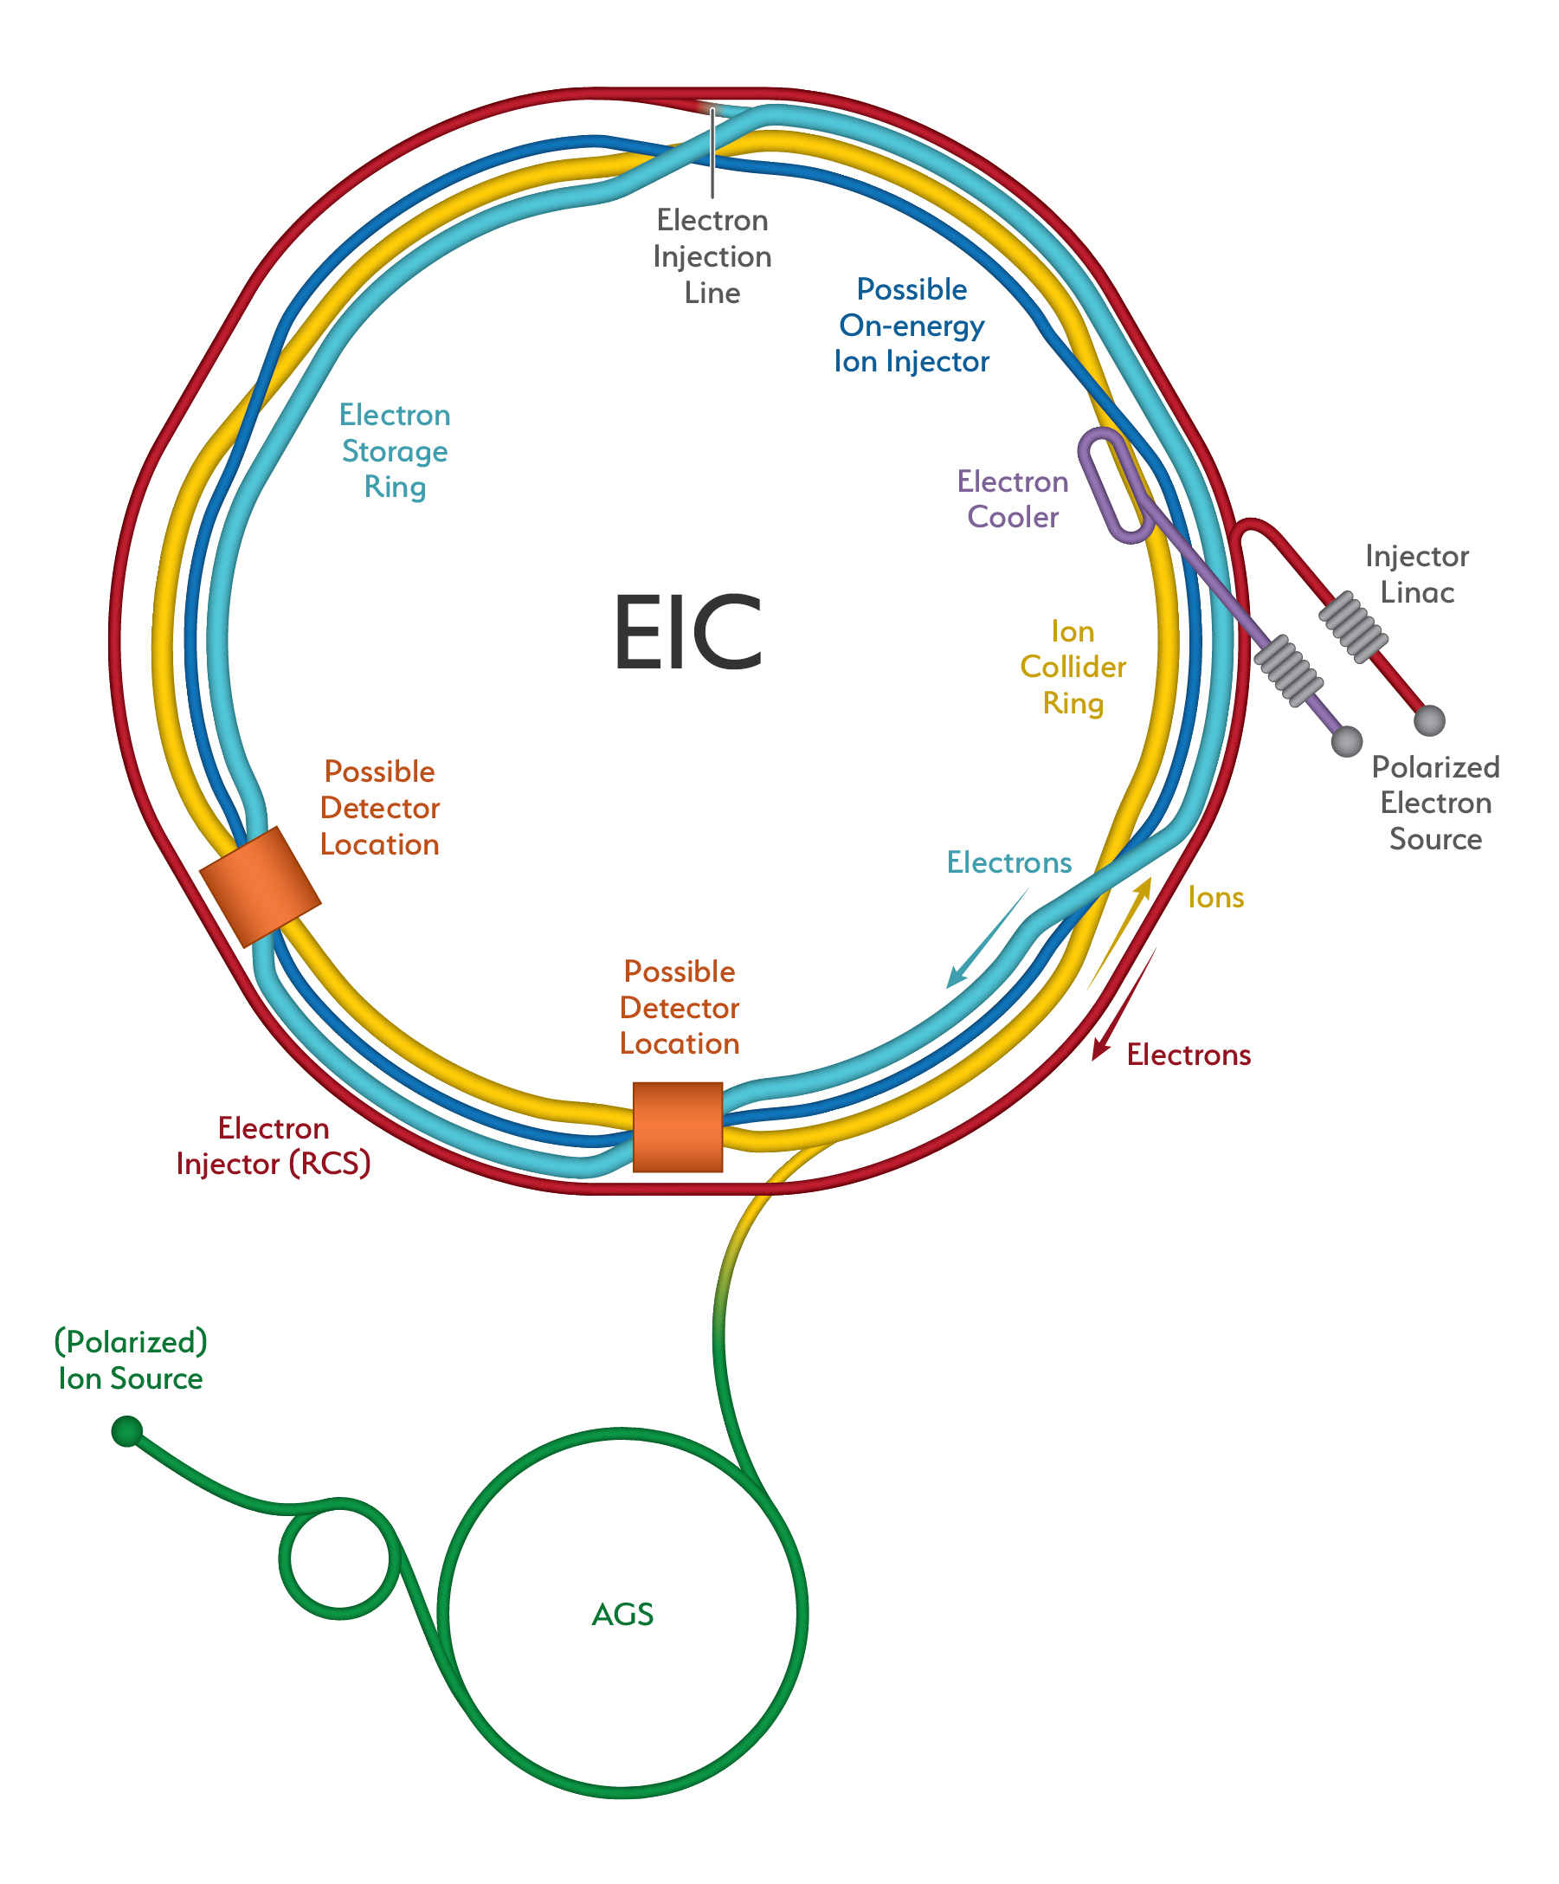
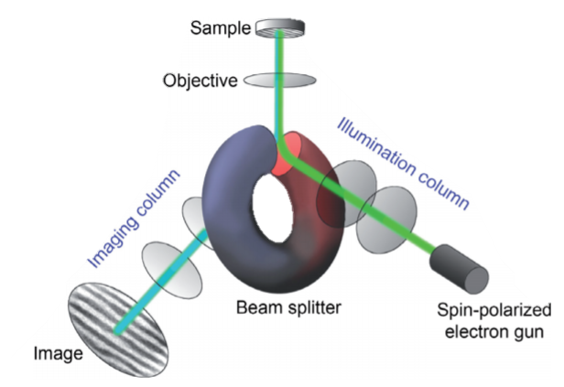
Electron spin polarization applications
Electron beams uses include:
  Research
  Medical therapy
  X-ray imaging
  Electron microscopes
  Surface treatment
Polarized electrons are needed for research in accelerator facilities and some microscopies.
  This type of beam production is only possible using GaAs based materials.
Notes:
As for today, the only material used in ESP photocathodes is GaAs based materials.
Optical transition from heavy holes to light holes
Spin-polarized low-energy electron microscopy studied by Berkeley National lab for imaging magnetic microstructures at surfaces and in thin films.
Besides the EIC, there are other facilities which would require even higher currents of ESP, such as the large hadron electron collider

Slide 3




Production of polarized electron beams
There are three primary parameters that determine the capability of photocathodes
  $QE=\frac{\# electrons}{\# photons}$ , $ESP=\frac{N^{↑}−N^{↓}}{N^{↑}+N^{↓}}$ and $1/τ=\ln\left(\frac{QE_{o}}{QE}\right)/t$
Advances in photocathode fabrication
Bulk GaAs
Strained GaAs
III-V GaAs SL with DBR
QE $\sim$ 10%
ESP $\sim$ 40%
QE $\sim$ 0.1%
ESP $\sim$ 80%
QE $\sim$ 6%
ESP $\sim$ 85%
Polarization limited by energy degeneracy
QE and ESP limited by optical absorption and crystal defects
State-of-the-art
Unmatched result
D.T. Pierce et al., Phys. Lett. 51A, 465 (1975)
T. Maruyama et al., Phys. Rev. B, 46 , 4261 (1992)
W. Liu et al., Appl. Phys. Lett. 109, 252104 (2016)
Notes:
$$charge before QE=\frac{1}{e}QE_{o}$$
Results are unexpected, the progress is slow, this is where computational tool will help explore wider range of materials and structures
Include timeline & lifetime, we need to say liftm is a problem (next slide), it is roughly the same for the three
Include pictures for change in complexity
Despite the progress we are still using GaAs
GaAs will not support the operation because it requires the e source to navigate electron current much higher than what GaAs is capable

Slide 4
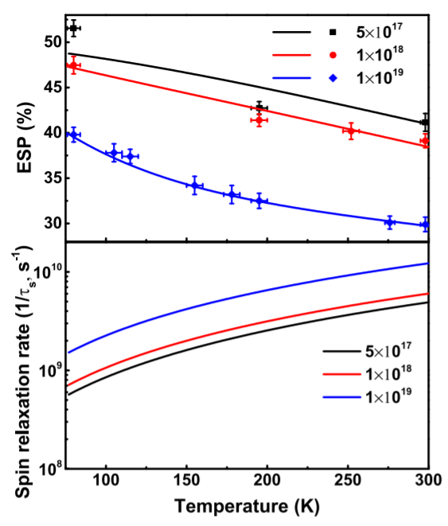
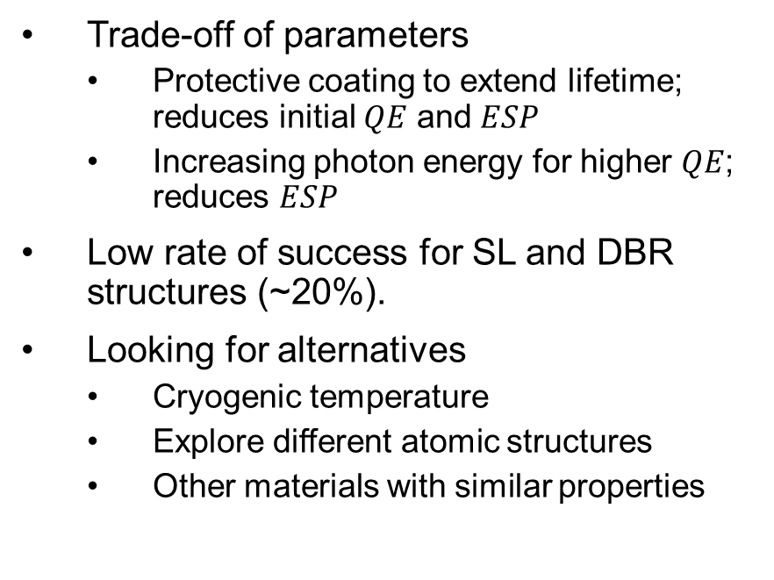
The problem: Creating more efficient photocathodes
Trade-off of parameters
  Protective coating to extend lifetime; reduces initial $QE$ and $ESP$
  Increasing photon energy for higher $QE$; reduces $ESP$
Low rate of success for SL and DBR structures (~20%).
Looking for alternatives
  Cryogenic temperature
  Explore different atomic structures
  Other materials with similar properties
Notes:
Cryogenic has be done for bulk
Reduce text, change title;
The lifetime is the same

Slide 5
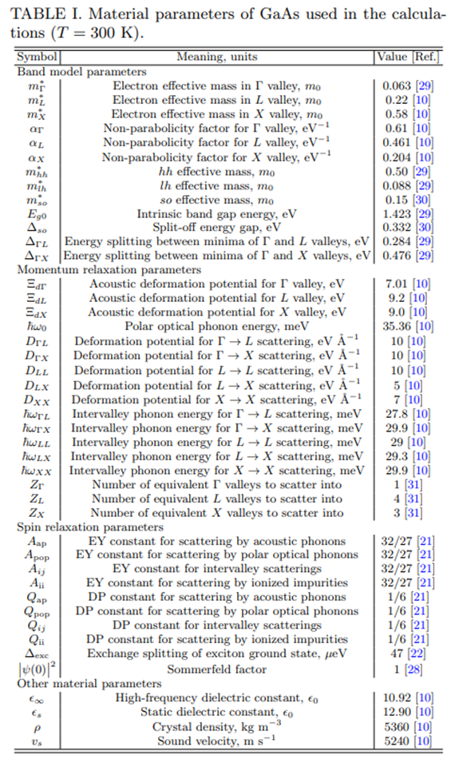
Research method: Numerical simulations
Experimental results can be predicted for different conditions and structures.
Inexpensive and considerable fast
Implementation of three step model in a Monte Carlo simulation to reproduce the electron’s transport
DFT model for varying band structure parameters and numerical approach for other parameters
Picture yet to be made
Notes:
Synthetization of strained GaAs SL with DBR has a success rate of 20%
Results are unexpected and the progress is slow
Three step model is conceptual; MC allows
Change the picture as this is for metal

Slide 6
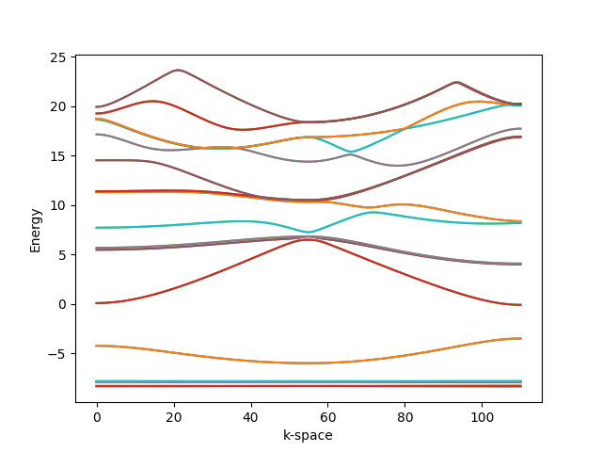
Research method: Expanding capabilities of existing simulation code
First aim is to include temperature dependence
  Cryogenic conditions improve ESP
  We expect to modify excitation and transport parameters
  Include generalized procedures as to reduce the amount of numerical input parameters needed
Validate simulation results with experimental datasets
Further development of the project
  Expanding the project to support strained structure and SL
  Generalize for different materials
Notes:
DBR has no contriution to photoemission

Slide 7
Acknowledgements
This project was supported in part by the Brookhaven National Laboratory (BNL), Instrumentation Division and the U.S. Department of Energy, Minority Serving Institutions under the Fellowship Program for Research Excellence in Nuclear Physics.

