Slide 1
Barrel and Backward Jets: Delphes 1st Look
Brian Page

Slide 2
Introduction
Jets which go into the barrel / electron endcap will be low-x and low energy – important for photoproduction as well as other higher order processes
Evaluate the effect of HCal resolutions on jet reconstruction in barrel / electron endcap
Default Delphes ATHENA model
Barrel: σE/E = 100%/√E Ꚛ 10%
Electron Endcap: σE/E = 50%/√E Ꚛ 10%
Alternate models: GEANT studies show we can expect a constant resolution for energy ranges appropriate for the barrel with values depending on barrel ECal thickness. Also degrade electron endcap resolution
Barrel Mod 1: σE/E = 27%
Barrel Mod 2: σE/E = 35%
Electron Endcap: σE/E = 100%/√E Ꚛ 10%
Also look at case where we do not include Eflow neutral hadrons in jet-finding
Simulated 18x275 NC DIS with Q2 > 10 GeV with all beam effects included

Slide 3
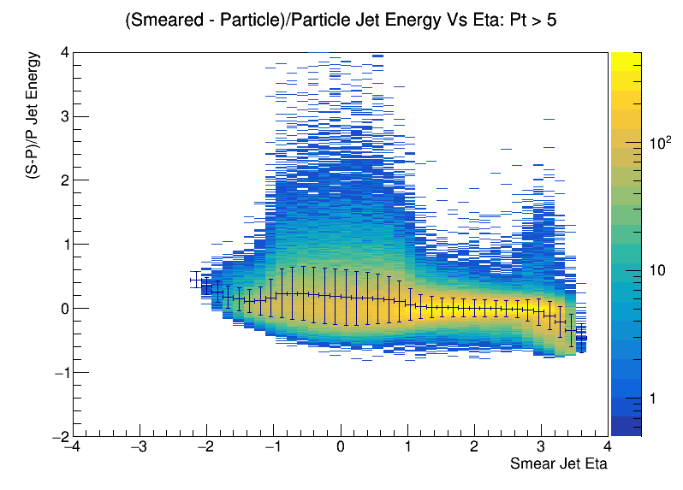
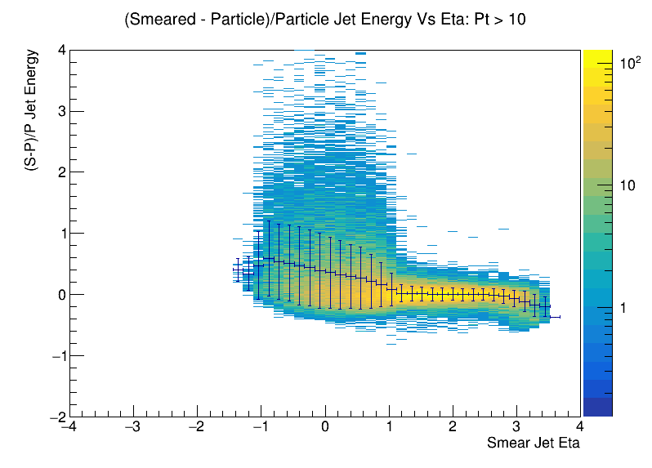
Jet Energy Resolution & Scale Definitions
Pick the highest Pt Eflow jet – find matching particle level jet (Smallest delta R < 0.5)
Construct (Eflow-Particle)/Particle Jet energy distribution vs eta
JER is the RMS of the distribution and JES is the average
Look at Eflow jets with minimum Pt > 5 GeV and 10 GeV

Slide 4
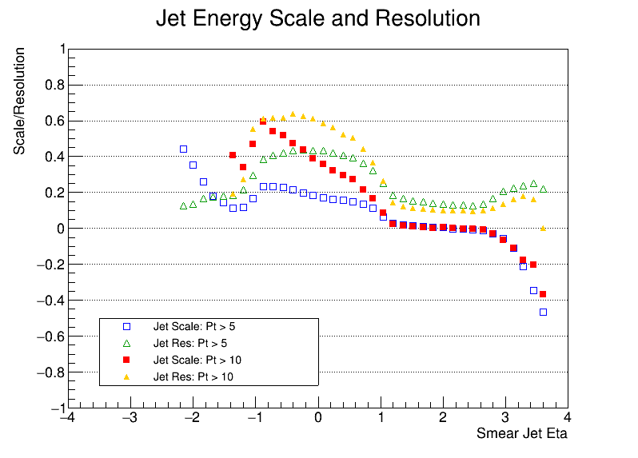
JES / JER Summary: Default ATHENA Model
Jet energy resolutions and scales blow up in the barrel
Oddly, JES and JER seem to be worse for higher Pt jets
Believe this is somewhat a phase space effect – for Pt > 10 GeV there is more room for tails (compare pp 8 and 9)

Slide 5
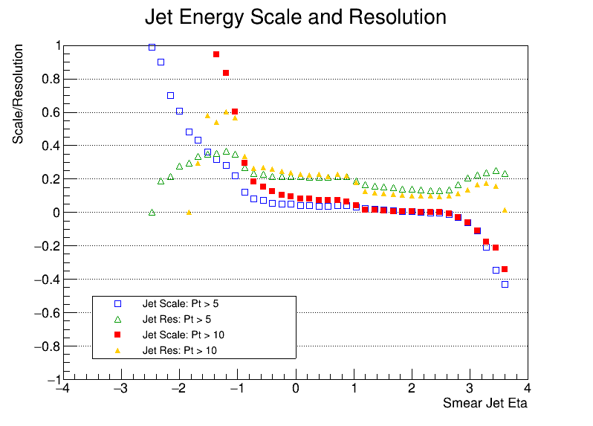
JES / JER Summary: Constant 35% Energy Res
The constant energy resolution (σE/E = 35%) drastically improves JES / JER in the barrel region
Significant degradation in the electron endcap due to the switch from 50%/√E Ꚛ 10% to 100%/√E Ꚛ 10%

Slide 6
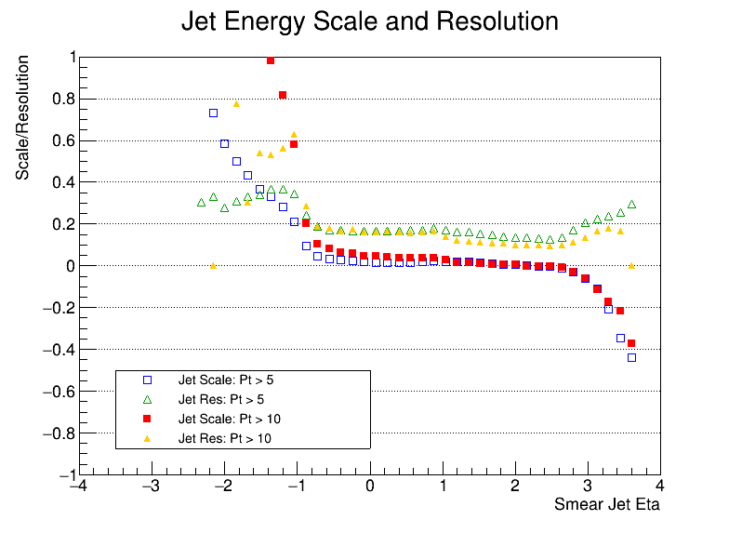
JES / JER Summary: Constant 27% Energy Res
Better JES / JER for constant energy resolution of 27%

Slide 7
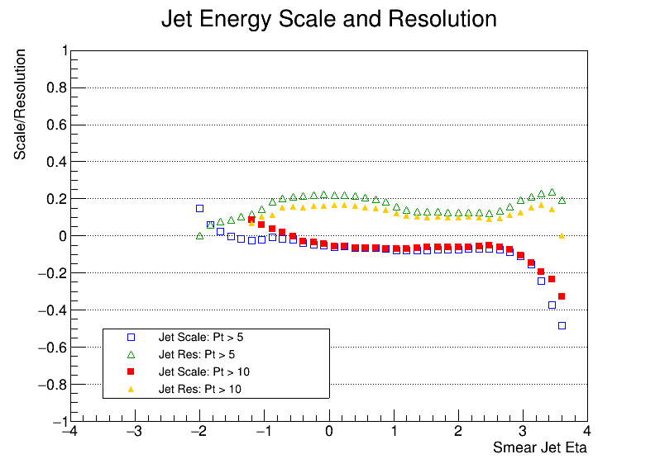
JES / JER Summary: No Neutral Hadrons
What happens if we construct jets from only track and photon Eflow objects?
See slightly worse JES and JER behavior in the barrel but dramatic improvement in the electron endcap
Back to conclusion that HCal in the electron endcap region may be better as a veto?

Slide 8
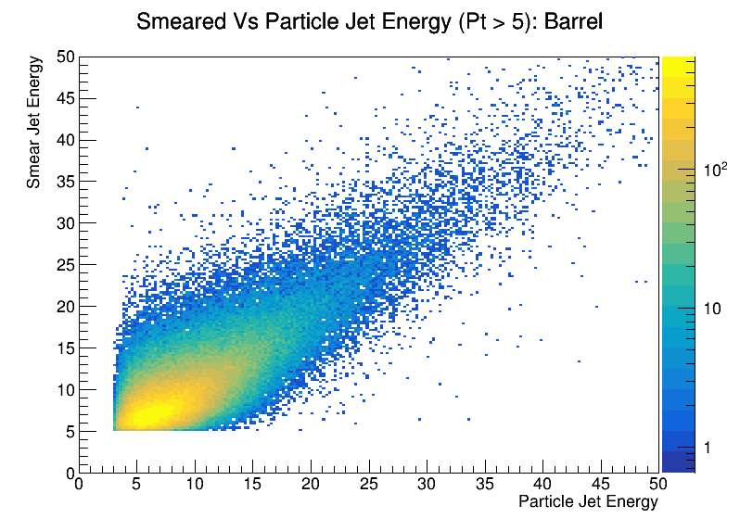
Eflow Vs Particle Jet Energy (Default): Barrel
Default barrel HCal resolution leads to a sizable tail of jets which are reconstructed at much higher energy than they were generated with
This leads to the large scale and resolution values
We can also see why scale and resolution are worse for Eflow jet Pt > 10 GeV – there is more phase space at lower particle jet Pt available for a given Eflow jet Pt than at Eflow jet Pt of 5 GeV

Slide 9
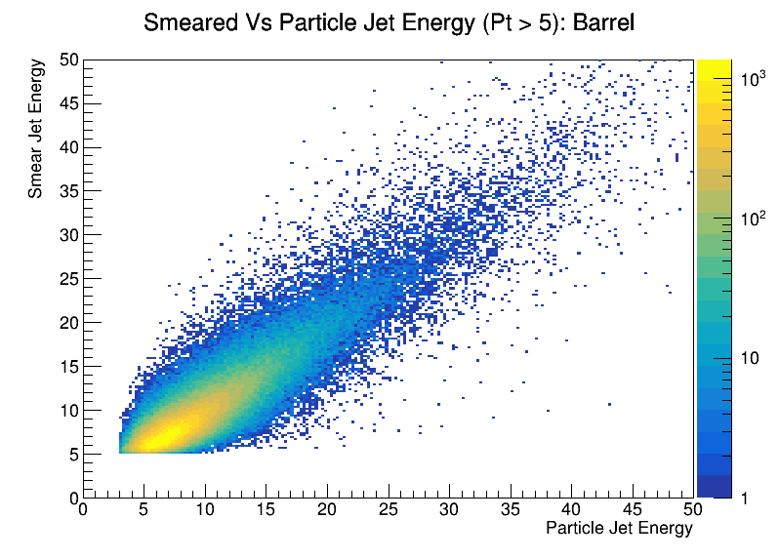
Eflow Vs Particle Jet Energy (35%): Barrel
The population of this tail region is significantly reduced for the constant HCal resolution case
Leads to better overall JES / JER and less severe discrepancy between low and high Pt curves

Slide 10
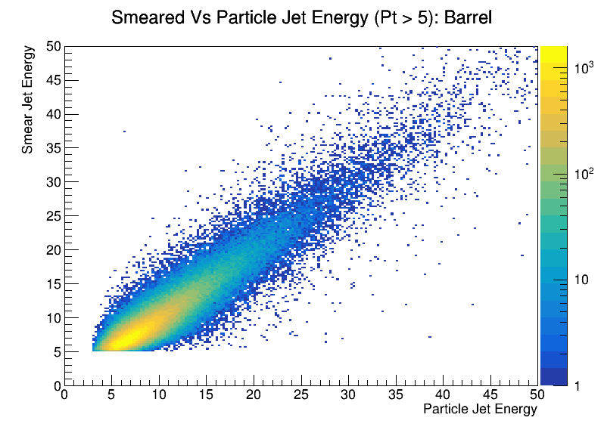
Eflow Vs Particle Jet Energy (27%): Barrel
The behavior of the 27% resolution is even better
Better resolutions are better ;)

Slide 11
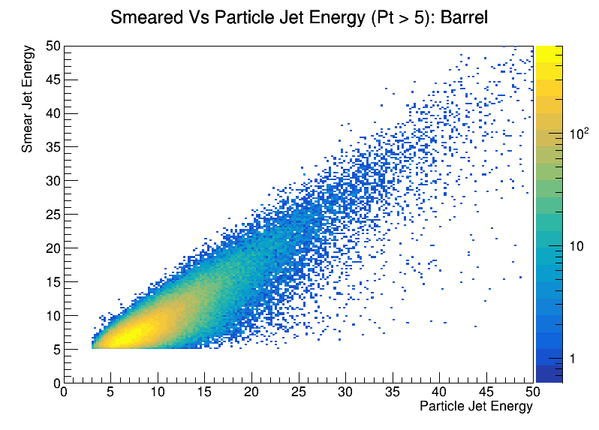
Eflow Vs Particle Jet Energy (No Neutral Had Eflow): Barrel
Removing Neutral Hadron Eflow objects from the jet finder dramatically reduces the number of particle level jets which get reconstructed at significantly larger energies
In the barrel, we pay the price in missing the neutral component of jets leading to an excess to the lower right of the plot
Leads to the negative JES seen above

Slide 12
Conclusions and Next Steps
Took a look at jet energy scale and resolution as a function of pseudorapidity with a focus on the barrel and electron endcap regions
Flat barrel HCal resolutions give much better performances compared to default resolution
50% -> 100% resolution for electron endcap HCal leads to much worse performance
Neglecting Neutral Hadron Eflow objects in electron endcap led to reasonable behavior
Want to start looking at this in full simu – calorimeter / track matching and subtraction
Continue to explore issues using fast simu

