Slide 1
ECCE Computing
Cameron Dean Los Alamos National Laboratory
08/04/2021 EICUG Summer Meeting

Slide 2
Overview
ECCE computing is entangled in several areas of our consortium
Detector simulation
Data production and storage
User interaction
AI/ML groups optimize design and physics potential
150M events already on disk
ECCE overview talk with more information

Slide 3
Production Workflow
JLab Runs Production
Detector Simulation And Reconstruction
Physics Analysis Production
Physics Teams Run Generators
Production Scripts Generate Batch Files
OSG Runs Production
Detector Simulation And Reconstruction
Physics Analysis Production
Storage at BNL and JLab
Detector Teams Simulate Subdetectors
Simulation Team Build Full Detector
BNL Runs Production
Detector Simulation And Reconstruction
Physics Analysis Production

Slide 4
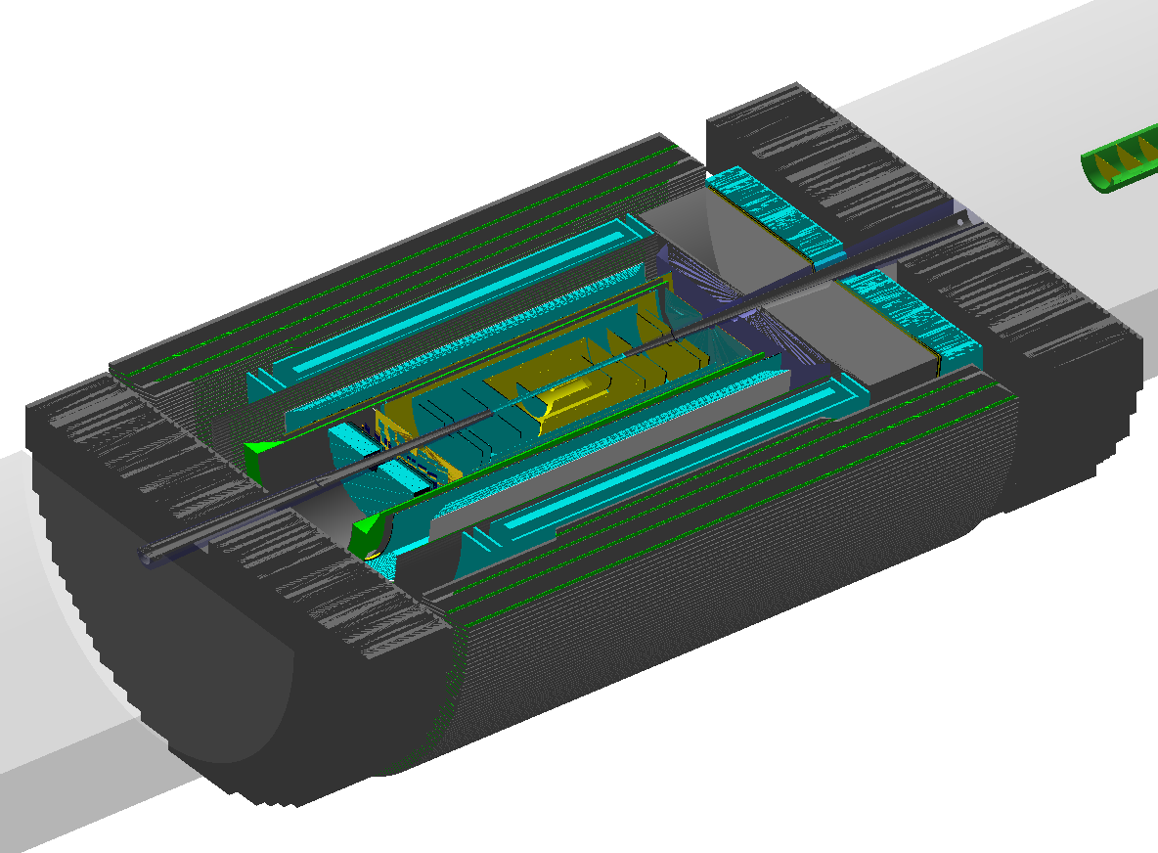
Detector Simulation & Reconstruction
Generator-level events produced in LUND format
Internal generator (pythia8)
Fed through EIC-smear
Beam crossing and divergence
Detector response (plus digitization/PID/clustering)
ECCE detector talks with more information: Calorimetry, tracking, PID, far forward/backward
GenFit tracking

Slide 5
(Re-)Producing Physics Simulations
Each collision sample (generator and beam conditions) produces a dataset file and associated ROOT files (direct analysis)
DST has truth info., hits, clusters, tracks, jet reco. and more
Typical file is 1k → 5k events
Reproducibility is very important
Must fix: software stack, detector simulation and seed
Seed solution: Use RooUnblindPar
Unique for each DST and reproducible anywhere with no user interaction!
$$G\left(x;μ, σ\right)=\frac{1}{\sqrt{2π}(Start+1)}exp⁡(−\frac{{\left(x−nEvents\right)}^{2}}{2{\left(Start+1\right)}^{2}})$$
First event and nEvents define width and mean
First event, nEvents and file string (plus scale) selects seed from Gaussian
Seed

Slide 6
Metadata logs
Each production job automatically writes metadata to help debug issues
====== Your production details ======
Production started: 2021/07/25 17:10
Production site: BNL
Production Host: spool0680.sdcc.bnl.gov
ECCE build: prop.2
ECCE macros branch: production
ECCE macros hash: c131177
PWG: SIDIS
Generator: pythia6
Collision type: ep-10x100
Input file: /gpfs02/eic/DATA/YR_SIDIS/ep_10x100/ep_noradcor.10x100_run001.root
Output file: DST_SIDIS_pythia6_ep-10x100_000_0000000_05000.root
Output dir: /gpfs/mnt/gpfs02/eic/DATA/ECCE_Productions/MC/prop.2/c131177/SIDIS/pythia6/ep-10x100
Number of events: 5000
Skip: 0
=====================================
Seeds:
1322570549 (plus more)
md5sum:
01da8efd4555739dfa18fd96ee5b6a36
Fully and uniquely defines seed

Slide 7
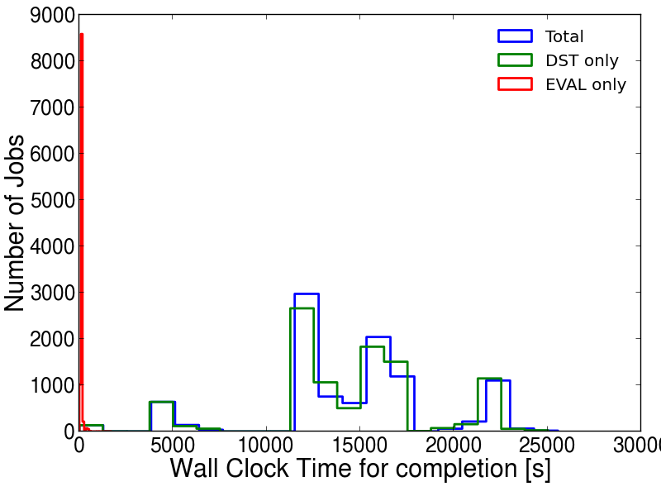
Production Statistics and Notes
Planned simulation campaigns | 2
Predicted events per campaign | 120M - 160M
Typical event size | 200kB
Typical event generation time | 7s
Total storage per campaign* | 30 TB
Typical job memory size | < 1.5 GB
Current events simulated in campaign one | 101.3M
> 90% job success rate (OSG > 98% success rate)
Separated sim./reco. from physics production
Automatic revisions of physics analysis production (compare updates, add features etc)
To-do: add job monitoring/resubmission (in beta-testing)
*Undecided if first campaign raw data will be kept after second campaign

Slide 8
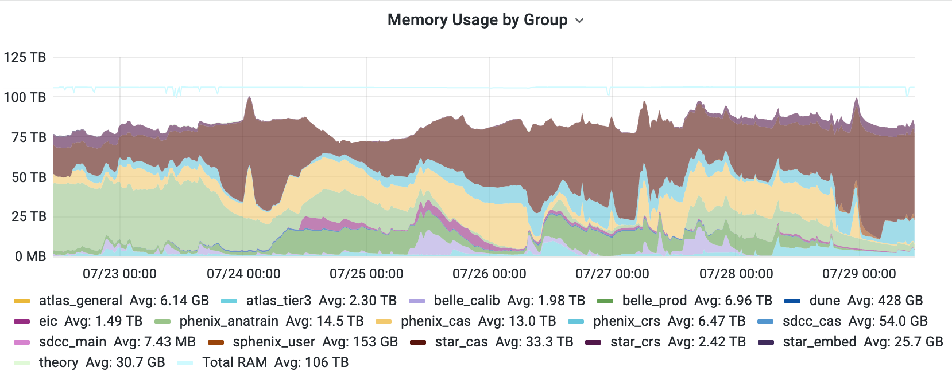
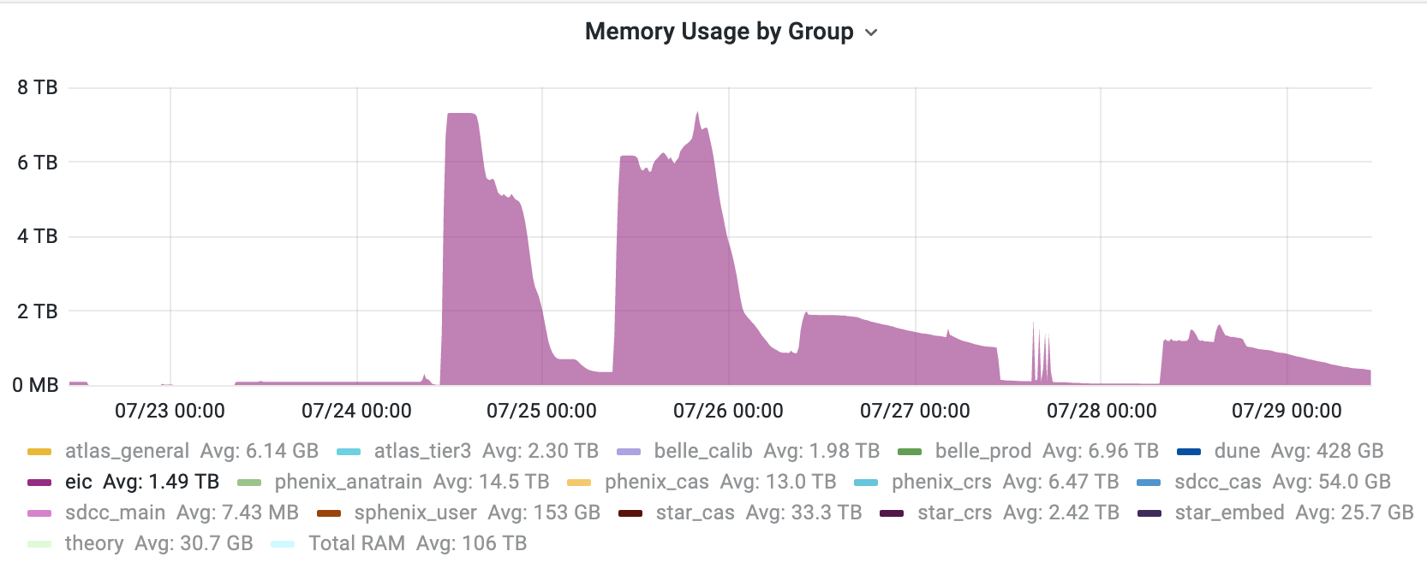
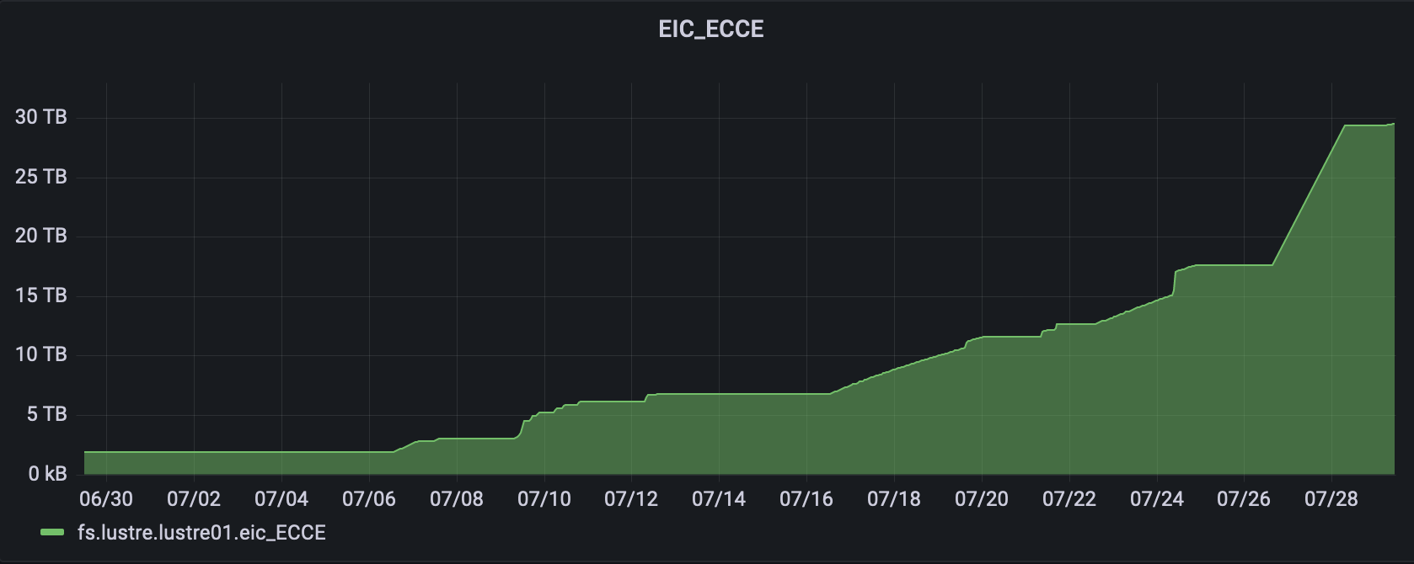
BNL Usage
ECCE physics analysis re-production
Large event production for ECCE
Not ECCE production
EIC Condor use is small but noticeable
Note, no distinction between ATHENA, CORE and ECCE on condor
S3 storage is creeping up for ECCE
150M events in storage so far

Slide 9
Co-design at ECCE
What is co-design of particle detectors?
Machine learning to optimize layout, material and performance
Detector design is not a 1D problem:
Physics goals met with reduced materials – reduced cost
New technology needed to reach targets – increased cost
AI reoptimization of design
Base physics simulation
Detector simulation
Physics analysis
Tomorrows talk on co-design with more information

Slide 10
Co-design example: Tracking
Simultaneously optimize all trackers
Optimise for Kalman filter efficiency, DCA, p and φ resolutions
Constraints:
Outer barrel radius < 51 cm
Vertex layer radius < 15 cm
Furthest disk position < 125 cm in z
Optimizing placement gives larger change than additional detectors
ECCE Preliminary
C. Fanelli and K. Suresh

Slide 11
Co-design example: PID
Optimisation of mRICH:
Spherical Mirror radius
Mirror position (r, z)
PhotoSensor position (x, y, z)
Aerogel Refractive Index
Aerogel Thickness
Optimised design reduces Cherenkov saturation at higher momenta
JINST 15 P05009 (2020)

Slide 12
Co-design example: PID
Current hpDIRC design: reused BaBar DIRC bars
Performs beyond required 6 GeV/c!
Fast sim parametrization based on detailed G4 simulation
Full reconstruction in Fun4All almost ready
Next steps:
Cost/performance optimization
Validation of performance with magnetic field
Optimisation performed using scikit-learn
Right – $6 GeV/c{ π}^{±} at {30}^{O}$
G. Kalicy, W. Phelps, A. Quiroga and N. Wickramaarachchi

Slide 13
Co-design example: Calorimetry
Started co-design of electron-going endcap EMCal
Maintain resolution while reducing the number of crystals?
Optimises:
PbWO₄ crystal geometry
Inner/outer calo. radius
Densities
Efficiencies
V. Berdnikov, M. Bondi, C. Fanelli, Y. Furletova,
T. Horn, I. Larin, D. Romanov, R. Trotta

Slide 14
Conclusions
ECCE members have risen to the challenge of the detector charge
Realistic detector simulations are in place
150M already in storage
Aim to store > 300M events by end of August
AI working group is looking to the future with continual optimization
UI streamlined – Data can be studied < 20 minutes after joining ECCE
Thank you

Slide 15
Backup

Slide 16
Code Production
All users are welcome to submit packages or updates
Analysis code is written in C++
Other languages are used for more specific tasks (e.g. python and bash for productions)
Code-conventions established by Chris Pinkenburg
All code must compile with clang, have no unused objects, cpp-check must have no serious issues, valgrind used to find memory leaks
coresoftware (reconstruction/
evaluators/tracking and more)
fun4all_eicdetectors (subdetector simulations)
Stacks: Daily (4 day history)
Weekly (permanent)
Proposal (fixed for sim. campaigns)
fun4all_eiccalibration (subdetector geometry files)
Macros (global call to subdetectors, full detector, tracking, reconstruction)
ECCE software talk with more information

Slide 17
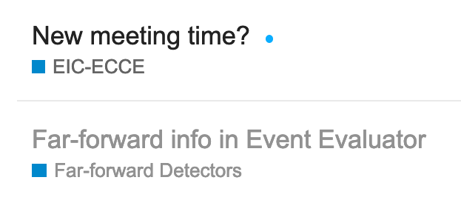
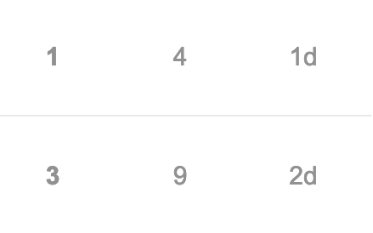
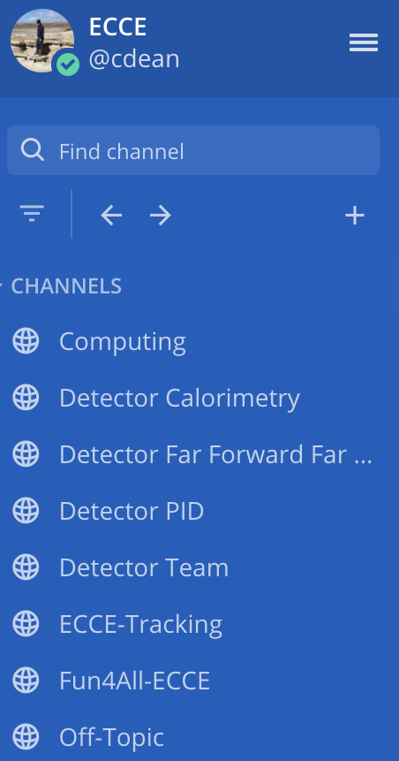
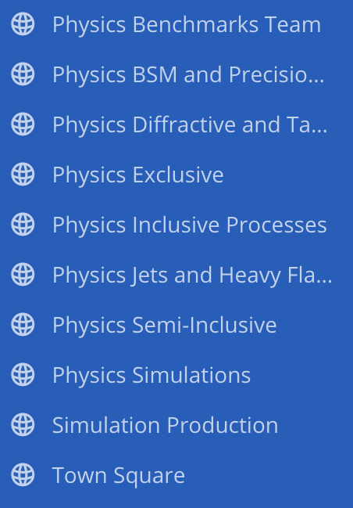
User Work Methods
Many users across the world, not everyone joins with active BNL membership
Not feasible to get everyone accounts in proposal timescale
Singularity (and VirtualBox) is used to distribute daily software stacks (and simulations)
S3 (BNL) and xrootd (JLab) protocols used to distribute data
minIO client and read-access keys are distributed from ECCE stack
Users are encouraged to use low-volume nTuples over DSTs
Keeps bandwidth to a minimum
Many physics plots can be made without large data processing
We use mattermost and discourse for quick communication. We can manually authenticate, no need to have a BNL account

