Slide 1
Calorimeter WG Integration Update
erhtjhtyhy
Paul E Reimer, Oleg Tsai, & Vladimir Berdnikov
28 July 2021
This work is supported in part by the U.S. Department of Energy, Office of Nuclear Physics under contract No. DE-AC02-06CH11357.

Slide 2
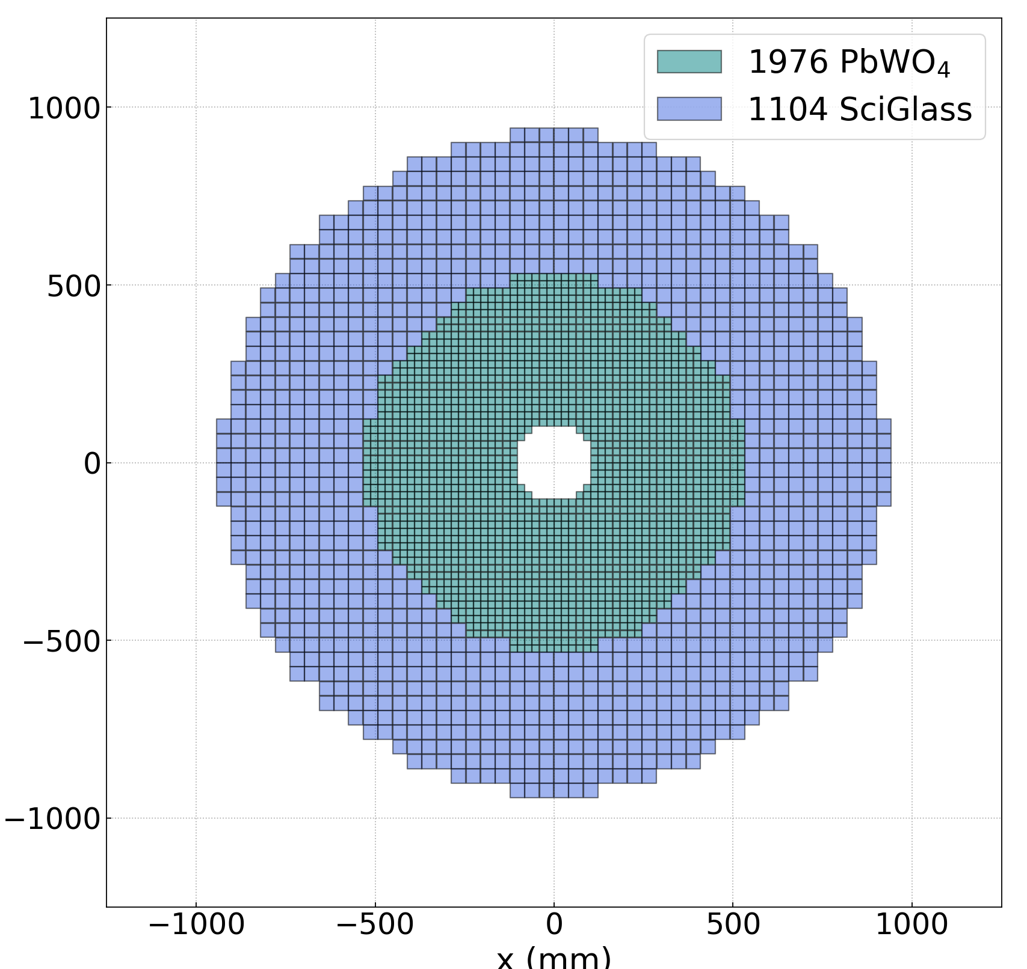
Recent Items
DD4HEP
nECal
accommodate 60 cm of space for hybrid (Crystal+Glass), ~20 cm needed for read-out. So far it`s 40cm so no space for glass region readout at all.
add two PWO layers for inner ring to achieve eta~-3.5 and change first glass layer to two PWO in order to achieve eta~-2, for highest resolution according to YR requirement
pECal
Verifying W/SciFi is implemented correctly
Monte Carlo studies—not really integration
Effect of noise hits—Miguel Arratia, Owen Long
Reconstruction techniques—Xiaoxuan Chu
DELPHES simulations of Jets—Brian Page

Slide 3
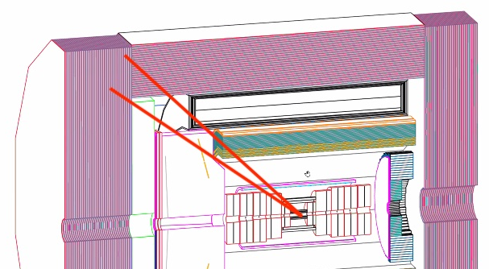
Hole in eCal acceptance
Overlap between beCal and peCal possibly not sufficient
Extension of beCal would encroach on RHIC
Jlab EIC Detector Menagerie
Inspection also shows area with minimal overlap
Noticed multiple interferences with RICH volume and support structures
From DD4HEP model

