Slide 1
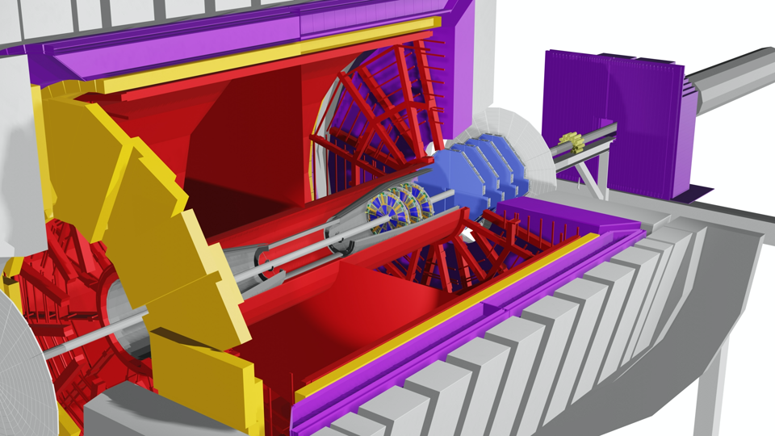
STAR forward upgrades – small-Strip Thin Gap Chamber (sTGC)
Isaac Upsal
Rice University
iupsalp@gmail.com
August 8, 2020

Slide 2
Forward upgrade @ STAR
Forward Calorimeter System
Hadron
Calorimeter
Collision!
Electron
Calorimeter
Forward silicon tracker
Forward sTGC Tracker
Forward Tracking System

Slide 3
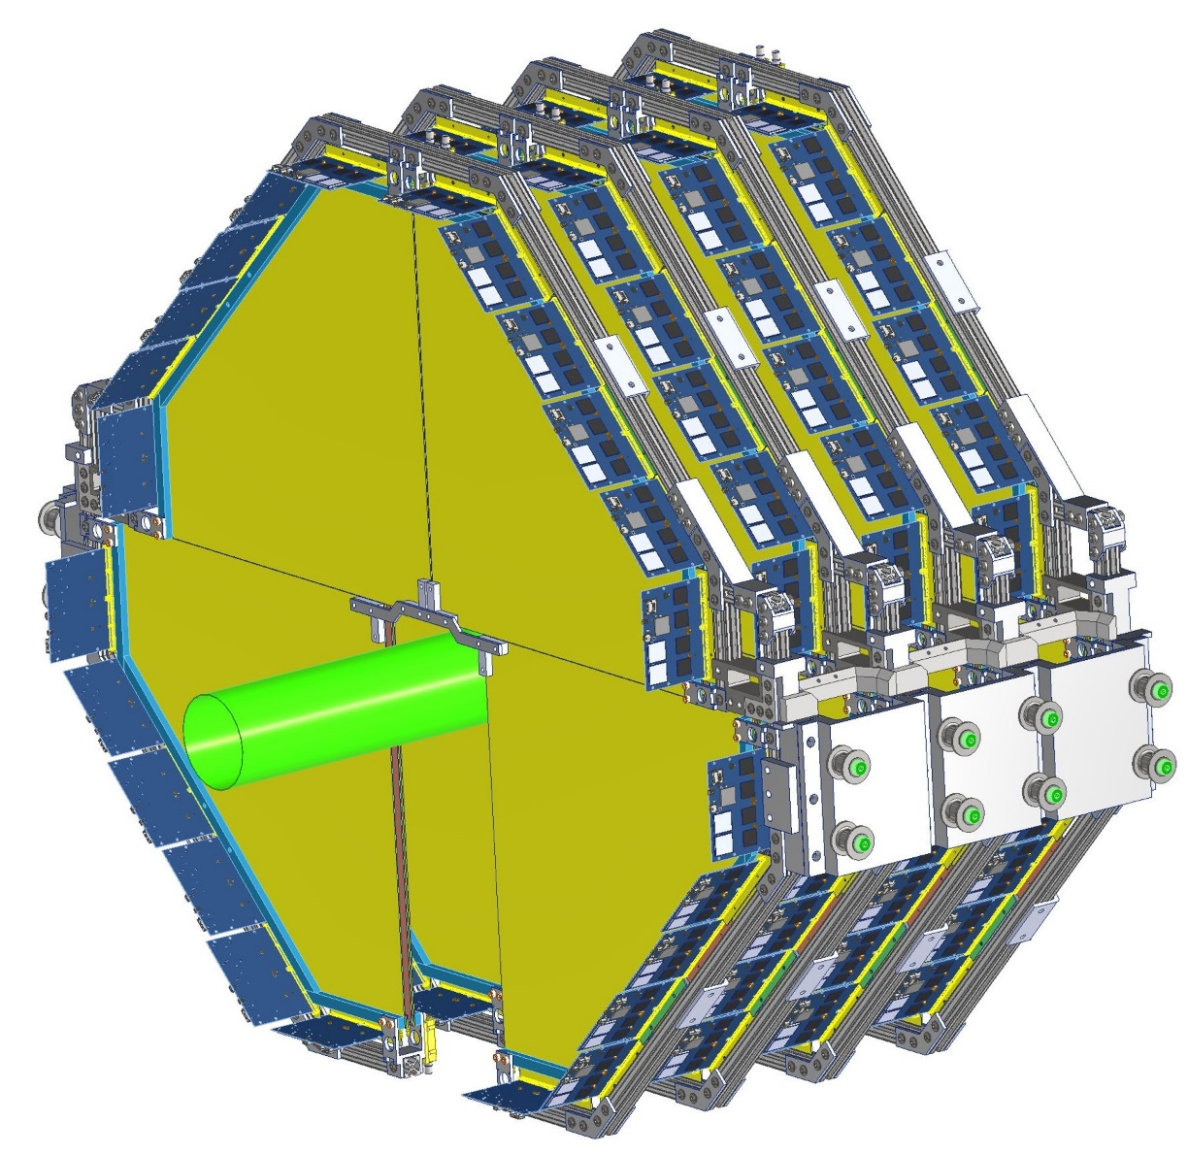
sTGC basics
The sTGC is a detector system currently being tested and assembled as an upgrade to STAR
The technology has been around for decades, but has recently been used at ATLAS
Potential use in the Electron ion Collider
Pros: low cost and low material budget
cons: good, but not incredible position resolution and only useful in low particle flux

Slide 4
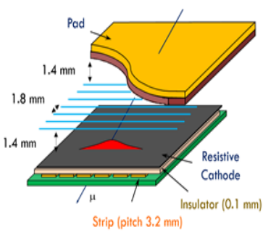
sTGC construction
Sealed volume filled with gas
Anode (-HV): 50 μm Gold plated tungsten wires held at a potential of ~ -2900 V
Cathode(Ground): graphite epoxy mixture with high resistivity
Sprayed on G-10 (fiberglass) insulator
Readout: Small copper strips, perpendicular to anode wires, outside of cathode, printed on single large PCB
Wires and pads may also be read out, but are not used here

Slide 5
sTGC process
Essentially a Multi-Wire Proportional Chamber (MWPC)
MWPC: Invented in the 60s to replace bubble chambers
At least three orders of magnitude faster
The STAR TPC is an example of a MWPC
1992 Nobel prize
Charged particles pass through ionizing gas
Electron from ionization makes cascade in electric field
Cascade is measured in the strips as a hit

Slide 6
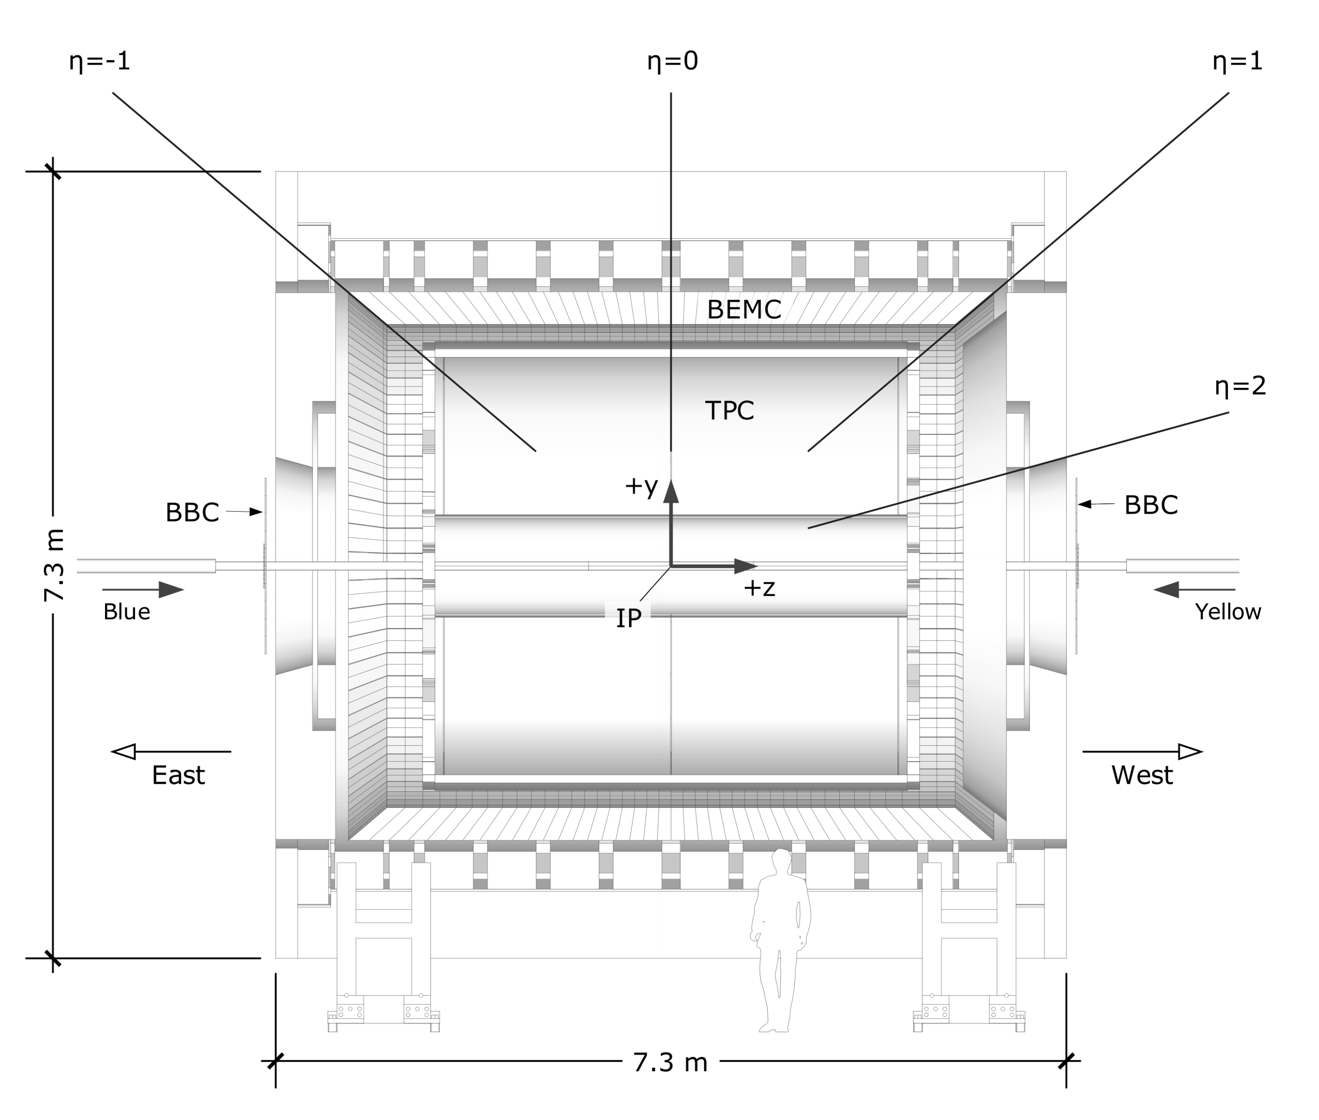
STAR performance parameters
In STAR the sTGC is part of the forward upgrade system
sTGC expected to properly separate charge (identify + vs – particles) and facilitate tracking (along with the FST)
Coverage: 2.4 < η < 4 @ 270, 300, 330, 360 cm from the Interaction Point (IP)
Position resolution: <200um
Dead channels: <1% (detector + electronics)
Detection efficiency: > 95%

Slide 7
STAR sTGC team
This list is not exhaustive, I just want to give a rough idea on what goes into a project like this
Much of the software and simulation – BNL
Detector construction and design – Shandong University (SDU)
SDU ATLAS group also made the sTGCs for them, so this was a significant advantage
Electronics for readout – University of Science and Technology of China (USTC) + BNL
Testing and characterizing modules shipped from SDU – BNL
Integration into STAR – BNL
Triggering and remote control of detector in STAR – STAR groups

Slide 8
“Stations” from SDU
30cm*30cm square
60cm*60cm square
~55cm*55cm pentagon
A “station” is an x and a y plane sandwiched together to make a grid for hits
30cm*30cm square prototype finished in Oct. 2018, 1 station is produced, delivered to BNL in Jan. 2019, installed in STAR on Jun. 2019
60cm*60cm square prototype finished in Jan. 2019, 4 stations are produced, delivered to BNL in Jul. 2020, installed in STAR
55cm*55cm pentagon 19 stations completed and sent to BNL (as of last week!)

Slide 9
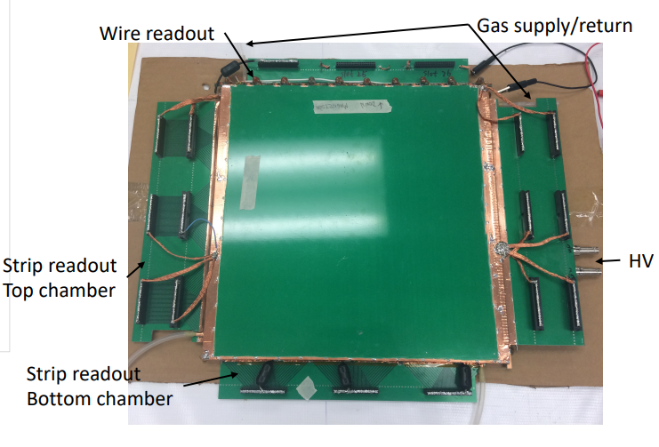
First “30x30”prototype – 2019

Slide 10
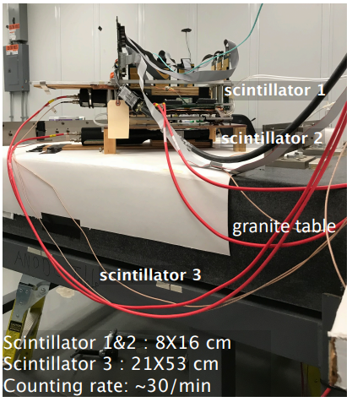
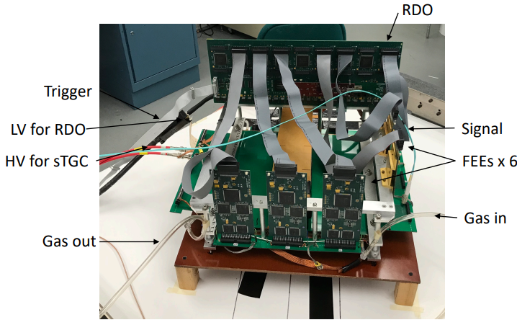
30x30 cosmic rays
Start BNL tests with cosmic rays – trigger on scintillator triple coincidence
No custom electronics yet, so we use old TPC electronics

Slide 11
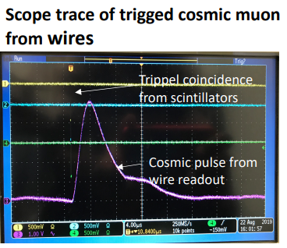
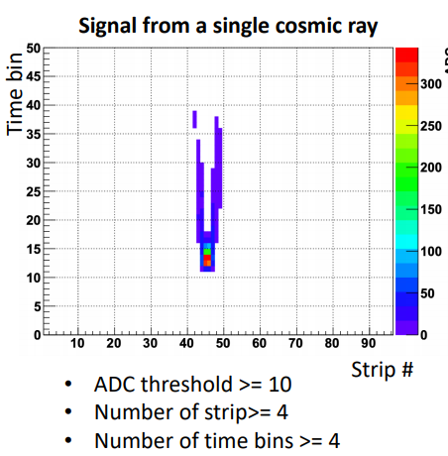
30x30 cosmic ray trigger
We can’t see the strip response on a scope and the wire response is much too wide to use
Wire still indicates it’s working
Use data acquisition (DAQ) → if there are three scintillator hits at the “same time” read out electronics
Good single-muon signal

Slide 12
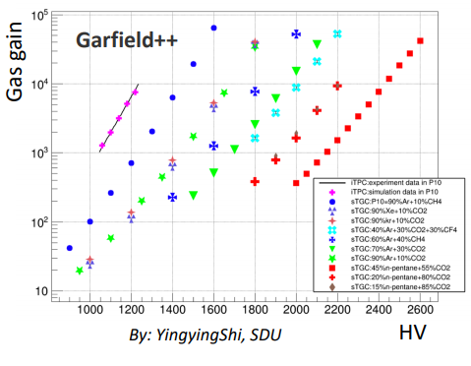
30x30 gas tests
sTGC uses n-pentane + CO2 (55+45)% in ATLAS
n-pentane is flammable and liquid below 960 F (360 C) (like gasoline)
This gives us RHIC safety issues
Trying different gases:
C10 -> Ar 90% + CO2 10%
P8.5 -> Ar 91.5% + CH4 8.5%
i-Butane(C4H10) + Ar (30+70)%
n-pentane(C5H12) + CO2 (45+55)%

Slide 13
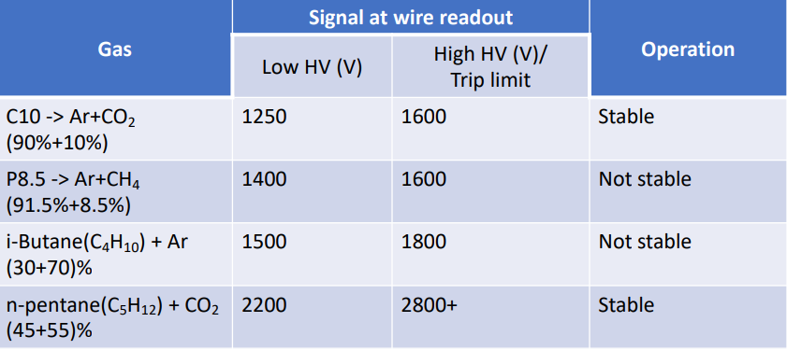
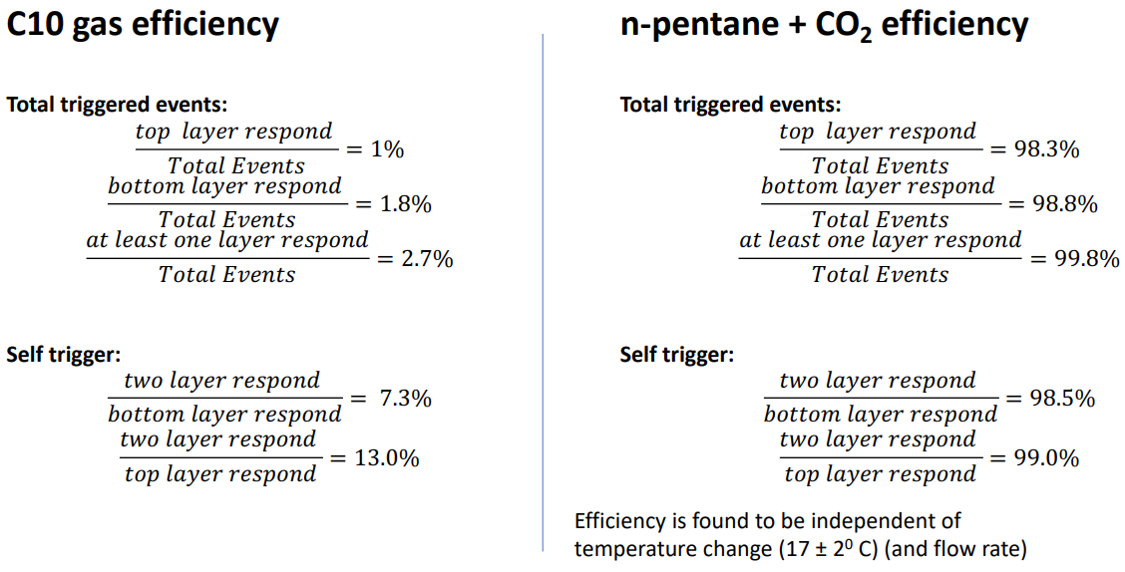
30x30 gas results
n-pentane allows for higher voltages and, consequently much better efficiencies
→ it cannot be replaced

Slide 14
Pentane gas system
Pentane is liquid, CO₂ is bubbled through it
How much pentane is carried away and is very dependent on temperature
Temp. cannot change too much, or you get flammable gas in the tubes!
This becomes a huge effort for the final detector

Slide 15
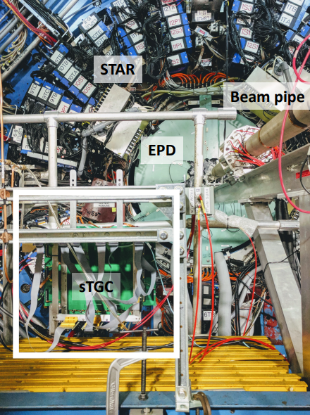
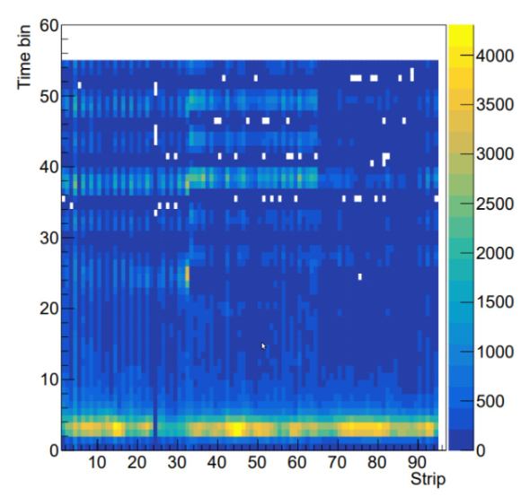
Prototype in STAR
Collected data was analyzable
Detector exhibited good uniformity
Prototype mounted on the west platform on 06/05/19
Electronics and DAQ were integrated to STAR + remote control
Used pre-mixed C10 gas – pentane not approved
Collected data with Au+Au 7.7, 9.2, and 200 GeV collisions

Slide 16
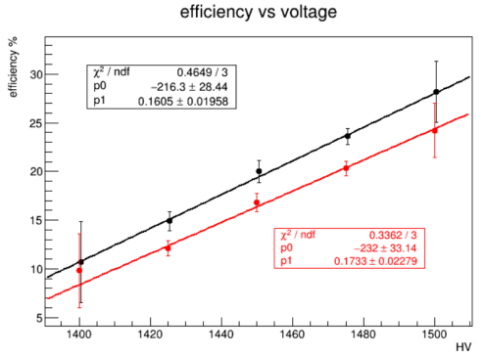
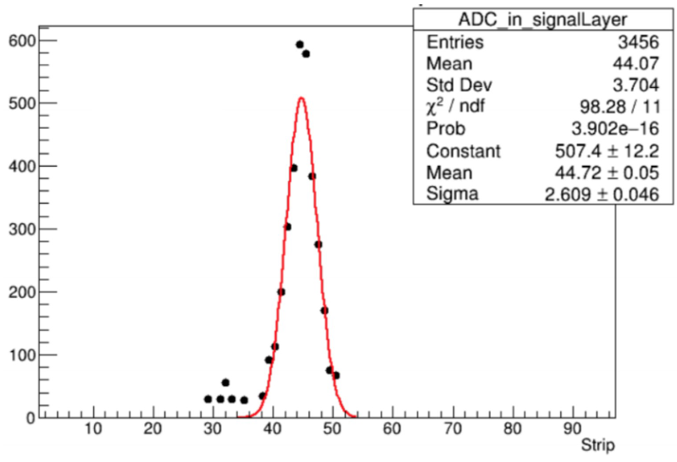
Prototype data analysis
Efficiency low, but measurable, and rising with voltage
Shower size analysis possible

Slide 17
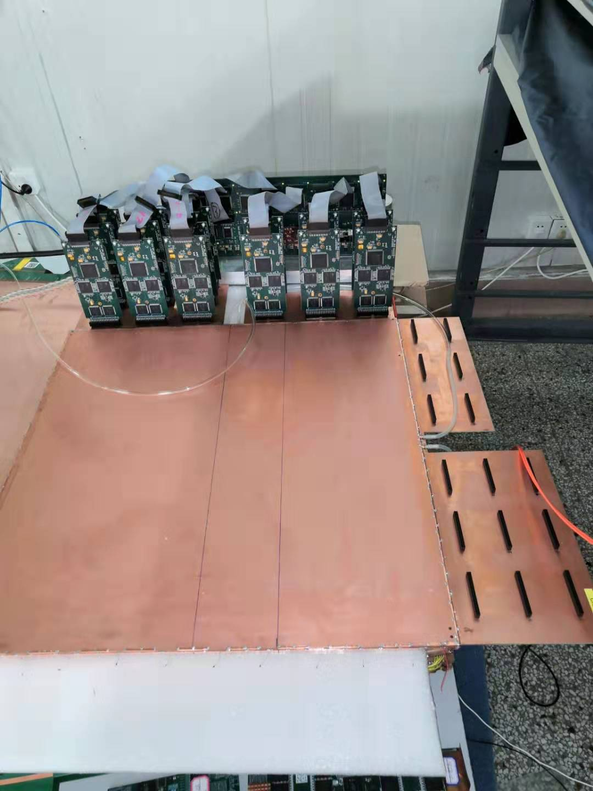
60x60 prototype (2020)
Detector arrived with no leaks
Efficiency studies prevented by lack of available resources
Used bespoke sTGC electronics for the first time
n-pentane brought into STAR hall for the first time, gas system approved and working

Slide 18
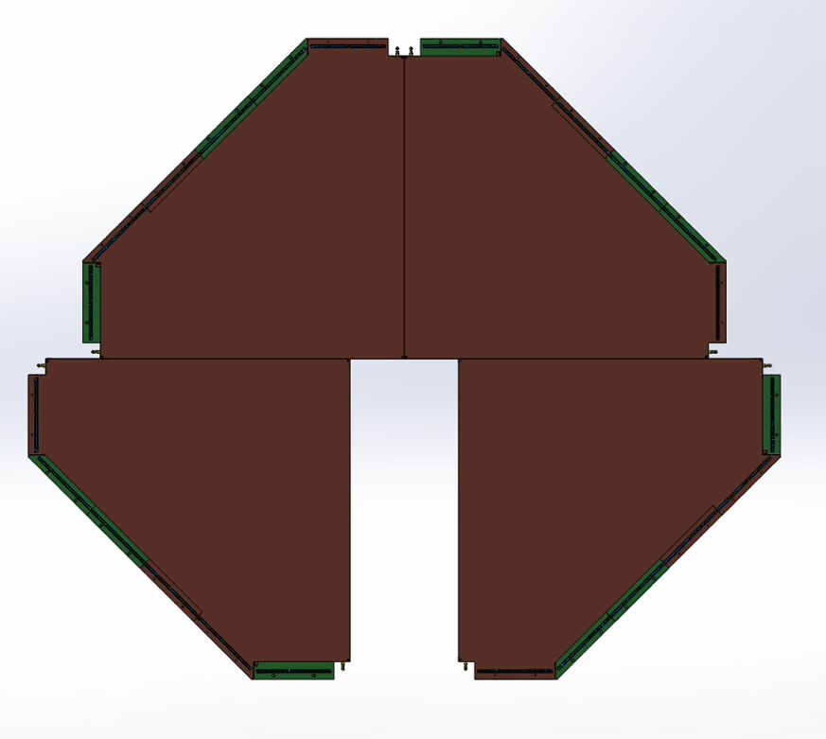
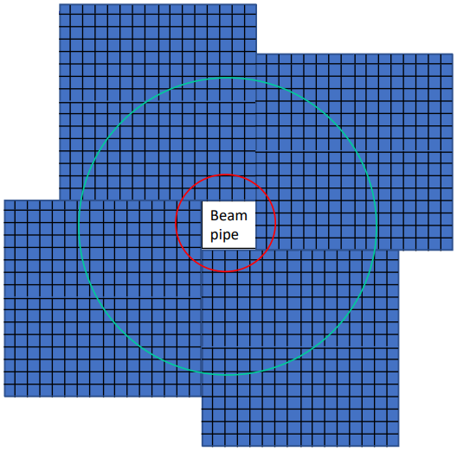
Final production
With lessons learned from constructing the prototype SDU was ready to start with the final design
Square sTGC stations had to become irregular pentagons to make space for the pole tip bar

Slide 19
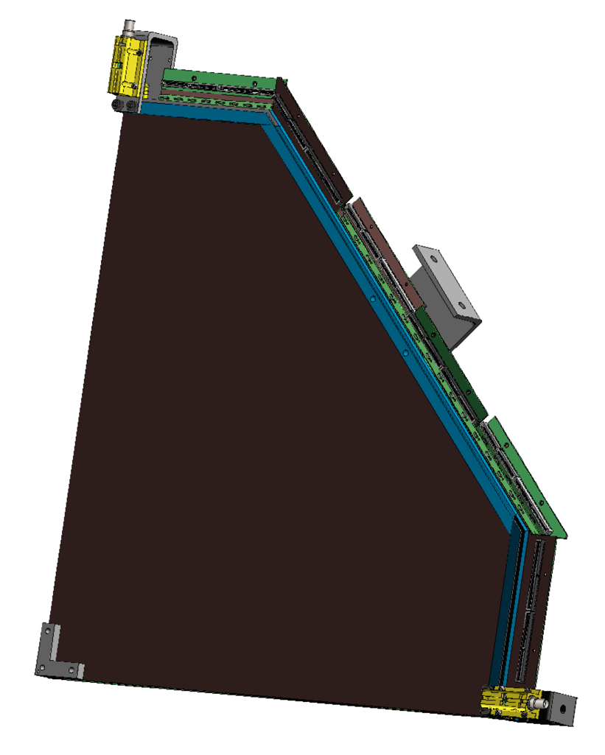
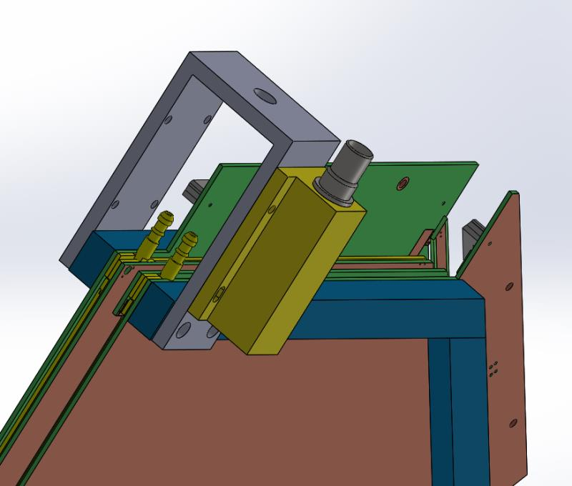
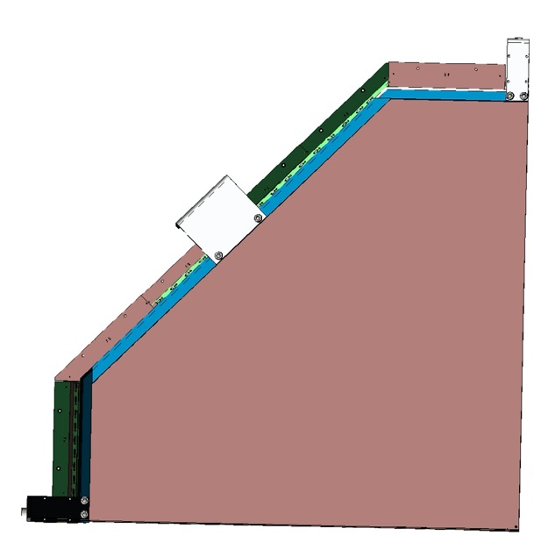
anchor point
Final design
anchor point
sHV connectors
RC filter
Gas intake
Electronic slot
anchor point
Back view

Slide 20
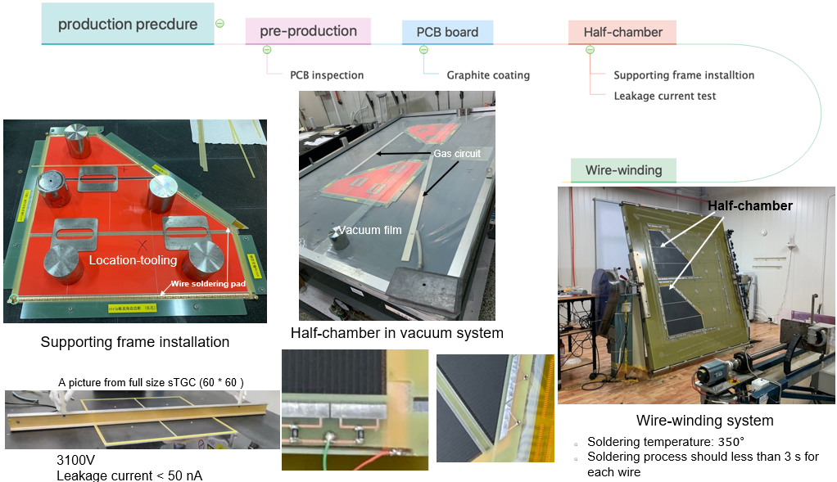
Production steps 1

Slide 21
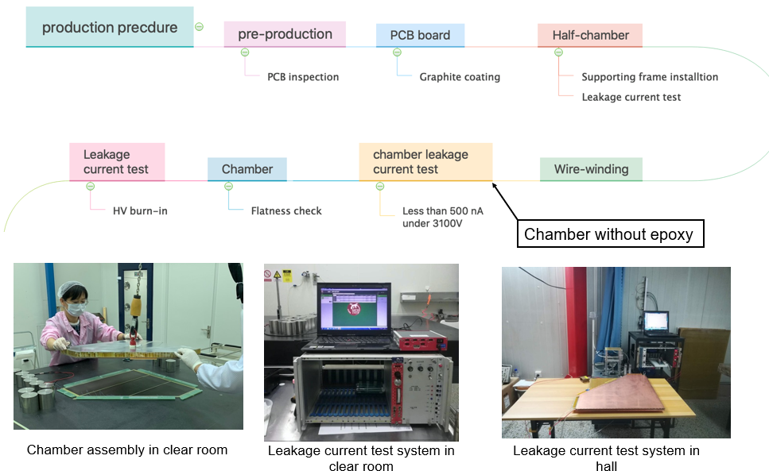
Production steps 2

Slide 22
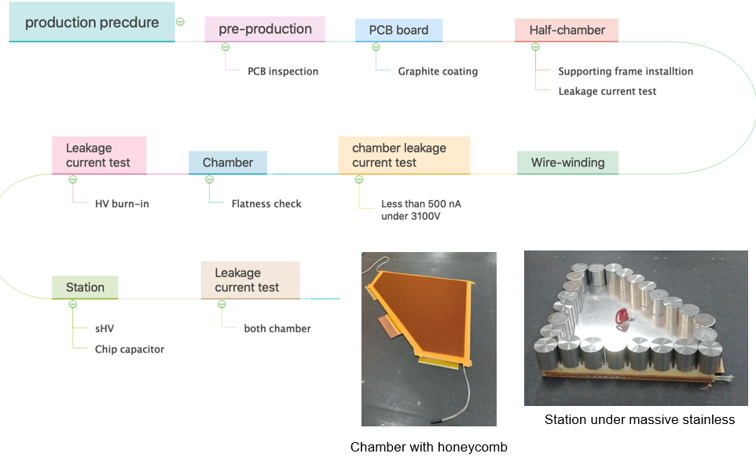
Production steps 3

Slide 23
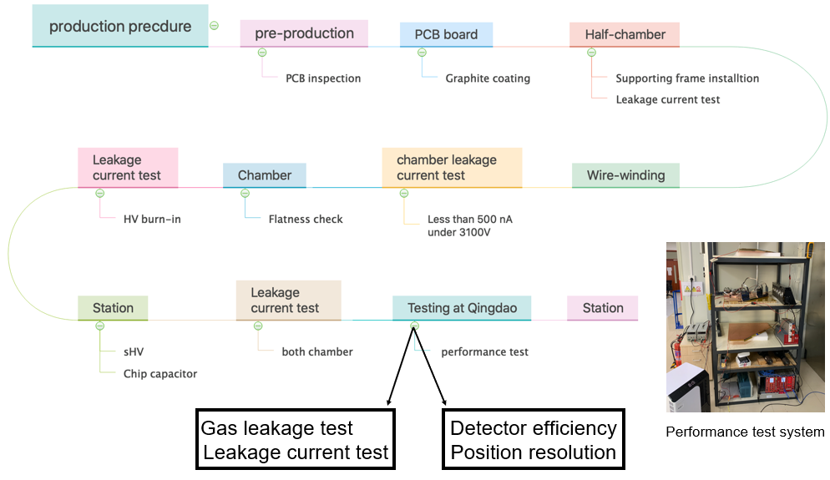
Production steps 4

Slide 24
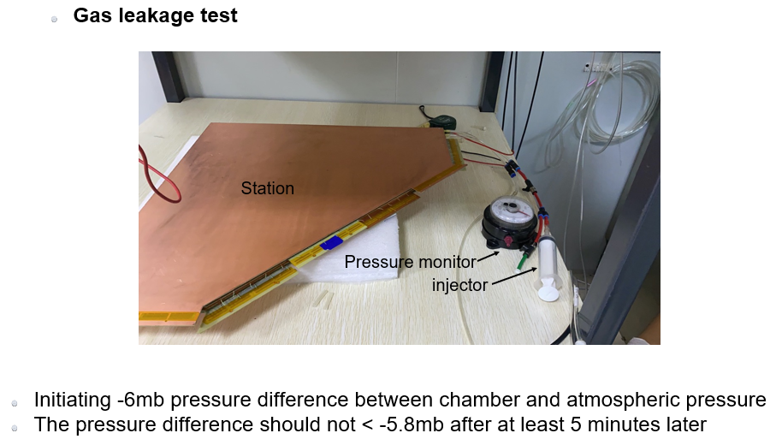
Production QA 1
(the same test is repeated at BNL after shipping)

Slide 25
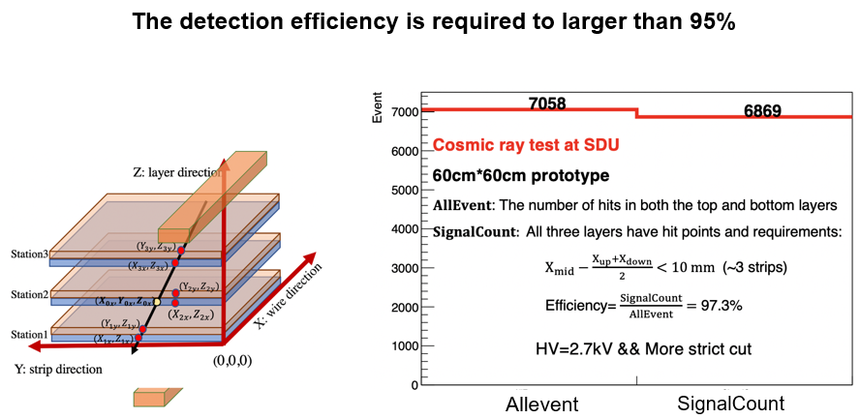
Production QA 2

Slide 26
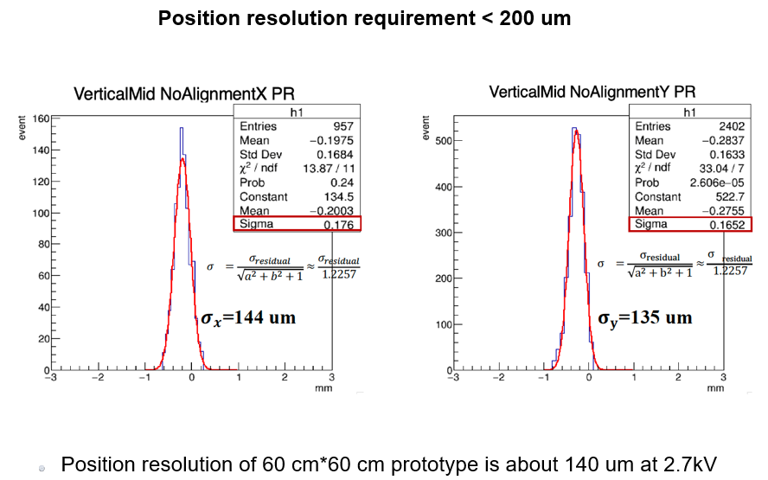
Production QA 3

Slide 27
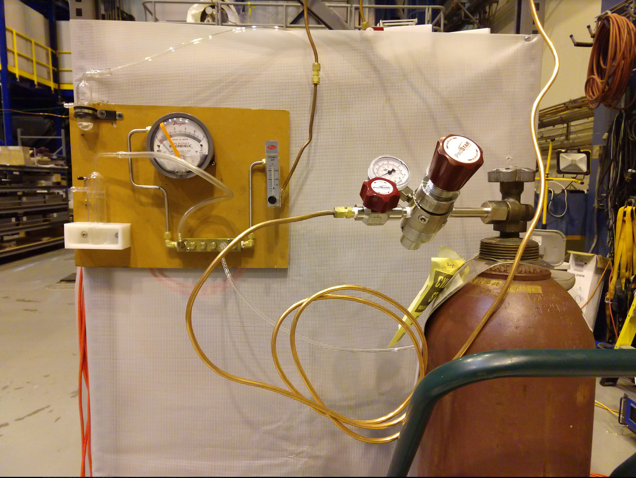
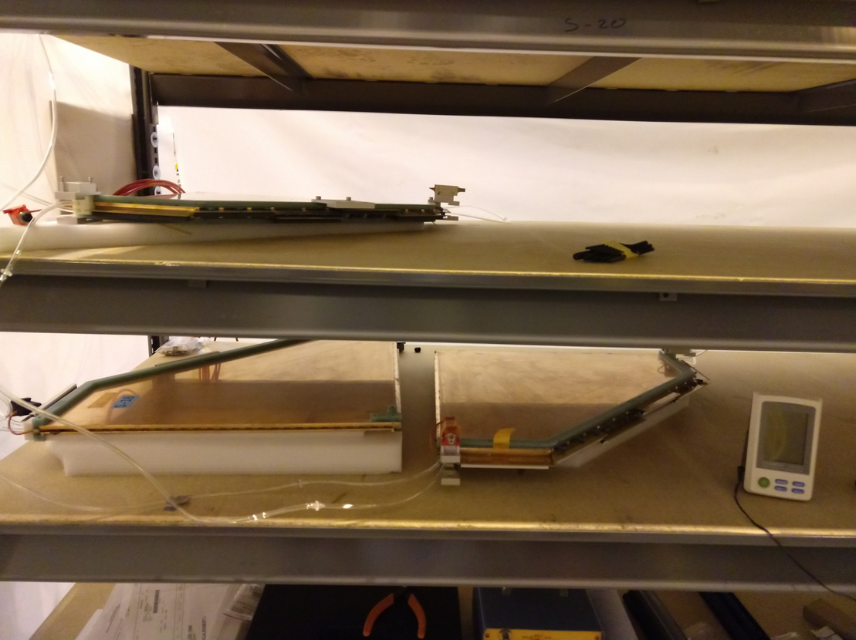
BNL QA
After arriving in BNL stations are unpacked, gas leak tested, and gas is flowed
We flow N₂ for a few days to dry them out and then flow CO₂ to “burn” the chambers

Slide 28
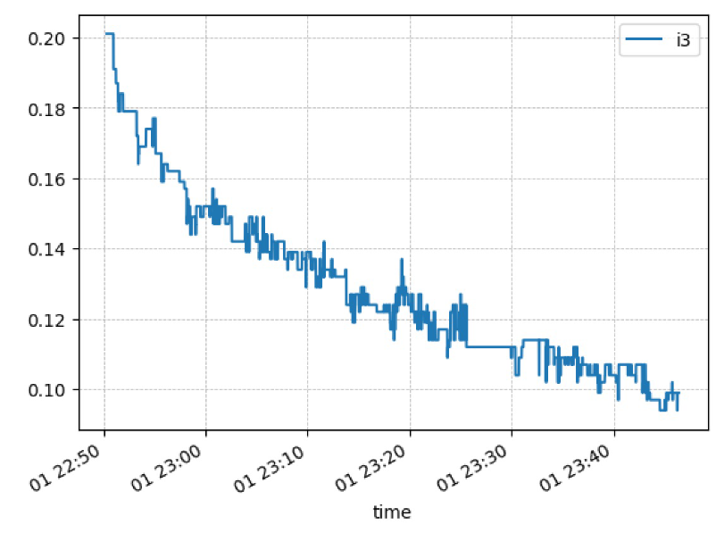
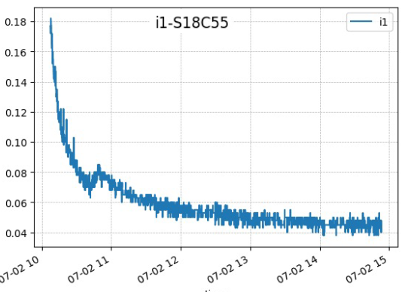
BNL burning
Burning means we slowly ramp up the voltage to operating voltage (2900 V)
We watch the current the chamber draws until it evens out over the course of a few days
We are nearly done with four stations and can do the rest simultaneously
500 V
Current in micro amps
1000 V

Slide 29
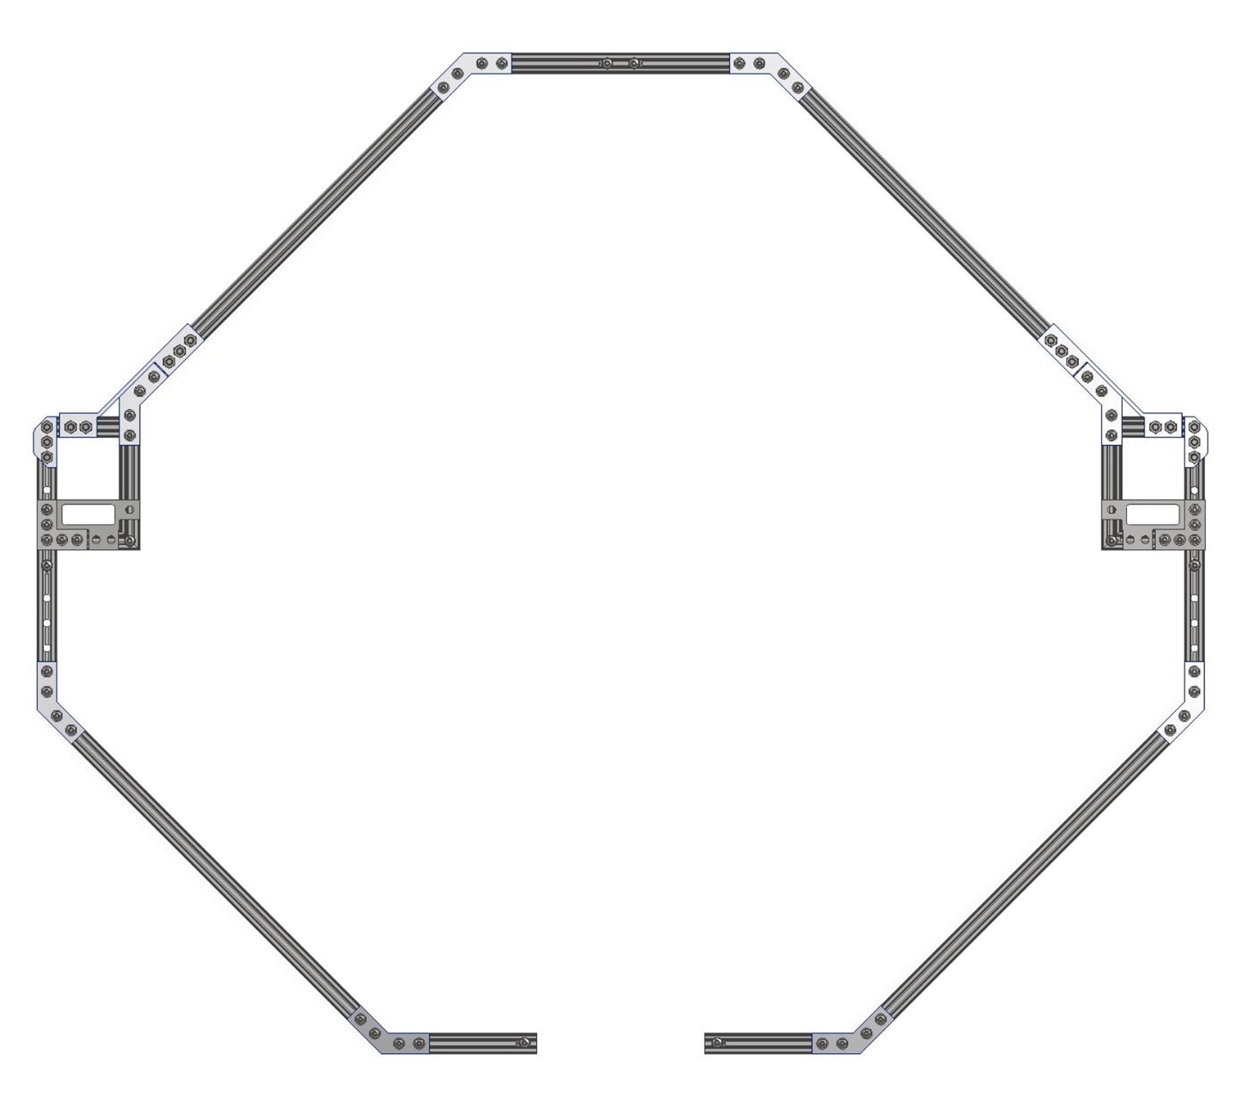
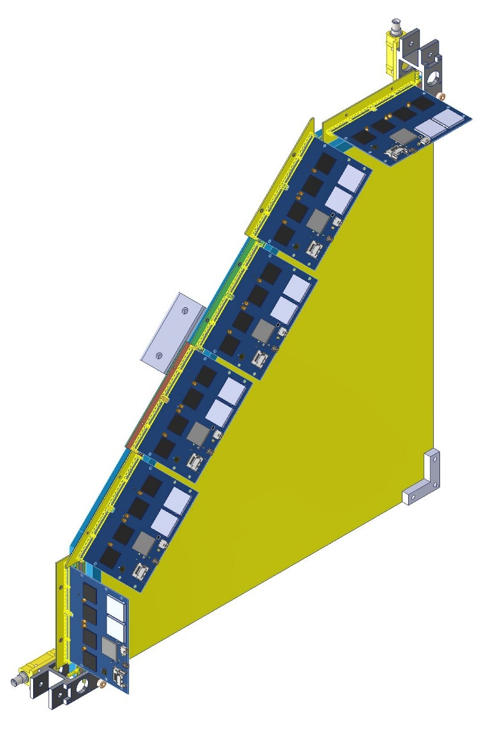
Future: installation 1
FEE cards connected to quarters
Quarters put inside of support structure
We plan on filling one such structure this week

Slide 30
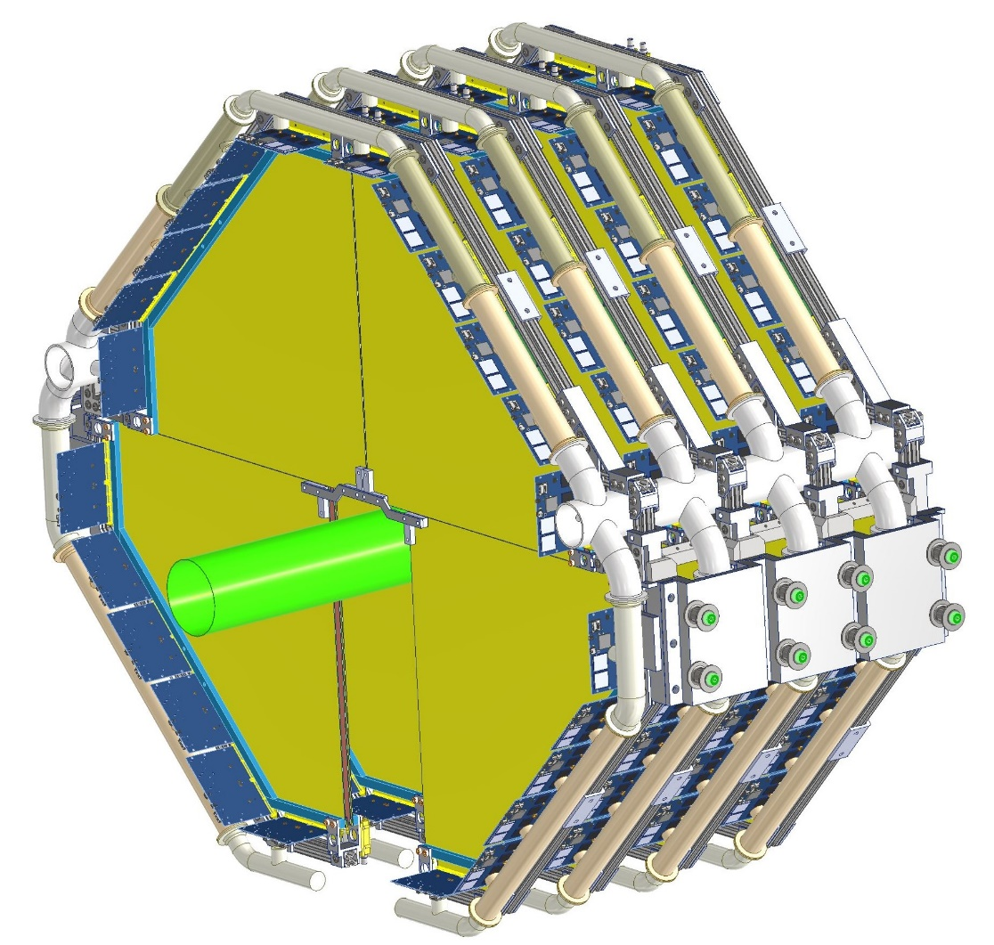
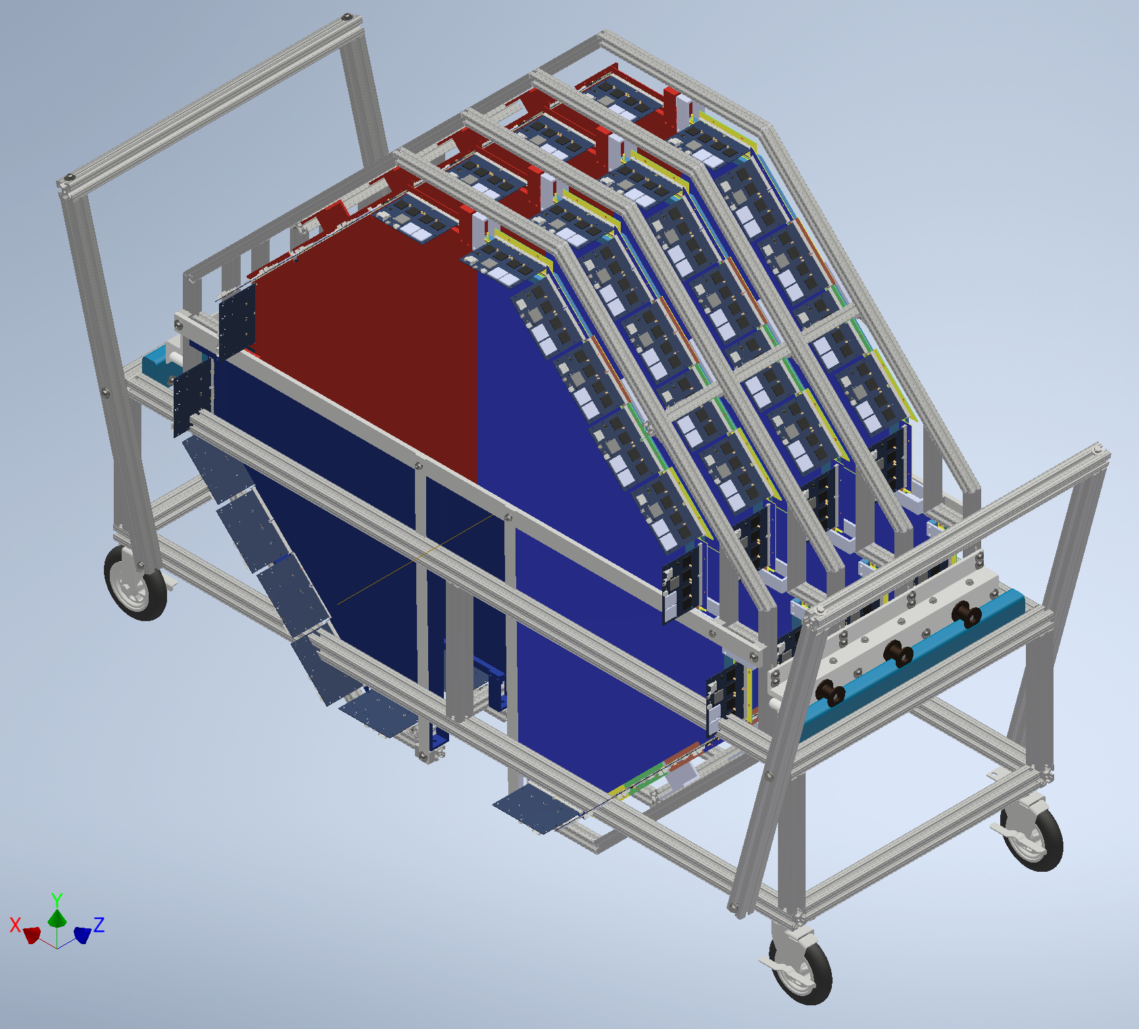
Future: installation 2
Once assembled they’re ready to be moved into the STAR hall

Slide 31
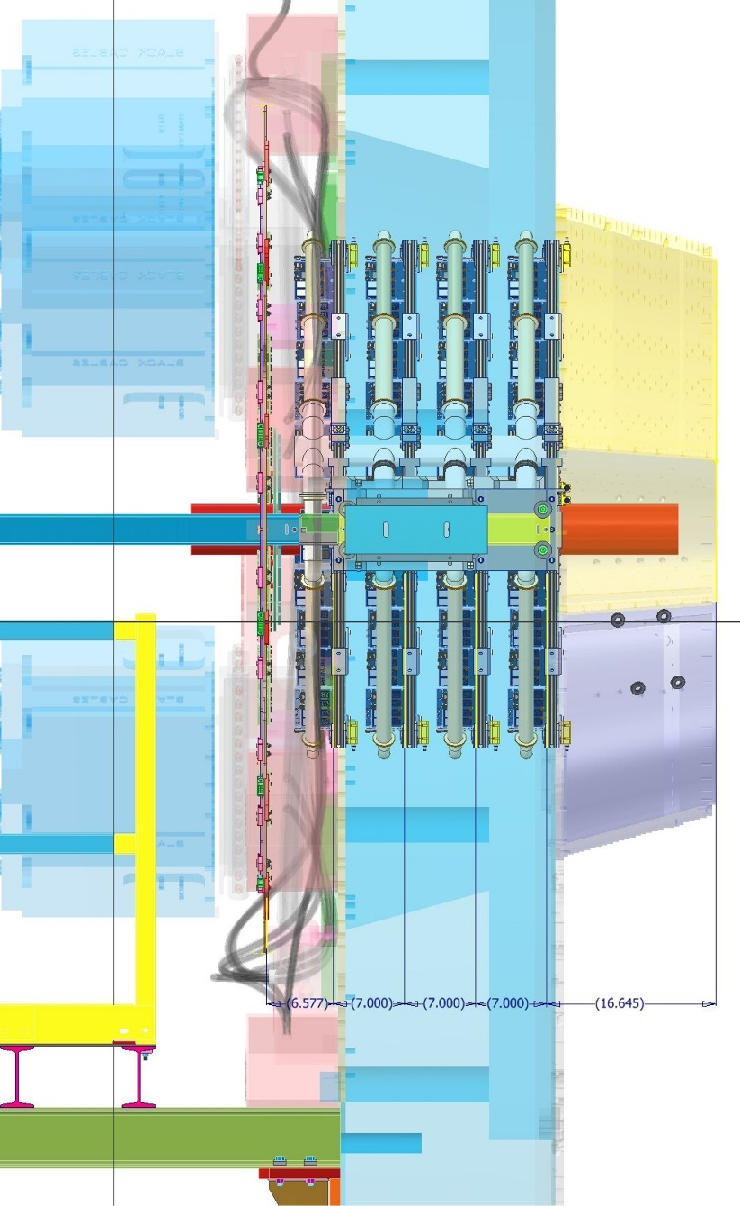
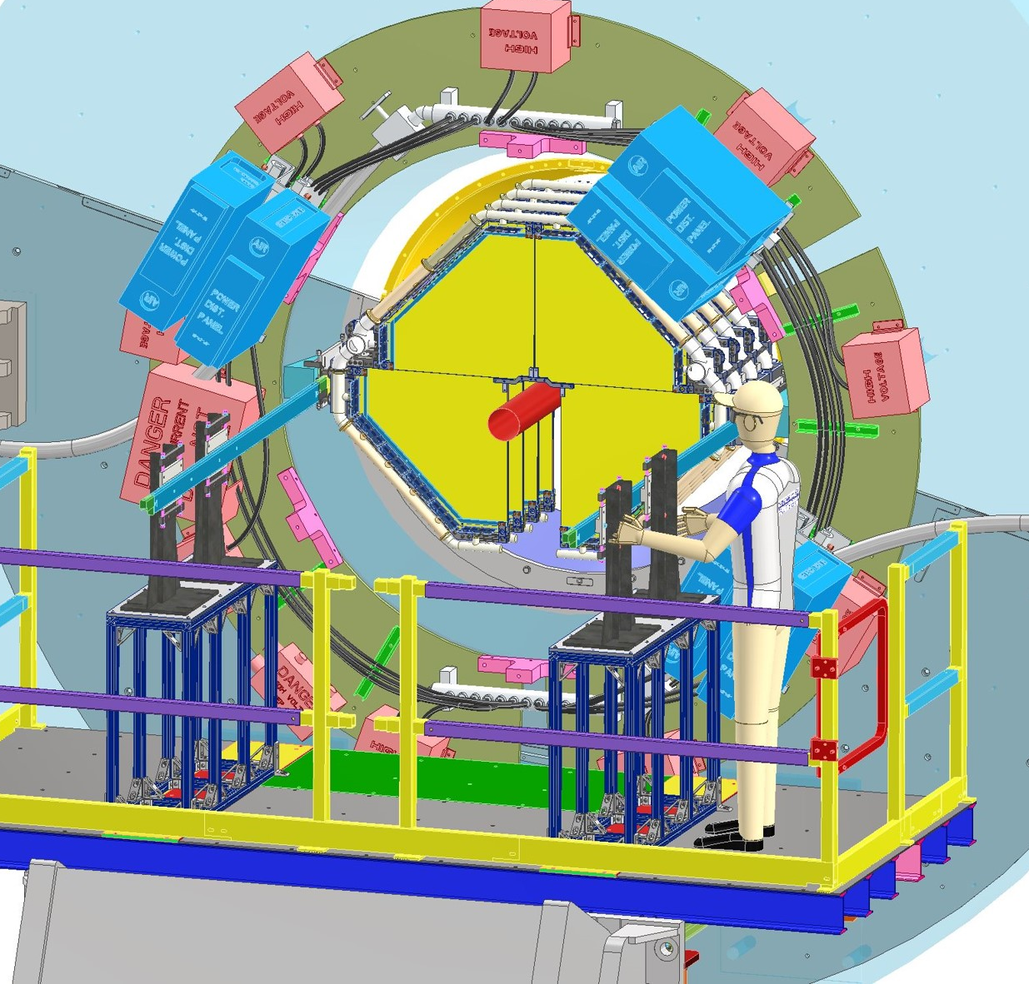
Future: installation 3
From there they’re brought on a lift and secured behind the STAR poletip

Slide 32
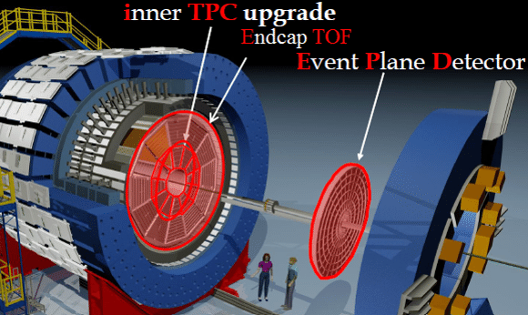
Extra STAR view
The pole tip is the large piece of blue iron on the right
It gets closed before we take data

Slide 33
Why a forward upgrade?

Slide 34
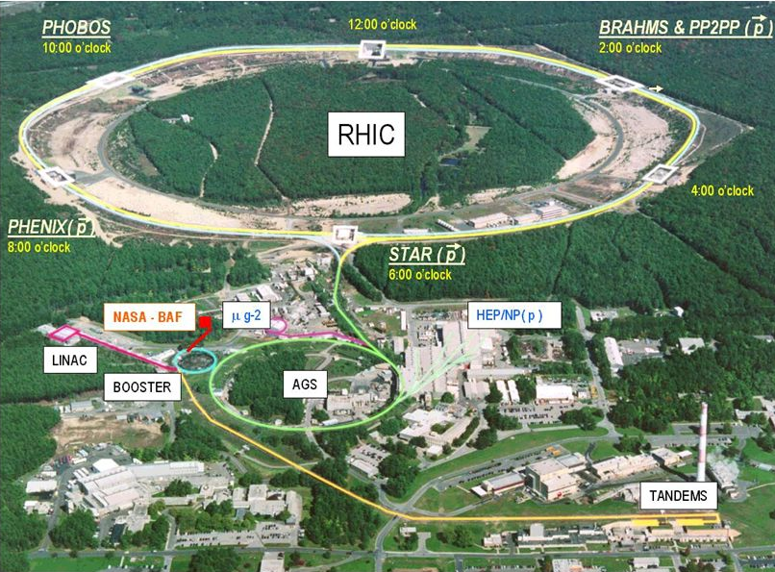
RHIC
RHIC is an incredibly versatile collider
Systems: p, d, t, O, Al Cu, Zr, Ru, Au, and U (+ combinations thereof)
Collider energies: 7.7 – 200 GeV (ion), 500 GeV (pp), and 3 – 7.7 GeV (fixed-target)
In addition to this, RHIC can collide transversely and longitudinally polarized protons

Slide 35
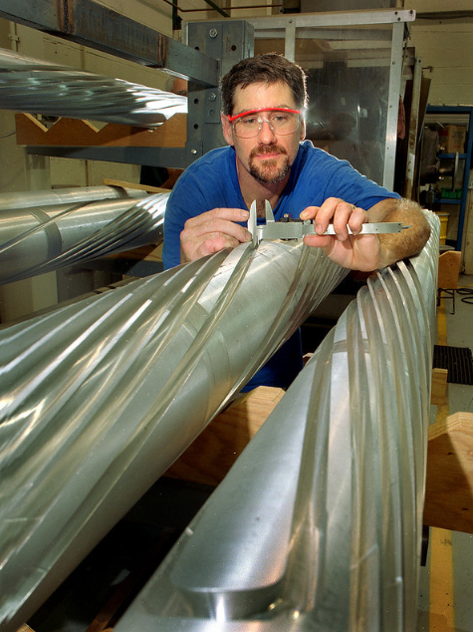
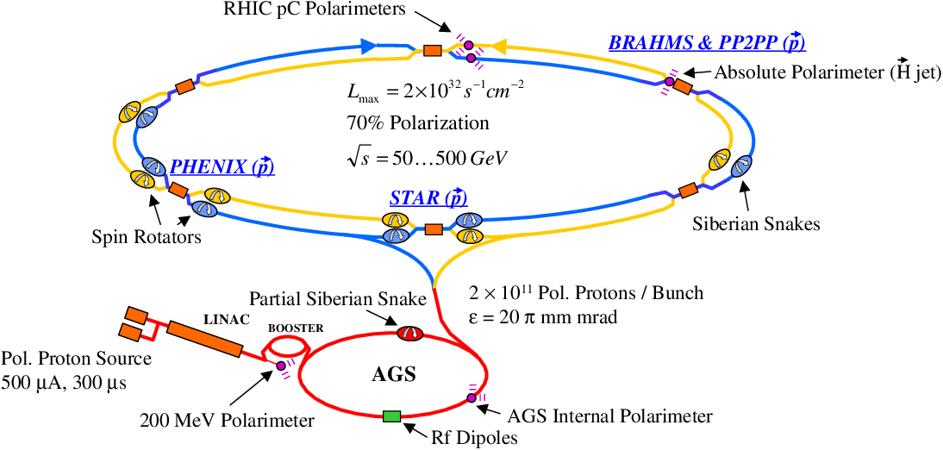
RHIC polarization schematic
Forward upgrade largely driven by spin physics (a truly unique capability at RHIC)
Heavy-ion physics also hopes to learn something along the way
Siberian snake polarizing magnets

Slide 36
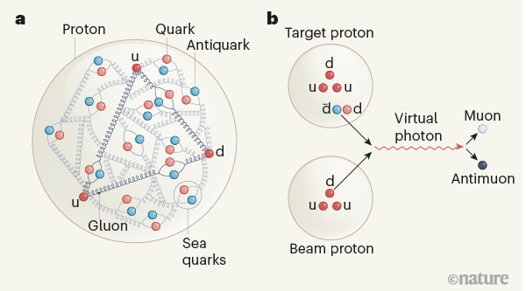
Picture of a proton
It is natural to think of the proton as being composed of only its valence quarks (uud), however this is simplistic
Protons are also composed of off-shell sea quarks and gluons
The momentum fraction of the constituents can be determined via deep inelastic scattering (scattering a lepton onto a hadron)

Slide 37
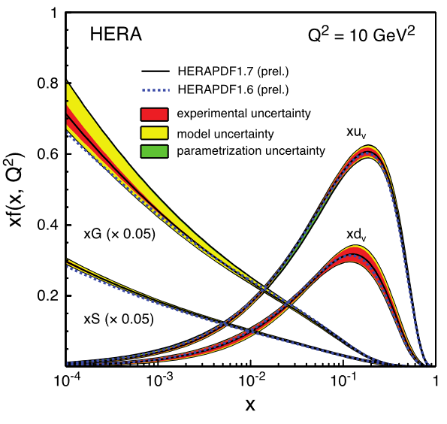
DIS -> PDF
This momentum fraction (x) is generally plotted against xf, the fraction of the proton’s momentum coming from each constituent.
At low x this is dominated by gluons
The particular shape will also depend on the momentum transfer of the lepton (Q^2)
This distribution is the Parton Distribution Function (PDF)

Slide 38
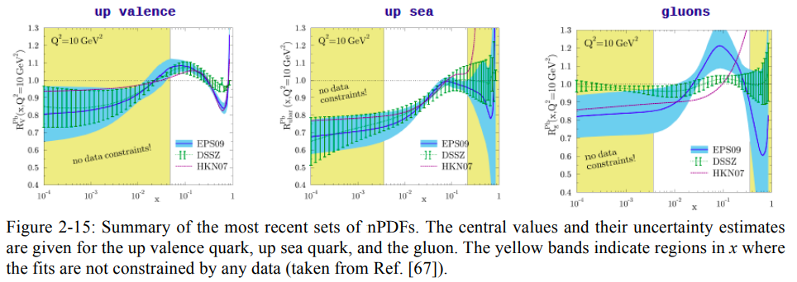
Nuclear PDF
At RHIC we’re interested in many emergent properties of large systems.
Effects from the distributions of partons are often seen in our observables
Though free-nucleon PDFs are well constrained, the PDF of a nucleon bound inside of a large nucleus is not
In order to better understand and constrain our measurements we need to such distributions, called nuclear PDFs (nPDFs)
Such distributions are not measured directly, but calculated via models from spin measurements of pA data

Slide 39
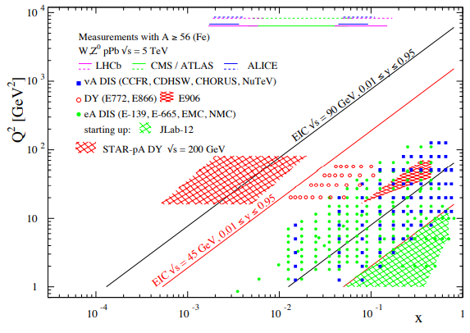
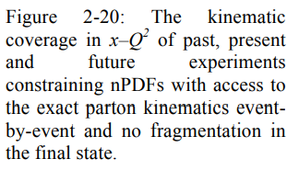
Nuclear PDF – Forward Upgrade
STAR can compete with the EIC in a way the LHC cannot
This provides not only useful unique data, but also a measurement for the EIC analysis to compare to
It has also been suggested that we take p-Al data to further map out the p-A dependence of the nPDF
Forward instrumentation increases the x range of the measurement

Slide 40
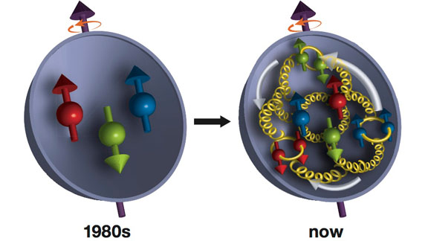
Proton spin
In the 1980s physicists assumed the spin of the proton came from the simple addition of the spin of the valence quarks
The EMC experiment proved that quark spin was a small fraction of the proton spin (called proton spin crisis!)
Where is the missing angular momentum?
In the gluons and the orbital angular momentum of the partons

Slide 41
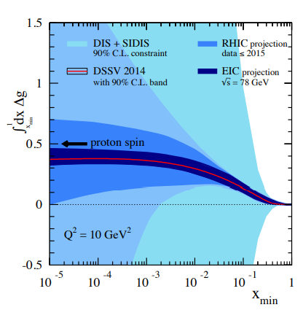
Gluon spin component
Measurements at pp 500 GeV can constrain the gluon polarization component of the proton spin
This again is the product of a fit of measurements, in this case dijet measurements, which can be done at STAR
Forward instrumentation allows measurements at wider ranges of x to better constrain the fits.

Slide 42
Transversity
Spin degrees of freedom are different for transversely polarized protons.
Knowing both distributions give insight into physics which is beyond the scope of this talk
The coverage of STAR’s measurements of the Collins and Sivers asymmetries are greatly enhanced in the forward region

Slide 43
Saturation
At arbitrarily low x the gluon component of the PDF dominates, but it is expected that there is a regime at which the production of partons is balanced by their recombination. This is called gluon saturation
Saturation provides an infrared cutoff of the strong coupling constant, allowing tree-level perturbative QCD calculations
Essentially we have deconfinement
The saturation scale grows with system size (A), so study pA collisions

Slide 44
Why care about saturation?
The standard model of heavy-ion collisions looks like this →
The data we get is at the extreme right of this evolution
In order to learn something about the medium phase – the Quark Gluon Plasma (QGP) we have to project backwards in time via models
Such models, e.g. hydrodynamics start after the pre-equilibrium dynamics, which are poorly constrained
Typically models use a parameterization, but real calculations may be possible with saturation physics

Slide 45
Flow – “the ridge”
Off-center AA collisions have a spatial anisotropy along the direction of the impact parameter.
If there is a medium this is translated into a momentum anisotropy, called elliptic flow
In two-particle collisions this causes a long-range (large η) correlation at Δφ=0
ATLAS has seen a ridge in high multiplicity pp collisions adding to a heated debate on if QGP is possible in such small systems
With a forward upgrade STAR can make plots with comparable η ranges
(PLB 718 (2013) 795)

Slide 46
Electron-ion collider @ BNL

Slide 47
EIC detector requirements

Slide 48
EIC concept detectors 1

Slide 49
EIC concept detectors 2

Slide 50
sTGC @ EIC

Slide 51
Conclusions
sTGC has managed to stay within time and hit all major QA guidelines so far
Important consideration for EIC detectors
Burning still in progress
Installation work yet to be done, as well as some remote control software work
After this it should be ready to take data and we can see how well it can track!

