Slide 1
Some Thoughts on Collaborative Software Projects: Beam Effects in Monte Carlo
Brian Page
Brookhaven National Laboratory
EIC Software Town Hall
January 27th, 2022

Slide 2
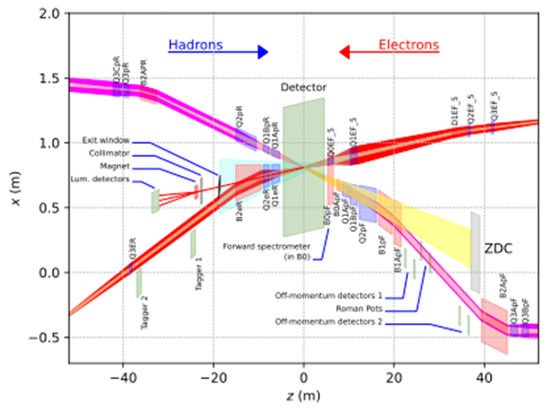
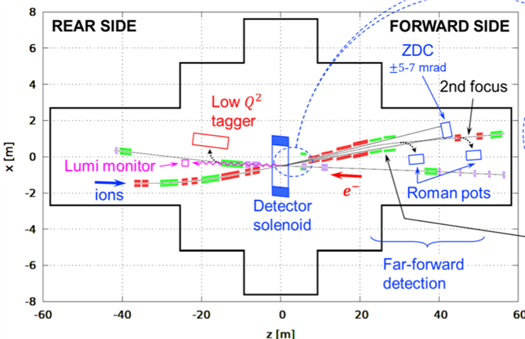
Background
Both proposed interaction regions at the EIC will have a substantial crossing angle
Need to include this effect in simulation – along with other accelerator effects such as beam divergence, energy spread, and perturbations from crab cavities
Early in 2021, cross-collaboration task force forms to quantify these effects and ensure consistent implementation – two options emerge for simulation:
Generator Agnostic Afterburner
Native Pythia8 Tools
I had been interested already in mocking up crossing angle effects in Pythia8 for jet studies, so I jumped on the Pythia8 implementation

Slide 3
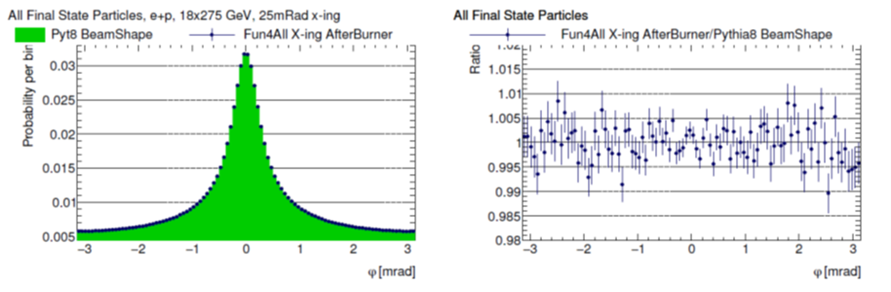
Collaboration and Cross-Validation
Ensuring consistency between approaches was key – both for consistency of results and to convince ourselves we weren’t making mistakes
Collaborated heavily with Jin Huang (and later Dmitry Romanov)who was developing Afterburner approach – code doesn’t need to be perfect, but should be such that others can make sense of what you are doing
Devil is in the details – agreement to the ~95% level was easy, last 5% was a deep dive into implicit assumptions about y cuts, electron cuts, particle lifetimes, etc

Slide 4
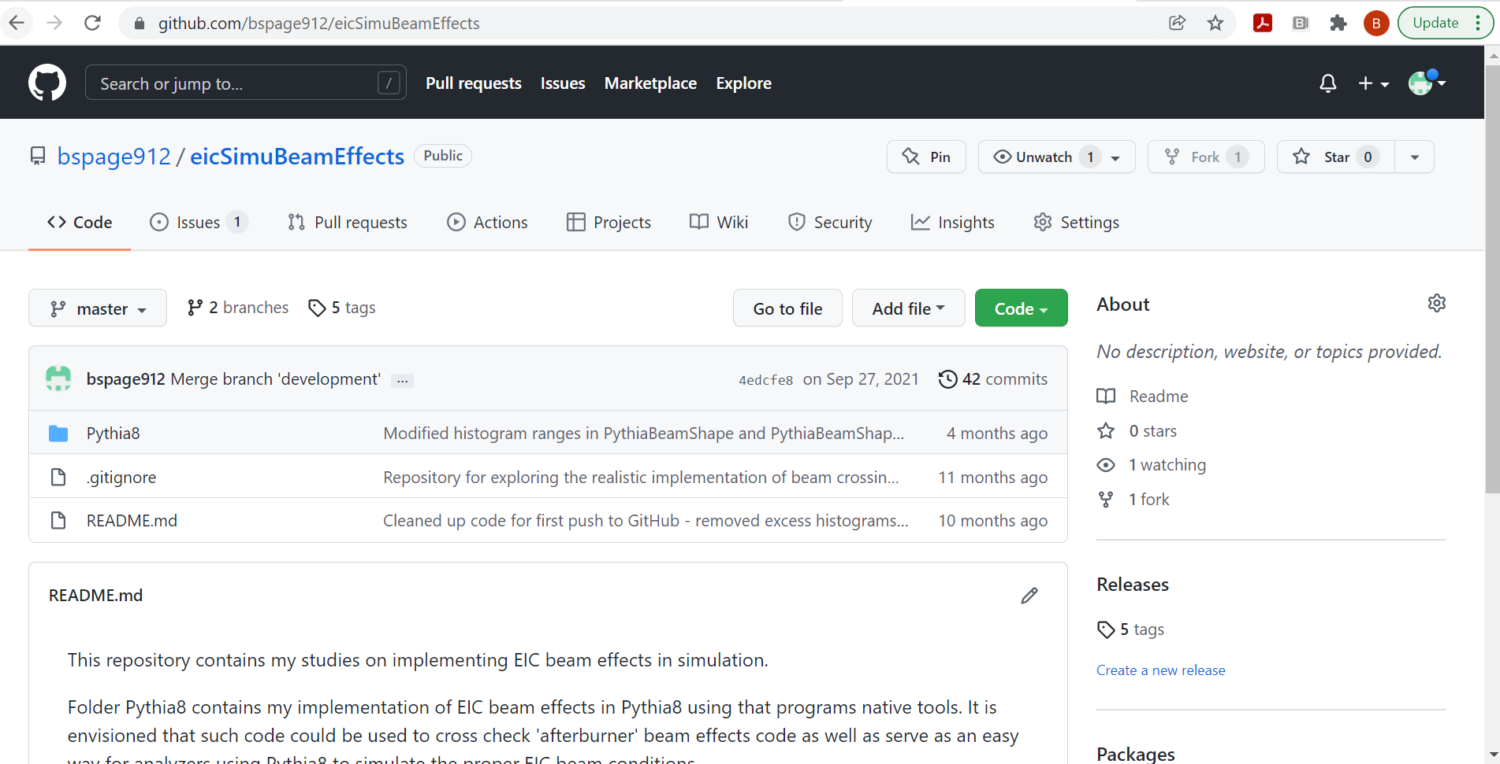
If You Build It, They Will Come (and Break It)
Once the task-force was convinced both methods were giving consistent and correct results, it was time to make the tools available to the various proto-collaborations
Once your code is out of your direct control, possibility that people will use it in unexpected ways and/or find bugs you simply overlooked
Specification of crossing angle: radians vs miliradians
Problem with energy non-conservation when simulating soft-diffractive events

Slide 5
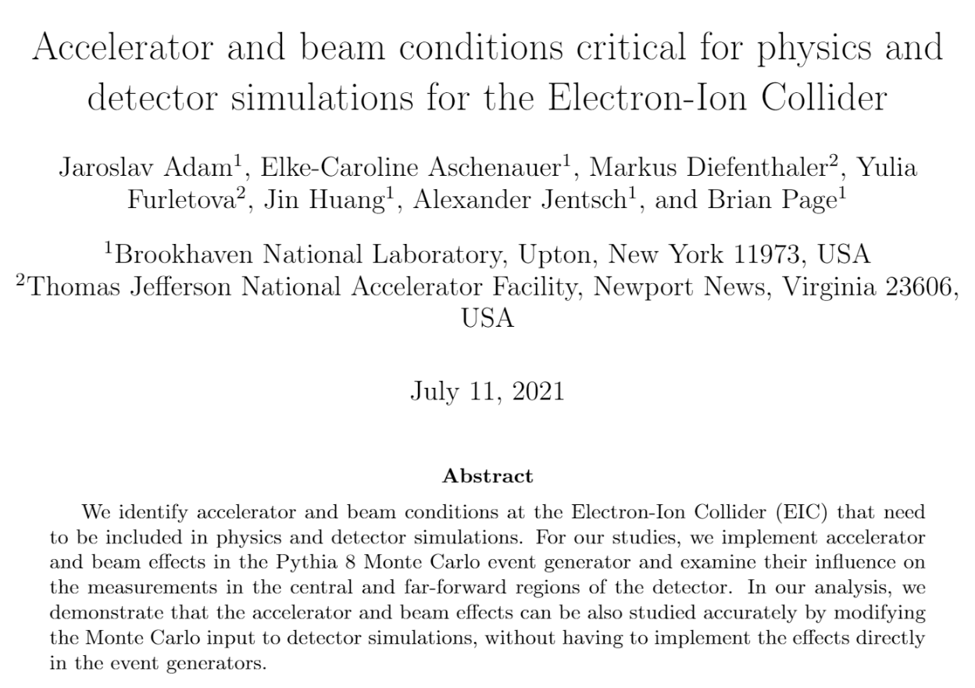
Engaging the Wider Community
A technical note was produced and made available to all proto-collaborations detailing all the accelerator conditions and how they were simulated
This is in the process of being turned into a publication
This effort spurred creation of a crossing angle theory task force in the EICUG
Has also gotten the attention of Pythia developers – in discussion about using this as a test case for a new ‘contrib’ repository for useful, user developed tools
https://eic.github.io/resources/simulations.html

