Slide 1
Internal rotation of Milky Way dwarf spheroidal satellites with Gaia
Early Data Release 3
Alberto Manuel Mart.nez-Garc.a,1.2★ Andr.s del Pino,3 Antonio Aparicio,1.2
Roeland P. van der Marel,3.4 and Laura L. Watkins5
1Instituto de Astrof.sica de Canarias, Calle V.a L.ctea S/N, E-38205 La Laguna, Tenerife, Spain
2Universidad de La Laguna, Dpto. Astrof.sica, Avda. Astrof.sico Fco. S.nchez S/N, E-38206 La Laguna, Tenerife, Spain
3Space Telescope Science Institute, 3700 San Martin Drive, Baltimore, MD 21218, USA
4Center for Astrophysical Sciences, Department of Physics & Astronomy, Johns Hopkins University, Baltimore, MD 21218, USA
5AURA for the European Space Agency (ESA), ESA Office, Space Telescope Science Institute, 3700 San Martin Drive, Baltimore, MD 21218, USA
Monthly Notices of the Royal Astronomical Society
Volume 505, Issue 4, August 2021, Pages 5884–5895, https://doi.org/10.1093/mnras/stab1568

Slide 2
Galaxies for which a statistically significagant Proper Motion (PM) could be determined.
The highlighted dwarf galaxies are the ones analyzed here.
Rotation detected in line of sight velocity

Slide 3
GAIA – capabilities
ASTROMETRY
Determine the position, parallax, and annual proper motion of 1 billion stars with an accuracy of about
20 µas at 15 mag, and
200 µas at 20 mag.
Or position equivalent
7 μas at 10 mag
12 and 25 μas down to V = 15
100 and 300 μas to V = 20
PHOTOMETRY
Wavelengths continuous spectra in the band 330-1050 nm for astrophysics and chromaticity calibration of the astrometry
SPECTROMETRY
Radial velocities measurements with a precision between 1 km/s (V=11.5) and 30 km/s (V=17.5)

Slide 4
Early Type – Stars are young and formed more recently, usually more heavy elements
Late Type – Stars are old and formed longer ago, usually less heavy elements
Dwarf Elliptical (dE) and Dwarf Spheroidal (dSph) and Ultra faint Dwarfs (UfD) Galaxies – Late type, old stars, little gas
Dwarf Irregular ( DIrr ) Galaxies- Early type, young stars and much gas (not the topic here)
All these galaxies are satellites of the Milky Way Galaxy (gravitationally bound)

Slide 5
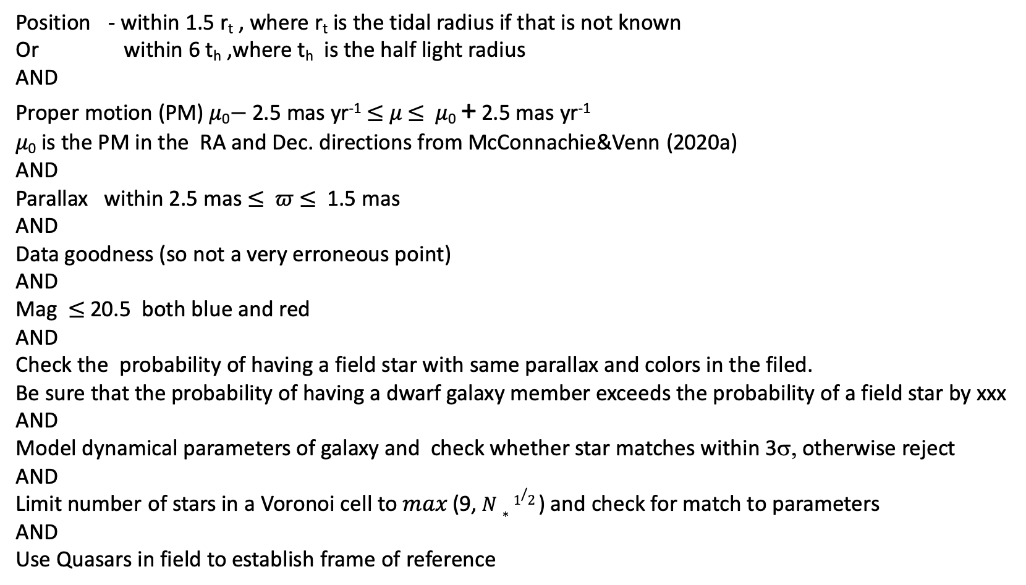
Selecting the Stars in dwarf galaxies, distinguishing from others in the FOV sequentially applied criteria to screen out non members
Position - within 1.5 r_{t} , where r_{t} is the tidal radius if that is not known
Or within 6 t_{h} ,where t_{h} is the half light radius
AND
Proper motion (PM) 𝜇₀$−$2.5 mas yr⁻¹ $≤$ 𝜇 $≤$ 𝜇₀ + 2.5 mas yr⁻¹
𝜇₀ is the PM in the RA and Dec. directions from McConnachie&Venn (2020a)
AND
Parallax within 2.5 mas $≤$ 𝜛 $≤$ 1.5 mas
AND
Data goodness (so not a very erroneous point)
AND
Mag $≤$20.5 both blue and red
AND
Check the probability of having a field star with same parallax and colors in the filed.
Be sure that the probability of having a dwarf galaxy member exceeds the probability of a field star by xxx
AND
Model dynamical parameters of galaxy and check whether star matches within 3σ, otherwise reject
AND
Limit number of stars in a Voronoi cell to 𝑚𝑎𝑥 (9,$N∗1/2$ ) and check for match to parameters
AND
Use Quasars in field to establish frame of reference

Slide 6
Left: the spatial distribution of the stars
in the sky. Middle: the distribution of the stars in the PM space. Right: the CMDs of the stars. In all panels, the black points represent the selected member stars
while grey points represent the sources extracted from Gaia EDR3 that were rejected by the selection procedure (see Section 2.1.2). In the leftmost panels, the
centre of the galaxies is located at Å0. 0º, and marked by a cross. Solid and dashed ellipses represent, respectively, the half-light and tidal radii of the galaxies.
Ursa Major
Carina
Fornax

Slide 7
Number of stars that passed the tests, number of Quasars, and proper motions
Quasars within 3º were used to establish a center of mass velocity for the field and the stars in the dwarf galaxy.

Slide 8
Galaxies for which velocities were computed ( dispersion in line of sight vel is smaller than mean velocity uncertainty)
Columns: (1) galaxy name, (2) projected ellipticity (McConnachie & Venn 2020b), (3) derived projected ellipticity (see Section 4.2.1), (4) velocity dispersion (McConnachie & Venn 2020b),
(5) dynamic mass within the half-light radius (see Section 4.2.1), (6) mean radial velocity in the plane of the sky, (7) mean tangential velocity in the plane of the sky, and (8) ratio rotation velocity to velocity dispersion. y, estimated in this work
Carina seems to be rotating, removed from some of the successive results since there are few stars.

Slide 9
Correlation of Ellipticity of Galaxy and Mass to Rotation Support Light blue lines are Monte Carlo Sim of relationship. These are used to give uncertainty. Assumes all stars in each dwarf galaxy are at the same distance

Slide 10
Rotation Results
Rotational speeds not
Generally Fornax, Sculptor, Carina
rotate in plane of sky, support is from
random motions.
Standard deviations derived from Monte Carlo
Simulations. Radial here is in the plane of the sky
toward/away from the center of the dwarf galaxy.
Radial (in plane of sky) red
Tangential blue
Radial variation
Azimuthal variation

Slide 11
Velocity as a function of distance from MW center Seeking to explore the effect of gravitation from MW on the internal rotation Not much evidence of rotational support for these galaxies.

Slide 12
RETICULUM II , Ultra Faint Dwarf
A HIDDEN, TINY GALAXY. Reticulum II (Ret II) is an ultrafaint dwarf galaxy on the outskirts of the Milky Way. (a) This image shows all the stars in the direction of Ret II. The horizontal bars on the brighter stars arise from saturation effects. (b) Sophisticated image search algorithms can identify the stars in panel a that are members of Ret II. A coherent structure is clearly visible. (Courtesy of the Dark Energy Survey/Fermilab.)

Slide 13
Bootes I, dSph
About 10⁵ L_{solar}

Slide 14
Sagittarius II dSp or dE
Messier 54, believed to be at the core of Sgr dSph. Greyscale image created from the HST's Advanced Camera for Surveys
Includes 4 known globular clusters, and has lost Palomar 12 to the Milky Way via gravitational interaction.

Slide 15
Sagittarius II dSp or dE
Visible light image, negative, 9 arcmin on a side, Schmidt 48 inch telescope

Slide 16
Draco, dSph
Mass/Light =400 solar masses/solar luminosity

Slide 17
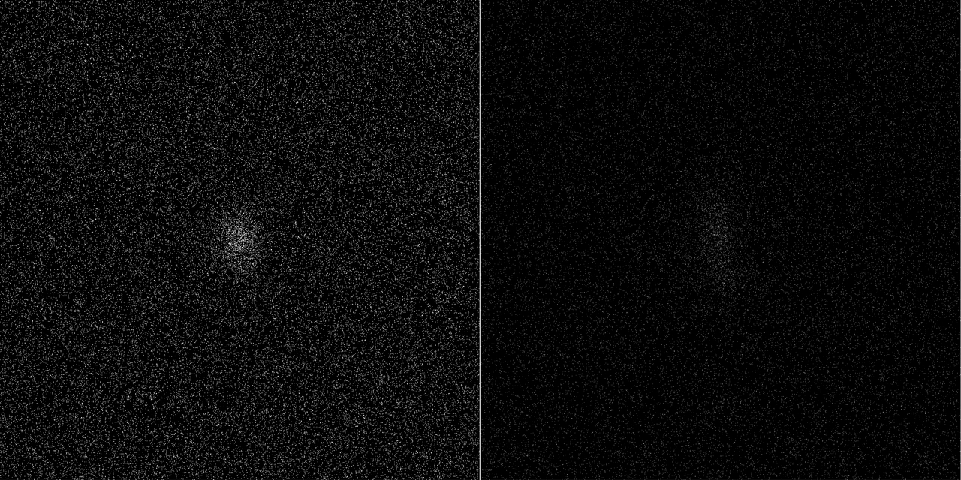
Ursa Minor
Images from Gaia
Draco and Ursa Minor dwarf galaxies
Date: 25 April 2018

Slide 19
Ursa Minor

Slide 20
Sculptor

Slide 21
Sextans

Slide 22
Ursa Major I
Much less dense than Sextans

Slide 23
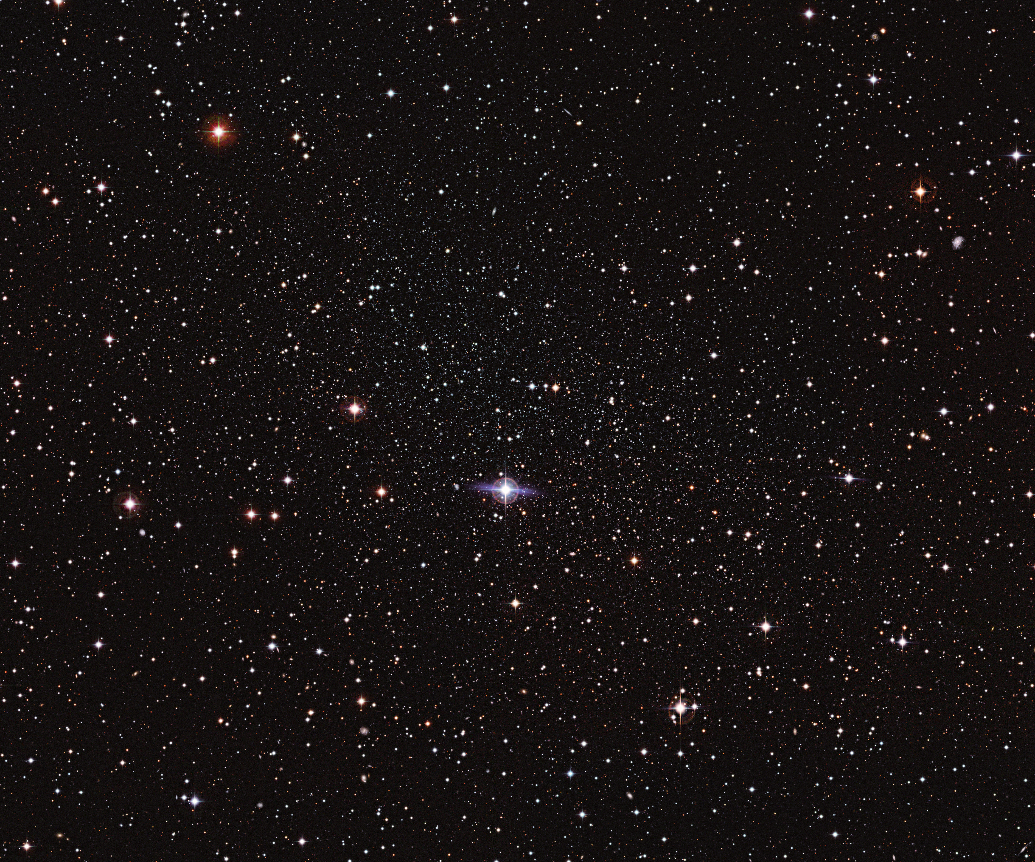
Carina

Slide 24
Crater II
No photos found, over density discovered numerically.

Slide 25
Fornax

Slide 26
Canes Venatici I
Fig. 8.— The spatial distribution of CVn II dSphs. Left: Thespatial distribution of the member candidates selected from each CMD. The tidal radius of CVn II is shown as solid. Right: The isodensity contour of the member candidates. The solid and dashed arrows indicate the directions of Galactic centre
(Sgr A) and Galactic latitude toward the disk respectively.

Slide 27
Leo I
Regulus, star
Dwarf Galaxy

Slide 28
Leo II

