Slide 1
Proposed path forward for EIC proto-collaborations engagement with the EICSC (and beyond)
Goal: Agree on above
To inform the discussion, we will present some background on:
The EICSC
Proposal for a common set of silicon tracking detector CAD files for all proto-collaborations
Discussion of how this fits into the proto-collaboration goals and needs and how we can collaborate.
How this fits into the overall EICSC goals and schedule.

Slide 2
History and goals
The idea of adapting MAPS silicon sensors that were under development at CERN for the ALICE ITS-3 detector for use in an EIC tracking detector was first presented in December 2019
https://indico.jlab.org/event/348/sessions/1224/attachments/4665/5789/open-mic.pdf
This idea formed the basis of the eRD25 project (Birmingham, LBNL, RAL) whose aim was to lay the groundwork for the development of an EIC vertex and tracking detector based on this technology:
https://wiki.bnl.gov/conferences/images/1/1c/ERD25-proposal-Jul20.pdf
One fundamental aspect of the proposal was the establishment of a much broader EICSC to grow the required base of expertise to develop a full inner tracking solution for EIC detectors based on a new 65 nm MAPS technology (sensors, mechanics, services, cooling, readout, etc.).
This was the basis of the EICSC proposal to BNL for the Expression of Interest, that was signed by LBNL, BNL, CCNU, JLAB, ORNL, and seven UK groups: https://indico.bnl.gov/event/8552/contributions/43219/. This EOI formalized the start of the EIC SC.

Slide 3
History and goals
The EICSC is a collection of institutions that work towards the common goal of developing a complete silicon tracking detector solution based on ITS-3 technology for use at EIC. We have welcomed anyone with interest in our goals to join from the start and continue to do so. What we can produce is limited by our membership resources, and at the moment, EICSC institutions are dedicating their own resources to advance this effort.
The EICSC is not tied to a specific detector proposal/proto-collaboration, but open to institutes from all proto-collaborations interested to work on the proposed detector solution for their specific EIC detector implementation, as stated here https://wiki.bnl.gov/conferences/images/3/36/ERD25-Mar20-final.pdf. It has always been our goal to provide a forum and structure for those working on silicon for EIC and we will of course work on all aspects that are useful to the (proto-) collaborations and consistent with our focus.
This format is only natural as all proto-collaborations have adopted the technology proposed by the EICSC and work on the realisation of the detector can only progress if the EICSC has enough resources. What we generate should be useful to all. This approach maximises the successful delivery of the technology with the lowest cost to the project.
We encourage all proto-collaborations to engage actively with the EICSC effort to reach their goal of realising a silicon tracker for the EIC.

Slide 4
Path forward for development of silicon tracking detector for EIC: Stage 1
Meeting held on 2021_07_03 with Leo Greiner, Jim Fast, Walter Sondheim, Ernst Sichtermann, Laura Gonella with discussion of how to move forward with agreement on a two-stage plan.
Stage 1. Generation of simple silicon tracking detector simulation model. This would be the all-silicon design with the parameters shown in the YR and documented (insert link). It will contain:
the active silicon areas
proper sizes of the detector elements (stave thickness, discs, etc. to map out the needed space)
elementary mechanics that put mass of the proper types in the proper places to provide internal supports and interface to global supports.
Elementary service loads based on the parameterization already done and presented. This will be modified to reflect at least DC-DC converters for power and more in subsequent versions.
This model would be released to the proto-collaborations and will form the basis of a common silicon tracking detector baseline based on the all-silicon concept. This should allow more realistic simulations to begin as quickly as possible. Proto-collaborations that wish to modify the models to fit their particular detector design ideas would have a good starting point and they should continue consultation on those within the EICSC.

Slide 5
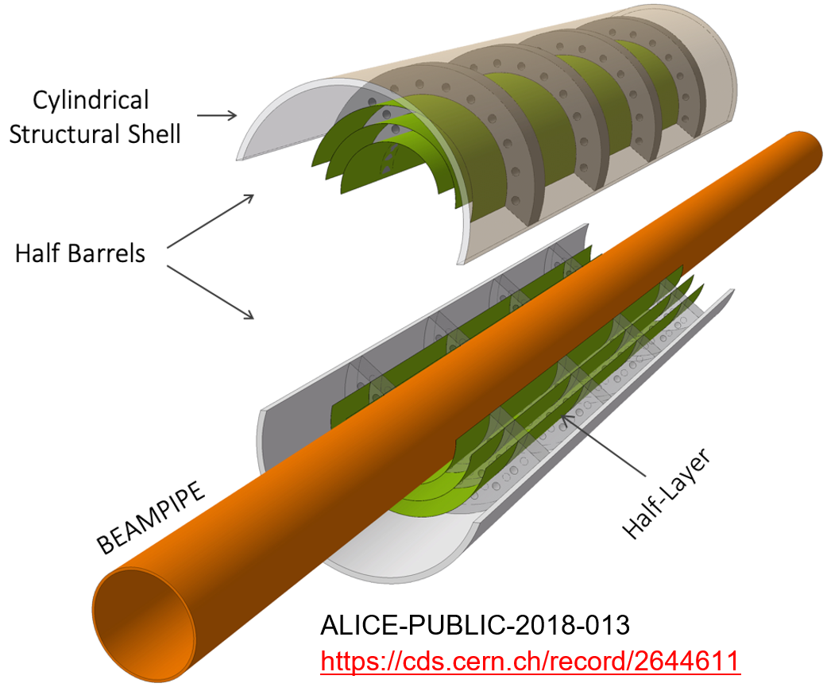
Elements of the vertexing layers
2 x 40um silicon layers at nominal all-silicon radii
structural shell (300 um thick) and carbon foam (5%?).
services of appropriate sizes exiting from both ends of vertexing layers and routed out.
Provision in the full design for air cooling needs (ducts and exit from the carbon support shell).
Mechanics for positioning the vertexing layer assemblies into the full silicon tracking detector.

Slide 6
Elements of the barrel layers
silicon
Composite flex PCB and cooling plate
50 um thick silicon active areas
Flex PCB and composite cooling plate material definitions to give nominal X/X0.
Layers at nominal positions defined for all-silicon detector.
Layer tilt and overlap to be defined and then tested by simulation (start with 1mm overlap and 15 degree tilt? TBD).
services of appropriate sizes exiting from one end (hadron) of stave layers and routed out.
Mechanics for positioning the set of barrel layer assemblies into the full silicon tracking detector.
Mechanical space holder for support truss

Slide 7
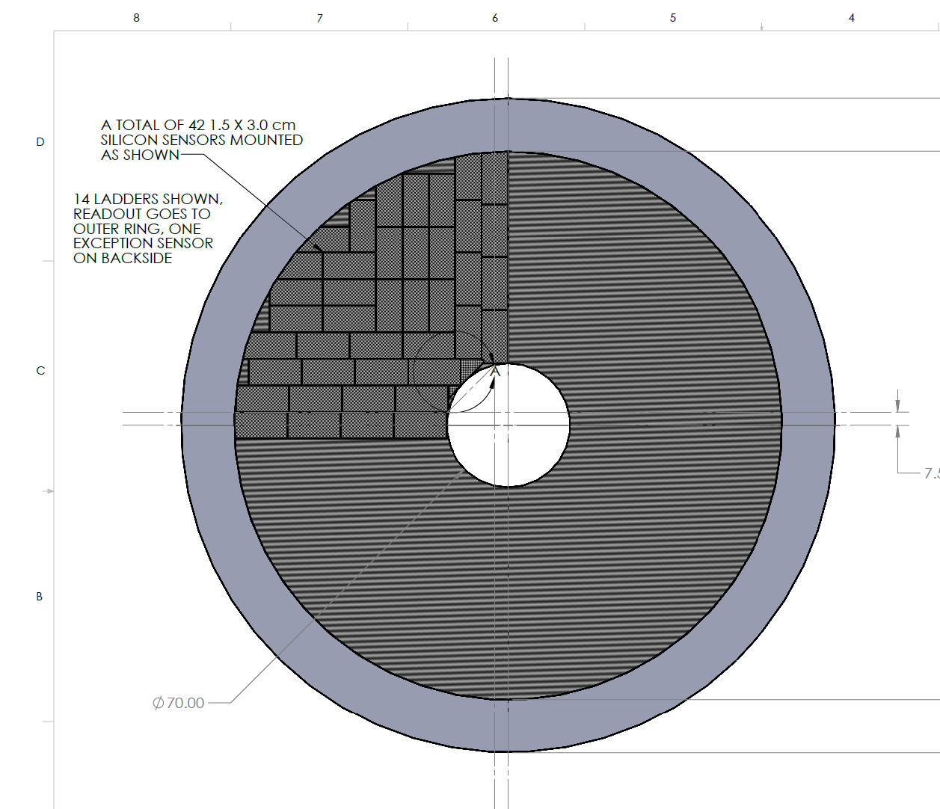
Elements of the discs
component | % X/X0
plate | 0.15
Si | 0.05
FPC | 0.13
Water + tube | 0.03
Glue + other | 0.04
total | ~0.4%
Start with single sided plate option (see next slide for dimensions, X/X0.
Keep nominal all-silicon detector active areas and positions
services of appropriate sizes exiting from the outer circumference of the disc layers and routed out.
Mechanics for positioning the set of layer assemblies into the full silicon tracking detector.
Tiling comes later

Slide 8
Cross section of half disc plate (for all plate models) under each sensor
10% carbon foam (4 mm)
0.15% X/X0
(0.11% carbon, 0.04% glue)
Carbon fiber face sheet (200 um)
Silicon (50 um) = 0.05% X/X0 / layer
Al conductor FPC (60 um Al + 25 um kapton) = 0.13% (Al thickness reduced assuming ITS-3 like power dissipation)
water + kapton cooling tube (2mm) = 0.03% (assume 1 cooling tube per sensor due to reduced dissipation

Slide 9
Path forward for development of silicon tracking detector for EIC: Stage 2
Stage 2. After the baseline all-silicon model is delivered, we would then continue work on the design and detailing of our CAD models for use in the project full detector model concept. This would include:
Work on the effects of reticle size and implications for vertex layer spacing.
Design of discs and tiling of reticles – gaps.
Detailing of mechanical supports and design ideas for inserting vertexing layers as clamshell (still need to figure out how to keep disc edges away from hot beam pipe).
Interfacing to global mechanical supports.
Detailing and revising services routing and quantities.
Tracking support shells and how to integrate the packages.
Meeting the constraints imposed by overall detector needs (bakeout, inserting full detector, etc.)
The idea is that as we refine the design, we would make more detailed models that would then be passed to the proto-collaboration simulation efforts. We would also take feedback from the simulations and identify areas where we need to modify the baseline designs to improve the design to meet physics needs. This will be an ongoing feedback loop that will continue through the development of the overall detector design tailing off after the TDR and CD-3.

Slide 10
Discussion
During Stage 2, as the models reach a moderate level of maturity and we have some better understanding of the form of the mechanics and services, we will begin work on the generation of costing and schedule for the all-silicon model. This can be the basis for cost estimates for all the proposed configurations.
How well does this proposal meet the needs of the proto-collaborations?
How can the proto-collaborations help in this effort?
Currently we have people from the proto-collaborations helping in the EICSC efforts. As we move into full detector collaboration(s) we hope and expect that the effort will continue and focus on the proposed detector layout(s).
Again, all are welcome, and we have a large amount of development to produce a viable silicon tracking detector design. The work spans many disciplines.

Slide 11
Additional upcoming EICSC tasks
Technical tasks are best described in EICSC meeting of May 17, 2021
https://indico.bnl.gov/event/11683/contributions/49634/attachments/34496/55944/2021_05_06_EICSC_WP_proposal.pptx
However – tasks like the ones currently under discussion are needed by the community and are also important and time critical and we engage with them as the need arises.

Slide 12
Plans – (strongly tied to ITS-3 schedule)
2021 –
Testing and characterization of MLR1
Sensor design for MLR2 or ER
R&D into powering, stave/disc construction, cooling, overall infrastructure
MLR2 submission
Thinning, bending and sensor interconnection
2022 -
Testing and characterization of MLR2
Sensor design for ER
R&D + prototyping into powering, stave/disc construction, cooling, overall infrastructure
ER submission
2023 -
Testing and characterization of ITS3 ER and assessment of yield
Assessment and planning for EIC sensor fork of ITS3 design
Fork off sensor design and work on EIC variant for staves and discs (may move to next year depending on results)
Detailed prototyping into powering, stave/disc construction, cooling, overall infrastructure
ER submission for EIC variant sensor for staves and discs (may move to next year depending on results)
Investigation of adaptation of ITS3 design for use in EIC inner layers (different radii, # layers, services from both ends to meet length requirements, etc.
2024 –
Testing and characterization of EIC ER and assessment of yield
Si design for EIC ER2
Detailed prototyping into powering, stave/disc construction, cooling, overall infrastructure using EIC ER1 prototypes.
ER2 submission for EIC variant sensor for staves and discs
adaptation of ITS3 design for use in EIC inner layers and integration of design into ER2 if necessary.
We are developing two detector concepts:
ITS3 like for the vertexing layers.
EIC variant for the staves and discs.
We will need to develop the capabilities to bring both detector concepts and the associated infrastructure to completion.

Slide 13
Expanded task list for 2021 (applies to following years as well)
These tasks complement and are in addition to robust participation in the ITS3 work packages to prepare for the EIC vertexing layers design.
2021
Testing and characterization of MLR1 – EICSC WP3
design of testing system that extends into the testing of the next submissions. Beam testing, Latch-up testing, SEU testing, radiation tolerance testing (kRAD, NIEL), firmware, software, mechanical carriers, alignment stations, analysis, etc. This work is starting in ITS3, we can/should join this effort.
Sensor design for MLR2 or ER – EICSC WP2
Inclusion of other silicon design sites into the design process (in progress), Assessment of the testing results and incorporation into the new designs, significant digital design (in pixel logic, readout structures and architecture), design for stitching, significantly more complex structures and pixel layout studies, design for yield, etc.
R&D into powering, stave/disc construction, cooling, overall infrastructure – EICSC WP5
Take up DC-DC converter and serial powering R&D, studies of stave and disc design, cooling studies (air for inner layers, liquid? For outer layers and discs), investigation of on detector data multiplexing and implications for single point failure and redundancy studies, initial studies for carbon fiber designs for overall mechanical support structures, services routing studies, radiation length minimization, etc.
MLR2 submission – EICSC WP2
Detailed silicon design as per sensor design section, layout and DRC, integration into MLR, etc.
Thinning Bending and Interconnection – EICSC WP3
Thinning/bending studies, test beams and assessment, interconnection designs

