Slide 1
CORE Tracking
9 August 2021

Slide 2
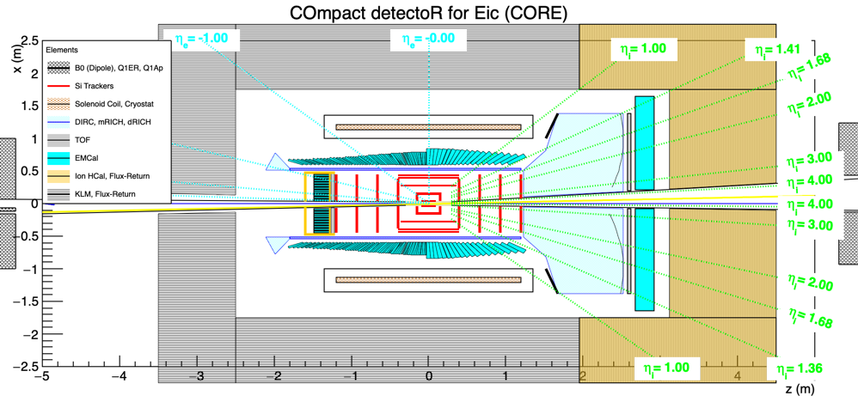
Si Tracker with dimensions/layout or eRD25. (45 cm outer radius)
Added Barrel layer for K_{S}
Extend outer barrel layer to 2nd Disk for DIRC resolution → Similar to ATHENA all Si
3-layer DC-LGAD after last MAPS Disk

