Slide 1
Improvements to the CeC Systems
CeC Experiment at RHIC
CeC X Retreat
Jean Clifford Brutus
August 16th,2021

Slide 2
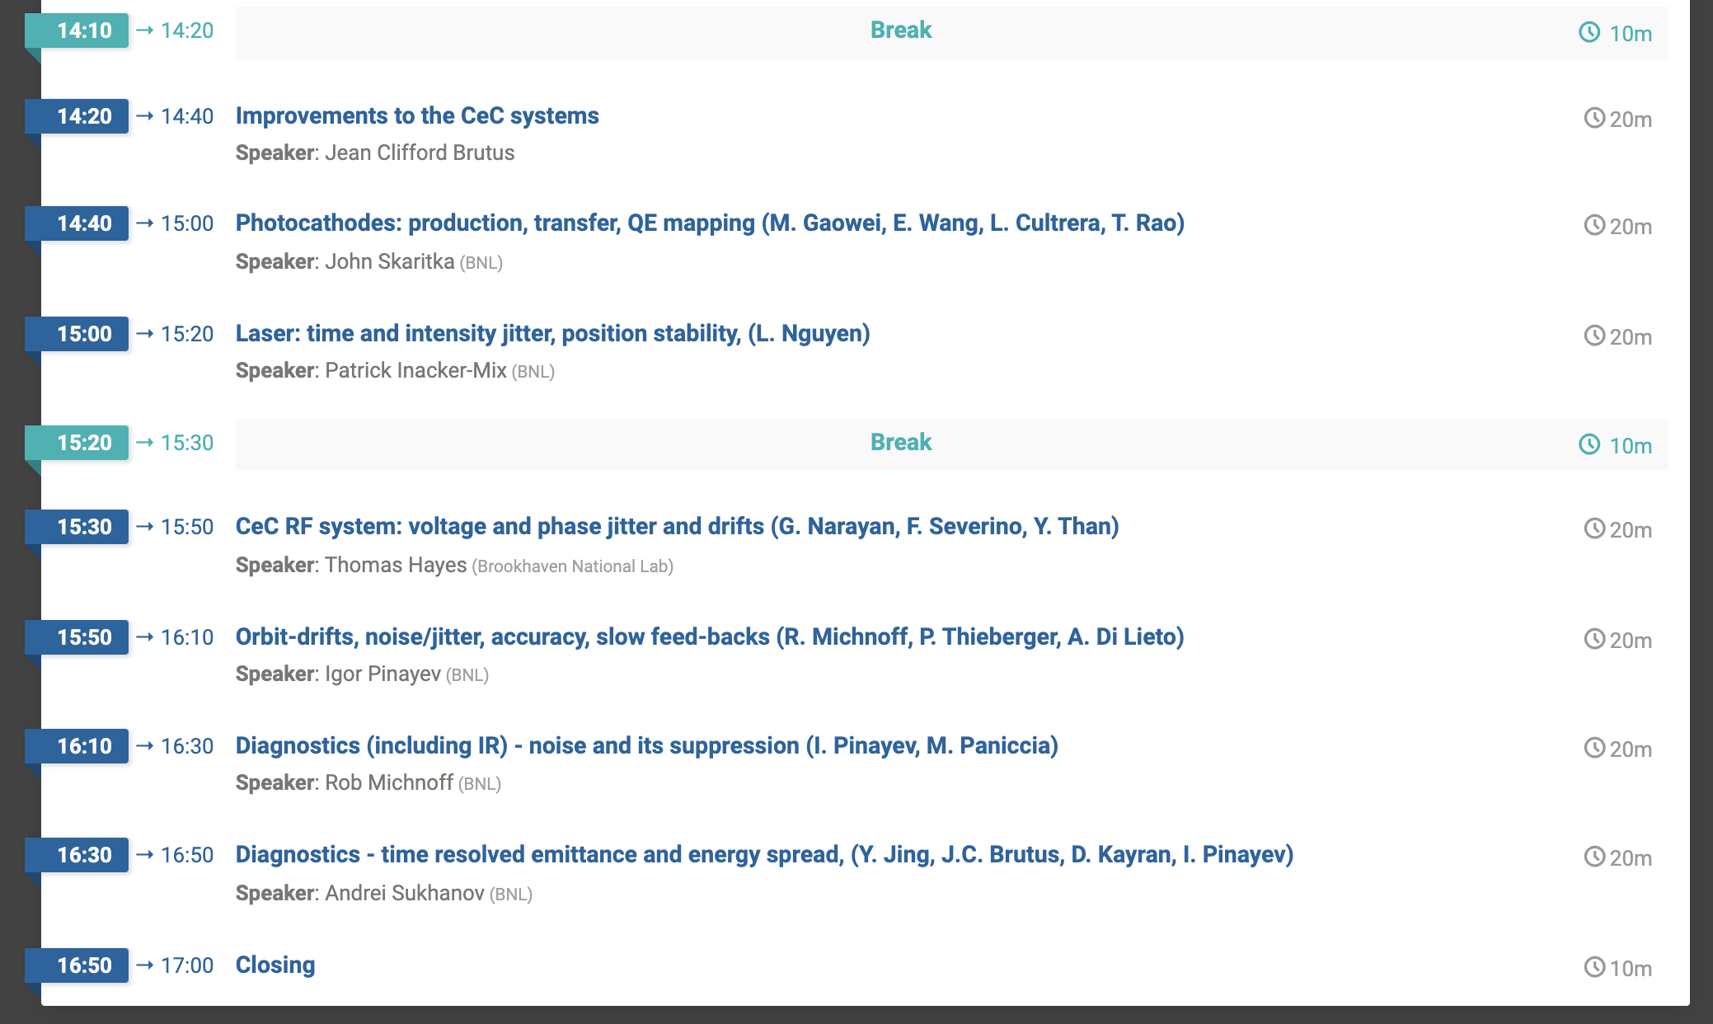
Key Presentations
2

Slide 3
CeC Shutdown 2021 Upgrades
# | Work
1 | 500 MHz Removal
2 | Horizontal/Vertical Slit
3 | Profile Monitor
4 | Cathode System Upgrade
5 | Replace Q1 in the TRDBL by one with working trim coils - in current quad two out of 4 trim coils are broken
6 | 500MHz Coax Inspection
7 | DCCT
8 | Solenoid
9 | H/V Trims relocation
10 | Wiggler/Undulator
11 | Heating Jackets Removal
12 | Compensating Coil
3

Slide 4
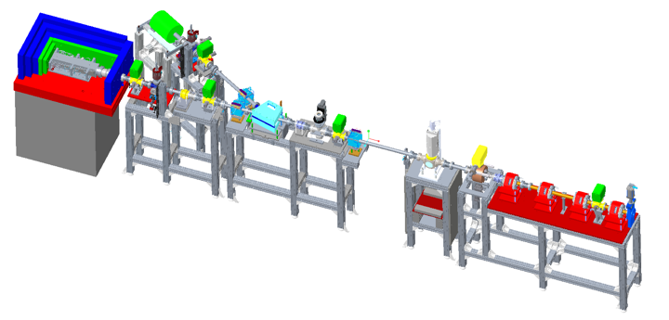
CeC Beamline Modifications
Time Resolved Diagnostics Beamline
4

Slide 5
Changes to Diagnostics Beamline
V/H Slit
New Profile Monitor & Solenoid
Replace Quad
5

Slide 6
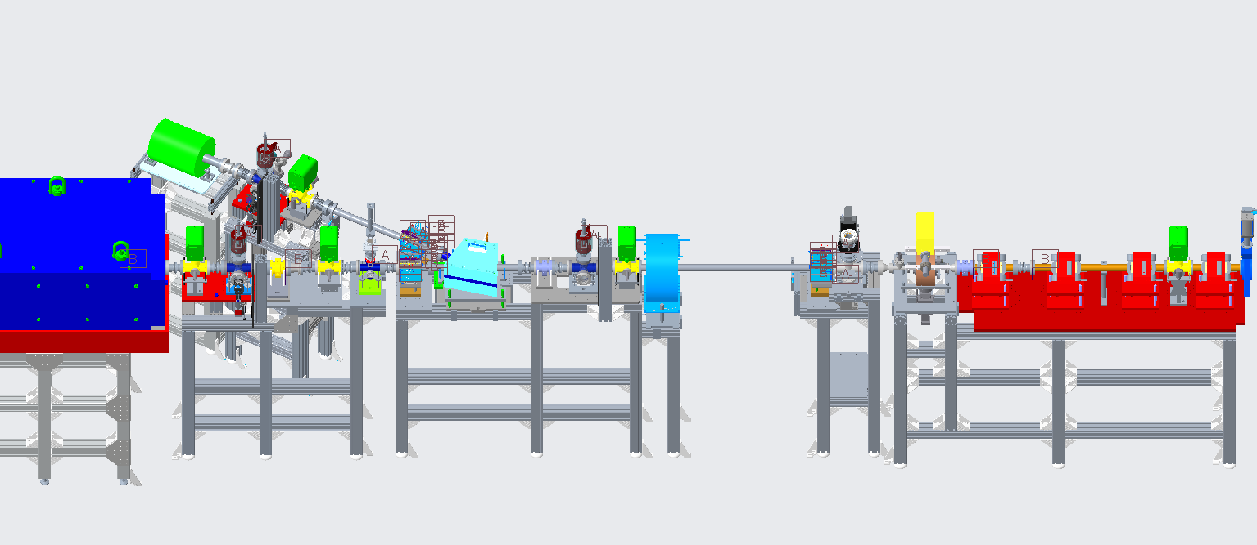
Diagnostics Beamline Upgrade
New Solenoid
TROG
New spool
New spool
New V/H Slit
New Profile Monitor
H/V Corrector
Replace Quad
6

Slide 7
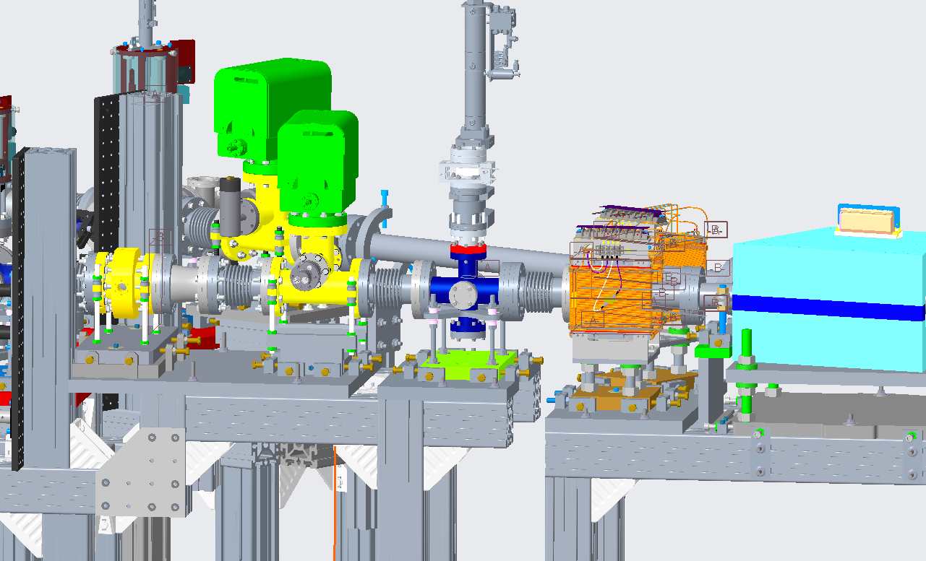
H/V Slit
Stand modification design completed
Beamline vented and vacuum components removed
BPM and ion pump relocated; survey to follow
Delay from vendor for H/V Slit Custom cross 10/05/21
7

Slide 8
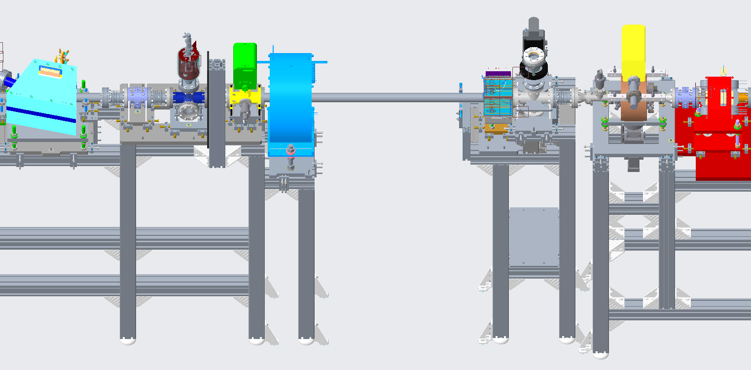
Profile Monitor and Solenoid
Stand modification design completed
Work in progress for relocation of H/V corrector and removal of Diamond detector stand
Delay from vendor for profile monitor cross 10/05/21 – fabrication of new cross in house as backup
8

Slide 9
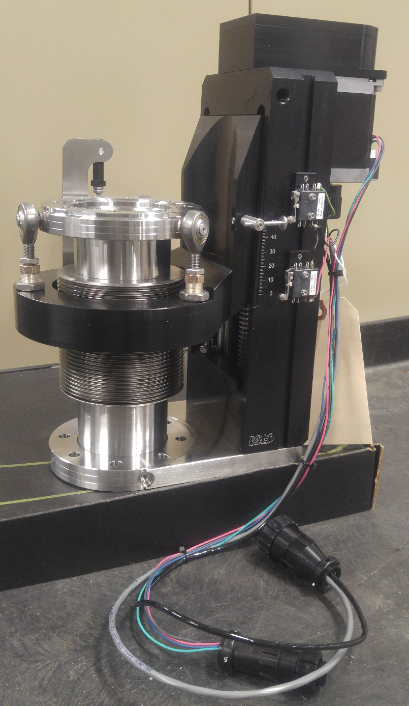
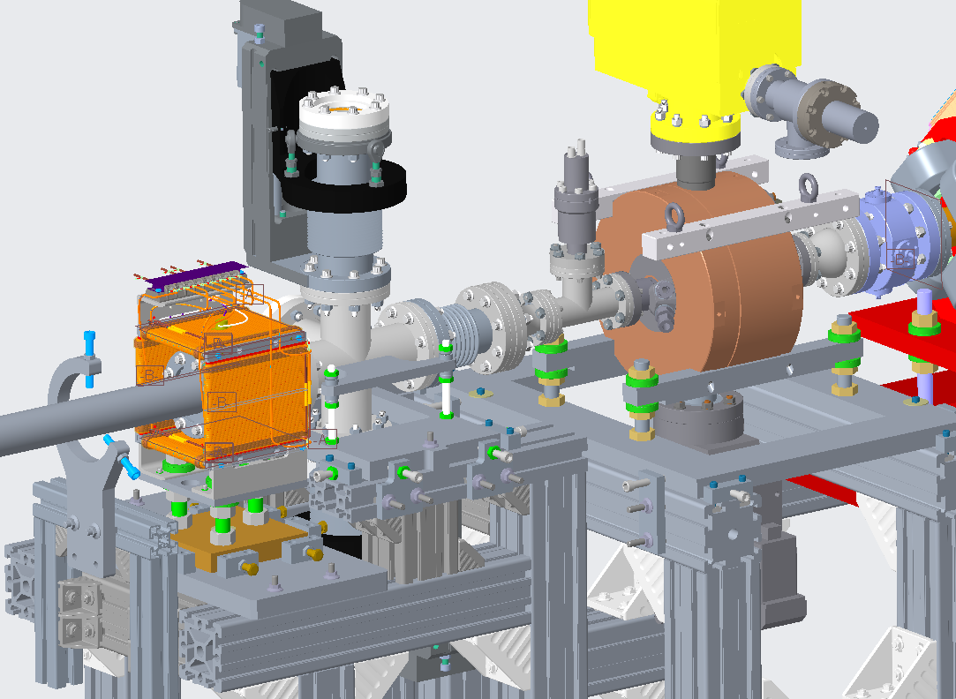
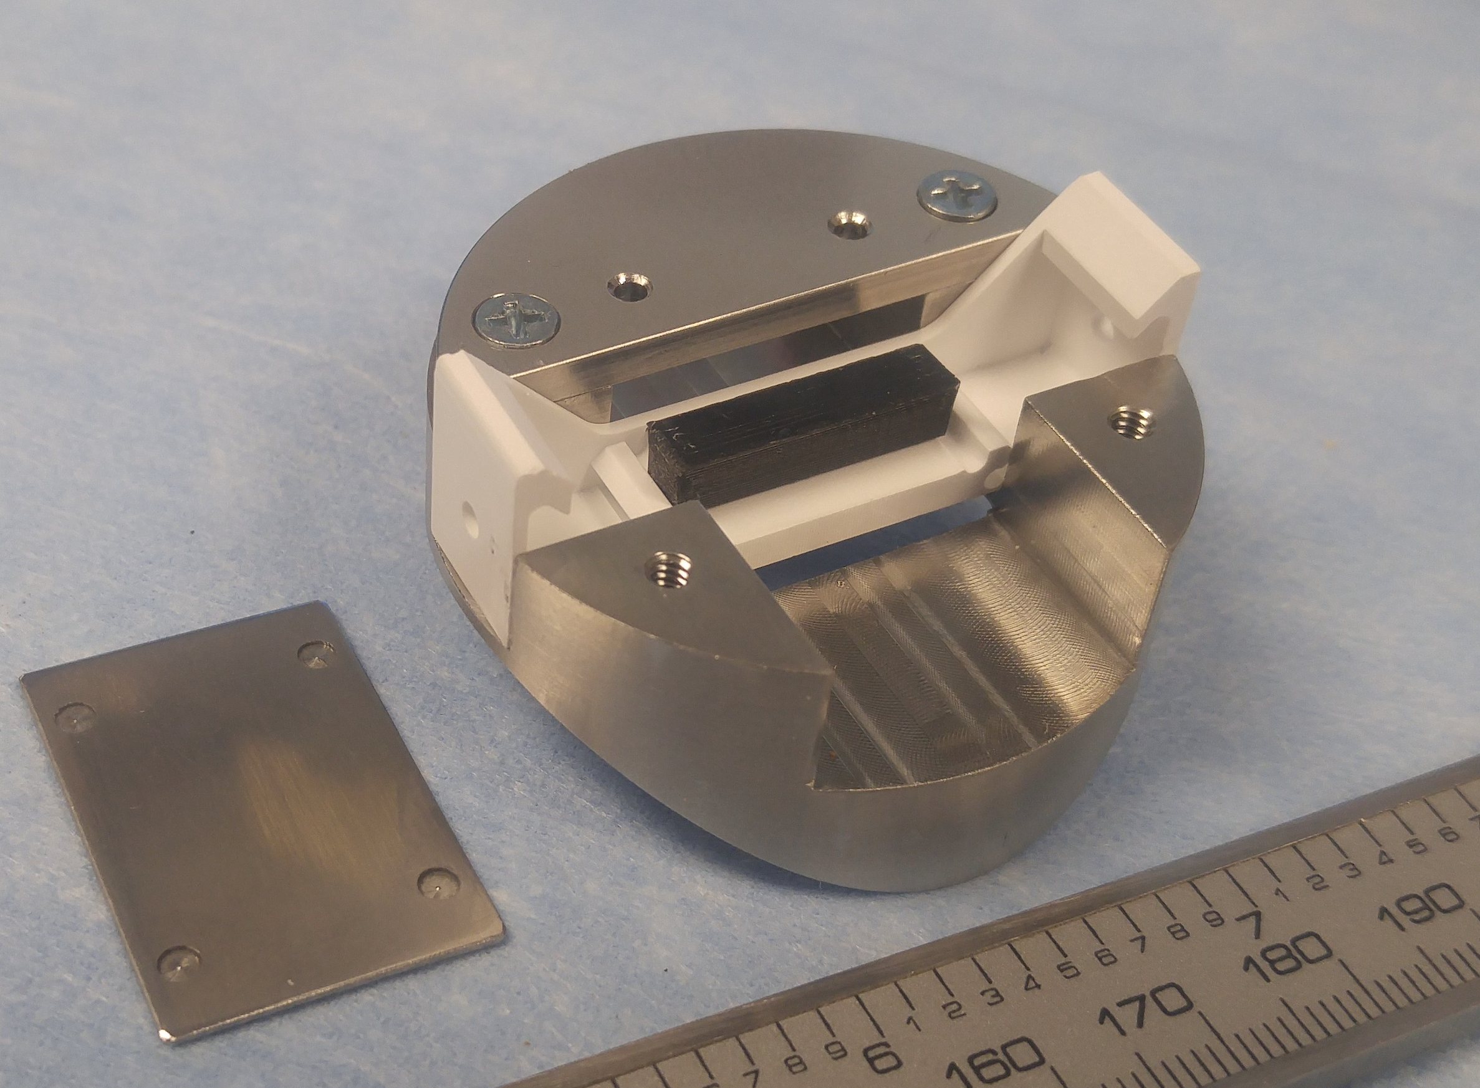
Temporally Resolved Optical Gating - TROG
New stand design completed
Fabrication in progress
Diagnostics (including IR) - noise and its suppression (Speaker: Rob Michnoff (BNL)
9

Slide 10
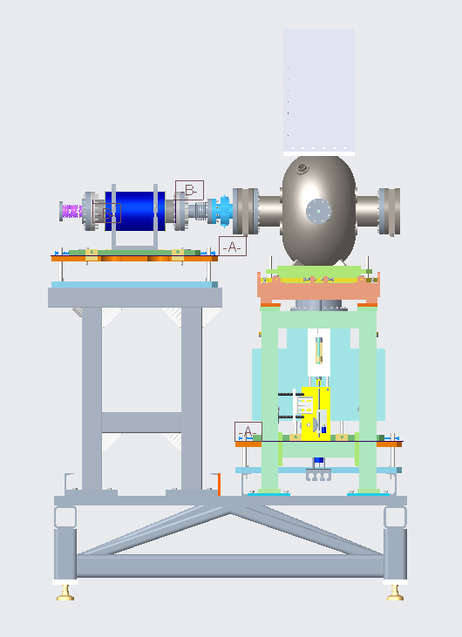
500 MHz Removal
Design completed
Design of coax reconfiguration completed
Parts ordered and in house
Single 500MHz surveyed: -1.5 mm axis; 0.02 degrees about Y axis
10

Slide 11
500 MHz & DCCT
Removal completed
All parts in house
Installation in progress
11

Slide 12
500MHz Coax Inspection/Cleaning
Received cleaning process from manufacturer
Spare parts/Replacement parts ordered
Courtesy: J. Butler, RF Group
12

Slide 13
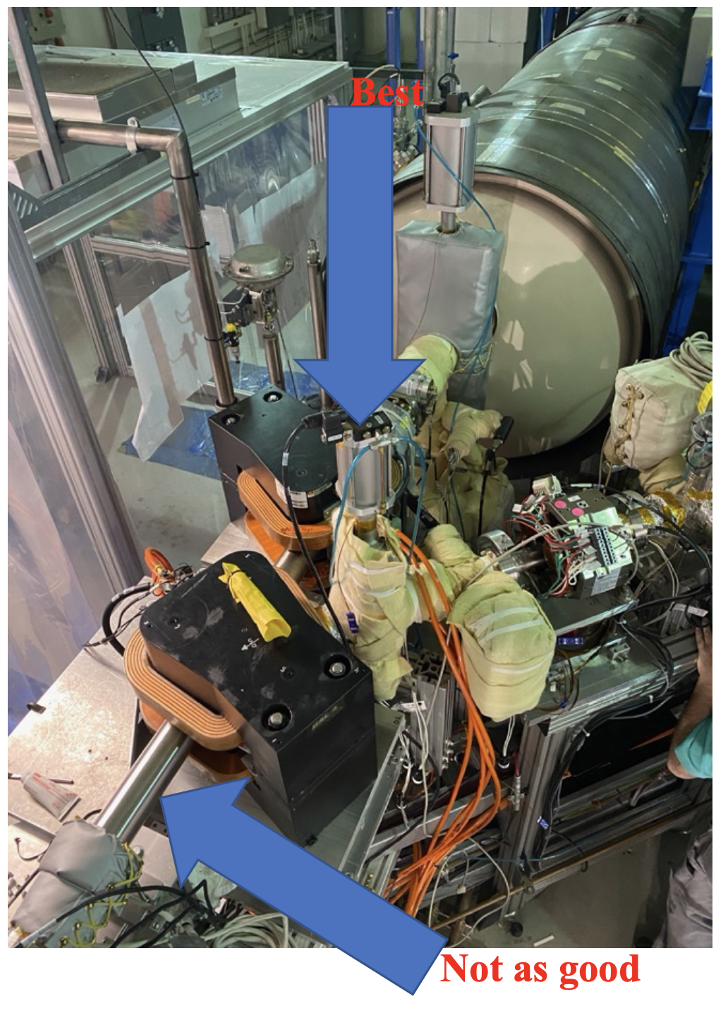
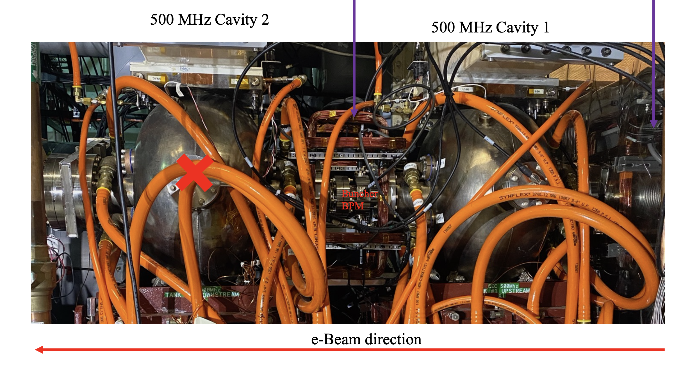
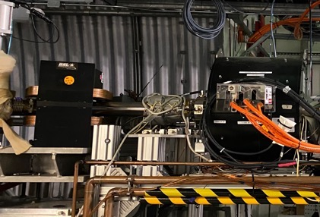
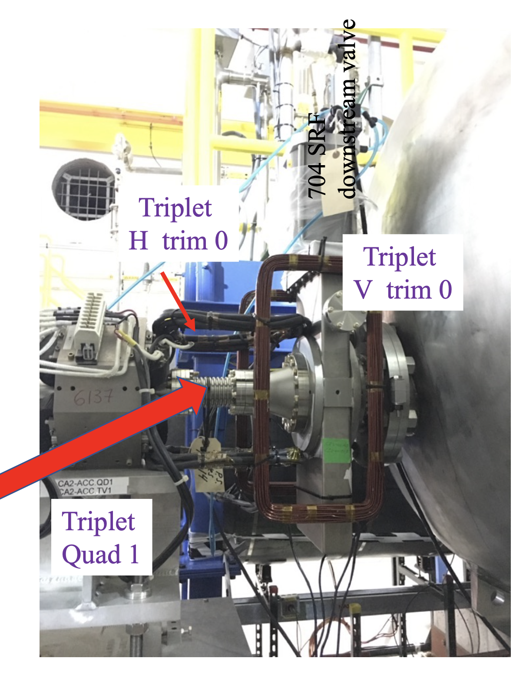
Trim modifications in CeC Accelerator
Take out Gun Trim 2 (large coils): Need to accurately fix Gun Trim 1
Restore trims after 500Mhz and after DCCT (E-measurement trims)
Replace trims after 704MHz linac with new H/V correctors
Replace TRDBL new large aperture with old trims with 2” aperture Keep H and V trims fed in series
CeC section: Add vertical trim coils at the entrance and at the exit
13

Slide 14
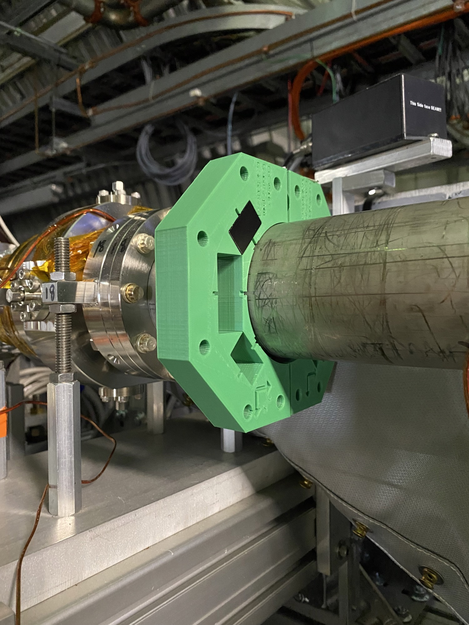
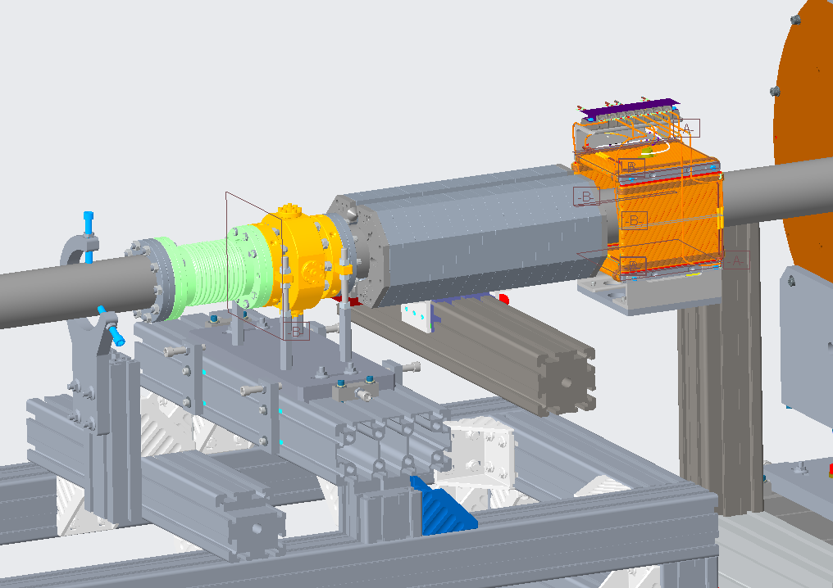
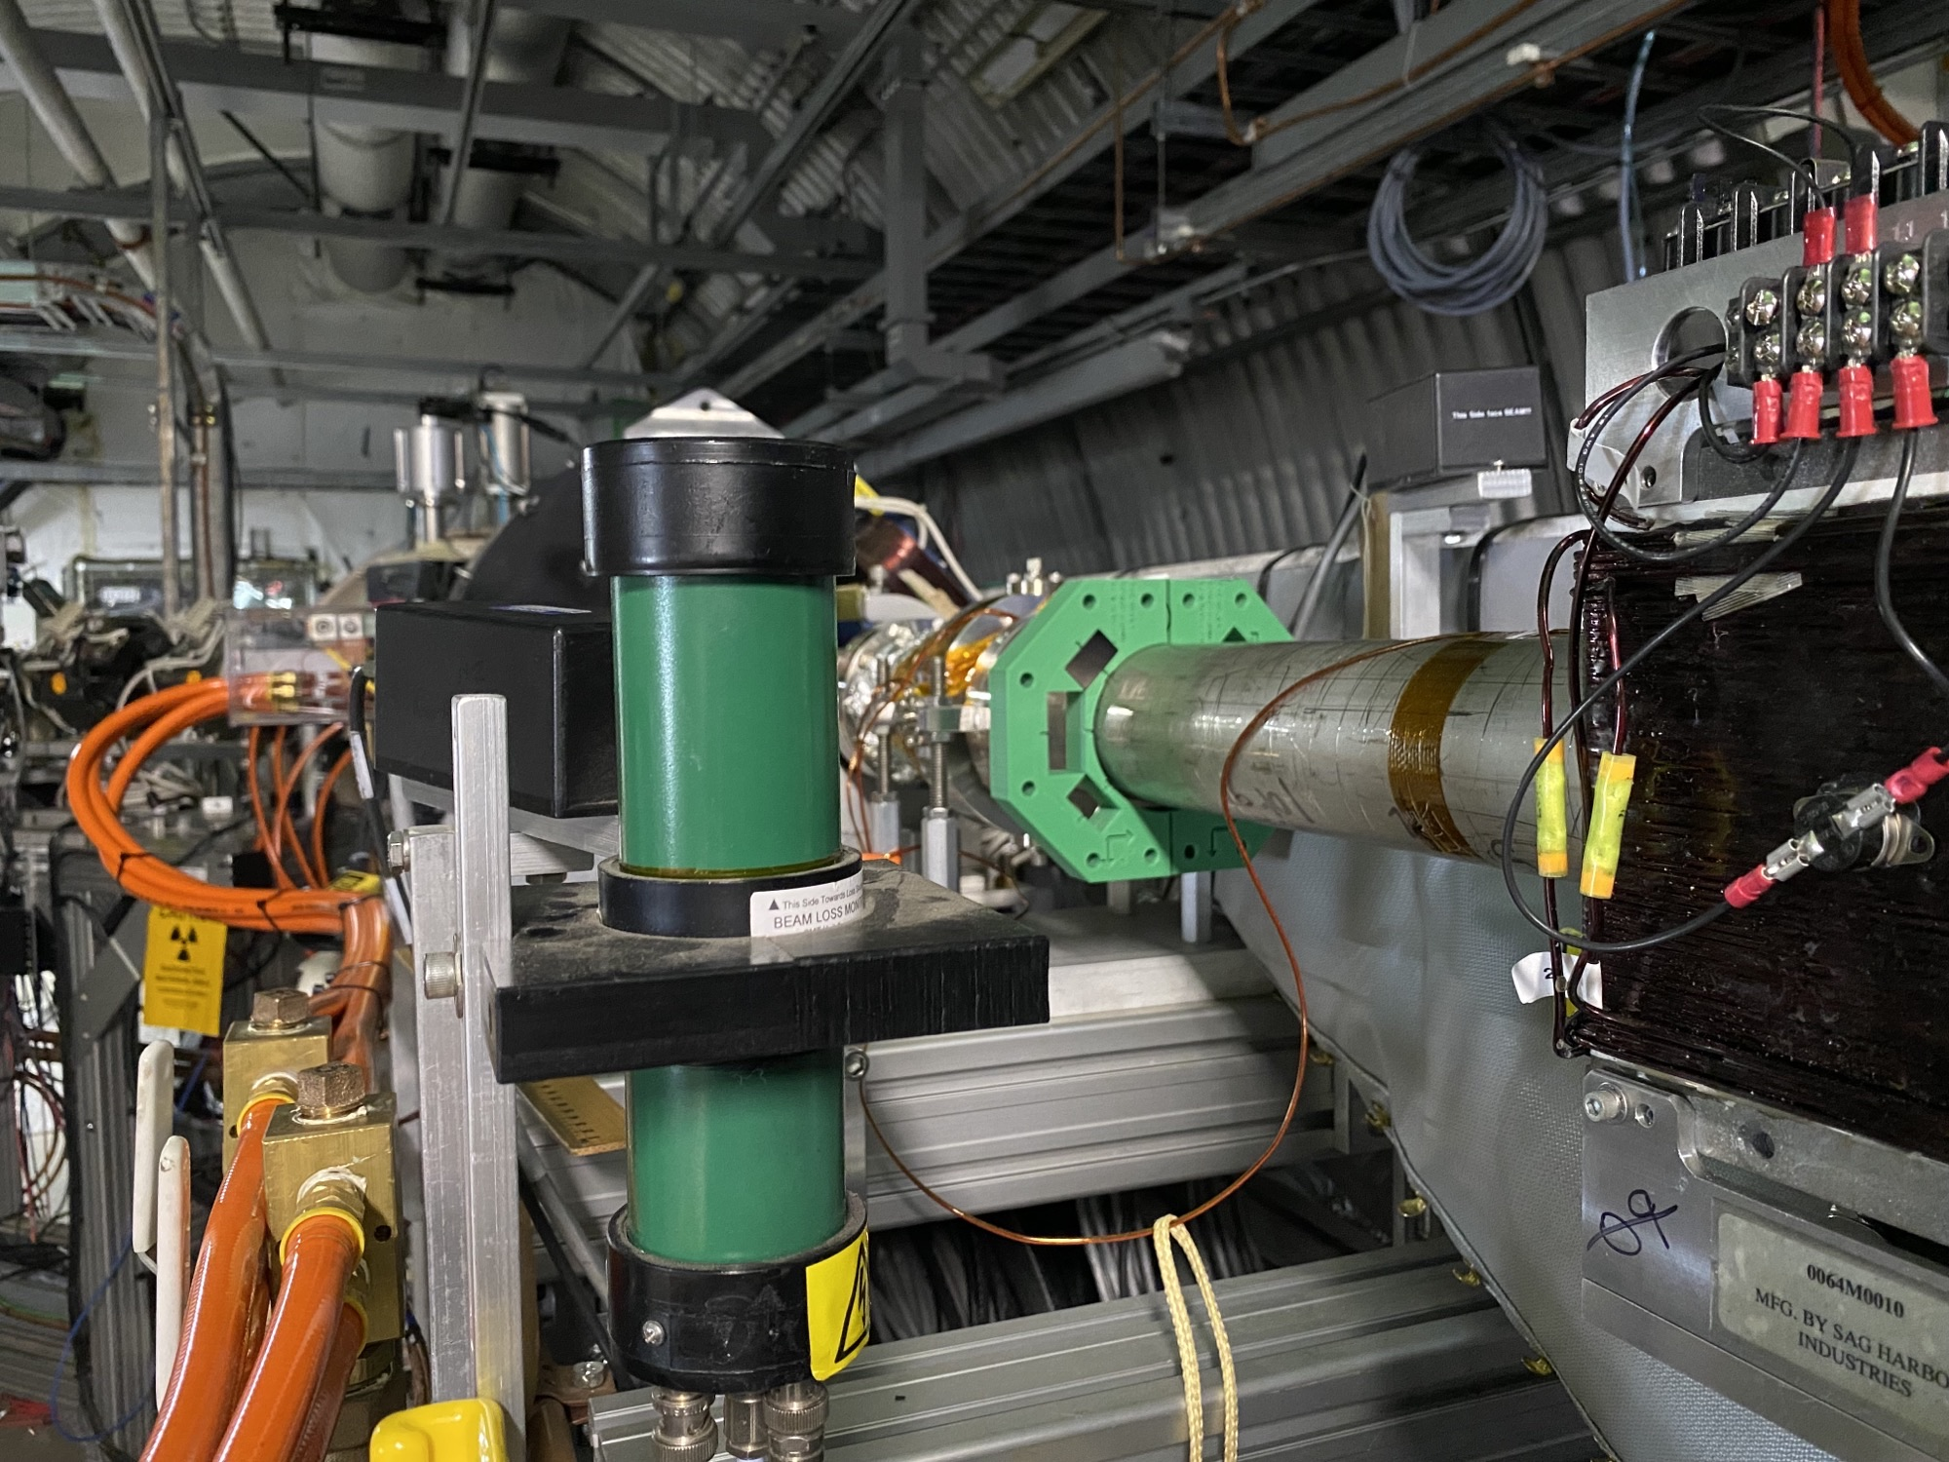
Short Diagnostics Undulator: 8 cm period, 0.6 kGs
Will serve as source of THz radiation at at frequency ~ 5 THz to tune PCA. Will be removed for CeC demonstration.
Design and prototype in progress
14

Slide 15
Stray fields studies in CeC section
Results
15

Slide 16
Heating Jackets
Search for explanation for unusual kinks in e-beam trajectory discovered, that in contrast with specifications, heating blankets and their cables have significant amount of magnetic materials, which distort magnetic fields in the CeC section
Heating Jackets and their cables are highly magnetic and have to be removed from the insides of the solenoids, trims, quads… and the rest of the CeC section.
7 correctors need to be taken apart to remove jackets
When blankets are removed, we need to remeasure stray fields from the solenoids, dipoles and most importantly – cables! Table shows that stray fields 1 m from solenoids are rather large for some of them and small for the others - we need to understand the reason and check if there are cable loops?
16

Slide 17
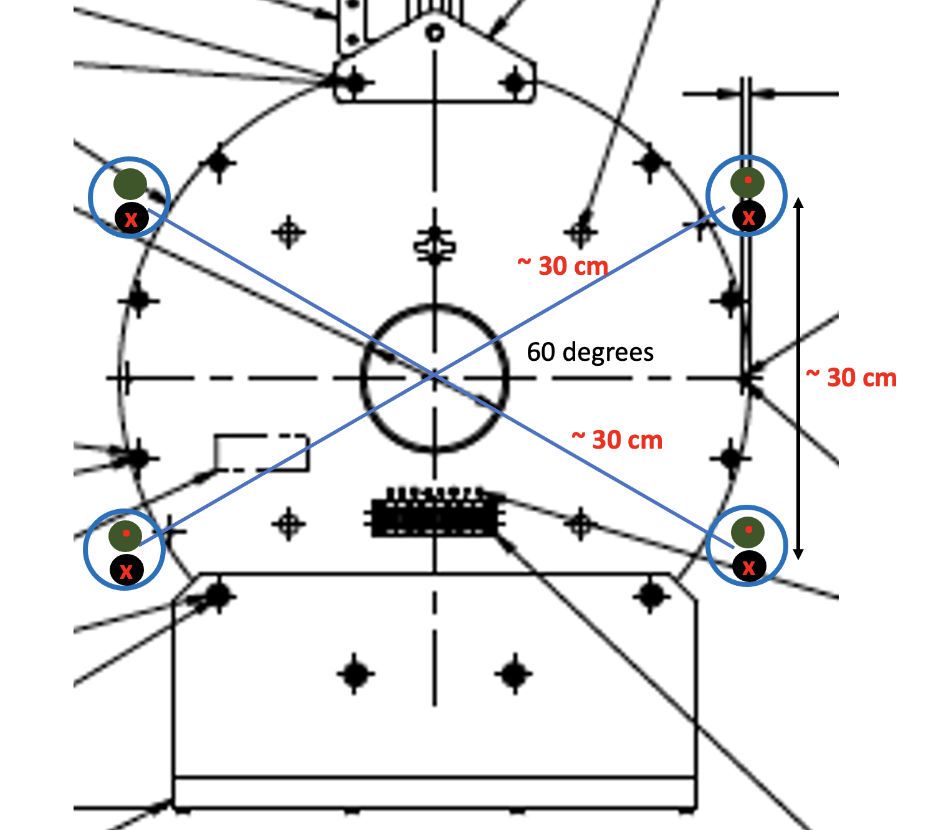
Earth field compensation coil
.
R | 30 | cm
L | 188.495559 | cm
Angle | 30 | degrees
 | 0.52359878 | rad
Cos | 0.8660254
Sin | 0.5
Ratio Vert | 0.0057735 | Gs/A/turn
Ratio Hor | 0.00333333 | Gs/A/turn
Field V | 0.5 | Gs
Field H | 0.25 | Gs
Hor coil | 86.60 | A turns
Ver coil | 75.00 | A turns
Per cable | 43.30 | A turns
Per cable | 37.50 | A turns
x
x
x
.
.
.
x
17

Slide 18
Summary
Priority list
Anthony is checking if we need to run new cable and order more PS for new compensating coils and H/V trims 8-12 weeks lead time
Design modifications of beamline completed
500MHz removal completed
Damaged quad replacement completed
500MHz coax inspection in progress
Heating jackets removal in progress (7 correctors have to be split)
DCCT installation in progress
Delay of parts from KJL for H/V slit and profile monitor – looking for backup solution
TRDBL modifications in progress
Undulator design and fabrication in progress
H/V trims relocation design in progress
18

Slide 19
Thank You !
19

